Slide 1
UrbanCart
Predicting Customer Churn Before It Happens
A cost-aware classification model to flag at-risk customers early enough for the retention team to act
Obinna Muonanu | TeSA AI Specialization

Slide 2
The Problem & The Data
Churn was only visible in hindsight. By the monthly report, at-risk customers were already gone
~20,000
5
7.8%
0
customer records
behavioral features
churn rate (class 1)
missing values / duplicates
Features collected per customer
Business goal
MonthsActive — tenure with UrbanCart
AvgOrderValue — typical spend per order
NumOrdersLastQuarter — recent purchase frequency
DaysSinceLastOrder — recency of last purchase
SupportTicketsFiled — friction / dissatisfaction signal
Build and compare at least two models that can flag at-risk customers early and evaluated properly for the ~8% imbalance, since a model can look “accurate” while catching zero real churners.
Problem & Data
UrbanCart Churn Prediction

Slide 3
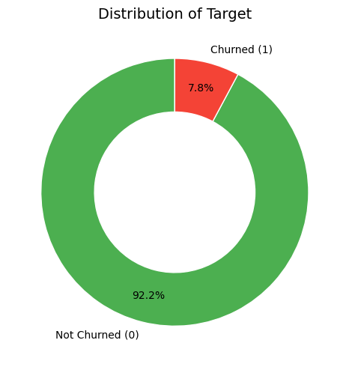
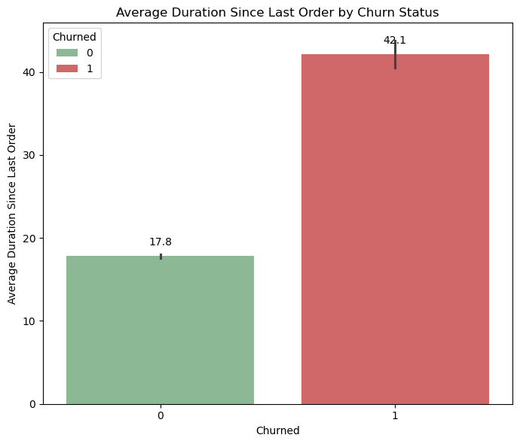
What the Data Shows
A severe class imbalance, and one standout behavioral signal
Only 7.8% of customers churned. Accuracy alone is misleading here
Churned customers had gone quiet ~2.4x longer (42 vs. 18 days)
Insights — Exploratory Analysis
UrbanCart Churn Prediction

Slide 4
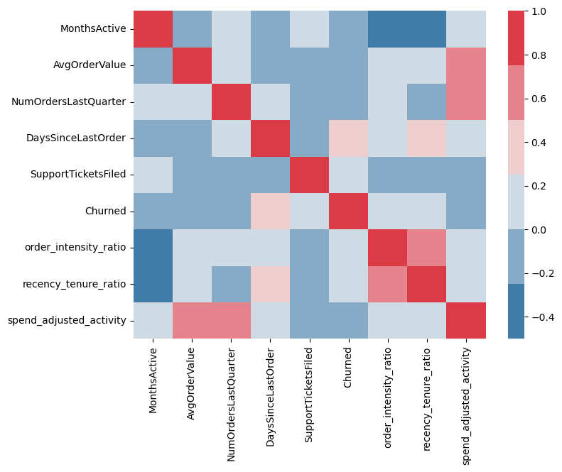
The Rest of the Picture
Tenure, spend and order volume alone don’t separate churners from loyal customers
MonthsActive, AvgOrderValue, NumOrdersLastQuarter, and SupportTicketsFiled show little to no difference between churned and loyal groups
AvgOrderValue and DaysSinceLastOrder are right-skewed with real (not erroneous) outliers which were kept in the data, but handled via robust scaling
No duplicates or missing values were found
Engineered a recency_tenure_ratio feature (recency relative to tenure) that separates the two groups more clearly than recency alone
Insights — Exploratory Analysis
UrbanCart Churn Prediction

Slide 5
Preprocessing — Feature Scaling
RobustScaler, chosen specifically for this data’s outliers
StandardScaler vs. RobustScaler
Why RobustScaler?
It scales features using the median and interquartile range instead of the mean and standard deviation, so it isn’t distorted by the extreme, but valid, outliers in AvgOrderValue and DaysSinceLastOrder.
 | StandardScaler | RobustScaler
Centers on | Mean | Median
Scales by | Std. deviation | Interquartile range
Sensitive to outliers? | Yes | No
Fit for this dataset? | Risky because of skewed features | Yes
Applied inside a pipeline (fit on train only) to avoid data leakage into validation and test.
Data Preprocessing
UrbanCart Churn Prediction

Slide 6
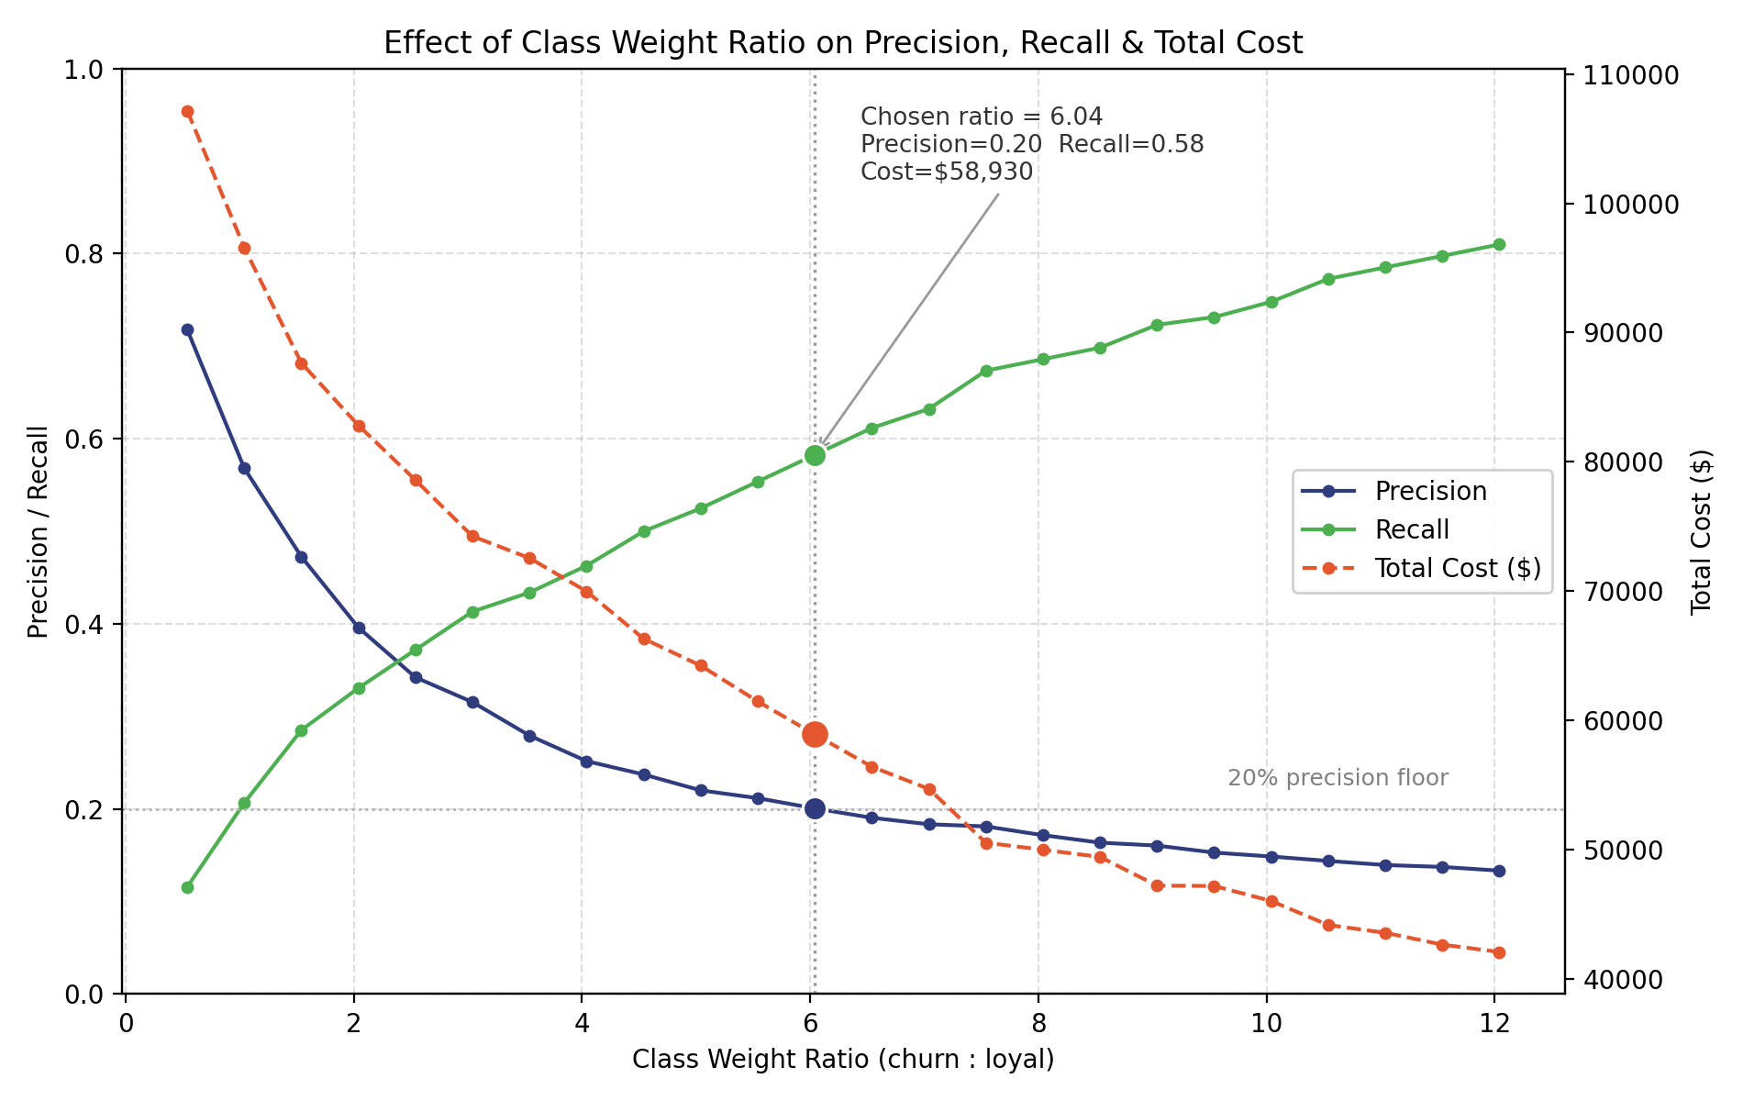
Preprocessing — Handling Class Imbalance
Class weighting over resampling, then tuned against a real business cost
Considered: resampling
Random oversampling risks memorizing duplicated churn records; SMOTE can synthesize unrealistic “customers” that never actually existed. Neither was used.
Chosen: class weighting
Keeps training data 100% real. The loss function penalizes missed churners more heavily, forcing the model to learn the minority class’s real patterns.
As the churn class weight rises, recall climbs and precision falls; total cost keeps dropping past the 20% precision floor, so the ratio (6.04) at that floor minimizes cost without flooding the team with false alarms.
Data Preprocessing
UrbanCart Churn Prediction

Slide 7
Model Development
Two models compared under a shared, cost-aware evaluation framework
Why not Accuracy?
Metric used: PR-AUC
Recall > Precision
~93% accuracy by predicting “not churned” for everyone, which is useless to the retention team.
Captures the precision–recall tradeoff across all thresholds; ignores the flood of easy true negatives that inflate ROC-AUC.
A missed churner (false negative) costs far more than a wasted outreach (false positive), so recall is prioritized within a 20% precision floor.
Models compared
Model | Approach | Outcome
Logistic Regression | RobustScaler + tuned class weight, threshold selected within cost sweep | Selected — higher recall at the 20% precision cap
XGBoost | Equivalent class weight (scale_pos_weight), thresholds 0.3–0.7 | Underperformed — likely limited by the small feature set
Model Development
UrbanCart Churn Prediction

Slide 8
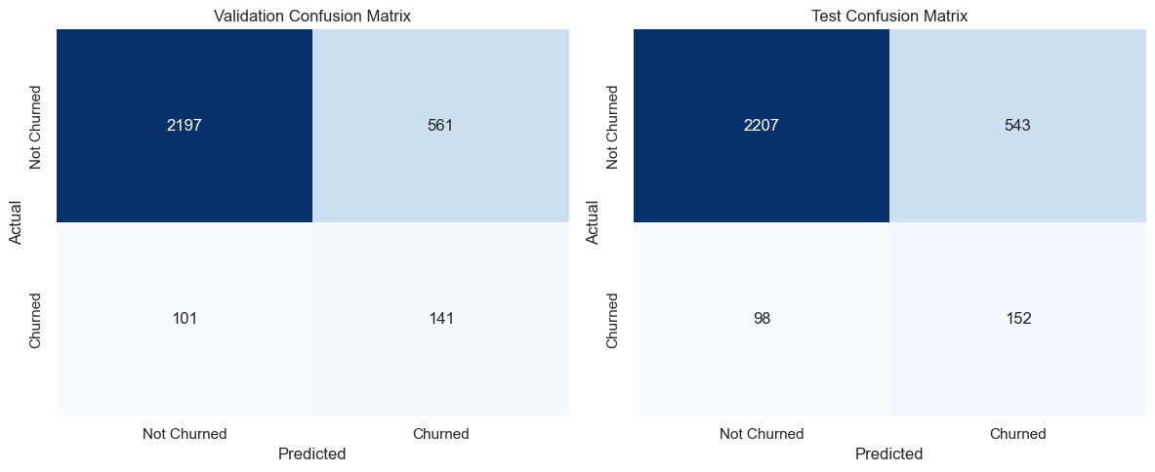
Model Results — Validation & Test
Final Logistic Regression, evaluated at the chosen decision threshold
Metric (churn class) | Validation | Test
Precision | 20% | 22%
Recall | 58% | 61%
Fbeta-score | 0.42 | 0.45
Overall accuracy | 78% | 79%
Test performance (61% recall, 22% precision) is slightly better than validation, confirming the model is not overfit to the validation set.
Model Results
UrbanCart Churn Prediction

Slide 9
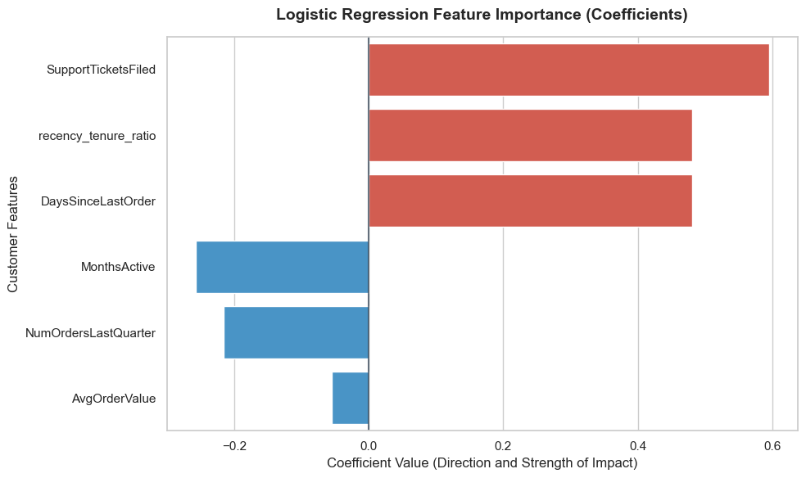
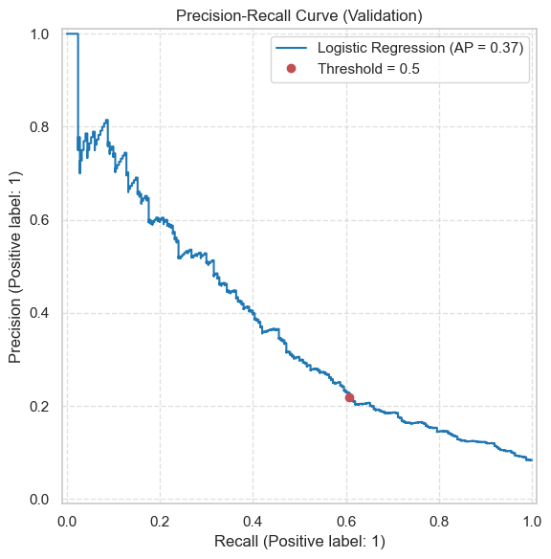
What Drives the Model
Feature importance and the precision–recall tradeoff behind the chosen threshold
SupportTicketsFiled, recency_tenure_ratio and DaysSinceLastOrder push predictions toward churn; MonthsActive and order volume push the other way.
Model Results
UrbanCart Churn Prediction

Slide 10
Business Impact & Recommendation
Per 3,000 customers scored, at the chosen 20% precision / 61% recall operating point
~250
~152
~98
~550
customers actually churn
correctly flagged (61%)
Missed, the costly errors
false alarms, within team capacity
Recommendation
Deploy the Logistic Regression model to flag customers weekly using DaysSinceLastOrder, recency_tenure_ratio, and SupportTicketsFiled as the leading signals
Operate at the tuned threshold (20% precision floor), optimizing for accuracy or precision alone would let far more expensive churners slip through undetected
Revisit with richer features, the limited feature set likely caps current performance, and explains why XGBoost underperformed Logistic Regression
Business Impact & Recommendation
UrbanCart Churn Prediction

