Slide 1
KTP REPORT System Associates/UoR
By
Obinna Onyimadu

Slide 2
Project till date
Search engine improvement and evolution
Design for intuitive user experience
Testing and Debugging
Updating development framework
Efficient code – Performance and memory bottlenecks
Algorithms
Revising and improving logic.
Implementing new features – Sentiment and opinion mining.
Testing

Slide 3
Project till date (contd)
JIST Conference
Presented research In-Use track
Well received
Published - LNCS 7774 proceedings

Slide 4
Achievements
We now know
Basic algorithms and logic
How to implement them
How to make them perform better
We have an Information Retrieval System designed around web 3.0 principles that is
Replicable
Open source
Supports more advance features like
Fact and snippet retrieval
Trend discovery
Social relationships

Slide 5
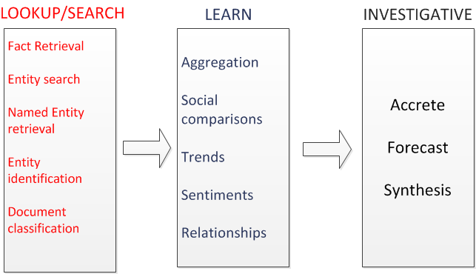
Where we want to be

Slide 6
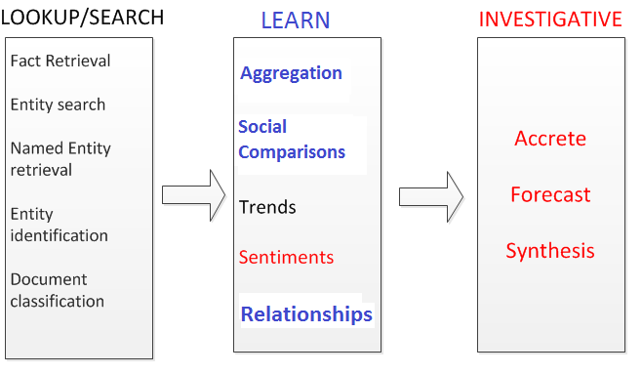
Where we want to be (cont.)
Black – Completed
Blue – On-going (Advanced but not completed)
Red – Early stages or yet to be done

Slide 7
Current Objective
Current stable release
Debugging and testing
Develop stable interface
Improve logic – Rule base, Entity extractors etc
Standardize application framework
Code efficiency
Adhere to company standards
Iterative testing
Inclusion of latest data
Sentiment and opinion mining
Paper - ISWC

Slide 8
Personal Development
Improved technical skills
Adhering towards company standards
PhD
Written technical paper

Slide 9
Personal Development Goals
Write second paper before end of project
Advance business and entrepreneurship qualities

Slide 10
Thank You

