Slide 1
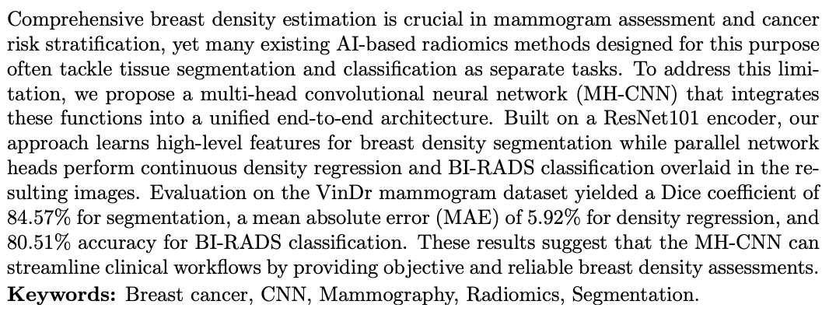
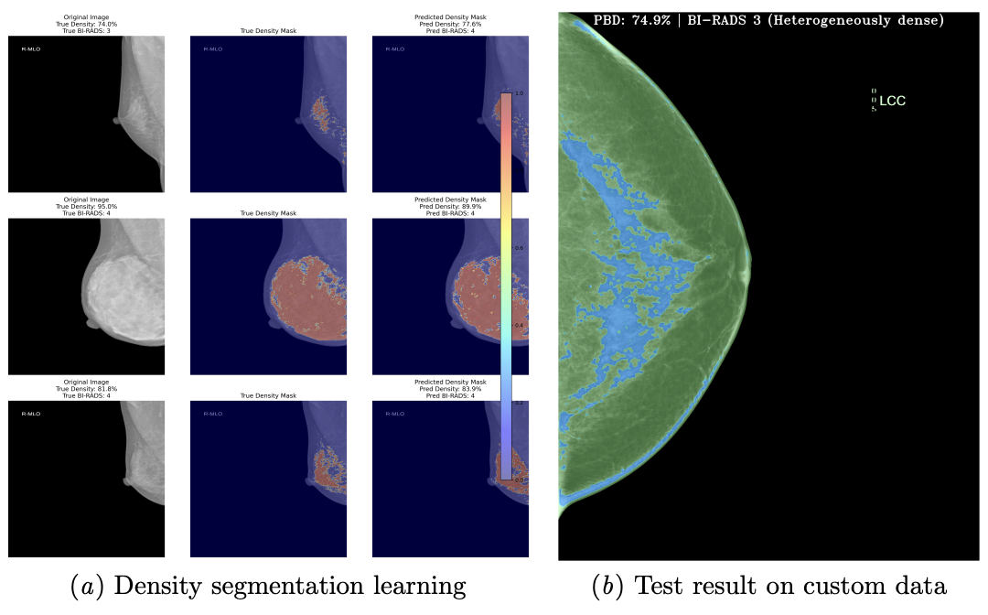
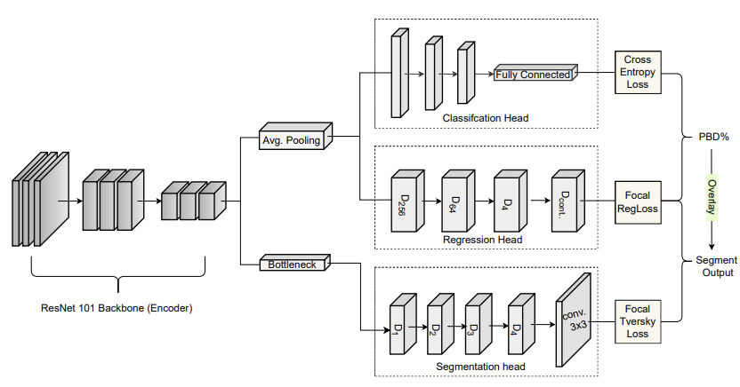
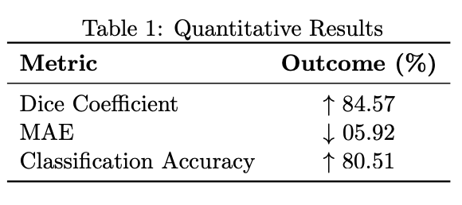
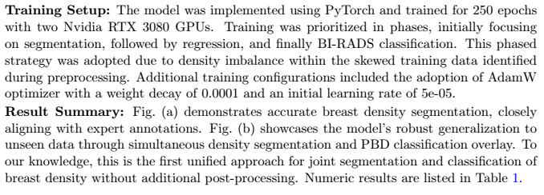
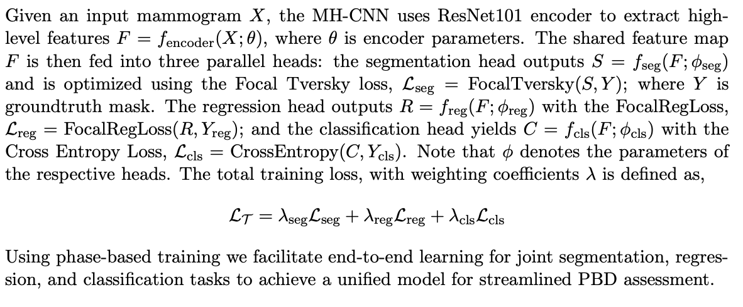




Deep Multi-Head CNN for Unified Breast Density Segmentation and BI-RADS Estimation in 2D Mammograms
Obinna Agbodike, ChangFu Kuo, and Jenhui Chen
1. Executive Summary
3. Results
4. Experiment Overview
2. Implementation in Brief
5. Sponsorship
Link to paper

