Slide 1


Text-to-SQL Empowered by Large Language Models: A Benchmark Evaluation
Obinna Onyema
Damilola Agbolabori

Slide 2
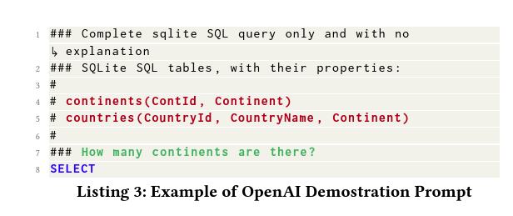
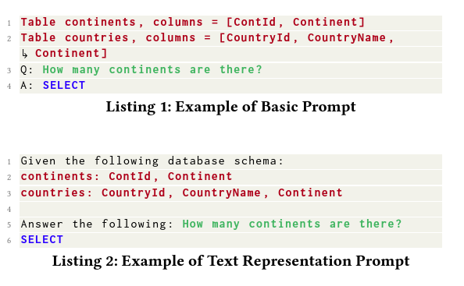
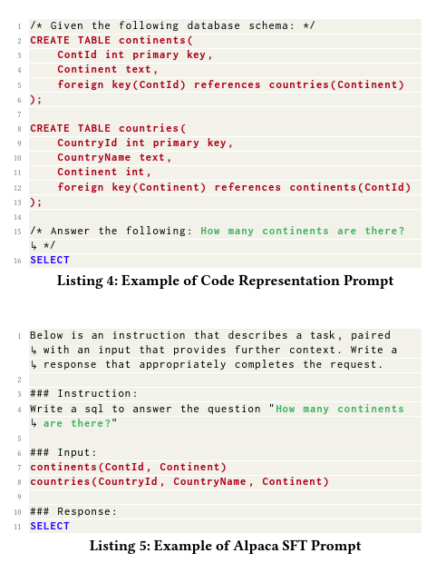
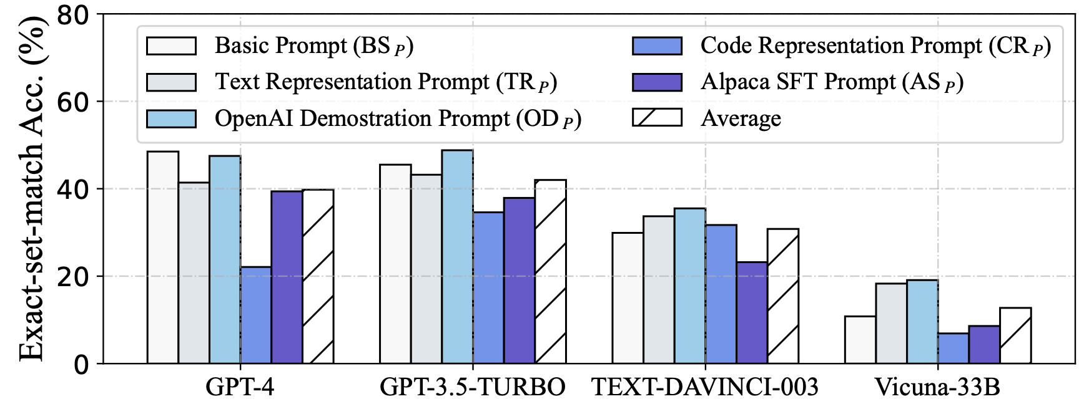
Background
Problem Description:
Text-to-SQL involves translating natural language questions into SQL queries that can be executed on a given relational database. The task is essential for enabling non-expert users to interact with databases effectively, as it allows them to pose questions in natural language rather than requiring knowledge of SQL syntax.
Many studies have made attempts to improve Text-to-SQL abilities of LLMs and other deep learning models with less than exciting accuracy results. Challenges arise from prompt generation:
BS: simple question without instructions
TR: question with instruction to LLM
OD: instruction, table schemas and question
CR: Provides comprehensive code samples
AS: supervised fine-tuning method that provides sequential instructions to LLM
Notes:
Problem Description:
Text-to-SQL (Structured Query Language) is a challenging task in both natural language processing (NLP) and database communities. It involves translating natural language questions into SQL queries that can be executed on a given relational database. This task is essential for enabling non-expert users to interact with databases effectively, as it allows them to pose questions in natural language rather than requiring knowledge of SQL syntax.
Context of the Problem:
Traditionally, Text-to-SQL systems relied on predefined rules or query enumeration techniques to handle this task. However, with the advent of deep learning and large language models (LLMs), such as GPT (Generative Pre-trained Transformer) models, there has been a shift towards more data-driven approaches. These models can learn complex patterns and mappings between natural language questions and SQL queries, making them well-suited for Text-to-SQL tasks.
The goal of this Text-to-SQL project is to test the DAIL-SQL method. This method uses the supervised fine-tuning text-to-SQL and prompt engineering empowered by large language models (LLMs) for generating syntactically correct SQL queries.

Slide 3
Related Works
Reference | Explanation | Dataset/Input | Weakness
Yu et al. (2018) | They used a Seq2Seq model to create a tree based SQL decoder that can identify columns better as well as create nested queries | Spider dataset | Only 48% accuracy
Wang et al. (2020) | They focused on the medical domain considering the unique structure and terminology of medical records. They introduced the Translate-Edit Model for Question-to-SQL (TREQS) generation task by first generating the targeted SQL directly then editing with both attentive-copying mechanism and a recover technique | MIMICSQL | High accuracy of 85% but small dataset of 10k records
Dawei et al. (2023) | They focused on mplementing and refining two key methodologies from DAIL-SQL: DAIL Selection (DAIL𝑆) and DAIL Organization (DAIL𝑂). DAIL𝑆 emphasizes candidate example selection based on question and query similarity, while DAIL𝑂 focuses on efficient organization of examples while preserving question-SQL mapping. Our aim is to enhance Text-to-SQL systems by optimizing these methods for improved performance and accuracy. | Spider dataset | 86.6% accuracy. Highest on spider dataset upon completion and 2nd highest ranking today

Slide 4
Methodology
The study's methodology focuses on exclusively evaluating Text-to-SQL methods using the GPT-4 model, with the Spider datasets. Spider comprises extensive instances split into training and development sets.
In this project, our primary focus was on testing the capabilities of the GPT-4 model to enhance Text-to-SQL performance. We tested two key methodologies, DAIL Selection (DAIL𝑆) and DAIL Organization (DAIL𝑂), tailored specifically for GPT-4. DAIL𝑆 selects examples based on questions and queries, while DAIL𝑂 organizes examples to balance quality and quantity, preserving question-to-SQL mappings. Integrated into our approach, these methodologies aim to significantly elevate Text-to-SQL task execution accuracy.

Slide 5

Implementation
There are 3 parts to the experiment
Preprocess data: table schemas are detected and question samples from the various databases in the Spider dataset are linked to table schemas
Generate questions: this part generates prompts for the LLMs depending on the configurations such as dataset type, name of LLM for tokenization, prompt representation, k-shot. The output also includes estimated cost of running all questions against the various LLMs supported by the project.
Get SQL responses from LLM: This part queries the selected LLM and outputs a file containing SQL responses.
The prediction experiment we ran had 2 major configurations:
Provide sample queries and responses in the prompt
Provide database schema
1034 questions are generated from the spider dataset
Notes:
In the question examples, the prompts include examples of questions and SQL responses. (DAILS query selection method)
Prompts also include the description of database schema. (DAILO organization)
Essentially DAIL technique is a combination of SQL examples and database schema in the prompt supplied to the LLM.

Slide 6
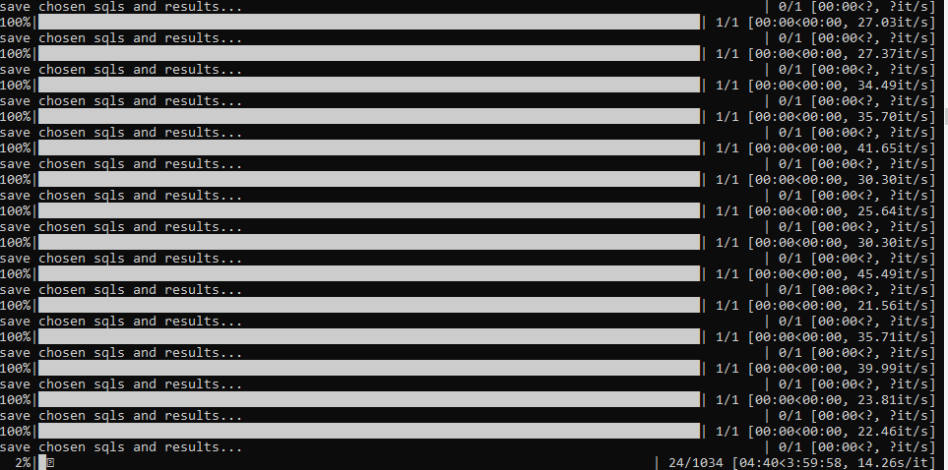
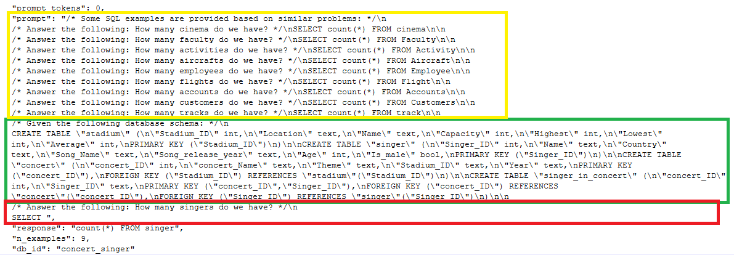
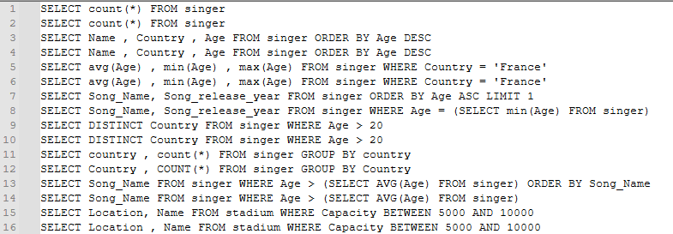
Implementation
The output of our experiment are a set of queries which are the output of the LLM.
We used GPT-4 for prediction in this experiment. Only 333 queries were returned out of the 1034 because of rate limiting on the OpenAI API.
Prediction in progress
Prompt Samples
Prediction output

Slide 7
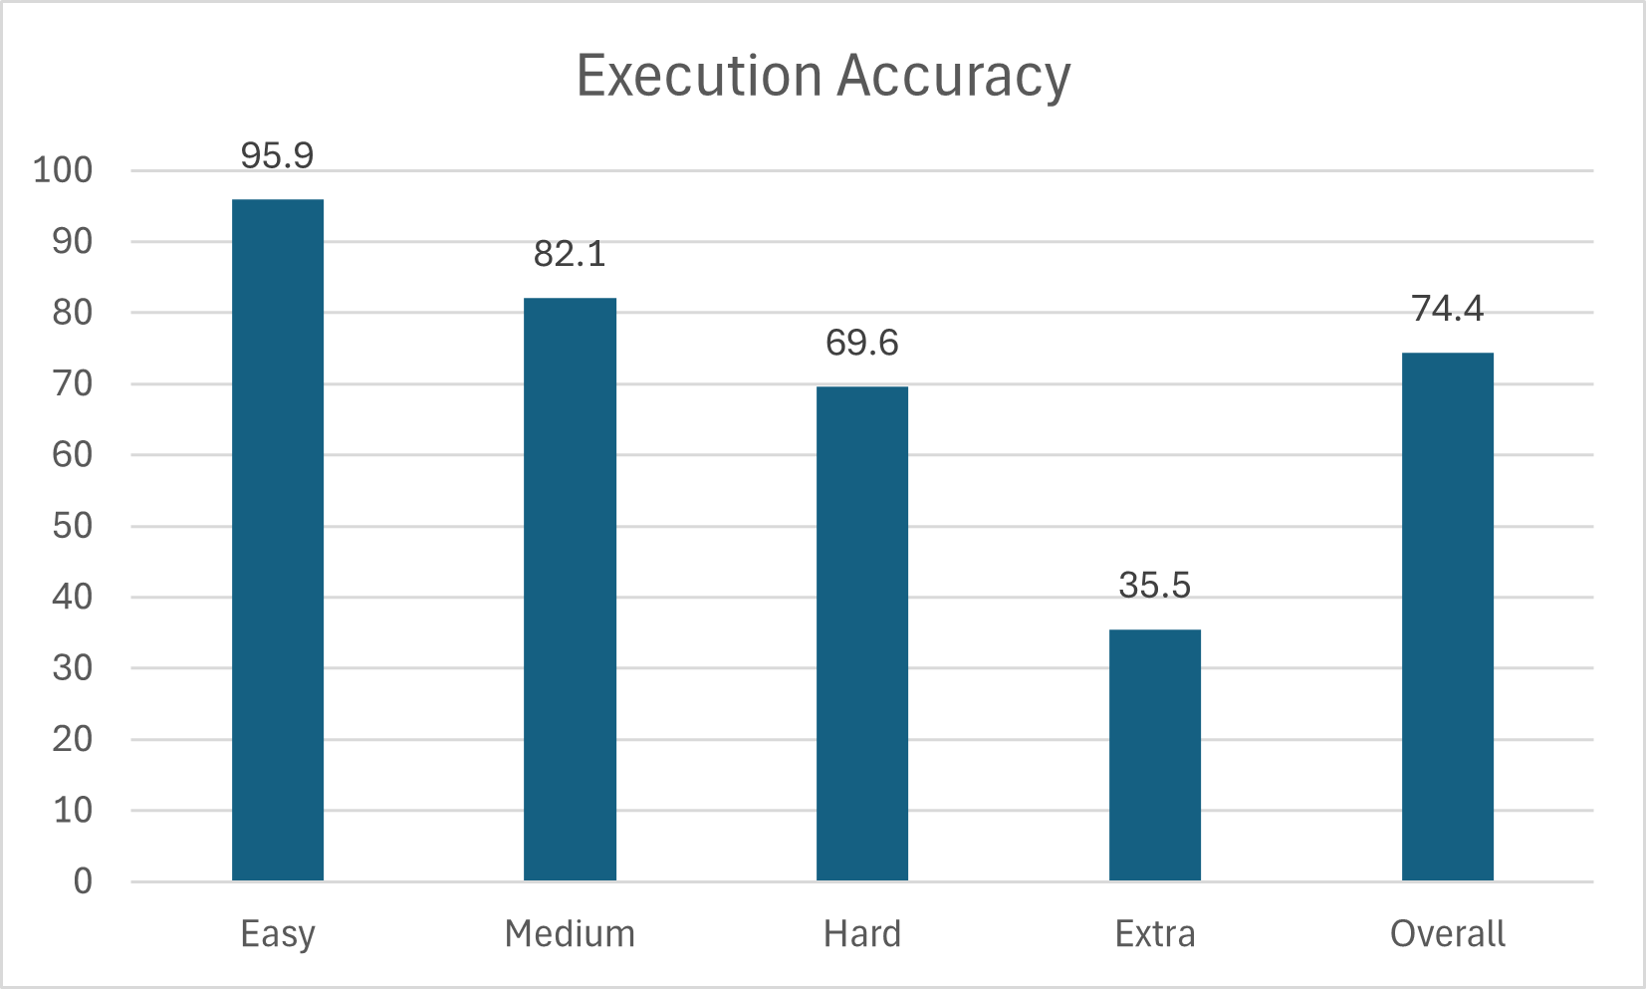
Conclusion
We achieved 74.4% overall execution accuracy although we had a smaller dataset due to rate limiting on the API as well as cost. Comparatively, the authors of the original paper achieved overall execution accuracy of 86.2%
LLMs require "coaching" when they are expected to generate SQL to query an unseen database. The study provided a comparison of various prompt generation methods.
Prompt Engineering improves performance of LLMs. The best performance comes from
providing sample queries and responses in the prompt to teach the LLM what is expected - (DAIL𝑆)
providing some level of awareness of the database schema - (DAIL𝑂)
This provides a baseline for future works in this topic to reference

