Slide 1


Slide 2

10Analytics global hackathon 2023
Email: acobapaul@gmail.com
Phone: +234-8174506829
Presenter:
Paul Okafor

Slide 3
Project Overview and Objectives
Unemployment remains one of the most daunting challenges facing African nations today. It is a multifaceted problem with deep roots in socio-economic, educational, and policy-related factors.
The primary goal of this case study is to analyze data, identify patterns, and propose informed, data-driven recommendations that governments and stakeholders can implement to effectively address and reduce unemployment rates, particularly focusing on the African context

Slide 4
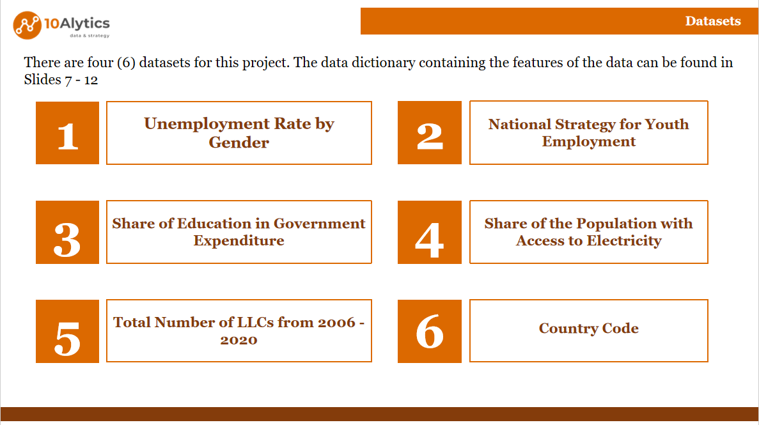

Slide 5
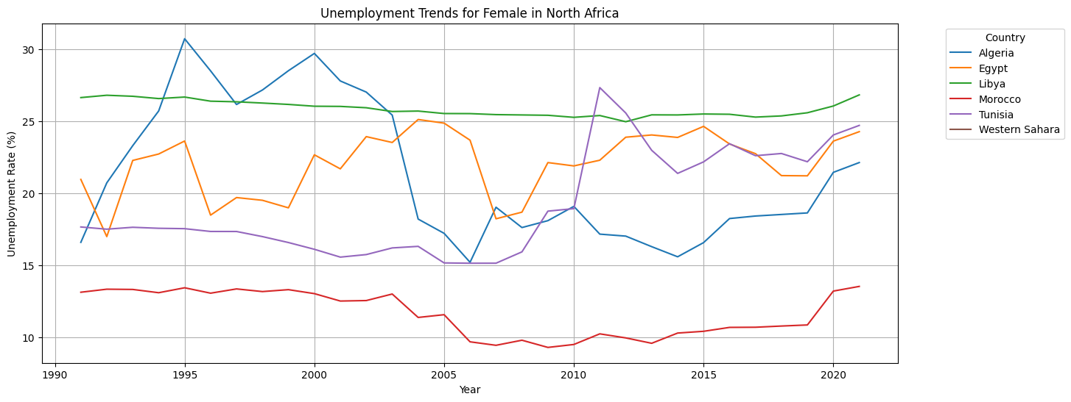
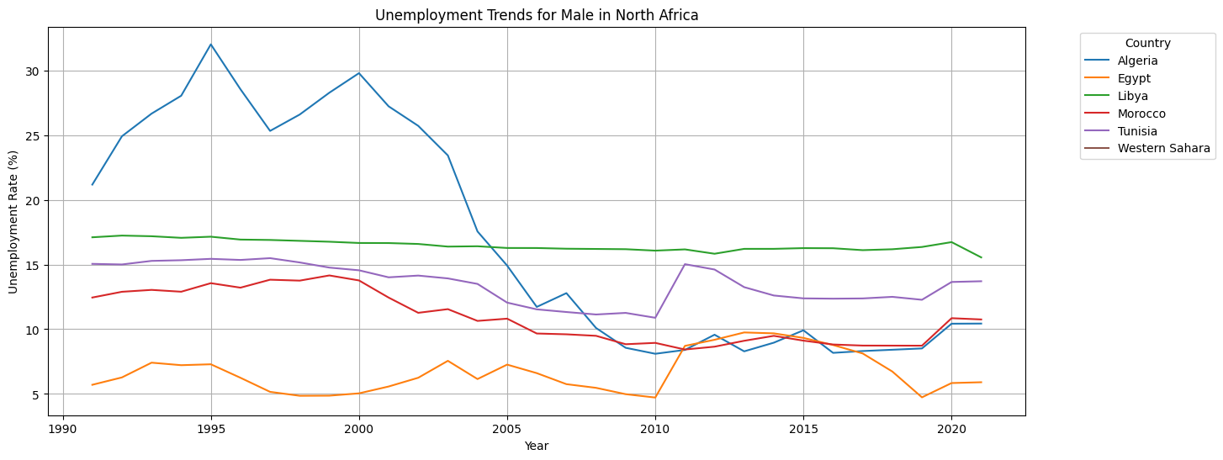
Unemployment trends for different geopolitical regions in Africa

Slide 6
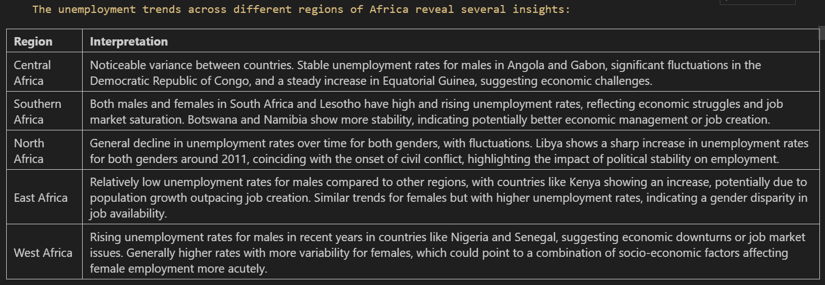
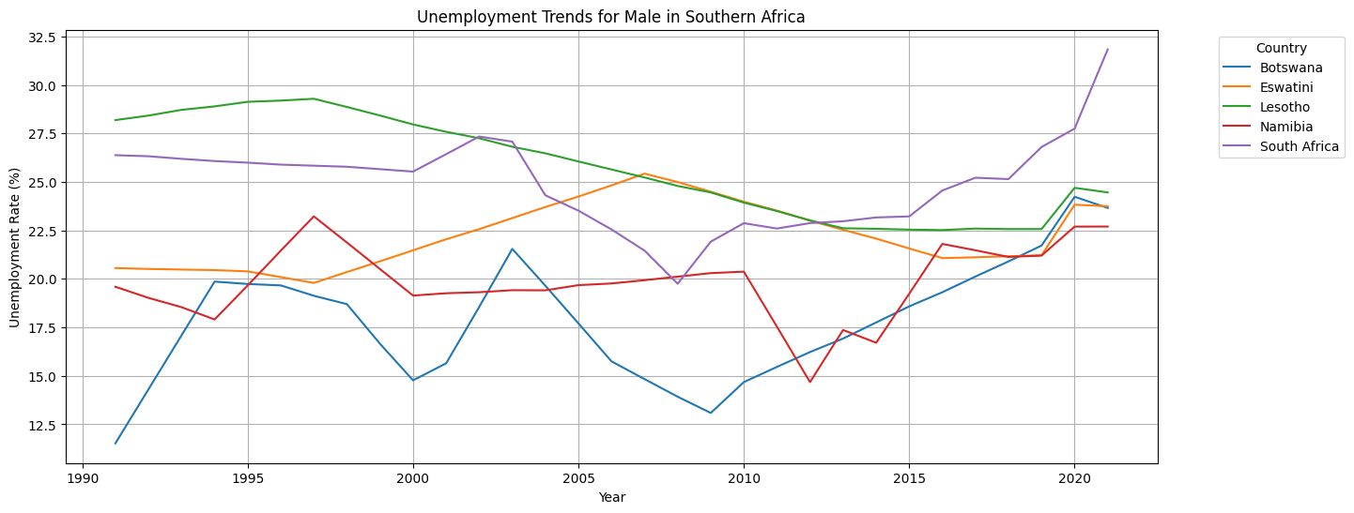
THE FIRST AMENDMENT AND OU

Slide 7
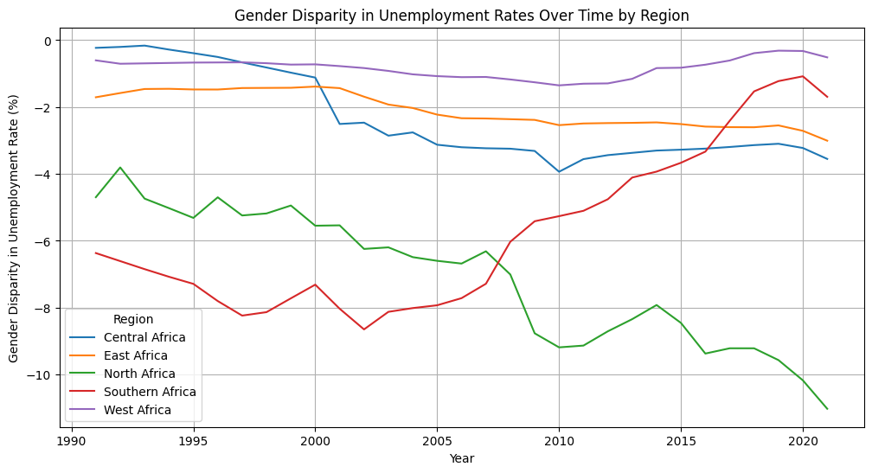
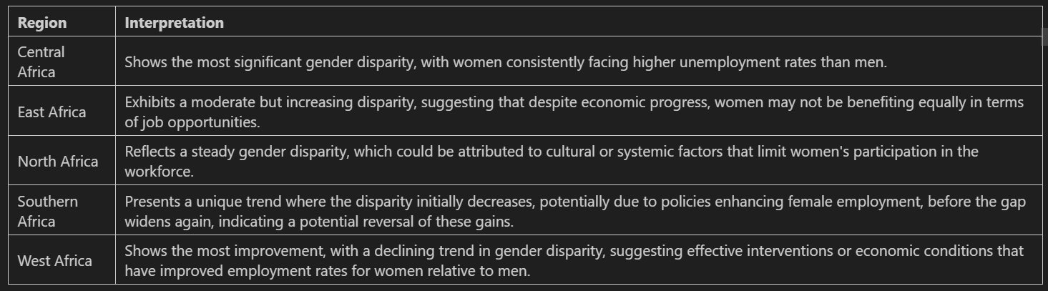
Unemployment rates – gender disparity

Slide 8
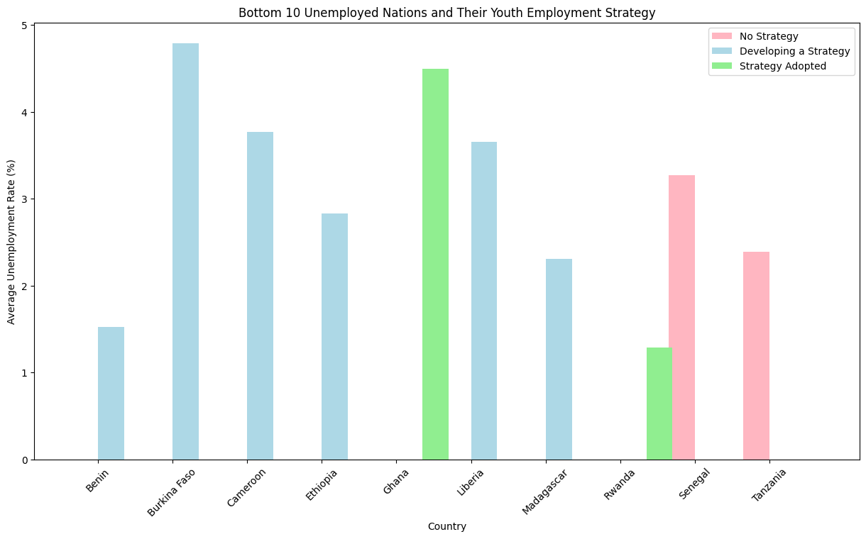
Youth Employment Strategy vs Unemployment Rates
While the adoption of youth employment strategies can be correlated with lower unemployment rates, the mere existence of such strategies is not a panacea. Effective implementation, along with addressing other underlying economic issues, is crucial for these strategies to mitigate unemployment effectively.

Slide 9
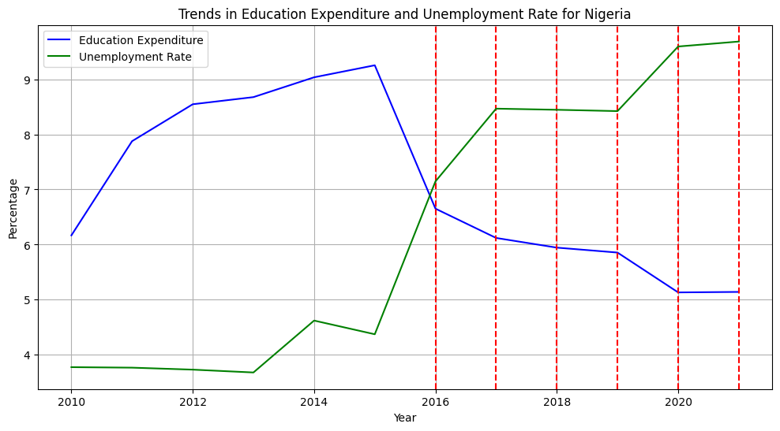
Countries with a decline in Government expenditure over a 5-year period
In Nigeria, Congo, and Botswana, there is a visible trend where a decrease in education expenditure is followed by an increase in unemployment rates within the 5-year periods marked by the red dashed lines. However, in Guinea, the unemployment rate does not show a similar pattern, remaining low regardless of changes in education spending. This suggests that while there can be a relationship between education spending and employment, it is not uniform across different countries and could be influenced by various local economic and social factors.

Slide 10
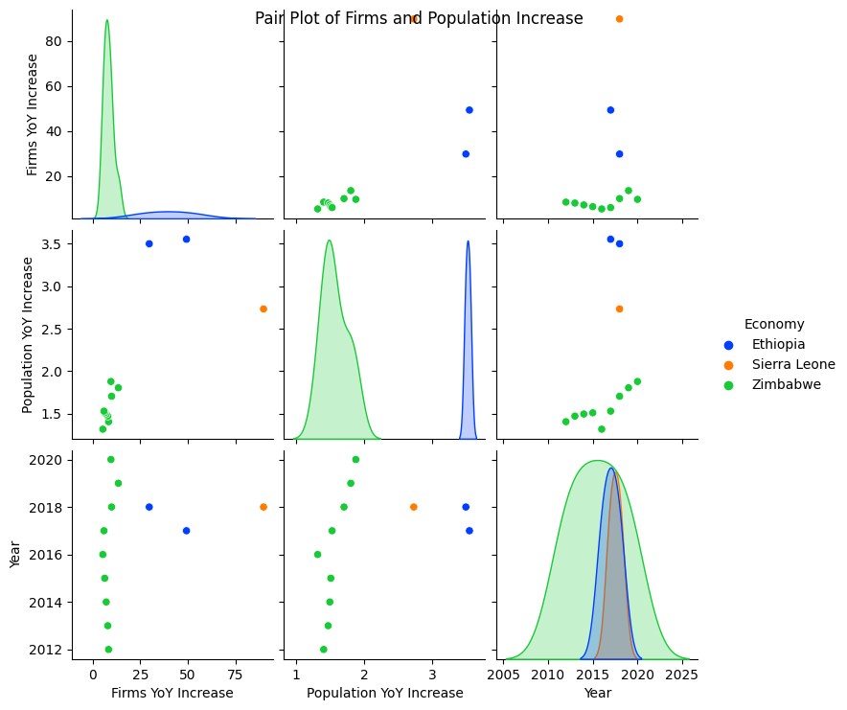
Firm Growth Relative to Population Growth
Firm growth does not always align with population growth. Ethiopia's pronounced spikes in firm growth contrast with Sierra Leone's and Zimbabwe's more modest increases. This suggests that while entrepreneurial activity is booming in some areas, it may not be sufficient to absorb the growing population into the workforce in others.
The visualizations for Tunisia and Togo reinforced the notion that a decline in the number of firms correlates with rising unemployment rates, underlining the importance of a robust private sector in job creation.

Slide 11
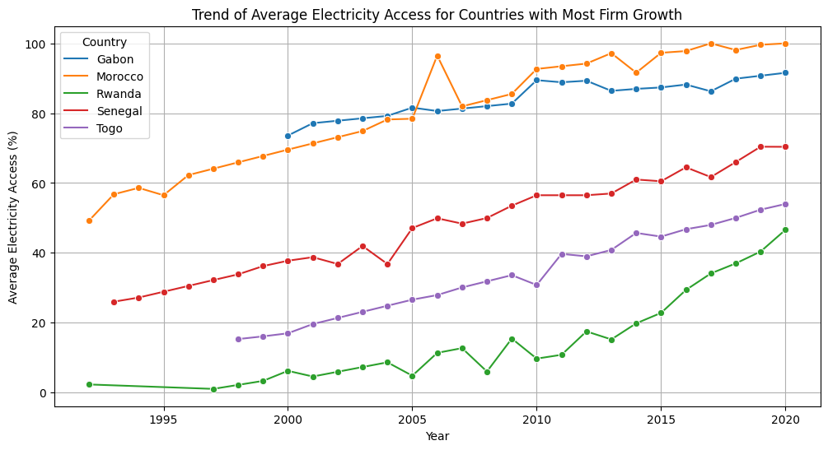
Population with Access to Electricity for Countries with the most and least Firm Growth
These plots suggest that electricity access is a critical factor for firm growth, with countries showing increased access to electricity generally experiencing more firm growth. Increased access to electricity is a fundamental component of economic development, which can encourage the establishment and expansion of firms. More firms in a country can lead to more job opportunities, which could potentially lower unemployment rates.

Slide 12
SUMMARY

Slide 13
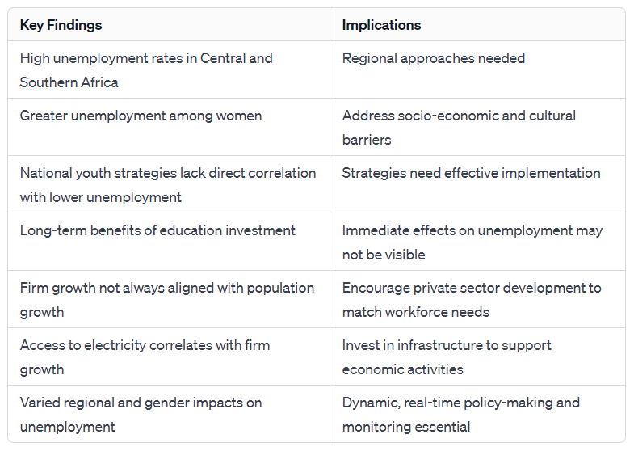

Slide 14
Thank You

