Slide 1
Multi-Disease Detection and Classification in Chest Radiography: A Deep Convolutional Neural Network Approach
DSA 5503 - Healthcare Analytics Project
Paul Okafor
May 6th, 2024

Slide 2
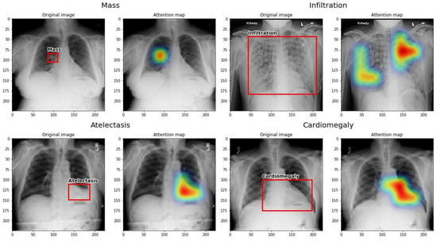
Introduction
Chest Radiography
A diagnostic tool for thoracic diseases, widely accessible and non-invasive.
Critical for detecting a range of pathologies, from pneumonia to chronic conditions like emphysema and cardiomegaly..
Challenges in Radiographic Interpretation
Interpretation is complex due to the subtle manifestations of diseases and variability in patient anatomy and image quality.
High expertise required, with a significant risk of diagnostic errors
Notes:
Thoracis pathologies/diseases refer to diseases and abnormalities that affect the thoracic cavity, which includes the chest area encompassing the lungs, heart, and other structures within the rib cage.

Slide 3
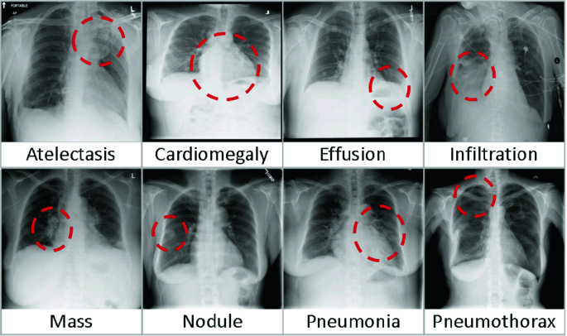
Problem Statement
Complexity of Diseases:
Thoracic diseases present nuanced challenges in diagnosis due to the subtle and overlapping radiographic features, which are compounded by the variability in patient anatomy.
Image Complexity:
The high dimensionality and complexity of chest X-ray images require advanced models that can efficiently process and extract meaningful information without overfitting.
Notes:
A sleep study, called a polysomnogram, is a test used to help diagnose sleep apnea, restless legs syndrome (RLS), and other sleep disorders. People usually spend the night at a hospital sleep laboratory or an outpatient sleep clinic. Electrodes attached to their body monitor their brain waves, breathing, and movement while they sleep.

Slide 4
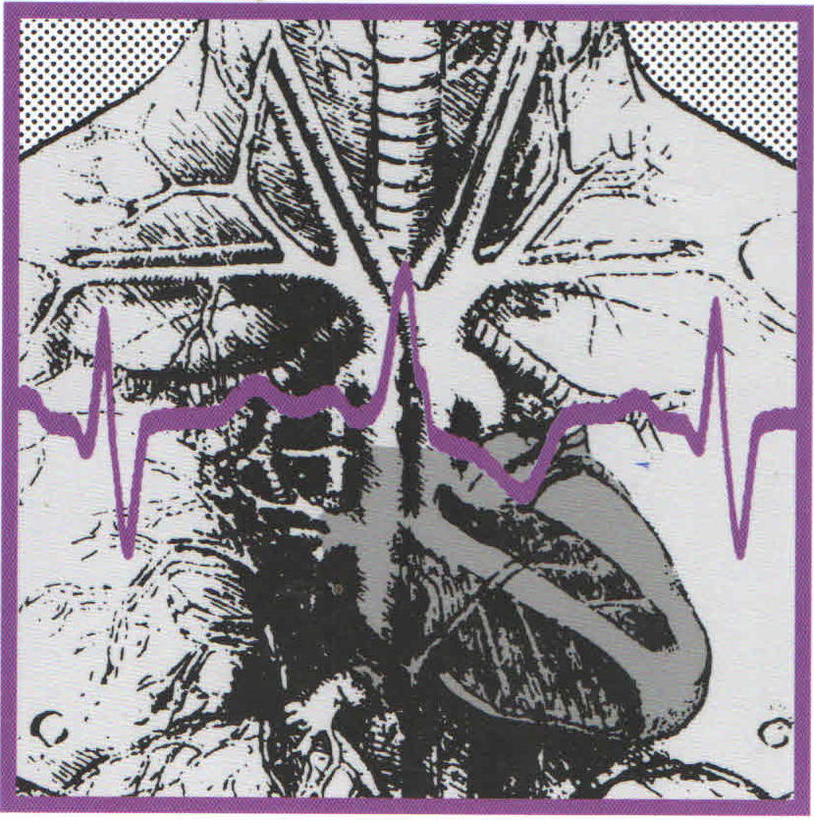
Dataset Overview
Source: NIH Chest X-ray Dataset, encompassing 112,120 frontal-view X-ray images.
Subjects: 30,805 unique patients
Annotation Details:
Images labeled for 14 thoracic pathologies using advanced NLP techniques on radiological reports.
Pathologies include Atelectasis, Cardiomegaly, Consolidation, Edema, Effusion, Emphysema and more.
Dataset Demographics and Characteristics:
Gender Distribution: Balanced (Males 54%, Females 46%).
Age Distribution: Varied, with significant patient age ranges across diseases.

Slide 5
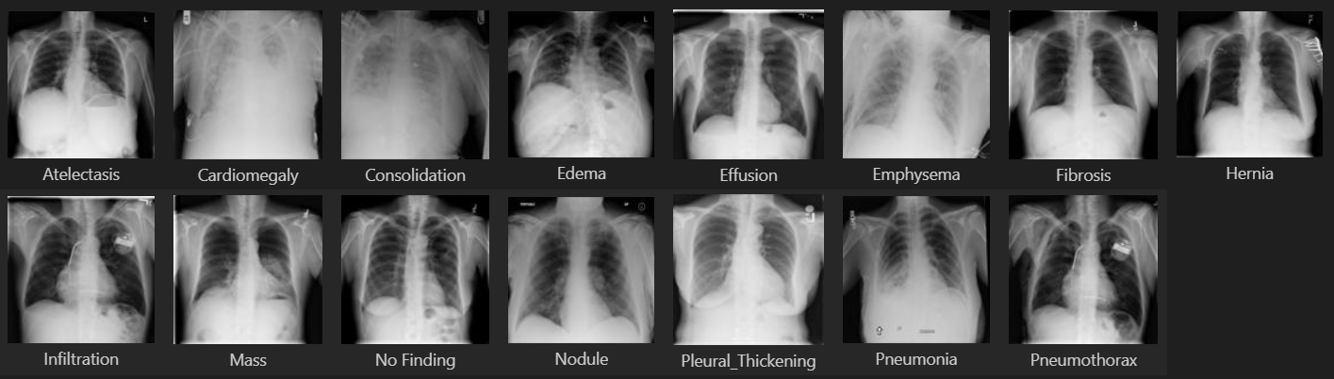
Dataset Overview
14 Thoracic Pathologies
Notes:
Non-apnea/hypopnea arousals are sleep disruptions that cause a person to transition from a deeper stage of sleep to a lighter one or even to wakefulness, without being associated with apnea (complete cessation of breathing) or hypopnea (significant reduction in breathing). These arousals can be caused by various factors other than breathing difficulties, such as:
Respiratory Effort Related Arousals (RERAs): These are episodes where there is increased breathing effort due to partial airway obstruction, but they don't meet the criteria for apnea or hypopnea.
Teeth Grinding (Bruxism): This can cause brief awakenings or transitions to lighter sleep stages.
Muscle Jerks or Limb Movements: Sudden involuntary muscle contractions can disrupt sleep.
Pain or Discomfort: Can lead to arousal from sleep without being linked to breathing problems.
Noise or Environmental Factors: External disturbances can also cause a person to briefly wake up or shift to a lighter sleep stage.

Slide 6
Methodology and Model Design

Slide 7
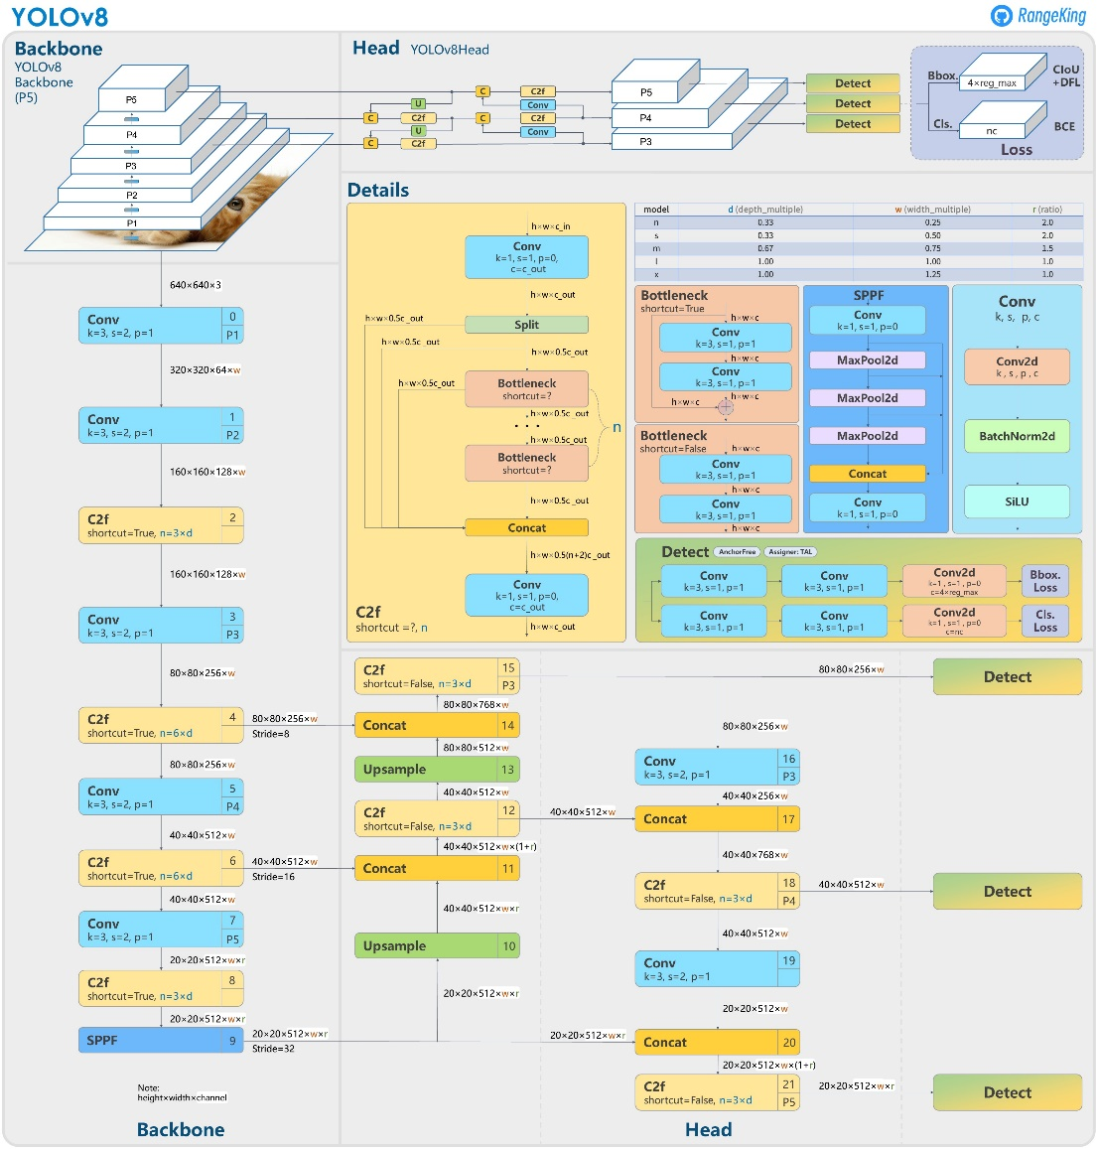
Methodology
Model Selection:
employs the YOLO (You Only Look Once) architecture for both detection and classification of thoracic pathologies because of its real-time processing capabilities.
Training:
Both image classification and object detection models were trained using YOLO across 100 epochs.
Object detection trained on a subset of fewer than 1,000 images, focusing on eight well-represented classes due to limited bounding box annotations
Notes:
YOLO is preferred because it achieves high accuracy while also being significantly faster than other detection models. It can identify objects in images and video at a high speed, making it suitable for applications that require real-time processing, like video surveillance, self-driving cars, and industrial automation.

Slide 8
Results

Slide 9
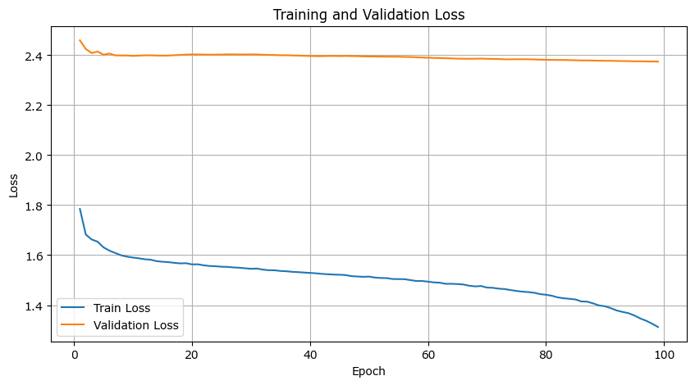
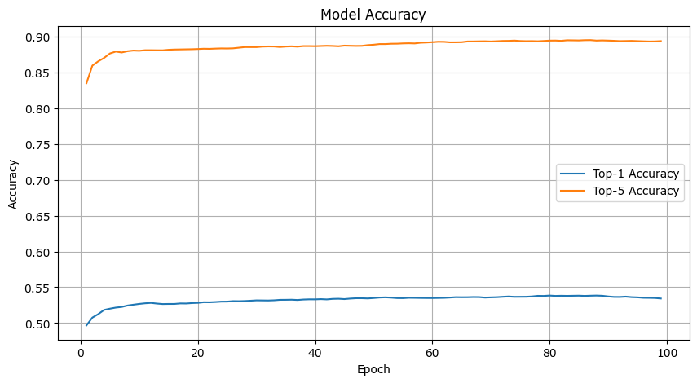
Classification Results
Significant decline observed in training loss across epochs, demonstrating effective model learning and adaptation.
Validation loss shows an initial drop but remains relatively high and flat, suggesting potential overfitting or distribution mismatches between training and validation datasets.
Top-5 accuracy is consistently high and stable, indicating that the model reliably includes the true class among its top five predictions.
Notes:
High AUROC (close to 1) (Area Under the Receiver Operating Characteristic" curve): Indicates that the model has a high ability to discriminate between the positive and negative classes (true positive rates and false positive rates). It means the model can effectively distinguish between true positives (correctly predicted positives) and true negatives (correctly predicted negatives), regardless of the class distribution.
High AUPRC (close to 1): Precision-Recall curves are suitable for imbalanced datasets, as they focus on the performance of the positive class. Signifies that the model not only identifies positive cases effectively (high recall) but also ensures that the cases it predicts as positive are actually positive (high precision). This is particularly important in imbalanced datasets where positive cases are rare.

Slide 10
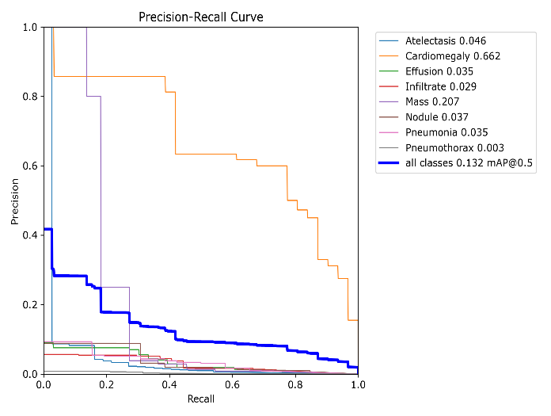
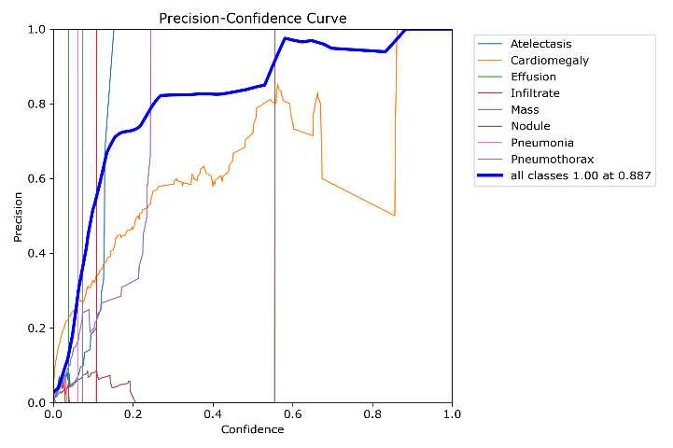
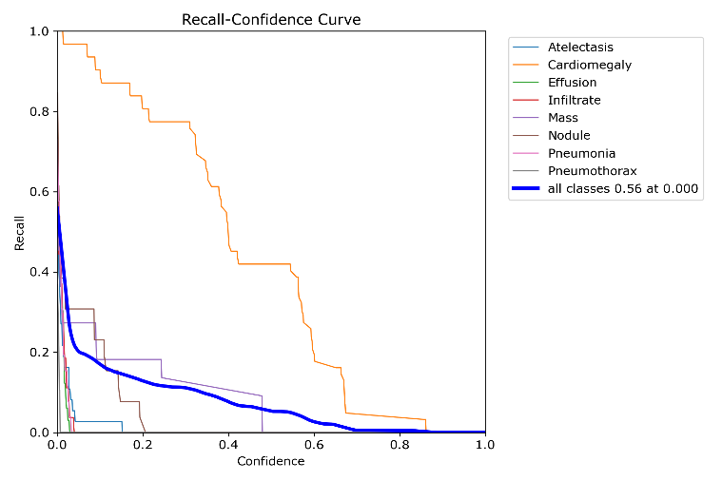
Detection Results
Precision demonstrated variability, indicating fluctuations in the model's ability to correctly identify positive samples.
Recall showed a gradual increase, confirming the model’s improving sensitivity in detecting all relevant objects
Loss metrics displayed consistent downward trends across box loss, class loss, and object loss during both training and validation phases, indicating improved accuracy in object detection and classification
Notes:
High AUROC (close to 1) (Area Under the Receiver Operating Characteristic" curve): Indicates that the model has a high ability to discriminate between the positive and negative classes (true positive rates and false positive rates). It means the model can effectively distinguish between true positives (correctly predicted positives) and true negatives (correctly predicted negatives), regardless of the class distribution.
High AUPRC (close to 1): Precision-Recall curves are suitable for imbalanced datasets, as they focus on the performance of the positive class. Signifies that the model not only identifies positive cases effectively (high recall) but also ensures that the cases it predicts as positive are actually positive (high precision). This is particularly important in imbalanced datasets where positive cases are rare.

Slide 11

Limitations
Limited Dataset for Object Detection: The YOLO object detection model was trained on a relatively small subset of the NIH Chest X-ray Dataset, with only 984 images having annotated bounding boxes, potentially impacting its ability to generalize.
Challenge in Distinguishing Similar Conditions: Both the classification and detection models faced challenges in accurately distinguishing between thoracic conditions that have similar radiographic presentations, such as different types of lung infiltrates or effusions.
Computational Resources and Efficiency: The extensive computational resources required for training deep convolutional neural networks on large datasets like the NIH Chest X-ray Dataset.
Notes:
Outliers were noted, but shared such a small portion of the data that they were not considered to have an impact on modeling.
Data mean-centered and scaled

Slide 12
Thank You

