Slide 1

https://www.veriochi.com
VERIOCHI
Your AI. Your Studios. One Workspace.
www.veriochi.com
Pitch deck
Paul Okafor

Slide 2


https://www.veriochi.com
Improved Productivity

Slide 3


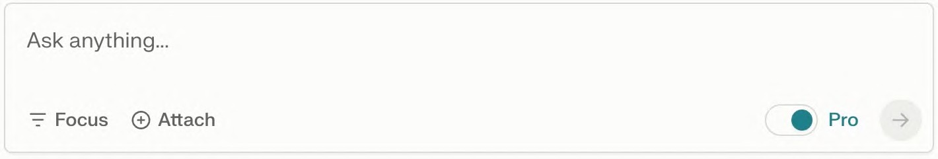
Search like never before.
https://www.veriochi.com

Slide 4

No more software as a SERVICE
https://www.veriochi.com

Slide 5
PROBLEM
The shift
Models replace tools, rather than enhance them. Replacing human input required for creative work
THE GAP
Current workflows lack true collaboration, users simply “prompt” an AI, losing the ability to iterate and refine during the process
The cost
Without a workspace to build and without AI, professionals lose creative control and nuance in their final output
The need
We need Studios, actual software environments (Code, Design, Docs) where humans and AI work side-by-side on the same canvas

Slide 6
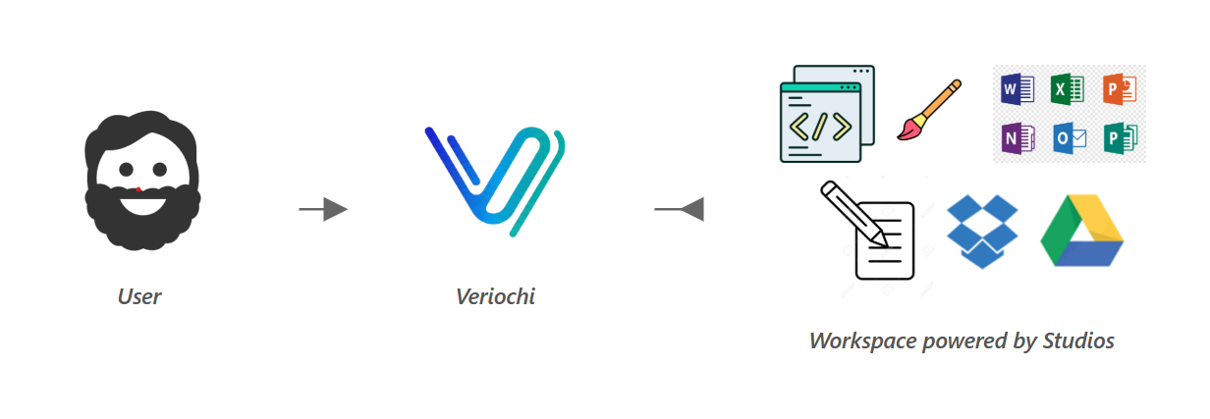
https://www.veriochi.com

Slide 7
PRODUCT OVERVIEW
https://www.veriochi.com
CHAT STUDIO
Product development and rapid prototyping with AI assistance
BUILD STUDIO
coding environment that accelerates development.
DESIGN STUDIO
Visual design and creative workspace where ideas come to life
DOCS STUDIO
AI-powered writing, spreadsheet and documentation assistant

Slide 8
MARKET OVERVIEW
https://www.veriochi.com
$638 Billion
$81 Billion
$24 Billion
Total Addressable Market (TAM)
Global AI Software Market (2025)
Includes all AI Services & Hardware
Serviceable Available Market (SAM)
Global Productivity Software
High-growth collaborative tools sector
Serviceable Obtainable Market (SOM)
Unified Workspaces & Dev Tools
Veriochi's Core Target Segment

Slide 9
Market projection and competition
https://www.veriochi.com
$500B
OPENAI
$57B
PROJECTED
$2B
GAMMA
Infrastructure
Foundation Layer
Veriochi Target
Unified Workspace (2030)
Point Solution
Single Feature Tool

Slide 10
Our competition
https://www.veriochi.com
Convenient
Competitor A
Gamma AI
Cursor
Affordable
Expensive
Univer AI
Anthropic
Google Gemini
OpenAI
Kortix.AI
XAI
Inconvenient

Slide 11
FUNDING REQUEST
https://www.veriochi.com
$6,000
Cloud Infrastructure Hosting
Model Inference Credits
Initial Deployment Scale

Slide 12
ONE-YEAR ACTION PLAN
https://www.veriochi.com
TEST MVP
PRODUCT LAUNCH
FUNDING ROUND
2026
JAN
FEB
MAR
APR
MAY
JUN
JUL
AUG
SEP
OCT
NOV
DEC
2025
JAN
FEB
MAR
APR
MAY
JUN
JUL
AUG
SEP
OCT
NOV
DEC
BUILD PROTOTYPE

Slide 13






MEET THE TEAM
https://www.veriochi.com
PAUL OKAFOR
FEMI ADENIRAN
FLORA BERGGREN​
RAJESH SANTOSHI​
Chief Executive Officer
Chief Technology Officer
Chief Operations Officer
VP Marketing

Slide 14
THANK YOU
https://www.veriochi.com
Paul Okafor​
405-320-7784
acobapaul@gmail.com
www.veriochi.com

