Slide 1
Pinehill Unified School District Analysis and Recommendation
Jared Oberg

Slide 2
Approach to Analysis
1. Purpose
Identify why some schools outperform others and determine where district resources should be focused.
2. Analyze Scores and Performance Metrics
ELA and Math Proficiency percetages (12 schools).
D/F course grade rates (four combined Middle and High schools).
Cohort reading performance (eight Elementary Schools).
3. Investigate Potential Drivers
Student demographics and attendance records.
Staffing metrics including student-teacher ratios, vacancies, and teacher turnover.
Budget and financial allocation.
4. Discovery and Recommendations
Demographic and attendance factors explained much of the variation in school performance.
Schools with higher teacher turnover also experienced higher absenteeism rates.
Financial budget and allocation recommendations to improve turnover and student scores.

Slide 3

Data Cleaning & Validation
Data Quality & Cleaning
Removed one duplicate record from the Grades dataset (Junction Middle School).
Identified undocumented race codes affecting 290 students (3.8% of records).
Corrected a data-entry error in Elm Elementary's Books & Supplies budget allocation ($2.13M; 952% of budget).
Data Reconciliation
Site crosswalk file was incomplete and required manual reconciliation for Dogwood Elementary (PH-04).
Mapped three different site ID systems.
Standardized date formats.
Feature Engineering
Derived chronic absenteeism.
Calculated per-pupil spending.
Calculated funding per student in need.
Integration Challenges
Student-level joins limited to SIS data.
Other systems merged at school level.

Slide 4
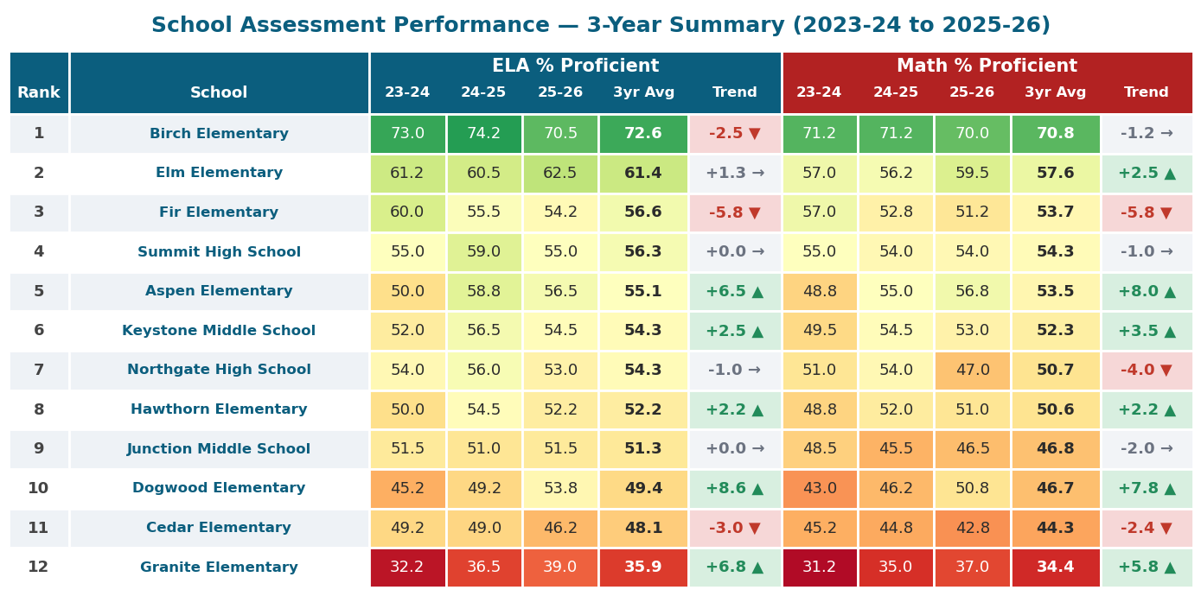
Exploratory Analysis
Initial Analysis - ELA/Math Scores
Reviewed district ELA and Math proficiency rates across all schools from 2023-24 through 2025-26.
Birch Elementary consistently achieved the highest proficiency rates in both ELA and Math.
Granite Elementary consistently ranked lowest in proficiency across both ELA and Math and became a focus for further analysis.
*Trend is the total score difference from 23/24 schoolyear to the 25/26 school year

Slide 5
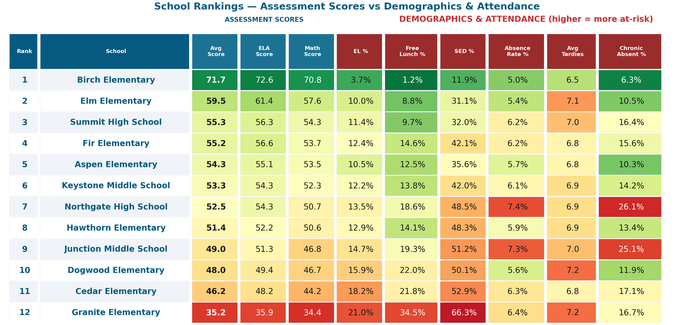
Student Demographics & Attendance
Schools with higher EL%, Free Lunch%, and SED% generally scored lower in ELA and Math.
Attendance measures (absence, tardies, chronic absenteeism) also aligned with lower performance.
Granite Elementary had the highest at-risk population and lowest assessment scores, while Birch Elementary showed the opposite pattern.

Slide 6
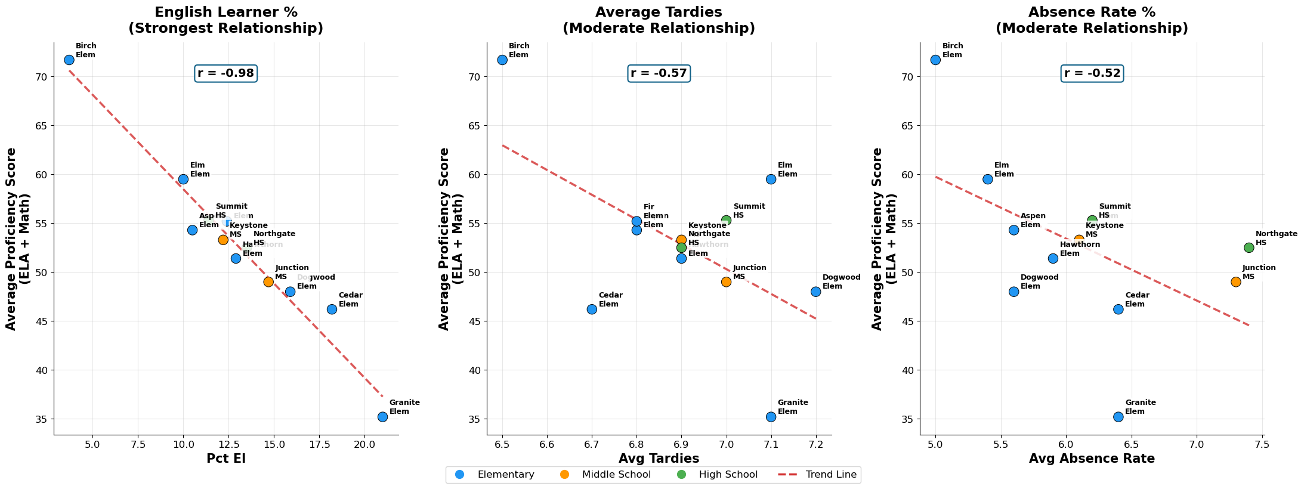
Demographic & Attendance Relationships
EL% showed the strongest negative relationship with achievement (r = -0.98).
Free Lunch% was highly correlated with EL% (r = 0.96), making the two factors difficult to separate.
Attendance metrics were also associated with lower achievement, though less strongly than demographics.
Combined demographic and attendance variables explained 94% of score variation (R² = 0.94).

Slide 7
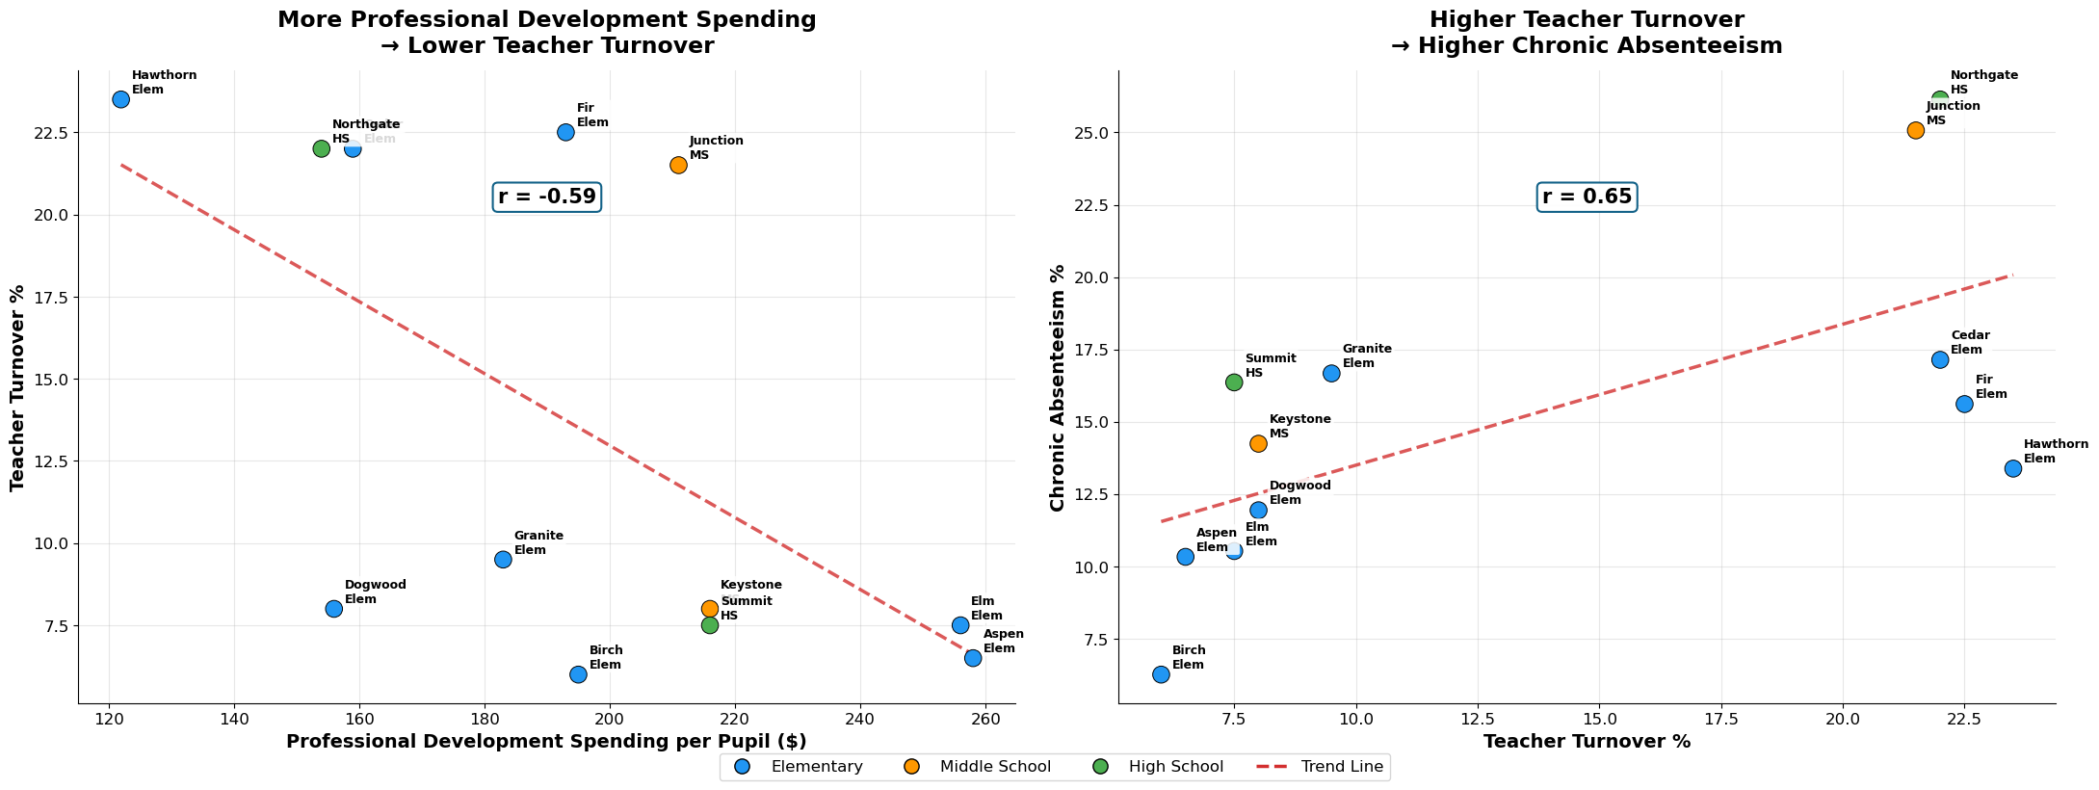
Budget and Staffing
Schools investing more in professional development generally experienced lower teacher turnover.
Teacher turnover was associated with higher chronic absenteeism, suggesting staffing stability may influence student engagement.
Fir Elementary provided a practical example of this relationship, increasing professional development spending while reducing turnover by 11%.
Professional development was the only budget variable showing a statistically significant relationship with teacher turnover.

Slide 8
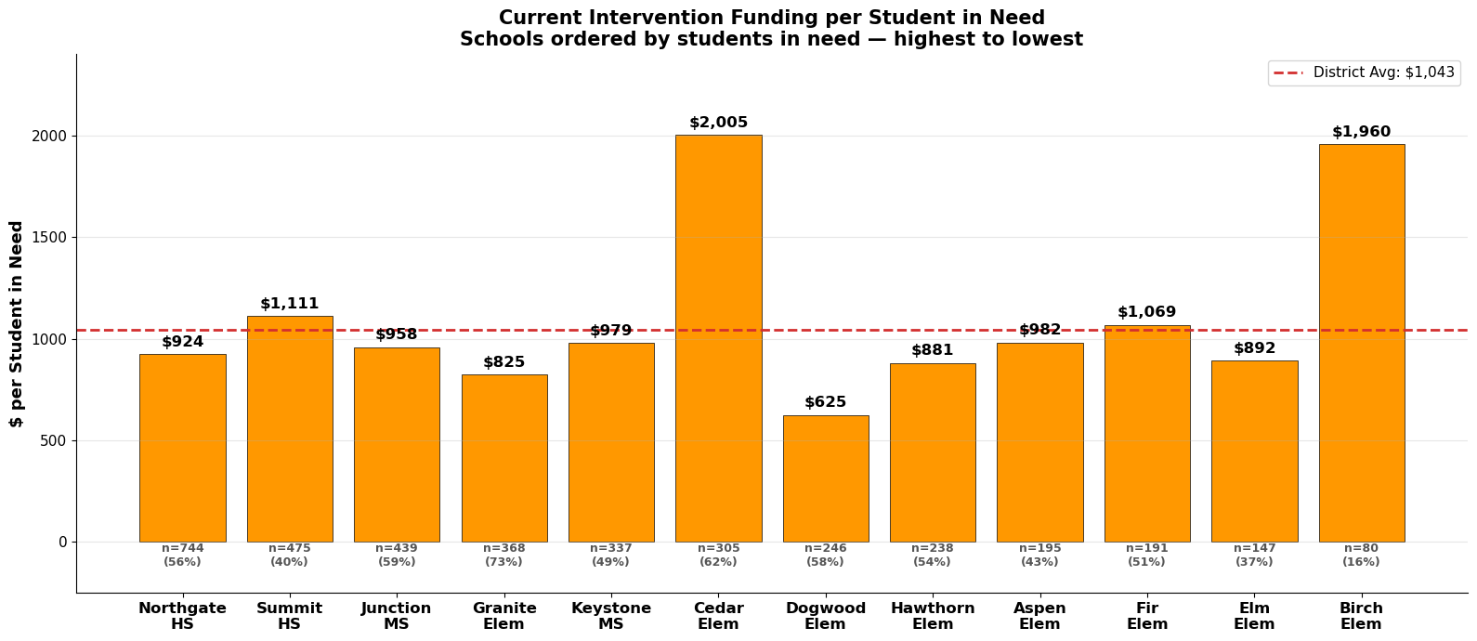
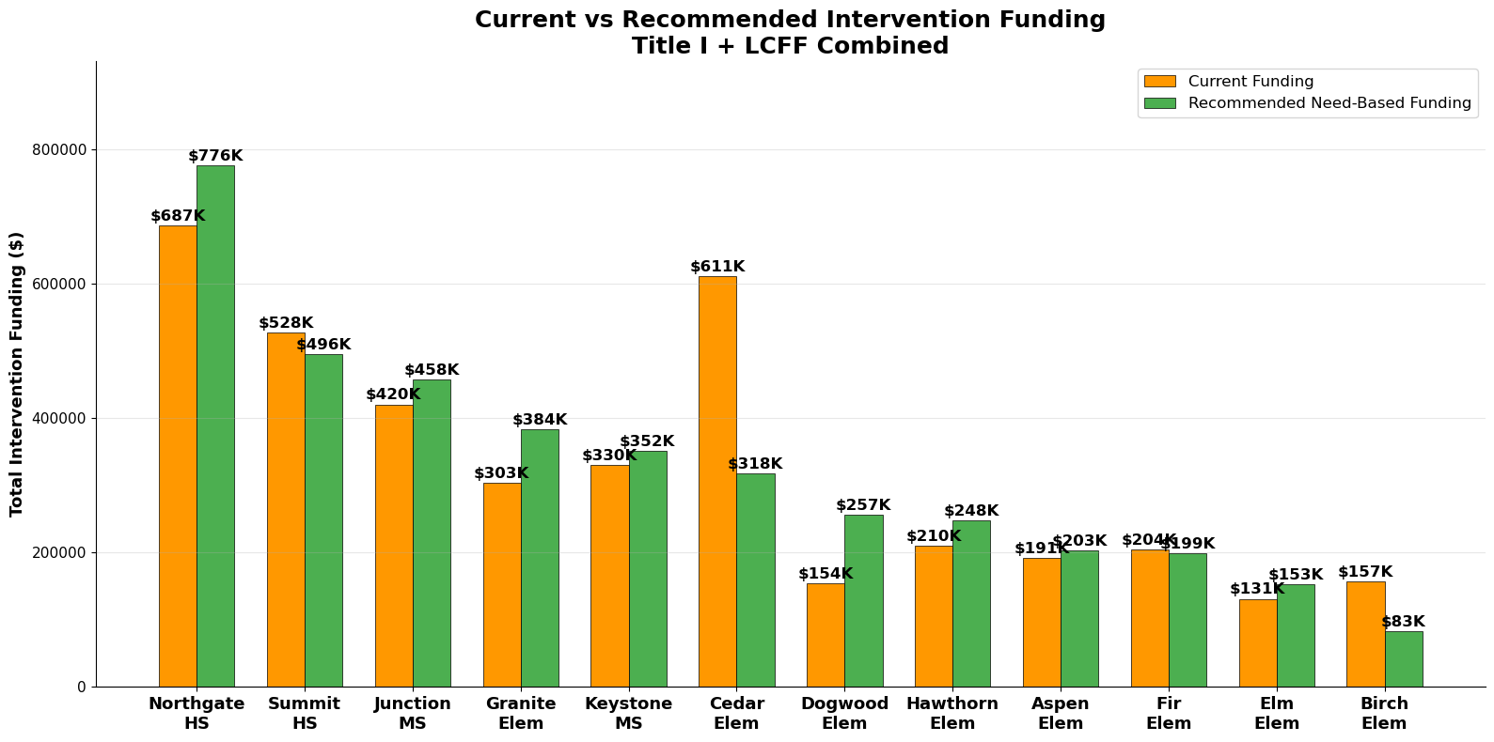
Recommendation-Intervention Funding Allocation
Allocate Title I and LCFF based on students in need.
Current Title I and LCFF intervention funding is not distributed proportionally to student need.
Granite Elementary (368 students in need) receives $303K, while Cedar Elementary (305 students in need) receives $611K.
Funding per student in need ranges from $625 to $2,005, indicating substantial variation across schools.
More consistent funding per student in need across schools while maintaining the existing district budget.
Recommendation: Allocate intervention funding using a standardized need-based formula tied to EL and/or SED student counts.

Slide 9
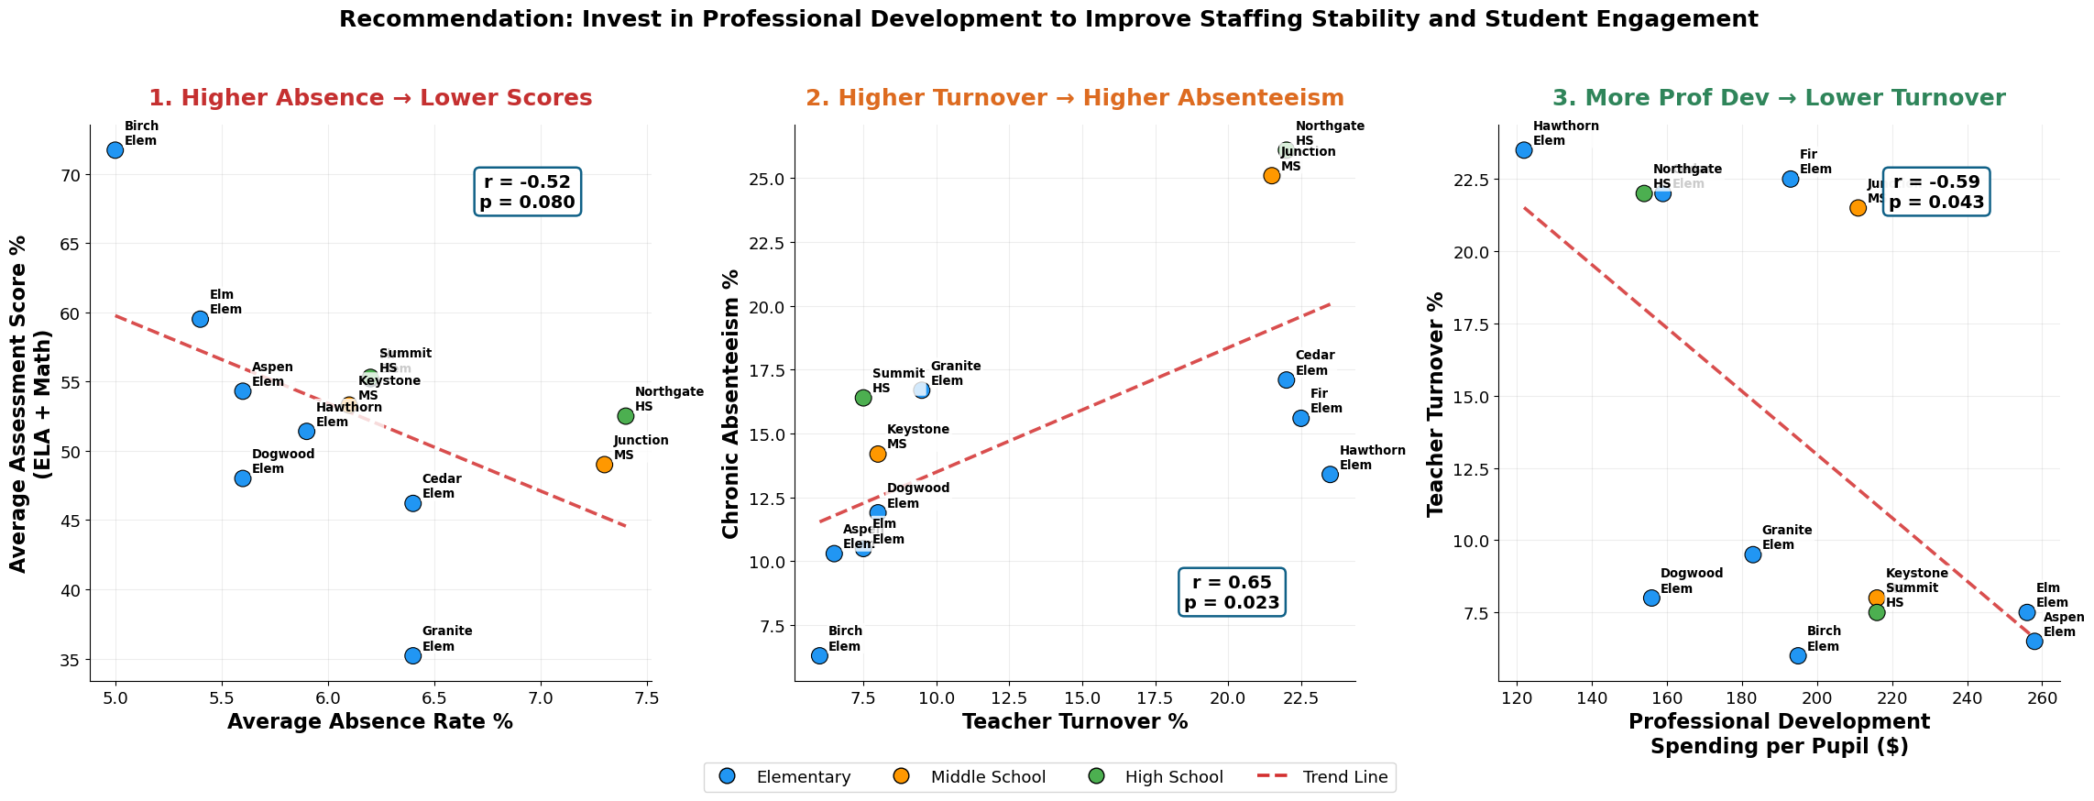
Recommendation-Professional Development
Students with better attendance achieve higher ELA and Math scores (r = -0.52).
Teacher turnover was significantly associated with increased chronic absenteeism (r = 0.65, p = 0.023), suggesting staffing instability contributes to lower student engagement.
Professional Development spending is the only statistically significant budget lever for reducing turnover (r = -0.59, p = 0.043).
The highest-turnover schools invested the least in Professional Development:
Hawthorn Elementary: $126/student → 24% turnover
Cedar Elementary: $162/student → 24% turnover
Junction Middle School: $145/student → 23% turnover
Recommendation: Prioritize Professional Development funding at high-turnover schools to improve staff retention, reduce absenteeism, and support higher student achievement.

Slide 10
Data Limitations
Small school-level sample (24–168 observations)
Limited budget variation (95.24% spend rate)
Only 2 years of staffing and budget data
EL% and Free Lunch% collinearity (r = .96)
Student attendance data was the strongest dataset (7,535 records)
Cautions
Correlation ≠ causation
Funding alone does not explain achievement
Turnover does not necessarily cause absenteeism
Findings should guide investigation, not decisions
Additional Data
Student-level assessment data
Teacher experience, credentials, and retention
Program participation data
Early childhood education data
Additional years of staffing and budget history
Limitations, Cautions & Future Research

Slide 11
Superintendent
Uses the dashboard for a district-wide overview.
Identifies schools with low performance, high absenteeism, or staffing challenges.
Prioritizes resource allocation and intervention efforts.
Site Principal
Filters to their school and compares performance against district averages.
Reviews subgroup achievement, D/F rates, attendance, and staffing indicators.
Identifies areas requiring targeted support.
HR / Business Services
Monitors teacher turnover, vacancies, and funding allocation. Evaluates whether staffing and intervention resources are aligned with student needs.
Supports budgeting and workforce planning decisions.
Dashboard Link
https://public.tableau.com/views/tabschool/Dashboard1?:language=en-US&publish=yes&:sid=&:redirect=auth&:display_count=n&:origin=viz_share_link
Dashboard End Users

