Slide 1
Project Sweetwater
Domain Manager
Index Manager
Domain Scheduler Invoker
Security Manager
Domain Evaluator

Slide 2
Domain Manager
Index Manager
Domain Scheduler Invoker
Application
Architecture

Slide 3
Application
Concept
  Manage discrete domains across repositories of groups and indexes.
Features
  Build repositories composed of indexes and groups, each containing domains.
  Assign a domain to any index over time, enabling basic workflow.
  Search indexes and domains.
  Load grouped domains via a file.
  Monitor application server events.

Slide 4
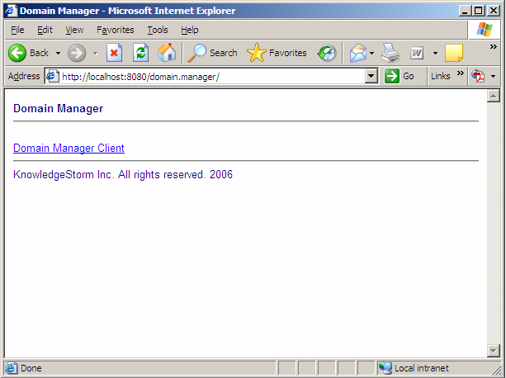
Web Start Application

Slide 5
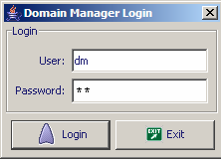
Login

Slide 6
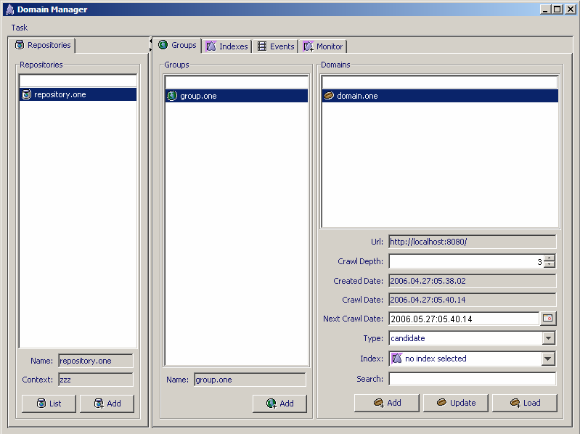
Client

Slide 7
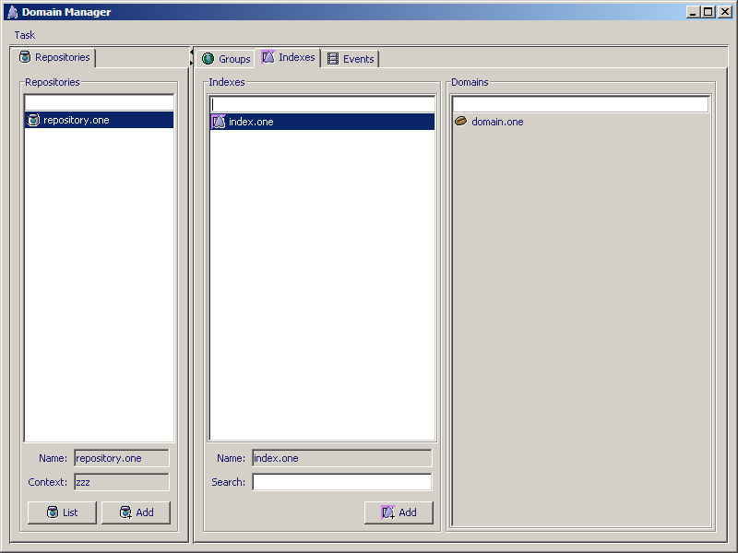
Client

Slide 8
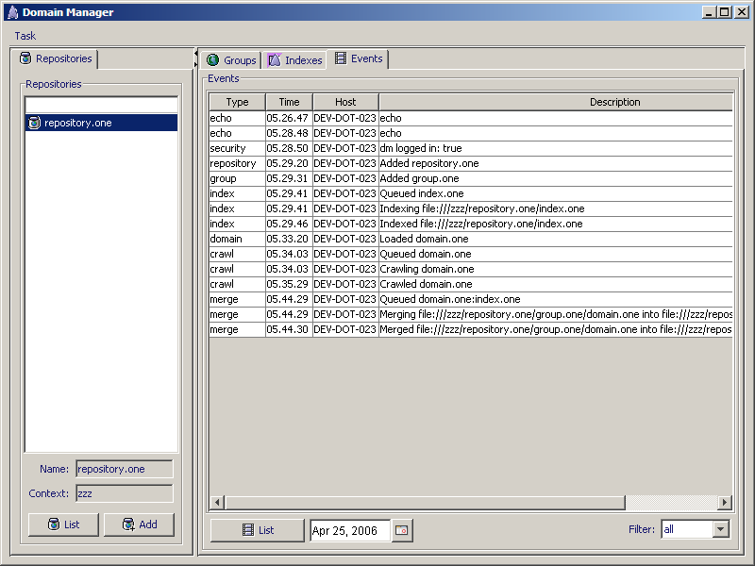
Client

Slide 9
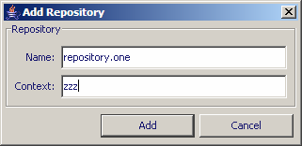
Add Repository

Slide 10
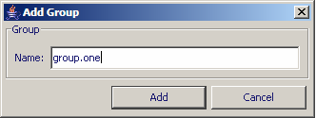
Add Group

Slide 11
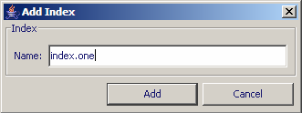
Add Index

Slide 12
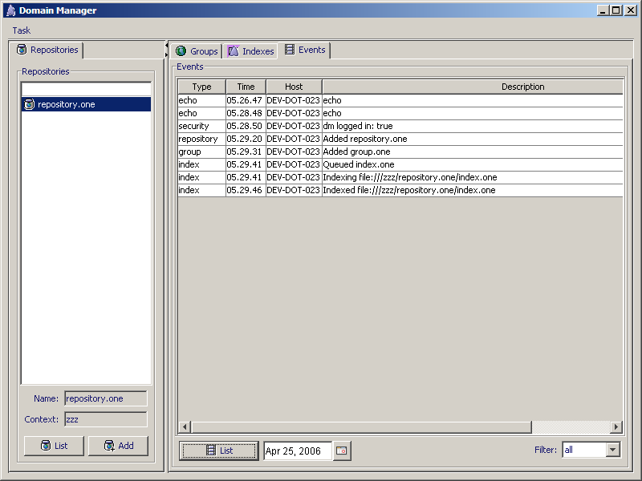
Monitor Events

Slide 13
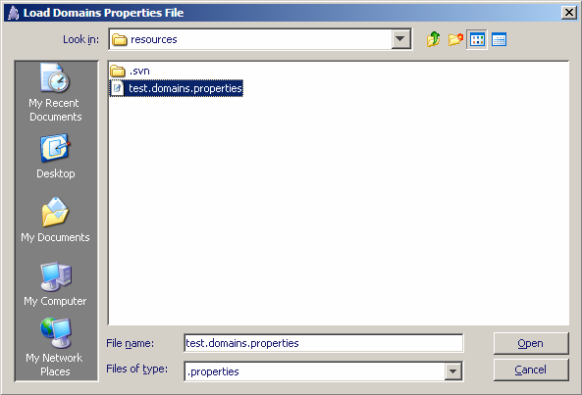
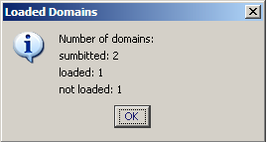
Load Domains

Slide 14
Crawled Domain

Slide 15
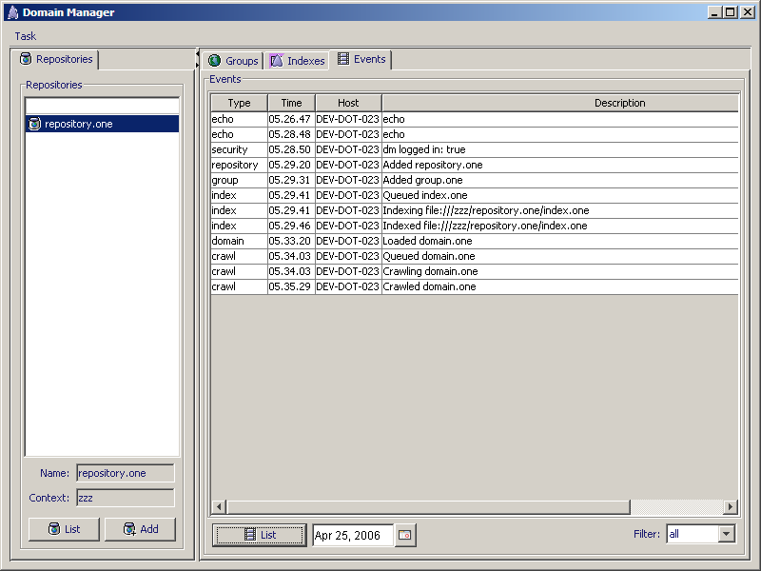
Monitor Events

Slide 16
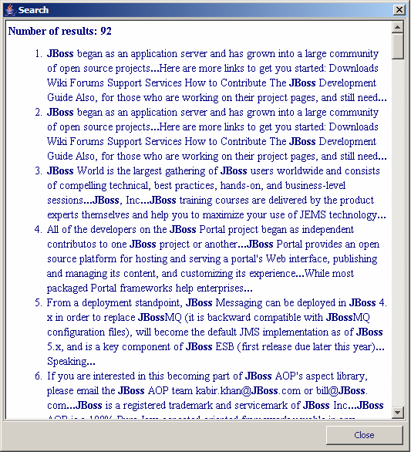
Searched Domain

Slide 17
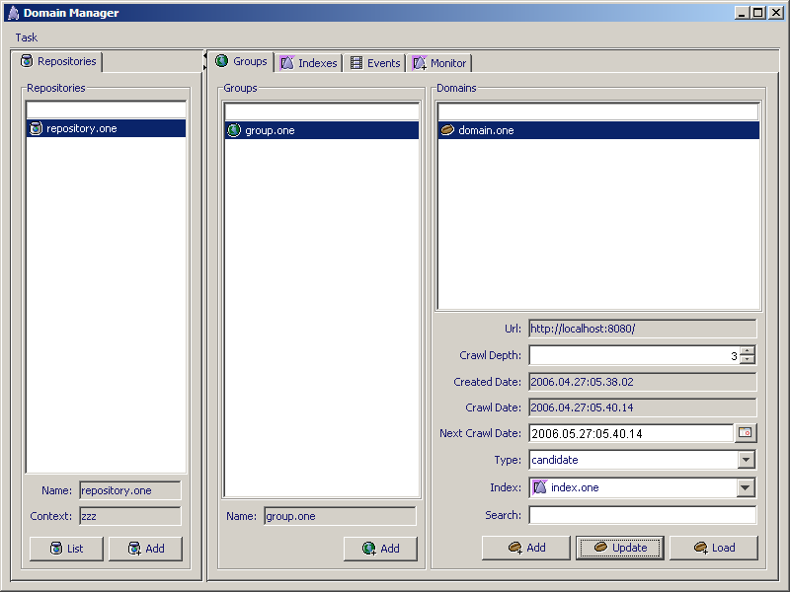
Adding Domain to Index

Slide 18

Added Domain to Index

Slide 19
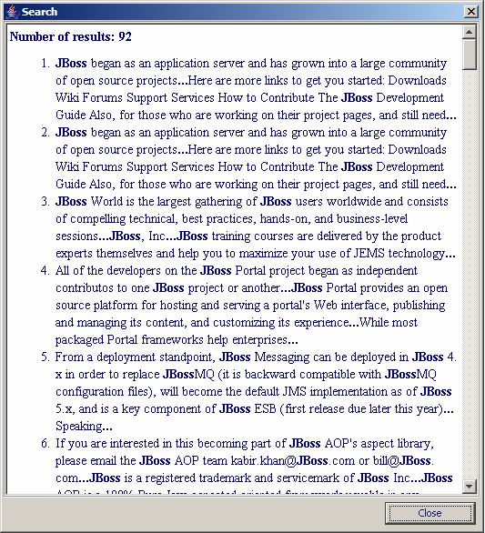
Searched Index

Slide 20

Monitor Events

Slide 21
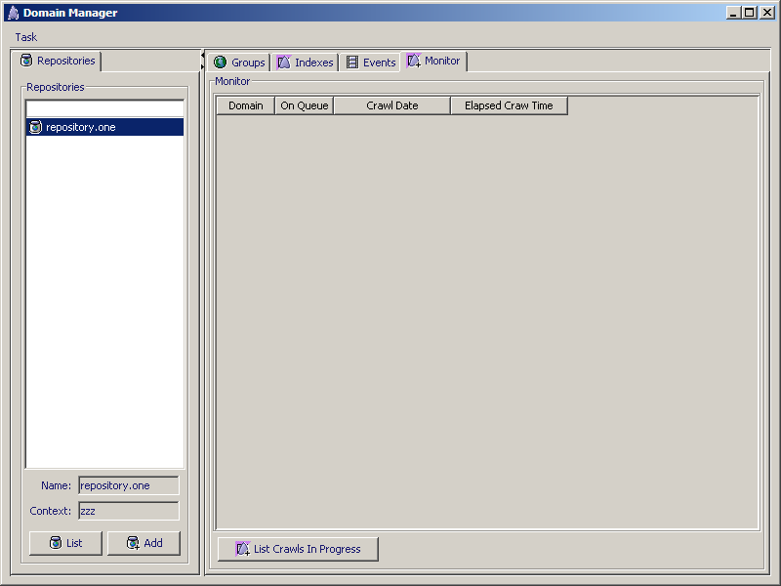
Monitor Crawls

Slide 22
Architecture
Features
  Domain Manager Client Application
  Domain Scheduler Invoker Application
  Domain Manager Application Server - JBoss Cluster
  Index Manager
  Oracle Database
  Storage Area Network
Technologies
  Nutch
  Lucene
  Spring
  Hibernate
  AspectJ

Slide 23
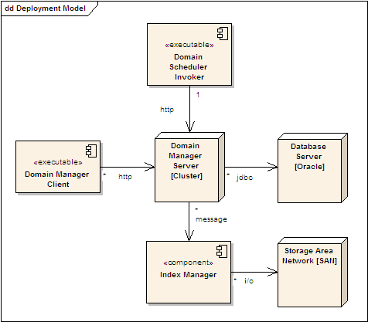
Deployment Model

Slide 24
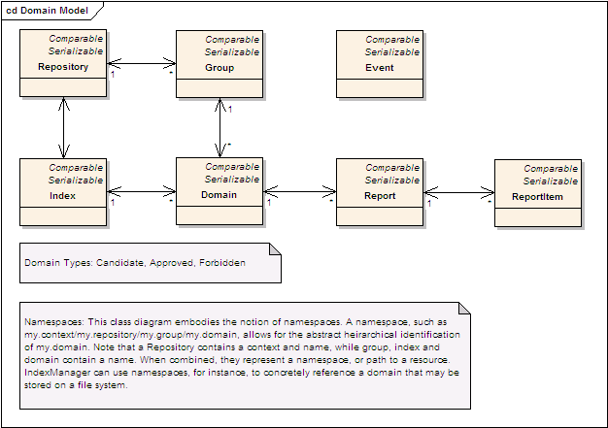
Domain Model

Slide 25
Heirarchical Domain Model
Repository
  Groups
    Group
      Domains
        Domain
  Indexes
    Index
      Domains
        Domain

Slide 26
Namespace URI
Context = san1
Repository = r1
Group = g1
Index = i1
Domain = d1
Domain URI = san1/r1/g1/d1
Index URI = san1/r1/i1

Slide 27
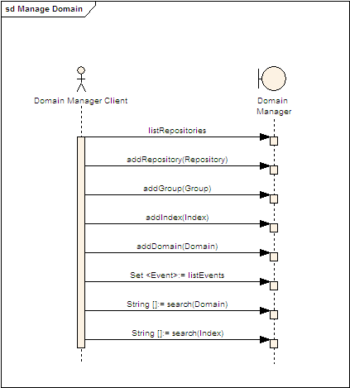
Domain Manager Client Scenarios

Slide 28
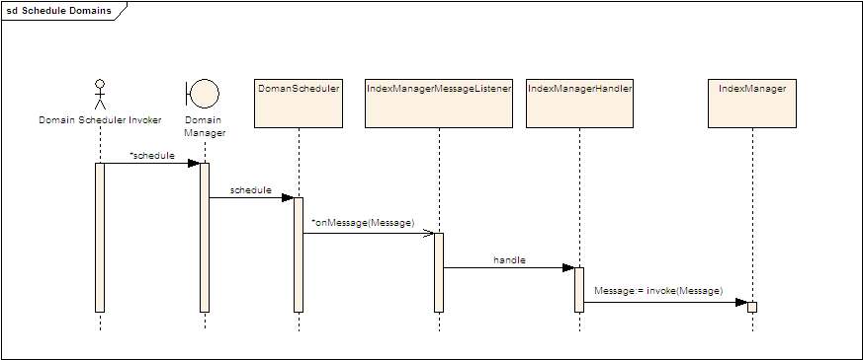
Domain Scheduler Invoker Scenario

Slide 29
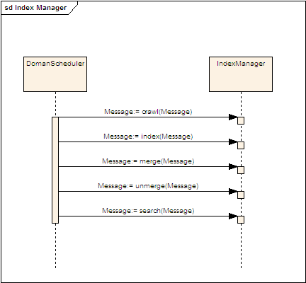
Index Manager Scenarios

Slide 30
Index Manager Notes
2500 sites corresponds to about 100 GB of data. The products people want to crawl 10,000 sites. By extrapolation, about 400 GB.
The products people want to crawl new sites on a daily basis. Assume 10% of the sites are news sites, this implies crawling 40 GB of data per day, or about 2 GB per hour, or about 500 KB/sec, or 4 MB/sec. This is about 3 T1's worth of bandwidth.
Crawing 1000 sites/day, leaves another 9000 sites/month. About 300 sites/day, on average. This means crawling about 55 sites/hour, with 4 T1's worth of bandwidth.

Slide 31
Security Manager
Application
Architecture

Slide 32
Application
Features
  Manage multiple applications, each containing roles with permissions, mapped to principals.
  Authentication based on application id, name and credential.
  Authorization based on application principals, each mapped to a user and set of roles.

Slide 33
Architecture
Features
  Role-base actions.
Technologies
  Spring
  Hibernate
  Swing

Slide 34
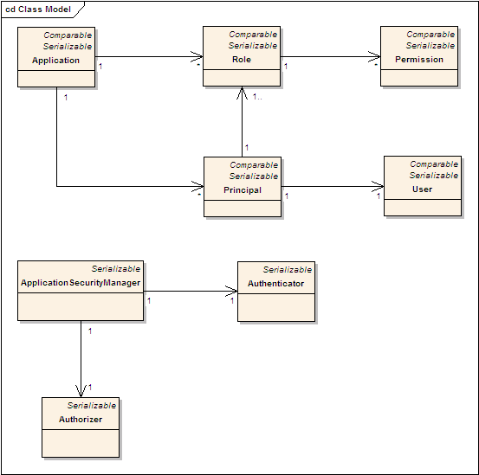
Domain Model

Slide 35
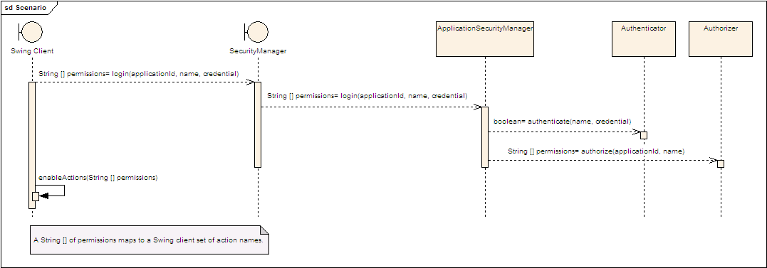
Login Secanrio

Slide 36
Domain Evaluator
Application
Architecture

Slide 37
Configuration Management
Subversion
  https://svn.knowledgestorm.com

Slide 38
Build Process
Maven
  //waterworks/home/devteam/.m2/repository/
  //${user.home}/.m2/repository/
Cruise Control
  http://build.knowledgestorm.com

Slide 39
Development Process
Scrum
Scrumworks
  http://scrumworks.knowledgestorm.com/

Slide 40
Roadmap
May
  Test Domain Manager, Index Manager and Domain Scheduler Invoker
  Develop Domain Evaluator
  Develop Security Manager
June
  Deploy Domain Manager, Index Manager and Domain Scheduler Invoker
  Deploy Security Manager
  Develop Domain Evaluator
  Develop Index Manager
July
  Develop Domain Evaluator
  Develop IndexManager
August
  Deploy Domain Evaluator
  Deploy Index Manager

