Slide 1
Measles: deciphering the ecological clockworks
Ottar Bjornstad – Penn State University
onb1@psu.edu

Slide 2
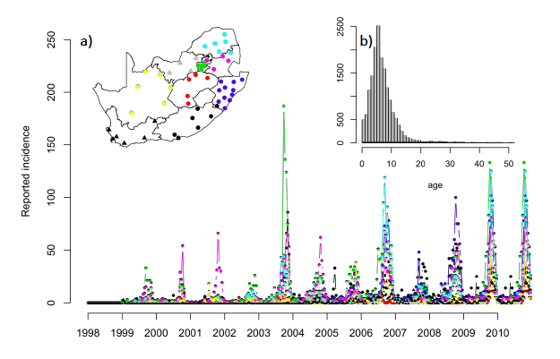
Childhood diseases:
Bacterial or viral etiology characterized by attacks restricted towards children and teens
Usually exhibit ‘recurrent epidemics’
Rubella (Togavirus)
South Africa
(Annual epidemics)
Notes:
Childhood diseases bacterial or viral characterized by attacks restricted children and teens

Slide 3
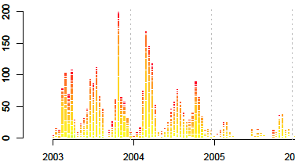
Rubella (Togavirus)
Kenya (Three epidemics / year)
South Africa
(Annual epidemics)

Slide 4
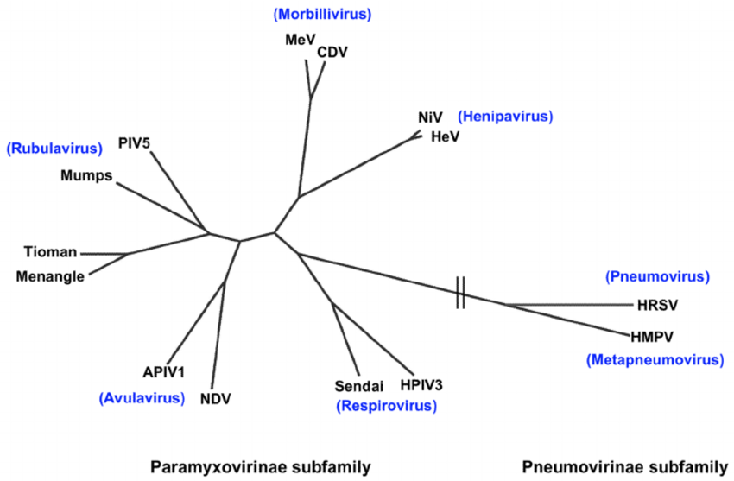
Croup
HPIV2, HPIV4
HPIV1, HPIV3

Slide 5
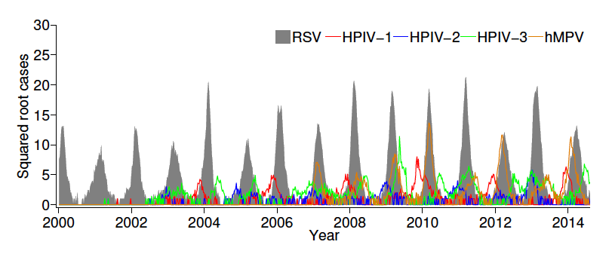
Croup by agent
Salt Lake Utah
childrens hospital

Slide 6
RSV, P3, MP: Seasonal winter epidemics
Croup by agent
Salt Lake Utah
childrens hospital
RSV
P3
MP

Slide 7
RSV, P3, MP: Seasonal winter epidemics
Croup by agent
Salt Lake Utah
childrens hospital
RSV
P3
MP
P1
P2
P1, P2: Biennial epidemics (offset by 180°)

Slide 8
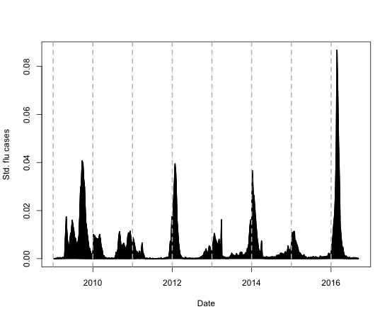
Influenza (OrtomyxoV)
Influenza A/B in Mexico: Annual winter epidemics?

Slide 9
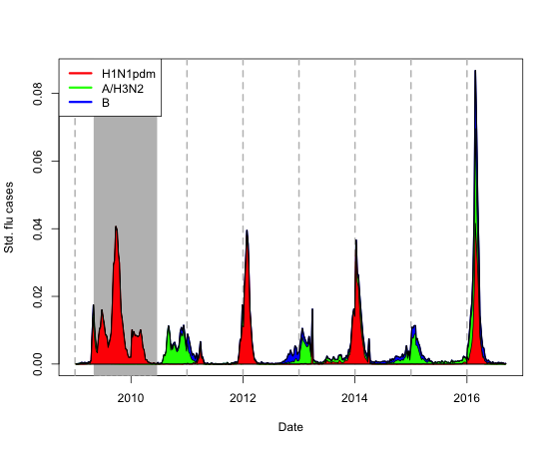
Influenza A/B in Mexico: Annual winter epidemics?

Slide 10
Measles

Slide 11
Annual to 2-4 year regular or irregular recurrent epidemics
Liverpool
New York
Cases (in 1000s)
London
Baltimore
Cases (in 1000s)

Slide 12
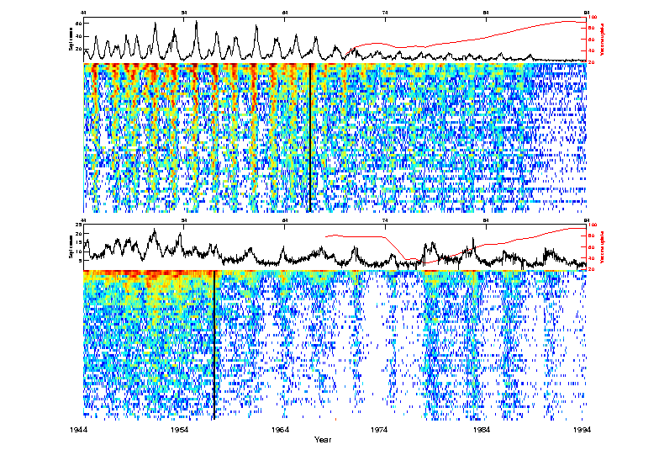
Measles in England and Wales (1944-1994)
Big
city
Small
town
Lessons from Measles Epidemics
Before the onset of mass-vaccination in England & Wales, strong spatial synchrony due to:
human mobility
very infectious virus
seasonal forcing
After vaccination, case reports in cities very much
out-of-phase:
dynamic complexity - multiple attractors
fewer infections ⇒ weaker epidemiological coupling
1944-50 annual epidemics
1950s-60s strongly synchronised biennial cycles in most large cities
1970s-1990s declining incidence due to vaccination -- irregular, desynchronised patterns.
>> 60 city Animation

Slide 13
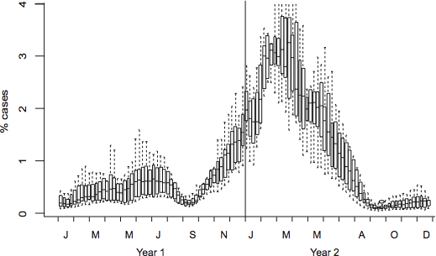
The typical biennial cycle (London)
.

Slide 14
The time-series SIR (TSIR) model

Slide 15
The London ‘55 and ‘57 epidemics
12
8
Infected
(in thousand)
4
0
Oct 53
Aug 54
Apr 55
Jan 56
Nov 56
Aug 57
Each week children were born
Mean: 995
Min: 957
Max: 1041

Slide 16
The London ‘55 and ‘57 epidemics
140
12
8
Susceptible
(in thousand)
Infected
(in thousand)
125
4
110
0
Oct 53
Aug 54
Apr 55
Jan 56
Nov 56
Aug 57
Births replenish the susceptible pool
Weekly births
Mean: 995
Min: 957
Max: 1041

Slide 17
The London ‘55 and ‘57 epidemics
140
12
8
Susceptible
(in thousand)
Infected
(in thousand)
125
4
110
0
Oct 53
Aug 54
Apr 55
Jan 56
Nov 56
Aug 57
Reccurent epidemics are the results of predator/prey-like cycles
Births fuel epidemics through providing new susceptibles
Transmission depletes the susceptible pool
Post-epidemics troughs are deep with little transmission
5000
1000
Infected
200
50
20
110000
120000
130000
140000
Susceptibles

Slide 18
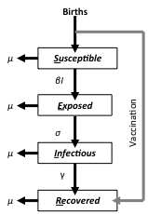
The S-E-I-R flow for Measles
After 3-6mos maternal immunity, children become susceptible
Susceptibles become infected through aerosol contact with infectious
After a short period (latent + infectious = 2 weeks) individuals Recover (or die)
Recovered individuals are immune for life with “bullet-proof” sterilizing immunity
Vaccine provides “bullet-proof” sterilizing immunity –
“short-circuits” chain-of-transmission

Slide 19
Seasonality in transmisssion ->
Ressonance & Dissonance

Slide 20
The typical biennial cycle
Xmas
Easter
Summer
Xmas
Easter
Summer
.

Slide 21
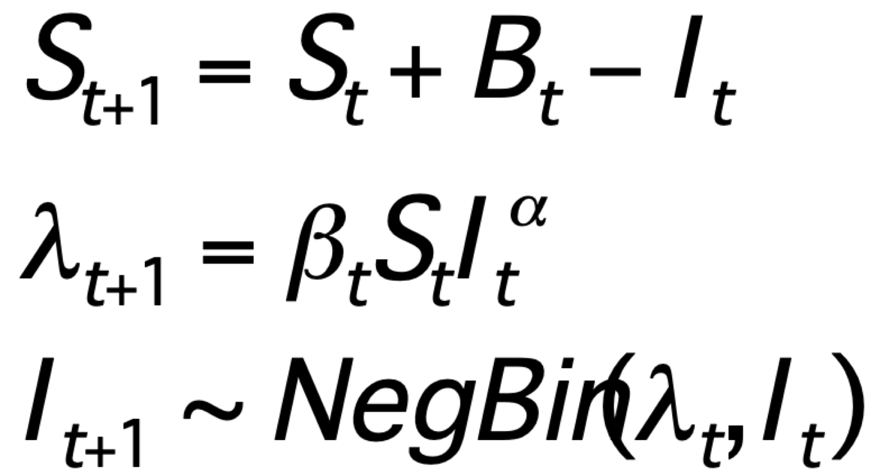
140
12
8
Susceptible
(in thousand)
Infected
(in thousand)
125
4
110
0
Oct 53
Aug 54
Apr 55
Jan 56
Nov 56
Aug 57
We can estimate time-varying transmission rates by regressing “current infected” on infected*susceptible 2-weeks in the past (2 weeks is ≈ latent + infectious period ≈ serial interval).
The so-called Time-series SIR (TSIR) model*:
Susceptible balance
Expected new cases
Epidemic birth-and-death process
*I’m skipping some details here (see Bjornstad et al. 2002. Ecological Monographs 72:169-184)

Slide 22
Easter
Summer
Xmas
Jan Dec
Seasonality in effective transmission rate:
Low transmission when schools are closed

Slide 23
500 generation
ahead forecast
20 YEAR FORECAST OF THE MODEL (starting from conditions in Jan 1944)

Slide 24
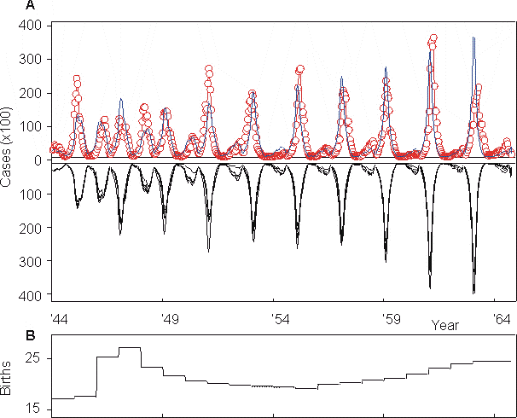
10 stochastic realizations: Almost no divergence!
Bry
Bryan Grenfell’s “Emergent simplicity”
Notes:
require(shiny)
require(deSolve)
# This creates the User Interface (UI)
ui <- pageWithSidebar(
headerPanel("Seasonally forced SEIR"),
sidebarPanel(
sliderInput("beta0", "Transmission (yr^-1):", 1000,
min = 0, max = 3000),
sliderInput("beta1", "Seasonality:", 0,
min = 0, max = 1),
sliderInput("Ip", "Infectious period (days)", 5,
min = 1, max = 100),
sliderInput("oneoversigma", "Latent period (days):", 8,
min = 1, max = 100),
sliderInput("mu", "birth rate (per 1000):", 0.02,
min = 0, max = .1),
sliderInput("T", "Time range:",
min = 0, max = 100, value = c(0,20)),
checkboxInput("lg", "un-Log", TRUE)
),
mainPanel(
tabsetPanel(
tabPanel("Time", plotOutput("plot1")),
tabPanel("Phase plane", plotOutput("plot2")),
tabPanel("Equations",
withMathJax(
helpText("Susceptible $$\\frac{dS}{dt} = \\mu (N - S) - \\frac{\\beta(t) I S}{N}$$"),
helpText("Exposed $$\\frac{dE}{dt} = \\frac{\\beta(t) I S}{N} - (\\mu+\\sigma) E$$"),
helpText("Infecitous $$\\frac{dI}{dt} = \\sigma E - (\\mu+\\gamma) I$$"),
helpText("Removed $$\\frac{dR}{dt} = \\gamma I - \\mu R$$"),
helpText("Seasonality $$\\beta(t) = \\beta_0 (1 + \\beta_1 cos(2 \\pi t))$$"),
helpText("Reproductive ratio $$R_0 = \\frac{\\sigma}{\\sigma +\\mu} \\frac{1}{\\gamma+\\mu} \\frac{\\beta N}{N}$$")
))
)
)
)
# This creates the 'behind the scenes' code (Server)
server <- function(input, output) {
seirmod2=function(t, x, params){
S=x[1]
E=x[2]
I=x[3]
R=x[4]
mu=params["mu"]
N=params["N"]
beta0=params["beta0"]
beta1=params["beta1"]
sigma=params["sigma"]
gamma=params["gamma"]
dS = mu * (N - S) - beta0 * (1+beta1*cos(2*pi*t))* S * I / N
dE = beta0 * (1+beta1*cos(2*pi * t))* S * I / N - (mu + sigma) * E
dI = sigma * E - (mu + gamma) * I
dR = gamma * I - mu * R
res=c(dS, dE, dI, dR)
list(res)
}
output$plot1 <- renderPlot({
times = seq(0, input$T[2], by=1/100)
paras = c(mu = input$mu, N = 1, beta0 = input$beta0, beta1 = input$beta1, sigma = 365/input$oneoversigma, gamma = 365/input$Ip)
xstart = c(S=0.06, E=0, I=0.001, R = 0.939)
R0 = round(with(as.list(paras), sigma/(sigma+mu)*beta0/(gamma+mu)), 1)
out=ode(y=xstart,
times=times,
func=seirmod2,
parms=paras)
out=as.data.frame(out)
sel=out$time>input$T[1]&out$time<input$T[2]
par(mar = c(5,5,2,5))
#lg=ifelse(input$lg==TRUE, "y", "")
plot(x=out$time[sel], y=out$I[sel], ylab="fraction", xlab="time", type="l",
ylim=range(out[sel,-c(1,2, 5)]), xlim=c(input$T[1], input$T[2]), log=ifelse(input$lg==TRUE, "y", ""), col="red")
lines(x=out$time, y=out$E, col="blue")
title(paste("R0=", R0))
# lines(x=out$time, y=out$S, col="green")
par(new=T)
plot(x=out$time, y=out$S, type="l", col="green", axes=FALSE, xlab=NA, ylab=NA,
ylim=range(out[sel,2]), xlim=c(input$T[1], input$T[2]), log=ifelse(input$lg==TRUE, "y", ""))
axis(side = 4, col="green")
mtext(side = 4, line = 4, "S", col="green")
legend("right",
legend=c("I", "E", "S"),
lty=c(1,1,1),
col=c("red", "blue", "green"))
})
output$plot2 <- renderPlot({
times = seq(0, input$T[2], by=1/100)
paras = c(mu = input$mu, N = 1, beta0 = input$beta0, beta1 = input$beta1, sigma = 365/input$oneoversigma, gamma = 365/input$Ip)
xstart = c(S=0.06, E=0, I=0.001, R = 0.939)
R0 = with(as.list(paras), sigma/(sigma+mu)*beta0/(gamma+mu))
out=ode(y=xstart,
times=times,
func=seirmod2,
parms=paras)
out=as.data.frame(out)
sel=out$time>input$T[1]&out$time<input$T[2]
plot(out$S[sel], out$I[sel], log=ifelse(input$lg==TRUE, "xy", ""), type="l", xlab="fraction susceptible", ylab="fraction infected")
abline(v=1/R0, col="green")
curve(paras["mu"]*(1-x)/(paras["beta0"]*x), min(out$S), max(out$S), add=TRUE, col="red")
legend("topright",
legend=c("I-socline", "S-isocline"),
lty=c(1,1),
col=c("red", "green"))
})
}
shinyApp(ui, server)

Slide 25
The “seasonally-forced” SEIR model’s dynamics depend on
Strength of seasonality
susceptible recruitment
birth
vaccination

Slide 26
Dynamics and seasonal forcing
High seasonality: erratic outbreaks
20000
15000
10000
Summer
holiday
5000
0
UK seasonality: 2-year cycles
10000
Seasonal transmission
8000
Observed
6000
4000
2000
0
Low seasonality: annual outbreaks
3500
3000
2500
2000
1500
2
4
6
8
10
12
1000
Month
500
0
2yr
Notes:
Seasonal variation in transmissionis an important parameter
Here’s the empirical transmission rates through the year for london
Y-axis
X-axis
Note summer low
Thick line is london
Bifurcation plot
October abundance against transmission variability
Annual cycle
biannual cycle
chaotic dynamics

Slide 27
Bifurcation plot for seasonality
Seasonality = 0.05
1st week of October
3500
3000
10000
2500
2000
1500
1000
1000
500
0
2yr
100
Seasonality = 0.15
10000
Infected (in October)
8000
10
6000
4000
2000
1
0
0.1
Seasonality = 0.30
20000
15000
0.01
10000
5000
0.0
0.1
0.2
0.3
0.4
0
seasonality
Notes:
This slide shows this in more detail
bifurcation diagram
Three cases: Cases, Lines are biennia
annual dynamics
Biannual cycles
Chaotic fluctuations

Slide 28
But patterns modulated by birth rate
UK seasonality but varying birth rates
Notes:
In this model I simulate a linear drop in brithrates from high to intermediate
Line + Right Y
The change (bifurcation is fairly abrupt):
Cases agains years
See the dynamics in the phase-plot
Susceptible vs log cases
Finally in - sorry - reverse time(Z)
Thus the irregularity in dynamics appear to be due to ‘attractor evolution’ and thightly regulated dynamics
Rather than chaotic irregularity

Slide 29
Annual dynamics in UK post WWII due to baby-boom
>> SEIR Shiny App – resonance gives way to dissonance

Slide 30
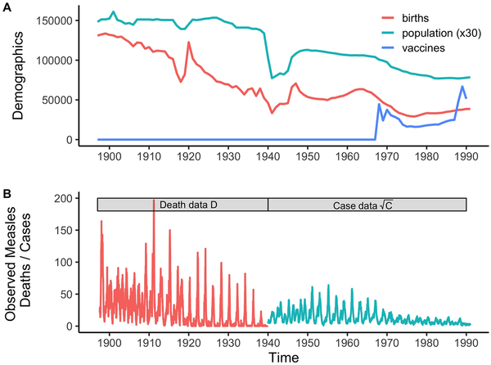
Fig 1. The demographic, vaccination, and measles data analyzed.
Becker AD, Wesolowski A, Bjørnstad ON, Grenfell BT (2019) Long-term dynamics of measles in London: Titrating the impact of wars, the 1918 pandemic, and vaccination. PLOS Computational Biology 15(9): e1007305. https://doi.org/10.1371/journal.pcbi.1007305
https://journals.plos.org/ploscompbiol/article?id=10.1371/journal.pcbi.1007305

Slide 31
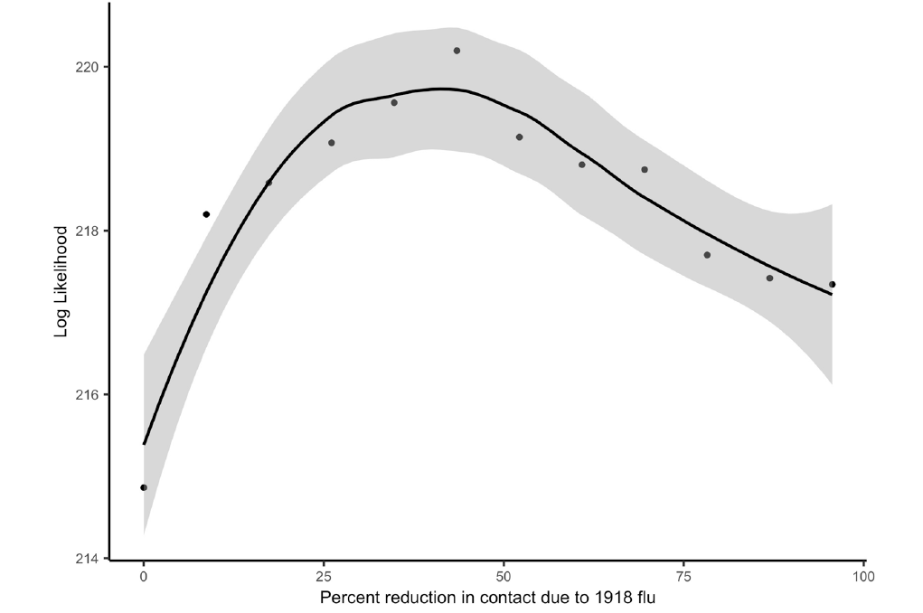

Slide 32
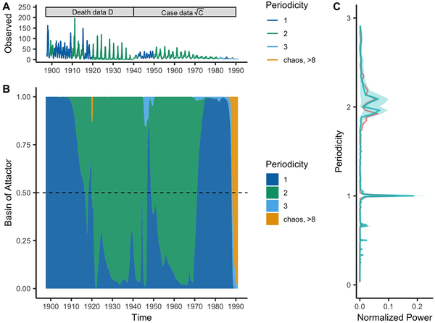
Fig 3. A comparison of predicted against observed measles dynamics for London 1897–1991 based on periodicity inferred from wavelet analysis.
Becker AD, Wesolowski A, Bjørnstad ON, Grenfell BT (2019) Long-term dynamics of measles in London: Titrating the impact of wars, the 1918 pandemic, and vaccination. PLOS Computational Biology 15(9): e1007305. https://doi.org/10.1371/journal.pcbi.1007305
https://journals.plos.org/ploscompbiol/article?id=10.1371/journal.pcbi.1007305

Slide 33
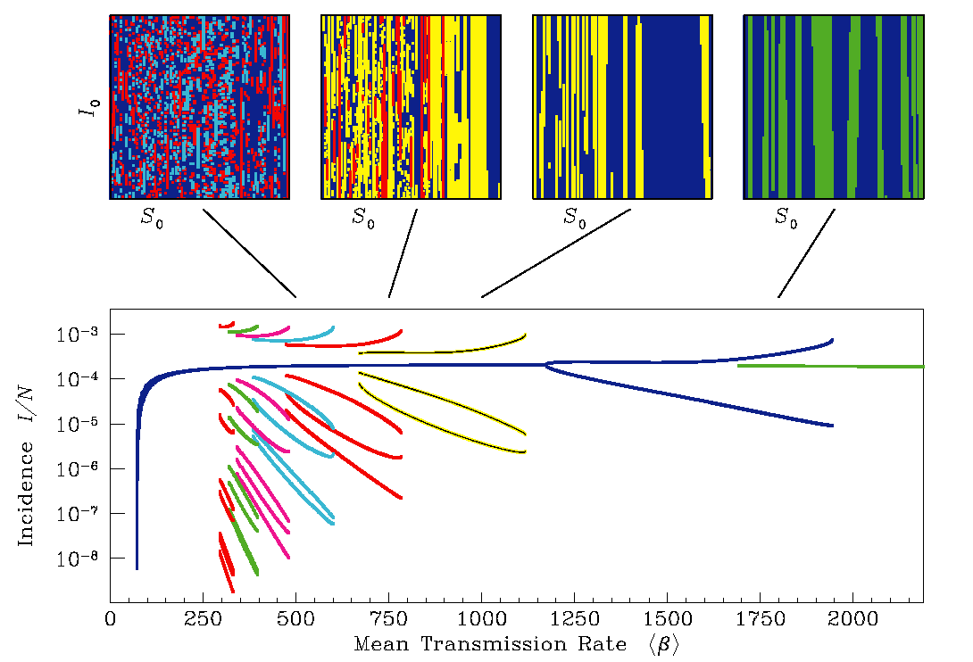
Bifurcation plot for susceptible recruitment rate
3500
3000
10000
2500
2000
8000
1500
20000
6000
1000
500
15000
4000
0
10000
2000
2yr
0
5000
0
Low birth rate/high vacc
High birth rate/low vacc

Slide 34
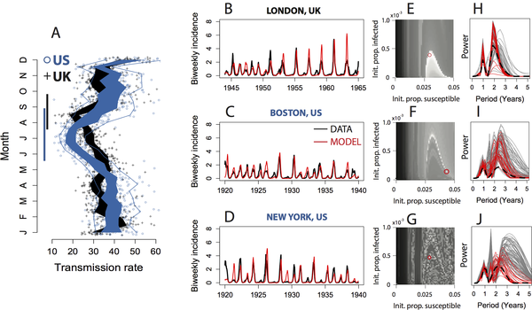
Predictable but erratic dynamics in US due to longer summer holiday!
Dalziel et al. (2016) PLOS Computational Biology 12(2): e1004655.

Slide 35
Conclusion:
The diverse dynamics of certain immunizing childhood infections is governed by a remarkably simple clockwork.
Susceptible recruitment rate and seasonality are key ingredients
(Combined with transportation models, we can also predict spatial dynamics)
Funding:
NSF
USDA/NRI/AFRI
DHS/RAPIDD
Bill & Melinda Gates foundation
onb1@psu.edu
(Select) Collaborators :
Bryan Grenfell
Jess Metcalf
Ben Dalziel
Matt Ferrari
Cecile Vibud
Samit Battacharrya
Git: https://github.com/objornstad
CIDD: www.cidd.psu.edu MOOC: www.coursera.org/learn/epidemics

