Slide 1
Logistics:
Install R/Rstudio
https://cloud.r-project.org
https://rstudio.com/products/rstudio/download/#download
Install Epimdr-package
https://CRAN.R-project.org/package=epimdr
Bookmark:
https://rseek.org
https://github.com/objornstad/epimdr2
Optional download
https://link.springer.com/book/10.1007/978-3-031-12056-5
(If U Ghana is not inside springer paywall I’ll share a secret)

Slide 2
At the population level we see several distinct incidence patterns (that reflects distinct patterns of prevalence)
1) Closed epidemic
Defintions:
Epidemic A rapid increase in the levels of an infection. Typical of the microparasitic infections (with long lasting immunity and short generation times) an epidemic is usually heralded by an exponential rise in the number of cases and a subsequent decline as susceptible numbers are exhausted.
Epidemics may arise from the introduction of a novel pathogen (or strain) to a previously unexposed (naive) population or as a result of the regrowth of susceptible numbers following the end of a previous epidemic.
e.g. 2014/15 Ebola

Slide 3
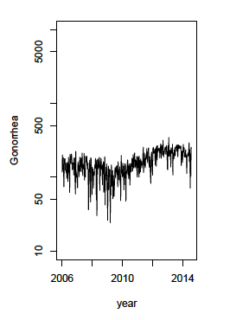
Patterns of endemicity
2) Stable endemism
Defintions:
Endemic A term to describe levels of infection which do not exhibit wide fluctuations through time in a defined place.
Stable endemicity is where the incidence of infection or disease shows no secular trend for increase or decrease.
For example Gonorrhea in
Pennsylvania

Slide 4
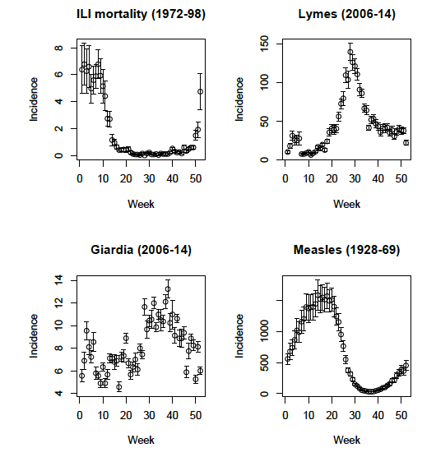
3) Seasonal endemism (Pennsylvania data from Tycho)

Slide 5
4) Recurrent epidemics
Ex. Measles historically exhibited more or less periodic epidemics withg a variety of inter-epidemic periods
Liverpool
New York
Cases (in 1000s)
London
Baltimore
Cases (in 1000s)

Slide 6
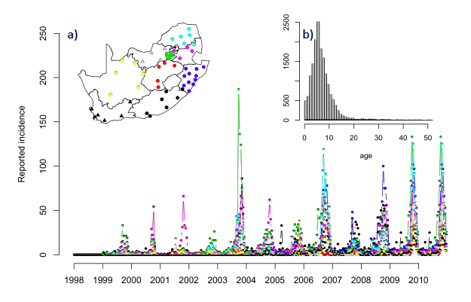
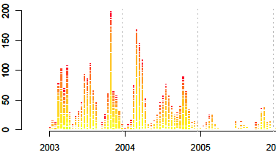
Rubella in SA
Epidemics and age-structure
Rubella in Kenya

