Slide 1
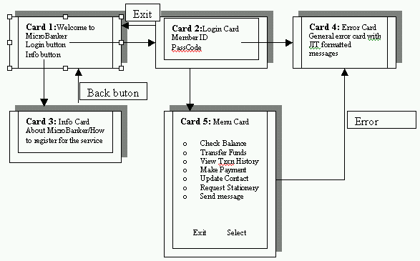
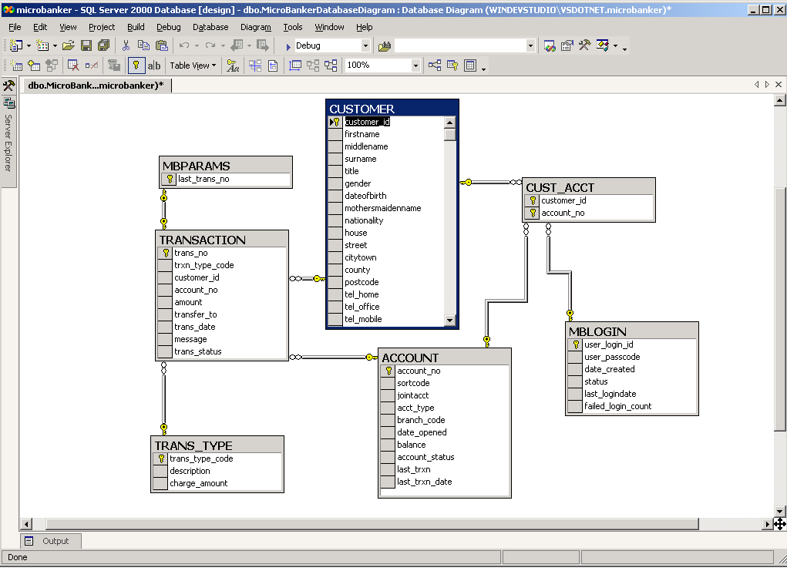
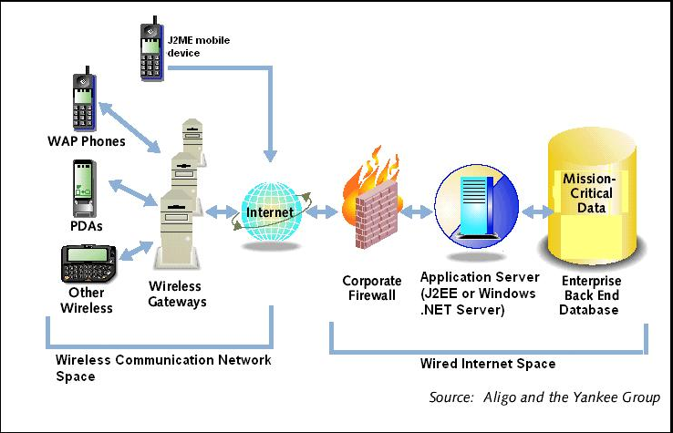
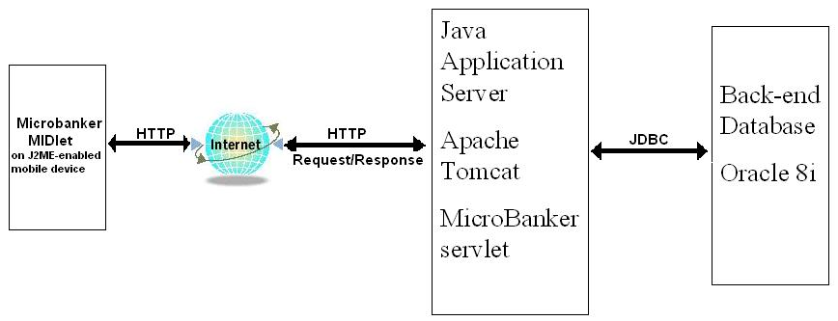
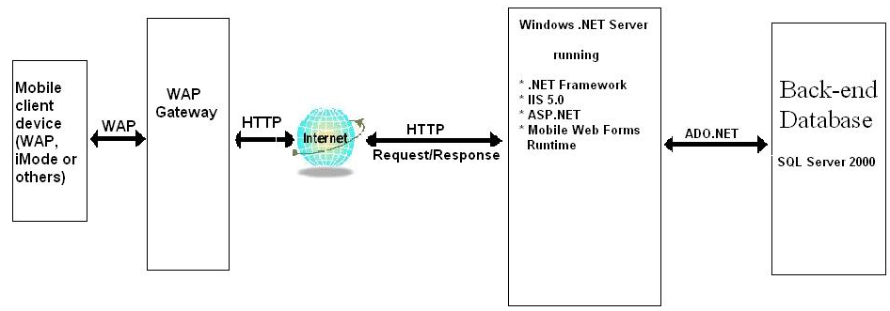
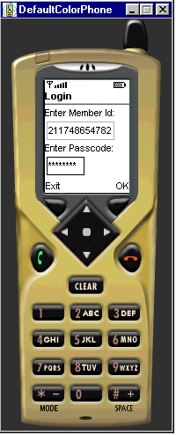
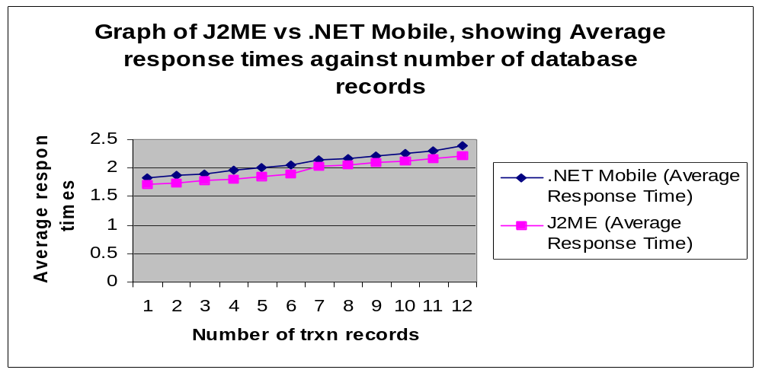
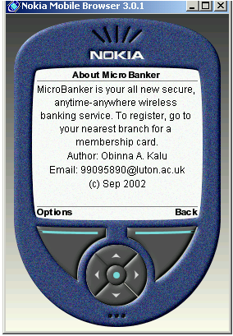
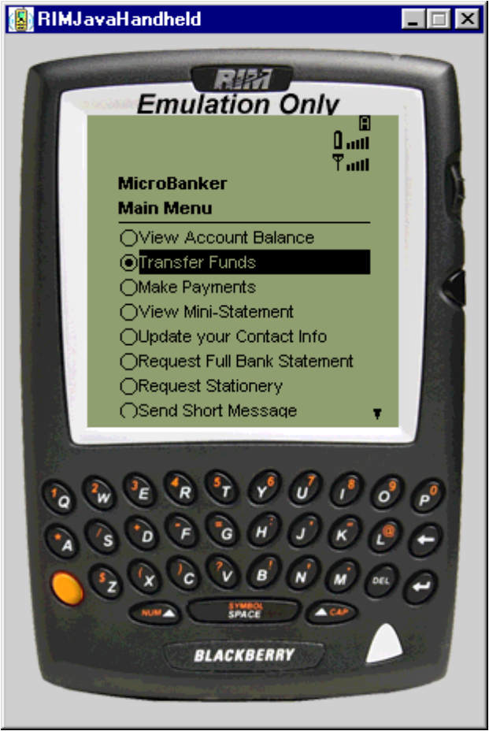
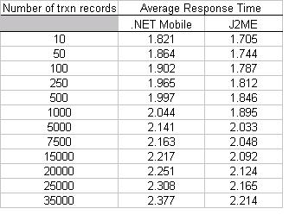
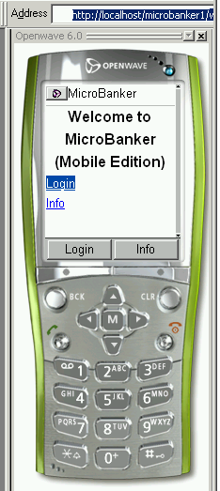
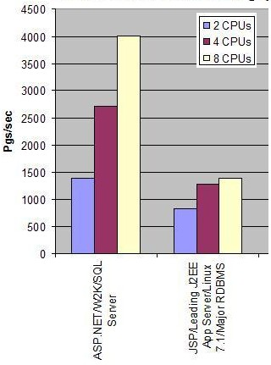
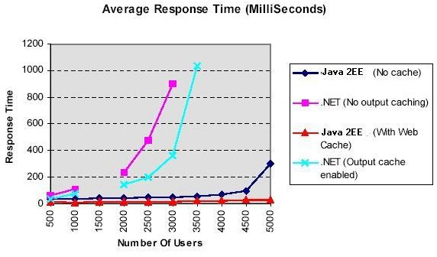
Making the Mobile Internet:
An assessment of J2ME versus .NET Mobile
University of Luton
Dept of Computing & IS
Supervisor: Dr C. Maple
Author: Obinna Kalu
Contact: 99095890@luton.ac.uk
Abstract
Showcase m-Commerce Application – MicroBanker
The continuous gradual convergence of the Internet and wireless communication networks, is giving rise to a new phenomenon known as the Mobile Internet, with promises of exciting, new opportunities and challenges for the various stakeholders – Wireless Network Operators, Mobile Device Vendors, Wireless Internet Service Providers and Application Developers.
This project investigates the key technologies driving the emergence of the Mobile Internet, the problems & limitations. It attempts to assess, particularly, two alternative software platforms/technologies for developing mobile Internet applications (namely J2ME and .NET Mobile).
In order to assess J2ME and .NET Mobile, a typical data-driven wireless application, named MicroBanker, was analysed, designed and implemented using J2ME/Java Servlet technology on one hand and MMIT/ASP.NET on the other. MicroBanker is a wireless application for providing basic banking services that customers can access at anytime and from any location, using any compliant mobile device such as a cell phone, PDA or pager.
MicroBanker (Mobile Edition) – The Design
User Interface Design
Database design
Introduction
What is the Mobile Internet?
The open, global network of systems & mobile/wireless devices, that provides “anytime-anywhere” Internet services (m-Commerce, Email etc.) to users. Diagram below shows a typical architecture:
Development & Test Environment Set-up
J2ME
.NET Mobile
JRE/Apache Tomcat/Java Servlet/J2ME/Oracle 8i
.NET Framework/IIS/ASP.NET/MMIT/SQL Server 2000
Tools: J2ME wireless toolkit
Language: Java
Web Tier: Apache Tomcat 4.0.1/Servlet 2.3
Back-end database: Oracle 8i
Data access technology: JDBC
Device simulators: GrayPhone, RIM Handheld & Motorola i85s
System: Intel PII 233/128MB RAM/Windows 2000 Professional
Tools: VS.NET, Mobile Internet Toolkit
Language: C# (c sharp)
Web Tier: IIS 5.0/ASP.NET
Backend database: Microsoft SQL Server 2000
Data Access: ADO.NET
Device simulators: Openwave, Nokia 6210, 3330 & Siemen S45
System: Intel PII 233/128MB RAM/Windows 2000 Professional
The Enabling Technologies, Standards & Protocols
Wireless Communication Technologies: 1G – AMPS; 2G – GSM, PCS, CDMA, TDMA; 2.5G – HSCSD, GPRS, EDGE, CDMA2000; 3G – UMTS/IMT-2000, W-CDMA, iMode.
Standards & Protocols: WAP, TCP/IP, HTTP, SSL, WTLS, IPv6
Mark-up & Scripting Languages: HDML, WML/WMLScript, cHTML, XHTML-MP
Wireless Applications: m-Commerce [(m-B2C – Banking, Retail etc.), m-B2E – Applications for Sales Force, Field Technicians etc.], Location-based services – E911, Map/direction services; Entertainment & Games.
MicroBanker Architecture using J2ME
MicroBanker Architecture using .NET Mobile
Developing Internet Applications for Mobile Devices
Performance Tests and Results
The Problems
Available Solutions
A number of performance tests were carried out to measure the effect of increased work-load (higher volume of data) on the applications’ average response times for a given transaction. The “View Account Balance” transaction was used. A summary of the test results and sample screen-shots are shown below:
Devices have limited processing power and data storage capacity.
Limited display (screen size and graphics capability)
Limited data input facility.
Limited electrical power supply (devices are mostly battery-operated).
Poor reliability of wireless networks.
Wireless networks offer slow data transfer speeds due to high latency & limited bandwidth.
Highly varied device types and markup languages supported.
Wireless security issues (e.g WAP gap, Wireless data-packet sniffing)
iMode / cHTML
WAP/WML/XHTML-MP/WMLScript
BREW
J2ME Screen-shots
.NET Mobile Screen-shots
J2ME (Java 2 Micro Edition)
  Java platform for resource- constrained devices.
  Made up of Configurations and Profiles.
  Configurations: CDC & CLDC
  Profiles: MIDP, PDAP, Personal Profile & Foundation Profile
.NET Mobile
  Is based on the .NET Framework which is a language-agnostic platform for developing software solutions for Windows and the Web.
  An extension of ASP.NET.
Past assessments of Java against .NET
Subject of a long running debate has sought to answer the question: Which platform out-performs the other, .NET or Java?
Benchmark tests on these two platforms have been carried out by various bodies (e.g. Doculabs Inc., TPC – Transaction Processing Council etc.).
The charts below show a couple of published test results:
@Peak Throughput
The Nile .NET vs J2EE Benchmark ©2001 Doculabs Inc.
J2EE/Oracle9iAS vs .NET Benchmark ©2002 Oracle Corp..
Analysis of Test Results
Conclusion
J2ME’s RecordStore facility provides a client-side data manager which helps minimise network roundtrips, hence slightly faster data retrieval times. However, J2ME applications require some time to initially download and install within the mobile client-device.
.NET Mobile is heavily server-side oriented and relies on WAP gateway for inter-protocol translations.
.NET Mobile’s Adaptive User Interface generation technique enables it to support varied mobile client-device types (cell phone, PDA or pager) using the same code base. On the other hand, J2ME requires developing using separate profiles for cell phones and PDAs.
.NET Mobile offers better overall performance for one-off wireless data access such as Account balance check or Viewing transaction history.
With downloadable/device-executable MIDlets which are more client-side capable than microbrowser-based WAP, J2ME provides better support for robust wireless applications requiring substantial client-side data manipulation such as Games, PIM, Stock Trading etc.
Wireless web consumer survey
References
A consumer survey carried-out around the Luton area found the following:
98% of respondents have never accessed the mobile Internet before.
52% of respondents are willing to buy an Internet-enabled mobile device if the price is right.
Doculabs® Inc (2001). “Microsoft .NET vs. Sun Microsystem’s J2EE: The Nile E-commerce Application Server Benchmark”. Accessed online at http://www.gotdotnet.com/compare on 28-Aug-2002.
Oracle Corp. (2002). “J2EE/Oracle 9iAS vs. Microsoft .NET Benchmark Results”. Accessed online at http://otn.oracle.com/9ias on 27-Aug-2002.

