Slide 1
DSC530 – Data exploration and analysis
Myrna Paulina acuna

Slide 2
Statistical question
Do Chicago Divvy (Shared) Bike Rides Last longer in warmer temperatures?

Slide 3
Variables used in analysis
Trip Duration of bike ride
Temperature during the bike ride
Month – the month that the ride took place
Week – the week that the ride took place
Day – the day that the ride took place
Hour – the hour the ride took place

Slide 4
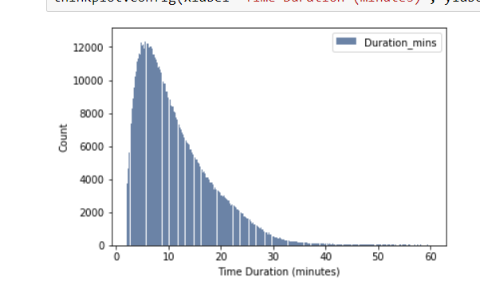
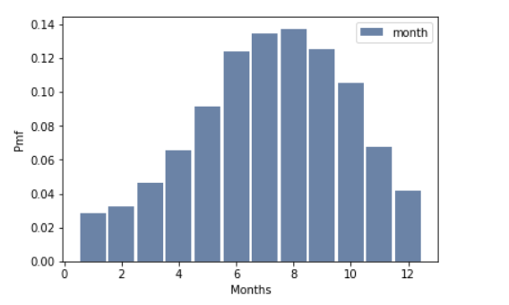
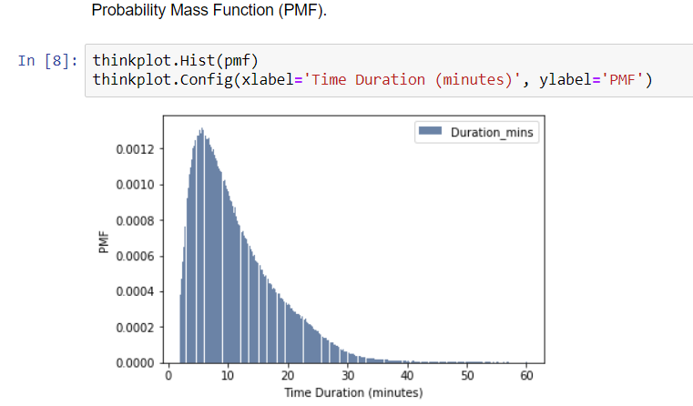
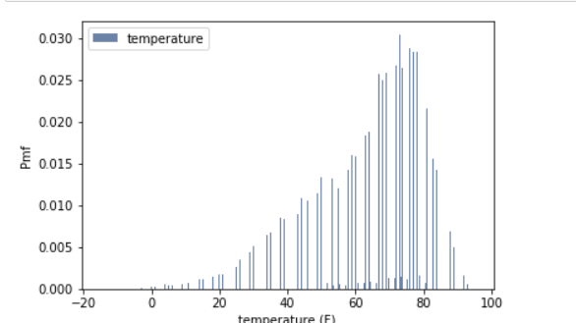
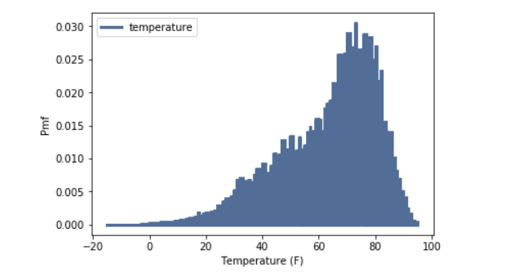
histograms

Slide 5


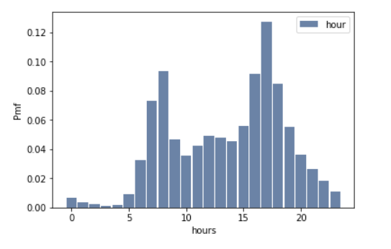
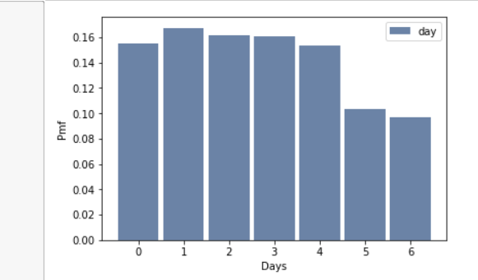
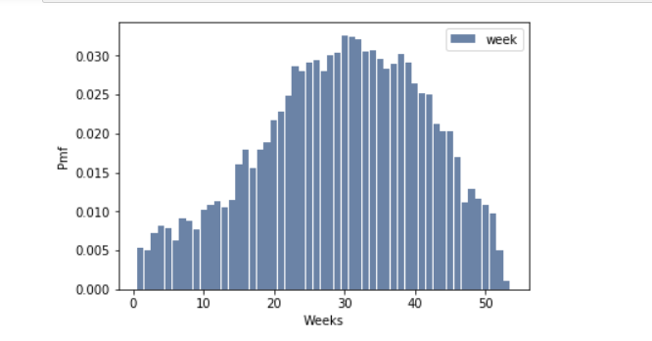
Histograms (continued)

Slide 6
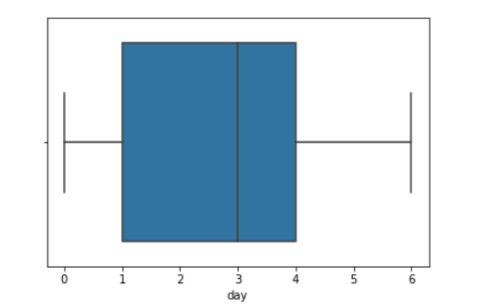
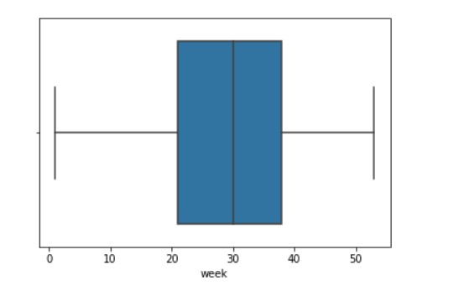
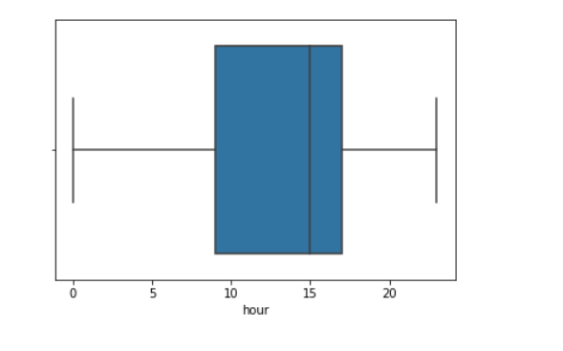
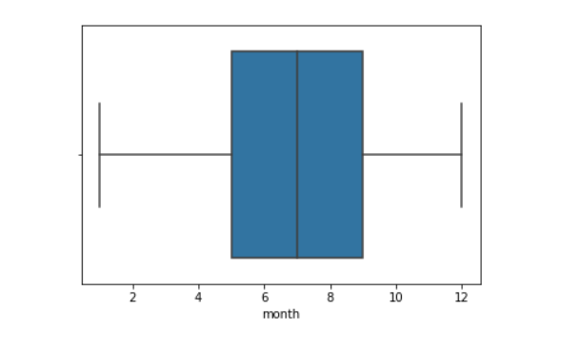
outliers

Slide 7
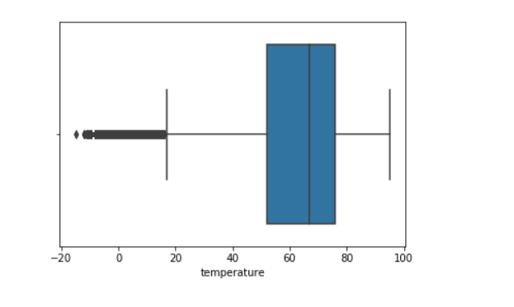
Outliers - temperature
The only notable outlier was temperature, but it was all kept within the data just because Chicago winters get very cold

Slide 8
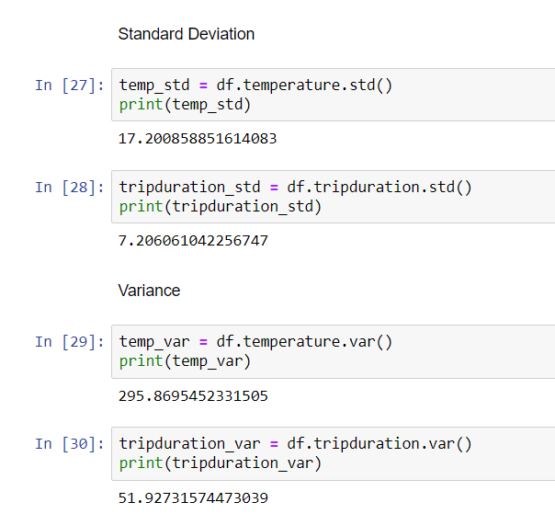
Descriptive statistics
Standard deviation of temperature was 17.2
Standard deviation of trip duration was 7.2
Variance of Temperature was 295.869
Variance of trip duration was 51.92

Slide 9
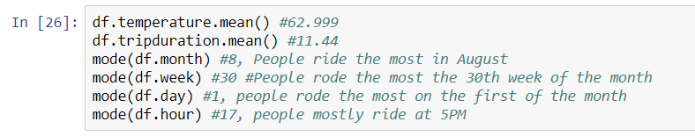
Descriptive statistics (continued)
Mean, Mode of variables

Slide 10
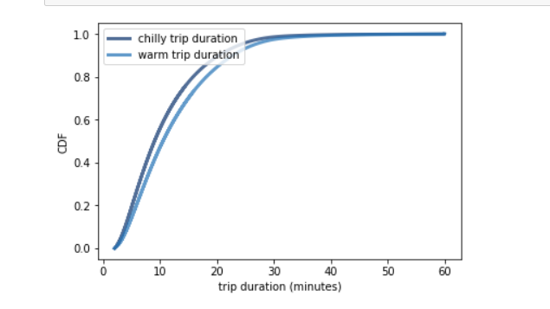
PMF Comparison
Comparing cold and warm (>70 degrees) rides
By comparing colder and warmer temperatures with their duration, we can see that chilly bike rides are slightly shorter than warmer bike rides

Slide 11
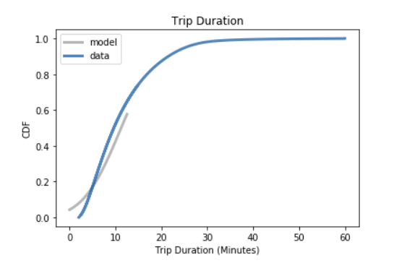
Cdf analysis
Model fits data except for left tail (<15 Minutes Duration)

Slide 12
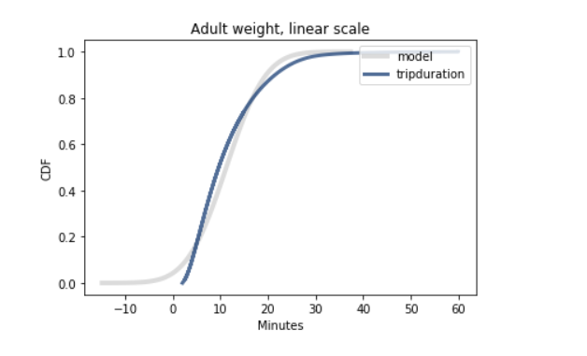
Analytical distribution
After creating a normal distribution plot that didn’t fit the model, I created a logarithmic distribution that was a better fit for the model

Slide 13
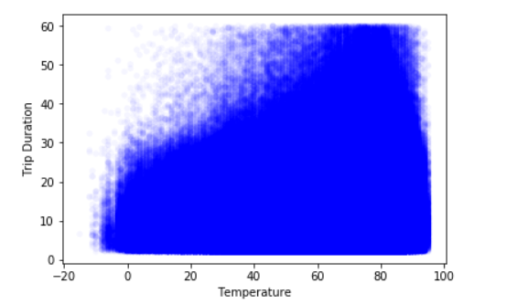
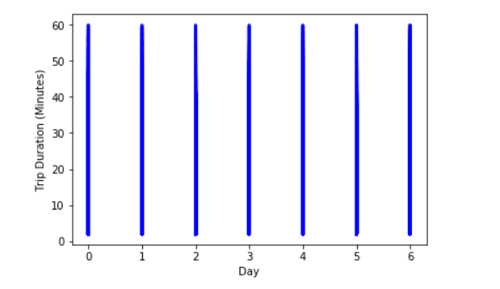
Scatter plots

Slide 14
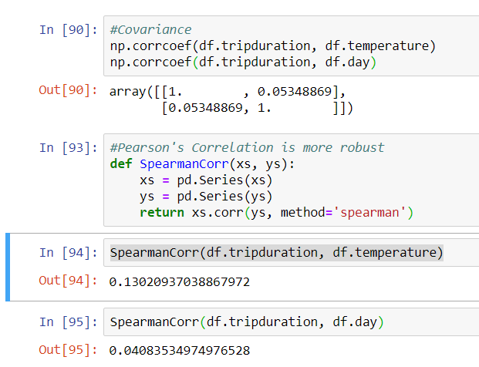
Correlation analysis
Very weak correlation because a strong correlation would be -1 or 1, it assumes there is very little correlated between the two variables

Slide 15
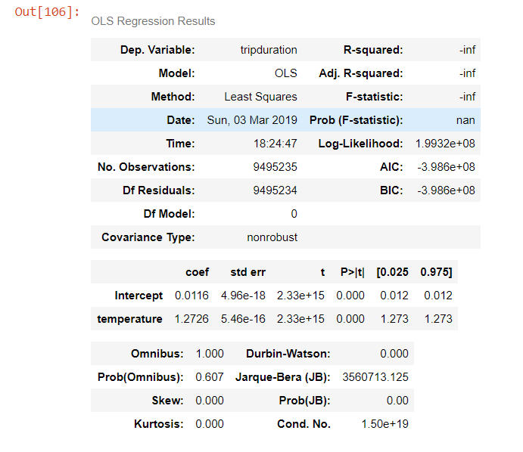
Regression test results – trip duration and temperature

