Slide 1
Evolving ROP Chains
Francisco Blas Izquierdo Riera,
Lucca Fraser & Lauren Moos
Special Circumstances LLC

Slide 2
History of Return Oriented Programming

Slide 3
History of ROP
At the beginning stacks were executable
Buffer overflow attacks were simple:
  Overwrite return address to point to stack
  Follow return address with code to be ran
Stack position was randomized (ASLR)
  Increase the injected program size adding No Operation (NOP) instructions to make falling somewhere in those instructions likely
Stack was made non executable
  Find already executable code that could be useful (gadgets)
  Make them return in to each other to attain desired result (ROP)

Slide 4
Genetic Programming Design Decisions

Slide 5

Genotypes: Two Approaches
Vector of machine words
  Each genotype a potential ROP payload
  Phenotype developed by
    Writing genotype to the stack of the (emulated) target process
    Setting the IP to the head
    Incrementing the SP
    Executing emulation
Vector of instructions intermediary, payload-constructing VM
  Programs aware of memory image
  Semantic analysis primitives available
  Outputs a payload of type (1)...

Slide 6

Phenotype
Execution behaviour monitored through Unicorn hooks and callbacks
Attributes are committed to record only when the execution reaches a composable point – a return, for example.
A variety of attributes are recorded
A fitness formula, with these attributes for variables, is given by experiment configuration file
Fitness scalar obtained by evaluated fitness formula

Slide 7

Selection
Different methodologies tested:
  Roulette
  Pareto front
  Lexicase
  Tournament selection
Tournament selection performed best
  Optional geography
  N (usually 5) contestants drawn on each iteration and evaluated
  P (usually 2) best are bred
  P offspring displace the P worst performers

Slide 8

Geography
Islands with migration
  Simple parallelization
  Fosters diversity
  Each island is handled independently
  Each island may send or receive individuals through a shared “pier” (lockfree queue) randomly
Linear geographies
  Circular buffer on each island
  First contestant picked randomly
  Other contestants picked from neighbors within n slots
    If n is the buffer size selection is unrestricted

Slide 9

Genetic operators
Alternating crossover
  Stitch together from alternating between parents
  Length from exp. dist.
  Prevents genetic bloat (maximum child length = maximum parent length)
Single point crossover
  Pick two cut points and concatenate results
Mutation
  Integer bitwise operators
  Replace with memory reference
  Replace with memory contents

Slide 10
Technical obstacles

Slide 11
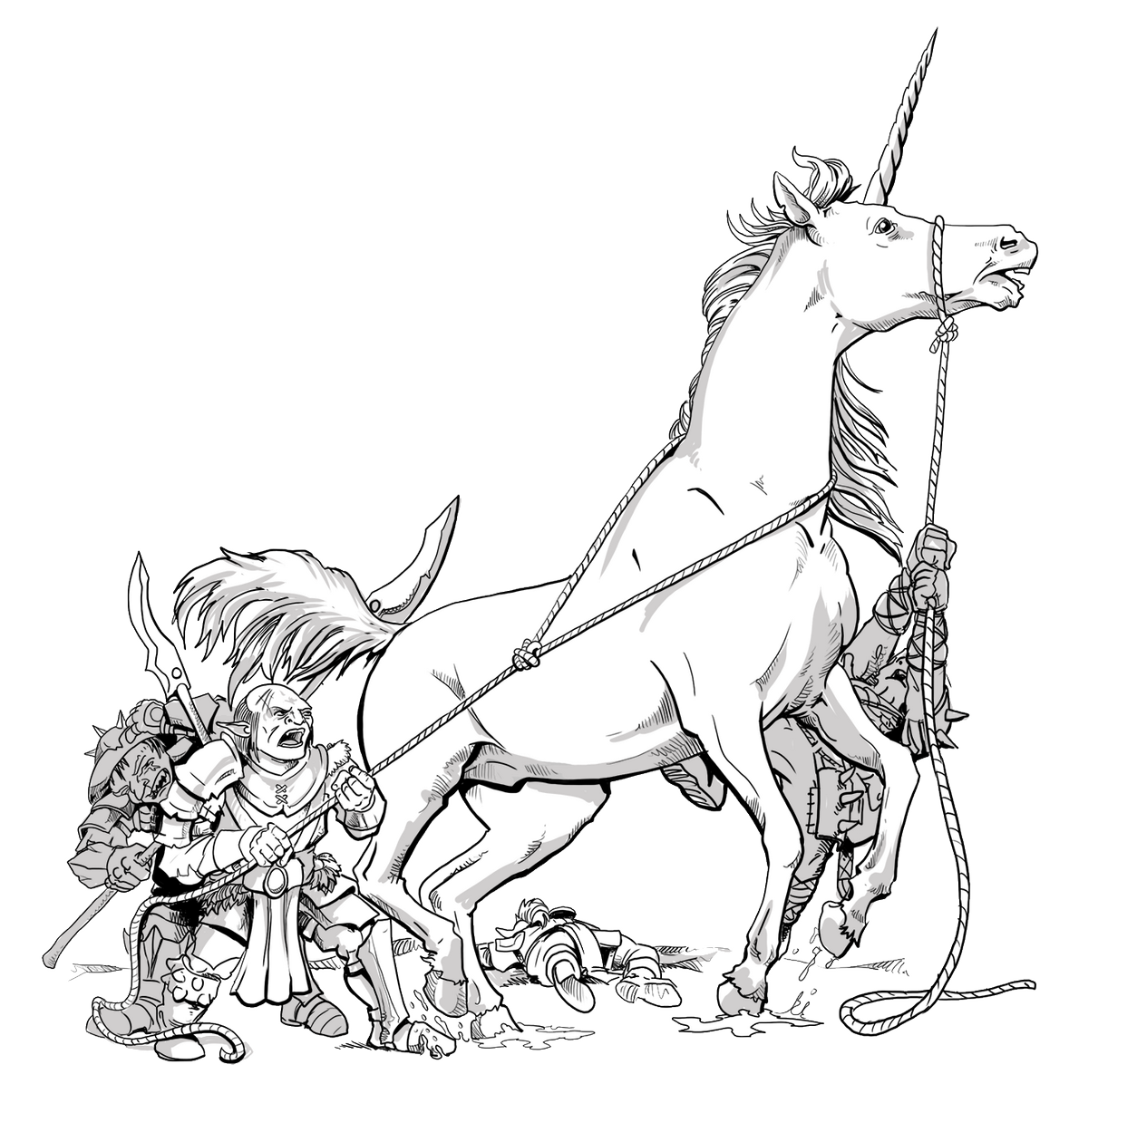
Race condition in unicorn
Infrequent segmentation faults encountered in large-scale experiments
Traces point to null struct write on unicorn library
Cause: timeout callbacks racing against main thread
Solution: synchronize accesses using a mutex

Slide 12
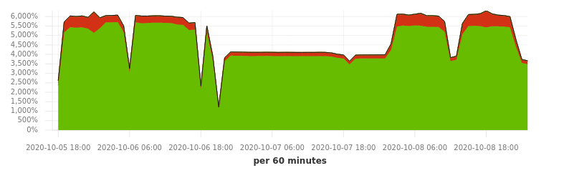
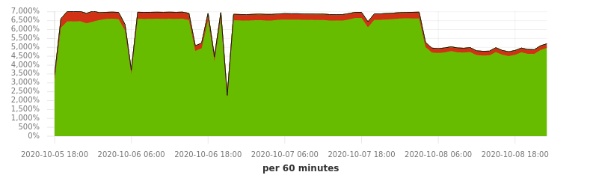
CPU scalability issues
Benchmarks testing slowed down by the race condition
Once fixed system won’t scale over 4/5 cores
But system load shows enough workers were waiting
Suspected causes are memory or I/O pressure

Slide 13
Experiments

Slide 14
The Effects of
Phenotypic Novelty Pressures

Slide 15
Zero Count Experiment
Objective is to minimize the zero bits in the bitwise product:
EAX & EBX & ECX & EDX
Target binary is a statically compiled OpenSSH_6.8p1 for i386 architecture
Phenotypic novelty is measured by feeding resulting register vectors into a CountMinSketch
We compare runs in which novelty is a component of the fitness score, with runs in which it is not

Slide 16
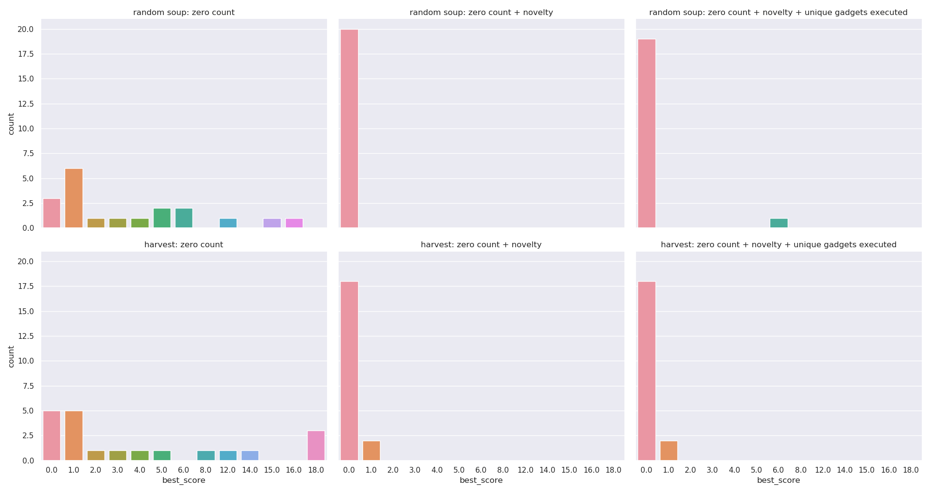
Distribution of Solutions

Slide 17
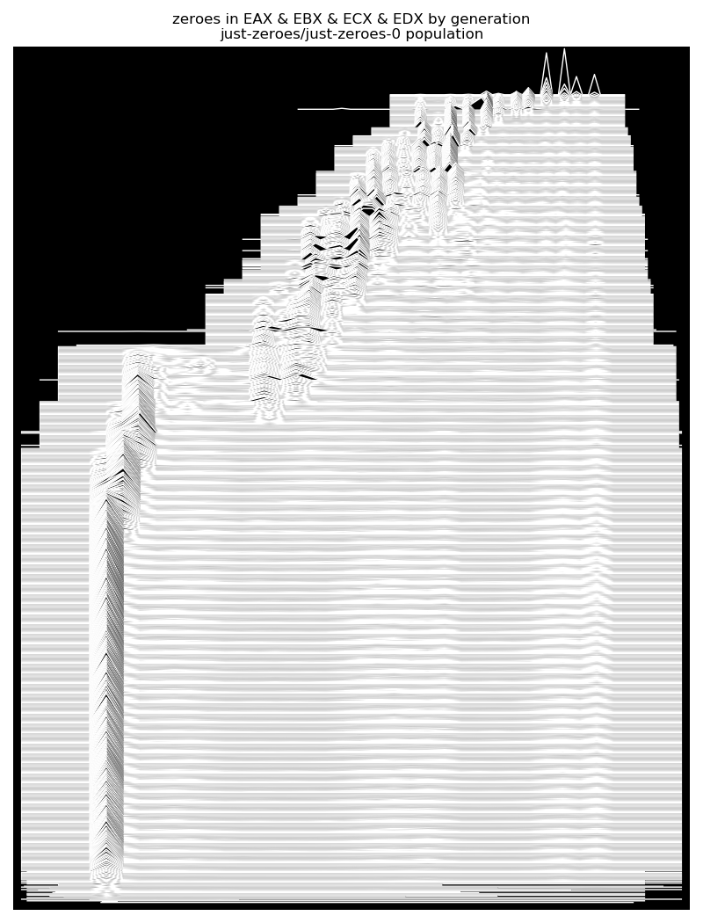
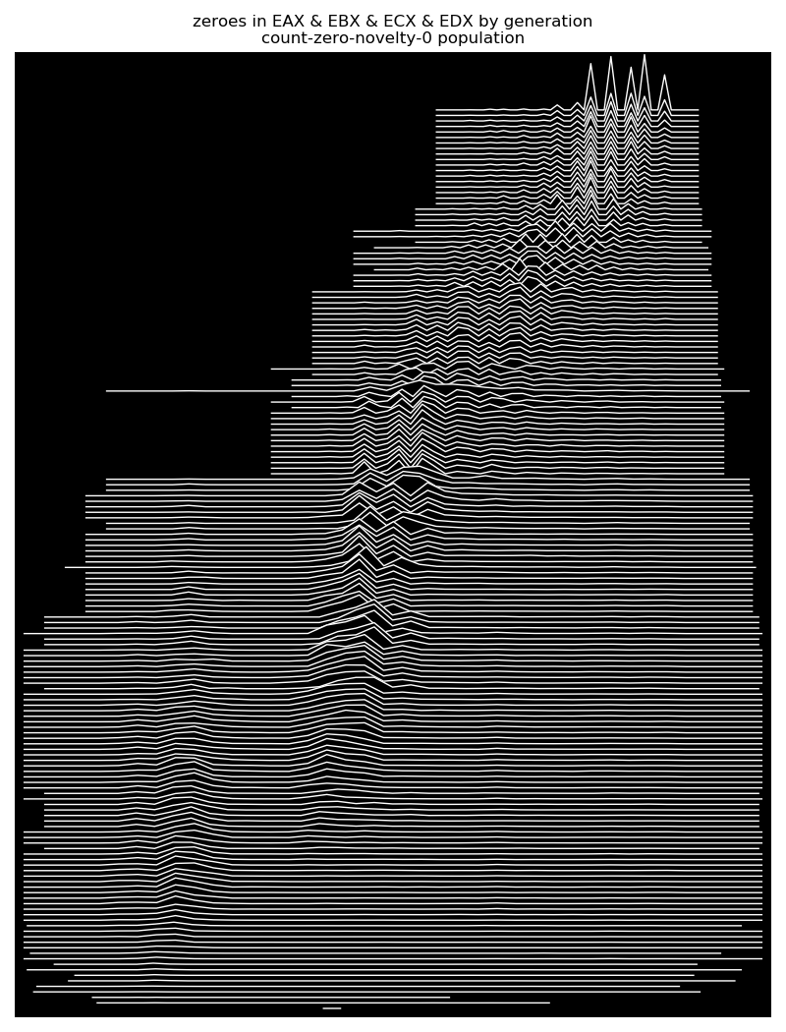
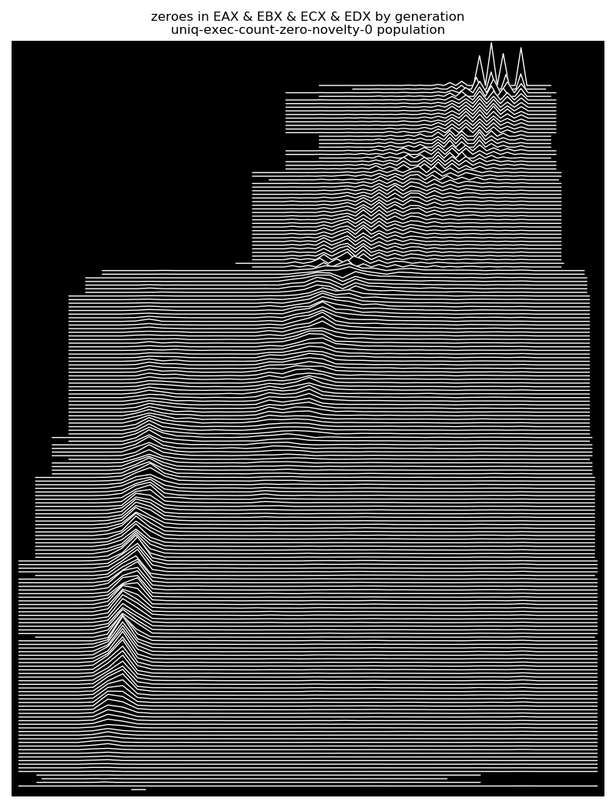
Distribution of Fitness by Generation
No novelty pressure
With novelty pressure
With novelty + unique executed gadget pressure

Slide 18
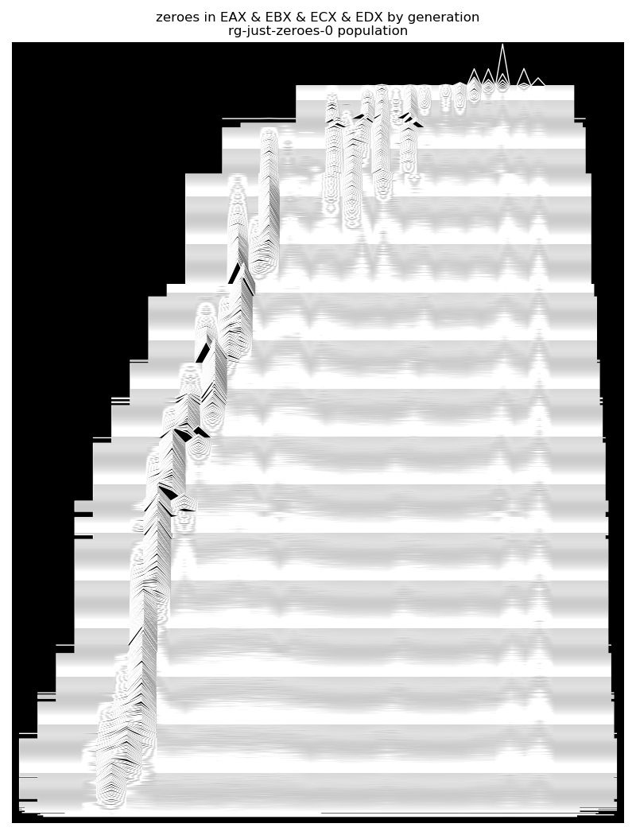
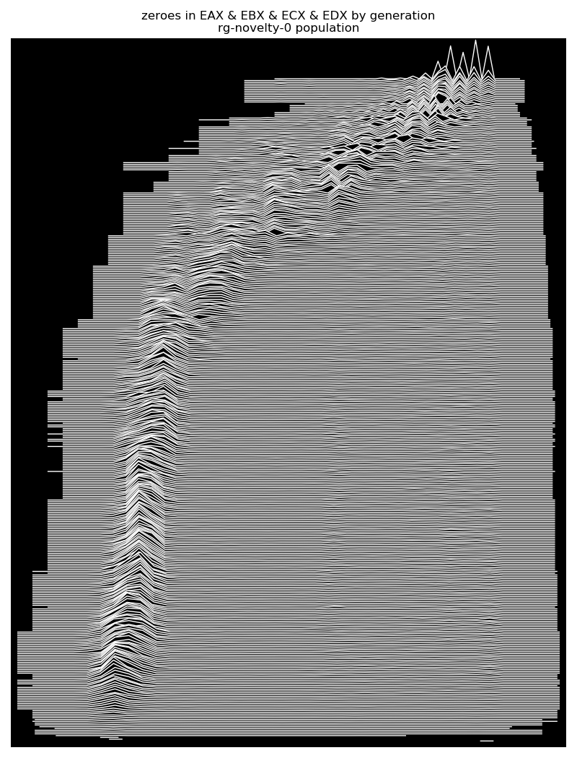
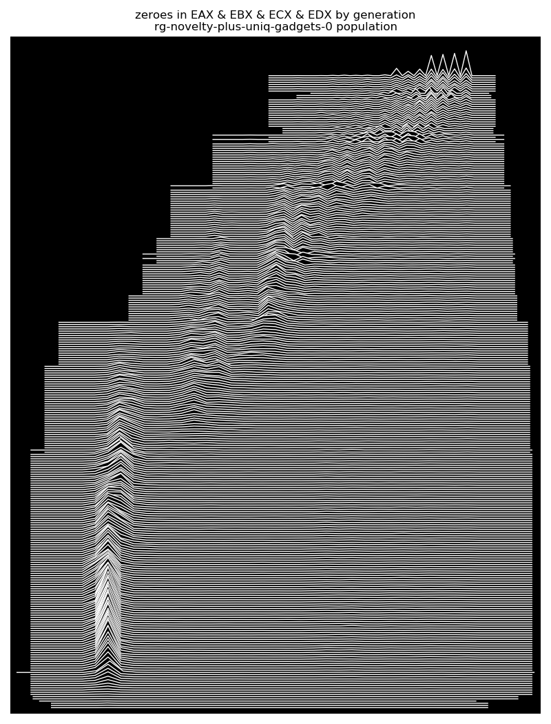
Same, but seeded with ROPGadget
No novelty pressure
With novelty pressure
With novelty + unique executed gadget pressure

Slide 19
Sex & Composability

Slide 20
Sexual reproduction and composability
The mixability theory for the role of sex in evolution holds that sexual reproduction favours the emergence of genes that perform well in multiple genetic contexts.
Our conjecture: crossover should favour gadgets that compose well with others.
See: Adi Livnata, Christos Papadimitrioub, Jonathan Dushoffc, & Marcus W. Feldmand, “A mixability theory for the role of sex in evolution”, PNAS December 16, 2008 105 (50) 19803-19808.

Slide 21
Sexual reproduction and composability
Tested three crossover approaches:
  Asexual (only mutations)
  Alternating
  Single-Point
Tested two seeding techniques:
  Random initial values
  Values extracted by ROPgadget
Metrics:
  Return instruction executed
  Code coverage
  Allele circulation
  Generational distribution
Fitness function: code coverage

Slide 22
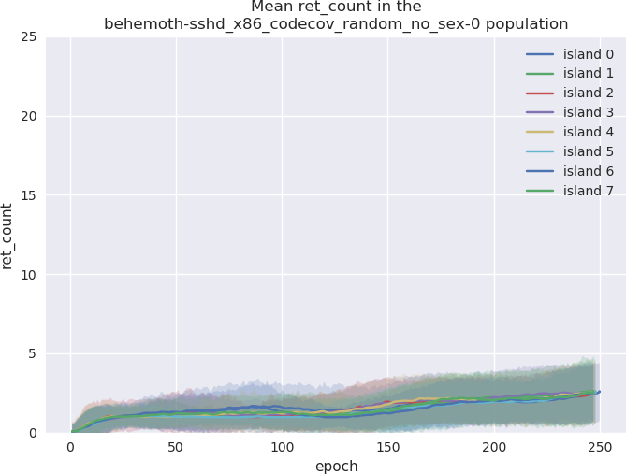
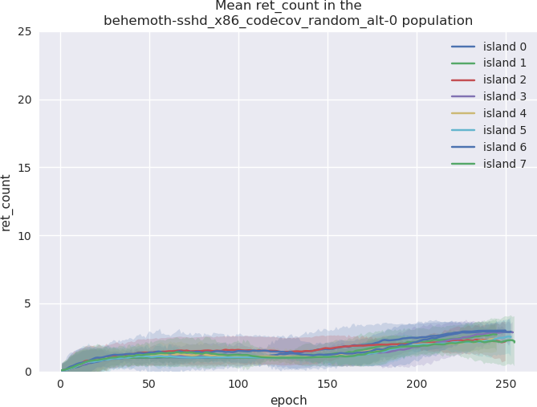
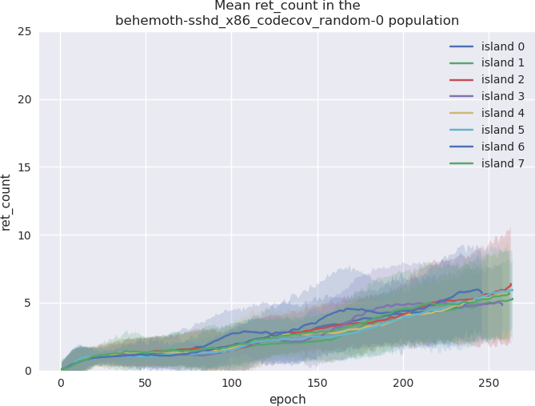
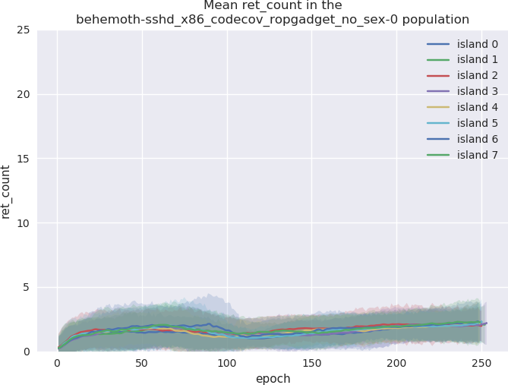
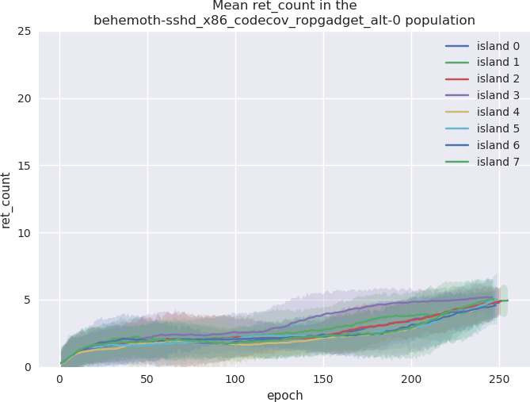
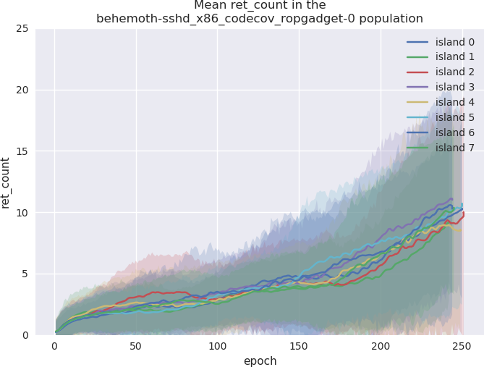
Return Count

Slide 23
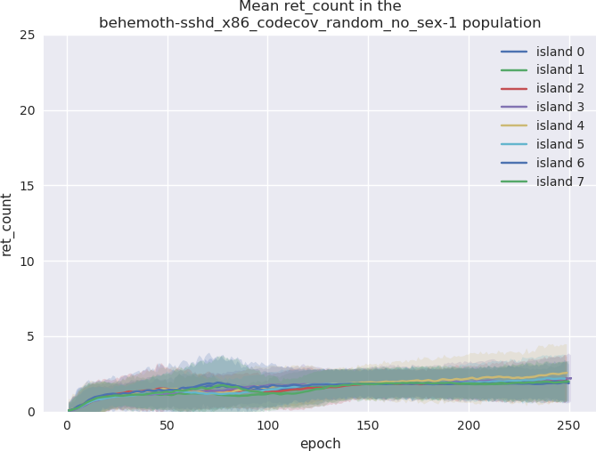
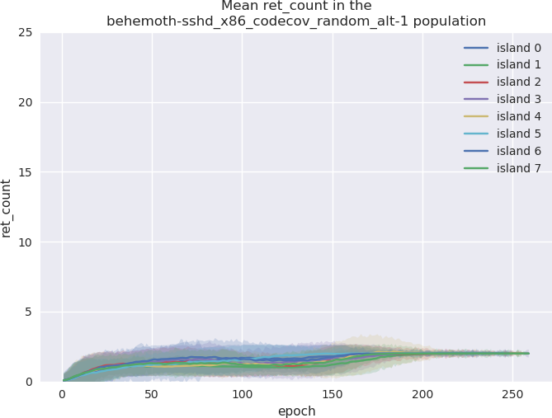
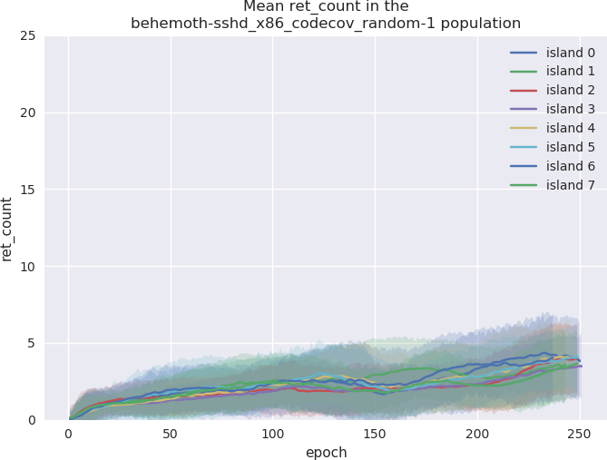
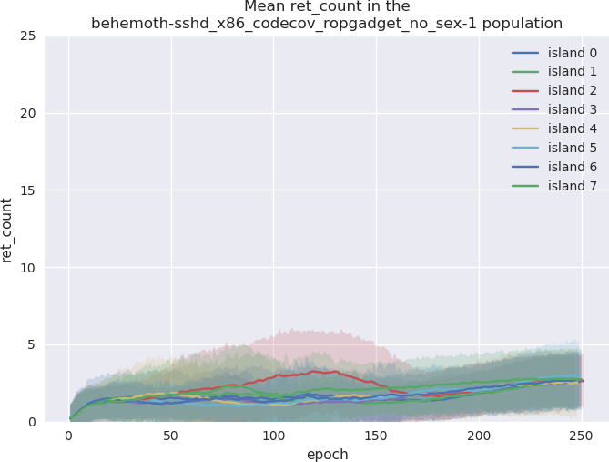
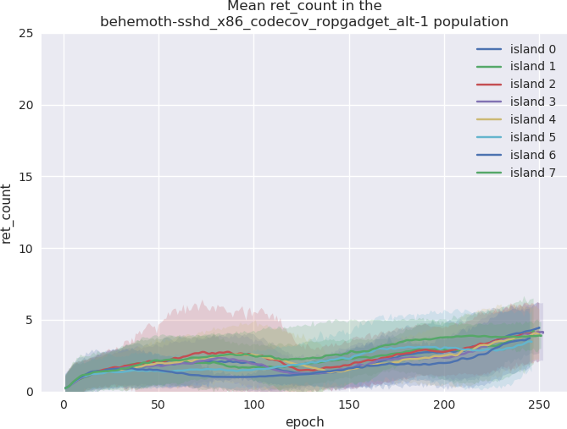
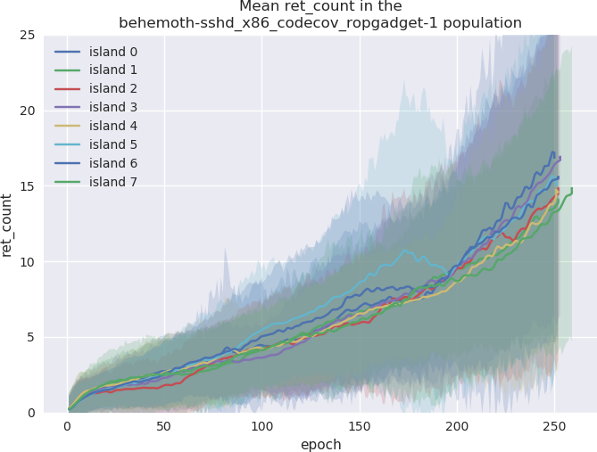
Return Count

Slide 24
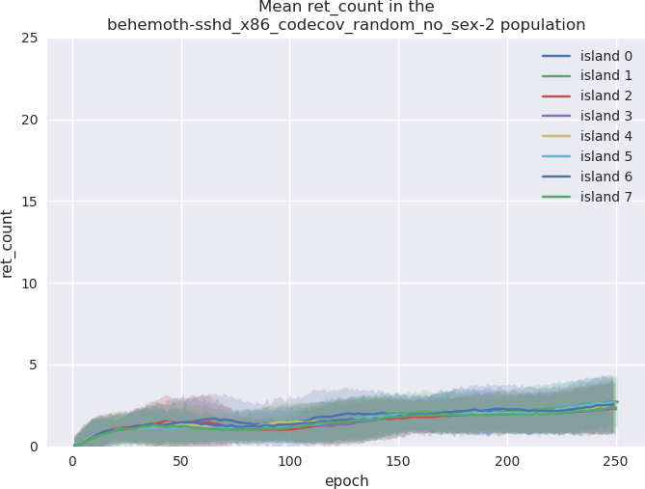
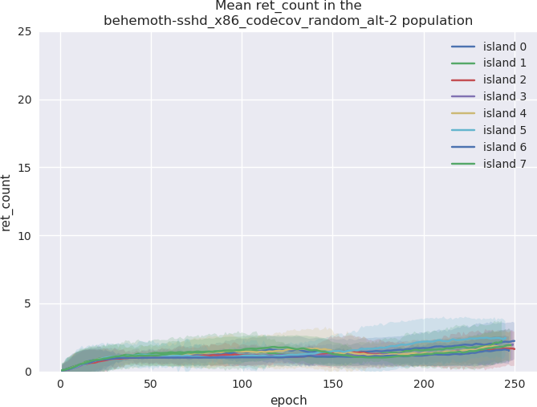
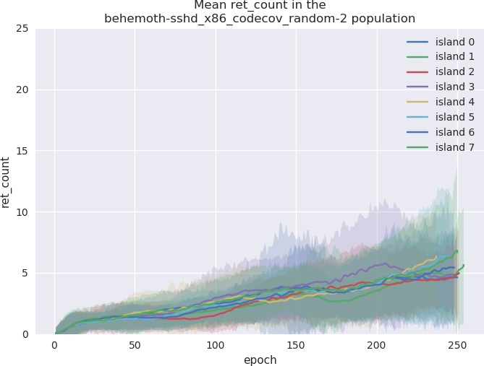
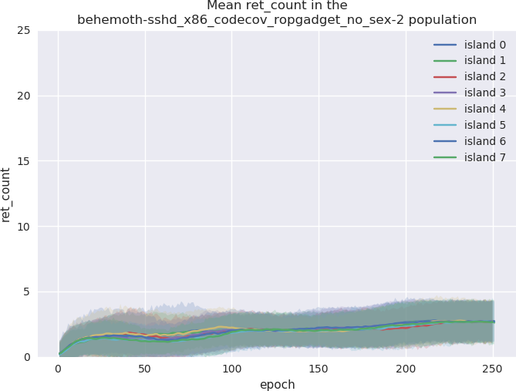
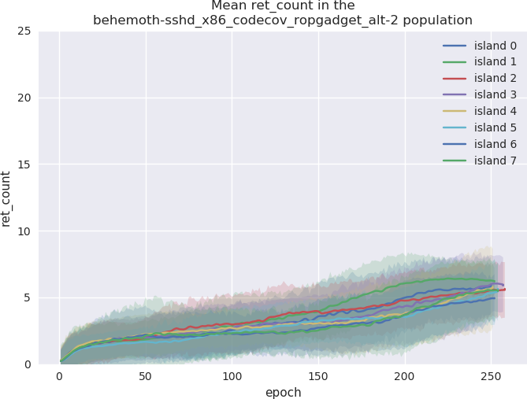
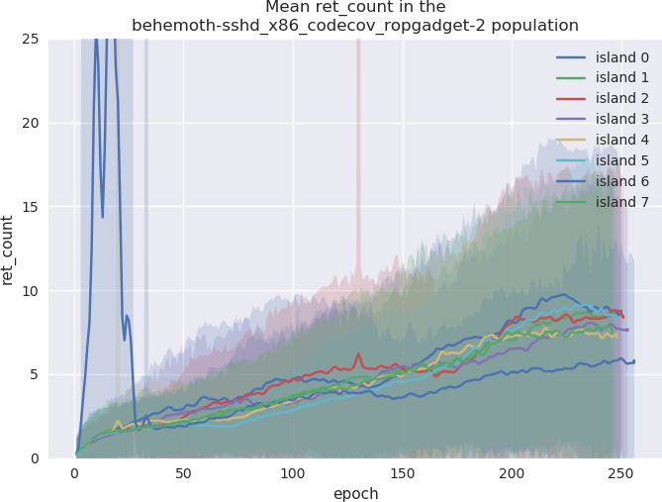
Return Count

Slide 25
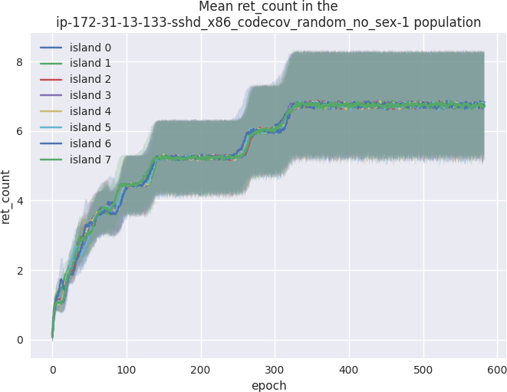
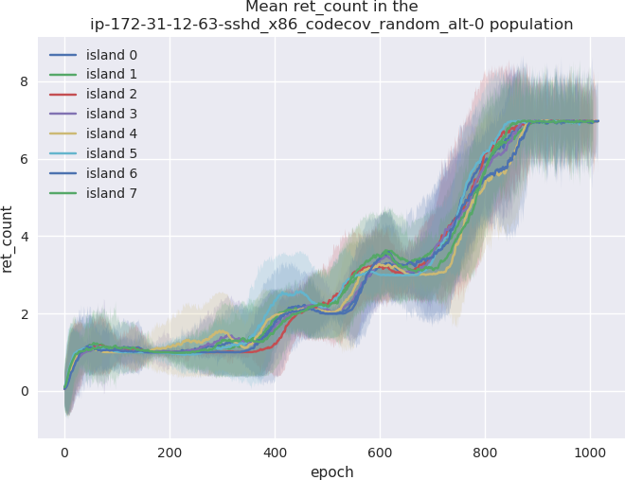
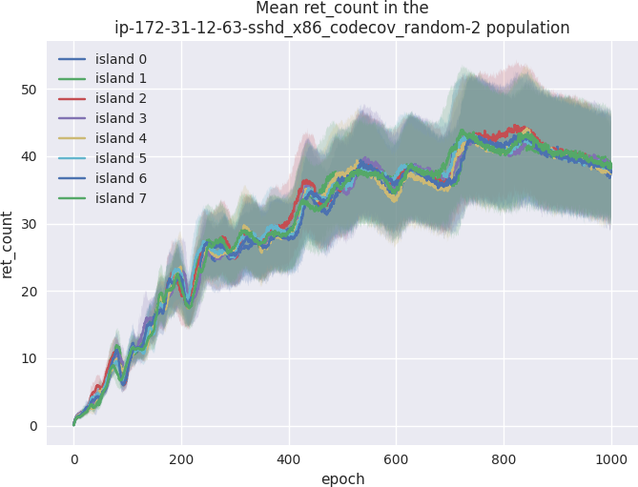
Return Count (long runs, not scaled)

Slide 26
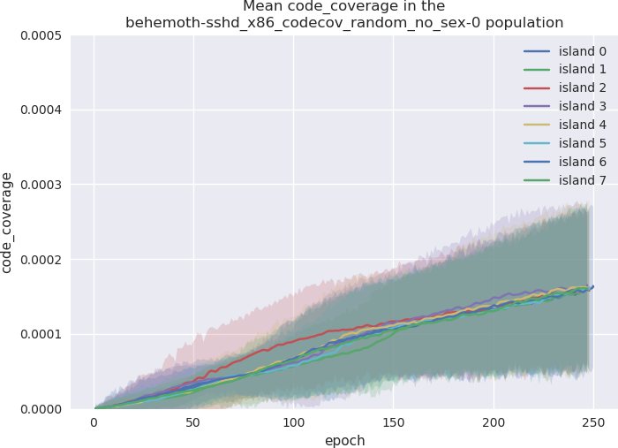
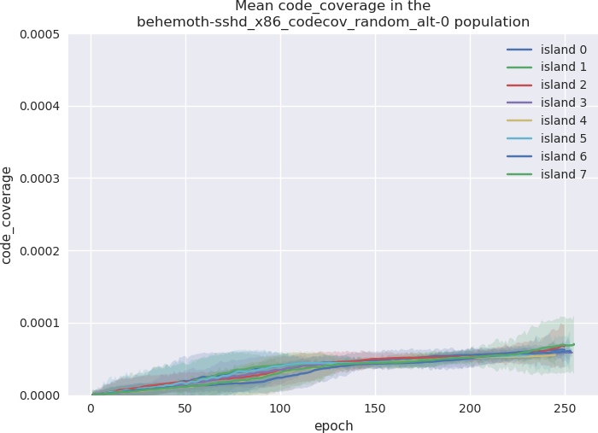
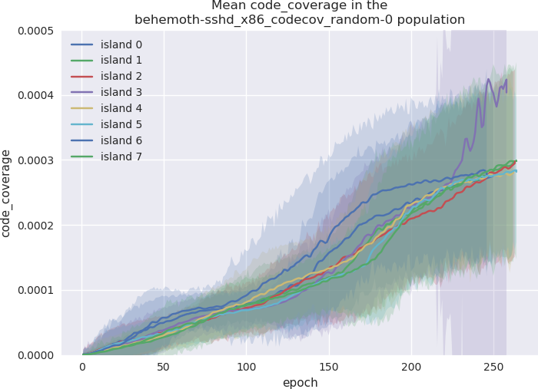
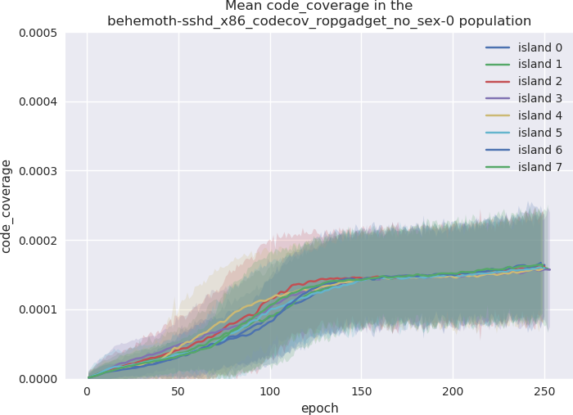
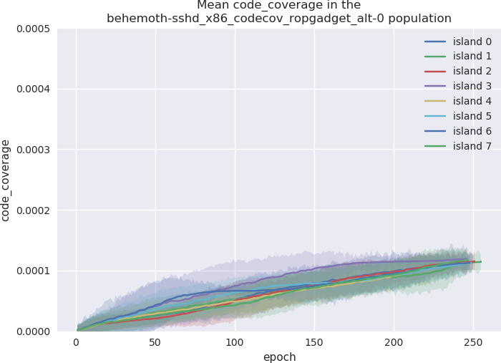
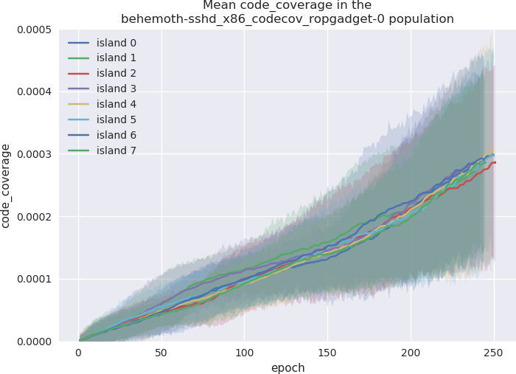
Code Coverage

Slide 27
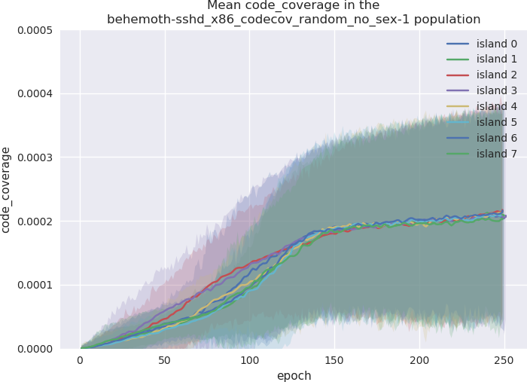
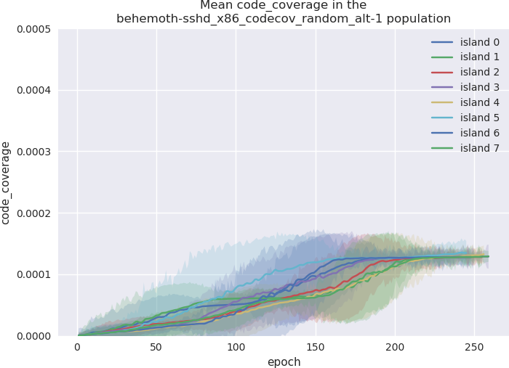
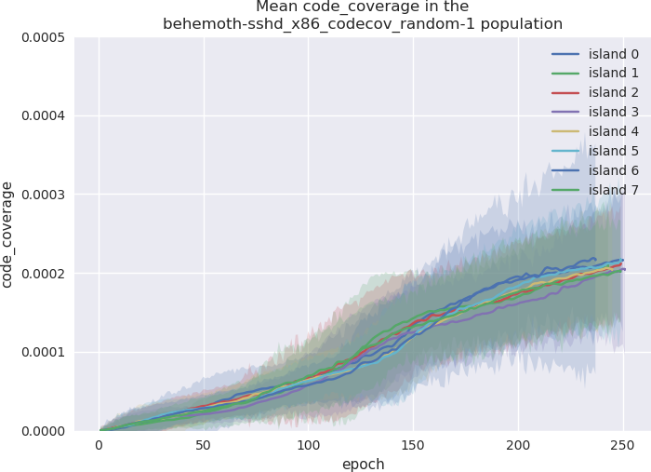
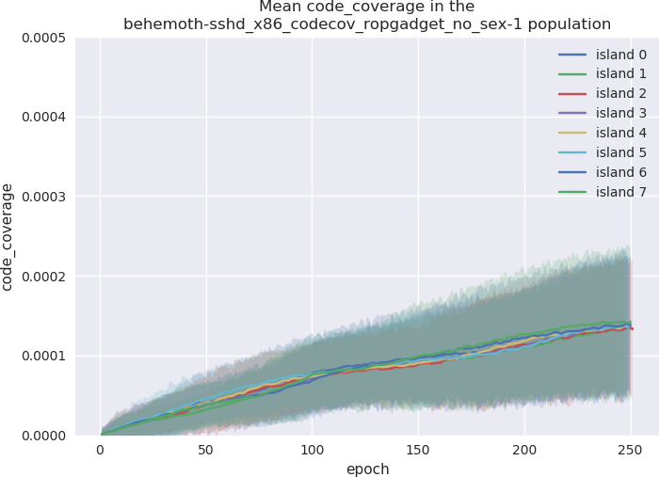
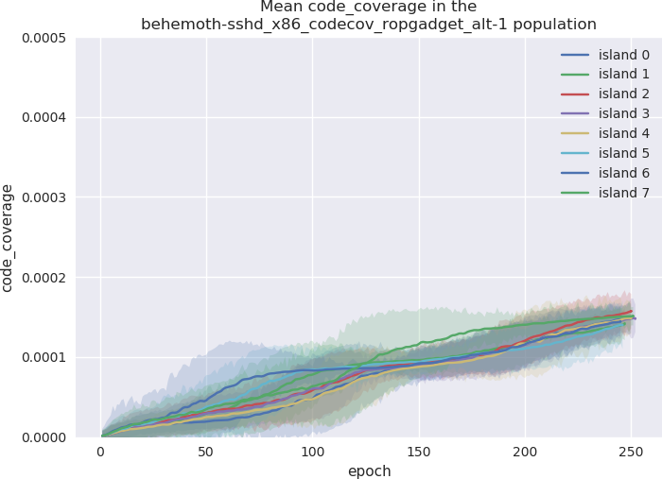
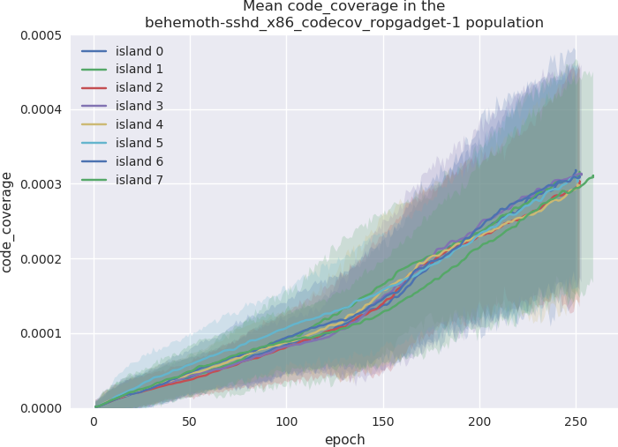
Code Coverage

Slide 28
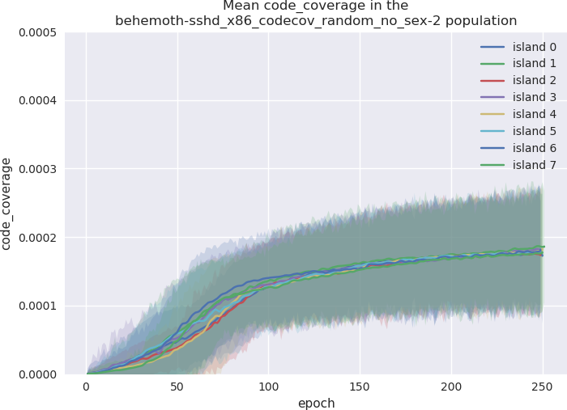
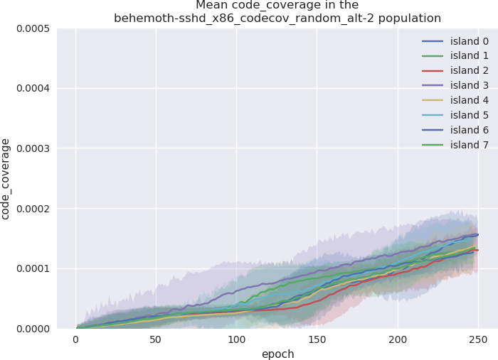
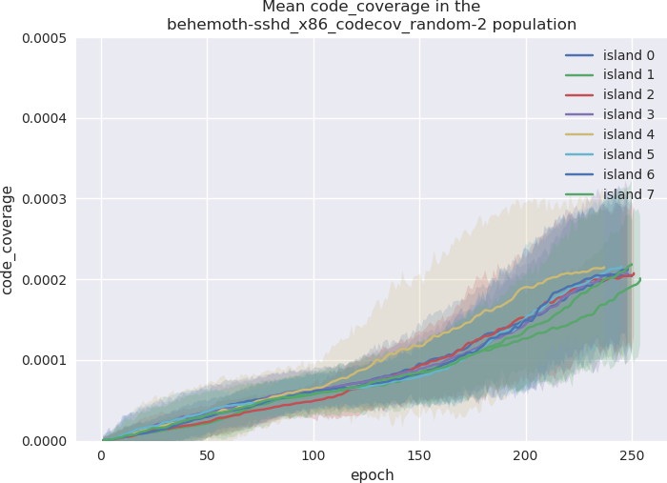
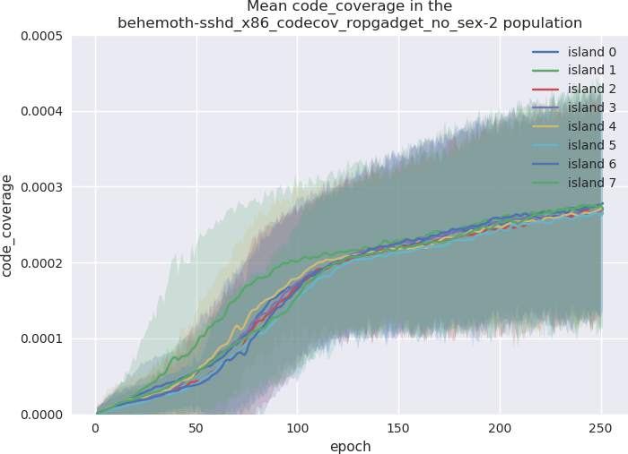
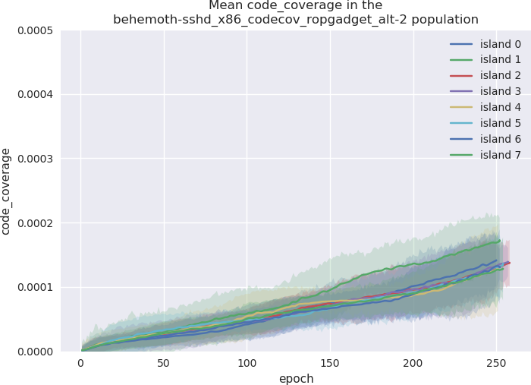
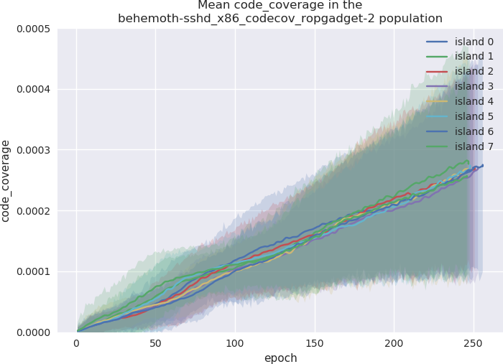
Code Coverage

Slide 29
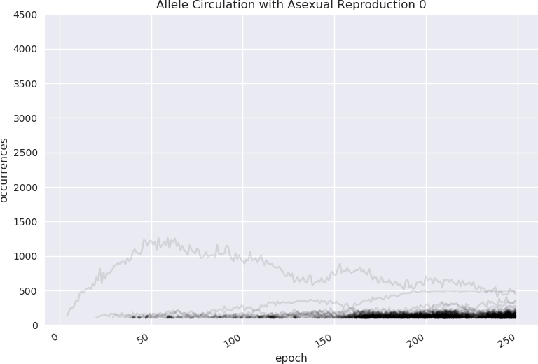





Allele Circulation

Slide 30






Allele Circulation

Slide 31






Allele Circulation

Slide 32
Experiments
Generational distribution

Slide 33






Generational Distribution

Slide 34






Generational Distribution

Slide 35






Generational Distribution

Slide 36
Experiment conclusions

Slide 37
Experiment conclusions
Support for the mixability theory of sexual reproduction?
Alternating crossover is not much better than asexual reproduction
ROPgadget does not help asexual reproduction significantly
Allele circulation is faster on single point crossover
It is slowest with alternating crossover
Higher return count correlates with code coverage

Slide 38
Register control

Slide 39
Register control
Difficult to define proximity
  Graph with state transitions: too expensive
  Euclidean distance: too inaccurate
  Hamming distance: too inaccurate
How to handle indirections?
How do we handle writable memory?

Slide 40
Register Control
Weighted hamming distance
  For each register and first m references:
    Choose closest target, add 1 for each disagreement
    Apply penalty if result is in different register
  Sum all the results to get distance

Slide 41

Specimen #1

Slide 42


Specimen #2

Slide 43
Register Control
Full solutions are rare (2 out of 10 trials with 1000 epochs)
Required applying secondary novelty pressure
  Count-min-sketch used to weight errors (so new errors are less important)
Push VM did not prove better than bare ROP chains

Slide 44
Current status

Slide 45
ROPER 3: Slothrop
Moving over to Julia
  A robust scientific computing ecosystem
  Interoperability with C(++) and Python
    Writing Julia bindings for Unicorn was a pleasant experience
  Makes for a good lingua franca, and facilitates collaboration
Focusing on support for large populations, distributed over a network, rather than on single-host, efficiently threaded nodes

Slide 46
Next Steps: Problem
Genetic programming is extremely effective, but uses a naive encoding of strings
Strings are encoded as categorical data with distance/similarity a function of string edit distance
“cat” → neighbors → “cot” - this doesn't reflect similarities in the meaning of the words
With machine instructions, memory-adjacent machine instructions can have similar effects (or “meaning”) but this is far from guaranteed

Slide 47
Next Steps: Intuition
Deep Learning already has an unreasonably effective solution to this problem: namely Word2Vec
Word2Vec learns a vector representation of words that reflects their contextual similarity and difference
This allows for analogical reasoning with extremely simple vector operations

Slide 48
Next Steps: Solution
Goal: Reduce the amount of time for convergence in symbolic regression and increase transferability of solution
Bootstrap an encoding by creating labeled data through the original genetic programming process, learn context
Then switch to performing symbolic regression on the discovered latent space

Slide 49



Mario project
Attempt at generalizing current results
AI targets memory corruption glitches
AI being used to automate exploitation (from induced weird states) in old videogames

Slide 50
Schedule
Jan 2021 Demonstrate generalized design against other systems (Mario project)
March 2021 Final report
June 2021 Academic papers submitted

Slide 51
Sources
October report (and a lot of other information) on https://github.com/oblivia-simplex/berbalang/blob/master/org/october_report.org
Berbalang source code: https://github.com/oblivia-simplex/berbalang
Slothrop source code: https://github.com/oblivia-simplex/slothrop
Thread-safe fork of Unicorn: https://github.com/oblivia-simplex/unicorn
Julia Unicorn bindings: https://github.com/oblivia-simplex/unicorn-jl

Slide 52
Questions?
Lucca Fraser
lucca@special-circumstanc.es

