Slide 1
Database Security
By Lucca Fraser, Damien Robichaud, Taylore Kane and Francis Bosse

Slide 2
Table Of Contents
SQL Injection
Password Vulnerabilities

Slide 3
SQL Injection
Injection is the process of bypassing the input program protocol and inputting commands directly to the database.
When Websites don’t properly secure their entry methods, the tables become vulnerable to injection.
Making sure the user input is secure is called Sanitization.

Slide 4
Examples of Injection
Exfiltration Based
SELECT * FROM users WHERE name = ‘’ OR ‘1’ = ‘1’;
Data Falsification
[Some SQL Statement]’, ‘’); UPDATE submissions SET grade=99; --
Destructive
[Some SQL Statement]’ ); DROP TABLE table_name; --

Slide 5
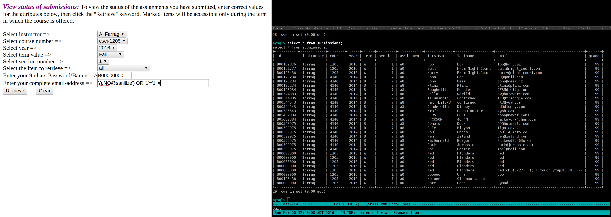
Example

Slide 6
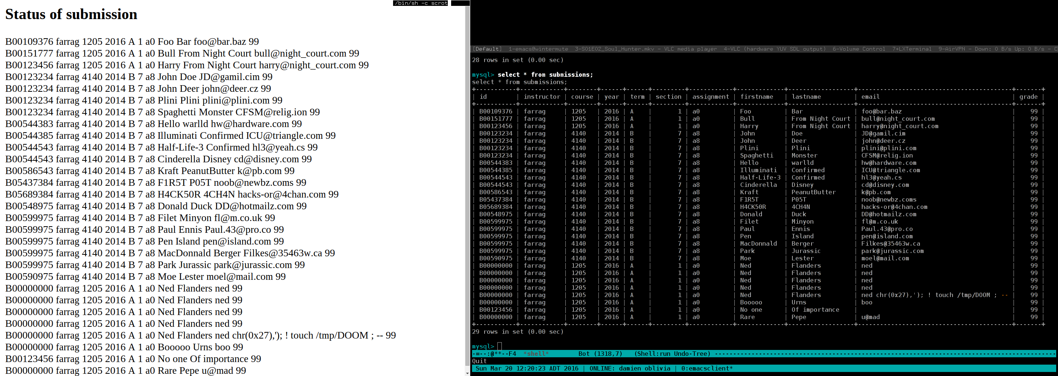
Example

Slide 7
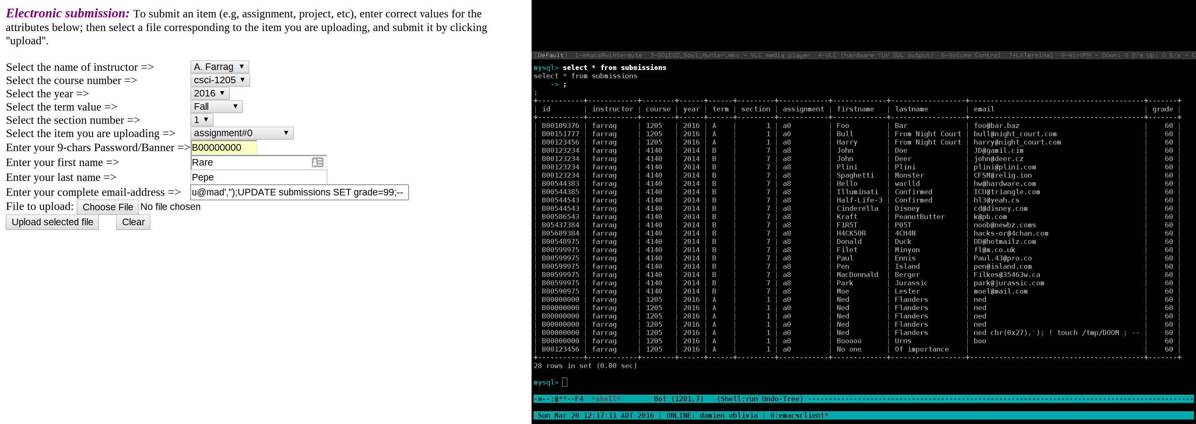
Example

Slide 8
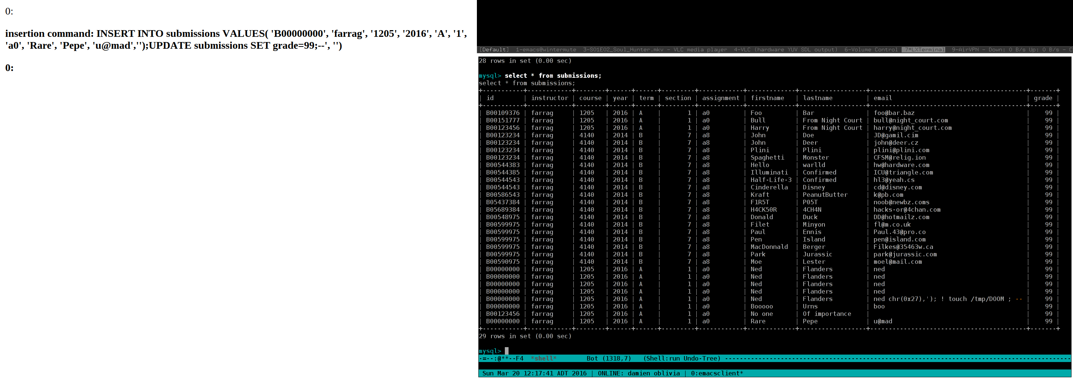
Example

Slide 9
SQL Injection Demonstration
http://straylight.cuboniks.work/db-project/farrag-upload-clone.html

Slide 10
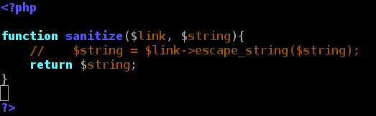
How To Sanitize

Slide 11
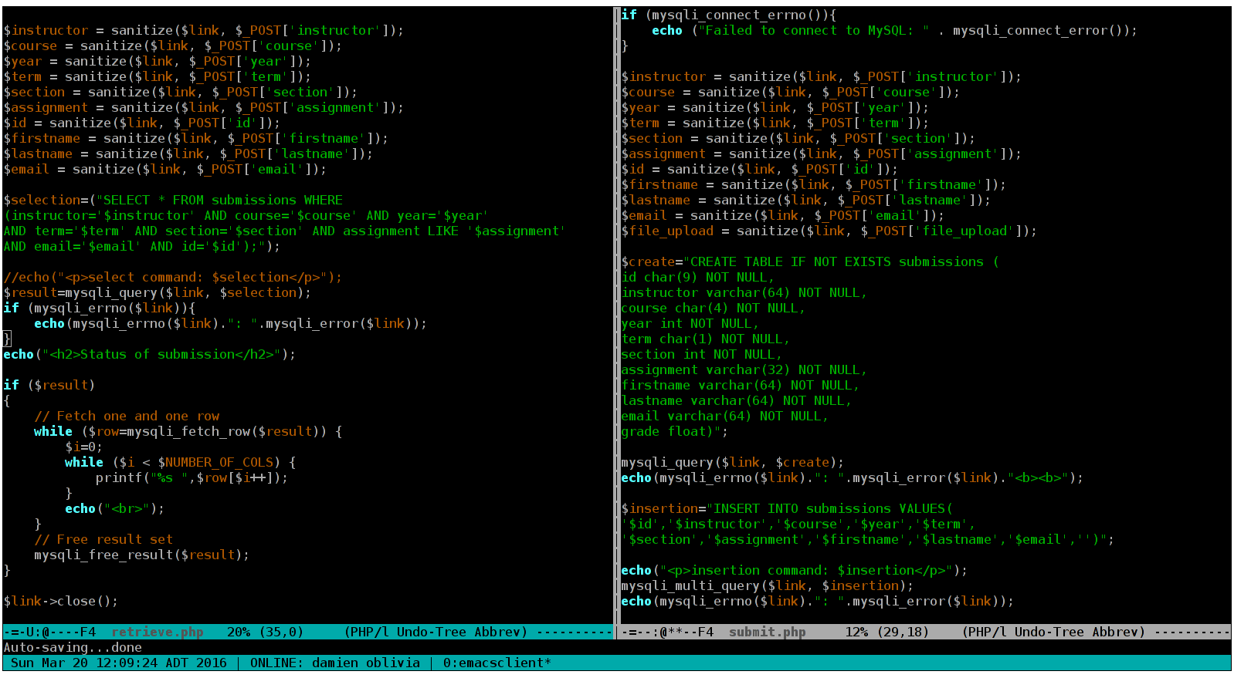

Slide 12
SQL Injection Honorable Mentions
“In 2011, Hammond used an SQL injection to gain access to Stratfor’s database, where he found troves of data including credit card numbers stored in plaintext and five million e-mail messages, which were eventually posted to WikiLeaks in 2012. Hammond charged a total of $700,000 in donations to nonprofit groups using the stolen credit card information.”
-- (http://arstechnica.com/)

Slide 13
Storing Passwords
Password storage is another place where database security is required.
It becomes important to protect the user data correctly.
By storing passwords insecurely, your users become vulnerable.

Slide 14
Storing Passwords as Plain Text
Anyone with access to the database can read it.
If there is a security hole, an attacker can easily get the data.

Slide 15
Encrypting the Passwords
Anyone with access to the encryption key can access it.
Repeated (popular) passwords can be identified easily.

Slide 16
Salting and Hashing
This method is currently recommended.
It uses a Salt (a very long random string) and hashes the concatenation of the salt and the password.
No repetition of popular passwords.

Slide 18
References
http://arstechnica.com/tech-policy/2013/11/lulzsec-member-sentenced-to-10-years-for-hacking-intel-firm-stratfor/
https://www.youtube.com/watch?v=8ZtInClXe1Q
http://imgs.xkcd.com/comics/encryptic.png
https://imgs.xkcd.com/comics/exploits_of_a_mom.png

