Slide 1
Aims and scope
Design a neutron source from synchrotron radiation and we want to investigate its feasibility in power production AND other applications
First attempt: too early
Subcritical reactor design (thermal)

Slide 2
Aims and scope
Design a neutron source from synchrotron radiation and we want to investigate its feasibility in power production AND other applications
Roadmap
Do we have versatile and verified tools for the post-accelerator simulations?
Quantification of the synchrotron advantages in these kind of setups
Design of the subcritical ADS
Other applications?
First attempt: too early
→ In these months we aimed at a solid foundation of the problem
Subcritical reactor design (thermal)

Slide 3

Roadmap
First attempt: too early
→ In these months we aimed at a solid foundation of the problem
Subcritical reactor design (thermal)
1) Do we have versatile and verified tools for the post-accelerator simulations?
Verification of OpenMC with MCNP and FLUKA
PHYSOR 2026

Slide 4
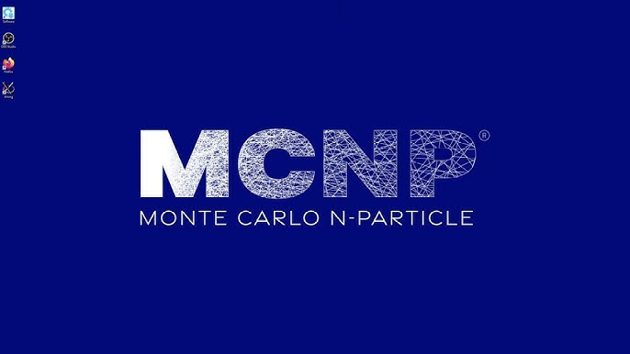




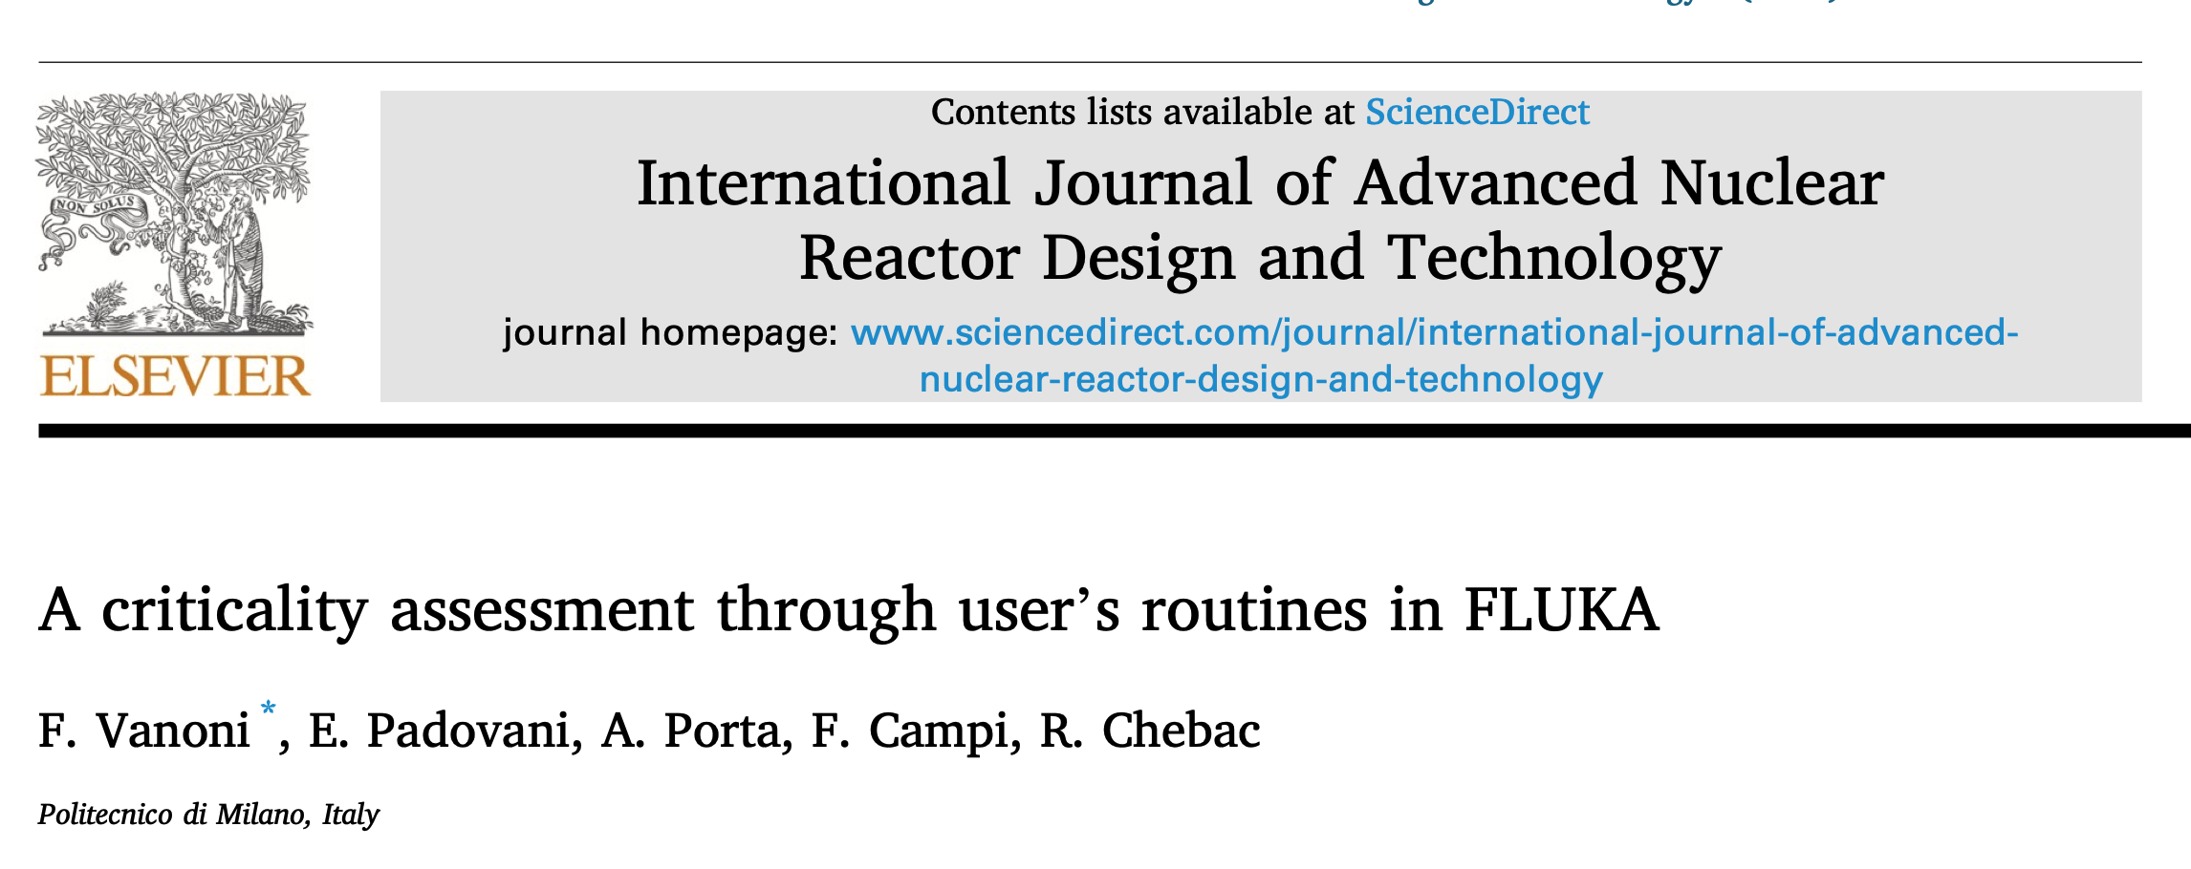
Post-accelerator simulation framework
 | Eigenvalue mode (keff) | Fixed source mode (power) | With Photonuclear | Possible improvements
 |  |  |  | -
Branch under development by a user on Github (@GuySten). The branch is available and we made a preliminary verification with this new OpenMC version
Modified FLUKA version that accounts for keff: FLUKeff, developed at Polimi in 2023. We have the source code and parallel calculations are planned
X
X
X
X

Slide 5
Do we have faster and verified tools for the post-accelerator simulations?
Verification of OpenMC with MCNP and FLUKA
PHYSOR 2026
monoenergetic
photons
Broomstick problem
photoneutrons
Comparison of photonuclear reaction rates and photoneutron energy distribution

Slide 6
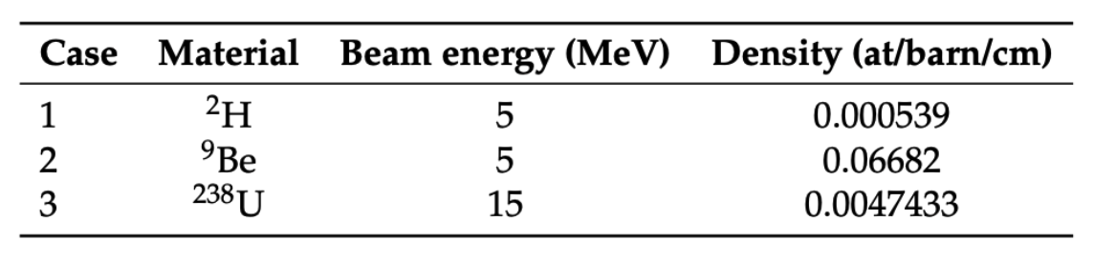
Do we have faster and verified tools for the post-accelerator simulations?
Verification of OpenMC with MCNP and FLUKA
PHYSOR 2026
Broomstick problem
photoneutrons
Comparison of photonuclear reaction rates and photoneutron energy distribution
- Good agreement within the three codes

Slide 7
Do we have faster and verified tools for the post-accelerator simulations?
Verification of OpenMC with MCNP and FLUKA
PHYSOR 2026
Broomstick problem
photoneutrons
Comparison of photonuclear reaction rates and photoneutron energy distribution
Total number of photoneutrons ok, but:
- FLUKA better models the three body kinematic within n and alphas

Slide 8
Do we have faster and verified tools for the post-accelerator simulations?
Verification of OpenMC with MCNP and FLUKA
PHYSOR 2026
Broomstick problem
photoneutrons
Comparison of photonuclear reaction rates and photoneutron energy distribution
Total number of photoneutrons ok. Difference in
Energy distribution problem: MCNP does not considers the kinematic in the laboratory frame
Mean value problem : reported bug within the nuclear library data
Correct mean value
Correct shape

Slide 9
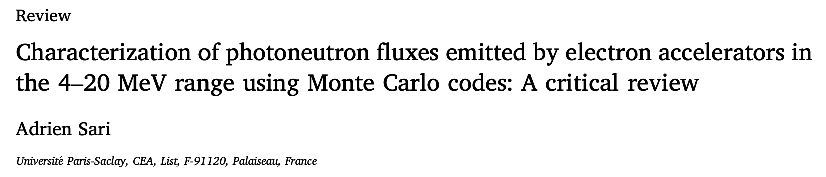
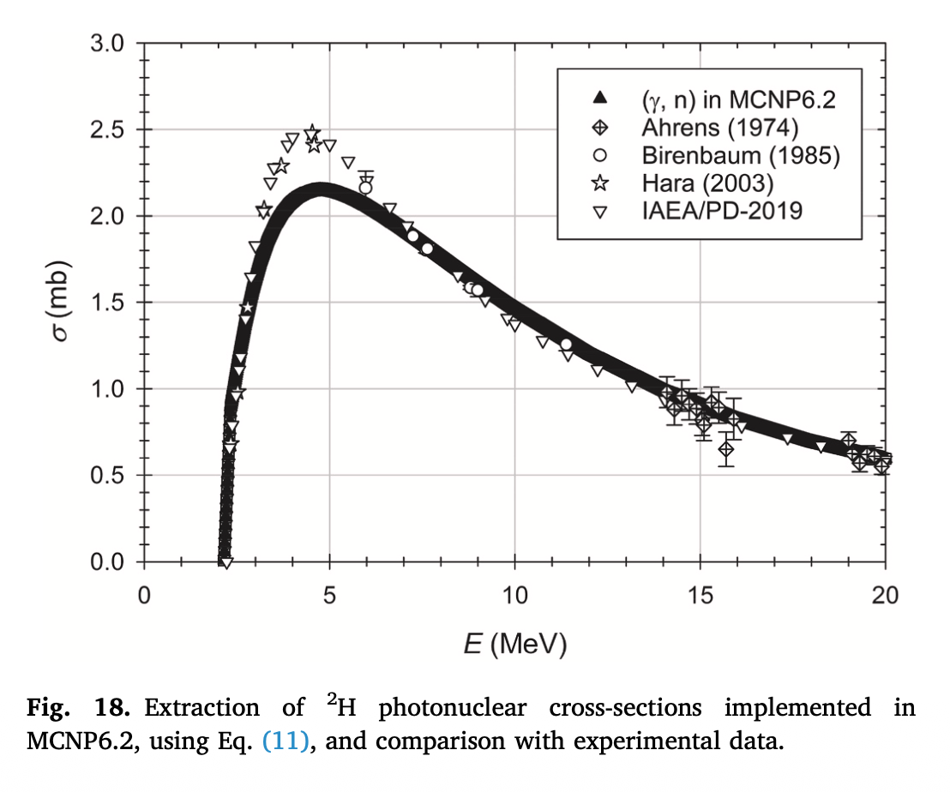
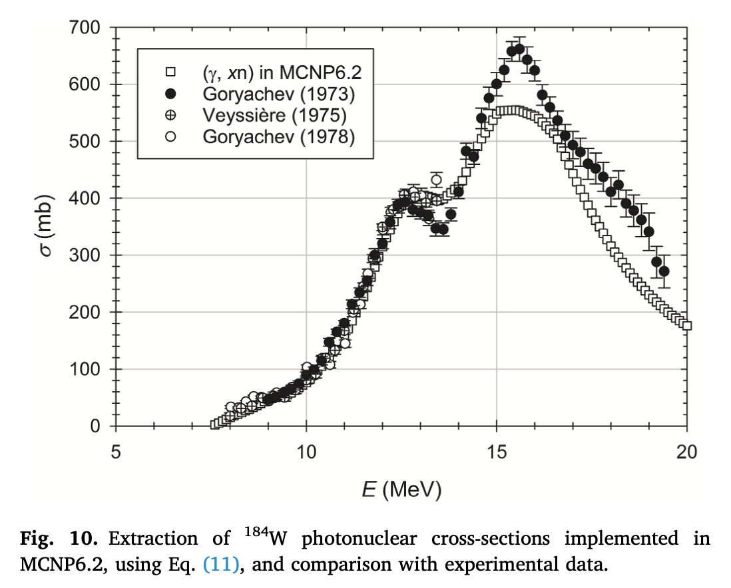
Nuclear data problems:
Bug with the code that process them (NJOY)
Wrong data with respect to experiments
→ Systematic underestimation of MC codes in photoneutorn yields
Bias in the photonuclear libraries

Slide 10
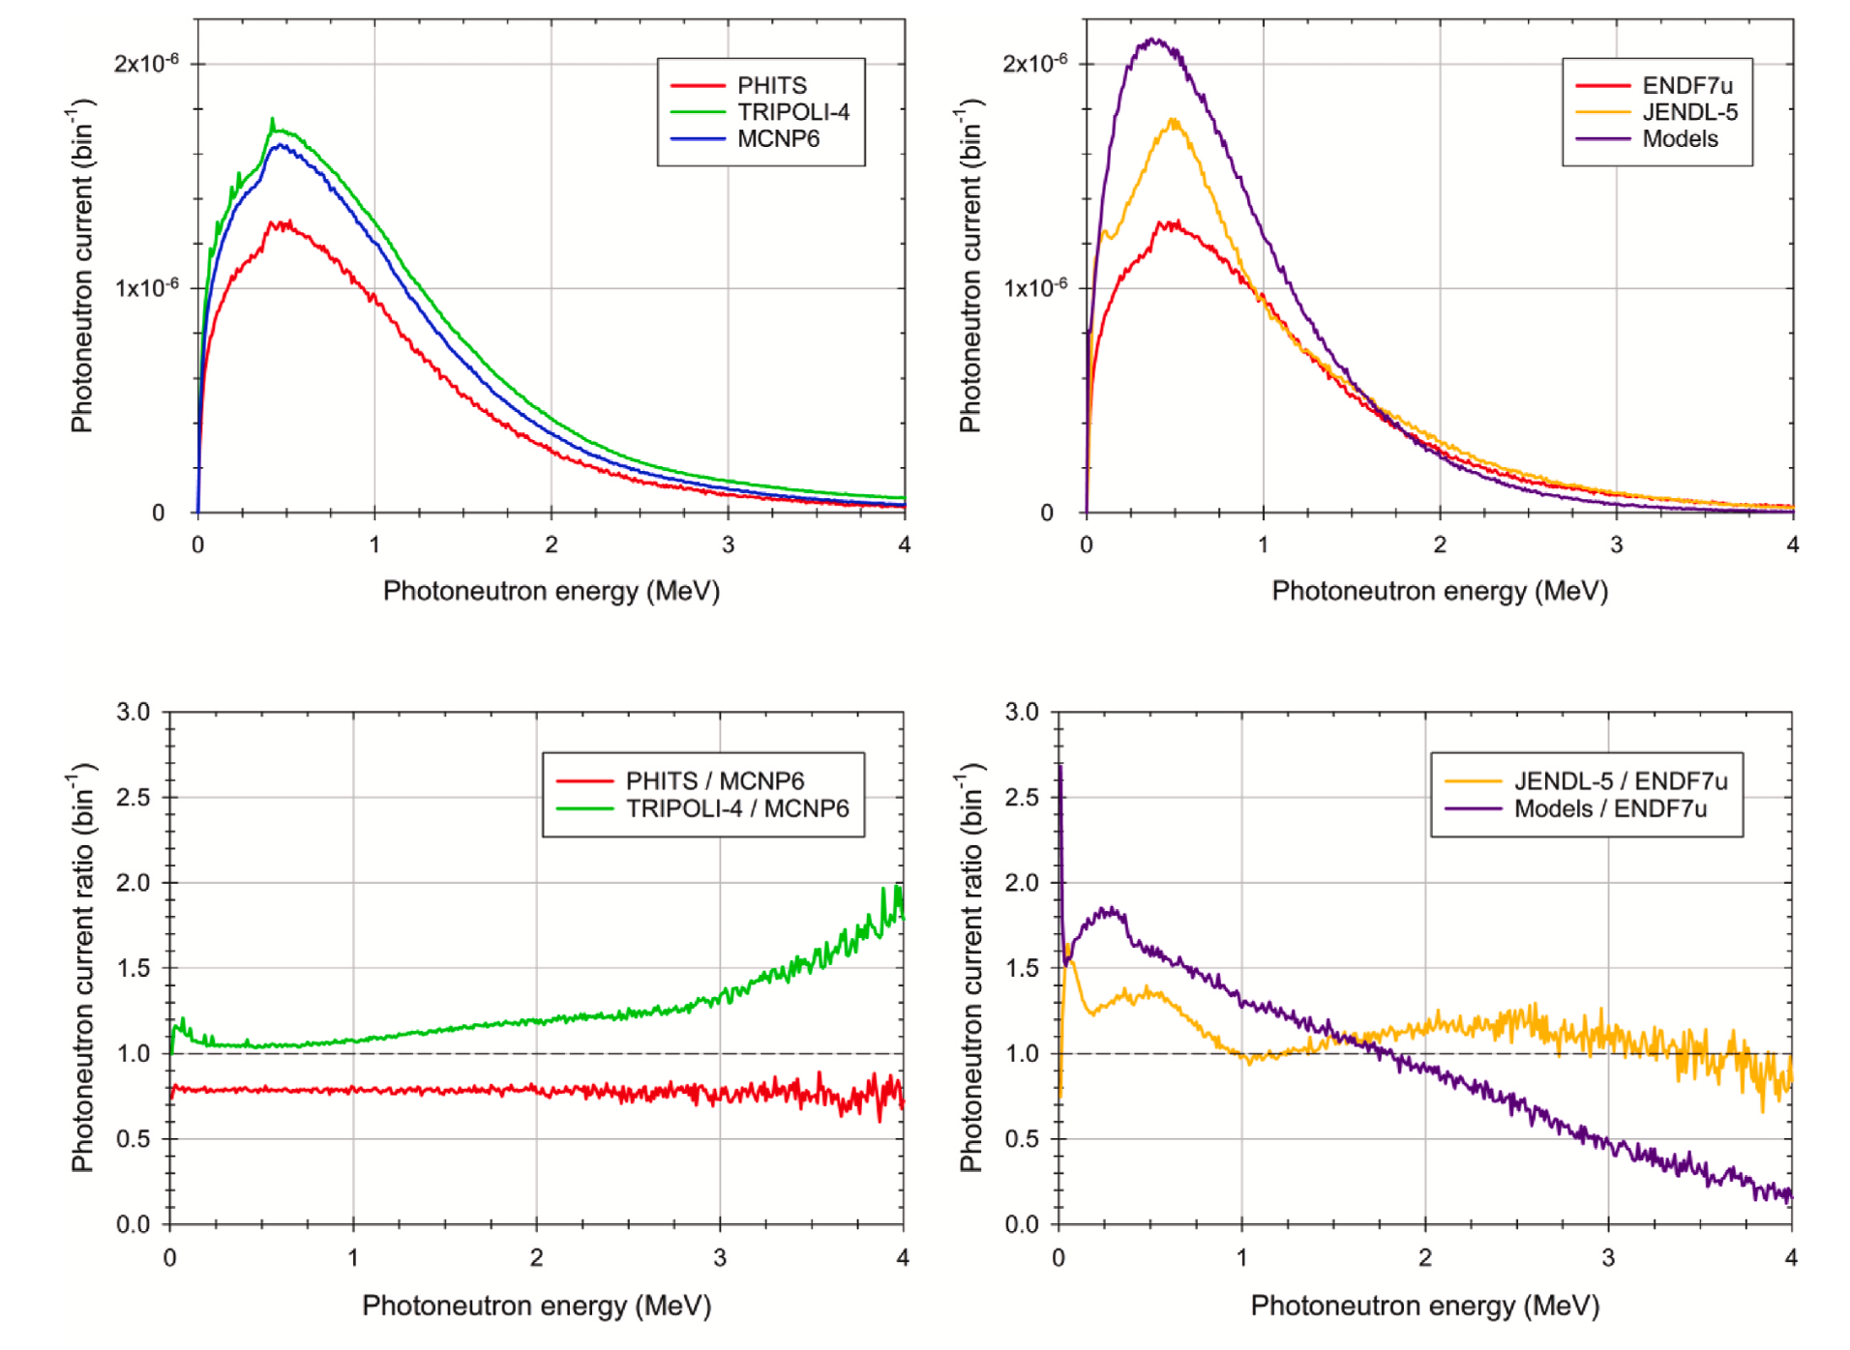
Bias in the photonuclear libraries
Same library
Same code
Case: electrons on tungsten

Slide 11
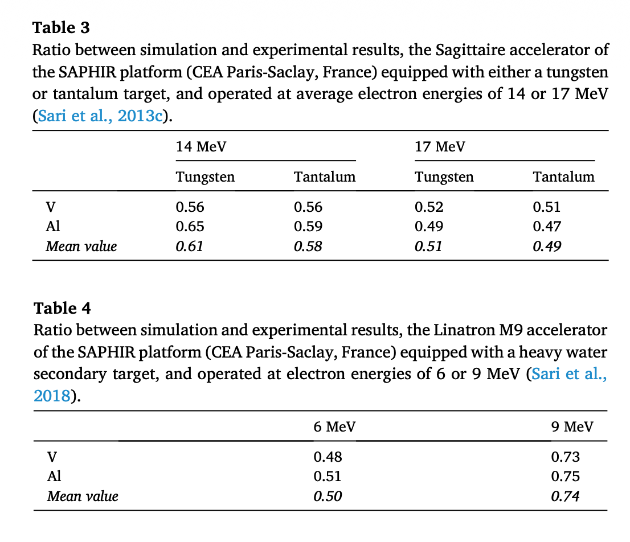
Bias in the photonuclear libraries
There was also a validation.
Simulation predicts half of the interactions with respect to the experiment!!
We are in contact with the authors, asking for communications about the U238 data

Slide 12
Bias in the photonuclear libraries
There was also a validation.
Simulation predicts half of the interactions with respect to the experiment!!
We are in contact with the authors, asking for communications about the U238 data
We can conclude that the photonuclear capabilities of OpenMC are verified : the code is able to simulate always the same number of photoneutrons as MCNP/FLUKA (with some caveats in the energy distribution)

Slide 13
Roadmap
Other applications: BNCT, etc..
Subcritical reactor design (thermal)
Journal (FLUKA+MCNP, more results, more context)
2) Why do we want to use a synchrotron? Need for quantitative justification!
Target optimization and justification for synchrotron usage
PHYSOR 2026 (only OpenMC)
1) Do we have versatile and verified tools for the post-accelerator simulations?
Verification of OpenMC with MCNP and FLUKA
PHYSOR 2026

Slide 14
Why do we want to use a synchrotron? Need for quantitative justification!
Target optimization and justification for synchrotron usage
PHYSOR 2026 (only OpenMC)

Slide 15
Why do we want to use a synchrotron? Need for quantitative justification!
Target optimization and justification for synchrotron usage
PHYSOR 2026 (only OpenMC)
TAILORED case
EXPANDED case

Slide 16
Why do we want to use a synchrotron? Need for quantitative justification!
Target optimization and justification for synchrotron usage
PHYSOR 2026 (only OpenMC)

Slide 17
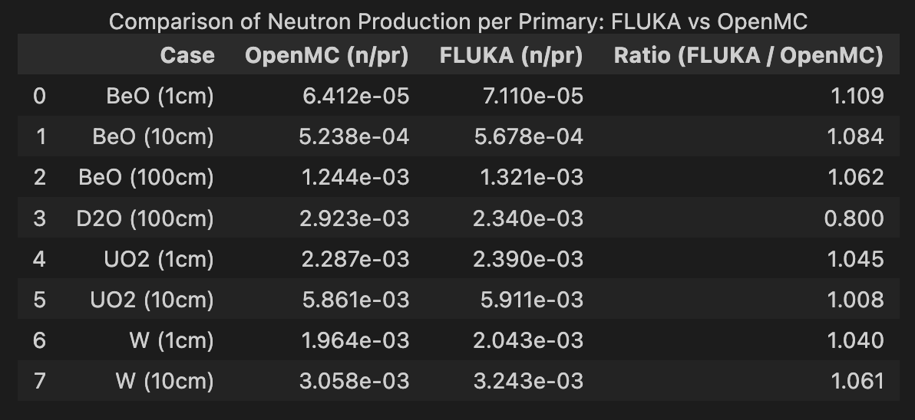
Why do we want to use a synchrotron? Need for quantitative justification!
Target optimization and justification for synchrotron usage
PHYSOR 2026 (only OpenMC)
Some random cases were also simulated in FLUKA to have a parallel confirmation of the results

Slide 18
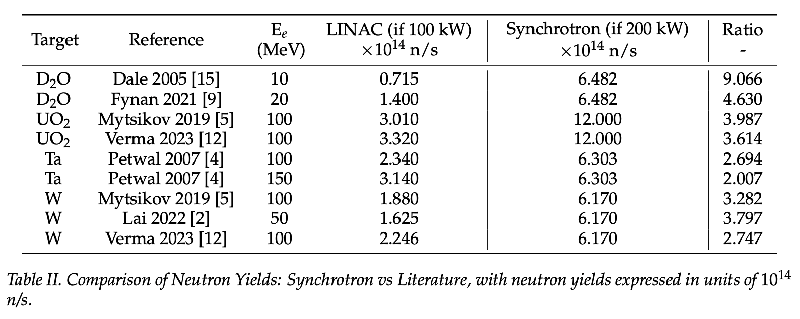
Why do we want to use a synchrotron? Need for quantitative justification!
Target optimization and justification for synchrotron usage
PHYSOR 2026 (only OpenMC)
Highlights:
Synchrotron’s photoneutron yield is higher than LINAC’s photoneutron yield (at their maximum reasonable power)
Synchrotron remove the problems related to the e-gamma interactions in the target
Synchrotron may exploit multiplexity (multiple beamlines)

Slide 19
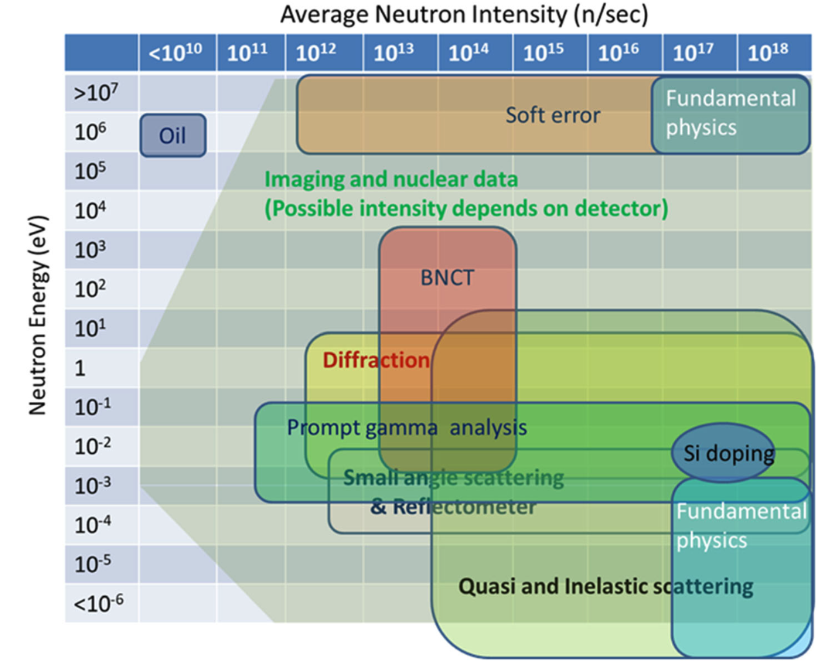
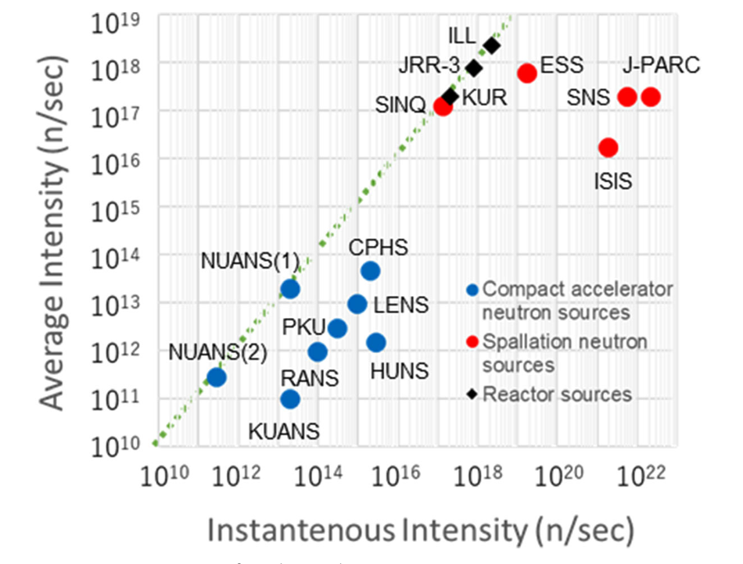
Journal (FLUKA+MCNP, more results, more context)
Why do we want to use a synchrotron? Need for quantitative justification!
Target optimization and justification for synchrotron usage

Slide 20
Roadmap
Other applications: BNCT, etc..
Other designs
Subcritical reactor design (fast)
k-eff limits
PRELIMINARY
3) A lot of case tested, a couple show COP around 6
Subcritical reactor design (thermal)
Journal (FLUKA+MCNP, more results, more context)
2) Why do we want to use a synchrotron? Need for quantitative justification!
Target optimization and justification for synchrotron usage
PHYSOR 2026 (only OpenMC)
1) Do we have versatile and verified tools for the post-accelerator simulations?
Verification of OpenMC with MCNP and FLUKA
PHYSOR 2026

Slide 21
Roadmap
Other applications: BNCT, etc..
Other designs
Subcritical reactor design (fast)
k-eff limits
Subcritical reactor design (thermal)
Journal (FLUKA+MCNP, more results, more context)
Next steps:
Finalization of the thermal ADS design (different coolant and fuel tested: some cases showed a COP around 6) in stationary condition
For how much time the thermal ADS may operate withoout refuelling?
Evaluation of transient accidental scenarios
…
Target optimization and justification for synchrotron usage
PHYSOR 2026 (only OpenMC)
Verification of OpenMC with MCNP and FLUKA
PHYSOR 2026

Slide 22

Polimi manpower
Antonio Cammi – Full Professor
Lorenzo Loi – 3° year PhD
Andrea Missaglia - 3° year PhD
Arianna Iorio – MSc student
Riccardo Bossi - MSc student
Carolina Introini – Postdoc

