Slide 1
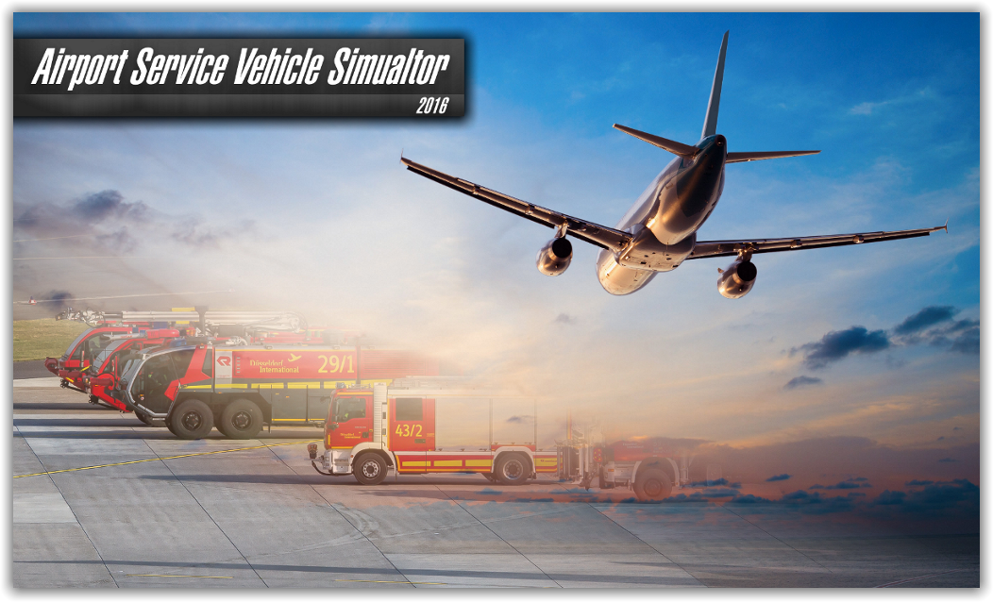
Airport Ground Vehicle Accident Management
Created by:
Patrick Mawhinney Matthew Brooks
Christian Heimlich
Kevin Murphy
Nicholas Parisi

Slide 2
Problem Space
27,000 ramp accidents and incidents per year
9 injuries per 1,000 departures
Damages (direct and indirect cost) nearing $7 billion
Ground Accident Prevention Program (2003)
Only implemented for apron movement
Areas and vehicles of concern
Aprons, runway safety area, taxiways, runways, loading zones, etc.
Aircraft Rescue and Fire Fighting, Foreign Object Debris removal, jet refueler, baggage cart, mobile passenger stairs, catering truck, tow tractor, toilet truck, etc.

Slide 3
Physical Domain
Includes all the actual vehicles on the ground and their interactions with each other and the aircraft.
Ultimately, this domain is the one that needs to be optimized and controlled.
This can be done through an improvement in the other domains for this system.

Slide 4
Information Domain
Includes all the information that the drivers share with each other and surroundings.
A lack of information caused by human error is the leading factor to causing ground vehicle accidents.
Minimizing human error by implementing a system in which paths are decided by simulations that have knowledge of each vehicle's position could be a solution.

Slide 5
Cognitive Domain
Includes the driver’s ability to make decisions during potential accidents.
This domain is greatly affected by the Information Domain, since decisions are affected by the amount of information available.
Temporary fixes to this domain include higher training for the drivers, or assigning particular routes for certain types of ground vehicles.

Slide 6
Social Domain
Includes the interactions between the drivers and other people who communicate with them to provide them information.
The quality of these interactions are crucial for a driver to have the correct amount and quality of information about his surroundings and goals.
Either improved communication protocols or an automated system to decided paths or provide information can be implemented to improve this domain.

Slide 7
Simulation

Slide 8
Aspects of the Simulation
Airport Layout Design
Pathing Algorithm
GUI

Slide 9
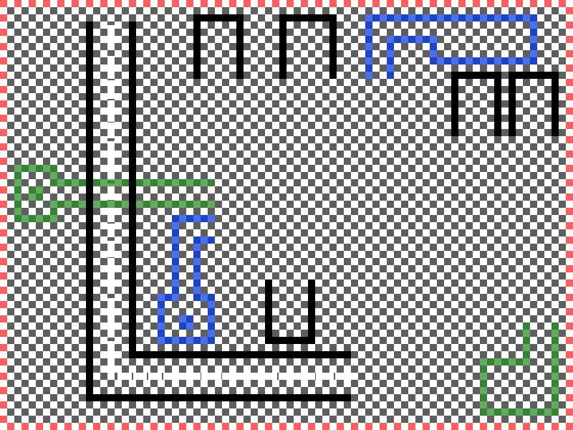

Slide 10
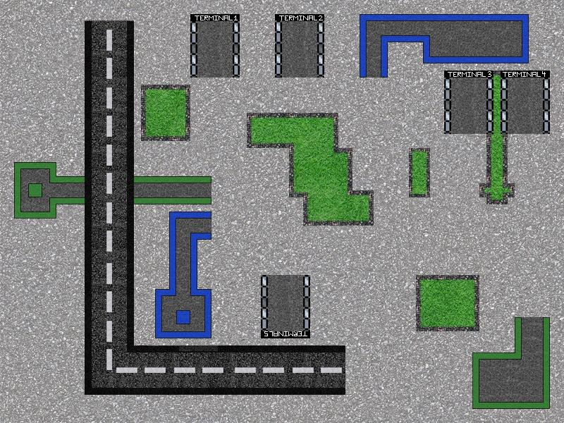

Slide 11
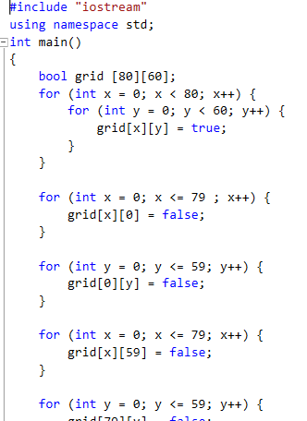
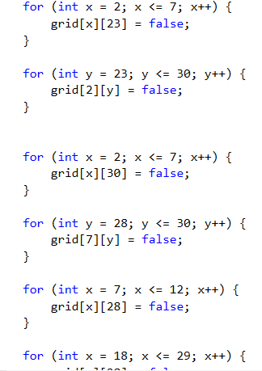

Slide 12
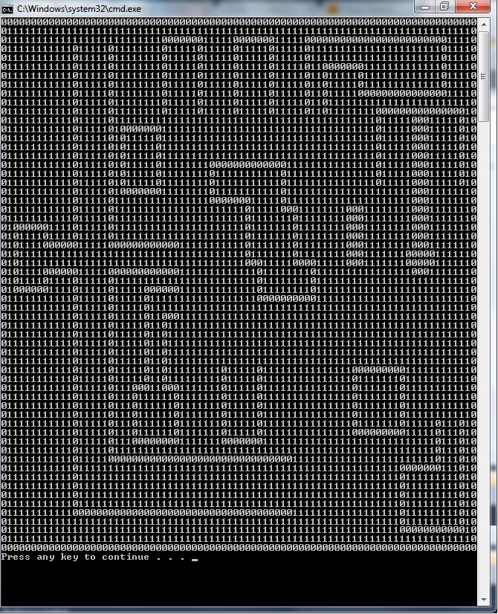

Slide 13
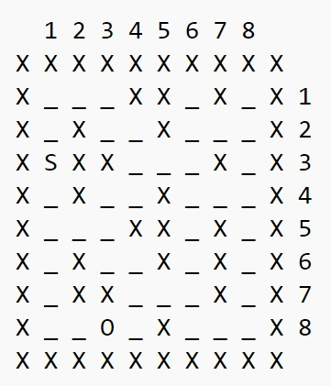
Pathing Algorithm
Provides a list of moves that provides the shortest route between two points on a 2-D grid. X = wall, _ = open space, S = start, O = end
Utilizes two lists: a main list to collect all possible moves, and a supplementary list.
Algorithm begins by adding the end coordinate to the main list.
Loop through the main list and add each possible move to the main list.

Slide 14
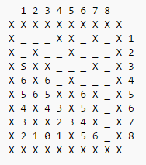
Pathing Algorithm
Then, the algorithm begins at the start, and chooses the shortest path to get to the end coordinate.
Finally, an array of coordinates is returned, representing the coordinates a vehicle would have to take to get to the desired coordinate.

Slide 15
GUI System
A tool for the user/company to fine tune parameters to match their specific needs
Allows precise observation of the simulation for maximum adjustment efficiency
Gives feedback of various events relative to each ground based vehicle
Robust function implementation allows for a variety of expansions to easily be developed

Slide 16
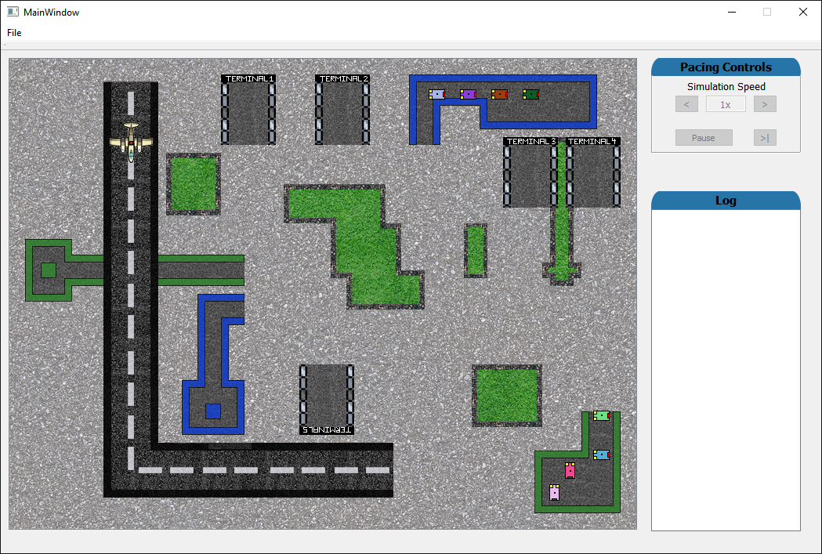
GUI System (cont.)

Slide 17
Conclusions
The current ground vehicle implementation at airports is an example of a modern day command and control failure.
Attempted to remove as much human control from the system as possible to try and eliminate human error.
As with every model based on a real world phenomenon, the simulation is not perfect. There are sources of error beyond humans which comes from the randomness that can’t be planned for.
Real world airports feature much more complex layouts and have a much larger force of ground vehicles.

Slide 18
Questions?

