Slide 1
Pong
By: Traz Daczkowski and Christian Heimlich

Slide 2
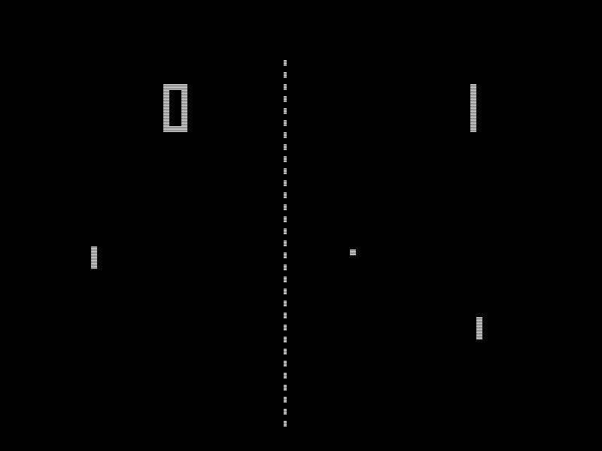
Original Pong
Released in 1972
Made entirely using transistor logic gates
8 different ball angles

Slide 3
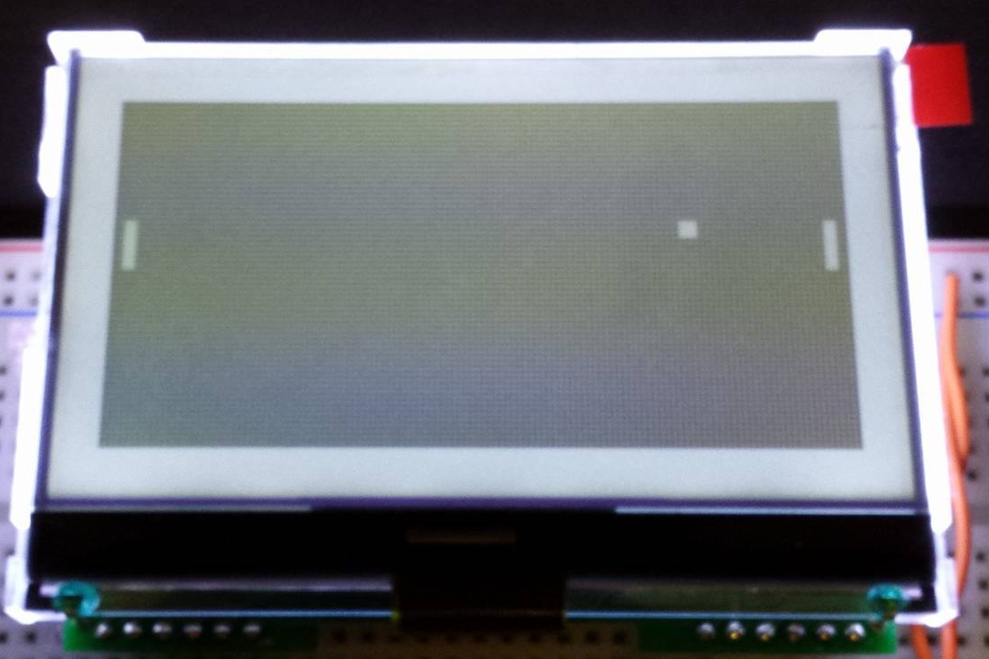
Our Pong
Made in 2015
Made on the MSP430 Launchpad
Utilizes SPI communication
100s of ball angles
30 fps 128p
~2MHz clock speed
2 header files

Slide 4
Ball movement
Ball x direction
Direction is Boolean
0 Boolean goes toward Player 1. 1 goes to Player 2.
1 pixel every .01s
Ball y velocity
Determined by input angle and ball impact location
Utilizes subpixels to be compatible with low angles
Position evaluated every time ball moves along x axis
Increases velocity every 100 frames

Slide 5
Paddle movement
Grid with number of segments controlled by #define
Easier to make balance changes
Paddle location defined as center pixel of paddle
Extends ±paddle length

Slide 6
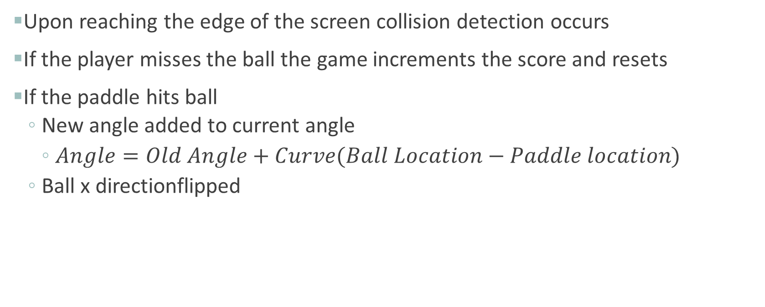
Ball-Paddle Interaction
Upon reaching the edge of the screen collision detection occurs
If the player misses the ball the game increments the score and resets
If the paddle hits ball
New angle added to current angle
$Angle=Old Angle+Curve(Ball Location−Paddle location)$
Ball x directionflipped

Slide 7
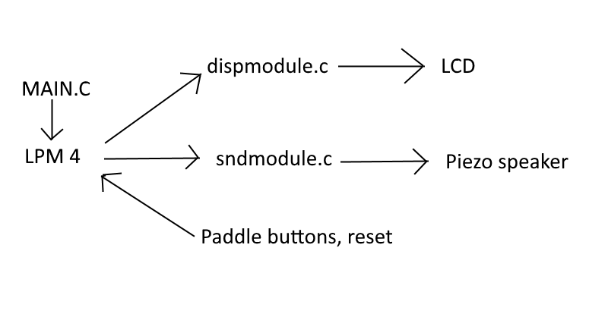
Program overview

Slide 8
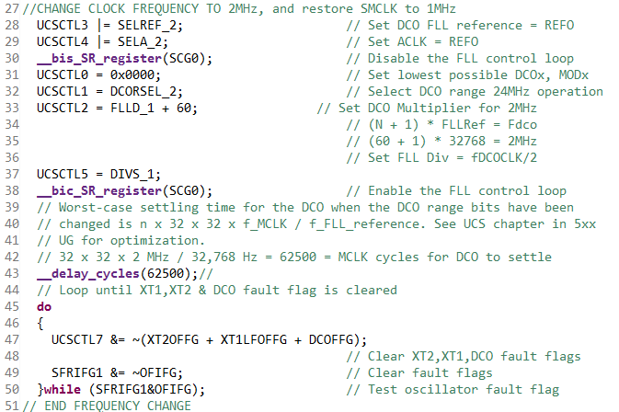
Increasing MSP430 clock speed
Default MCLK speed is ~1MHz
Must divide SMCLK afterwards
Use Digitally Controlled Oscillator (DCO)

Slide 9
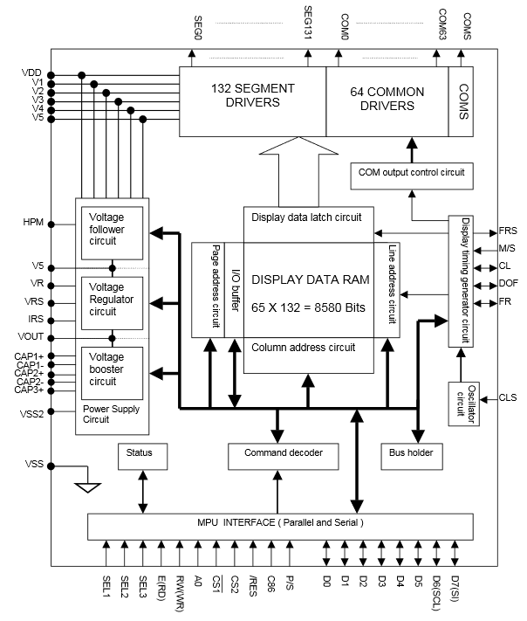
The Screen
NewHaven Display
128x64 resolution
Utilizes horizontal ‘pages’
Obviously meant for text
SPI Interface
Built in controller with dedicated RAM
Backlight
Optional Heater Element

Slide 10
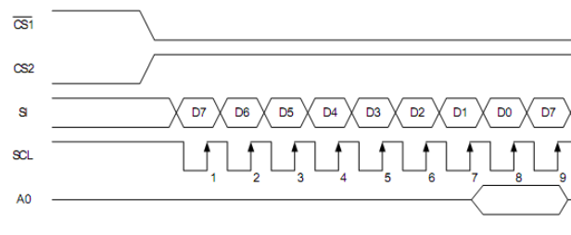
Screen Communication
Software ‘Bit-Banging’
Limited to a 500ns period (~2.5MHz)
Ghosting/Viewing Angle issue
Can’t run screen in reverse mode

Slide 11
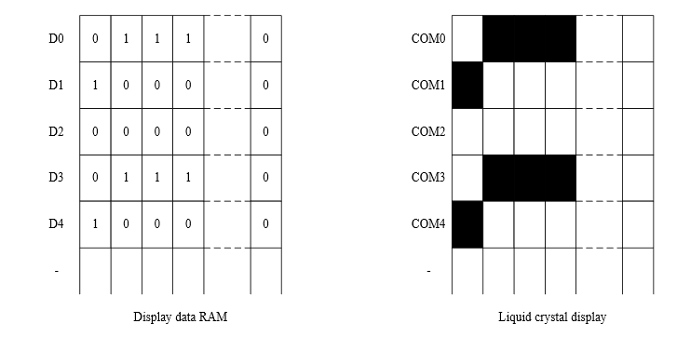
Drawing the Screen
8x8-bit (x128) Registers that correspond directly to ram

Slide 12
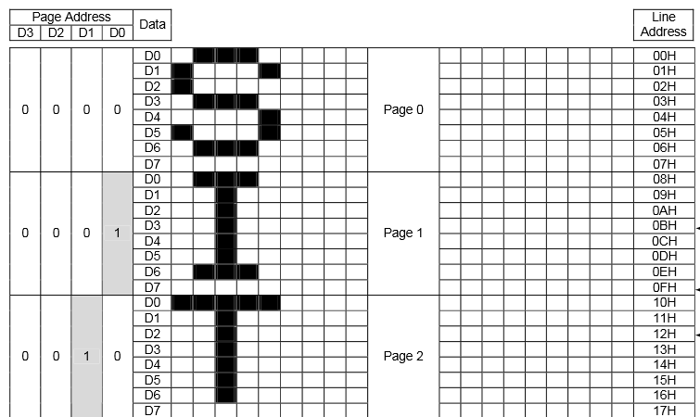
Drawing the Screen (cont.)
8 Pages with 128 columns

Slide 13
General Screen Operation
Screen refresh is separate from ball/paddle movement
Constant 30FPS
Previous game elements are erased, new are drawn
Game elements only are cleared, not entire screen (Speed)

Slide 14
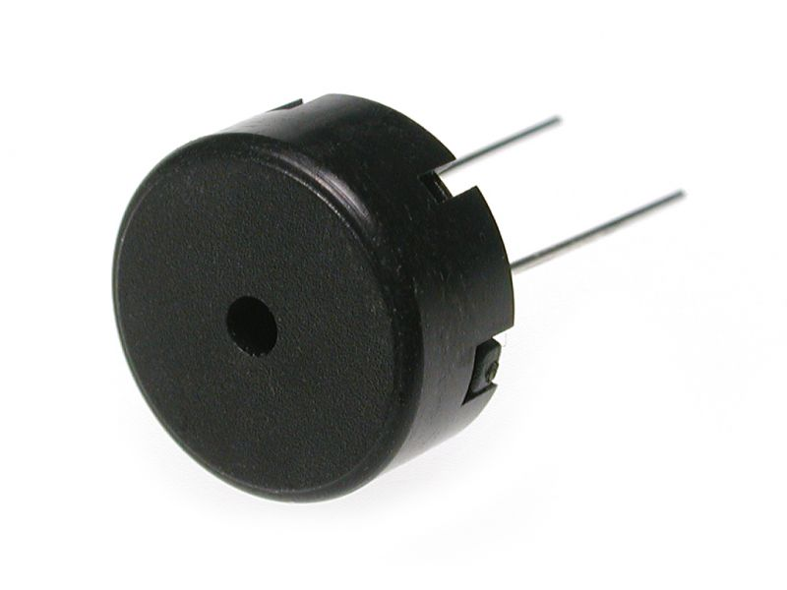
Sound
PWM (square wave) piezo speaker
Double timer system
Scaling frequency based on game speed

Slide 15
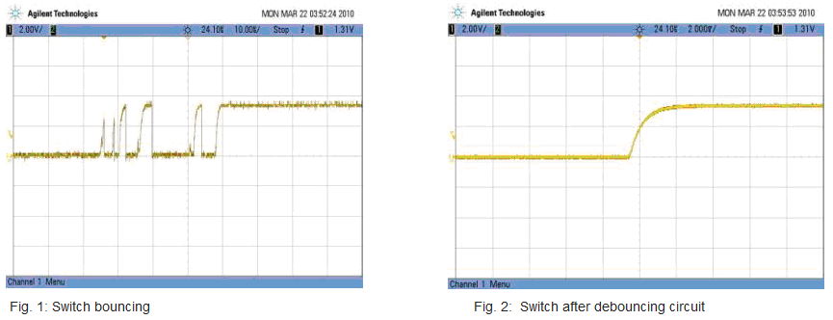
Button Debouncing
Digital buttons suffer from ‘bouncing
Software delay workaround was used
Critical for playability

Slide 16
Summary
128x64 resolution at 30FPS
SPI display, page & column based draw system
Two player support with debounced controls
Multi-frequency PWM sound output
Uses 12 I/O pins
Scaling game speed (and sound)
Ball curving
Main + 2 header files

