Slide 1

Rainbow Snake
Christian Heimlich

Slide 2
Project - Introduction
Rainbow Snake: A new take on the classic game “Snake” with added mechanics based on four colors
Designed so that the base game looks and feels like the original
Simple 2D frame-by-frame rendering + basic UI
C++ with Qt 5.7
Thought of while considering linked-lists

Slide 3
Project - Objectives
Implement a full 2D game modeled after Snake, expand on gameplay
Use a linked-list to store and retrieve information about the Snake
Simple and repayable experience, accessible but challenging
Major use of at least one other data structure

Slide 4
Topics Covered (primary)
Linked-lists
Stacks
Trees
Virtual functions
Proper Classes
enum, struct, pointers, etc.
UI and 2D scene rendering

Slide 5
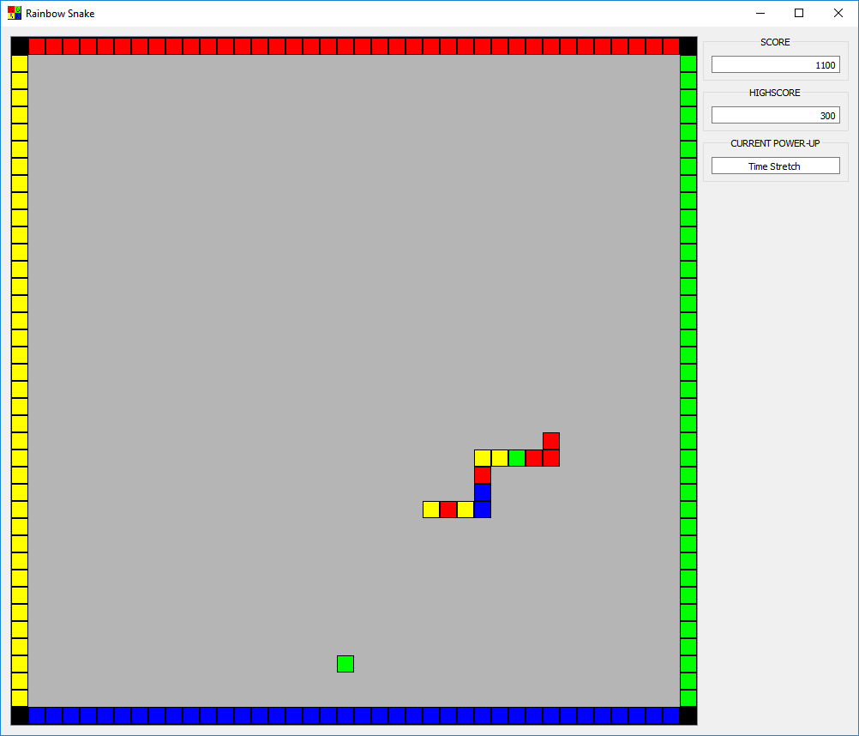
Gameplay
Move using arrow keys
Space Bar: Power-ups
Simple score system
Color looping/pass-through

Slide 6
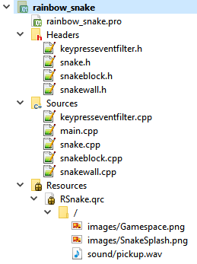
Implementation - General
Snake stored as linked list
Power-ups stored in a stack (FILO)
Key presses capture in event filter
Timer based game clock
Getters and setters for game state info

Slide 7
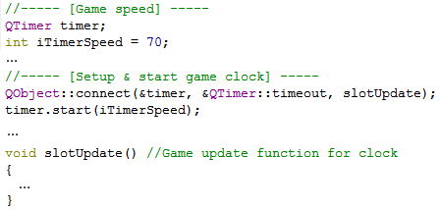
Implementation – Game Clock
Main.cpp

Slide 8
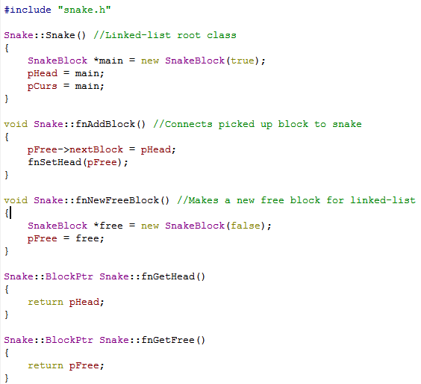
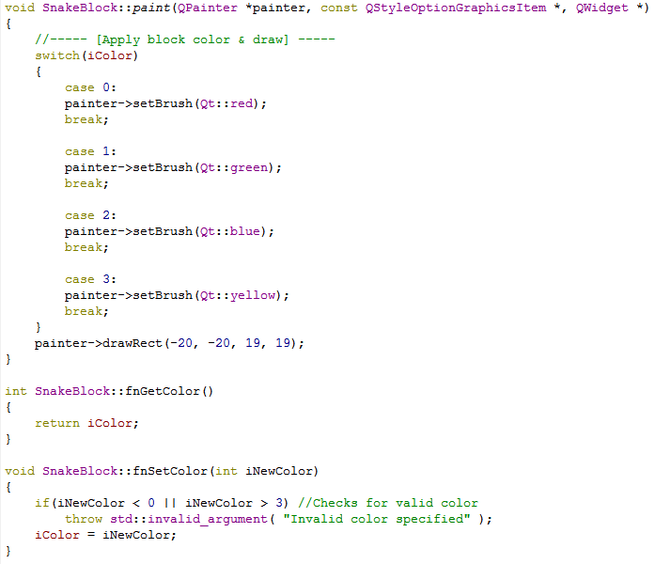
Implementation – Snake (linked-list)
Snake.cpp
SnakeBlock.cpp

Slide 9
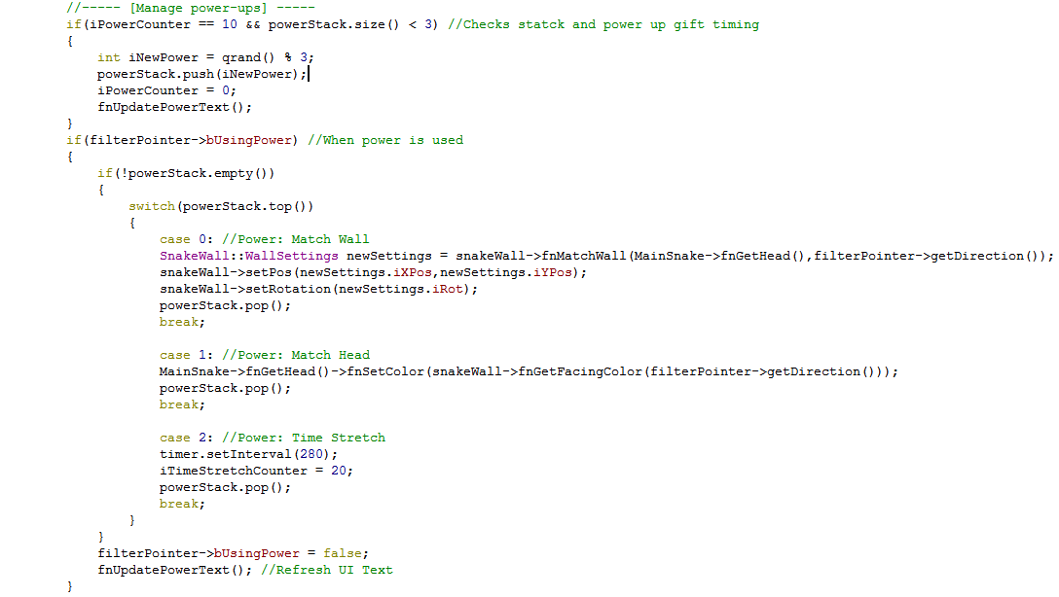
Implementation – Power-ups (stack)
Main.cpp

Slide 10
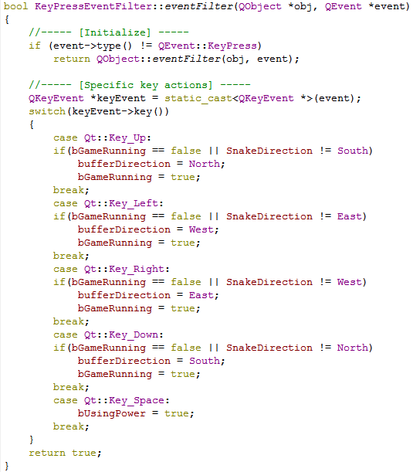
Implementation – Key press event filtering
Keypresseventfilter.cpp

Slide 11
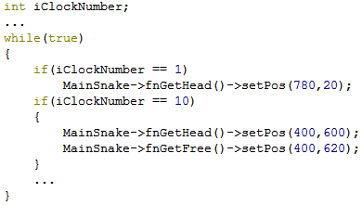
Testing
3 Methods:
Set and playtest
Step through debug value check during implementation
Repeating forced gameplay cases

Slide 12

Questions?

