Slide 1

– Weird python – Honeynet chalLenges
Created by: Omoremi Adeleke

Slide 2
AGENDA
Scenario
Digital Evidence – Dataset
.pcapng
Web pages accessed
Race COndition
Python bytecode
Tools
WireShark, network miner, unrar, uncompyle6
Task 1 – Determine Source of Attack
Task2 – DNS Spoofing
Task 3 – Analyze Network traffic Attack
Task 4 – Ananlyze Executable download
Task 5 – Report
Challenges
REFERENCES

Slide 3
Case Intro | Scenario
Your boss John went to a BYOD conference lately. Yeah, he’s that kind of security guy… After some mumble about targeted attacks happening during the event, your team finally got their hands on a PCAP with his traffic. Your colleague Pete Galloway investigated the incident. Yesterday, he casually mentioned that he found some weird Python bytecode but couldn’t make much sense out of “random” payloads yet.

Slide 4
Case Intro | Timeline – Personnel
Network Compromise
Attacker gains access through DNS spoofing, targeting John’s device with a malicious payload.
Malware Execution
John unknowingly runs the payload, initiating data collection and network infiltration.
Malware communicates with external servers, triggering unusual network activity.
Detection & Initial Analysis
Security detects suspicious activity, isolating the malware and beginning investigation.
Full Forensic Analysis
Investigators link Pete to traffic redirection; deeper analysis confirms potential insider risk.
Escalation & Containment
Company escalates, isolates devices, strengthens network protections, and updates security protocols.
Post-Incident Review
Formal report with findings and recommendations for improved security policies and employee training.

Slide 5
Case Intro | Analysis – Scope
The purpose of this case overview is to analyze a security incident involving potential insider threats and malicious Python code, enhancing understanding of cyber-attack methodologies.
The event centers around a suspicious incident at a BYOD conference where user John accessed malicious content, leading to an investigation triggered by colleague Pete's discovery of unusual Python bytecode. The incident took place during a Bring Your Own Device (BYOD) conference, where network traffic and user activities were monitored for forensic analysis.
Analyzing DNS spoofing and malicious payload delivery on John’s device, with packet analysis and detection of threat vectors.
Reverse engineering the Python bytecode to understand its evasion tactics and data exfiltration methods. Assessing data exposure risk, recommending security upgrades (DNS security, IDS/IPS, network segmentation). Evaluating Pete’s involvement, potential insider risk, and policy adherence.

Slide 6
Digital Evidence
.pcapng file
Web Pages Accessed
Requested Resources
IP Addresses and Hosts
DNS Responses
File Downloads
Transaction ID
Malicious Python bytecode

Slide 7
Digital Evidence
Investigating HTTP Requests
PCAP (Packet Capture) File (conference.pcapng)
Captured network traffic, providing a timeline of John's online activity, including web pages visited, resources requested, IP addresses involved, DNS responses, file downloads, and potentially malicious payloads.
Web Pages Accessed and Requested Resources
Through filtered HTTP GET requests in Wireshark, specific actions were identified, showing that John accessed several web pages, including Reddit and 9gag, and conducted a search on Reddit for “BYOD,” leading to interactions with potentially malicious websites.

Slide 8
Digital Evidence
IDENTIFYING DNS SPOOFING
DNS Responses
By analyzing DNS traffic, evidence of DNS spoofing was uncovered, indicating that an attacker likely intercepted DNS requests and redirected John's requests to spoofed IP addresses. This redirection allowed the attacker to serve malicious payloads from domains that appeared legitimate.
Transaction IDs and DNS Spoofing Evidence
A DNS race condition was detected, where the attacker’s DNS response with an IP address of 81.166.122.238 won over the legitimate IP 207.150.212.43. The matching transaction ID and minimal time difference (.02 seconds) between responses reveal how the attacker effectively intercepted John’s request, enabling redirection to a malicious site.

Slide 9
Digital Evidence
Identifying DNS Spoofing
File Downloads
The investigation of packet 5675 revealed a suspicious file download with a .zip extension from harveycartel.org, suggesting that John's device downloaded malware unknowingly. This was potentially the root of the network compromise.
Malicious Python Bytecode (main.pyc)
Python bytecode embedded in the downloaded payload hints at malware execution. This bytecode was decompiled to understand its functionality and purpose, which was ultimately to evade detection and monitor network interactions.

Slide 10
Digital Forensics Tools
Wireshark
1
Wireshark is a powerful open-source network protocol analyzer that allows forensic analysts to capture and interactively browse the traffic running on a computer network, providing detailed insights into packet-level data for effective incident investigation and analysis.
2
Network Miner
Network Miner excels in extracting files from network traffic, enabling analysts to recover potentially malicious payloads and other relevant artifacts that may aid in the investigation of cyber incidents.
Uncompyle2
3
Uncompile2 is a powerful tool used to decompile Python bytecode (.pyc files) back into readable source code, facilitating the analysis of malicious scripts by revealing their structure, functions, and potential vulnerabilities that can be exploited during forensic investigations.
4
Python 'strings' Command
Powerful tool used in digital forensics and reverse engineering to extract human-readable text from binary files. It scans files for ASCII and Unicode characters that are at least a certain length (typically three characters or more by default), displaying sequences that might provide clues about the file’s purpose and functionality

Slide 11
Digital Forensics Tools
Wireshark
1
Wireshark is a powerful open-source network protocol analyzer that allows forensic analysts to capture and interactively browse the traffic running on a computer network, providing detailed insights into packet-level data for effective incident investigation and analysis.
Loaded the .Pcapng file to analyze john's network activity during the conference.
Applied filters to identify relevant HTTP GET and POST requests, narrowing down malicious interactions.
Monitored DNS queries and responses to detect potential DNS spoofing. By analyzing the timestamps and IP addresses in DNS traffic, it was possible to recognize the fake DNS responses associated with the attack.

Slide 12
Digital Forensics Tools
Network Miner
2
Network Miner excels in extracting files from network traffic, enabling analysts to recover potentially malicious payloads and other relevant artifacts that may aid in the investigation of cyber incidents.
Extracted files embedded within network traffic, helping to identify potentially exfiltrated data.
Provided a structured view of IP addresses, hostnames, and MAC addresses involved in the communication.
Analyzed HTTP session details to locate download/upload activity and identify files sent to or from john’s device.

Slide 13
Digital Forensics Tools
Decompiled the suspicious main.pyc file discovered by pete. This revealed the python code embedded within the bytecode, providing insights into its functions.
Analyzed decompiled code to identify potential malware actions, such as anti-debugging measures and specific functions that pointed to data exfiltration or system manipulation.
Uncompyle2
3
Uncompile2 is a powerful tool used to decompile Python bytecode (.pyc files) back into readable source code, facilitating the analysis of malicious scripts by revealing their structure, functions, and potential vulnerabilities that can be exploited during forensic investigations.

Slide 14
Digital Forensics Tools
Used on the main.exe and main.pyc files to search for any recognizable strings that might indicate URLs, IP addresses, filenames, or keywords associated with the malware's behavior.
Provided quick insights into the content of the executables without full decompilation, identifying key strings that guided deeper analysis
Python 'strings' Command
Powerful tool used in digital forensics and reverse engineering to extract human-readable text from binary files. It scans files for ASCII and Unicode characters that are at least a certain length (typically three characters or more by default), displaying sequences that might provide clues about the file’s purpose and functionality
4

Slide 15
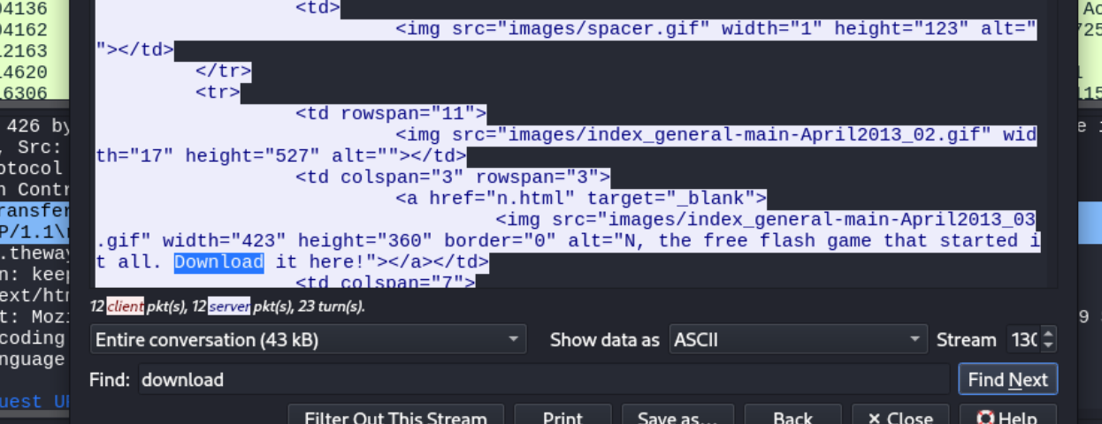
TASK 1 – Determine the Source of the Attack
Overview
The first task involved analyzing network traffic to identify how John interacted with various web pages, specifically focusing on his search for "byod" on Reddit.
Analysis of HTTP GET Requests
To filter the HTTP GET requests, the following command was applied:
http.request.method == "GET" && http.accept contains "text/html"
This command enabled the identification of the resources requested by John, allowing us to trace his interactions.
Findings
Webpages Accessed by John:
- Reddit
- 9gag
- Thewayoftheninja
Specific Search:
John searched for “byod” on Reddit.
Links Reviewed:
1. [GET /r/talesfromtechsupport/comments/2i46ss/satans_cpa_did_sign_the_byod_policy_from_hr/ HTTP/1.1]
2. [GET /r/sysadmin/comments/1ue8qd/for_all_you_powershell_fans_nice_blog_about_using/ HTTP/1.1]

Slide 16
TASK 2 – DNS Spoofing
Overview
The second task focused on analyzing DNS traffic to understand the relationship between DNS responses and potential spoofing.
DNS Packet Analysis
Using the modified filter:
(http.request.method == "GET" && http.accept contains "text/html") or (udp.port == 53 or dns)
The analysis showed three DNS packets with identical source and destination addresses.

Slide 17
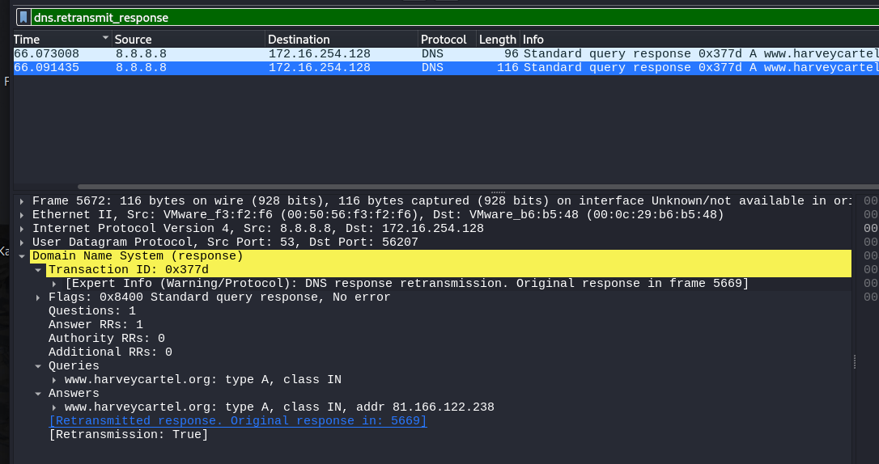
TASK 2 – DNS Spoofing
Findings
- The URL of one DNS response was `ninga-game.org`, associated with the IP `81.166.122.238`.
- A retransmission response indicated potential DNS spoofing, with original IP `207.150.212.43` and the spoofed IP `81.166.122.238`.
- Transaction ID: `0x377d`, demonstrating a race condition where the spoofed IP responded faster than the legitimate one.

Slide 18
TASK 3 – Analyze Network Traffic
Overview
This task involved identifying files that were potentially exfiltrated through HTTP POST requests.
User-Agent and File Exfiltration
Using NetworkMiner, we identified User-Agent strings and extracted files related to John's actions.
User-Agent:
Mozilla/5.0 (Macintosh; Intel Mac OS X 10_10_2) AppleWebKit/537.36 (KHTML, like Gecko) Chrome/40.0.2214.115 Safari/537.36

Slide 19
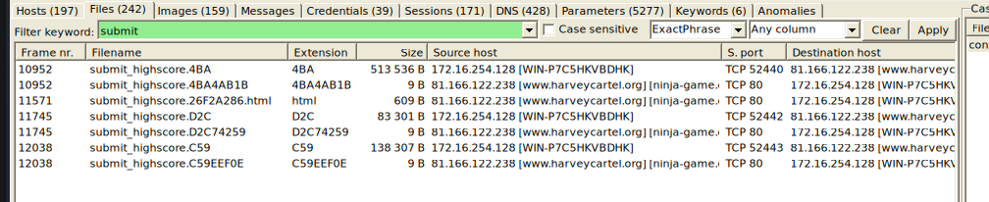
TASK 3 – Analyze Network Traffic
Extracted Files
1. `C:\Users\admin\Desktop\sensitive documents.doc`
2. `C:\Users\admin\Desktop\Tools\odbg201\help.pdf`
3. `C:\Users\admin\Documents\private\affair\holiday\EmiratesETicket1.pdf`
4. `C:\Users\admin\Documents\private\affair\holiday\EmiratesETicket2.pdf`
Failed Upload
The second upload of `help.pdf` failed due to HTTP Error 413 (Request Entity Too Large)

Slide 20
TASK 4 – Analyze Executable Download
Overview
The final task analyzed the executable files downloaded during the session.
File Extraction and Analysis
NetworkMiner facilitated the extraction of files from the downloaded executable, revealing both benign and malicious files.
Extracted Files
- `n_v14.exe` (the game)
- `main.exe` (the malware)
Using the command `strings main.exe`, we identified several Python-related strings indicating its original coding language.

Slide 21
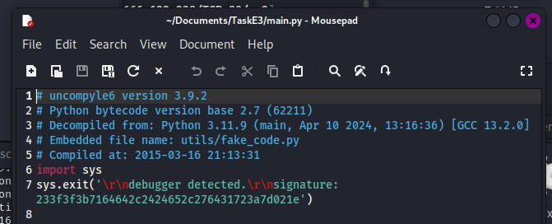
TASK 4 – Analyze Executable Download
Decompiling
The command `uncompyle6 -o /home/kali/Documents/TaskE3/ main.pyc` successfully decompiled the `main.pyc` file, revealing its functionality, which includes detecting execution under a debugger.
This script is meant to detect when the .pyc is being ran under a debugger and if detected, prints the message on line 7
This script is meant to detect when the .pyc is being ran under a debugger and if detected, prints the message on line 7

Slide 22
CHALLENGES
Real-time DNS Spoofing Detection
Interpreting Network Requests
Decompiling Python Bytecode
The process of decompiling and interpreting python bytecode presented difficulties due to obfuscation techniques employed by the malware, complicating the extraction of meaningful insights and requiring specialized tools for effective analysis.
Identifying DNS spoofing in real-time proved challenging due to the rapid changes in network traffic patterns, requiring advanced monitoring techniques to distinguish between legitimate and malicious requests effectively.
Understanding the intent behind various network requests was complex, as many appeared benign at first glance, necessitating a thorough analysis of context and correlation with other evidence to uncover malicious activities.

Slide 23
Attack Methodology Overview
The analysis revealed that the attack involved DNS spoofing and file exfiltration, highlighting the need for organizations to strengthen their defenses against such tactics in future cybersecurity strategies.
Malware Characteristics Identified
The decompiled Python bytecode exhibited anti-debugging techniques and obfuscation, indicating a sophisticated approach by the attacker, which necessitates ongoing education for analysts on emerging malware trends.
Recommendations for Future Prevention
Emphasizing the importance of comprehensive network traffic analysis and timely incident response, organizations should implement regular training and updates to forensic methodologies to adapt to evolving cyber threats.
CONCLUSION

Slide 24

REFERENCES
https://www.honeynet.org/challenges/forensic-challenge-14-weird-python/

