Slide 1

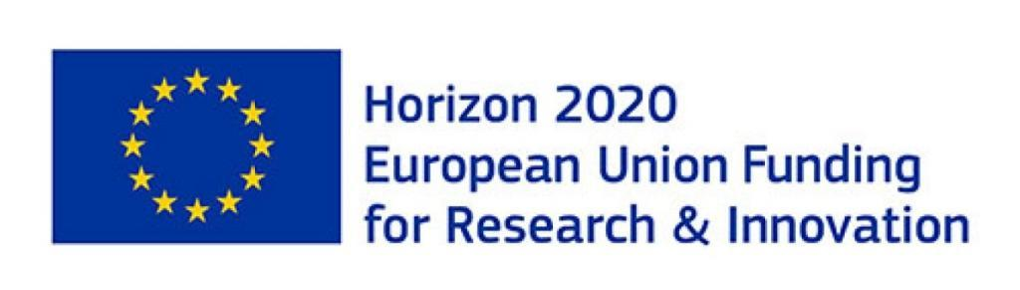

EAGRE/AEGIR: HIGH-SEAS WAVE-IMPACT MODELLING
ESR2 –“WaveTurbineImpact”: Water-Wave Impact on Dynamic and Flexible(Wind-Turbine) Structures
WAJIHA REHMAN

Slide 2
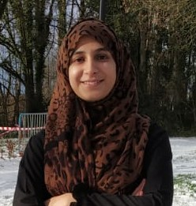
SELF INTRODUCTION
WAJIHA REHMAN
EDUCATION:
Master Marine Technology (EMSHIP+)
Ecole Centrale de Nantes, France
Thesis: Numerical Analysis of Composite Propeller for the Validation of Fluid-Structure Interaction Tool
Class of 2020
Master Mechanical Engineering focused on Advanced Ship Design (EMSHIP+)
University of Liege, Belgium
Project: Designing and Towing Tank Testing of the scaled model of a 24 m Cruise Yacht
Class of 2019
B.Sc. Mechanical Engineering
University of Engineering and Technology Lahore, Pakistan
Thesis: Designing and Analysis of Gravitational Vortex Turbine
Class of 2017

Slide 3
ESR2 –“WaveTurbineImpact”
Objectives:
To create a numerical wavetank to model the water-wave impact on a dynamic and flexible wind-turbine mast
The method used will be (dis)Galerkin Finite Element Method
Placement:
The first 18 months at the University of Leeds (The UK) under the supervision of Prof. Onno Bokhove
The second 18 months at MARIN (The Netherlands) under the supervision of Dr. Tim Bunnik

Slide 4
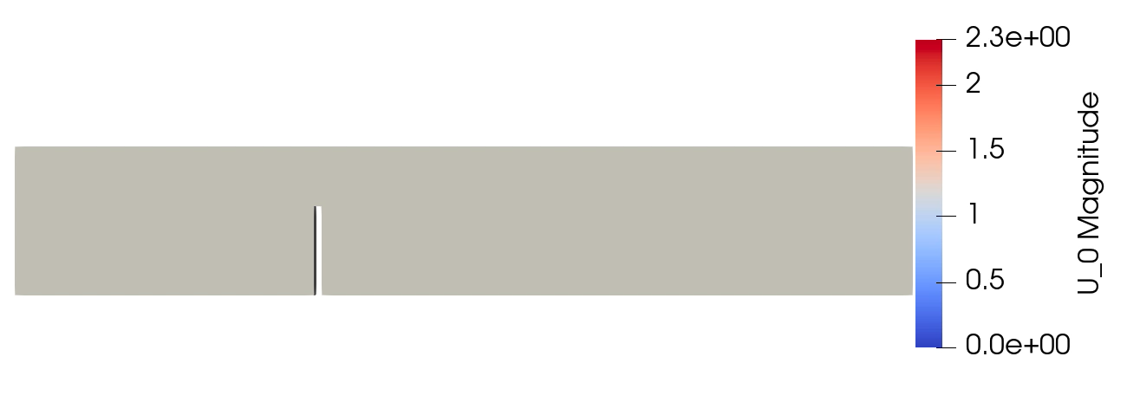
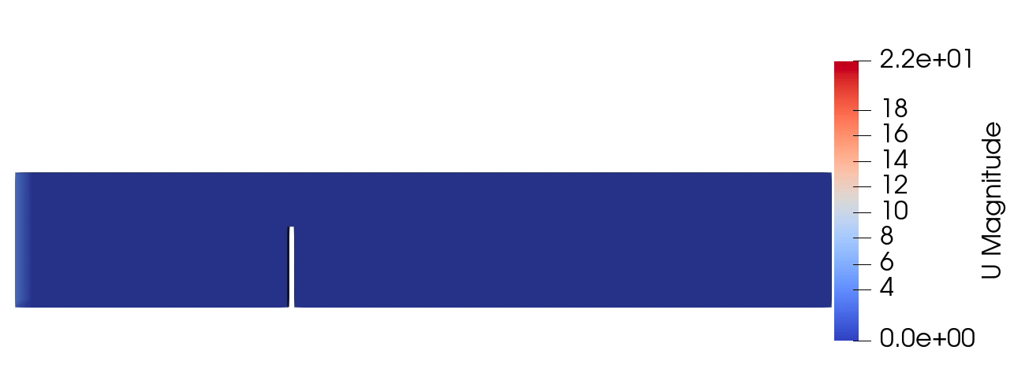
TRAINING COURSES
Foundations of Fluid Mechanics:
Theoretical part
Numerical part (FDM,FVM, FEM)
Fluid-Structure Interactions:
Used variational principle to derive hyper-elastic beam equations of motion
Lectures, seminars and projects related to FSI
Hands-on-experience on various in-house and commercial software
FSI analysis of hyper-elastic beam by using foam-extend

Slide 5
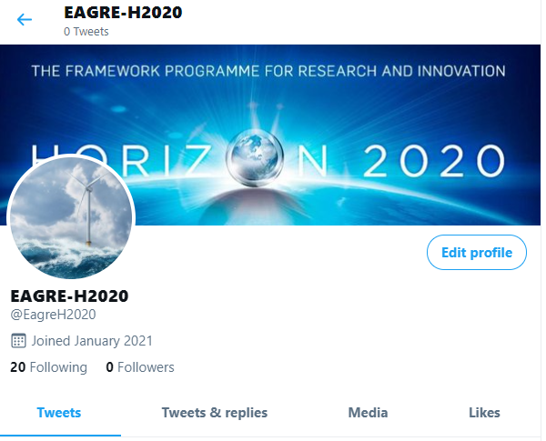

PUBLIC OUTREACH
Virtual outreach:
Social media platforms
Twitter
Weibo
Personal webpages
https://wajiharehman.bitrix24.site/
Physical outreach:
In2science UK mentorship
Headingley cafè Scientifique in Leeds
School of Mathematics Open days

Slide 6
CURRENT STATUS (WP2)
TARGETS
Complete the module Foundations of Fluid Mechanics (Theory and Numerical)
Public outreach plan
ACHIEVEMENTS
The module (Foundations of Fluid Mechanics) is completed (except N3)
A preliminary public outreach plan is ready
Complete the module Fluid-Structure Interactions
The module (Fluid-Structure Interactions) will be completed by the end of April, 2021

Slide 7
Thank you

