Slide 1


Computer Networking :
Principles, Protocols and Practice
Part 1 : Introduction
  Olivier Bonaventure
  http://inl.info.ucl.ac.be/
CNP3/2008.1.
© O. Bonaventure 2008
Notes:
These slides are licensed under the creative commons attribution share-alike license 3.0. You can obtain detailed information about this
license at http://creativecommons.org/licenses/by-sa/3.0/
The slides are part of an effort to develop an open-source networking textbook. See http://inl.info.ucl.ac.be/CNP3 for the current version of the textbook and more information on how to contribute.

Slide 2
Module 1 : Basics
Contents
  Introduction
  Services in computer networks
    Connectionless service
    Connection oriented service
  Layered reference models
CNP3/2008.1.
© O. Bonaventure 2008

Slide 3
A network ...
A network is ...
  a set of hardware and software that allows to transmit information from one sender to one or more receivers
Current networks
  Plain Old Telephone System (POTS)
  Mobile Telephone
  Broadcast networks
    television, radio
  Computer networks
    Internet
    Proprietary networks
CNP3/2008.1.
© O. Bonaventure 2008

Slide 4
Network classification
Based on their geographical coverage
  0.1-1 m : Internal bus/network
  10 m - 1 km : Local Area Network (LAN)
  1 km - 100 km : Metropolitan Area Network(MAN)
  100 km ->... : Wide Area Network (WAN)
  and more ... : Satellite networks
  Interplanetary network
CNP3/2008.1.
© O. Bonaventure 2008

Slide 5
Network classification (2)
Based on their topologies
Bus
Tree
Star
Full-mesh
Ring
CNP3/2008.1.
© O. Bonaventure 2008

Slide 6
Internet growth
CNP3/2008.1.
© O. Bonaventure 2008
Notes:
Source : http://www.isc.org
See also http://hdr.undp.org/ for information about how Internet is spread across countries

Slide 7
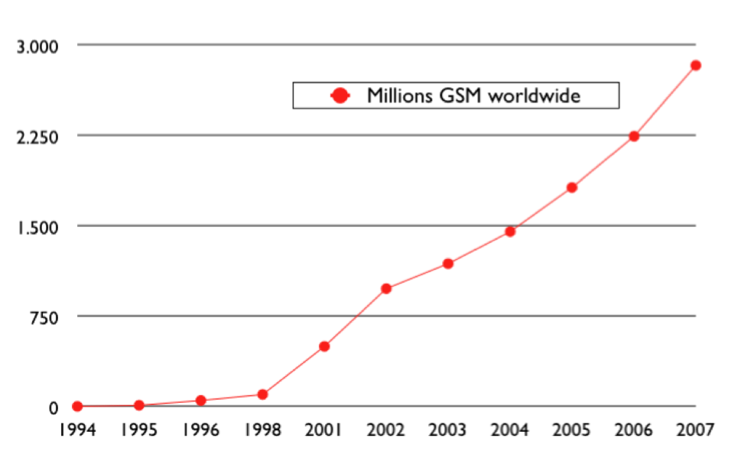
Mobile GSM telephone networks
CNP3/2008.1.
© O. Bonaventure 2008
Notes:
Source : http://www.gsmworld.com/news/statistics/index.shtml and http://www.gsmworld.com/about/history.shtml
The number of fixed telephone lines reached 1 billion worldwide in 2000 and the growth of fixed lines has been
rather slow since then to reach 1.2 billions in 2005. See http://www.itu.int/ITU-D/ict/mdg/storyline/index.html

Slide 8
Evolution of networks
Plain Old Telephone
TV and radio
broadcast
Mobile
Networks
Computer
Networks
CNP3/2008.1.
© O. Bonaventure 2008

Slide 9
The future
Most specialists expect
  A strong convergence between all technologies
    Triple play
    Quadruple play
New services will probably be deployed first (and perhaps exclusively) on data networks
  Television service provided by telecom operators
  Mobile data services
  Mobile television services
  Voice or video over IP
  New services
CNP3/2008.1.
© O. Bonaventure 2008

Slide 10

Transmission modes
Unicast
Unicast or point-to-point
  one sender
  one receiver
    example : telephone
E
A
S
B
C
D
CNP3/2008.1.
© O. Bonaventure 2008
Notes:
The unicast mode is the most widely used transmission mode. We will study it in details.

Slide 11
Transmission modes
Multicast
Multicast or point-to-multipoints
  one sender
  a group of receivers
  The same information is sent to
  all members of the group
    example : videoconference
  Broadcast
  The same information is sent to everyone
E
A
S
B
C
D
CNP3/2008.1.
© O. Bonaventure 2008
Notes:
The multicast transmission mode is described later.

Slide 12
Anycast
Anycast
  Information is sent from one sender to one receiver among a group of possible receivers
    Example :find server hosting popular content
*
A
S
B
*
*
CNP3/2008.1.
© O. Bonaventure 2008
Notes:
The anycast transmission mode was proposed in
C. Partridge, T. Mendez, W. Milliken, Host Anycasting Service, RFC 1546, 1993

Slide 13
How to carry data through a network ?
Circuit switching
  Principle
    before transmitting data, a circuit is established from the source to the destination hosts
    each intermediate host knows how to forward information received on a circuit that crosses itself
  Example : POTS
D1
S1
A
B
S2
D2
color link send to
Red NW NE
Blue SW SE
Rcvd from sent to
NW SE
SW NE
CNP3/2008.1.
© O. Bonaventure 2008

Slide 14
How to carry data through a network ? (2)
Packet switching
  Principles
    An address is associated to each host
    data is divided in small packets
      each packet contains
        the data to be exchange
        the address of the source host
        the address of the destination host
    Each intermediate host knows how to reach each destination
    Example : post, Internet
S1 D1
D2
S1
A
B
S2
D1
Dest address Link
D1 SE
D2 SE
Dest address Link
D1 SE
D2 NE
CNP3/2008.1.
© O. Bonaventure 2008

Slide 15
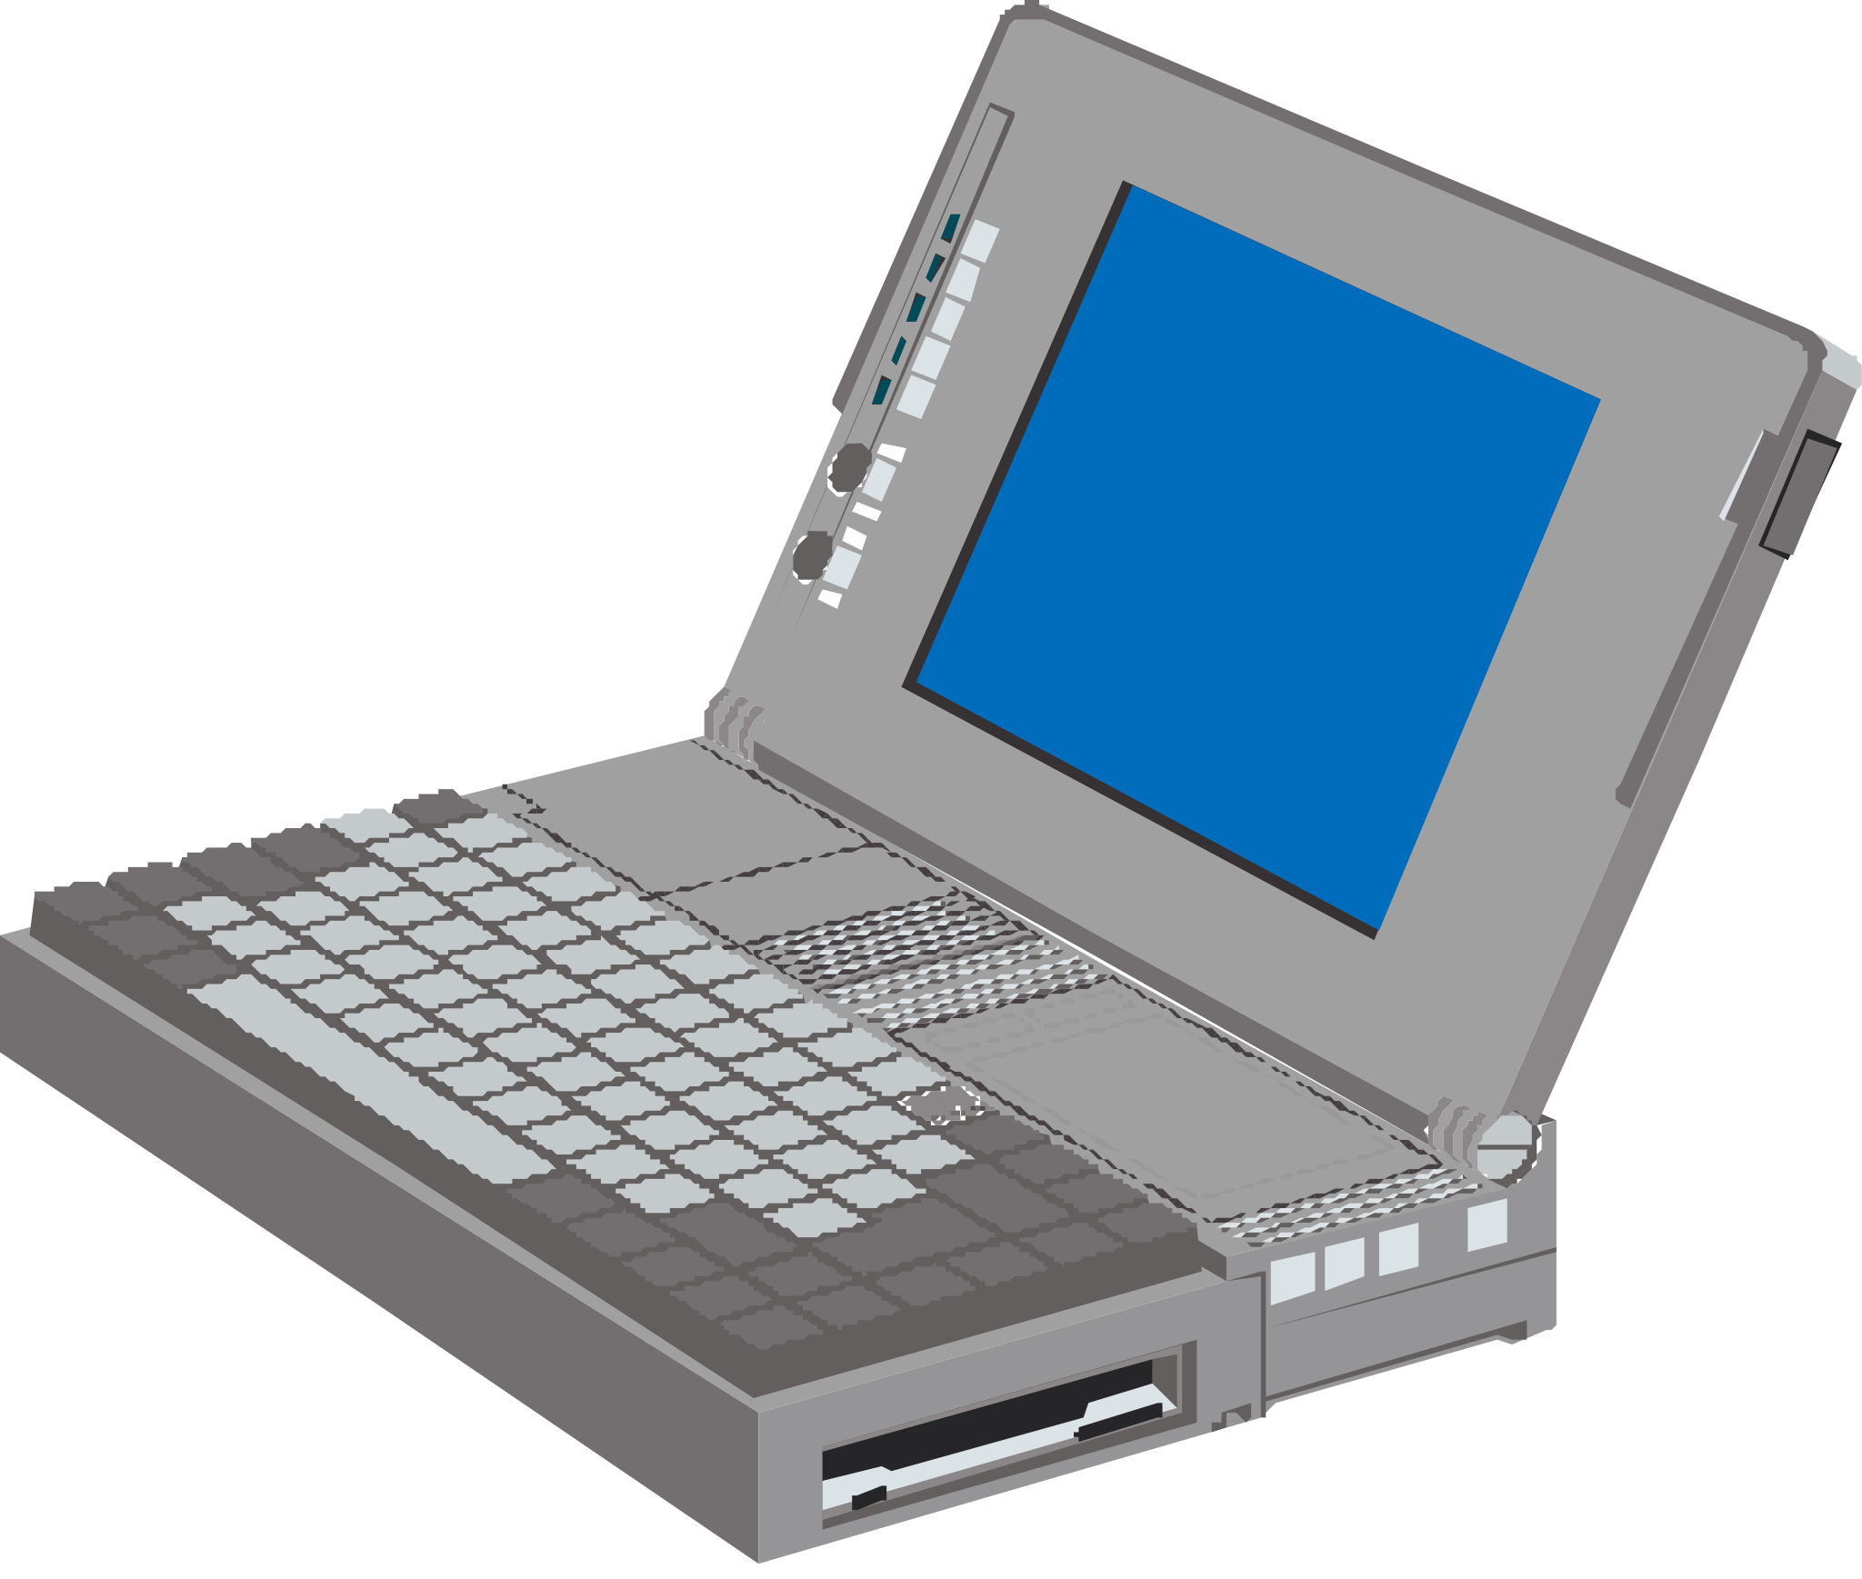
A small Internet
S
R
ISP3
R
beta.be
alpha.com
R
R
R
ISP4
R
R
R
ISP2
R
R
R
S
R
Societe.fr
PSTN
R
ISP1
R
ADSL
CNP3/2008.1.
© O. Bonaventure 2008

Slide 16
Module 1 : Basics
Contents
  Introduction
  Services in computer networks
    Connectionless service
    Connection oriented service
  Layered reference models
CNP3/2008.1.
© O. Bonaventure 2008

Slide 17
Basic concepts
Abstract model of the network behaviour
  Network is considered as a black box
  Users interact with the network by using primitives that are exchanged through a service access point (SAP)
User A
User B
Service Access Point
Primitives
Service provider (‘the network”)
CNP3/2008.1.
© O. Bonaventure 2008

Slide 18
Types of primitives
Service provider (“network”)
Primitive
  Abstract representation of the interaction between one user and its network provider
  Can contain parameters such as :
    source
    destination
    message (SDU or Service Data Unit)
CNP3/2008.1.
© O. Bonaventure 2008

Slide 19
Types of primitives (2)
User A
User B
X.request
X.confirm
X.response
X.indication
Service provider (the network)
    X.request
      request from a user to a service provider
    X.indication
      primitive generated by the network provider to a user (often related to an earlier and remote X.request primitive)
    X.response
      primitive used to answer to an earlier X.indication primitive
    X.confirm
      primitive generated by the network provider to a user (related to a remote X.response primitive)
CNP3/2008.1.
© O. Bonaventure 2008

Slide 20
The connectionless service
Goal
  Allow a sender to quickly send a message to one receiver
Principle
  The sender places the message to be transmitted in a DATA.req primitive and gives it to the network provider
  The network provider carries the message and delivers it to the receiver by using a DATA.ind primitive
Utilisation
  useful to send short-length messages
  example : post office
CNP3/2008.1.
© O. Bonaventure 2008

Slide 21
Connectionless service
Primitives
  DATA.request(source, destination, SDU)
  DATA.indication(source, destination, SDU)
Source
Provider
Destination
DATA.request(S,D,"M")
DATA.indication(S,D,"M")
Time
CNP3/2008.1.
© O. Bonaventure 2008

Slide 22
Connectionless service (2)
Variants of connectionless service
  confirmation
    primitive DATA.confirm delivered by provider to sender to confirm that some message has been delivered to destination
  reliability
    reliable connectionless service (no errors)
    unreliable connectionless service (errors are possible)
  protection against transmission errors
    service may or may not detect/correct errors
  protection against losses
    the service may or cannot lose messages
  in sequence delivery
    not guaranteed
    in-sequence delivery for all messages sent by one source
CNP3/2008.1.
© O. Bonaventure 2008

Slide 23
Connectionless service (3)
Example of acknowledged service
Source
Provider
Destination
DATA.request(S,D,"M")
DATA.indication(S,D,"M")
DATA.confirm
Time
CNP3/2008.1.
© O. Bonaventure 2008

Slide 24
Connection-oriented service
Goal
  Create a logical binding (connection) between two users to allow them to efficiently exchange messages
Main phases of service
  Connection establishment
  Data transfer
    both users can send and receive messages over connection
  Connection release
Utilisation
  useful when the two users either
    must exchange a large number of messages
    need a structured exchange
    example : telephone
CNP3/2008.1.
© O. Bonaventure 2008

Slide 25
Connection oriented service
Connection establishment
    Primitives
      CONNECT.request
      CONNECT.indication
      CONNECT.response
      CONNECT.confirm
Source
Network provider
Destination
CONNECT.request
CONNECT.indication
CONNECT.response
Destination considers
connection open
CONNECT.confirm
Source considers
connection open
CNP3/2008.1.
© O. Bonaventure 2008

Slide 26
Connection oriented service (2)
Connection can be rejected
Source
Provider
Destination
CONNECT.request
CONNECT.indication
DISCONNECT.request
Connection rejected by destination
DISCONNECT.indication
CONNECT.request
DISCONNECT.indication
Connection rejected
by provider
CNP3/2008.1.
© O. Bonaventure 2008

Slide 27
Data transfer : message mode
Source
Provider
Destination
CONNECT.request
CONNECT.indication
CONNECT.response
CONNECT.confirm
DATA.request("A")
DATA.ind("A")
DATA.request("BCD")
DATA.ind("BCD")
DATA.request("EF")
DATA.ind("EF")
Provider delivers one Data.ind for each Data.req
CNP3/2008.1.
© O. Bonaventure 2008

Slide 28
Data transfer : stream mode
The providers delivers a stream of characters from source to destination
Source
Provider
Destination
CONNECT.request
CONNECT.indication
CONNECT.response
CONNECT.confirm
DATA.request("AB")
DATA.ind("A")
DATA.request("CD")
DATA.ind("B")
DATA.request("EF")
DATA.ind("C")
DATA.ind("DEF")
CNP3/2008.1.
© O. Bonaventure 2008

Slide 29
Connection release
Abrupt release
  SDUs can be lost during connection release
  Such an abrupt connection release can be caused by the network provider or by the users
Source
Provider
Destination
Connection opened
Connection opened
DATA.request("A")
DATA.request("B")
DISCONNECT.req(abrupt)
DATA.indication("A")
DATA.request("C")
DISCONNECT.indication
CNP3/2008.1.
© O. Bonaventure 2008

Slide 30
Connection release (2)
Ordered/graceful connection release
  A single direction is closed at a time
  no SDUs can be lost
Source
Provider
Destination
Connection opened
Connection opened
DATA.request("A")
DATA.request("B")
DATA.request("C")
DISCONNECT.req(graceful)
DATA.indication("A")
Source->Destination
connection closed
DATA.indication("B")
DISCONNECT.ind(graceful)
DATA.indication("C")
DATA.request("D")
DATA.indication("D")
DISCONNECT.req(graceful)
DISCONNECT.ind(graceful)
Connection closed
Connection closed
CNP3/2008.1.
© O. Bonaventure 2008

Slide 31
Characteristics of the connection-oriented service
Possible characteristics
  bidirectional transmission
    both users can send and received SDUs
  reliable delivery
    All SDUs are delivered in sequence
    No SDU can be lost
    No SDU can be corrupted
  message mode or stream mode
  Connection release
    Usually abrupt when the provider is forced to release a connection
    Abrupt or graceful when the users request the end of a connection
CNP3/2008.1.
© O. Bonaventure 2008

Slide 32
Module 1 : Basics
Contents
  Introduction
  Services in computer networks
    Connectionless service
    Connection oriented service
  Layered reference models
CNP3/2008.1.
© O. Bonaventure 2008

Slide 33
Layered reference models
Problem
  How is it possible to reason about complex systems such as computer networks or the Internet ?
Solution
  Divide the network in layers
  Layer N provides a well defined service to
  layer N+1 by using the service provided by layer N-1
Layer N+1
Layer N
Layer N-1
CNP3/2008.1.
© O. Bonaventure 2008

Slide 34
Layered reference model
Application
Transport
Network
Datalink
Physical
Physical transmission medium
CNP3/2008.1.
© O. Bonaventure 2008
Notes:
For more information about the design philosophy of the Internet Protocols, see:
D. Clark, The Design Philosophy of the DARPA Internet Protocols, Proceedings of ACM SIGCOMM 1988, August 1998, http://www.acm.org/sigcomm/ccr/archive/995/jan95/ccr-9501-clark.html
A widely known reference model is the OSI reference model :
H. Zimmerman. Osi reference model - the iso model of architecture for open systems interconnection. IEEE Transactions on Communications, 28(4):425--432, April 1980.
In this reference model, the upper layer is divided in three layers
- application layer
- session layer
- présentation layer

Slide 35
The physical layer
Bits
Physical layer
010100010100010101001010
Physical layer
Physical transmission medium
  Goal
    Transmit bits between two physically connected devices
  Service provided by physical layer
    bit transmission and reception
    unreliable service
      The receiver may decode a 1 while the sender sent 0
      Some transmitted bits may be lost
      The receiver may decode more bits than the bits that were sent by the sender
CNP3/2008.1.
© O. Bonaventure 2008

Slide 36
Physical layer : an example
A very simple physical layer operating at one megabit per second
  One bit is transmitted by sender every microsecond
  One bit is receiver by receiver every microsecond
  Sender operation
    To transmit bit=1, set V=5 Volts during one microsecond
    To transmit bit=0, set V=-5 Volts during one microsecond
  Receiver operation
    During each microsecond, measure V
      If V=5 Volts, a 1 has been decoded
      If V=-5 Volts, a 0 has been decode
  Possible problems
    electromagnetic perturbations
    clock drift (sender faster than receiver or opposite)
CNP3/2008.1.
© O. Bonaventure 2008

Slide 37
Transmission mediums
Tapes, CDROMs and DVD
Twisted pair
  Telephone networks, ADSL, VDSL, ...
    bandwidth : from a few megabits to a few 10 Mbps depending on the distance between endpoints
  Enterprise networks
    UTP (category 3, category 5)
    STP (rarely used today)
    bandwidth :up to 1 Gigabit today
      new types of cables are being developed to reach 10 Gbps
Wireless
  radio
  optical
CNP3/2008.1.
© O. Bonaventure 2008

Slide 38
Transmission mediums (2)
Coaxial cable
  Cable TV networks (CATV)
    about 1Ghz frequency range
    available bandwidth : depends on the split among tv distribution and data transmission
  Computer networks
    Used a few years ago, but not anymore today
Optical fiber
  monomode (laser, long distance)
  multimode (LED, short distance)
    frequency range : up to 100.000 Ghz
    available bandwidth
      10 Gbps per wavelength and more
      hundreds of wavelength per fiber
CNP3/2008.1.
© O. Bonaventure 2008

Slide 39
The datalink layer
Datalink
Frames
Datalink
Physical
Physical
Goals
  Provide a service that allows the exchange of frames
    Frame : structured group of bits
  Support local area networks
Services
  Reliable connection-oriented service
  Unreliable connectionless service
CNP3/2008.1.
© O. Bonaventure 2008

Slide 40
The Network Layer
Network
Packets
Network
Packets
Network
Datalink
Datalink
Datalink
Physical layer
Physical layer
Physical layer
Goals
  Allow information to be exchanged between hosts that are not attached to the same physical medium by using relays
  The unit of information in the network layer is called a packet
  Services
    unreliable connectionless (Internet)
    reliable connection-oriented
CNP3/2008.1.
© O. Bonaventure 2008

Slide 41
The Transport Layer
Transport
Segments
Transport
Network
Network
Network
Datalink
Datalink
Datalink
Physical layer
Physical layer
Physical layer
Goals
  Ensure a reliable exchange of data between endsystems even if the network layer does not provide a reliable service
Services
  Unreliable connectionless service
  Reliable connection-oriented service
CNP3/2008.1.
© O. Bonaventure 2008

Slide 42
The application layer
Application
SDU
Application
Transport
Transport
Network
Network
Network
Datalink
Datalink
Datalink
Physical layer
Physical layer
Physical layer
Goals
  Exchange useful information between applications by relying on the transport layer that hides the complexity of the network
  Unit of information
    Service Data Unit, SDU
CNP3/2008.1.
© O. Bonaventure 2008

Slide 43
The OSI reference model
Application
SDU
Application
Presentation
Presentation
Session
Session
Transport
Transport
Network
Network
Network
Datalink
Datalink
Datalink
Physical layer
Physical layer
Physical layer
  Higher layers
    Application
    Presentation
      Provides services to hide application from complexities of data/image/audio/video encoding
    Session
      Organise the exchange of information between applications
      Recover from failures of transport layer
CNP3/2008.1.
© O. Bonaventure 2008
Notes:
A detailed description of the OSI reference model may be found in :
D. Piscitello, L. Chapin, Open Systems Networking : TCP/IP and OSI, Addison Wesley,1993

Slide 44
Course schedule
  First week : application layer
Weeks 2-3 : transport layer (key mechanisms)
Weeks 4-5 : transport layer in Internet (TCP,UDP)
Weeks 6,7,8 : network layer (IP, RIP, OSPF)
Weeks 9,10 : interdomain routing (BGP)
Weeks 11,12 : Datalink layer (Ethernet, 802.11)
Application
Application
Transport
Transport
Network
Network
Network
Datalink
Datalink
Datalink
Physical layer
Physical layer
Physical layer
CNP3/2008.1.
© O. Bonaventure 2008

Slide 45
Exams and grading
Exercises
  A set of questions or a small implementation in groups of 7/8 students every week
    answers on svn repository by Tuesday at 13.00
    discussions in small groups Tuesday at 16.15 or 17.15
    Participation and answers are graded as
      A : better than average answer/participation
      B : average answer/participation
      C : not enough answer/participation
      D : did not answer the questions/write the implementation
      Total : 25% of finale grade
Oral exam
  Theory
    Several oral questions about theory
    50% of final grade
  Exercises
    Several written questions similar to the exercises
    25% of final grade
CNP3/2008.1.
© O. Bonaventure 2008

