Slide 1
Part 10 Congestion control
O. Bonaventure, 2016-2022

Slide 2
Agenda
Congestion Control
Principles
Additive Increase/Multiplicative Decrease
Explicit Congestion Notification
Modern TCP Congestion control
Router behavior

Slide 3
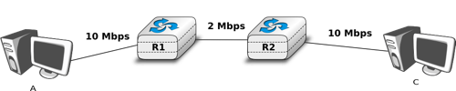

Adapting to different bandwidth
What is the round-trip-time in milliseconds in this network if A sends 10,000 bits segments, all links are 1 m long and B returns 100 bits acks ?
If A sends four 10,000 bits segments in a row, after how many msec will it receive the last ack ?

Slide 4
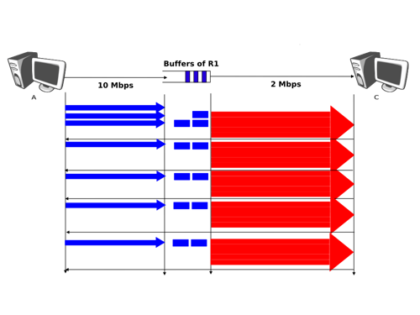
Self-clocking

Slide 5
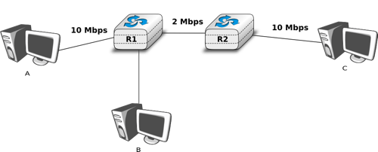


The congestion problem
If R1 has a buffer of five 10,000 bits long packets, how many packets will be dropped if A and B send a burst of ten packets at line rate ?

Slide 6
Fairness
How should bandwidth be distributed among different flows ?
On a single link
Fair share
In a large network
Max-min fairness

Slide 7
Max-min fairness
a max-min allocation of bandwidth is an allocation of bandwidth which maximises the allocation of bandwidth to the sources receiving the smallest allocation
a max-min fair allocation is such that in order to increase the bandwidth allocated to one source, it is necessary to decrease the bandwidth allocated to another source which already receives a lower allocation

Slide 8
Max-min fairness
a max-min allocation maximises the allocation of bandwidth to the sources receiving the smallest allocation
Property
to increase the bandwidth allocated to one source, it is necessary to decrease the bandwidth allocated to another source which already receives a lower allocation

Slide 9
Example
D1 D3 D4
D2
D5
D6
D7
D8
S1
Link2
Link4
R
R
R
S2
Link1
Link3
1000 Mbps
100 Mbps
R
R
S3
S4
S5 S6 S7 S8
Max-min fair bandwidth allocation
S3-D3 ?
S2-D2 ?
S1-D1 ?
Notes:
How to determine a max-min fair bandwidth allocation for a given network ?
Algorithm [Bertsekas & Gallager, Data Networks, 2nd edition, Prentice Hall 1992]
First start with an allocation of 0 Mbps for each source
Then equally increment the allocation to each source until one link becomes saturated. At this point, each source which uses the saturated link receives an allocation equal to the bandwidth of this saturated link divided by the number of sources using this bottleneck link.
Next, the allocation of all the sources which do not use a saturated link is equally incremented until another link becomes saturated.
The algorithm continues from step to step, always incrementing the allocation of the sources which do not use a saturated link, until all sources use at least one of the saturated links.

Slide 10
How to achieve max-min fairness ?
Two possible approaches
Modify the routers to reach max-min fairness
Modify the endhosts to reach max-min fairness

Slide 11
How to detect congestion ?
Packet losses
Increased delay
Routers add information to packets
Forward binary feedback
Backward binary feedback
Rate feedback

Slide 12
Agenda
Congestion Control
Principles
Additive Increase/Multiplicative Decrease
Explicit Congestion Notification
Modern TCP Congestion control
Router behavior

Slide 13
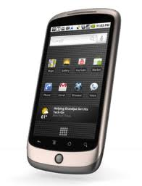

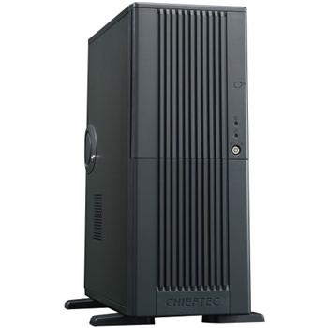
The congestion problem
Bottleneck link
N Mbps
How to efficiently share the bandwidth ?

Slide 14

Delay versus bandwidth
observed
rtt
buffer almost overloaded
huge packet losses
min rtt
$∑$Bwi

Slide 15
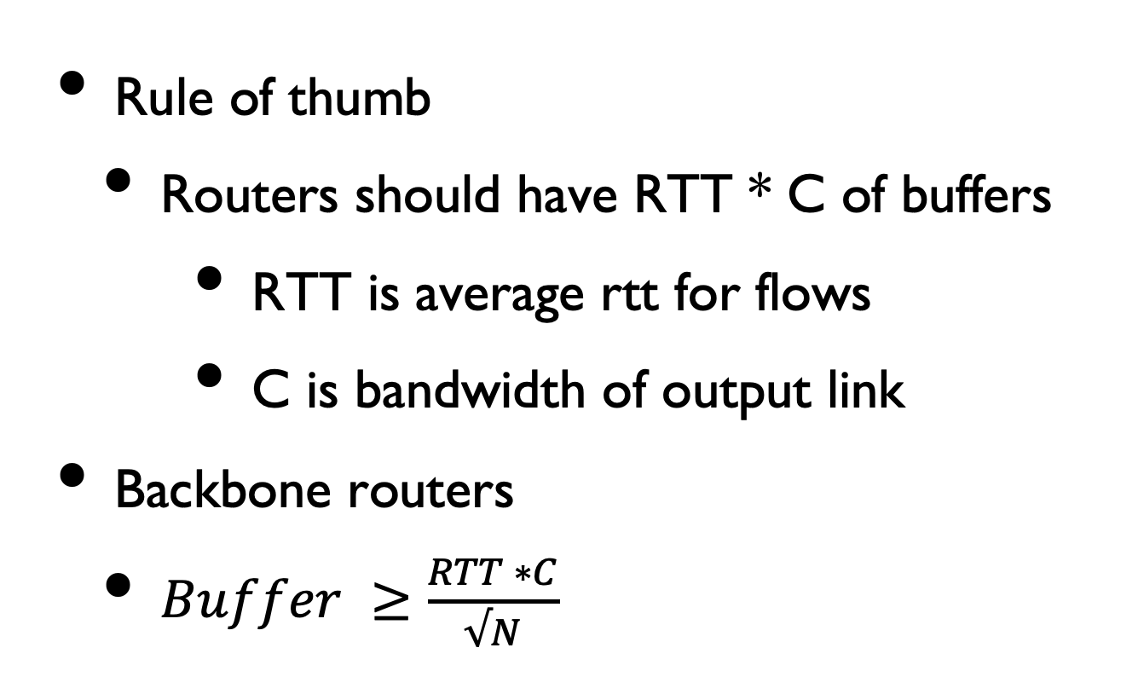
Router buffers
Rule of thumb
Routers should have RTT * C of buffers
RTT is average rtt for flows
C is bandwidth of output link
Backbone routers
$Buffer ≥\frac{RTT ∗C}{√N}$
N. McKeown, G. Appenzeller, I. Keslassy, Sizing Router Buffers (Redux), SIGCOMM CCR October 2019

Slide 16
Congestion signals
Main types of congestion signals
Packet loss
most popular signal
Explicit Congestion Notification
requires router cooperation
Increase in measured round-trip-time
can be fragile

Slide 17
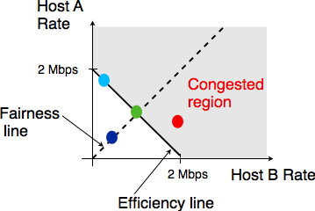
Congestion control

Slide 18
Congestion control
Additive Increase / Multiplicative Decrease
# Additive Increase Multiplicative Decrease
if congestion :
rate=rate*betaC # MD, betaC<1
else
rate=rate+alphaN # AI

Slide 19
Additive Increase
No congestion ?
All acks move window
Additive increase
Increment cwnd by one MSS every rtt
Cwnd
Time

Slide 20
Faster increase
How to speed up the growth of the congestion window at connection startup ?
Slow-start
Double cwnd every rtt
Cwnd
Max window
Time
Slow-start
exponential increase of cwnd

Slide 21
Multiplicative decrease
How to detect congestion ?
Three duplicate acks
mild congestion for TCP
cwnd/2 and restart additive increase
Expiration of retransmission timer
severe congestion
Reset cwnd at 1 MSS
Perform slow-start until half previous cwnd and then continue with congestion avoidance

Slide 22
TCP with mild congestion
Mild congestion
Cwnd
Fast retransmit
Fast retransmit
Threshold
Threshold
Slow-start
exponential increase of cwnd
Congestion avoidance
linear increase of cwnd

Slide 23
Severe congestion
Cwnd
Timer expiration
Timer expiration
Threshold
Threshold
Time
Slow-start
exponential increase of cwnd
Congestion avoidance
linear increase of cwnd

Slide 24
TCP with mild congestion
Cwnd
Fast retransmit
Fast retransmit
Threshold
Threshold
Slow-start
exponential increase of cwnd
Congestion avoidance
linear increase of cwnd

Slide 25
Severe congestion
Cwnd
Timer expiration
Timer expiration
Threshold
Threshold
Time
Slow-start
exponential increase of cwnd
Congestion avoidance
linear increase of cwnd

Slide 26
How to implement AIMD ?
Initialisation :
cwnd = MSS;
ssthresh= swin;
Ack reception :
if (network not congested ) // no segment losses
{
if (cwnd < ssthresh)
{ // increase quickly cwnd
// double cwnd every rtt
cwnd = cwnd+ MSS;
}
else
{ // increase slowly cwnd
// increase cwnd by one mss every rtt
cwnd = cwnd+ mss*(mss/cwnd);
}
}
Slowstart
Congestion avoidance

Slide 27
AIMD in TCP
# Initialisation
cwnd = MSS ssthresh= swin dupacks=0
# Ack arrival (assumes no delayed acks)
if tcp.ack > snd.una : # new ack, no congestion
if dupacks==0: # not currently recovering from loss
if cwnd < ssthresh :
# slow-start : increase quickly cwnd
# double cwnd every rtt
cwnd = cwnd + MSS
else:
# congestion avoidance : increase slowly cwnd
# increase cwnd by one mss every rtt
cwnd = cwnd+ mss*(mss/cwnd)
else: # recovering from loss
cwnd=ssthresh # deflate cwnd rfc5681
dupacks=0

Slide 28
Slow-start
cwnd=1000
ssthresh=64000
0-999
cwnd ?
ACK(1000)
cwnd=2000
ssthresh=64000
1000-1999
2000-2999
cwnd=3000
ssthresh=64000
ACK(2000)
ACK(3000)
cwnd=4000
ssthresh=64000
3000-3999
4000-4999
5000-5999
6000-6999
ACK(4000)
ACK(7000)

Slide 29
Congestion avoidance
cwnd=2000
ssthresh=4000
1000-1999
2000-2999
cwnd=3000
ssthresh=4000
ACK(2000)
ACK(3000)
3000-3999
cwnd=4000
ssthresh=4000
4000-4999
5000-5999
cwnd ?
6000-6999
ACK(4000)
cwnd=4000+(1000*1000/4000)=4250
ACK(7000)
cwnd=4250+(1000*1000/4250)=4485
cwnd=4485+(1000*1000/4485)=4707
cwnd=4707+(1000*1000/4707)=4919

Slide 30
AIMD in TCP
else: # duplicate or old ack
if tcp.ack==snd.una: # duplicate acknowledgment
dupacks++
if dupacks==1 or dupacks==2:
send_next_unacked_segment # rfc3042
if dupacks==3:
retransmitsegment(snd.una)
ssthresh=max(cwnd/2,2*MSS)
cwnd=ssthresh
if dupacks>3: # rfc5681
cwnd=cwnd+MSS # inflate cwnd
else: # ack for old segment, ignored
Expiration of the retransmission timer:
send(snd.una) # retransmit first lost segment
sshtresh=max(cwnd/2,2*MSS)
cwnd=MSS

Slide 31
Examples
Time to transmit 6 TCP segments without losses
Time to transmit 6 TCP segments if 3rd is lost
Time to transmit 10 TCP segments if 5th is lost

Slide 32
TCP and losses
write(5000 bytes)
cwnd=1000
0-999
ACK(1000)
cwnd=2000
1000-1999
2000-2999
cwnd=3000
ACK(2000)
3000-3999
4000-4999
cwnd=3000
dupack=1
ACK(2000)
ACK(2000)
cwnd=3000
dupack=2

Slide 33
TCP and losses
cwnd=3000
dupack=2
RTO expires
cwnd=1000
dupack=0
ssthresh=2000
2000-2999
ACK(5000)
cwnd=2000
dupack=0

Slide 34
TCP and losses
write(10000 bytes)
cwnd=1000
ssthresh=64000
0-999
ACK(1000)
cwnd=2000
ssthresh=64000
1000-1999
2000-2999
cwnd=3000
ssthresh=64000
ACK(2000)
ACK(3000)
cwnd=4000
ssthresh=64000
3000-3999
4000-4999
5000-5999
6000-6999

Slide 35
TCP and losses
cwnd=4000
ACK(3000)
dupack=1
ACK(3000)
dupack=2
ACK(3000)
7000-7999
dupack=3
8000-8999
cwnd=2000
dupack=0
ssthresh=2000
3000-3999
ACK(9000)
9000-9999
ACK(10000)

Slide 36
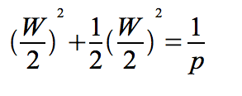

Simplified model
Assume all segment losses are periodic and that every 1/p segment is lost
Cwnd(segments)
W
W/2
0
Surface
0 W/2 W 3W/2 2W time(rtt)
It can be shown that the throughput of a TCP
connection can be approximated by :
Maximum throughput without losses
Throughput with losses/congestion
Notes:
More detailed models can be found in the scientific literature :
M. Mathis,J. Semke, J. Mahdavi and T. Ott, The macroscopic behaviour of the TCP congestion avoidance algorithm, ACM Computer Communication Review, 1997

Slide 37
Agenda
Congestion Control
Principles
Additive Increase/Multiplicative Decrease
Explicit Congestion Notification
Modern TCP Congestion control
Router behavior

Slide 38
Limitations of packet drops
Router drops packets when it is congested
The packets that are dropped by the congested router have already consummed resources upstream
How can we control congestion without dropping packets to inform the senders of the current level of congestion ?

Slide 39

Basic ECN
Congestion Notification
Mark the IP packet that caused congestion by setting one bit flag (CE: Congestion Experienced)
A
D
R1
R2
TCP source behaviour
Upon reception of a ECN-Echo=1 TCP ack,
behave as if the corresponding segment was lost (perform congestion avoidance).
TCP destination behaviour
Upon reception of a CE=1 IP packet indicate the congestion to the source by setting a special
flag (ECN-Echo) in the returning TCP ack
Issues
What happens if the returning ECN-echo is lost ?
How can we deploy ECN?

Slide 40
Dealing with lost acks

Slide 41
Deploying ECN
On endhosts
Update the TCP stack to support ECN
Negotiate ECN usage in SYN
Encode ECN info in packets/segments
For other transport protocols…

Slide 42
Deploying ECN
On routers
Routers need to distinguish between
ECN-capable hosts that react to ECN
If congestion, such packets are marked
Other hosts that do not react to ECN
If congestion, such packets are dropped

Slide 43
ECN support on routers
ECN-capable source
If destination is also ECN capable
Set ECT bit in all IP packets towards destination
Otherwise
Reset ECT bit
In case of congestion
If ECT bit is set
Mark the IP packet that caused congestion by setting on bit flag (CE: Congestion Experienced)
If ECT bit is not set
Discard the IP packet that caused congestion
A
D
R1
R2
Specialised buffer acceptance algorithms

Slide 44
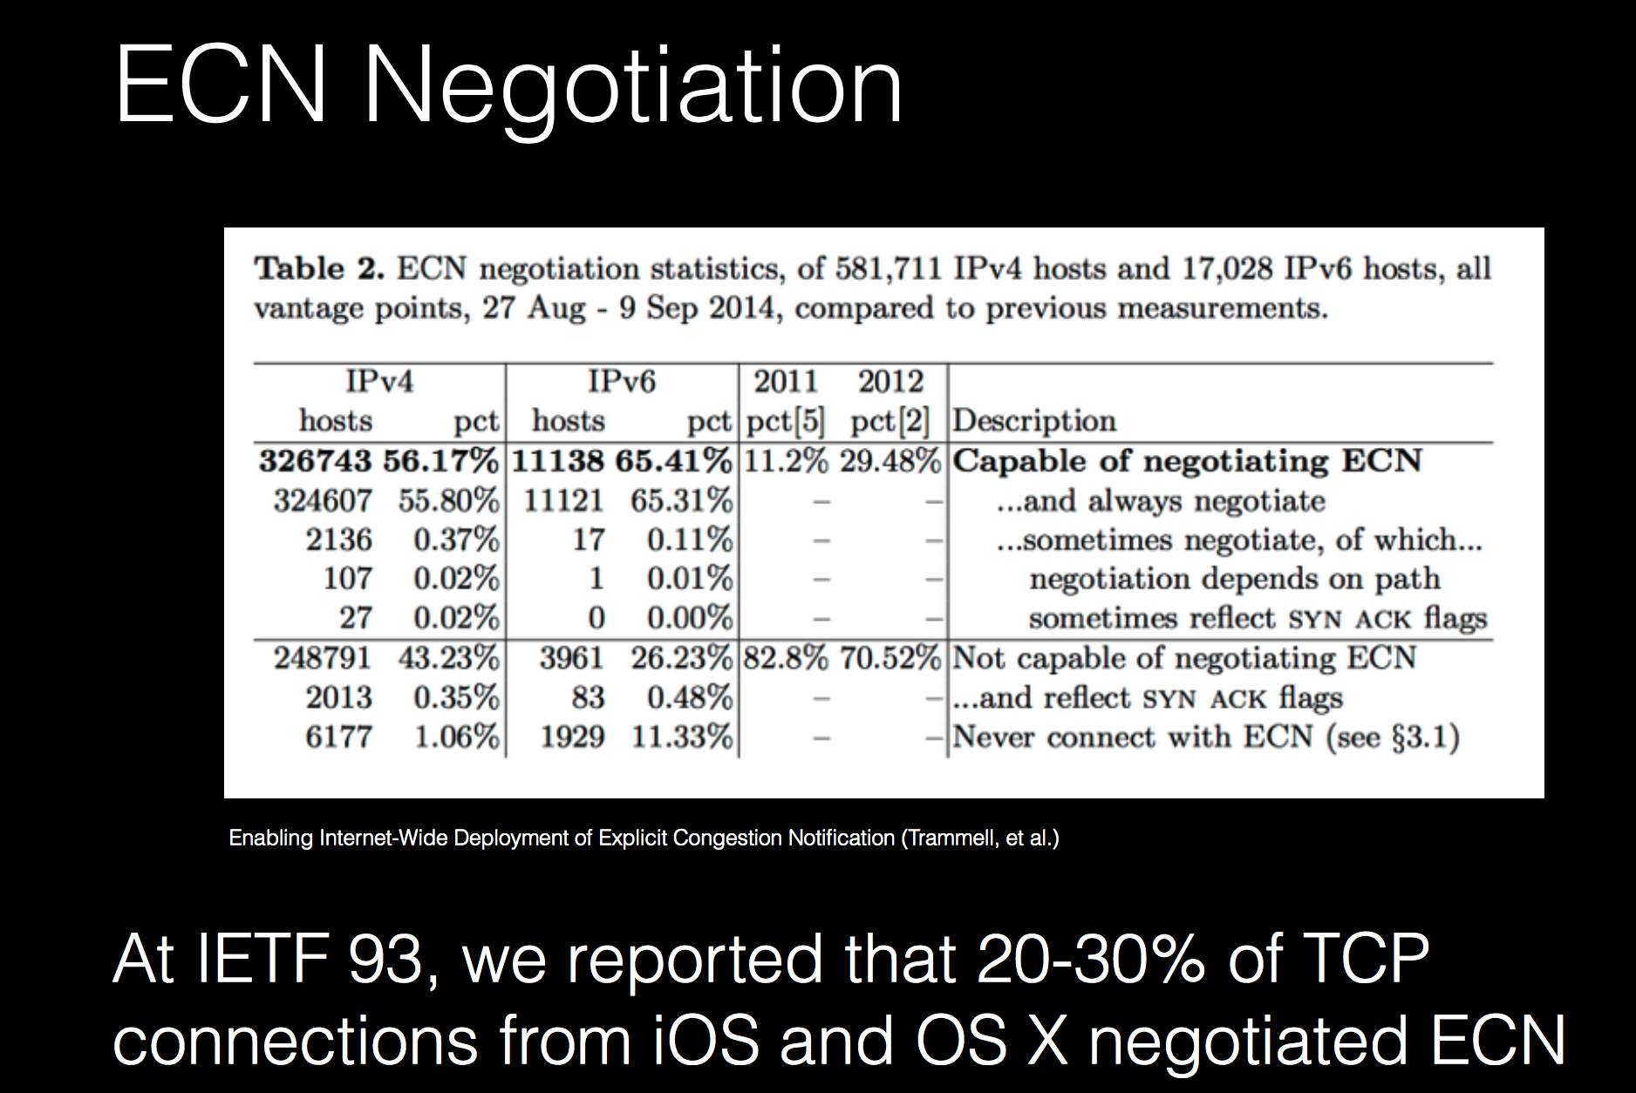
http://www.ietf.org/proceedings/94/slides/slides-94-hopsrg-7.pdf

Slide 45
Agenda
Congestion Control
Principles
Additive Increase/Multiplicative Decrease
Explicit Congestion Notification
Modern TCP Congestion control
Router behavior

Slide 46
Issues with AIMD
Performance on high bandwidth*delay links
Each loss forces TCP in congestion avoidance and grows slowly
Bufferbloat
TCP AIMD tries to saturate buffers until it causes congestion
Inflates round-trip-times
Fairness
TCP sources with a lower rtt are favored

Slide 47
Tuning TCP @google
Objectives
Minimize time to receive result from search engine
HTTP GET fits a single segment
HTTP Response in <16 KBytes

Slide 48
Initial congestion window
What is the impact of initial congestion window and the slow-start on the time to receive an HTTP response ?

Slide 49
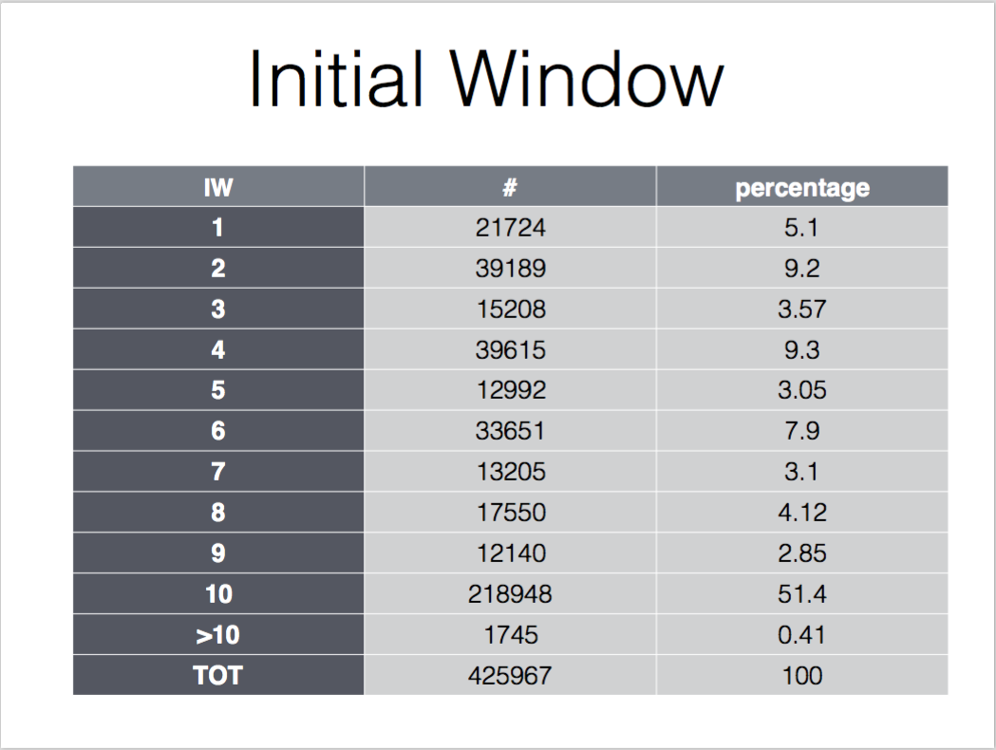
Initial TCP congestion window today
Source: M. Bagnulo, tcpmp mailing list, Nov 16th, 2016

Slide 50
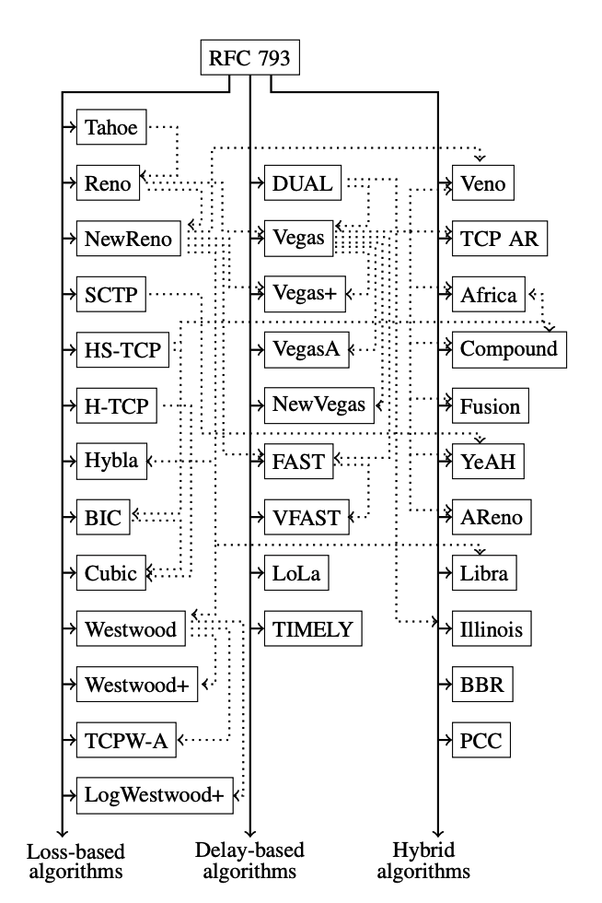
TCP Congestion Controls
Supposed to be fair
MSS size
rtt
Many congestion control schemes
Source: B. Turkovic, F. Kuipers and S. Uhlig, Fifty Shades of Congestion Control: A Performance
and Interactions Evaluation, https://arxiv.org/pdf/1903.03852.pdf

Slide 51
CUBIC
A modern congestion controller designed for high bandwidth*delay product links
Default on Linux, Apple and Microsoft
Principles
Use concave and convex profiles of cubic function to increase cwnd
CUBIC behaves like AIMD with small rtt/bw
CUBIC provides linear bandwidth sharing among flows with different rtt

Slide 52
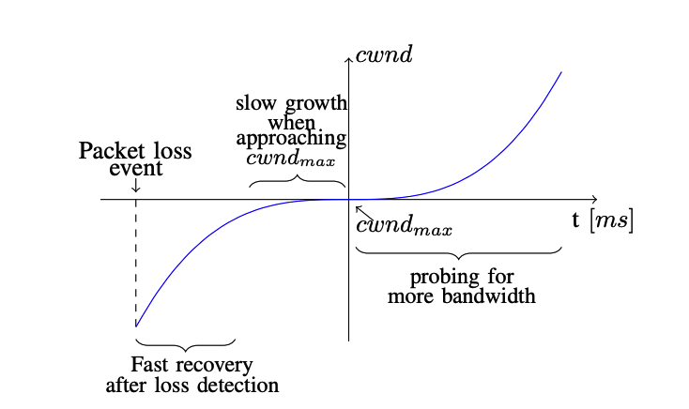
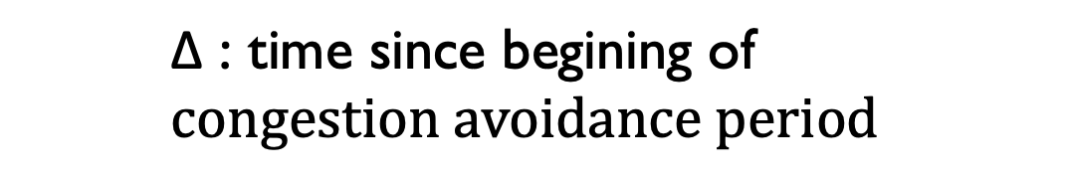
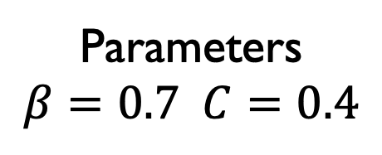
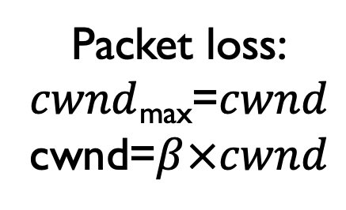
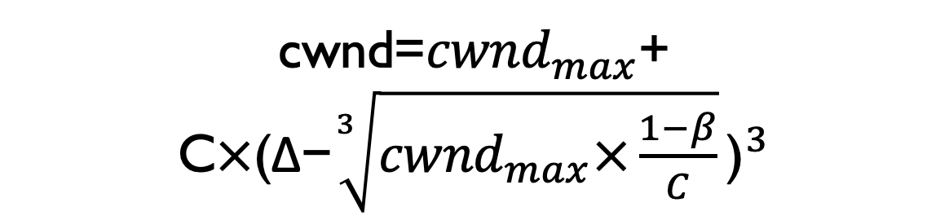
CUBIC
Congestion window increase during congestion avoidance
cwnd=${cwnd}_{max}$+ C$×{\text{(}\text{Δ}\text{−}\sqrt[3]{{cwnd}_{max}×\frac{1−β}{C}}\text{)}}^{3}$
$$\text{Δ}\text{ : }\text{time} \text{since} \text{begining} \text{of} \\ congestion avoidance period$$
Packet loss:
$cwnd$_{max}=$cwnd$
cwnd=$β×cwnd$
Parameters
$$β=0.7 C=0.4$$
Source: B. Turkovic, F. Kuipers and S. Uhlig, Fifty Shades of Congestion Control: A Performance
and Interactions Evaluation, https://arxiv.org/pdf/1903.03852.pdf and RFC8312

Slide 53
Bottleneck Bandwidth and Round-Trip-Time (BBR)
Recent congestion control scheme that aims at achieving high throughput and low delay
Operates in four phases
Startup (similar to slow-start until measured rate stops increase)
Drain (empty the queues, send at 0.75 rate)
compute rtt_{min} over last 10 seconds
Probe bandwidth every 8 rtt (send at 1.25 rate for one rtt and then at 0.75 rate)
Probe RTT (reduce rate for more precise rtt_{min})

Slide 54
Reno, CUBIC, BBR
Cwnd
ssthresh
Slow-start
exponential increase of cwnd
Congestion avoidance
linear increase of cwnd

Slide 55
Reno, CUBIC, BBR
Cwnd
W_max
ssthresh
Slow-start
exponential increase of cwnd
Congestion avoidance

Slide 56
Reno, CUBIC, BBR
Cwnd
Fast retransmit
Startup
Congestion avoidance

Slide 57
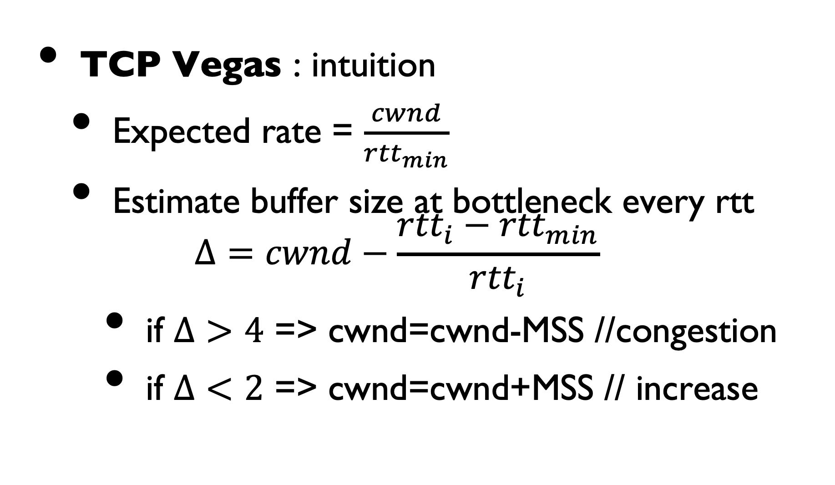
Delay-based techniques
TCP Vegas : intuition
Expected rate = $\frac{cwnd}{{rtt}_{min}}$
Estimate buffer size at bottleneck every rtt $Δ=cwnd−\frac{{{rtt}_{i}−rtt}_{min}}{{rtt}_{i}}$
if $Δ>4$ => cwnd=cwnd-MSS //congestion
if $Δ<2$ => cwnd=cwnd+MSS // increase

Slide 58
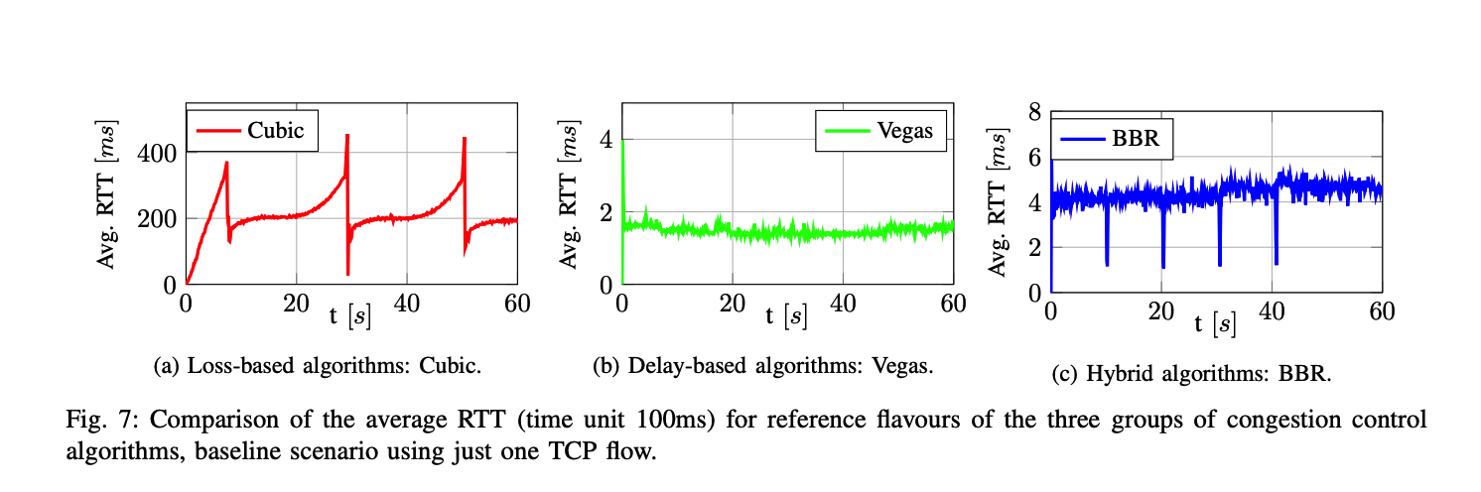
CUBIC, Vegas and BBR
Source: B. Turkovic, F. Kuipers and S. Uhlig, Fifty Shades of Congestion Control: A Performance
and Interactions Evaluation, https://arxiv.org/pdf/1903.03852.pdf and RFC8312

Slide 59
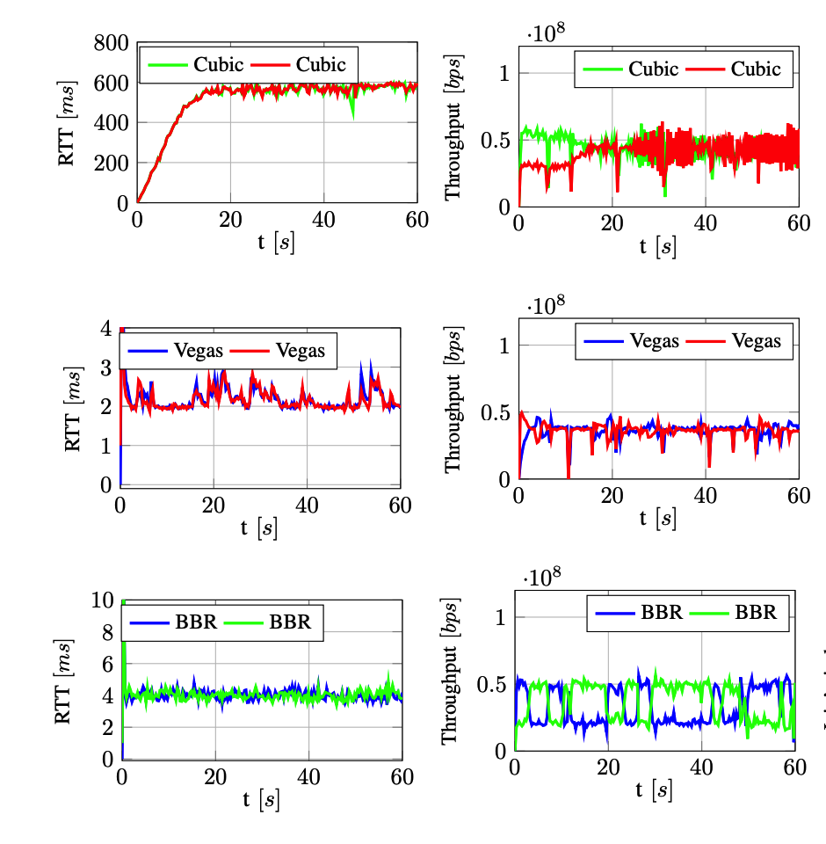
Two TCP connections
Source: B. Turkovic, et al., Fifty Shades of Congestion Control: A Performance
and Interactions Evaluation, https://arxiv.org/pdf/1903.03852.pdf

Slide 60
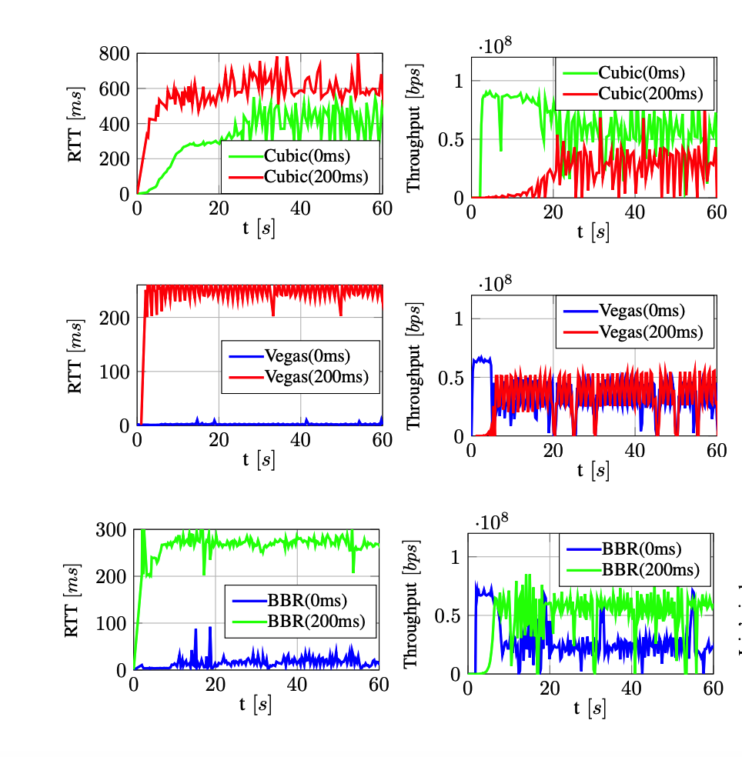
Two TCP connections, different rtt
Source: B. Turkovic, et al., Fifty Shades of Congestion Control: A Performance
and Interactions Evaluation, https://arxiv.org/pdf/1903.03852.pdf

Slide 61
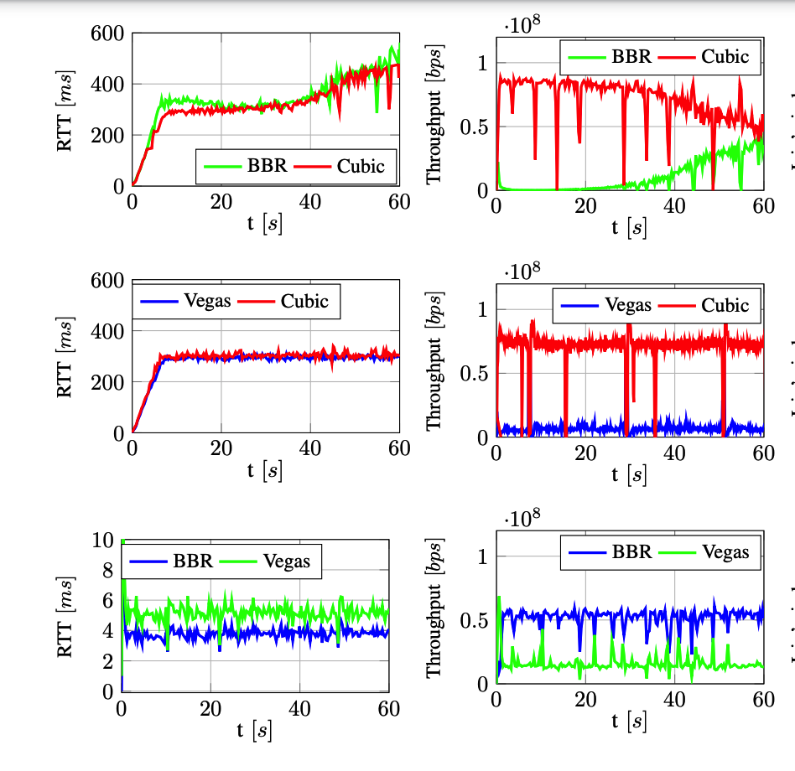
Two different congestion controllers
Source: B. Turkovic, et al., Fifty Shades of Congestion Control: A Performance
and Interactions Evaluation, https://arxiv.org/pdf/1903.03852.pdf

Slide 62
Agenda
Congestion Control
Principles
Additive Increase/Multiplicative Decrease
Explicit Congestion Notification
Modern TCP Congestion control
Router behavior

Slide 63
Traffic control techniques
What are the techniques that a single router can use to provide different types of services to different applications ?
First step : identify the applications that need to obtain each service type
Second step : allocate network ressources to the different applications

Slide 64
Router output port
IP packets
IP packets with internal ID
IP packets
Input link 1
Classifier
Output link
Input link N

Slide 65
How would you implement a classifier ?
Per source classification ?
IP address, IP prefix, TCP/UDP ports ?
Per destination classification ?
IP address, IP prefix, TCP/UDP ports ?
Per application classification ?

Slide 66
Buffer Acceptance
How to decide which packets can be accepted inside the buffer ?
Input links
Classification
Buffer
Output link

Slide 67
Buffer Acceptance
The two key questions for a buffer acceptance algorithm
When should the BA algorithm decide to discard a packet ?
Which packet should be discarded ?

Slide 68
Buffer Acceptance Algorithms
Tail drop
Arrival (Packet p) : if isFull(Buffer) then discard p; else AddTail(Buffer, p);
What are its advantages and drawbacks ?

Slide 69
The traffic control building blockson router
Scheduler
Chooses the packet to
be transmitted first on
the output link
Queuing strategy
Logical organisation of the
router's buffers
Q[1]
Q[2]
Classification
Q[3]
Output link
Input links
Q[N]

Slide 70
Priority scheduling
Flow 1, class A
Output buffer
Flow 2, class B
Class A
Flow 3, class B
Class B
Flow 4, class B
Class C
Flow N, class C
Packet transmission :
if (Queue(A) not empty)
serve Queue(A);
else
if (Queue(B) not empty)
serve Queue(B);
else
if (Queue(C) not empty)
serve Queue(C);
else ....

Slide 71
Priority scheduling
High priority Queue
D
A
Medium Priority Queue
F
E
B
Low Priority Queue
C
With the priority scheduler, what is the ordering of the packets on the output link ?

Slide 72
Round-Robin scheduling
Flow 1
Flow 1
Flow 2
Flow 2
Flow 3
Flow 3
Flow 4
Scheduler :
Flow 5
Flow N
F1
FN
F2
F4
F3

Slide 73
Round robin
Queue 1
B
A
Queue 2
F
E
D
Queue 3
G
If the RR scheduler starts with queue1 and serves them in numerical order, what is the ordering of the packets on the output link ?

Slide 74
Round-robin : example
Flow1(L=1)
F1
Flow2 (L=2)
F2
Flow3 (L=1)
F3
F1
Flow1 and Flow3 send packets of size 1
Flow 2 sends packets of size 2
F3
F2

Slide 75
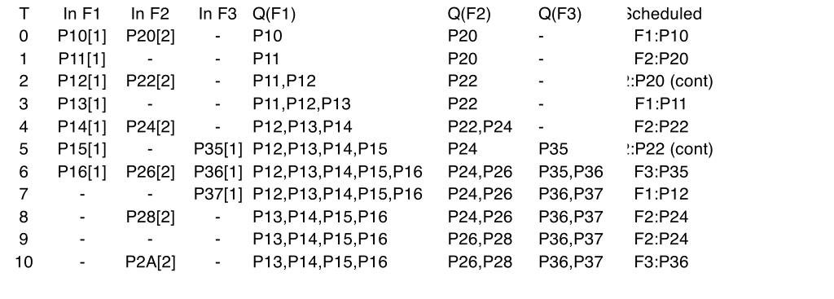
Example
Flow1(L=1)
F1
Flow2 (L=2)
F2
Flow3 (L=1)
F3
F1
Flow1 and Flow3 send packets of size 1
Flow 2 sends packets of size 2
F3
F2

Slide 76
Round-Robin
Advantage
Can provide fairness independently of the characteristics of the flows if flows use same packet size
Drawbacks
Difficult to scale to a very large number of flows
Unfair with different packet sizes

Slide 77
Deficit Round-Robin
Flow 1
Flow 1
Flow 2
Flow 2
Flow 3
Flow 3
Flow 4
Scheduler :
Flow 5
Flow N
F1
FN
F2
associate counter d[i] to each queue
increase d[i] by quantum every time queue[i] is visited
if first_packet of queue[i] larger than d[i] { packet stays in queue[i]; }
else { packet is transmitted on output link; d[i]=d[i]- packet length; if queue[i] is empty { d[i]=0; } }
F4
F3

Slide 78
Deficit Round-Robin : example
Flow1(L=1)
F1
Flow2 (L=2)
F2
Flow3 (L=1)
F3
F1
Flow1 and Flow3 send packets of size 1
Flow 2 sends packets of size 2
F3
F2

Slide 79
Deficit Round robin
Queue 1
B
A
Queue 2
F
D
Queue 3
G
If the DRR scheduler starts with queue1 and serves them in numerical order, what is the ordering of the packets on the output link ?

Slide 80
Weighted Round-Robin
Flow 1
Flow 1
Flow 2
Flow 2
Flow 3
Flow 3
Flow 4
Scheduler :
Flow 5
Flow 5
F1
F5
F2
F1
F1
F4
F3
F2
F1
Fraction of the bandwidth for each flow ?

Slide 81
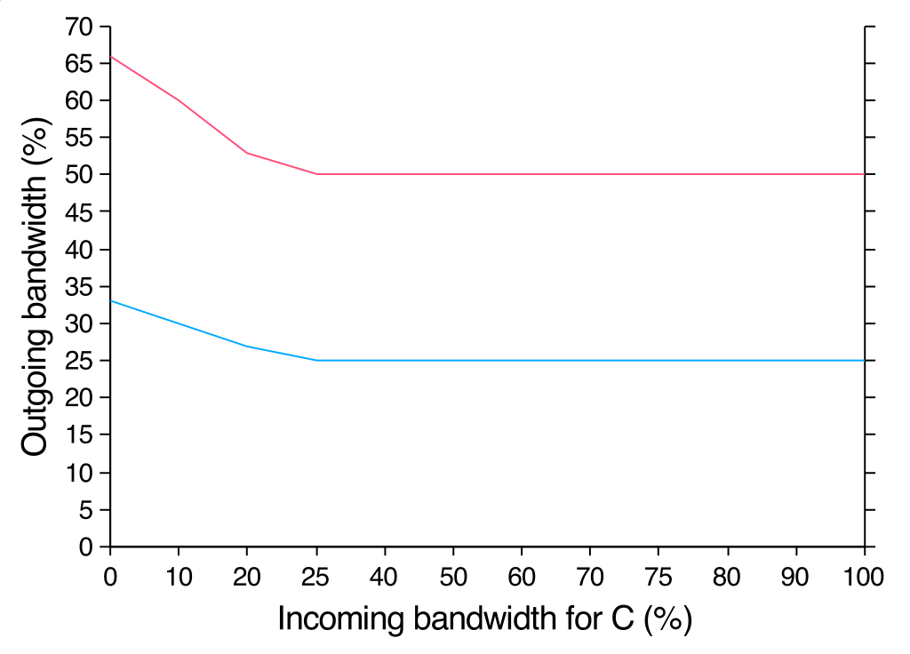
Weighted Round-Robin
Line rate
A : 25%
Line rate
B : 50%
Variable
C : 25%
B's share
A's share

Slide 82
Weighted Round Robin
A : 25%
B : 50%
C : 25%
Input Traffic pattern
A : 20%, regular
B: 60%
C: 50%

Slide 83
Weighted Round Robin
What is the impact of a burst of traffic ?
A : 75%
B : 24%
C : 1%
Input Traffic pattern
A : 20%, regular
B: 24%
C: 100%

