Slide 1
Part 2
Internet applications
Security principles

Slide 2
Agenda
Internet Applications
Email
DNS
HTTP
Making HTTP faster
Network security principles
Security protocols

Slide 3

How to find the mailserver for a domain?
How does a mailserver locate the mailserver responsible for a destination domain ?
dig -t MX gmail.com +short
40 alt4.gmail-smtp-in.l.google.com.
10 alt1.gmail-smtp-in.l.google.com.
5 gmail-smtp-in.l.google.com.
30 alt3.gmail-smtp-in.l.google.com.
20 alt2.gmail-smtp-in.l.google.com.
Notes:
Lower better

Slide 4
Email attachments
Email was designed in the 1970s and some mailservers still only accept ASCII messages containing up to 80 characters per line
How do can we send email attachments ?
Binary files, video, sound, …

Slide 5
MIME: Content-Type
Content-Type : type/encoding
type of content
text, image, video, application
multipart
encoding of content
text/plain , text/html, image/gif, image/jpeg , audio/basic, video/mpeg, video/quicktime, application/octet-stream, application/postscript
multipart/alternative, multipart/mixed
attachment

Slide 6
Character sets
How to support rich character sets ?
Content-Type: text/plain; charset=us-ascii
Content-Type: text/plain; charset=iso-8859-1
Character set suitable for Western European languages, defined by ISO, 8 bits per character
Content-Type: text/plain; charset=unicode
Universal character set

Slide 7
Content encoding
How to encode non-text data ?
Base64
Base64
uses ASCII characters A...Z,a...z,0...9, "+" et "/"
A=0, B=1, C=2, ... +=62 et /=63
Each character is used to encode 6 bits
24 bits from initial message -> 4 ASCII characters
Special character “=” used for padding

Slide 8
Multipart/mixed
Date: Mon, 20 Sep 1999 16:33:16 +0200
From: Nathaniel Borenstein <nsb@bellcore.com>
To: Ned Freed <ned@innosoft.com>
Subject: Test
MIME-Version: 1.0
Content-Type: multipart/mixed; boundary="simple boundary"
preamble, to be ignored
--simple boundary
Content-Type: text/plain; charset=us-ascii
partie 1
--simple boundary
Content-Type: text/plain; charset=us-ascii
partie 2
--simple boundary
Notes:
Exemple de message MIME
Received: from loriot.info.fundp.ac.be (loriot.info.fundp.ac.be [138.48.32.96])
by leibniz.info.fundp.ac.be (8.9.1/8.9.1) with SMTP id QAA19679;
Mon, 20 Sep 1999 16:37:25 +0200 (MET DST)
Message-Id: <3.0.5.32.19990920163316.00866340@info.fundp.ac.be>
Date: Mon, 20 Sep 1999 16:33:16 +0200
To: pers-aca, pers-sci
From: Gysele HENRARD <ghe@info.fundp.ac.be>
Subject: listes
Mime-Version: 1.0
Content-Type: multipart/mixed;
boundary="=====================_937830796==_"
--=====================_937830796==_
Content-Type: text/plain; charset="iso-8859-1"
Content-Transfer-Encoding: quoted-printable
Bonjour,
Voici des listes de 1M-1L, 2M-2L et ERASMUS mises =E0 jour ce lundi 20
septembre.
Gyselle
--=====================_937830796==_
Content-Type: application/octet-stream; name="1M_99_00.xls";
x-mac-type="584C5334"; x-mac-creator="5843454C"
...

Slide 9
Agenda
Internet Applications
Email
DNS
HTTP
Making HTTP faster
Network security principles
Security protocols

Slide 10
DNS lookup
How many loopkups do I need to do to retrieve the first web page of: www.computer-networking.info starting from the root

Slide 11

DNS resolution (1)
www.computer-networking.info
Root
2001:dc3::35
Info NS
2001:500:19::1
NS ? info
NS -> a0.info.afilias-nst.info. Additional a0..info = 2001:500:19::1
NS ? Computer-networking.info
NS -> ns20.ovh.net
NS ? net
NS -> m.gtld-servers.net. Additional m..net = 2001:501:b1f9::30

Slide 12
DNS resolution (2)
www.computer-networking.info
Net NS
2001:501:b1f9::30
OVH NS
2001:41d0:1:1981::1
Ns20.ovh.net
2001:41d0:1:198f::1
NS ? ovh.net
NS ? Ns10.ovh.net. Additional ns10.ovh.net = 2001:41d0:1:1981::1
AAAA ? Ns20.ovh.net
AAAA -> 2001:41d0:1:198f::1
AAAA ? www.computer-networking.info
CNAME cnp3book.info.ucl.ac.be

Slide 13
DNS resolution (3)
www.computer-networking.info
Root
2001:dc3::35
Ac.Be NS
2001:6a8:3c80::14
Be NS
2001:678:6c::1
NS ? be
NS -> d.nsset.be.
Additional d.nsset.be = 2001:678:6c::1
NS ? Ac.be
NS -> ns1.belnet.be.
Additional : 2001:6a8:3c80::14
NS ? Ucl.ac.be
NS -> ns1.belnet.be
NS -> ns1.sri.ucl.ac.be

Slide 14
DNS resolution (4)
www.computer-networking.info
Ucl.ac.Be NS
2001:6a8:3c80::14
Info.ucl.ac.Be NS
2001:6a8:308f:1::d
NS ? Info.ucl.ac.be
NS -> dnssrv.info.ucl.ac.be.
Additional dnss..be = 2001:6a8:308f:1::d
AAAA ? Cnp3book.info.ucl.ac.be
cnp3book.info.ucl.ac.be. CNAME mptcp.info.ucl.ac.be.
mptcp.info.ucl.ac.be. AAAA 2001:6a8:308f:8:0:82ff:fe68:e48c

Slide 15
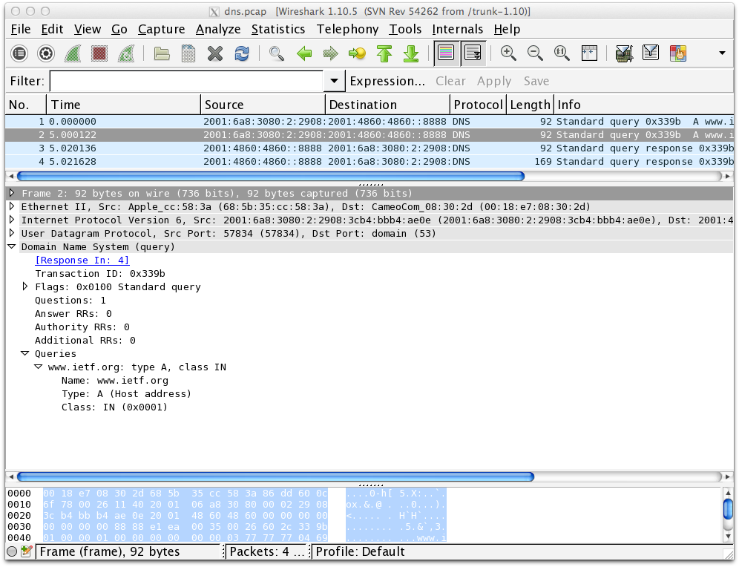
Using wireshark with DNS

Slide 16
The DNS TTL
What is the meaning of this field ?
Which value would you recommend for the DNS TTL of different records
How does a DNS resolver handle TTL ?

Slide 17
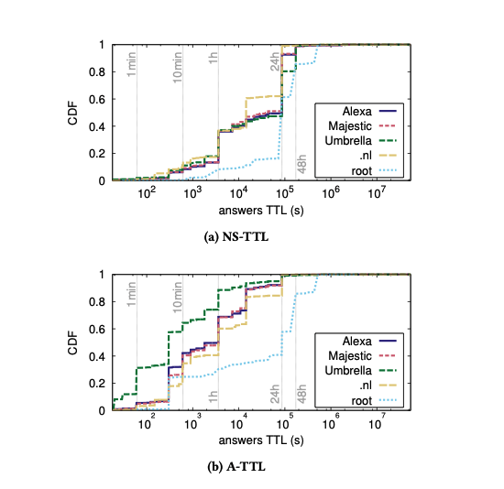
DNS TTL
https://blog.apnic.net/2019/09/27/how-to-choose-dns-ttl-values/

Slide 18
Attacks against DNS
DNS is key, if an attacker can change the responses returned by resolvers, this could have a major impact
Users rely on their resolver to obtain name-to-address mappings

Slide 19
Packet spoofing
On the Internet, every device has one IP address
All the packets sent by this device use its IP address as their source
Is it possible for Terrence to send a packet using Alice’s IP address ?

Slide 20
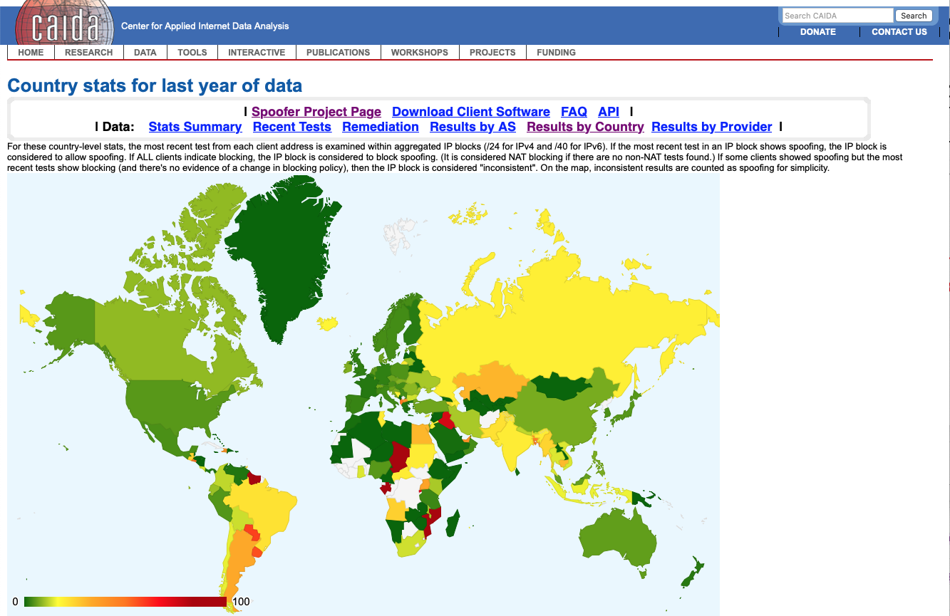
https://spoofer.caida.org/country_stats.php

Slide 21


Spoofing attack
Q? www.bob.net
A
B
www.bob.net=2001:db8:12::1
Response sent using Bob’s IP address
www.bob.net=2001:db8:34::55
How can Alice verify that Bob’s message is legitimate and Terrence’s message invalid ?
T

Slide 22
Countering spoofing attacks
Alice should use random source port in her queries and verify the server response
UDP
header
32 bits
Source port
Dest. port
UDP Length
Checksum
Identification
Flags
Number of questions
Number of answers
Alice should use random identifiers and verify the server response
DNS message
Number of authority
Number of additional
Questions
(variable number of resource records)
Answers
(variable number of resource records)
Authority
(variable number of resource records)
Total: 32 bits of randomness
Additional information
(variable number of resource records)
Can you do better ?
https://tools.ietf.org/html/rfc6056

Slide 23
Other approaches
DNSSEC
DNS extensions that allows servers to sign their reponse using public keys
DNS responses sent in clear over UDP
Alice can verify the cryptographic signature
DNS over TLS or DNS over HTTPS
Request/Response sent over TLS session(encrypted and authenticated)
cannot be hijacked by Trudy

Slide 24
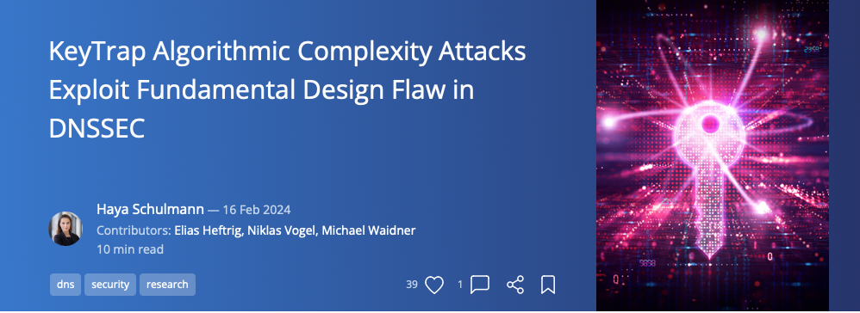
DNSSEC KeyTrap
https://labs.ripe.net/author/haya-shulman/keytrap-algorithmic-complexity-attacks-exploit-fundamental-design-flaw-in-dnssec/

Slide 25
DNSSEC KeyTrap
DNSSEC servers need to change their keys
When a resolver receives a signed DNSSEC response, it needs to validate it with one of the server keys
Keytrap attack
Create a DNSSEC server with many keys
Use algorithms that are CPU intensive
Send DNSSEC response that needs validation

Slide 26
Adding randomization
In the Identification field
But it is only 16 bits long
In the source port field of the UDP header
Different DNS requests use different source ports
The source port is only 16 bits long

Slide 27
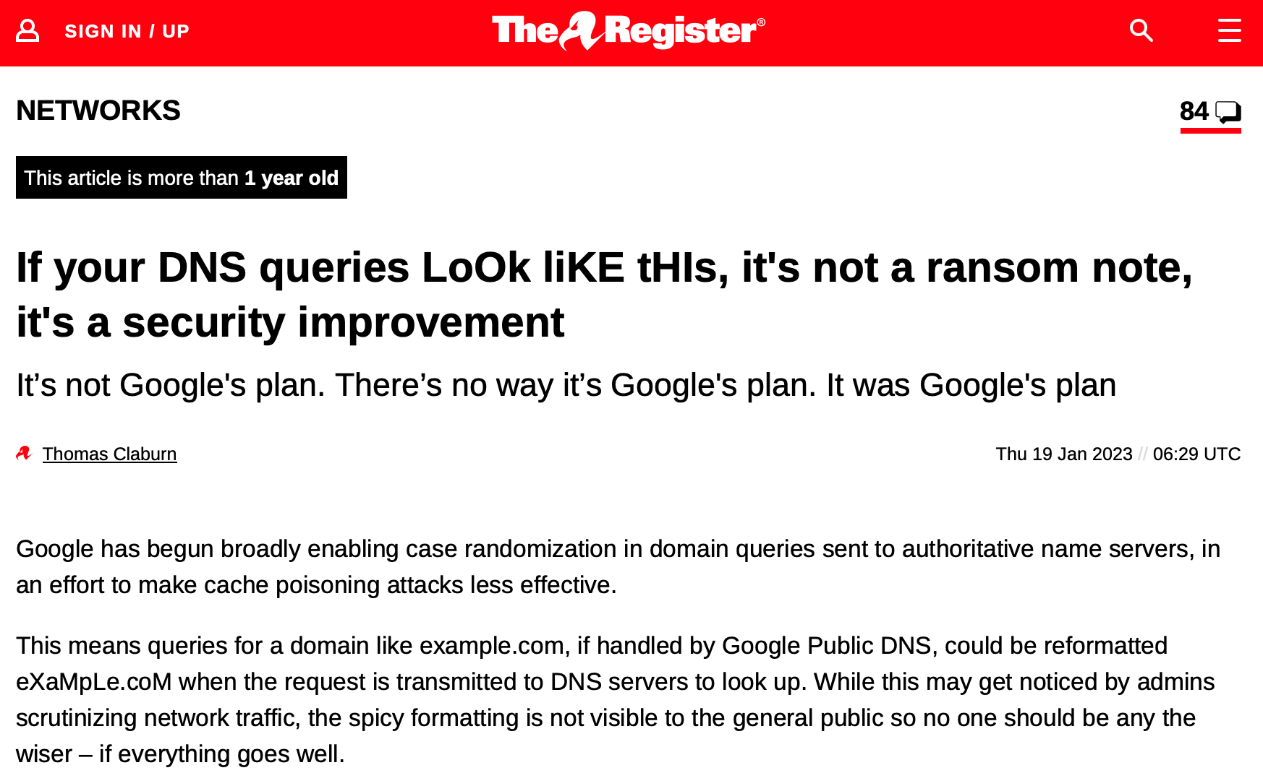
More randomization in the question field
https://www.theregister.com/2023/01/19/google_dns_queries/

Slide 28
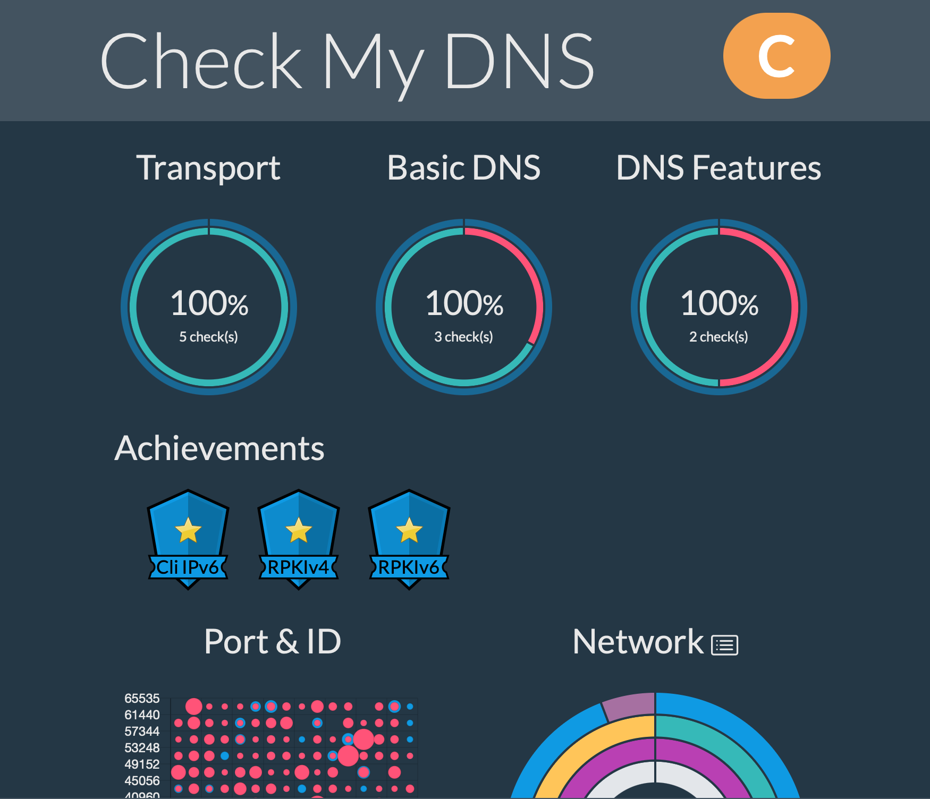
Checking DNS servers
https://cmdns.dev.dns-oarc.net

Slide 29
Agenda
Internet Applications
Email
DNS
HTTP
Making HTTP faster
Network security principles
Security protocols

Slide 30
Some request HTTP headers
Can you explain the following headers:
If-Modified-Since
Referer
Accept-Language
See for standard and non-standard headers https://en.wikipedia.org/wiki/List_of_HTTP_header_fields

Slide 31
Multiple webservers on a single host
When a server supports multiple web sites, which request header does it use to identify the web site which is the target for a given request ?

Slide 32
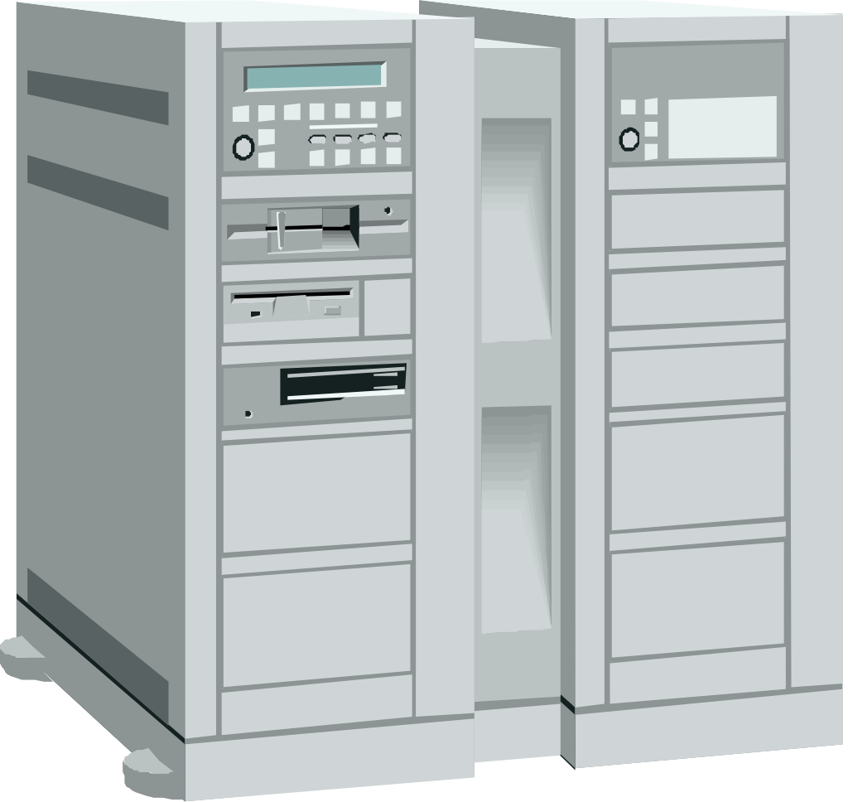

The range header
curl -v --range 0-50 http://www.china.com.cn
Server
www.example.org
GET / HTTP/1.1 Host: www.china.com.cn
Range: bytes=0-50
User-Agent: curl/8.7.1
Accept: */*
CRLF
Client
HTTP/1.1 206 Partial Content
Date: Wed, 12 Feb 2025 09:45:22 GMT
Content-Type: text/html; charset=UTF-8
Content-Length: 51
Connection: close
Server: Apache
Accept-Ranges: bytes
Content-Range: bytes 0-50/93466
X-Ser: i25073_c2919, i2103129_c25795, i2020957_c24821, i59478_c11236
CRLF
<!DOCTYPE html
PUBLIC "-//W3C//DTD XHTML 1.0 T

Slide 33
HTTP Authentication
Client
Server
GET / HTTP1.1
...
HTTP/1.0 401 Authorization req
WWW authenticate: machin
...
Browser asks user/password to user
GET / HTTP1.1
Authorization: User-password
...
HTTP/1.1 200 OK
...
GET /images/t.gif HTTP1.1
Authorization: User-password
...
Browser sends user/password in each request

Slide 34
HTTP Cookies
Client
Server
GET / HTTP1.1
...
HTTP/1.0 200 OK
Set-Cookie: machin
...
Browser saves cookie
Normal response
GET /doc HTTP1.1
Cookie: machin
...
HTTP/1.1 200 OK
...
Response is function of URL and cookie
GET /images/t.gif HTTP1.1
Cookie: machin
...
Browser sends cookie in all requests sent to server

Slide 35
Some response HTTP headers
Can you explain the following headers:
Last-Modified
Server
Upgrade
See for standard and non-standard headers https://en.wikipedia.org/wiki/List_of_HTTP_header_fields

Slide 36
Agenda
Internet Applications
Making HTTP faster
Network security principles
Security protocols

Slide 37
A faster web
How could we speed up the web ?
What is our objective ?

Slide 38
How to improve web ?
What can be done to improve web performance ?
Reduce unnecessary data transfers
If-Modified-Since

Slide 39
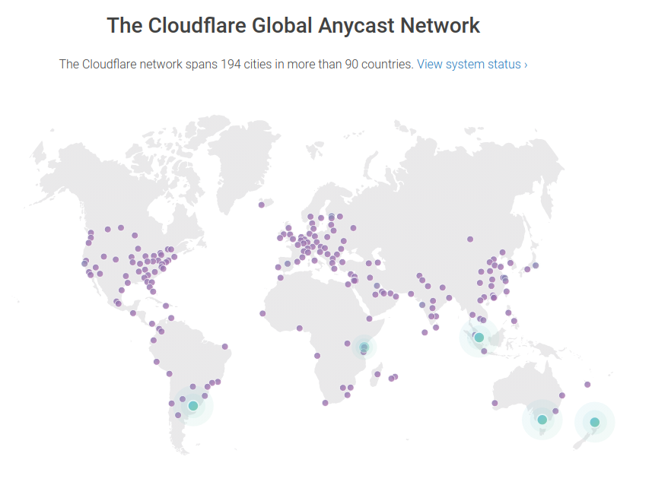
Reducing latency ?
How can we reduce latency ?
Move server closer to client – CDN

Slide 40
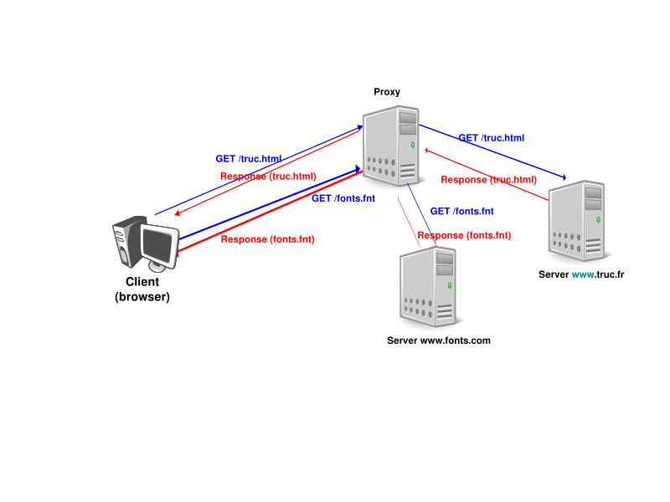
Web proxies

Slide 41
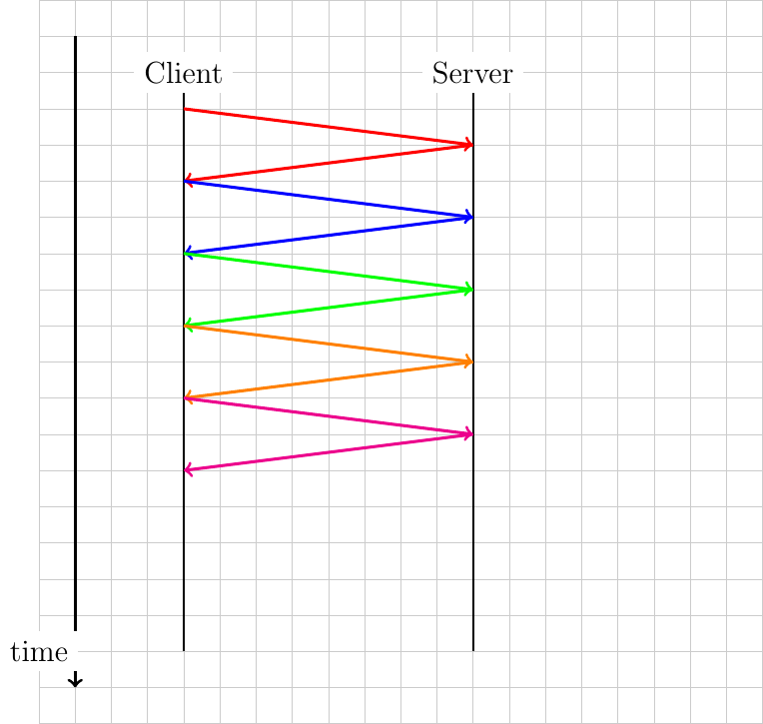
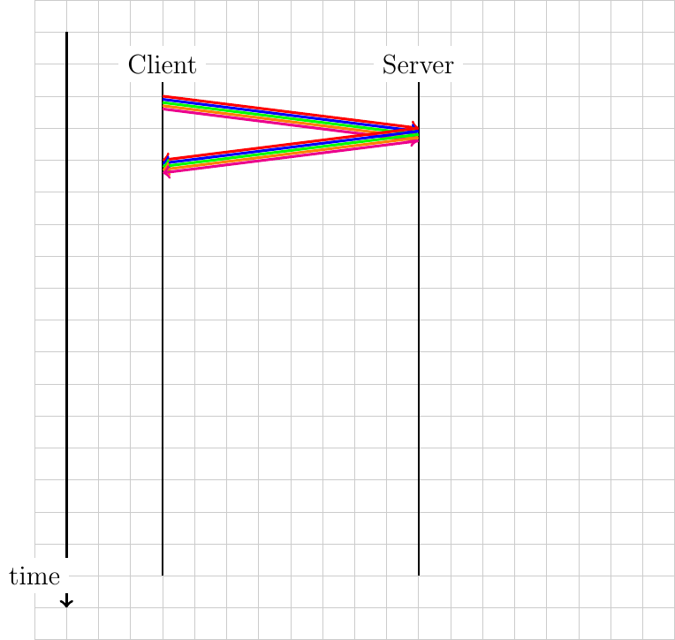
Improving HTTP

Slide 42
HTTP/2.0
Key changes from HTTP/1.x
Binary protocol instead of ASCII
Support multiple datastreams over the underlying transport connection

Slide 43
A single TCP connection
One TCP connection for all objects for a given client-server pair
Minimize in-network and server resources
Beware of head-of-line blocking
Can we do better than HTTP/1.1 ?

Slide 44
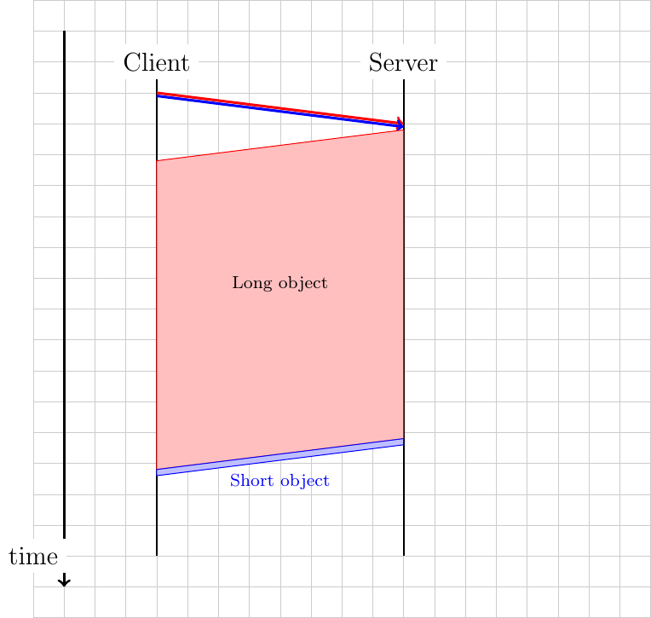
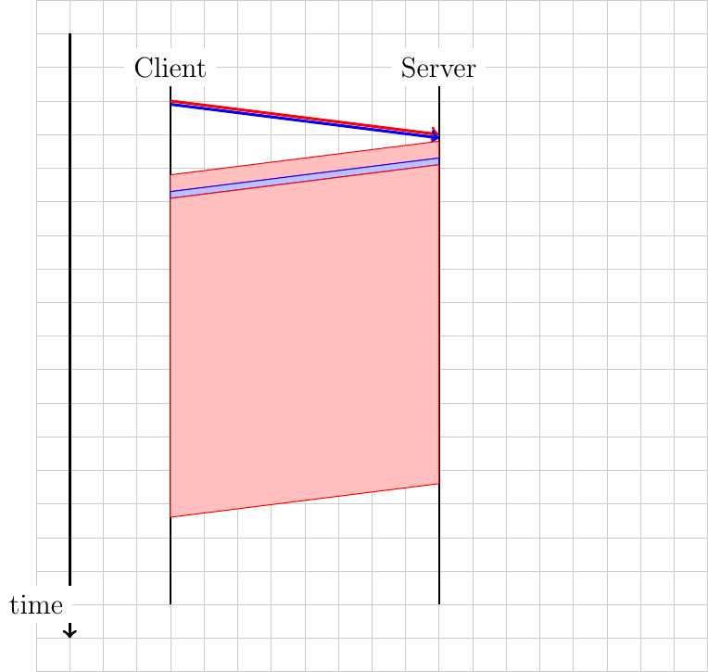
HTTP/2.0

Slide 45
HTTP/2.0 Streams
H: Headers frame
ES: End_Stream flag
R: RST_STREAM
Idle
Send/recv H
open
recv ES
Send ES
Send/recv R
Half closed
remote
Half closed
local
Send/recv R
Send ES
Send/recv R
Recv ES
closed

Slide 46
HTTP/2
Why changing HTTP ?
Reduce page load time
Minimize data exchanged
Reduce network load
Fewer transport connections
Reduce risks of attacks from ASCII parsing

Slide 47
Basics of HTTP/2
Main modifications compared to HTTP/1.1
Binary framing protocol
Will be used over TLS anyway
One connection for several objects
Several objects can be multiplexed
Server push
Data compression for requests and responses

Slide 48
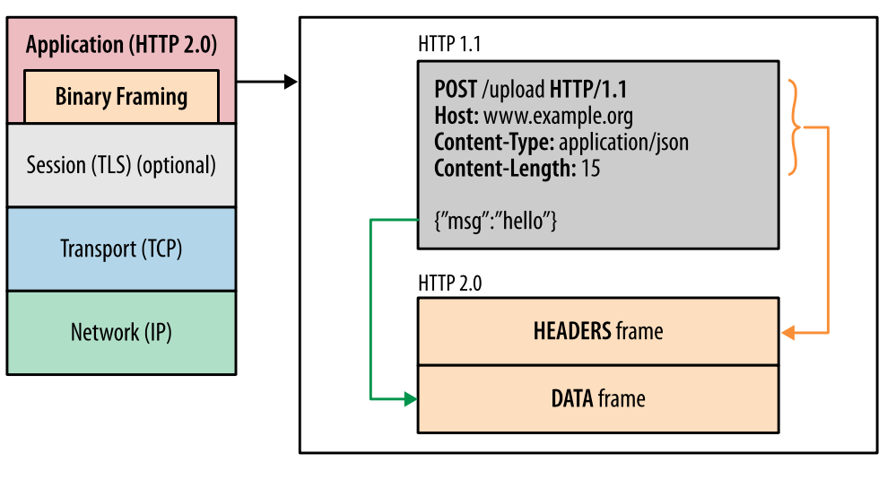
HTTP/2 versus HTTP/1
Source: https://hpbn.co/http2/

Slide 49
Issues with HTTP/1.1
Can use a single connection per server but
Client decides the order of the requests
Server sends objects in order requested by client
A large object (e.g. image) may block smaller but more important objects (e.g. css/javascript)

Slide 50
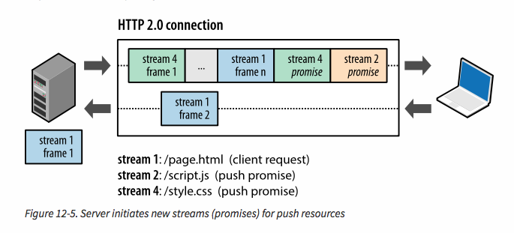
Server Push
Source: https://hpbn.co/http2/

Slide 51
Agenda
Internet Applications
Making HTTP faster
Network security principles
Crypto building blocks
Client authentication
Server authentication
Key exchange
Security protocols

Slide 52
The security landscape
Legitimate users
Attacker
B
A
Bob
Alice
T
Terrence

Slide 53

Security threat: Privacy
A
B
T
Security issue
Alice sends a confidential message to Bob
How to prevent Terrence from reading the message ?

Slide 54
Authentication
A
B
T
Security issue
Terrence sends a message to Bob impersonating Alice
How to prevent Terrence from spoofing messages or how can Bob verify that the message originates from Alice and not Terrence ?

Slide 55
Message integrity
A
T
B
Alice sends a message to Bob, but Terrence changes the message before it reaches Bob
How to prevent Terrence from changing the message or how to allow Bob to check that the message sent by Alice was not modified ?

Slide 56
Denial of Service
T
B
Terrence sends so many messages to Bob that Bob is unable to process the messages sent by Alice
How to prevent Terrence from overloading Bob so that Alice cannot contact Bob ?

Slide 57
Hash functions
Properties
Easy to compute H(Msg,key)
Very difficult to find Msg2 : H(Msg,k)=H(Msg2,k)
Example hash functions
MD5, MD4, SHA-1,SHA-256
key
key
m,H(m,key)‏
insecure channel
m
H
H
m valid ?
Alice
Bob

Slide 58
Hash functions
Can we use the Internet checksum as a hash function ?

Slide 59
MD5

Slide 60
SHA1 and SHA256
Benchmarks can be computed using openssl speed command

Slide 61
Secret-key crypto
key
key
E(m,key)‏
insecure channel
m
E
D
m
Examples : DES, AES, RC-4, IDEA, CHACHA
Alice
Bob

Slide 62
Cipher performance

Slide 63
Public-key crypto
Each user maintains two keys
A public key (Public_{Key}) which can be made public and can be used by any user to send him/her encrypted messages
A private key (Private_{Key}) which is kept secret and can be used to decrypt information encrypted with the public

Slide 64
Public-key crypto Encryption
Pub_{Bob}
Priv_{Bob}
Examples
RSA, ECC
E(m,Pub_{Bob})‏
unsecure channel
m
E
D
m
Alice
Bob
Security of RSA depends on the ability to factor numbers. Best factorisation so far is 829 bits long RSA key
https://en.wikipedia.org/wiki/RSA_Factoring_Challenge

Slide 65
Public-key crypto Signatures
Priv_{Alice}
Pub_{Alice}
S(m,Priv_{Alice})‏
insecure channel
Examples
RSA, DSS
m
V
yes
no
S
Alice
Bob

Slide 66
RSA

Slide 67
Agenda
Sharing resources
Network security principles
Crypto building blocks
Client authentication
Server authentication
Key exchange
Security protocols

Slide 68
Password authentication
Never ever store a password in clear in a file
A
B
Alice
Bob
Hello from Alice, password = blabla
Info about Alice
pass=blabla
What are the security risks with password based authentication ?

Slide 69
Attacks
Man in the middle attack
B
A
T
Alice
Terrence
Bob
Hello from Alice, password = blabla
If Terrence can capture the message, then he will know the password and ...
Info from Alice, password = blabla
Can we improve this by using hash functions ?

Slide 70
Hashed Password
A
B
T
Alice
Bob
Hello from Alice, password = Hash(blabla)
Info about Alice
pass=Hash(blabla)
Is this solution secure against a MITM attack ?

Slide 71
One-time passwords
Server stores for each user
username
n /* number of allowed authentications */
hash^{n}(pwd) /* hash³(pwd)=hash(hash(hash(pwd))‏*/
An implementation of this scheme is described in :
N. Haller, C. Metz, P. Nesser, M. Straw. A One-Time Password System. RFC 2289.February 1998.
Notes:
An implementation of this scheme is described in :
N. Haller, C. Metz, P. Nesser, M. Straw. A One-Time Password System. RFC 2289.February 1998.

Slide 72
One-time passwords
When user wishes to be authenticated
Server sends stored value of n
User sends hash^{n-1}(pwd)‏
Server compares hash(hash^{n-1}(pwd)) with hash^{n}(pwd)‏
If equal, user is authenticated, server decrements n and remembers hash^{n-1}(pwd)

Slide 73
One time passwords
A
B
Alice
Bob
Hello from Alice
Info about Alice
n=123
Hash¹²³(P)=ZROK
My current n is 123
Password : Hash¹²²(P)=VVBG
Info about Alice
n=122
Hash¹²²(P)=VVBG
Notes:
In the example above, hash(VVBG)=ZROK

Slide 74
One time passwords
A
B
Alice
Bob
Hello from Alice
Info about Alice
n=123
Hash¹²³(P)=ZROK
My current n is 123
Password : Hash¹²²(P)=VVBG
Info about Alice
n=122
Hash¹²²(P)=VVBG
Can Terrence attack this protocol ?
Notes:
In the example above, hash(VVBG)=ZROK

Slide 75
One-time passwords
A
T
B
Alice
Terrence impersonates Bob
Bob
Hello from Alice
Info about Alice
n=122
Hash¹²²(P)=VVBG
My current n is 8
Password : Hash⁷(P)=ABCT
Terrence already knows Hash⁷(P) ! and can compute Hash^{N}(P) with N>=7
Hello from Alice
Current n is 122
Hash¹²¹(P)=Z4FT
What can Alice do to counter this attack ?
Notes:
To avoid this Problem, Alice must remember the last value of n used by each server with whom she is communicating and should be warned when
the server requests a different value of n that the previous value.

Slide 76
Agenda
Sharing resources
Network security principles
Crypto building blocks
Client authentication
Server authentication
Key exchange
Security protocols

Slide 77
Server Authentication
A
B
Alice
Bob
Are you Bob ?
Yes, of course
A more secure protocol is necessary
Solution
Each server maintains a (public,private) key pair
Pub_{Bob} , Priv_{Bob}
Notes:
The public-private key pair can be a RSA key-pair for example.

Slide 78
Server authentication
A
B
Alice
Bob
Pub_{Bob,},Priv_{Bob}
Are you Bob ?
S(Yes,Priv_{Bob})
Is this a secure authentication (justify) ?
Alice must already know Pub_{Bob}
Notes:
In this slide and the subsequent ones,S(Yes,Priv_{Bob}) is a signed message that contains “Yes” and is signed by using the ,Priv_{Bob} private key . The validity of this signature can be checked by using ,Pub_{Bob}

Slide 79
Server authentication
A
T
B
Alice
Terrence
Bob
Pub_{Bob,},Priv_{Bob}
Are you Bob ?
S(Yes,Priv_{Bob})
Please send Pub_{Bob}
Bob's key : Pub_{Bob}
Is this secure ?
Possible Man in the Middle Attack
The two messages sent by Bob could also have been sent by Terrence
Notes:
A Man in the Middle or Woman in the Middle attack is possible in this case as Terrence can easily intercept the messages sent by Alice and replace them with fake messages that contain her public key and signature.

Slide 80

Server authentication
Public-key certificates
To authenticate public keys, Alice and Bob must trust a third party
Certificates
S(Pub_{Bob} , Priv_{C})‏
Charles
Pub_{C,},Priv_{C}
B
A
Bob
Alice
Pub_{C, ,}Pub_{Bob,},Priv_{Bob}
S(Pub_{Bob} , Priv_{C} )‏
Pub_{C,}
Are you Bob ?
S(Yes,Priv_{Bob})‏
S(Pub_{Bob} , Priv_{C} )‏
Notes:
In the example above, we use S(Pub_{Bob} , Priv_{C}) to indicate a certificate for Bob's key issued by Charles.
Charles usually checks the identity of Bob offline and then creates the certificate. Charles is sometimes referred to as a Trusted Third Party (TTP).

Slide 81
Server authentication
Public-key certificates
To authenticate public keys, Alice and Bob must trust a third party
Certificates
S(Pub_{Bob} , Priv_{C})‏
Charles
Pub_{C,},Priv_{C}
B
A
Bob
Alice
Pub_{C, ,}Pub_{Bob,},Priv_{Bob}
S(Pub_{Bob} , Priv_{C} )‏
Pub_{C,}
Are you Bob ?
S(Yes,Priv_{Bob})‏
S(Pub_{Bob} , Priv_{C} )‏
Is this protocol secure (justify) ?
Notes:
In the example above, we use S(Pub_{Bob} , Priv_{C}) to indicate a certificate for Bob's key issued by Charles.
Charles usually checks the identity of Bob offline and then creates the certificate. Charles is sometimes referred to as a Trusted Third Party (TTP).

Slide 82
Are certificates sufficient ?
A
B
T
Alice
Terrence
Bob
Pub_{C,}
Pub_{C, ,}Pub_{Bob,},Priv_{Bob}
S(Pub_{Bob} , Priv_{C} )‏
Are you Bob ?
S(Yes,Priv_{Bob})‏
S(Pub_{Bob} , Priv_{C} )‏
Terrence copies the message sent
by Bob for later...
Are you Bob ?
S(Yes,Priv_{Bob})‏
S(Pub_{Bob} , Priv_{C} )‏
Terrence sends the saved copy
of Bob's message
Notes:
Replay attacks are common threats to security protocols.

Slide 83
Improved authentication
A
T
B
Alice
Terrence
Bob
Pub_{C}
Pub_{C, ,}Pub_{Bob,},Priv_{Bob}
S(Pub_{Bob} , Priv_{C} )‏
Are you Bob ?, Random_{Alice}
S(Yes,Random_{Alice} ,Priv_{Bob})‏
S(Pub_{Bob} , Priv_{C} )‏
Random_{Alice} is a nonce
Terrence copies the message sent
by Bob for later...
This is useless as the next request
sent by Alice will contain a different
random number
Notes:
The nonce is a random number. Note that to be secure, this nonce should be truly random. In practice, generating random numbers is not easy, For a detailed discussion, see :
RFC1750 Randomness Recommendations for Security. D. Eastlake, S. Crocker, J. Schiller. December 1994.

Slide 84
Agenda
Sharing resources
Network security principles
Crypto building blocks
Client authentication
Server authentication
Key exchange
Security protocols

Slide 85

Key Exchange
How can Alice and Bob safely exchange a secret key in the presence of Terrence ?
A
B
T
T

Slide 86
Diffie-Hellman key exchange
Relies on modulo integer arithmetic
All users agree on
A modulus : p
A base : g

Slide 87
Diffie-Hellman key exchange
b=random int
a=random int
A
B
Alice
Bob
A=gª mod p
B=g^{b} mod p
Secret=Bª mod p
Secret=A^{b} mod p

Slide 88
Diffie-Hellman g=5, p=23
b=13
a=8
A
B
Alice
Bob
A=gª mod p=16
B=g^{b} mod p=21
Secret=Bª mod p
=21⁸mod 23=3
Secret=A^{b} mod p
=16¹³ mod 23=3

Slide 89
Diffie-Hellman
Is this safe ?
Mathematics
Researchers have tried to break the scheme for more than 4 decades
Attackers
Can Terrence find an attack against Diffie-Hellman ?

Slide 90
A possible MITM attack
b=random int
t=random int
a=random int
A
B
T
Alice
Terrence
Bob
A=gª mod p
T=g^{t} mod p
T=g^{t} mod p
B=g^{b} mod p
S_{B}=B^{t} mod p
S_{A}=A^{t} mod p
S_{B}=T^{b} mod p
S_{A}=Tª mod p

Slide 91
Solving the MITM attack
What can we do to prevent this Man in the Middle Attack ?
Pre-negotiated Shared secret
Use public keys
Public/Private keypair on Client
Public/Private keypair on Server

Slide 92
Authenticated Diffie-Hellman
Pub_{C, ,}Pub_{Bob,},Priv_{Bob}
S(Pub_{Bob} , Priv_{C} )‏
Charles
A
Pub_{C,},Priv_{C}
B
Alice
Bob
A=gª mod p
S(B=g^{b} mod p, Priv_{Bob})
Cert(Pub_{Bob} , Priv_{C} )‏
Secret=Bª mod p
Secret=A^{b} mod p

Slide 93
Agenda
Sharing resources
Network security principles
Security protocols
Transport Layer Security (TLS)
Ssh
Annoying attacks

Slide 94
TLS in the stack
Application
SDU
Application
TLS
Records
TLS
Transport
Segments
Transport
Network
Network
Network
Datalink
Datalink
Datalink
Physical layer
Physical layer
Physical layer

Slide 95
TLS works above TCP
Application
Application
TCP
TCP
TLS
TLS
All data exchanged by application is encrypted and authenticated

Slide 96
TLS building blocks
Handshake
Authenticate server
Negotiate crypto parameters
Negotiate encryption and authentication keys
Record protocol
Transmit data securely

Slide 97
Phases of a TLS session
Handshake
Session establishment, key negotiation
Data transfer phase
Encrypted and authenticated records are exchanged
Session termination
Data transfer stops and session terminates

Slide 98
TLS handshake
A
B
Alice
Bob
Pub_{C}
Pub_{C, ,}Pub_{Bob,},Priv_{Bob}
S(Pub_{Bob} , Priv_{C} )‏
ClientHello (Ciphers, Random_{Alice})‏
ServerHello(Ciphers,Random_{Bob} )‏
Certificate(Pub_{Bob} , Priv_{C} )‏
Alice chooses PreMaster Secret
E( PreMasterSecret , Pub_{Bob})‏
Finished( H(handshake msgs,Key)‏
Finished( H(handshake msgs,Key))‏

Slide 99
X.509 Certificates
C=country, O=organisation , OU=Organisation Unit, ST=State, L=City
CN=Common Name
Sometimes DNS name for a server
Key usage extensions
digitalSignature, keyEncipherment, dataEncipherment, keyCertSign, ...
Optional Fields
emailAddress, subjectAltName, ...

Slide 100
Sample certificates
subject=/C=BE/O=UCL/OU=INGI/CN=renoir.info.ucl.ac.be/emailAddress=webmaster@info.ucl.ac.be issuer=/C=BE/O=UCL/OU=CA/CN=UCL Certification Manager/emailAddress=ca@ucl.ac.be
subject=/C=US/ST=California/L=Mountain View/O=VeriSign, Inc./OU=Production Services/OU=Terms of use at www.verisign.com/rpa (c)00/CN=www.verisign.com issuer=/O=VeriSign Trust Network/OU=VeriSign, Inc./OU=VeriSign International Server CA - Class 3/OU=www.verisign.com/CPS Incorp.by Ref. LIABILITY LTD.(c)97 VeriSign
subject=/C=BE/CN=www.belgium.be/O=Belgian Federal Government/OU=Federal Public Service/ ST=Brussels/ L=Brussels/emailAddress=servicedesk@fedict.be issuer=/C=BE/CN=Government CA

Slide 101
ClientHello message
Protocol Version
32 bytes long random number
4 bytes Unix time (seconds since 01/01/1970)‏
28 bytes random number
Session Id
Each SSL session has an identifier which can be used later to restart a session
List of supported Ciphers
List of supported Compression Methods

Slide 102
ClientHello
Supported ciphers
Authentication+Key Exchange+Cipher+Hash
TLS RSA WITH NULL MD5
TLS RSA EXPORT WITH RC4 40 MD5
TLS RSA WITH RC4 128 MD5
TLS RSA WITH DES CBC SHA
TLS RSA WITH 3DES EDE CBC SHA

Slide 103
ServerHello
Protocol version
Random
Session Id
Optional, sent by server if it allows sessions to be resumed later
Cipher Suite
One of the client cipher suites Compression Method

Slide 104
Handshake (cont.)
A
B
Alice
Bob
Pub_{C, ,}Pub_{Bob,},Priv_{Bob}
S(Pub_{Bob} , Priv_{C} )‏
Pub_{C}
ClientHello (Ciphers, Random_{Alice})‏
ServerHello(Ciphers,Random_{Bob} )‏
Certificate(Pub_{Bob} , Priv_{C} )‏
ServerHelloDone
ClientKeyExchange (E(PreMasterSecret, Pub_{Bob}))‏

Slide 105
Data transmission
Divide the byte stream in records
Each record is authenticated
and encrypted
Data
Hash(H_{key})‏
Hash(H_{key})‏
Data(a)‏
MAC
Data(b)‏
MAC
Encrypt(E_{key})‏
Encrypt(E_{key})‏
Rec.
Header
Encrypted(Data(a)+MAC)‏
Rec.
Header
Encrypted(Data(b)+MAC)‏

Slide 106
Record Authentication
How to authenticate records ?
Key
Sequence number
Data
Cryptographic construction
HMAC

Slide 107
Key Derivation
Client
Random
Server
Random
PreMaster
Secret
Master
Secret
Key Block
Client
MAC
Server
MAC
Client
Encrypt
Server
Encrypt
Client
IV
Server
IV

Slide 108
Session resumption
A
B
Alice
Bob
Pub_{C,}
Session 123 : MasterKey
Pub_{C, ,}Pub_{Bob,},Priv_{Bob}
S(Pub_{Bob} , Priv_{C} )‏
Session 123 : MasterKey
ClientHello (Ciphers, Session:123)‏
ServerHello(Ciphers,Session:123 )‏
ChangeCipherSpec
Finished( H(handshake msgs,Key)‏
ChangeCipherSpec
Finished( H(handshake msgs,Key)‏

Slide 109

A single physical server for many TLS services
Server Name Indication
Tom
Alice
Bob
Pub_{C, ,}Pub_{Tom,},Priv_{Tom}
S(Pub_{Tom} , Priv_{C} )‏
Pub_{C,}
Pub_{C, ,}Pub_{Bob,},Priv_{Bob}
S(Pub_{Bob} , Priv_{C} )‏
ClientHello (SNI=bob.be Ciphers, Random_{Alice})‏
ServerHello(Ciphers,Random_{Bob} )‏
Certificate(Pub_{Bob} , Priv_{C} )‏
Alice chooses PreMaster Secret
E( PreMasterSecret , Pub_{Bob})‏
Finished( H(handshake msgs,Key)‏
Finished( H(handshake msgs,Key))‏

Slide 110
TLS 1.3
Why changing TLS ?
TLS was considered to be too slow
Two round-trip-times
TLS was considered to be too complex
Some attacks have affected TLS
Privacy became a strong focus within the IETF

Slide 111
Design objectives
simplify the design by removing unused or unsafe protocol features
only a small number of cipher suites
improve the security of TLS
no compression or unsafe features
improve the privacy of the protocol
perfect forward secrecy
reduce the latency of TLS

Slide 112
Perfect Forward Secrecy
Definition
An encryption system has the property of forward secrecy if plain-text (decrypted) inspection of the data exchange that occurs during key agreement phase of session initiation does not reveal the key that was used to encrypt the remainder of the session.

Slide 113
Does TLS support PFS ?
Not when RSA is used
Pub_{C}
Pub_{C, ,}Pub_{Bob,},Priv_{Bob}
S(Pub_{Bob} , Priv_{C} )‏
ClientHello (Ciphers, Random_{Alice})‏
ServerHello(Ciphers,Random_{Bob} )‏
Certificate(Pub_{Bob} , Priv_{C} )‏
Alice chooses PreMaster Secret
E( PreMasterSecret , Pub_{Bob})‏
Z
T
Some TLS ciphers use Diffie-Hellman

Slide 114
Simplifying the handshake
Reduce the number of ciphers supported
Less negotiation between client/server
Diffie-Hellman is now required
Client immediately starts Diffie-Hellman before having validated the server certificate

Slide 115
TLS 1.3 handshake
A
B
Alice
Bob
Pub_{C}
Pub_{C, ,}Pub_{Bob,},Priv_{Bob}
S(Pub_{Bob} , Priv_{C} )‏
ClientHello (gª mod p, Random_{Alice})‏
ServerHello(g^{b} mod p,Random_{Bob} )‏
Certificate(Pub_{Bob} , Priv_{C} )
Sign(DH_{key},Handshake)
Finished
Encrypted Data‏
Bob computes DH_{key}
Alice computes DH_{key}
Finished, Encrypted Data

Slide 116
A single physical server for many TLS services
Server Name Indication
Tom
Alice
Bob
Pub_{C, ,}Pub_{Tom,},Priv_{Tom}
S(Pub_{Tom} , Priv_{C} )‏
Pub_{C,}
Pub_{C, ,}Pub_{Bob,},Priv_{Bob}
S(Pub_{Bob} , Priv_{C} )‏
ClientHello (gª mod p, Random_{Alice,}SNI=Bob)‏
ServerHello(g^{b} mod p,Random_{Bob} )‏
Certificate(Pub_{Bob} , Priv_{C} )
Sign(DH_{key},Handshake)
Finished
Encrypted Data‏
Privacy concern: can be used to track sites visited by users if ClientHello is captured. ESNI

Slide 117
Agenda
Sharing resources
Network security
Security protocols
Transport Layer Security (TLS)
Ssh
Annoying attacks

Slide 118
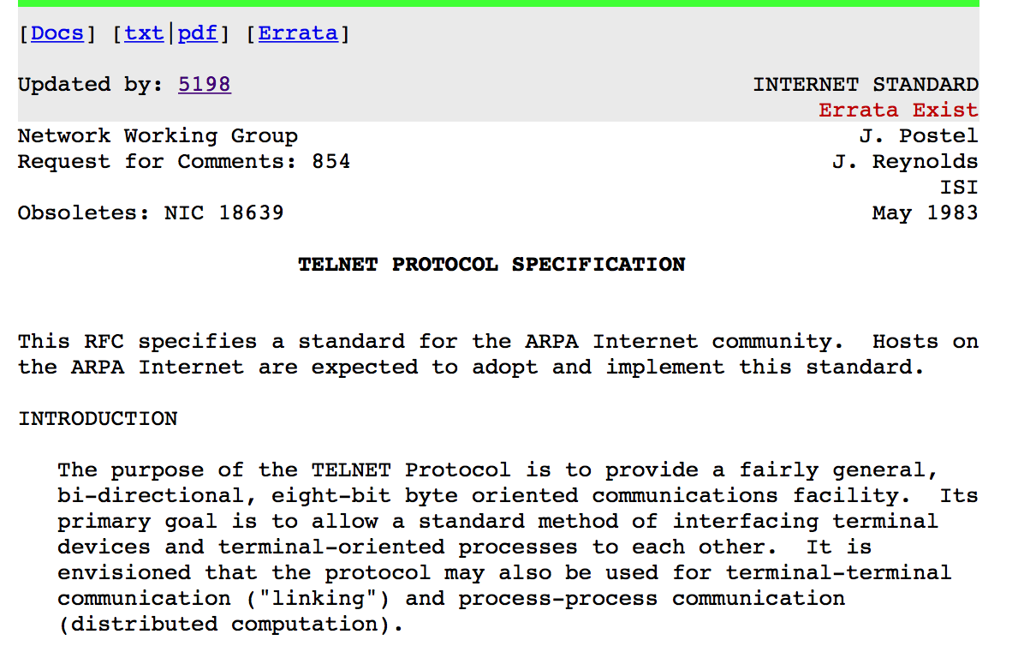
telnet

Slide 119
A telnet session
client
server
Connect_req
Connect_resp
Connect_conf
Login:
username
Password:
mypass
Is this secure ?

Slide 120
SSH
Basic principles
Public key used for authentication
Each host (client/server) has a public keypair
Diffie Hellman for key exchange
Secret key encryption for confidentiality

Slide 121
SSH
client
,Pub_{Server,},Priv_{Server}
SSH-2.0-OpenSSH_6.6.1
SSH-2.0-OpenSSH_6.9
SSH2_MSG_KEXINIT
SSH2_MSG_KEXINIT

Slide 122
SSH : key exchange
Principles
Diffie Hellman allows to securely exchange keys
but it needs to be authenticated !
When you use ssh to access UCLouvain’s servers, how do you authenticate them ?

Slide 123
Key exchange
client
,Pub_{Server,},Priv_{Server}
SSH2_MSG_KEXINIT
A=gª mod p
SSH2_MSG_KEXINIT
B=g^{b} mod p
Sign(Hash(V_{client}||V_{server}|| KEX_{Client}||KEX_{Server}||Pub_{Server}||A||B||K)
K=A^{b} mod p

Slide 124
User authentication
How does the server authenticate the user ?
Username/password
Sent over the encrypted channel
Public key authentication
User has his/her public/private keypair
Server knows user's public key and sends challenge

Slide 125
Agenda
Sharing resources
Network security principles
Security protocols
Transport Layer Security (TLS)
Ssh
Annoying attacks

Slide 126
Denial of Service attacks
How can Trudy saturate Alice’s link to make it impossible for her to use Internet ?
Naive approach
What was the bandwidth of the largest known DDoS attack ?
A
Lots of traffic sent by
Trudy
Can Terrence hide the attack and amplify it ?
T
https://www.cloudflare.com/en-gb/learning/ddos/famous-ddos-attacks/
Notes:
In 2024, Cloudflare mitigated the largest distributed denial-of-service (DDoS) attack ever reported, an attack that reached 5.6 terabits per second (Tbps) and 666 million packets per second at its peak. The attack lasted about 80 seconds and was part of a larger ongoing campaign of hyper-volumetric DDoS attacks. The Cloudflare network automatically mitigated the 5.6 Tbps attack and all other attacks that were part of the campaign, protecting Cloudflare customers.
The biggest DDoS attack to date took place in September of 2017. The attack targeted Google services and reached a size of 2.54 Tbps. Google Cloud disclosed the attack in October 2020.
The attackers sent spoofed packets to 180,000 web servers, which in turn sent responses to Google. The attack was not an isolated incident: the attackers had directed multiple DDoS attacks at Google's infrastructure over the previous six months.

Slide 127
Amplification attack
Protocol designers, beware !
S=B,D=A www.bob.net=...
A
B
S=A, D=B Q? www.bob.net
Terrence will try to send a short request that triggers a large response from Bob
T

