Slide 1
Part 3
Reliable data transfer over an unreliable network

Slide 2
Agenda
Making HTTP faster
Network security
Reliable data transfer over a reliable network
How unreliable is the Internet ?
Reliable data transfer techniques
The Alternating Bit Protocol
Go-Back-N
Selective repeat

Slide 3
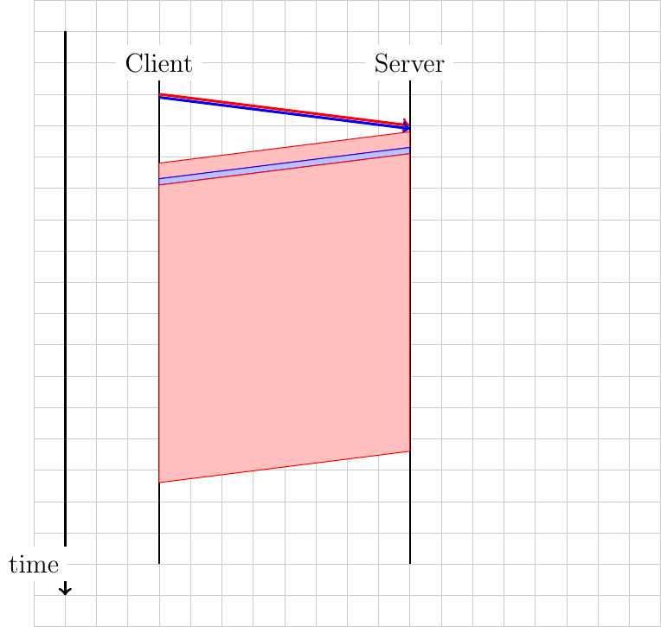
HTTP/2.0
How to realise ?
Source
Provider
Destination
DATA.request(”GET /a…")
DATA.ind(”GET /a")
DATA.request(“GET /b")
DATA.ind(”GET /b")
DATA.req(”AAAAAA")
DATA.ind(”AAAAAA")
DATA.req(”BBBB")
DATA.ind(”BBBB")
DATA.req(”AAAAAA")
DATA.ind(”AAAAAA")
DATA.req(”BBBB")
DATA.ind(”BBBB")

Slide 4
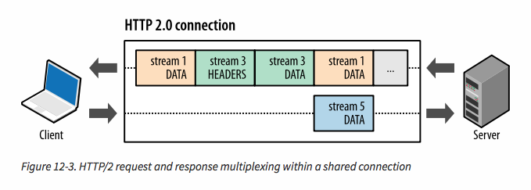
HTTP/2 streams
Source: https://hpbn.co/http2/

Slide 5
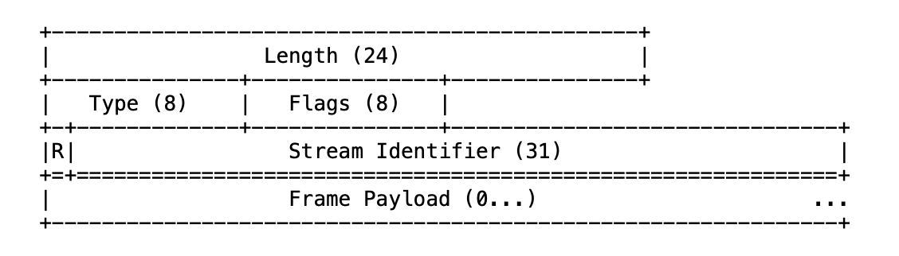

HTTP/2.0 Framing
How to divide the bytestream in different streams ?
AAAAABBBBBAAAAABBBB
Frame type
All implementations must support 16 KBytes
Reserved

Slide 6
HTTP/2.0 Frames
Different frame types
SETTINGS : configuration parameters
DATA : carries user data
Defines END_STREAM flag
HEADERS : HTTP command and headers
RST_STREAM : cancel stream

Slide 7

HTTP/2.0 Framing
Dividing stream in DATA frames
End of stream
AAAAABBBBAABBB
End of stream
Len=5,Type=Data,SID=1, Payload=“AAAAA”
Len=4,Type=Data,SID=2, Payload=“BBBB”
Len=2,Type=Data,Flag=ES,SID=1, Payload=“AA”
Len=3,Type=Data,Flag=ES,SID=2, Payload=“BBB”

Slide 8
HTTP/2 streams
Benefits
Client can send multiple requests in parallel
Server can decide the optimal delivery order
Server can interleave multiple objects and prioritise them

Slide 9
Agenda
Making HTTP faster
Network security
Reliable data transfer over a reliable network
How unreliable is the Internet ?
Reliable data transfer techniques
The Alternating Bit Protocol
Go-Back-N
Selective repeat

Slide 10
Agenda
Network security
Reliable data transfer over a reliable network
How unreliable is the Internet ?
Reliable data transfer techniques
The Alternating Bit Protocol
Go-Back-N
Selective repeat

Slide 11
How fast are hash functions
openssl speed md5
The 'numbers' are in 1000s of bytes per second processed.
type 16 bytes 64 bytes 256 bytes 1024 bytes 8192 bytes 16384 bytes
md5 103456.24k 270895.85k 516739.84k 663504.55k 721971.88k 706901.11k
openssl speed sha256
Doing sha256 ops for 3s on 16 size blocks: 28754762 sha256 ops in 3.00s
Doing sha256 ops for 3s on 64 size blocks: 24879496 sha256 ops in 2.98s
Doing sha256 ops for 3s on 256 size blocks: 16001414 sha256 ops in 2.99s
Doing sha256 ops for 3s on 1024 size blocks: 6468584 sha256 ops in 3.00s
Doing sha256 ops for 3s on 8192 size blocks: 962646 sha256 ops in 3.00s
Doing sha256 ops for 3s on 16384 size blocks: 473203 sha256 ops in 3.00s
version: 3.4.0
built on: Tue Oct 22 12:26:59 2024 UTC
options: bn(64,64)
compiler: clang -fPIC -arch arm64 -O3 -Wall -DL_ENDIAN -DOPENSSL_PIC -D_REENTRANT -DOPENSSL_BUILDING_OPENSSL -DNDEBUG
CPUINFO: OPENSSL_armcap=0x987d
The 'numbers' are in 1000s of bytes per second processed.
type 16 bytes 64 bytes 256 bytes 1024 bytes 8192 bytes 16384 bytes
sha256 153358.73k 534324.75k 1370020.73k 2207943.34k 2628665.34k 2584319.32k

Slide 12
How fast is encryption ?
openssl speed aes-256-cbc
Doing aes-256-cbc ops for 3s on 16 size blocks: 182049098 aes-256-cbc ops in 3.00s
Doing aes-256-cbc ops for 3s on 64 size blocks: 57304593 aes-256-cbc ops in 3.00s
Doing aes-256-cbc ops for 3s on 256 size blocks: 15250040 aes-256-cbc ops in 3.00s
Doing aes-256-cbc ops for 3s on 1024 size blocks: 3852487 aes-256-cbc ops in 3.00s
Doing aes-256-cbc ops for 3s on 8192 size blocks: 479772 aes-256-cbc ops in 2.98s
Doing aes-256-cbc ops for 3s on 16384 size blocks: 240162 aes-256-cbc ops in 3.00s
version: 3.4.0
built on: Tue Oct 22 12:26:59 2024 UTC
options: bn(64,64)
compiler: clang -fPIC -arch arm64 -O3 -Wall -DL_ENDIAN -DOPENSSL_PIC -D_REENTRANT -DOPENSSL_BUILDING_OPENSSL -DNDEBUG
CPUINFO: OPENSSL_armcap=0x987d
The 'numbers' are in 1000s of bytes per second processed.
type 16 bytes 64 bytes 256 bytes 1024 bytes 8192 bytes 16384 bytes
aes-256-cbc 970928.52k 1222497.98k 1301336.75k 1314982.23k 1318890.01k 1311604.74k

Slide 13
How fast is RSA ?
openssl speed rsa
version: 3.4.0
built on: Tue Oct 22 12:26:59 2024 UTC
options: bn(64,64)
compiler: clang -fPIC -arch arm64 -O3 -Wall -DL_ENDIAN -DOPENSSL_PIC -D_REENTRANT -DOPENSSL_BUILDING_OPENSSL -DNDEBUG
CPUINFO: OPENSSL_armcap=0x987d
sign verify encrypt decrypt sign/s verify/s encr./s decr./s
rsa 512 bits 0.000017s 0.000002s 0.000002s 0.000021s 58008.2 666143.2 574215.3 47738.5
rsa 1024 bits 0.000086s 0.000004s 0.000004s 0.000090s 11692.7 251421.5 231645.1 11099.6
rsa 2048 bits 0.000536s 0.000013s 0.000014s 0.000537s 1866.7 74949.8 72287.2 1860.7
rsa 3072 bits 0.001544s 0.000029s 0.000029s 0.001548s 647.5 34937.6 34066.1 646.2
rsa 4096 bits 0.003411s 0.000050s 0.000050s 0.003413s 293.2 20079.2 19871.5 293.0
rsa 7680 bits 0.027855s 0.000169s 0.000171s 0.027827s 35.9 5927.8 5841.4 35.9
rsa 15360 bits 0.149701s 0.000661s 0.000667s 0.149701s 6.7 1512.2 1500.0 6.7

Slide 14


One time passwords
A
B
Alice
Bob
Hello from Alice
Info about Alice
n=123
Hash¹²³(P)=ZROK
My current n is 123
Password : Hash¹²²(P)=VVBG
Info about Alice
n=122
Hash¹²²(P)=VVBG
Can Terrence attack this protocol ?
Notes:
In the example above, hash(VVBG)=ZROK

Slide 15
One-time passwords
A
T
B
Alice
Terrence impersonates Bob
Bob
Hello from Alice
Info about Alice
n=122
Hash¹²²(P)=VVBG
My current n is 8
Password : Hash⁷(P)=ABCT
Terrence already knows Hash⁷(P) ! and can compute Hash^{N}(P) with N>=7
Hello from Alice
Current n is 122
Hash¹²¹(P)=Z4FT
What can Alice do to counter this attack ?
Notes:
To avoid this Problem, Alice must remember the last value of n used by each server with whom she is communicating and should be warned when
the server requests a different value of n that the previous value.

Slide 16

Server authentication
Public-key certificates
To authenticate public keys, Alice and Bob must trust a third party
Certificates
S(Pub_{Bob} , Priv_{C})‏
Charles
Pub_{C,},Priv_{C}
B
A
Bob
Alice
Pub_{C, ,}Pub_{Bob,},Priv_{Bob}
S(Pub_{Bob} , Priv_{C} )‏
Pub_{C,}
Are you Bob ?
S(Yes,Priv_{Bob})‏
S(Pub_{Bob} , Priv_{C} )‏
Is this protocol secure (justify) ?
Notes:
In the example above, we use S(Pub_{Bob} , Priv_{C}) to indicate a certificate for Bob's key issued by Charles.
Charles usually checks the identity of Bob offline and then creates the certificate. Charles is sometimes referred to as a Trusted Third Party (TTP).

Slide 17
Are certificates sufficient ?
A
B
T
Alice
Terrence
Bob
Pub_{C,}
Pub_{C, ,}Pub_{Bob,},Priv_{Bob}
S(Pub_{Bob} , Priv_{C} )‏
Are you Bob ?
S(Yes,Priv_{Bob})‏
S(Pub_{Bob} , Priv_{C} )‏
Terrence copies the message sent
by Bob for later...
Are you Bob ?
S(Yes,Priv_{Bob})‏
S(Pub_{Bob} , Priv_{C} )‏
Terrence sends the saved copy
of Bob's message
Notes:
Replay attacks are common threats to security protocols.

Slide 18
Improved authentication
A
T
B
Alice
Terrence
Bob
Pub_{C}
Pub_{C, ,}Pub_{Bob,},Priv_{Bob}
S(Pub_{Bob} , Priv_{C} )‏
Are you Bob ?, Random_{Alice}
S(Yes,Random_{Alice} ,Priv_{Bob})‏
S(Pub_{Bob} , Priv_{C} )‏
Terrence copies the message sent
by Bob for later...
This is useless as the next request
sent by Alice will contain a different
random number
Random_{Alice} is a nonce
Notes:
The nonce is a random number. Note that to be secure, this nonce should be truly random. In practice, generating random numbers is not easy, For a detailed discussion, see :
RFC1750 Randomness Recommendations for Security. D. Eastlake, S. Crocker, J. Schiller. December 1994.

Slide 19
Diffie-Hellman g=5, p=23
b=13
a=8
A
B
Alice
Bob
A=gª mod p=16
B=g^{b} mod p=21
Secret=Bª mod p
=21⁸mod 23=3
Secret=A^{b} mod p
=16¹³ mod 23=3

Slide 20
Diffie-Hellman key exchange
b=random int
a=random int
A
B
Alice
Bob
A=gª mod p
B=g^{b} mod p
Secret=Bª mod p
Secret=A^{b} mod p

Slide 21
Diffie-Hellman
Is this safe ?
Mathematics
Researchers have tried to break the scheme for more than 4 decades
Attackers
Can Terrence find an attack against Diffie-Hellman ?

Slide 22
A possible MITM attack
b=random int
t=random int
a=random int
A
B
T
Alice
Terrence
Bob
A=gª mod p
T=g^{t} mod p
T=g^{t} mod p
B=g^{b} mod p
S_{B}=B^{t} mod p
S_{A}=A^{t} mod p
S_{B}=T^{b} mod p
S_{A}=Tª mod p

Slide 23
Solving the MITM attack
What can we do to prevent this Man in the Middle Attack ?
Pre-negotiated Shared secret
Use public keys
Public/Private keypair on Client
Public/Private keypair on Server

Slide 24
Authenticated Diffie-Hellman
Pub_{C, ,}Pub_{Bob,},Priv_{Bob}
S(Pub_{Bob} , Priv_{C} )‏
Charles
A
Pub_{C,},Priv_{C}
B
Alice
Bob
A=gª mod p
S(B=g^{b} mod p, Priv_{Bob})
Cert(Pub_{Bob} , Priv_{C} )‏
Secret=Bª mod p
Secret=A^{b} mod p

Slide 25
TLS handshake
A
B
Alice
Bob
Pub_{C}
Pub_{C, ,}Pub_{Bob,},Priv_{Bob}
S(Pub_{Bob} , Priv_{C} )‏
ClientHello (Ciphers, Random_{Alice})‏
ServerHello(Ciphers,Random_{Bob} )‏
Certificate(Pub_{Bob} , Priv_{C} )‏
Alice chooses PreMaster Secret
E( PreMasterSecret , Pub_{Bob})‏
Finished( H(handshake msgs,Key)‏
Finished( H(handshake msgs,Key))‏

Slide 26
Key Derivation
Client
Random
Server
Random
PreMaster
Secret
Master
Secret
Key Block
Client
MAC
Server
MAC
Client
Encrypt
Server
Encrypt
Client
IV
Server
IV

Slide 27
ClientHello message
Protocol Version
32 bytes long random number
4 bytes Unix time (seconds since 01/01/1970)‏
28 bytes random number
Session Id
Each SSL session has an identifier which can be used later to restart a session
List of supported Ciphers
List of supported Compression Methods

Slide 28
ClientHello
Supported ciphers
Authentication+Key Exchange+Cipher+Hash
TLS RSA WITH NULL MD5
TLS RSA EXPORT WITH RC4 40 MD5
TLS RSA WITH RC4 128 MD5
TLS RSA WITH DES CBC SHA
TLS RSA WITH 3DES EDE CBC SHA

Slide 29
ServerHello
Protocol version
Random
Session Id
Optional, sent by server if it allows sessions to be resumed later
Cipher Suite
One of the client cipher suites Compression Method

Slide 30
Session resumption
A
B
Alice
Bob
Pub_{C,}
Session 123 : MasterKey
Pub_{C, ,}Pub_{Bob,},Priv_{Bob}
S(Pub_{Bob} , Priv_{C} )‏
Session 123 : MasterKey
ClientHello (Ciphers, Session:123)‏
ServerHello(Ciphers,Session:123 )‏
ChangeCipherSpec
Finished( H(handshake msgs,Key)‏
ChangeCipherSpec
Finished( H(handshake msgs,Key)‏

Slide 31
Multiple https websites on a single server
Thanks to the Host HTTP header, we can have multiple web sites on the same physical server
When two https servers run on the same machine, do they use the same TLS certificate ?
dig +short ath.be
188.165.186.179
188.165.186.183
dig +short bastogne.be
188.165.186.179
188.165.186.183
dig +short namur.be
188.165.186.179
188.165.186.183

Slide 32
Exemple
openssl s_client -connect 188.165.186.179:443
Connecting to 188.165.186.179
CONNECTED(00000003)
Can't use SSL_get_servername
depth=2 C=US, O=Internet Security Research Group, CN=ISRG Root X1
verify return:1
depth=1 C=US, O=Let's Encrypt, CN=R11
verify return:1
depth=0 CN=actualites.enwallonie.be
verify return:1
---
Certificate chain
0 s:CN=actualites.enwallonie.be
i:C=US, O=Let's Encrypt, CN=R11
a:PKEY: rsaEncryption, 4096 (bit); sigalg: RSA-SHA256
v:NotBefore: Feb 17 16:20:39 2025 GMT; NotAfter: May 18 16:20:38 2025 GMT
1 s:C=US, O=Let's Encrypt, CN=R11
i:C=US, O=Internet Security Research Group, CN=ISRG Root X1
a:PKEY: rsaEncryption, 2048 (bit); sigalg: RSA-SHA256
v:NotBefore: Mar 13 00:00:00 2024 GMT; NotAfter: Mar 12 23:59:59 2027 GMT
---
Server certificate
openssl s_client -connect nivelles.be:443
Connecting to 188.165.186.183
CONNECTED(00000005)
depth=2 C=US, O=Internet Security Research Group, CN=ISRG Root X1
verify return:1
depth=1 C=US, O=Let's Encrypt, CN=R11
verify return:1
depth=0 CN=www.nivelles.be
verify return:1
---
Certificate chain
0 s:CN=www.nivelles.be
i:C=US, O=Let's Encrypt, CN=R11
a:PKEY: rsaEncryption, 4096 (bit); sigalg: RSA-SHA256
v:NotBefore: Dec 31 04:43:02 2024 GMT; NotAfter: Mar 31 04:43:01 2025 GMT
1 s:C=US, O=Let's Encrypt, CN=R11
i:C=US, O=Internet Security Research Group, CN=ISRG Root X1
a:PKEY: rsaEncryption, 2048 (bit); sigalg: RSA-SHA256
v:NotBefore: Mar 13 00:00:00 2024 GMT; NotAfter: Mar 12 23:59:59 2027 GMT
---

Slide 33

A single physical server for many TLS services
Server Name Indication
Tom
Alice
Bob
Pub_{C, ,}Pub_{Tom,},Priv_{Tom}
S(Pub_{Tom} , Priv_{C} )‏
Pub_{C,}
Pub_{C, ,}Pub_{Bob,},Priv_{Bob}
S(Pub_{Bob} , Priv_{C} )‏
ClientHello (SNI=bob.be Ciphers, Random_{Alice})‏
ServerHello(Ciphers,Random_{Bob} )‏
Certificate(Pub_{Bob} , Priv_{C} )‏
Alice chooses PreMaster Secret
E( PreMasterSecret , Pub_{Bob})‏
Finished( H(handshake msgs,Key)‏
Finished( H(handshake msgs,Key))‏
Privacy concern: can be used to track sites visited by users if ClientHello is captured. Ongoing effort towards ESNI

Slide 34
TLS 1.3
Why changing TLS ?
TLS was considered to be too slow
Two round-trip-times
TLS was considered to be too complex
Some attacks have affected TLS
Privacy became a strong focus within the IETF

Slide 35
Design objectives
simplify the design by removing unused or unsafe protocol features
only a small number of cipher suites
improve the security of TLS
no compression or unsafe features
improve the privacy of the protocol
perfect forward secrecy
reduce the latency of TLS

Slide 36
Perfect Forward Secrecy
Definition
An encryption system has the property of forward secrecy if plain-text (decrypted) inspection of the data exchange that occurs during key agreement phase of session initiation does not reveal the key that was used to encrypt the remainder of the session.
Does TLS support PFS ?

Slide 37
Does TLS support PFS ?
Not when RSA is used
Pub_{C}
Pub_{C, ,}Pub_{Bob,},Priv_{Bob}
S(Pub_{Bob} , Priv_{C} )‏
ClientHello (Ciphers, Random_{Alice})‏
ServerHello(Ciphers,Random_{Bob} )‏
Certificate(Pub_{Bob} , Priv_{C} )‏
Alice chooses PreMaster Secret
E( PreMasterSecret , Pub_{Bob})‏
Z
T
Some TLS ciphers use Diffie-Hellman

Slide 38
Simplifying the handshake
Reduce the number of ciphers supported
Less negotiation between client/server
Diffie-Hellman is now required
Client immediately starts Diffie-Hellman before having validated the server certificate

Slide 39
TLS 1.3 handshake
A
B
Alice
Bob
Pub_{C}
Pub_{C, ,}Pub_{Bob,},Priv_{Bob}
S(Pub_{Bob} , Priv_{C} )‏
ClientHello (gª mod p, Random_{Alice})‏
ServerHello(g^{b} mod p,Random_{Bob} )‏
Certificate(Pub_{Bob} , Priv_{C} )
Sign(DH_{key},Handshake)
Finished
Encrypted Data‏
Bob computes DH_{key}
Alice computes DH_{key}
Finished, Encrypted Data

Slide 40
A single physical server for many TLS services
Server Name Indication
Tom
Alice
Bob
Pub_{C, ,}Pub_{Tom,},Priv_{Tom}
S(Pub_{Tom} , Priv_{C} )‏
Pub_{C,}
Pub_{C, ,}Pub_{Bob,},Priv_{Bob}
S(Pub_{Bob} , Priv_{C} )‏
ClientHello (gª mod p, Random_{Alice,}SNI=Bob)‏
ServerHello(g^{b} mod p,Random_{Bob} )‏
Certificate(Pub_{Bob} , Priv_{C} )
Sign(DH_{key},Handshake)
Finished
Encrypted Data‏

Slide 41
Agenda
Improving HTTP
Network security
Reliable data transfer over a reliable network
How unreliable is the Internet ?
Reliable data transfer techniques
The Alternating Bit Protocol
Go-Back-N
Selective repeat

Slide 42


How to reliably transfer data ?
Hypothesis
Internet is fully reliable
A B
Data.request(a)
segment(a)
Data.request(b)
segment(b)
Data.ind(a)
Data.request(c)
segment(c)
Data.ind(b)
Data.ind(c)

Slide 43
The Internet is imperfect
Packets sent by a host can
Reach their destination correctly
Be affected by transmission errors on their way to their destination
10^-9
Never reach their final destination
Can affect a few percent of the packets

Slide 44
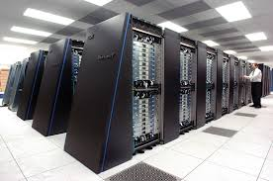
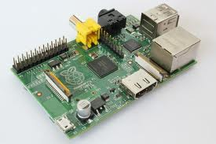
Does this always work ?

Slide 45
Question
What do we need to add to our “reliable” transfer to allow a datacenter to send data to an Internet of Things device without overflow ?

Slide 46
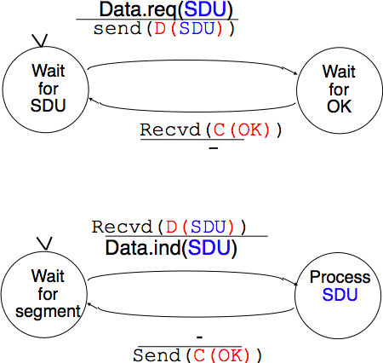
Finite State Machine
Sender
Receiver

Slide 47
Control and data segments
A B
Data.req(a)
D(a)
Data.req(b)
C(OK)
Data.ind(a)
D(b)
Round trip time (rtt)
C(OK)
Data.ind(b)
Header
Payload
Trailer

Slide 48
Question
Two hosts are connected with a 1 Gbps (10^9 bits/sec) network. It takes one msec to deliver a 1000 bits segment from host A to host B (and one msec in the opposite direction). What is the bandwidth that our protocol will achieve (in bits per second) ?

Slide 49
Agenda
Reliable data transfer over a reliable network
How unreliable is the Internet ?
Reliable data transfer techniques
The Alternating Bit Protocol
Go-Back-N
Selective repeat

Slide 50
The network is imperfect
What can happen to a packet sent over the Internet ?
Packet reaches destination
Packet can suffer transmission errors
Packet contents can be corrupted
Links have typically Bit Error Rates of 10⁻⁸ to 10⁻¹¹
Wireless suffers from more errors than cable and fiber
Packet can be dropped before reaching destination
Packet can be delayed

Slide 51
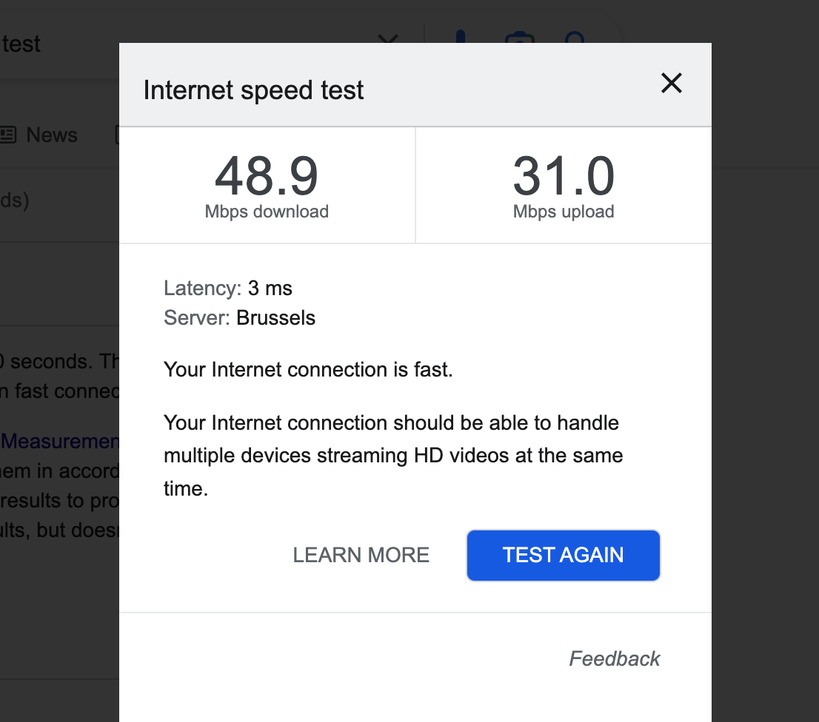
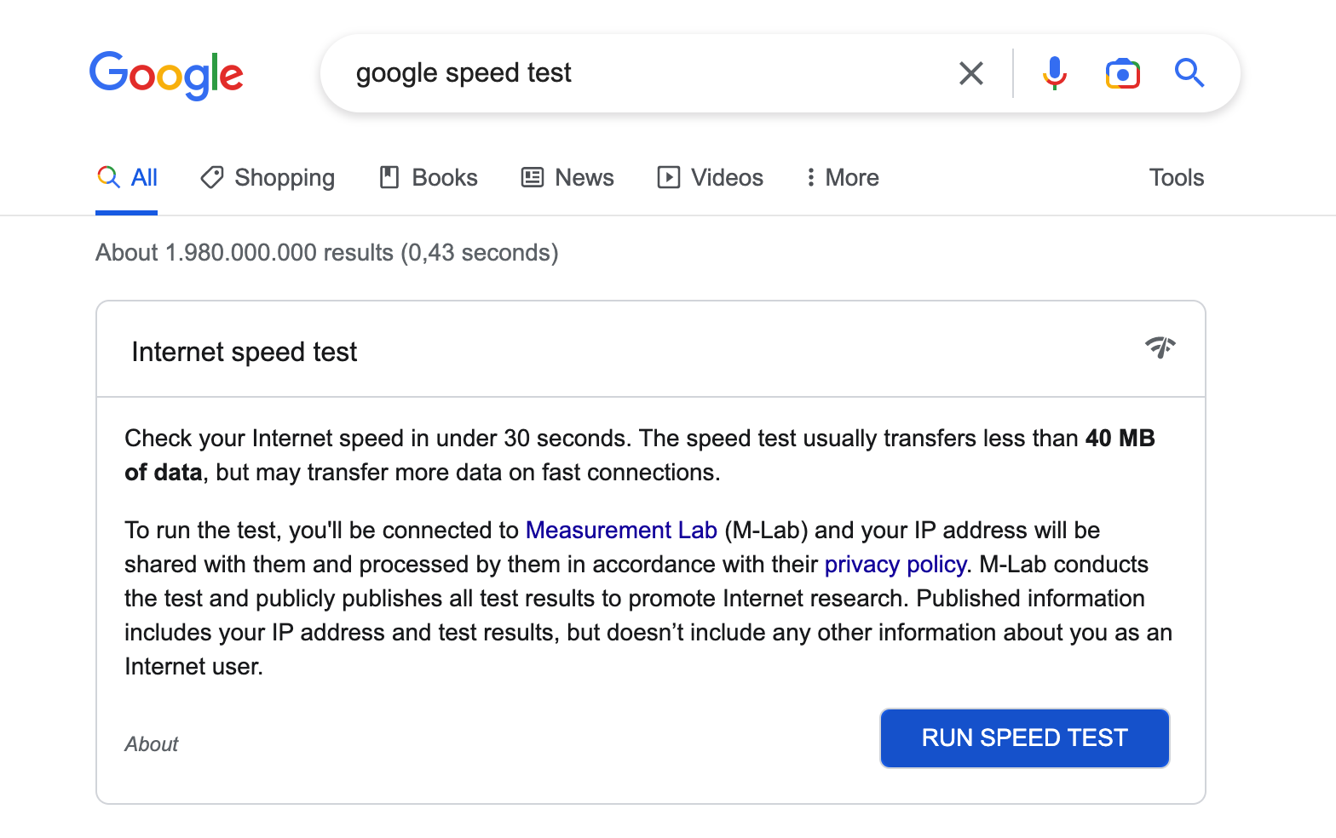
Measuring Internet performance

Slide 52
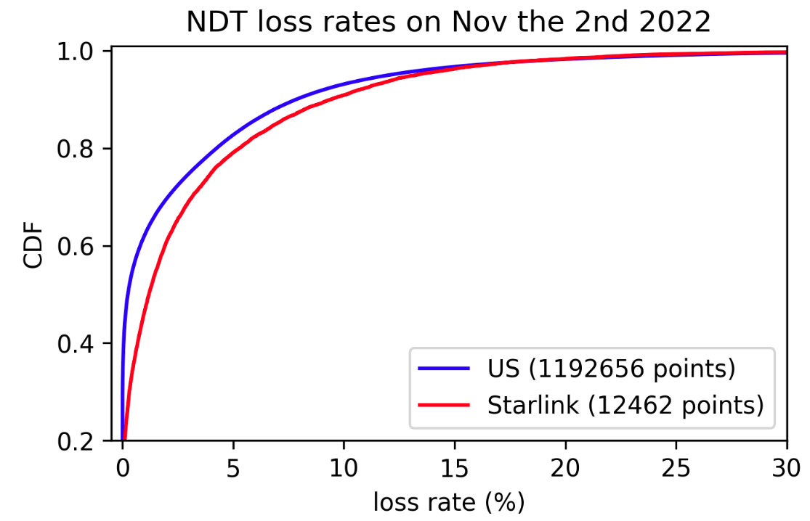
Internet packet losses
What can explain these packet loss ratios ?
Based on data extracted by François Michel from measurementlab’s big query

Slide 53
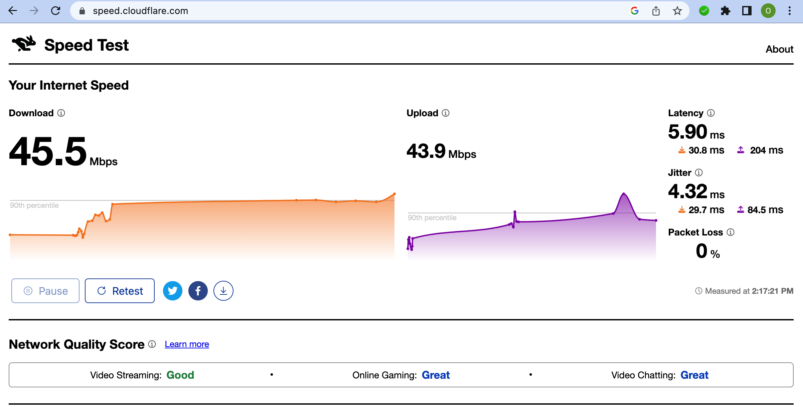
Measuring Internet performance (2)

Slide 54
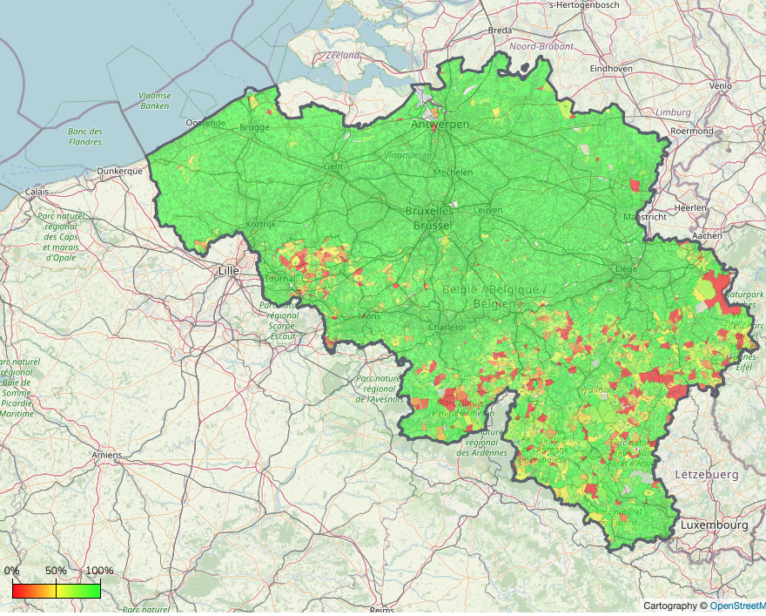
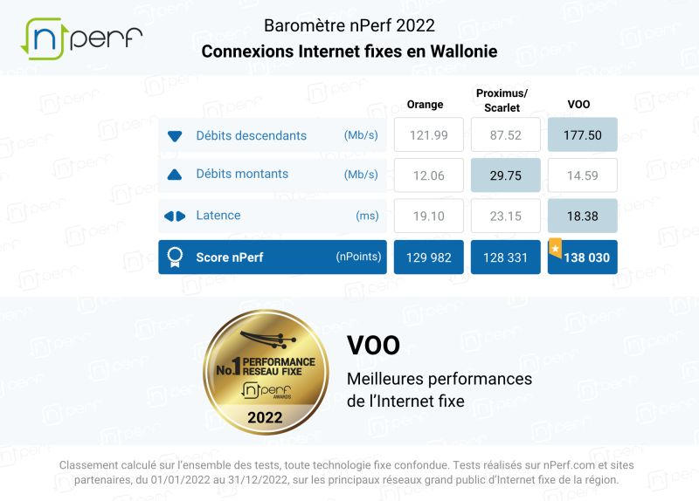
Internet performance in Wallonia
Broadband access at 30 Mbps or better

Slide 55
Initiative Amélie Améliorer Internet partout
Objectif
L’initiative Amélie vise à mettre sur pied une équipe d’étudiant.e.s bénévoles afin de proposer un service de diagnostic Internet d’habitations privées. L’objectif est d’aider les habitants à améliorer la qualité de leur connexion Internet sans nécessairement changer d’offre ou de fournisseur
Mise en oeuvre
Formation à l’analyse des performances en utilisant des outils adaptés et au diagnostic des facteurs qui réduisent les performances
Coaching par des chercheurs qui améliorent Internet et des étudiant.e.s de Master

Slide 56
Agenda
Reliable data transfer over a reliable network
How unreliable is the Internet ?
Reliable data transfer techniques
The Alternating Bit Protocol
Go-Back-N
Selective repeat

Slide 57
How to deal with transmission errors ?
The receiver must be able to detect that the content of a segment has been modified
Checksum, CRC

Slide 58
Checksums versus CRC
https://dl.acm.org/doi/pdf/10.1145/347057.347561

Slide 59
Question
How should a host react when it receives a data segment with an incorrect checksum ?

Slide 60
Coping with errors
A B
Data.req(a)
D(a)
Data.req(b)
C(OK)
Data.ind(a)
start timer
D(b)
timer expires
D(b)
Data.ind(b)
Does this protocol always works ?

Slide 61
Coping with errors
A B
Data.req(a)
D(a)
Data.req(b)
C(OK)
Data.ind(a)
start timer
D(b)
C(OK)
Data.ind(b)
timer expires
D(b)
Data.ind(b)
Is this a problem for you ?

Slide 62
A better approach
Key ideas
Identify each data segment with a sequence number
allows to prevent duplication
one bit is sufficient
Indicate the sequence number of the last data segment in the acknowledgement

Slide 63
Alternating Bit Protocol : basics
A B
Data.req(a)
D(0,a)
Data.req(b)
C(OK0)
Data.ind(a)
D(1,b)
Data.req(c)
Data.ind(b)
C(OK1)
D(0,c)
Data.ind(c)
C(OK0)

Slide 64
Alternating Bit Protocol : reaction to losses
A B
Data.req(a)
D(0,a)
Data.req(b)
C(OK0)
Data.ind(a)
D(1,b)
Data.ind(b)
D(1,b) recvd
C(OK1)
Data.req(c)
D(0,c)
Lost
Retransmission timer
D(0,c)
Data.ind(c)
C(OK0)

Slide 65
Alternating Bit Protocol : early timer
A B
Data.req(a)
D(0,a)
Data.req(b)
C(OK0)
Data.ind(a)
D(1,b)
Retransmission timer
D(1,b)
Data.ind(b)
D(1,b) recvd
C(OK1)
Duplicate detected
Which ack to send ?
C(OK1)
D(1,b) recvd
Data.req(c)
D(0,c)
Data.ind(c)

Slide 66
Question
Do we need to place a checksum/CRC inside the control segments ?

Slide 67
Alternating Bit Protocol : unprotected control segments
A B
Data.req(a)
D(0,a)
Data.req(b)
C(OK0)
Data.ind(a)
D(1,b)
Retransmission timer
D(1,b)
Data.ind(b)
D(1,b) recvd
C(OK1)
Duplicate detected
Data.req(c)
C(OK0)
Undetected transmission error
D(0,c) recvd
D(0,c)
Lost
Data.req(d)
D(1,d)
C(OK1)
Duplicate detected

Slide 68
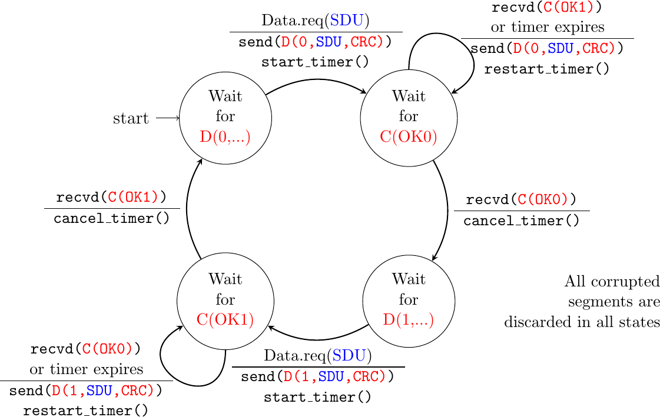
Alternating bit : sender

Slide 69
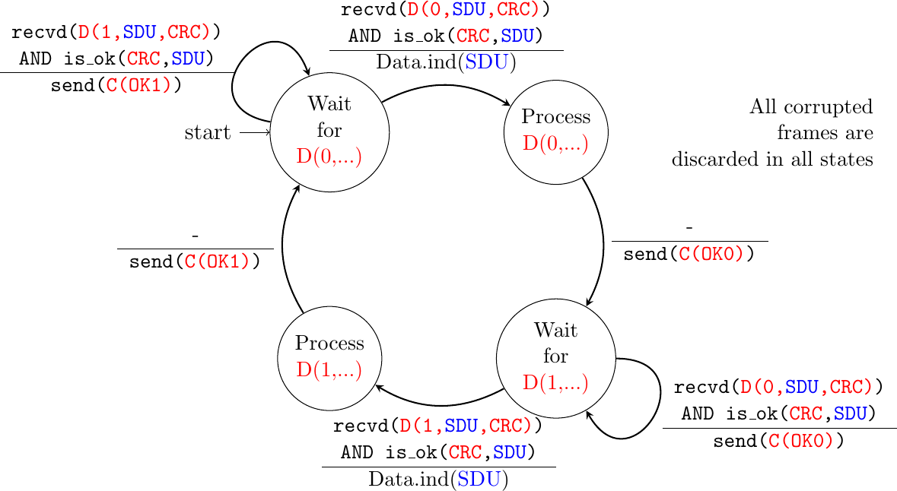
Alternating Bit : Receiver

Slide 70
Alternating Bit Protocol
A B
Data.req(a)
D(0,a)
Data.req(b)
C(OK0)
Data.ind(a)
D(1,b)
Retransmission timer
D(1,b)
Data.ind(b)
D(1,b) recvd
C(OK1)
Data.req(c)
C(OK0)
Duplicate detected
Transmission error
D(0,c) recvd
D(0,c)
Lost
Data.req(d)
D(1,d)
C(OK0)
Duplicate detected

Slide 71
Alternating Bit Protocol
Advantages
Simple to implement
Reliable data transfer
Drawback
Performance
only one segment per round-trip-time

Slide 72
Agenda
Reliable data transfer over a reliable network
How unreliable is the Internet ?
Reliable data transfer techniques
The Alternating Bit Protocol
Go-Back-N
Selective repeat

Slide 73
Pipelining
Key ideas
Allow the sender to send several segments without having an explicit ack
Sender stores unacked segments in a buffer called the sending window to be able to retransmit them

Slide 74
Pipelining
A B
Data.req(a)
D(0,a)
Data.req(b)
...
Data.ind(a)
Data.req(e)
...
D(4,e)
Data.ind(e)
How many segments can A send ?

Slide 75
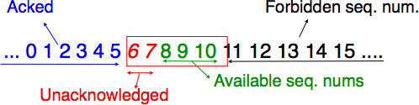
The sending window
Buffer managed by a sender
Stores segments sent but not yet acknowledged
Content of sending window can be retransmitted if needed
Sending window size limits the number of segments that a host can sent without acknowledgements

Slide 76
Pipelining example
A B
Sending window
0 1 2 3 4 5 6 7 8
Data.req(a)
0 1 2 3 4 5 6 7 8
0 1 2 3 4 5 6 7 8
Data.req(b)
D(0,a)
0 1 2 3 4 5 6 7 8
D(1,b)
Data.req(c)
D(2,c)
Data.ind(a)
0 1 2 3 4 5 6 7 8
Data.ind(b)
C(OK0)
Data.ind(c)
0 1 2 3 4 5 6 7 8
C(OK1)
Data.req(d)
C(OK2)
0 1 2 3 4 5 6 7 8
0 1 2 3 4 5 6 7 8
Data.req(e)
D(3,d)
0 1 2 3 4 5 6 7 8
Data.ind(d)
D(4,e)
Sending window must be larger than bandwidth x round-trip-time to fully use network

Slide 77
Sequence numbers are finite and reused
A B
Sending window
0 1 2 3
Data.req(a)
0 1 2 3
0 1 2 3
Data.req(b)
D(0,a)
0 1 2 3
D(1,b)
Data.req(c)
D(2,c)
Data.ind(a)
0 1 2 3
Data.ind(b)
C(OK0)
Data.ind(c)
0 1 2 3
C(OK1)
Data.req(d)
C(OK2)
0 1 2 3
0 1 2 3
Data.req(e)
D(3,d)
0 1 2 3
Data.ind(d)
D(0,e)

Slide 78
How to deal with losses ?
Go-back-n
Sender stores transmitted segments in sending window to be able to retransmit them if needed
Simple receiver, accepts only in-sequence segments. If a segment is errored, sender retransmits all unacked segments
Selective repeat
Sender stores transmitted segments in sending window to be able to retransmit them if needed
Advanced receiver, stores out-of-sequence segments. If a segment is errored, sender only retransmits the errored segments

Slide 79
Go-back-n
A B
Sending window
0 1 2 3
Data.req(a)
0 1 2 3
0 1 2 3
Data.req(b)
D(0,a)
Lost
0 1 2 3
D(1,b)
Data.req(c)
D(2,c)
Data.ind(a)
0 1 2 3
Retransmission
timer expires
C(OK,0)
Not expected seq num,
discarded
Data.req(d)
C(OK,0)
0 1 2 3
D(1,b)
0 1 2 3
Data.req(e)
D(2,c)
Data.ind(b)
Sending window is full
Data.ind(c)
D(3,d)
Data.ind(d)

Slide 80
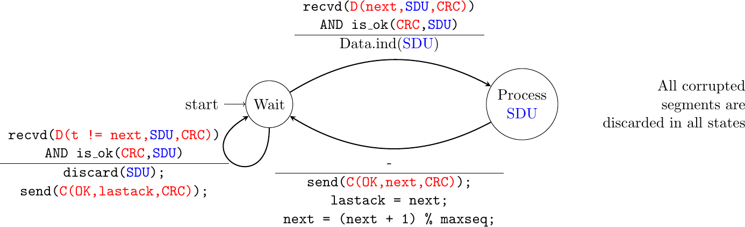
Go-back-n : receiver

Slide 81
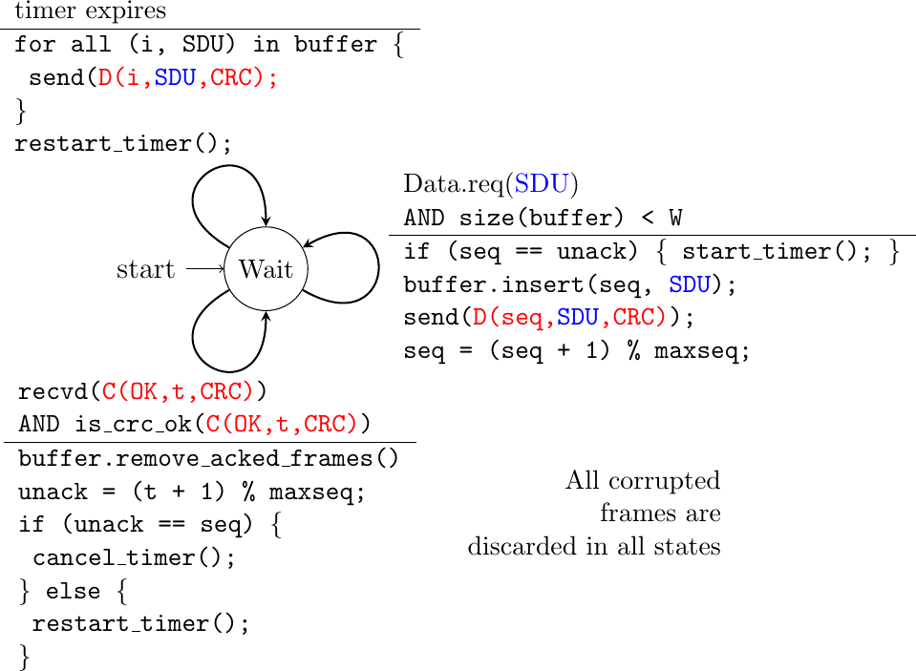
Go-back-n : sender

Slide 82
Go-back-n : example
A B
Sending window
0 1 2 3
Data.req(a)
0 1 2 3
0 1 2 3
Data.req(b)
D(0,a)
Lost
0 1 2 3
D(1,b)
Data.req(c)
D(2,c)
Data.ind(a)
0 1 2 3
Retransmission
timer expires
C(OK,0)
Not expected seq num,
discarded
Data.req(d)
C(OK,0)
0 1 2 3
D(1,b)
0 1 2 3
Data.req(e)
D(2,c)
Data.ind(b)
Sending window is full
Data.ind(c)
D(3,d)
Data.ind(d)

Slide 83
Question
You implement a go-back-n receiver using 3 bits to encode the sequence number. You have correctly received segment 7 and delivered its content. You now receive a correct segment 0, how do you react ?
you ignore the segment and send ACK(7)
you accept the segment, deliver it and send ACK(7)
you accept the segment, deliver it and send ACK(0)

Slide 84
Question
Go-back-n is used in a network where all data segments are correctly received, but every second acknowledgement is corrupted. How many data segments will be retransmitted by the sender if it needs to reliably send 20 data segments ?

Slide 85
Maximum window
What is the maximum window size that can be used with go-back-n ?
Sequence numbers are encoded in N bits

Slide 86
Question
Go-back-n is used by a protocol that encodes sequence numbers using 5 bits. What is the largest possible sending window (in segments) ?

Slide 87
Question
Go-back-n is used in a satellite network with a round-trip-time of 1 sec. What is the minimum sending window (in segments) to fully use a 1 Mbps link using 10.000 bits segments ?

Slide 88
Agenda
Reliable data transfer over a reliable network
How unreliable is the Internet ?
Reliable data transfer techniques
The Alternating Bit Protocol
Go-Back-N
Selective repeat

Slide 89
The receive window
Buffer managed by receiver
Stores segments received out-of-order
Segments remain in receive window until gaps are filled
Receive window size limits the number of segments that the sender can send without acknowledgements
Sending window cannot be larger than the other side receive’s window
Not yet received
Received
Forbidden seq. num.
0 1 2 3 4 5 6 7 8 9 10 11 12 13 14
Already delivered
Window

Slide 90
Selective repeat
A B
Sending window
Rec. window
0 1 2 3
Data.req(a)
0 1 2 3
0 1 2 3
0 1 2 3
Data.req(b)
D(0,a)
Lost
0 1 2 3
D(1,b)
Data.req(c)
D(2,c)
Data.ind(a)
0 1 2 3
0 1 2 3
Retransmission timer expires
C(OK,0)
0 1 2 3
Segment stored
0 1 2 3
C(OK,0)
0 1 2 3
Data.req(d)
0 1 2 3
D(1,b)
D(3,d)
Data.ind(b)
0 1 2 3
Data.ind(c)
0 1 2 3
C(OK,2)
Data.ind(d)
C(OK,3)
0 1 2 3

Slide 91
Buffer management
A reliable transport serves a variable number of applications with a limited buffer
The buffer/window allocated to a given connection may need to change dynamically as connections start and stop

Slide 92
Buffer management
A B
Swin=3, rwin=1
Swin=3, rwin=1
Rwin=1
0 1 2 3
0 1 2 3
Data.req(a)
D(0,a)
0 1 2 3
Data.ind(a)
0 1 2 3
Swin=3, rwin=1
Swin=3, rwin=1
0 1 2 3
C(OK,0, w=1)
0 1 2 3
Data.req(b)
2 new buffers become available
C(OK,0,w=3)
Swin=3, rwin=3
D(1,b)
0 1 2 3
Data.req(c)
0 1 2 3
D(2,c)
Data.ind(b)
Data.req(d)
C(OK,1,w=3)
D(3,d)
0 1 2 3

Slide 93
Buffer management
A B
Swin=3, rwin=1
Swin=3, rwin=1
Rwin=1
0 1 2 3
0 1 2 3
Data.req(a)
D(0,a)
0 1 2 3
Receiver cannot handle segment immediately
C(OK,0, w=0)
Data.ind(a)
Swin=3, rwin=0
Data.req(b)
0 1 2 3
2 new buffers are
available
Window blocked No transmission possible
Lost segment
C(OK,0,w=3)
0 1 2 3
Waits for control segment
Waits for data segment
How to recover from this deadlock ?
Persistence timer on receiver, resend control segment after timer expiration

Slide 94
Bidirectional transfer
How to efficiently carry data in both directions ?

Slide 95
Piggybacking
A B
Data.req(a)
Data.req(b)
D(0,0,a)
Error
Data.req(w)
Data.req(c)
D(1,0,b)
Data.ind(a)
D(2,0,c)
Data.ind(w)
D(5,0,w)
Discarded
D(5,0,w) acks D(0,0,a)
Data.req(x)
D(6,0,x)
Retransmission
Segment -> buffer
D(1,5,b)
Data.req(d)
Data.ind(x)
Data.ind(b)
D(3,6,d)
Data.ind(c)
C(OK,2)
Data.ind(d)
C(OK,3)

Slide 96
Bytestream
How to provide a bytestream service ?

Slide 97
Byte stream service (2)
A B
Data.req(abcdef)
D(0,ab)
Lost segment
D(2,cd)
Data.ind(ab)
D(4,ef)
Expiration timer
Retransmission
C(OK,1)
Placed in buffer
C(OK,1)
Data.req(ijkl)
Data.req(mnop)
D(2,cd)
D(6,ijklmnop)
Data.ind(cdef)
C(OK,5)
Data.ind(ijklmnop)
C(OK,13)

Slide 98
Delayed segments
Data.req(a)
A B
D(0,a)
Data.ind(a)
D(1,b)
C(OK,0)
D(3,d)
Timer expiration
Retransmission
C(OK,0)
D(1,b)
Data.ind(b)
C(OK,3)
Data.ind(e)
D(0,e)
Data.ind(e)
C(OK,0)
Data.ind(b) !!!!!!!!!!!!
C(OK,1)

Slide 99
Delayed segments
How to deal with them ?
Packets cannot live more than MSL seconds inside the network
Only one segment carrying sequence number x can be transmitted during MSL seconds
upper bound on maximum throughput
Notes:
MSL means Maximum Segment Lifetime

Slide 100
Checksums
How to verify that a transmission has not been affected by random errors ?
Checksum
CRC

Slide 101
Selective repeat
A B
Sending window
Rec. window
0 1 2 3
Data.req(a)
0 1 2 3
0 1 2 3
0 1 2 3
Data.req(b)
D(0,a)
Lost
0 1 2 3
D(1,b)
Data.req(c)
D(2,c)
Data.ind(a)
0 1 2 3
0 1 2 3
Retransmission timer expires
C(OK,0)
0 1 2 3
Frame stored
0 1 2 3
C(OK,0)
0 1 2 3
Data.req(d)
0 1 2 3
D(1,b)
D(3,d)
Data.ind(b)
0 1 2 3
Data.ind(c)
0 1 2 3
C(OK,2)
Data.ind(d)
C(OK,3)
0 1 2 3

Slide 102
Question
You implement a selective repeat receiver using 3 bits to encode the sequence number. You have correctly received segment 6 and delivered its content. You receive a correct segment 1, what do you do ?
you ignore the segment and send ACK(6)
you accept the segment, store it in your buffer and send ACK(6)
you accept the segment, store it in your buffer and send ACK(1)

Slide 103
Question
You implement a selective repeat receiver using 3 bits to encode the sequence number. You have correctly received segment 7 and delivered its content. You receive a correct segment 3, what do you do ?
you ignore the segment and send ACK(7)
you accept the segment, store it in your buffer and send ACK(7)
you accept the segment, store it in your buffer and send ACK(3)

Slide 104
Question
Which of these two techniques provides the best error detection capability ?
CRC
Internet checksum

Slide 105
Question
Where should we place the CRC/checksum ?
Header
Payload
Trailer

Slide 106
Question
Should the Checksum/CRC also protect the header ?
Header
Payload
Trailer

Slide 107
Hash functions
What is the role of hash functions like MD5 or SHA-1 ?
Do they play the same role as CRCs and checksums ?

Slide 108
Agenda
Reliable transmission
Checksums
Framing
Go-back-n
Selective repeat
Building a network

Slide 109
Framing techniques
Bit stuffing
Character stuffing

Slide 110
Question
How to combine bit stuffing and checksums ?
Apply stuffing first and then compute checksum on the sender
Compute checksum and then apply stuffing
Header
Payload
Trailer

Slide 111
Character stuffing
What are the advantages/drawbacks of character stuffing compared to bit stuffing ?

Slide 112
Maximum window
What is the maximum window size that can be used with selective repeat ?
Sequence numbers are encoded in N bits

Slide 113
Performance
What is the minimum window size required to achieve high throughput
When there are no losses ?
When a few frames are errored/lost ?
Go-back-n
Selective repeat

Slide 114
Take back lessons
Usage of Checksums/CRCs
Finite State Machines
Cumulative acknowledgements
Bandwidth x delay product

