Slide 1
Part 4 Reliable transport and TCP

Slide 2
Agenda
Reliable data transfer techniques
The Alternating Bit Protocol
Go-Back-N
Selective repeat
Managing a connection
Connection establishment
Connection release
TCP
Connection establishment
Data transfer
Connection release
Modern TCP

Slide 3
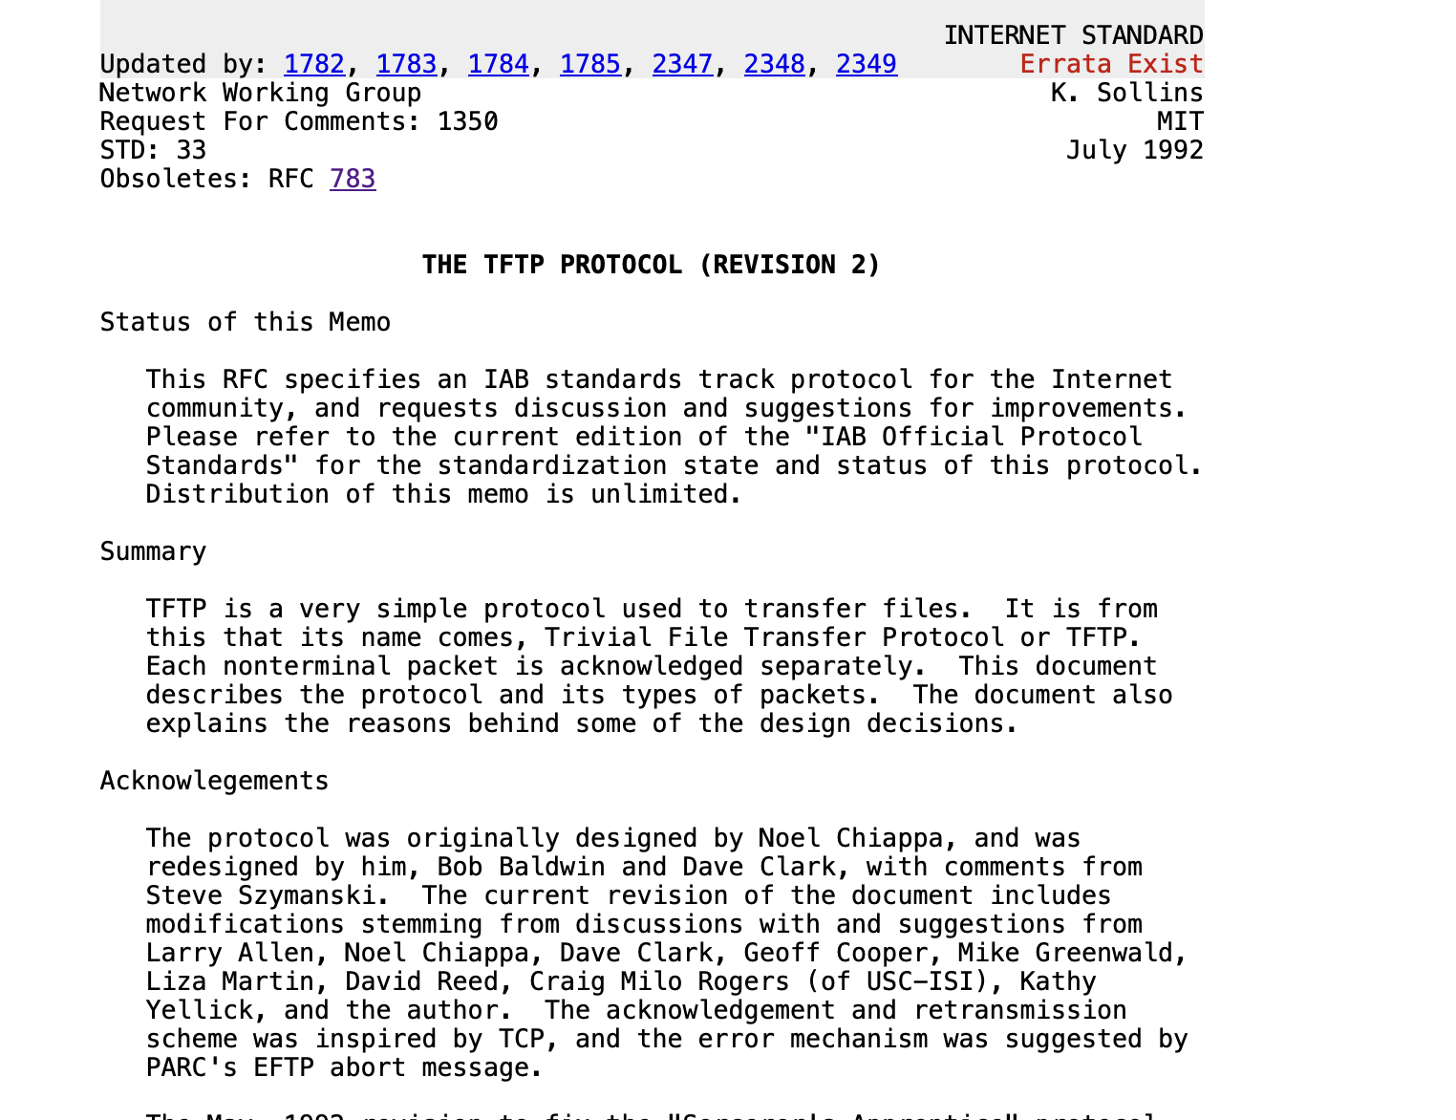
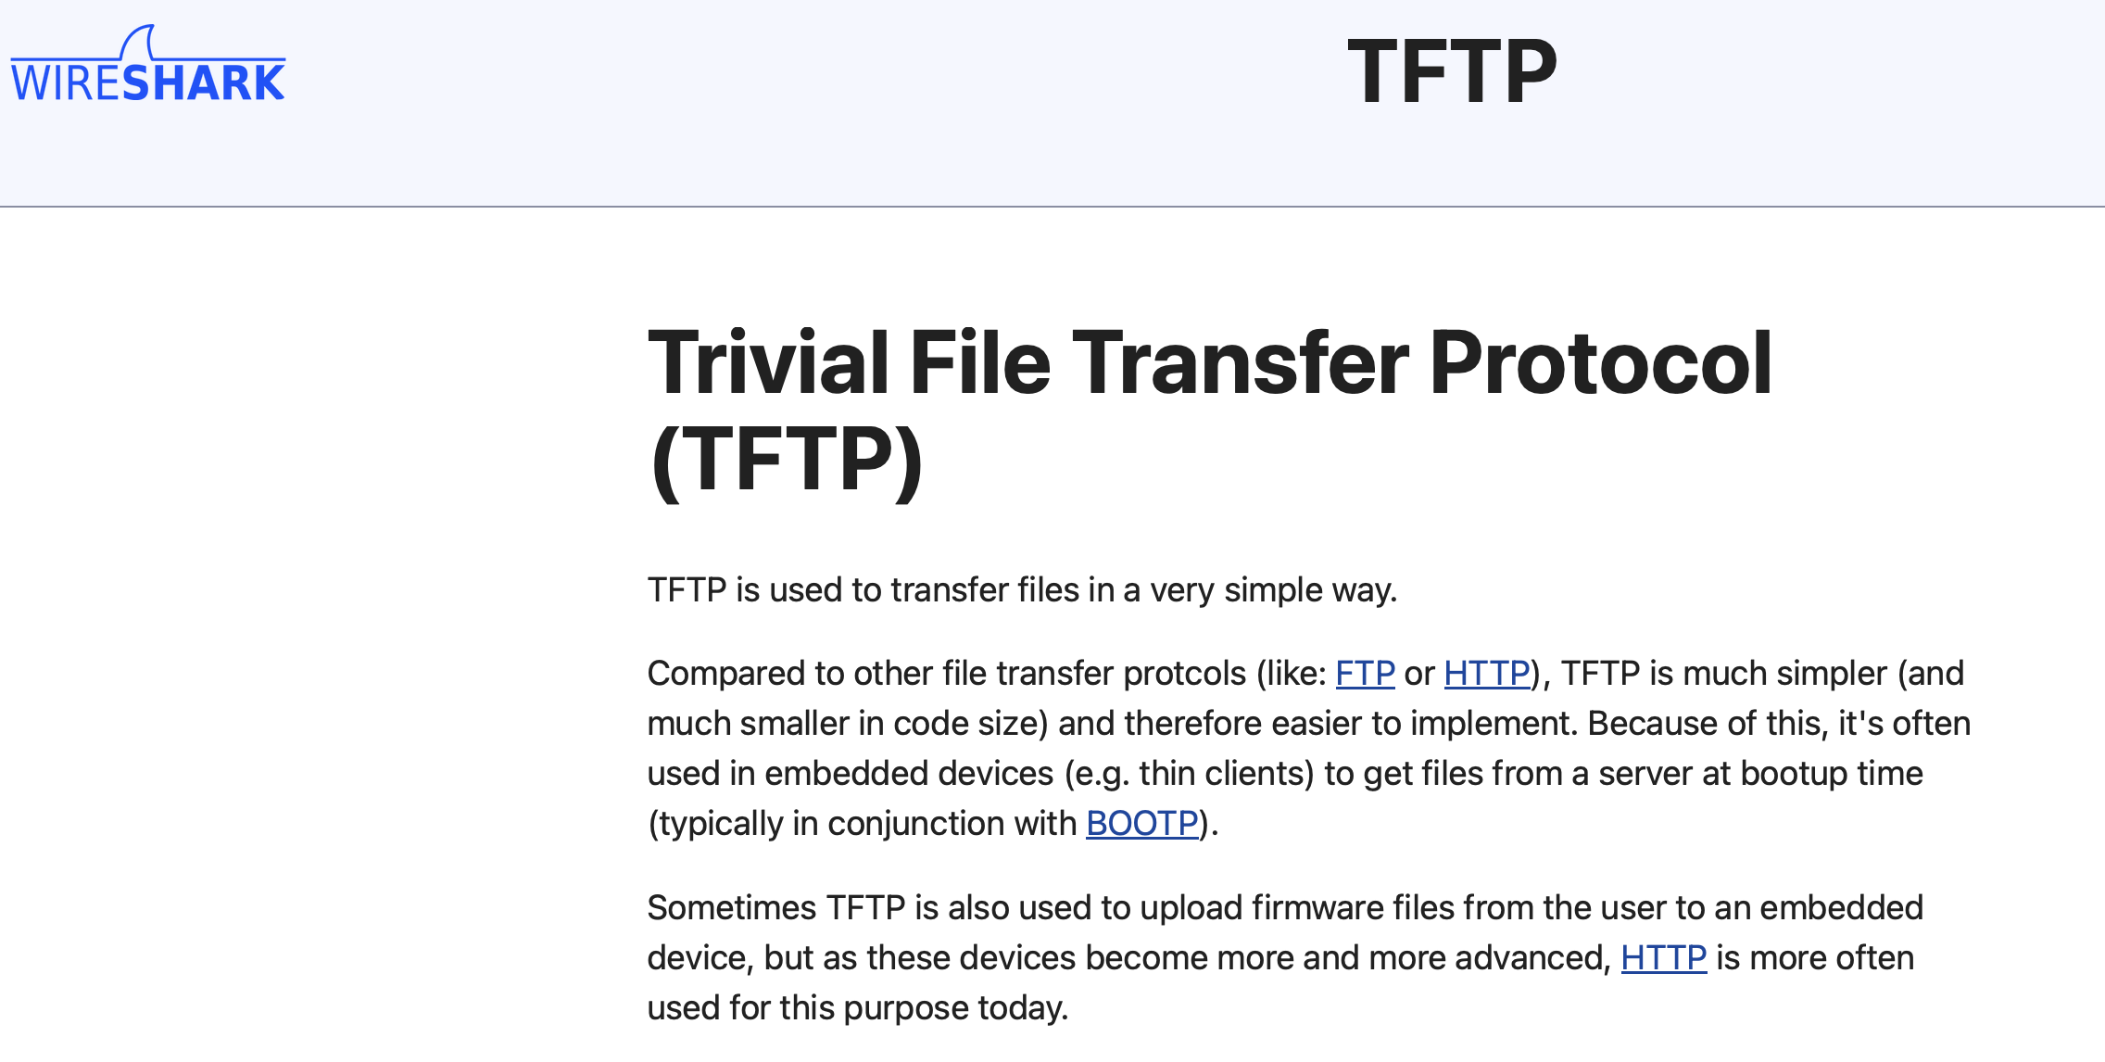
Real deployment of alternating bit protocol
Very rare, most protocols use sequence numbers longer than one bit
https://www.rfc-editor.org/rfc/rfc783
https://wiki.wireshark.org/TFTP

Slide 4

Which is the best technique to detect transmission errors ?
Internet Checksum
Cyclical Redundancy Checks (CRC)

Slide 5
Where should the Checksum/CRC be placed ?
Inside the segment header
Inside the segment trailer

Slide 6
Agenda
Reliable data transfer techniques
The Alternating Bit Protocol
Go-Back-N
Selective repeat
Managing a connection
Connection establishment
Connection release
TCP
Connection establishment
Data transfer
Connection release
Modern TCP

Slide 7
Question
Go-back-n is used in a network where all data segments are correctly received, but every second acknowledgement is corrupted. How many data segments will be retransmitted by the sender if it needs to reliably send 20 data segments assuming a sending window of 25 segments ?

Slide 8
Maximum window
What is the maximum window size that can be used with go-back-n ?
Sequence numbers are encoded in N bits

Slide 9
Question
Go-back-n is used by a protocol that encodes sequence numbers using 5 bits. What is the largest possible sending window (in segments) ?

Slide 10
Question
Go-back-n is used in a satellite network with a round-trip-time of 1 sec. What is the minimum sending window (in segments) to fully use a 1 Mbps link using 10.000 bits segments ?

Slide 11
Agenda
Reliable data transfer techniques
The Alternating Bit Protocol
Go-Back-N
Selective repeat
Managing a connection
Connection establishment
Connection release
TCP
Connection establishment
Data transfer
Connection release
Modern TCP

Slide 12
Buffer management
A reliable transport serves a variable number of applications with a limited buffer
The buffer/window allocated to a given connection may need to change dynamically as connections start and stop

Slide 13
Buffer management
A B
Swin=3, rwin=1
Swin=3, rwin=1
Rwin=1
0 1 2 3
0 1 2 3
Data.req(a)
D(0,a)
0 1 2 3
Data.ind(a)
0 1 2 3
Swin=3, rwin=1
Swin=3, rwin=1
0 1 2 3
C(OK,0, w=1)
0 1 2 3
Data.req(b)
2 new buffers become available
C(OK,0,w=3)
Swin=3, rwin=3
D(1,b)
0 1 2 3
Data.req(c)
0 1 2 3
D(2,c)
Data.ind(b)
Data.req(d)
C(OK,1,w=3)
D(3,d)
0 1 2 3

Slide 14
Buffer management
A B
Swin=3, rwin=1
Swin=3, rwin=1
Rwin=1
0 1 2 3
0 1 2 3
Data.req(a)
D(0,a)
0 1 2 3
Receiver cannot handle segment immediately
C(OK,0, w=0)
Data.ind(a)
Swin=3, rwin=0
Data.req(b)
0 1 2 3
2 new buffers are
available
Window blocked No transmission possible
Lost segment
C(OK,0,w=3)
0 1 2 3
Waits for control segment
Waits for data segment
How to recover from this deadlock ?
Persistence timer on receiver, resend control segment after timer expiration

Slide 15
Bidirectional transfer
How to efficiently carry data in both directions ?

Slide 16
Piggybacking
A B
Data.req(a)
Data.req(b)
D(0,0,a)
Error
Data.req(w)
Data.req(c)
D(1,0,b)
Data.ind(a)
D(2,0,c)
Data.ind(w)
D(5,0,w)
Discarded
D(5,0,w) acks D(0,0,a)
Data.req(x)
D(6,0,x)
Retransmission
Segment -> buffer
D(1,5,b)
Data.req(d)
Data.ind(x)
Data.ind(b)
D(3,6,d)
Data.ind(c)
C(OK,2)
Data.ind(d)
C(OK,3)

Slide 17
Question
You implement a selective repeat receiver using 3 bits to encode the sequence number. You have correctly received segment 6 and delivered its content. You receive a correct segment 1, what do you do ?
you ignore the segment and send ACK(6)
you accept the segment, store it in your buffer and send ACK(6)
you accept the segment, store it in your buffer and send ACK(1)

Slide 18
Question
You implement a selective repeat receiver using 3 bits to encode the sequence number. You have correctly received segment 7 and delivered its content. You receive a correct segment 3, what do you do ?
you ignore the segment and send ACK(7)
you accept the segment, store it in your buffer and send ACK(7)
you accept the segment, store it in your buffer and send ACK(3)

Slide 19
Question
Selective repeat is used by a protocol that encodes sequence numbers using 7 bits. What is the largest possible sending window (in segments) ?

Slide 20
Agenda
Reliable data transfer techniques
Managing a connection
Connection establishment
Connection release
TCP
Connection establishment
Data transfer
Connection release
Modern TCP

Slide 21
Connection establishment
How to reliably open a connection ?
Connections
A<->B : ...
Connect.req
CR
Connect.ind
Connect.conf
CA
Connect.resp
Connection established
Connection established
Connections
A<->B : ...

Slide 22
Segment loss
CR
Connect.req()
Retransmission timer expires
CR
Connect.ind()
Connect.resp()
Connect.conf()
Connection established
Connection established
CA

Slide 23
Segments delayed
Connect.req()
CR
Connect.ind()
Connect.resp
Connect.conf()
CA
First connection established
CR
First connection established
First connection stopped
First connection stopped
Old previous CR
How to detect duplicates ?
CA
D
Notes:
In this example, the duplicate CR is likely to be a previous retransmission of the CR that was delayed in the network.

Slide 24
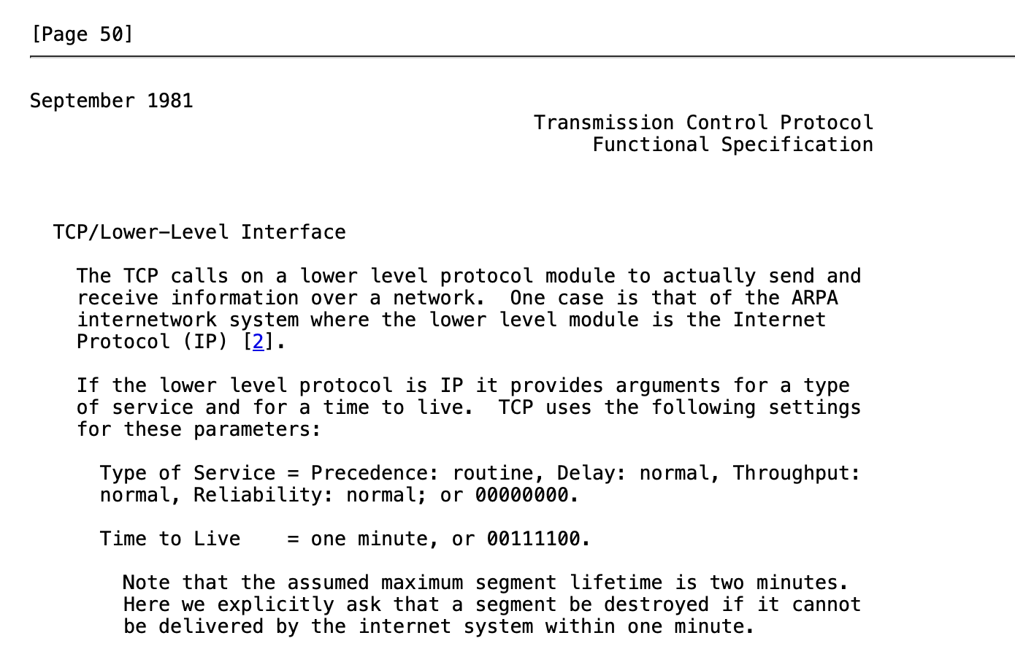
Delayed segments
How to deal with delayed segments ?
Network level guarantee
No packet will survive more than MSL seconds inside the network
Transport entities use on a local clock to detect duplicated connection establishment requests
https://www.rfc-editor.org/rfc/rfc793
What is a reasonable value for MSL in seconds ?

Slide 25
Three-way handshake
Host A
Host B
Sequence number x read from local transport clock
Local state :
Connection to B :
- Wait for ack for CR (x)
- Start retransmission timer
CR (seq=x)
Sequence number y read from local transport clock
CA sent to ack CR
Local state :
Connection to A :
- Wait for ack for CA(y)
CA (seq=y, ack=x)
Received CA acknowledges CR
Send CA to ack received CA
Local state :
Connection to B :
- established
- current_seq = x
CA (seq=x, ack=y)
Local state :
Connection to A :
- established
- current_seq=y
Connection established
D(x)
Connection established
The sequence numbers used for the data segments will start
from x
D(y)
The sequence numbers used for the data segments
will start from y

Slide 26
Agenda
Managing a connection
Connection establishment
Connection release
TCP
Connection establishment
Data transfer
Connection release
Modern TCP

Slide 27
Closing a connection
Two different approaches
abrupt release
send a segment that immediately closes the connection –> may lead to losses
graceful release
send a marker that indicates the end of the date, once the marker is acked, all data has been received and connection is closed
independent release of the two directions

Slide 28
Abrupt release
CR (seq=z)
CA (seq=w, ack=z)
CA (seq=z, ack=w)
Data.req()
D
Data.req()
D
Data.ind()
Disc.req()
Disc.req()
Connection closed
DR
Connection closed
This segment will not be delivered !

Slide 29
Graceful release
D(‘a’,1233)
DISCONNECT.req (A-B)
DATA.ind(‘a’)
DR(A-B,1234)
DISCONNECT.ind(A-B)
ACK,1234
Incoming connection (A->B) closed
DISCONNECT.conf(A-B)
Outgoing connection (A->B)
closed
DISCONNECT.req(B-A)
DR(B-A,4567)
DISCONNECT.ind(B-A)
Incoming connection (B->A) closed
DISCONNECT.conf(A-B)
ACK,4567
Outgoing connection (B->A)
closed

Slide 30
Graceful release (2)
D(‘a’,1230)
DATA.ind(‘a’)
DISCONNECT.req (A-B)
ACK(1230)
DR(A-B,1234)
D(‘bcd’,1231)
ACK(1230)
DATA.ind(‘bcd’)
DISCONNECT.conf(A-B)
ACK(1234)
DISCONNECT.ind(A-B)
Outgoing connection (A->B)
closed
Incoming connection (A->B) closed

Slide 31
Agenda
Managing a connection
Connection establishment
Connection release
TCP
Connection establishment
Data transfer
Connection release
Modern TCP

Slide 32
TCP
Service provided
Connection-oriented
Reliable
No losses, no errors, no duplications
Bytestream

Slide 33

TCP port numbers
Request
Client : C
Source Port : 1234
Destination Port: 5678
Server : S
Source Port : 5678
Destination Port: 1234
Response
Established TCP connections on client
Local IP Remote IP Local Port Remote Port
C S 1234 5678
Established TCP connections on server
Local IP Remote IP Local Port Remote Port
S C 5678 1234

Slide 34
Multiple connections
Client: A
Server : S
TCP connections on host A
IP local IP remote Port local Port remote
A S 1234 80
A S 1235 80
TCP connections on server
IP local IP remote Port local Port remote
S A 80 1234
S A 80 1235
S B 80 1235
Client : B
TCP connections on host B
IP local IP remote Port local Port remote
B S 1235 80

Slide 35
TCP segment
32 bits
Flags :
used to indicate the function of a segment
SYN : used during establishment
FIN : used during connection release RST : used in case of problems
ACK : if true, means that the Acknowledgement number inside the segment is valid
Source port
Destination port
Sequence number
Acknowledgement number
20 bytes
THL Reserved Flags
Window
Checksum
Urgent pointer
Optional header extension
Segment header length
Payload
Computed over the entire segment and part of the IP header
Notes:
Urgent pointer is rarely used and will not be described.
The THL is indicated in blocs of 32 bits. The TCP header may contain options, these will be discussed later.

Slide 36
TCP’s Three-way handshake
CONNECT.req
Initial sequence number (x)
Read from a clock incremented
Every 4 musec and after each
connection
SYN(seq=x)
CONNECT.ind
CONNECT.resp
CONNECT.conf
SYN+ACK(ack=x+1,seq=y)
Initial sequence number (y)
Read from a clock incremented
Every 4 musec and after each
connection
Connection established
The sequence numbers of all segments A->B will start at x+1
ACK(seq=x+1, ack=y+1)
Connection established
The sequence numbers of all segments B->A will start at y+1
Notes:
MSL in IP networks : 120 seconds

Slide 37
TCP’s three-way handshake and SYN losses
CONNECT.req
Initial sequence number (x)
SYN(seq=x)
retransmission
SYN(seq=x)
Initial sequence number (y)
CONNECT.ind
CONNECT.resp
CONNECT.conf
SYN+ACK(ack=x+1,seq=y)
Connection established
ACK(seq=x+1, ack=y+1)
Connection established

Slide 38
TCP’s three-way handshake and SYN losses
CONNECT.req
Initial sequence number (x)
SYN(seq=x)
CONNECT.ind
SYN+ACK(ack=x+1,seq=y)
CONNECT.resp
Initial sequence number (y)
retransmission
SYN(seq=x)
CONNECT.conf
SYN+ACK(ack=x+1,seq=y)
Connection established
ACK(seq=x+1, ack=y+1)
Connection established

Slide 39
TCP’s three-way handshake and SYN delays
CONNECT.req
Initial sequence number (x)
SYN(seq=x)
Old segment delayed
SYN+ACK(ack=z+1,seq=y)
Invalid SYN, discarded
retransmission
SYN(seq=x)
SYN+ACK(ack=x+1,seq=y)
ACK(seq=x+1, ack=y+1)

Slide 40
TCP’s three-way handshake and SYN delays
Old segment delayed
SYN(seq=z)
SYN+ACK(ack=z+1,seq=y)
No connection in progress
Initial sequence number (x)
RST(seq=x+1, ack=y+1)

Slide 41
TCP’s three-way handshake and SYN delays
Old segment delayed
SYN(seq=z)
Initial sequence number (y)
CONNECT.ind
CONNECT.resp
SYN+ACK(ack=z+1,seq=y)
Old segment delayed
ACK(seq=z+1, ack=w+1)
Invalid acknowledgement

Slide 42
TCP FSM
Init
!SYN
?SYN / !SYN+ACK
!SYN
SYN RCVD
?SYN / !SYN+ACK
SYN Sent
?SYN+ACK / !ACK
?ACK
?ACK
Established

Slide 43
Simultaneous open
CONNECT.req
SYN(seq=x)
CONNECT.req
SYN(seq=y)
SYN+ACK(seq=x, ack=y+1)
SYN+ACK(seq=y, ack=x+1)
CONNECT.conf
CONNECT.conf
Connection established
Connection established

Slide 44
Negotiating options
CONNECT.req
Initial sequence number (x)
Option proposed
SYN(seq=x),Option
CONNECT.ind
CONNECT.resp
CONNECT.conf
SYN+ACK(ack=x+1,seq=y) Option
Initial sequence number (y)
Option accepted
Connection established
Option accepted
The sequence numbers of all segments A->B will start at x+1
ACK(seq=x+1, ack=y+1)
Connection established
The sequence numbers of all segments B->A will start at y+1
Notes:
MSL in IP networks : 120 seconds

Slide 45
Negotiating Maximum Segment Size
CONNECT.req
Initial sequence number (x)
Accept segments up to 1234 bytes
SYN(seq=x),MSS=1234
CONNECT.ind
CONNECT.resp
CONNECT.conf
SYN+ACK(ack=x+1,seq=y) MSS=789
Initial sequence number (y)
Accepts segments up to 789 bytes
Connection established
Option accepted
The sequence numbers of all segments A->B will start at x+1
ACK(seq=x+1, ack=y+1)
Connection established
The sequence numbers of all segments B->A will start at y+1
Notes:
MSL in IP networks : 120 seconds

Slide 46
Connection refused
CONNECT.req
SYN(seq=x)
CONNECT.ind
DISCONNECT.req
DISCONNECT.ind
RST+ACK(ack=x+1,seq=0)
Connection refused
What is the next segment sent by the client ?
A TCP entity MUST never send an RST segment upon reception of another RST segment

Slide 47
Agenda
Managing a connection
Connection establishment
Connection release
TCP
Connection establishment
Data transfer
Connection release
Modern TCP

Slide 48
Reliable data transfer
Which ack is returned ?
DATA.req ("abcd")
(seq=123,"abcd")
DATA.req ("efg")
(ack=127)
DATA.ind("abcd")
DATA.req ("hi")
(seq=127,"efg")
Which ack is returned ?
(seq=130,"hi")
DATA.req ("jkl")
(seq=132,"jkl")
DATA.ind("efghijkl")
(ack=135)
Which ack is returned ?

Slide 49

Reliable data transfer
(seq=123,"abcd")
(seq=127,"ef")
Retransmission timer
“ef” placed in buffer
(ack=123)
Retransmission of all unacked segments
(seq=123,"abcd")
(seq=127,"ef")
"abcdef"
(ack=129)
(ack=129)
unnecessary retransmission

Slide 50
Reliable data transfer
(seq=123,"abcd")
(seq=127,"ef")
Retransmission timer
“ef” placed in buffer
(ack=123)
Retransmission of all unacked segments
(seq=123,"abcd")
(seq=127,"ef")
"abcdef"
(ack=129)
(ack=129)
unnecessary retransmission

Slide 51
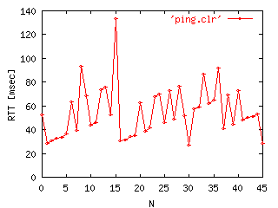
Retransmission timer
How to compute it ?
round-trip-time may change frequently during the lifetime of a TCP connection

Slide 52
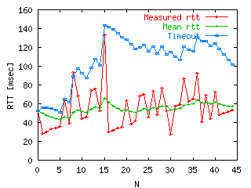
Retransmission timer
Algorithm
timer = mean(rtt) + 4*std_dev(rtt)
est_mean(rtt) = (1-α)*est_mean(rtt) +α*rtt_measured
est_std_dev=(1-β)*est_std_dev+ β*|rtt_measured - est_mean(rtt)|
Notes:
The computation of TCP’s retransmission timer is described in
RFC2988 Computing TCP's Retransmission Timer. V. Paxson, M. Allman. November 2000.
Usual values for alpha and beta are 1/8 and 1/4.

Slide 53
Multiple expirations of the retransmission timer
(seq=123,"abcd")
Retransmission timer
Retransmission of all unacked segments
(seq=123,"abcdef")
Retransmission timer
(seq=123,"abcdef")
If losses are due to network congestion, retransmitting all unacked segments quickly might not be the best idea
Exponential backoff : double the retransmission timer after each expiration for the same sequence number

Slide 54
RTT measurements
(seq=120,"xyz")
measured rtt
(ack=123)
(seq=123,"abcd")
which is the good rtt ?
Timer
(seq=123,"abcd")
(ack=128)
Solution (Karn/Partridge)
Do not measure rtt of retransmitted segments
Notes:
See
P. Karn, C. Partridge, Improving round-trip time estimates in reliable transport protocols, Proc. ACM SIGCOMM87, August 1987

Slide 55
TCP’s initial retransmission timer
How to compute TCP’s initial retransmission timer for the SYN ?
Initial solution
Limitations
Modern implementations

Slide 56
Flow control
Last_ack=122, swin=100, rwin=4
To transmit : abcdefghijklm
(seq=122,"abcd")
Last_ack=122, swin=96, rwin=0
(ack=126,rwin=0)
Last_ack=126, swin=100, rwin=0
(ack=126,rwin=2)
Last_ack=126, swin=100, rwin=2
Last_ack=126, swin=98, rwin=0
(seq=126,"ef")
(ack=128,rwin=20)
Last_ack=128, swin=100, rwin=20
Last_ack=128, swin=93, rwin=13
(seq=128,"ghijklm")
(ack=135,rwin=20)
Last_ack=135, swin=100, rwin=20

Slide 57
TCP’s flow control
16 bits to represent the receive window in bytes
32 bits
Source port
Destination port
Goodput:
- Number of payload bytes/sec
Throughput
- Total number of bytes (including header)/sec
Sequence number
Acknowledgement number
20 bytes
THL Reserved Flags
Window
Checksum
Urgent pointer
Optional header extension
Payload
What is the maximum goodput of such a TCP connection if the rtt is 100 msec (in bytes/sec) ?

Slide 58
Fast retransmit
(seq=120,"xyz")
(ack=123)
(seq=123,"abcd")
(seq=127,"ef")
(ack=123)
Out of sequence
First duplicate ack
(seq=129,"gh")
(ack=123)
Out of sequence
Second duplicate ack
(seq=131,"ij")
(ack=123)
Out of sequence
Third duplicate ack
Notes:
Don’t forget that TCP’s acknowledgements are cumulative.

Slide 59
Fast retransmit
(ack=123)
(seq=123,"abcd")
(seq=127,"ef")
(ack=123)
Out of sequence, in buffer
(seq=129,"gh")
(ack=123)
Out of sequence, in buffer
(seq=131,"ij")
(ack=123)
Out of sequence, in buffer
(seq=123,"abcd")
(ack=133)
"abcdefghij"
Which ack is returned ?
Notes:
See e.g.
RFC2001 TCP Slow Start, Congestion Avoidance, Fast Retransmit, and Fast Recovery Algorithms. W. Stevens. January 1997.

Slide 60
Agenda
Managing a connection
Connection establishment
Connection release
TCP
Connection establishment
Data transfer
Connection release
Modern TCP

Slide 61
Abrupt TCP connection release
Last sent data : x
DISCONNECT.req (abrupt)
RST(seq=x)
Connection closed
DISCONNECT.ind(abrupt)
State can be removed
Connection closed
State can be removed
Notes:
Some heavily loaded web servers, use abrupt release to close their connection to avoid maintaining state for 2*MSL seconds.

Slide 62
Abrupt TCP connection release
Last sent data : x
(seq=x,”y")
Retransmission timer
(seq=x,”y")
Retransmission timer
(seq=x,”y")
Many unsuccessful attempts
to reliably transmit data
DISCONNECT.ind(abrupt)
Connection closed
RST(seq=x)
DISCONNECT.ind(abrupt)
State can be removed
Connection closed
State can be removed
Notes:
Some heavily loaded web servers, use abrupt release to close their connection to avoid maintaining state for 2*MSL seconds.

Slide 63
TCP Connection release
Sent only after all data up to x has been received
Last sent data : x-1
DISCONNECT.req (A-B)
FIN(seq=x)
DISCONNECT.ind(A-B)
ACK(ack=x+1)
incoming connection closed
DISCONNECT.conf(A-B)
Last sent data : y-1
outgoing connection closed
DISCONNECT.req(B-A)
FIN(seq=y)
DISCONNECT.ind(B-A)
incoming connection closed
Time WAIT
Maintain state for this connection during twice MSL
to be able to retransmit ACK
if a segment is received from
the other entity
ACK(ack=y+1)
DISCONNECT.conf(A-B)
outgoing connection closed
State can be removed

Slide 64
TCP connection release in details
Many scenarios are possible depending when the FIN flag is set
Last sent data : x-1
Last sent data : y-1
DISCONNECT.req (A-B)
DISCONNECT.req(B-A)
FIN(seq=x)
DISCONNECT.ind(A-B)
FIN+ACK(ack=x+1, seq=y)
incoming connection closed
DISCONNECT.conf(A-B)
outgoing connection closed
DISCONNECT.ind(B-A)
ACK(ack=y+1)
DISCONNECT.conf(A-B)
incoming connection closed
outgoing connection closed
State can be removed
Time WAIT
Maintain state for this connection uring twice MSL
to be able to retransmit ACK
if a segment is received from
the other entity

Slide 65
Some servers operate as follows
Last sent data : x-1
DISCONNECT.req (A-B)
FIN(seq=x)
DISCONNECT.ind(A-B)
ACK(ack=x+1)
incoming connection closed
DISCONNECT.conf(A-B)
Last sent data : y-1
DISCONNECT.req(B-A)
outgoing connection closed
DISCONNECT.ind(B-A)
RST(ack=x+1, seq=y)
incoming connection closed
outgoing connection closed
State is removed
?
State is removed
What is the benefit of such an approach ?

Slide 66
TCP connection release
SYN RCVD
Established
?FIN/!ACK
!FIN
!FIN
CLOSE Wait
FIN Wait1
?FIN/!ACK
Closing
!FIN
?ACK
LAST-ACK
FIN Wait2
?ACK
?ACK
?FIN/!ACK
TIME Wait
Closed
Timeout[2MSL]

Slide 67
Agenda
Managing a connection
Connection establishment
Connection release
TCP
Connection establishment
Data transfer
Connection release
Modern TCP

Slide 68
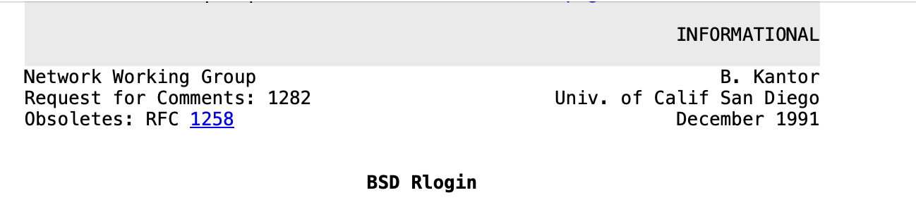
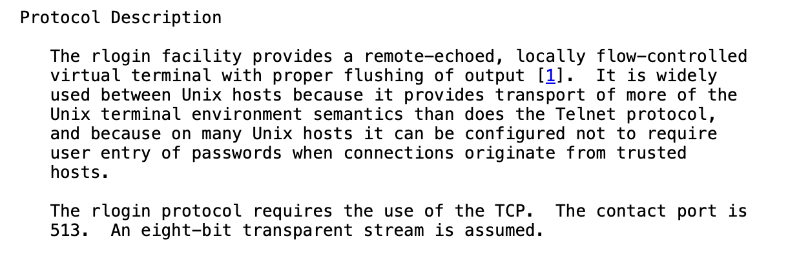
rlogin and rsh

Slide 69
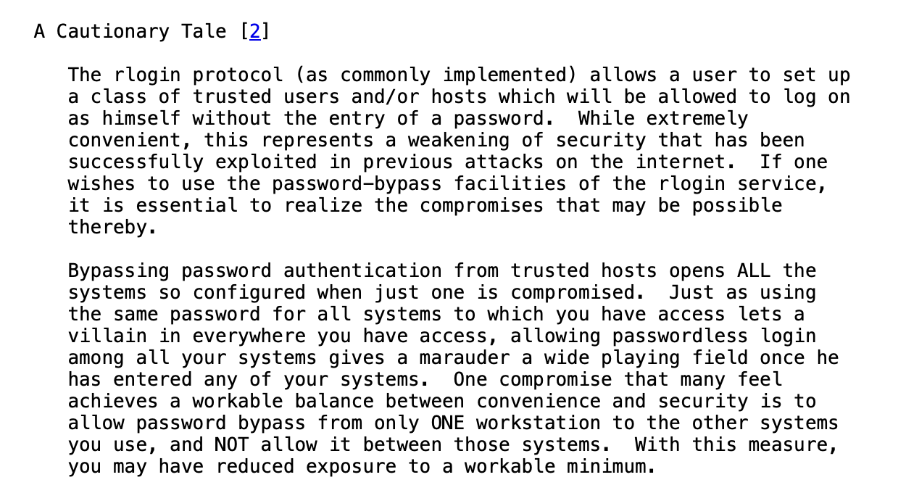
rlogin and rsh

Slide 70


The problem with trusted addresses
A
B
Connection coms from Alice’s IP address.
Bob does not need to ask username and password
SYN(seq=x)
SYN+ACK(ack=x+1,seq=y)
ACK(seq=x+1, ack=y+1)
DATA(seq=x+1, ack=y+1)
Can Terrence hijack this connection ?
T

Slide 71
TCP and spoofing
Can Terrence create a fake TCP connection by spoofing Alice's IP when she is away ?
Terrence can send spoofed IP packets to Bob using Alice’s address
But Terrence cannot receive the packets sent by Bob to Alice

Slide 72
TCP and spoofing
Terrence's view of the transfer
Bob
A
T
B
SYN(Src=A,seq=x)‏
Ignored if Alice is offline
Can Terrence predict y ?
SYN+ACK(Dst=A,ack=x+1,seq=y)‏
ACK(seq=x+1, ack=y+1)‏
Data(Src=A,seq=x+1)‏

Slide 73
Three-way handshake : initial specification
X is extracted from a local clock incremented every 4 musec
CONNECT.req
Initial sequence number (x)
SYN(seq=x)
CONNECT.ind
CONNECT.resp
CONNECT.conf
SYN+ACK(ack=x+1,seq=y)
Initial sequence number (y)
Connection established
The sequence numbers of all segments A->B will start at x+1
ACK(seq=x+1, ack=y+1)
Connection established
?
Y is extracted from a local clock incremented every 4 musec
The sequence numbers of all segments B->A will start at y+1
Can you improve TCP’s connection establishment ?
Notes:
MSL in IP networks : 120 seconds

Slide 74
Three-way handshake today
X is random
CONNECT.req
Initial sequence number (x)
SYN(seq=x)
CONNECT.ind
CONNECT.resp
CONNECT.conf
SYN+ACK(ack=x+1,seq=y)
Initial sequence number (y)
Connection established
The sequence numbers of all segments A->B will start at x+1
ACK(seq=x+1, ack=y+1)
Connection established
Y is random
The sequence numbers of all segments B->A will start at y+1
Notes:
MSL in IP networks : 120 seconds

Slide 75
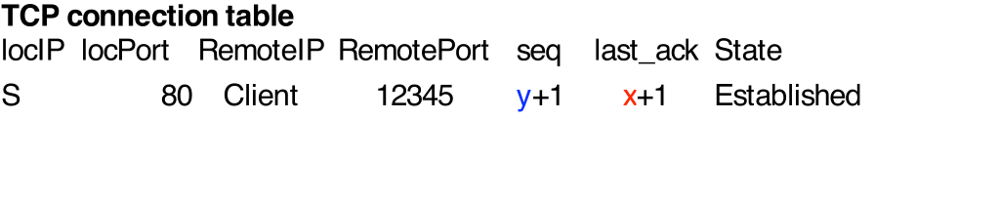

TCP connection establishment
CONNECT.req
SYN(seq=x)‏
CONNECT.ind
SYN+ACK(ack=x+1,seq=y)‏
ACK( seq=x+1, ack=y+1)‏
Server needs to maintain a connection table to check returned ack

Slide 76
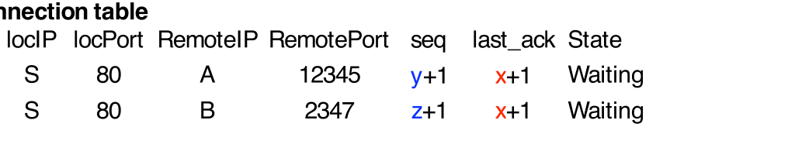
DoS attack
Attacker sends 1000s of (spoofed) SYNs
SYN(Src=A,seq=x)‏
CONNECT.ind
SYN+ACK(Dest=A,ack=x+1,seq=y)‏
SYN(Src=B,seq=x)‏
CONNECT.ind
SYN+ACK(Dest=B,ack=x+1,seq=z)‏
Some servers restrict the number of connections in the waiting state
Notes:
Most TCP implementations today have fixes for those problems. We will discuss them later.

Slide 77
Countering DoS attacks
Principle of the solution
Server should not create any state before being sure that the client can receive the segments that it sends
Server does not store anything
CONNECT.req
SYN(Src=C,seq=x)‏
SYN+ACK(Dest=C,ack=x+1,seq=y)‏
ACK(Src=A,seq=x, ack=y+1)‏
Server checks that third ACK is valid
and creates state
Notes:
Most TCP implementations today have fixes for those problems. We will discuss them later.

Slide 78
SYN Cookies
Server verifies third ack without any state
CONNECT.req
SYN(seq=x)‏
CONNECT.ind
No state created
y=Hash(IP_{Client},Port_{Client},Secret)‏
?
How should the server select y ?
CONNECT.conf
SYN+ACK(ack=x+1,seq=y)‏
ACK(seq=x+1, ack=y+1)‏
Verify that
ack=1+Hash(IP_{Client},Port_{Client},Secret)‏
State is created
Notes:
This utilization of a hash function to compute the value of the initial sequence number is usually called a SYN cookie.
In practice, the computation of the SYN cookie is slightly more complex than a simple hash function because the server must also remember inside the cookie the following information :
- the MSS value advertised by the client
- the optional utilization of TCP options such as RFC1323 large windows or timestamps or SACK by the sender
The original discussions that lead to the development of the SYN cookie solution may be found in :
http://cr.yp.to/syncookies/archive

Slide 79
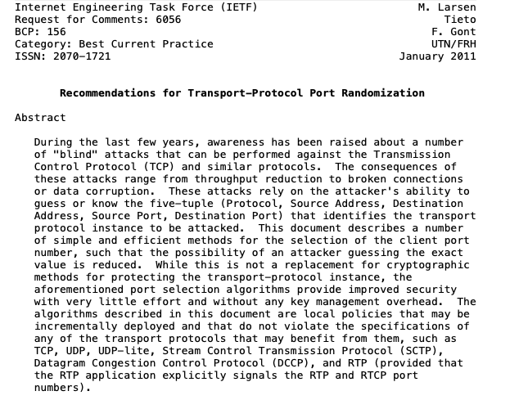
Simultaneous open
Is this frequent in practice ?
How does a client selects its source port ?

