Slide 1
Part 6 A QUIC introduction

Slide 2
Projet - soumission
Première soumission
Vendredi, cfr moodle. Nécessaire pour que l’on peut fixer les heures de presentation
Soft deadline, vous pourrez amender votre presentation jusque la hard deadline
Hard deadline
Jeudi 20 mars, 8h00
Présentation
Vos slides (en pdf uniquement) seront sur les laptops des assistants pour minimizer le temps de changer de groupe

Slide 3
Projet – grille d’évaluation de l’oral Volet forme (1/3)
Critère | Insuffisant | Suffisant | Bien | Très bien
Points clés | Le message ne passe pas du tout | Un point clé présenté, les autres restent flous | Deux points clés présentés | Tous les points importants sont clairs
Discours oral | Ne tient pas compte du public | Contact visuel continu | Présentation bien préparée et fluide | Captive son audience
Support visuel | Slides surcharges, vague, timing non respecté | Structure correcte de la presentation, slides appuient le discours | Slides pas trop chargés, figures utilisées intelligemment | Présentation agréable à suivre, grand soin apporté aux slides
Groupe | Pas de cohesion, une partie du groupe ne présente pas | Tous les étudiants parlent, mais certains répondent plus | Organisation du groupe pour répondre aux questions | Très bonne organisation du groupe, tous les étudiants maitrisent

Slide 4
Projet – grille d’évaluation de l’oral Volet contenu (2/3)
Critère | Insuffisant | Suffisant | Bien | Très bien
DNS | Pas de réponse ou incorrect | Quelques éléments liés à la matière vue au cours | Réponse argumentée avec des paquets/analyse code source | Explication détaillée qui apporte un plus par rapport à ce qui a été vu au cours
UDP | idem | idem | idem | idem
TCP | idem | idem | idem | idem
IPv4/IPv6 | idem | idem | idem | idem
Sécurité/TLS | idem | idem | idem | idem
Extensions | idem | idem | idem | idem

Slide 5
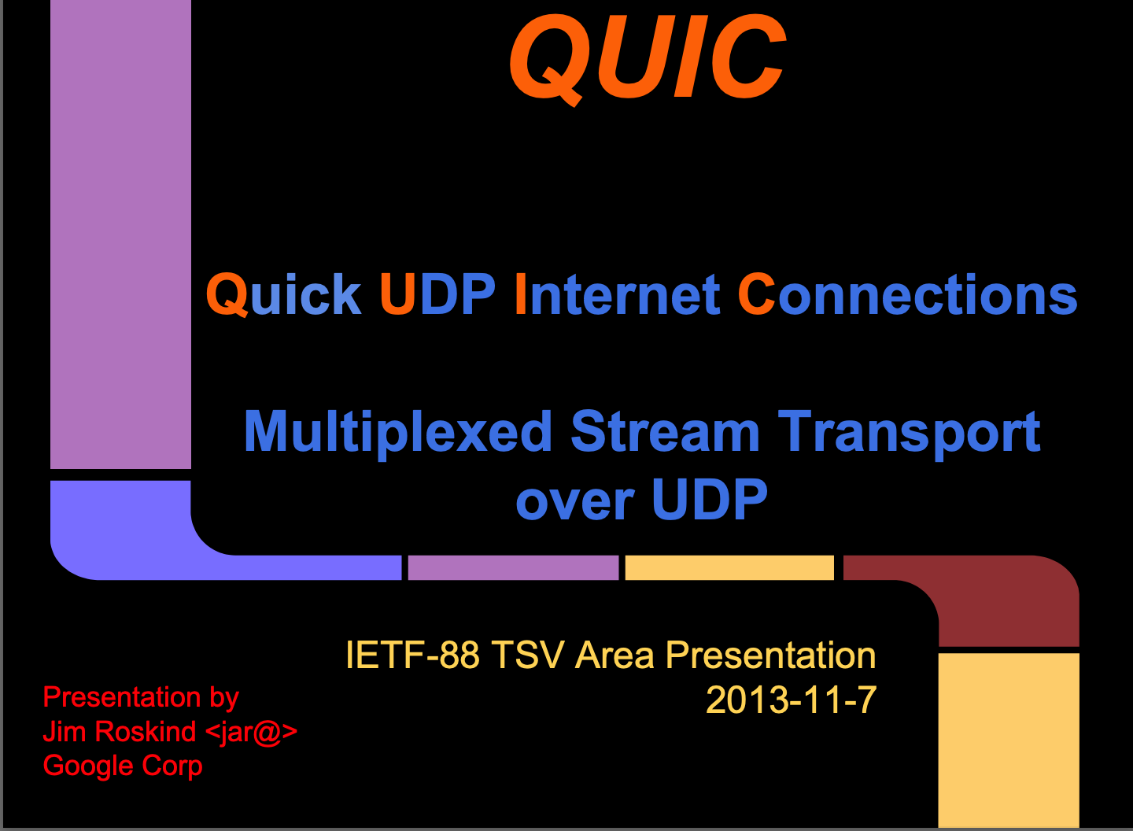
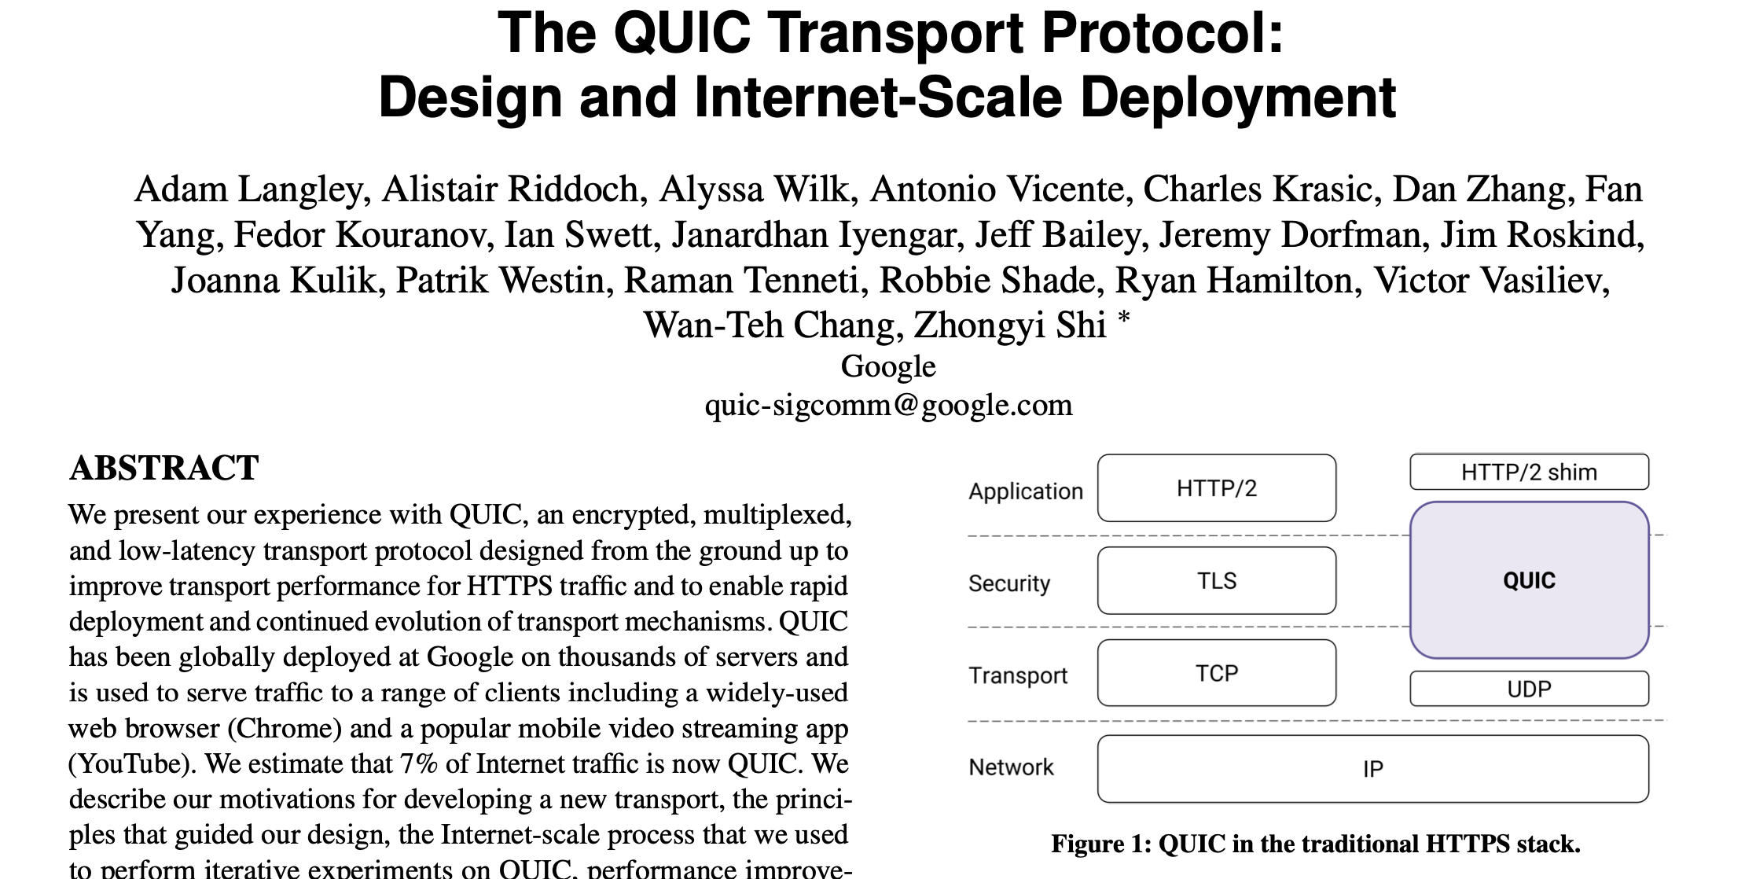
QUIC: a secure transport protocol
Initially proposed by Google to speedup HTTP
Main motivations
Speedup HTTP
Integrate security features
Be easier to deploy by running above UDP
Standardized within IETF
https://dl.acm.org/doi/pdf/10.1145/3098822.3098842
https://www.ietf.org/proceedings/88/slides/slides-88-tsvarea-10.pdf

Slide 6
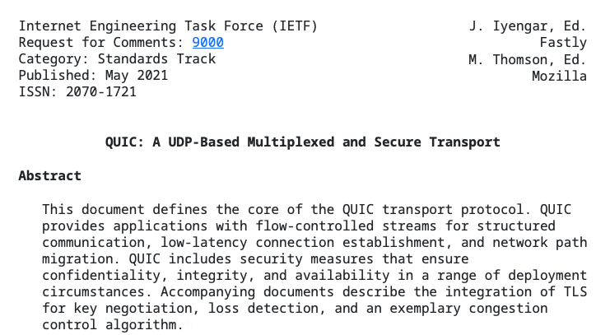
QUIC A UDP-based multiplexed and secure transport
https://datatracker.ietf.org/doc/html/rfc9000

Slide 7
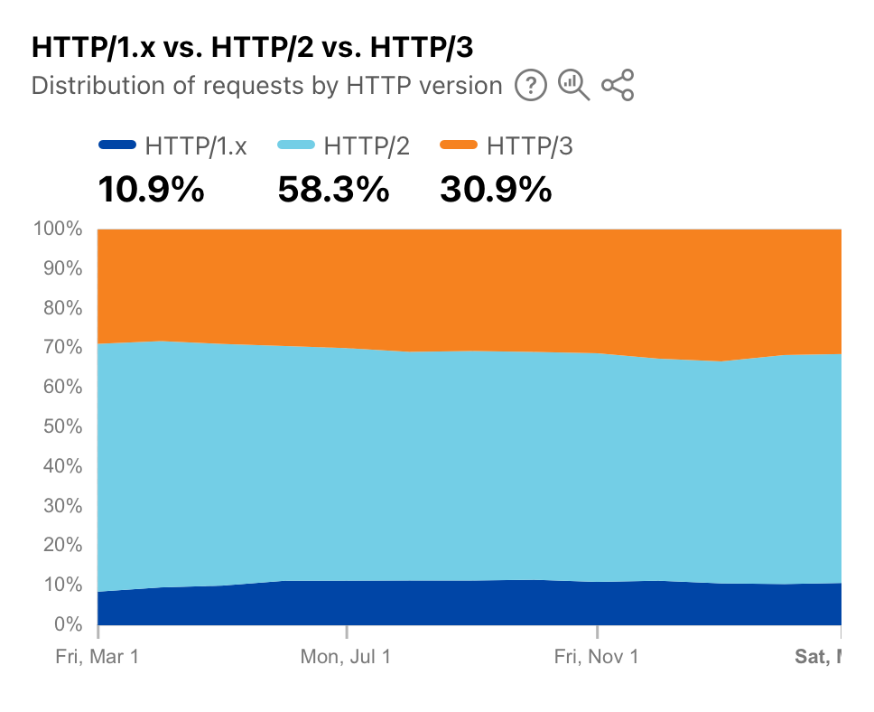
QUIC deployment since March 2024
https://radar.cloudflare.com/adoption-and-usage?dateRange=52w

Slide 8
Main characteristics of QUIC
Runs above UDP
Allows QUIC to pass through middleboxes such as NAT that only understand TCP, UDP and ICMP
A single connection can efficiently carry multiple bytestreams
Tuned to support HTTP/2 streams but much better than TCP
Same (or better) reliability and congestion control mechanisms as TCP
Several improvements are possible thanks to QUIC’s design
Directly integrates all the security features of TLS
QUIC provides better security than TLS above TCP
Connection migration
On smartphones, a QUIC connection can migrate from cellular to Wi-Fi
QUIC can also be used to carry datagrams

Slide 9
Protocol stack Physical layer
Physical
Physical
Physical
Types of physical layers
Radio (Wi-Fi, cellular, Bluetooth,…)
Optical fiber
Cat5 cable
Coaxial cable
xDSL
Modem
Unit of information : bit
Reliability
transmission errors
creation/suppression of bits

Slide 10

Protocol stack Datalink layer
Frame
Datalink
Datalink
Datalink
Physical
Physical
Physical
Unit of information
Frame
Services
Unreliable connectionless
Reliable connection-oriented
Protocols
Ethernet
Wi-Fi
Bluetooth
PPP

Slide 11
Protocol stack Network layer
Packet
Network
Network
Network
Datalink
Datalink
Datalink
Physical
Physical
Physical
Unit of information
packet
Services
Unreliable connectionless
Organisation
Datagram, virtual circuits
Protocols
IPv4
IPv6

Slide 12
Protocol stack Transport layer
Segment
Transport
Transport
Network
Network
Network
Datalink
Datalink
Datalink
Physical
Physical
Physical
Unit of information
segment
Services
Unreliable connectionless
Reliable connection-oriented
Protocols
TCP
UDP

Slide 13
Protocol stack Application layer
SDU
Application
Application
Transport
Transport
Layer4
Network
Network
Network
Layer3
Datalink
Datalink
Datalink
Layer2
Physical
Physical
Physical
Layer1
Application layer protocols
HTTP, SMTP, SSH, TLS, POP, IMAP, NTP, …

Slide 14
OSI (seven layers) Reference Model
Application
Application
Layer7
Presentation
SDU
Presentation
Session
Session
Transport
Transport
Network
Network
Network
Datalink
Datalink
Datalink
Physical
Physical
Physical

Slide 15
QUIC in the protocol stack
HTTP/2
HTTP/3
TLS
QUIC
Transport TCP
Transport (UDP)
Network layer (IPv4, IPv6)
Datalink layer (Ethernet, Wi-Fi, …)
Physical layer (radio, fiber, cable, …)

Slide 16
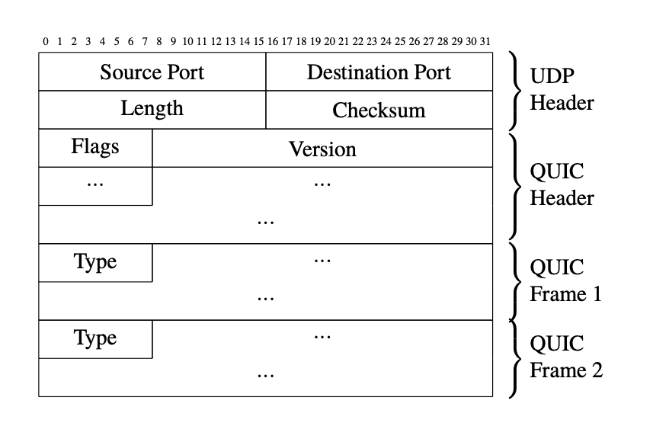
First principle : QUIC frames
A QUIC packet contains
a QUIC header
one or more frames identified by a type field
QUIC frames can carry data and control information
Easier to extend than the simple TCP header

Slide 17
Simplified QUIC connection establishment
TLS ClientHello
Param negotiation
Clear text
Initial (CRYPTO)
Initial (CRYPTO)
Handshake(CRYPTO)
TLS ServerHello
DH key known
TLS Encrypted Extensions
Certificate
TLS Finished
Handshake (CRYPTO)
Handshake_Done
TLS established for server
Basically a four-way handshake with Diffie Hellman to negotiate key

Slide 18
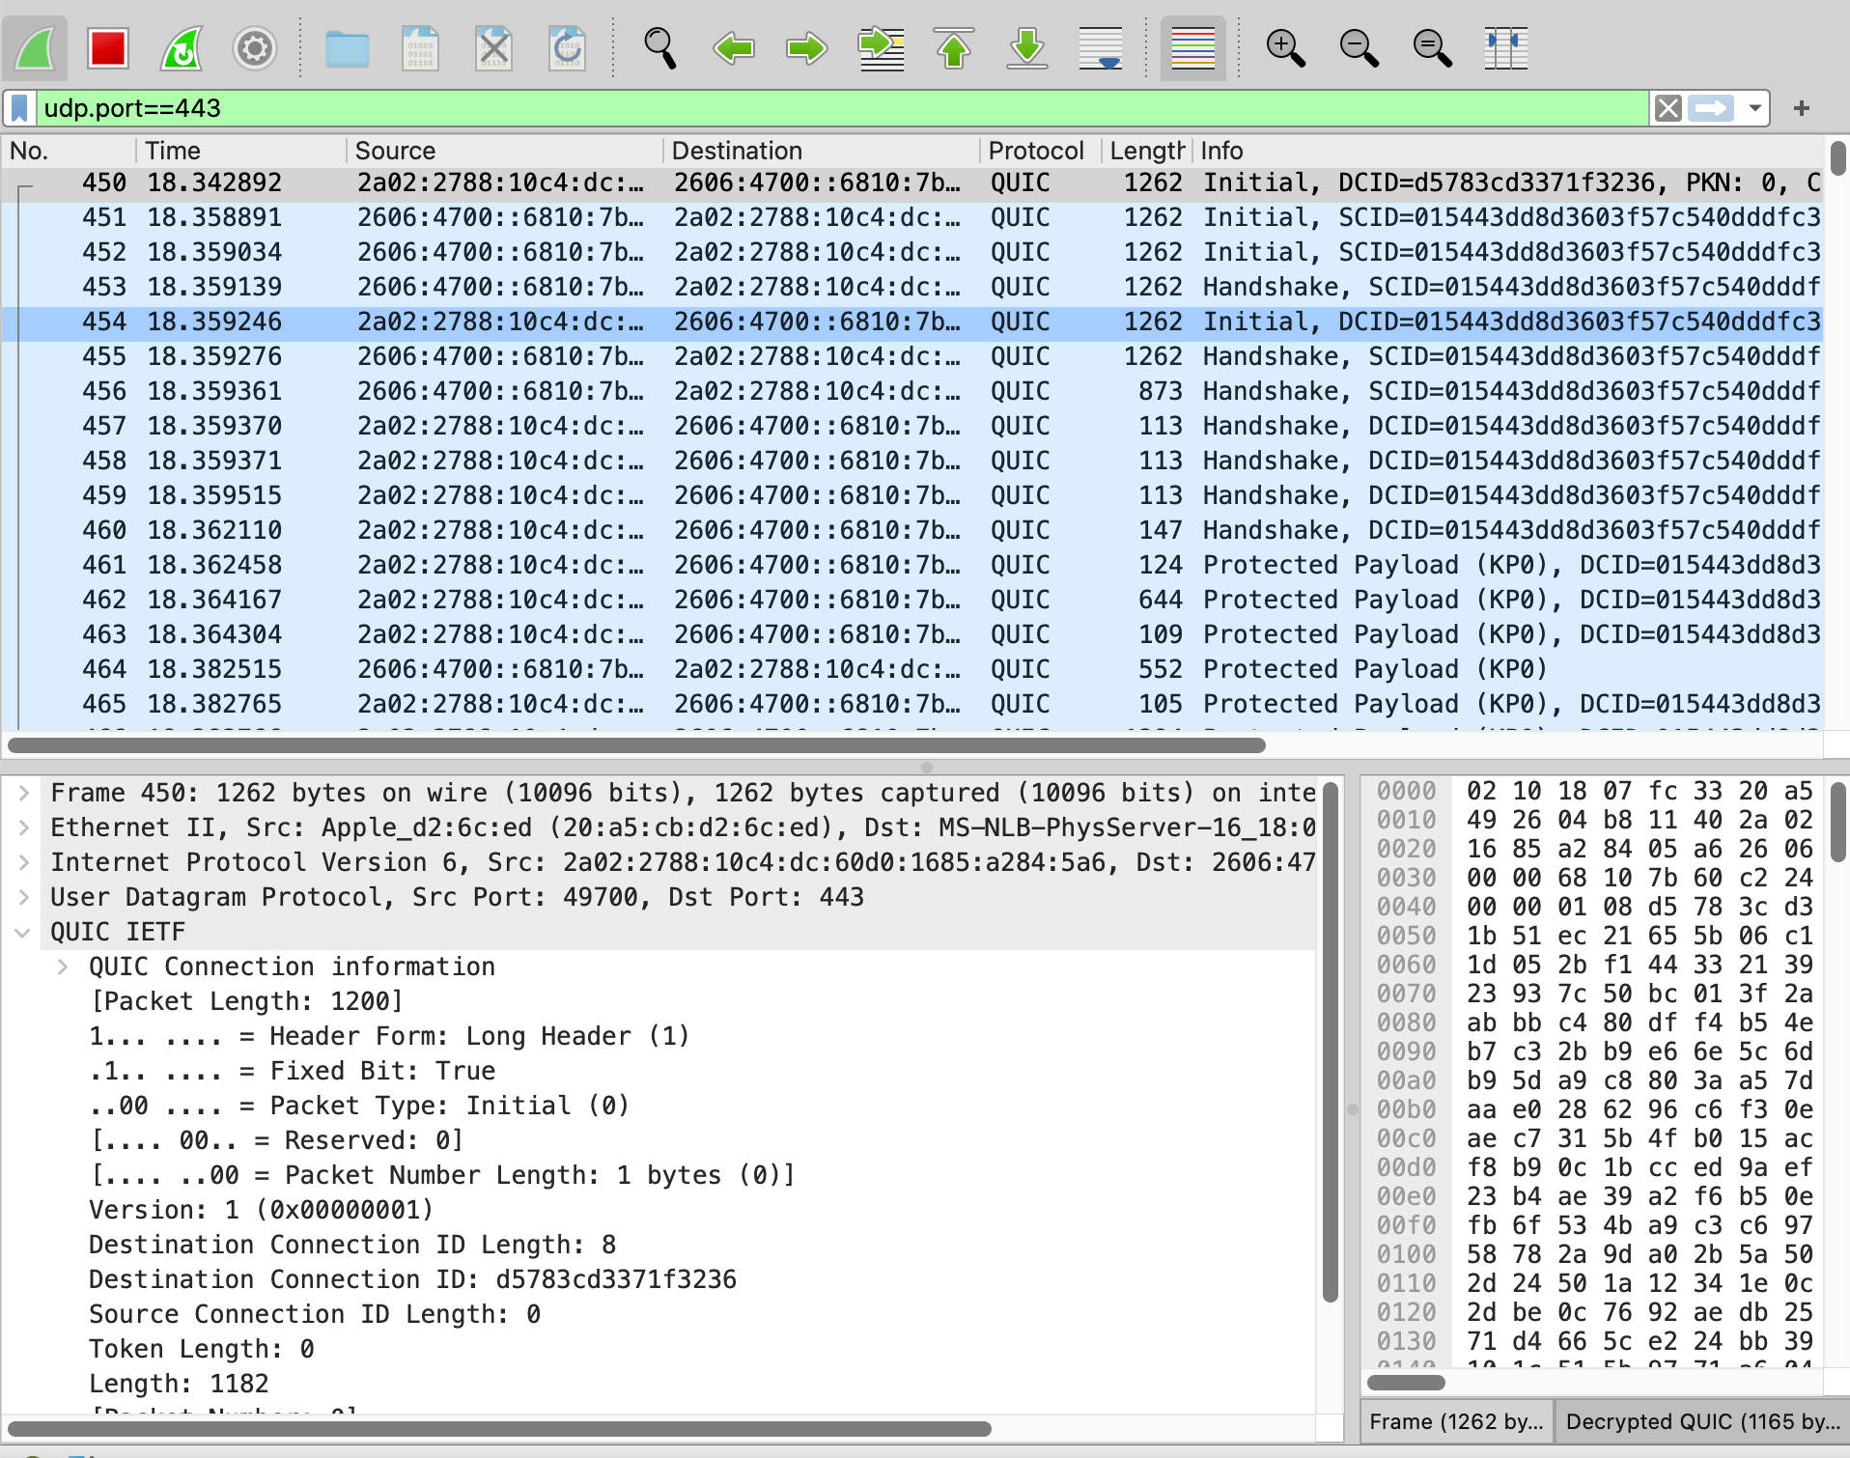
The QUIC Initial frame
?
Why is this packet so long ?

Slide 19
Constraint on the Initial packet sent by client
Must contain at least 1200 bytes
To be compared with TCP’s 40 bytes SYN over IPv4
Why forcing QUIC to send such a large initial packet ?
This goes against a fast connection establishment
One way to counter reflection attacks
Servers are not allowed to reply with more than 3 times the length of the initial client packet
Also allows to verify that packets containing 1200 bytes can pass without any problem from client to server

Slide 20
Protection against spoofed Initial packets
How can a QUIC server be protected against attacks using spoofed Initial packets ?
Amplification factor of 3, sometimes more with some servers that use a certificate longer than three packets
?

Slide 21

Protection against spoofed addresses
Client address unknown
Initial (CRYPTO)
Retry (Token)
No state !
Initial (CRYPTO) + Token
Token valid
Initial (CRYPTO)
Handshake(CRYPTO)
TLSServerHello
DH key known
Certificate
TLS Encrypted Extensions
TLS Finished
Handshake (CRYPTO)
Handshake_Done
TLS established for server
Is this the Retry token safer than TCP SYN cookies ?

Slide 22
Second principle identifying QUIC connections
Server selects unique
CID y to identify connection
How to identify a QUIC connection ?
Using the Source IP addresses and port numbers
Fragile if there are NATs
Client selects unique
CID x to identify connection
[SCID=x,DCID=z]
Initial (CRYPTO)
[SCID=y, DCID=x]
Initial (CRYPTO)
What is the size of the QUIC CID ?
QUIC uses its own Connection-IDs
QUIC enables the client and the server to use CIDs of different lengths

Slide 23
Negotiating options
How to negotiate options or QUIC extensions ?
Server selects agreed transport parameters in TLS Encrypted Extension
Client proposes transport parameters in Initial frame
[SCID=x,DCID=z]
Initial (CRYPTO)
[SCID=y, DCID=x]
Initial (CRYPTO)
Handshake(CRYPTO)

Slide 24
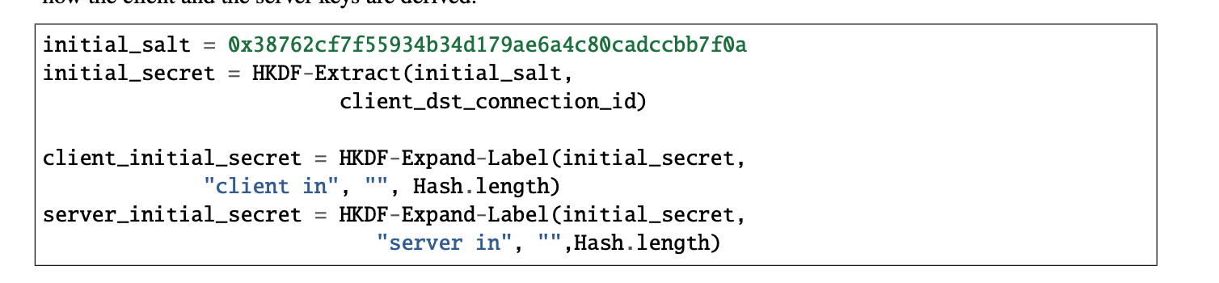
The first Initial packet is not sent in clear
In TLS1.3, the ClientHello is sent in clear over the TCP connection
Firewalls can observe the content of the ClientHello
QUIC wants to avoids as much as possible interference from firewalls and other types of middleboxes
The Initial packets are encrypted using a secret derived from the destination CID of the client’s Initial packet
Can wireshark decode an encrypted Initial ?

Slide 25
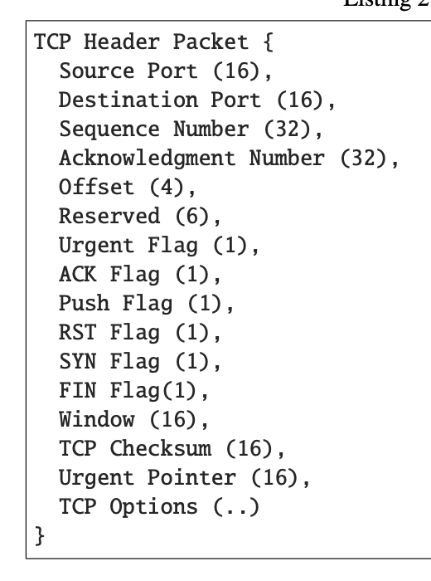
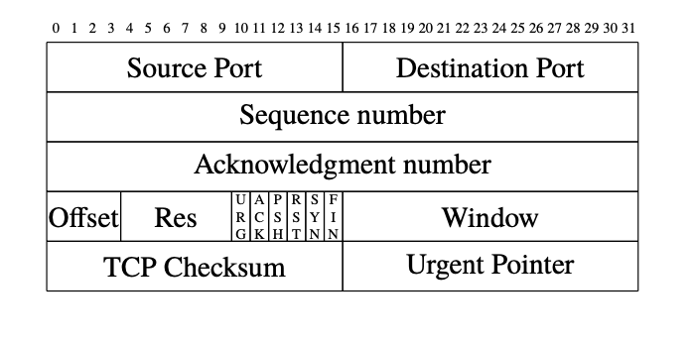
Third principle : QUIC variable length header
How to represent a TCP header ?
Textual representation

Slide 26
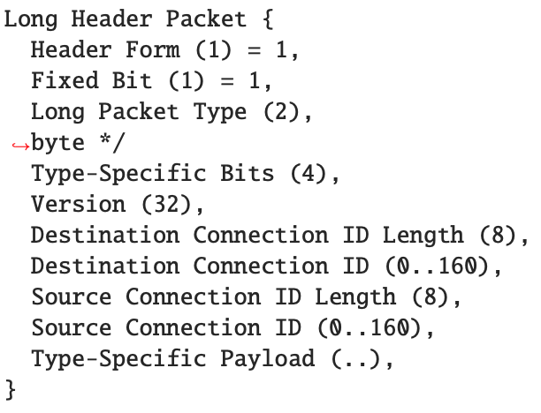
The (long) QUIC header
32bits for version number !
One byte to indicate packet type and subtypes
Variable length CIDs
Only used in the Initial, Retry and Handshake packets

Slide 27
Fourth principle: unique packet numbers
Each QUIC packet contains a unique packet number
If a packet is lost and needs to be retransmitted, the frames contained in the original packet will be copied in a new packet with a new packet number
On a QUIC connection, we never observe twice a packet with the same packet number !

Slide 28
Encoding QUIC packet numbers
What is the length in bits of the QUIC packet numbers ?
Use 8 bits
Low overhead, but too short for many connections
Use 16 bits
Medium overhead, but too short for long transferts
Use 32 bits
Too short for very long transferts
Use 64 bits
Packet numbers are unlikely to be reused
But this increases the per-packet overhead a lot
QUIC uses variable-length packet numbers to minimize overhead

Slide 29
QUIC’s varint
A method to encoded variable length integers using bytes
Two high order bits of the bytestring indicate the length
00: a one-byte long varint – from 0 to 2⁶-1
01: a two bytes long varint
10: a four-bytes long varint
11: an eigth-bytes long varint - from 0 to 2⁶²-1
All QUIC packet numbers are encoded as varints

Slide 30
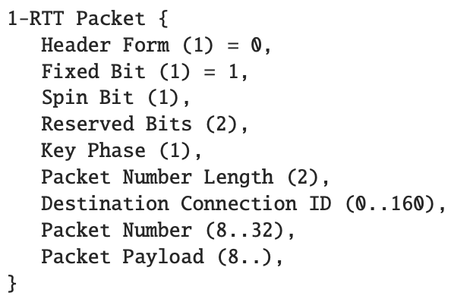
The (short) QUIC header
Used in all packets after the initial handshake
Type byte
The receiver knows the length of the CID it uses
varint
The frames that compose the packet

Slide 31
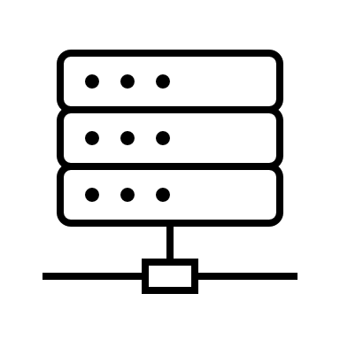
The roles of the Connection identifier
On the server
Identifies the corresponding QUIC connection
A server may support thousands of connections at the same time
Some servers are behind load balancers
Load balancer distributes load based on CID of incoming packets
On the client
The client supports a small number of QUIC connections
Each connection can be identified using the UDP port numbers and IP addresses
Some QUIC clients use zero-length CIDs
Server does not send CIDs in the returned packets
LB

Slide 32
How to close a QUIC connection ?
Implicit termination
During connection establishment, client and server exchange the max_idle_timeout parameter (in seconds)
Connection is closed if it has been idle for this duration
Explicit termination
Host sends CONNECTION_CLOSE frame to indicate the abrupt termination of a QUIC connection
Graceful termination
Part of the data exchange

Slide 33
Exchanging data during the handshake ?
To reduce latency, is it possible to exchange data during the handshake ?
Yes, provided that the client and the server have agreed on security keys which they can use to encrypt the data during the handshake
Pre-shared key
TLS session ticket containing the keys from a previous QUIC connection

Slide 34
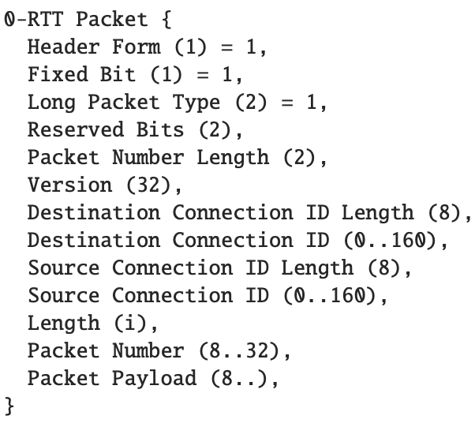
0-RTT packets
Can be sent during the handshake to exchange data
Encrypted using previous TLS ticket
[SCID=x,DCID=z]
Initial (CRYPTO) 0-RTT(Data)
[SCID=x, DCID=y]
Initial (CRYPTO)
Handshake(CRYPTO)

Slide 35
Replays and 0-RTT packets
QUIC cannot guarantee that 0-RTT data will be delivered only ONCE to a server
An application that uses QUIC’s 0-RTT must ensure that the data sent in 0-RT is idempotent and can be replayed without any problem
[SCID=x,DCID=z]
Initial (CRYPTO) 0-RTT(Data)
[SCID=x, DCID=y]
Initial (CRYPTO)
Handshake(CRYPTO)
[SCID=x,DCID=z]
Initial (CRYPTO) 0-RTT(Data)

Slide 36
QUIC allows to multiplex several bytestreams on a single connection
What is the information required in each STREAM frame to support this feature ?
?

Slide 37
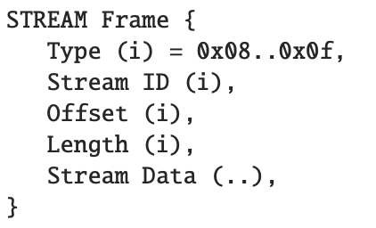
Transporting data streams
QUIC defines several types of frames to reliably exchange data
STREAM frame

Slide 38
The STREAM frame
FIN bit indicates end of STREAM
Each bytestream has a unique identifer
0001XYZF
Indicates whether Offset and length are present
Offset in bytes from beginning of bytestream
Length of frame in bytes
All integers are varint

Slide 39
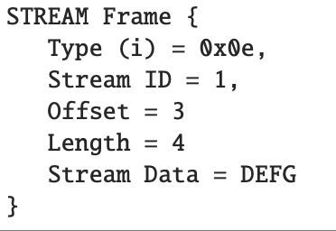
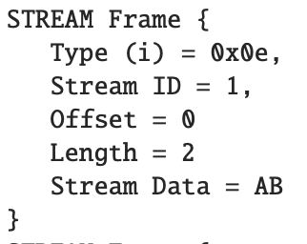
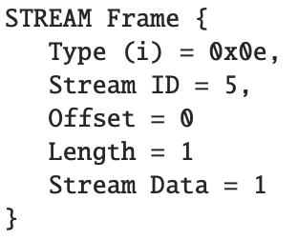
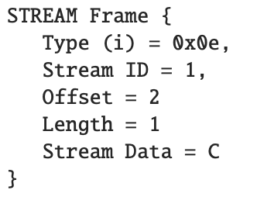
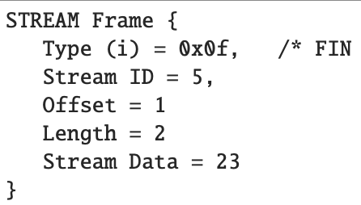
Example
Client sends ABCDEFG over STREAM 1 and 123 over STREAM 5
PN = 1
AB
PN = 3
C
23
PN = 4
DEFG
PN = 2
1

Slide 40
The stream identifiers
Each bytestream has a unique identifier, but who allocates thes identifiers ?
The client
The server
Both
Risk of collision
To prevent collisions, the low order bits of the stream identifier indicate the host that is responsible for the stream identifiers
00 : bidirectional stream identifier created by client
10 : unidirectional stream identifier created by client
01 : bidirectional stream identifier created by server
11 : unidirectional stream identifier created by server

Slide 41
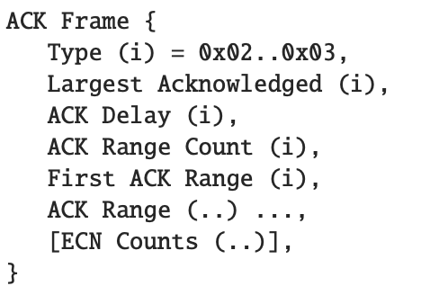
Acknowledging QUIC packets
A QUIC receiver always acknowledges the received packets
Not the individual frames (the sender must remember in which packet each frame was sent)
How would you design the QUIC ACK frame
?

Slide 42
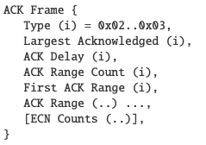
QUIC loss detection
How to detect packet losses ?
Sender always uses monotonically increasing packet numbers
Initial packet number may start at another value than zero
Sender can decide to create gaps in packet number if it wants
Receiver acknowledges QUIC packets using ACK frames
Packets containing only ACK, PADDING and CONNECTION_CLOSE frames do not need to be acked
Largest QUIC PN received
Similar to TCP’s SACK blocks

Slide 43
QUIC ack delays
QUIC needs to accurately measure round-trip-times like TCP
But a QUIC receiver may not always send an ACK for each received packet
Standard requires sending one ACK every two packets, but implementations vary
Some implementations delay the transmission of ACK frames
t₃
t₄
t₅
PN=3
PN=5
PN=4
Rtt=t_{a}- t₅-d
Rtt= ?
d
PN=9
ACK[L=5, Delay=d]
t_{a}

Slide 44
Closing bytestreams
How to close bytestreams ?
Gracefully
Sender sets the FIN bit in the STREAM frame containing the last byte of the stream
Abruptly by the sender
Sender sends a RESET_STREAM frame whose parameter is the identifier of the stream being closed
Abruptly by the receiver
Receiver sends a STOP_SENDING frame to indicate that it discards all data for a given bytestream

Slide 45
QUIC flow control
QUIC supports different levels of flow control
Connection level
When the connection starts, a receiver indicates the maximum amount of data that it accepts with initial_max_data transport parameter
During the connection, it can adjust this limit with the MAX_DATA frame
Number of streams
Initial_max_streams_bidi and Initial_max_streams_uni transport parameters exchanged during the handshake
MAX_STREAMS frame can be used to adjust this limit during the connection

Slide 46
QUIC flow control
At the stream level
Transport parameters allow to specify the maximum number on bytes which can be received on a stream
MAX_STREAM_DATA allows to adjust this limit on a given stream during the connection
When a sender is blocked by the flow control imposed by a receiver, it should send a DATA_BLOCKED or STREAM_DATA_BLOCKED to inform the receiver and encourage it to adjust the limits
These control frames are acknowledged and retransmitted if lost to prevent the window-zero problems that affect TCP

Slide 47
TLS/TCP and QUIC security
How can these protocols cope with on-path attackers that are able to observe packets and send spoofed packets ?
What kind of attacks are prevented by using TLS over TCP ?
Attacker is on-path but does not know security keys, it can change
Information inside payload
Inject new data in payload
Information inside TCP header
Generate new TCP segments for a connection
TLS records
[encrypted and authenticated]

Slide 48
Some on-path attacks
TCP RST attack
Attacker breaks an established TCP connection by sending a spoofed RST
When receiving a RST segment, receiver checks that it contains a valid sequence number
If yes, the TCP connection is terminated
TCP injection attack
Attacker injects new TCP segment with a specific payload
Attacker can easily determine the sequence numbers to use in TCP header
Attacker does not know security keys, receiver will reject incoming TLS records and stop the TLS session

Slide 49
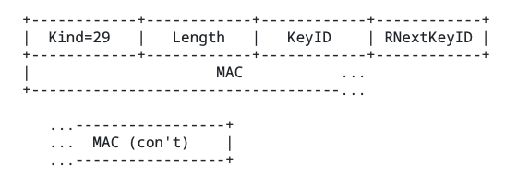
How to improve the resilience TCP against such attacks ?
We also need to protect the TCP header
Encrypt TCP header
Would break many middleboxes like firewals that inspect the TCP header
Authenticate the TCP header
Possible with the TCP-AO option, but requires security keys that usually need to be manually configured
https://datatracker.ietf.org/doc/html/rfc5925

Slide 50
Fifth principle: Encrypt and authenticate most of QUIC packets
Sent as clear text Visible by routers, NATs, firewalls
Encrypted and authenticated using connection keys
On-path attackers cannot even observe QUIC packet numbers !

Slide 51
QUIC and malformed packets
What happens if attacker modifies a packet on a QUIC connection ?
Packet reception
QUIC receiver verifies the integrity of the packet using the authentication
If packet fails this check, it is discarded
QUIC receivers decrypts the contents of the packet
It can then access the packet number and the frames contained in the packet
On-path attackers cannot break an established QUIC connection by injecting packets or modifying packets sent over this connection

Slide 52
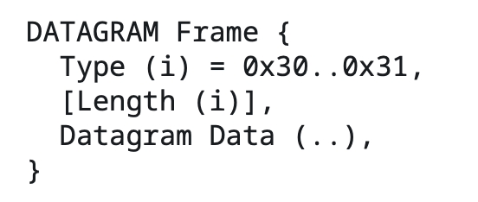
Exchanging datagrams
Can we use QUIC to carry datagrams (e.g. Voice over IP) ?
The STREAM frames are always acknowledged and retransmitted if needed
Negotiate DATAGRAM extension during handshake
Client proposes max_datagram_frame_size > 0
Server selects value if supported
New DATAGRAM frame
DATAGRAM frames are NOT retransmitted
But packets carrying these frames are acknowledged
Low order bit indicates if Length field is present

Slide 53
QUIC connection migration
Smartphone would like to migrate established QUIC connections to cellular when losing Wi-Fi and vice-versa
First approach
Smartphone has two IP addresses and uses them at will
IP1
Cell
IP2
Wi-Fi
IPS
Server
S=IP1,D=IPS, DCID=123
1-RTT(Data)
S=IPS, D=IP1
1-RTT(…)
S=IP2,D=IPS, DCID=123
1-RTT(Data)
How secure is this approach ?
S=IPS, D=IP2
1-RTT(…)

Slide 54
QUIC connection migration
Other CID: 456
Principle
Server allocates several connection identifiers to each client
If a client needs to use a different path to reach the server, it must use a new connection identifier
IP2
Wi-Fi
IPS
Server
IP1
Cell
S=IP1,D=IPS, DCID=123
1-RTT(Data)
S=IPS, D=IP1
1-RTT(…)
S=IP2,D=IPS, DCID=456
1-RTT(PATH_CHAL(x))
S=IPS, D=IP2
1-RTT(PATH_RESP(x), PATH_CHAL(y))
How can the server validate the client ?
S=IP2,D=IPS, DCID=456
1-RTT(PATH_RESP(y))

Slide 55
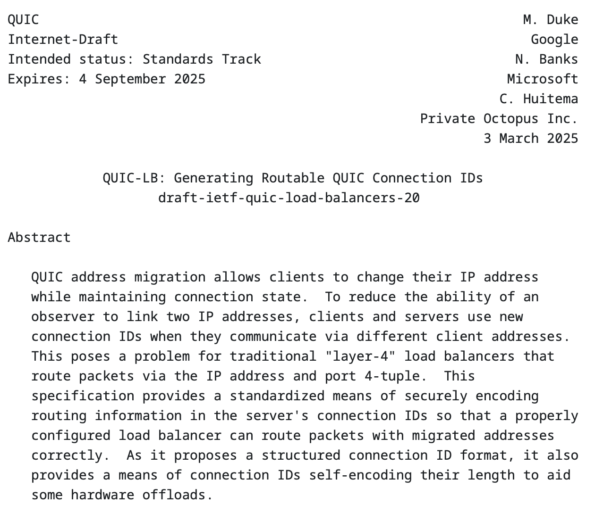
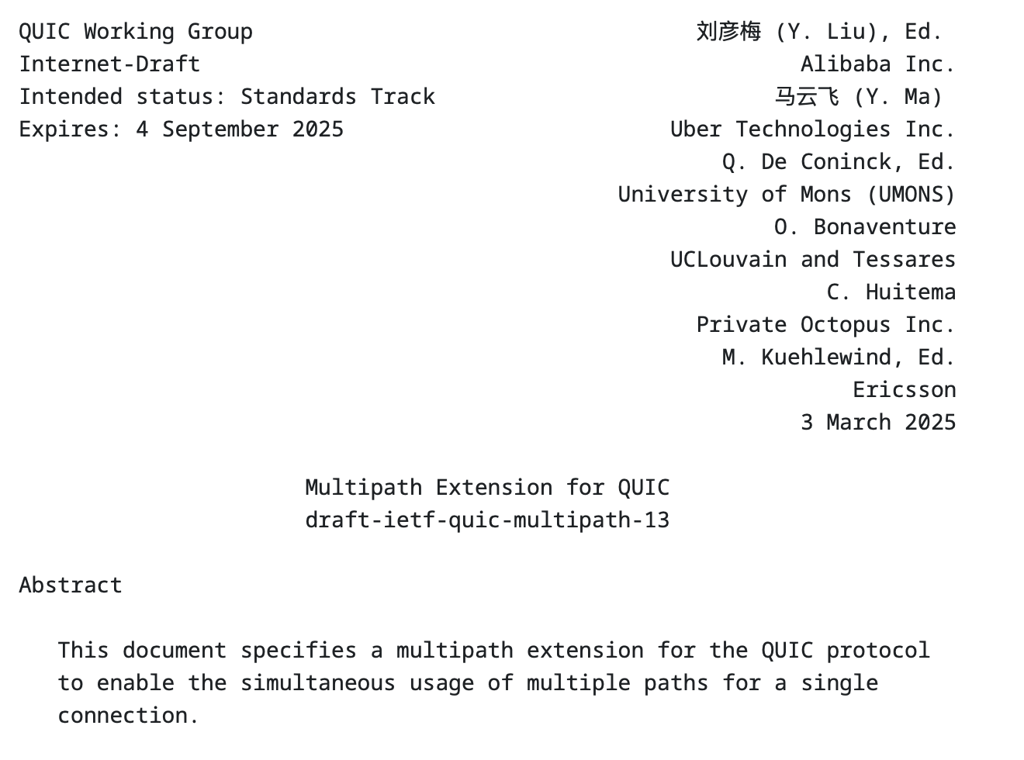
QUIC extensions

