Slide 1
Part 7 Building a network

Slide 2
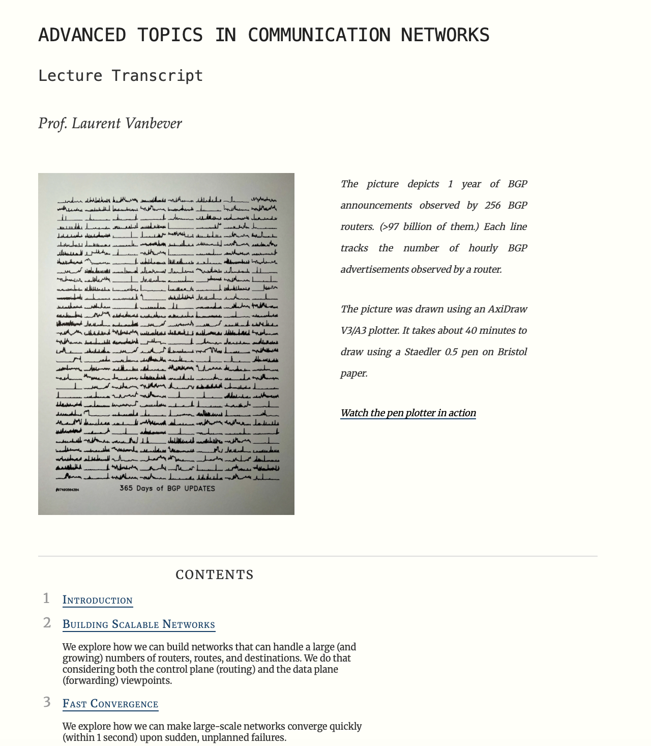
https://adv-net.ethz.ch/transcripts/

Slide 3
Agenda
Building a network
Virtual circuit organization
Datagram organization
Static routing
Distance vector routing
Link state routing

Slide 4

How to transfert information ?
Divide it in small blocks called packets which can be sent independently
ABCDEFGHIJKLMNOPQRSTUVWXYZ1234
ABCDEFGHIJKLM
NOPQRSTUVW
XYZ1234

Slide 5
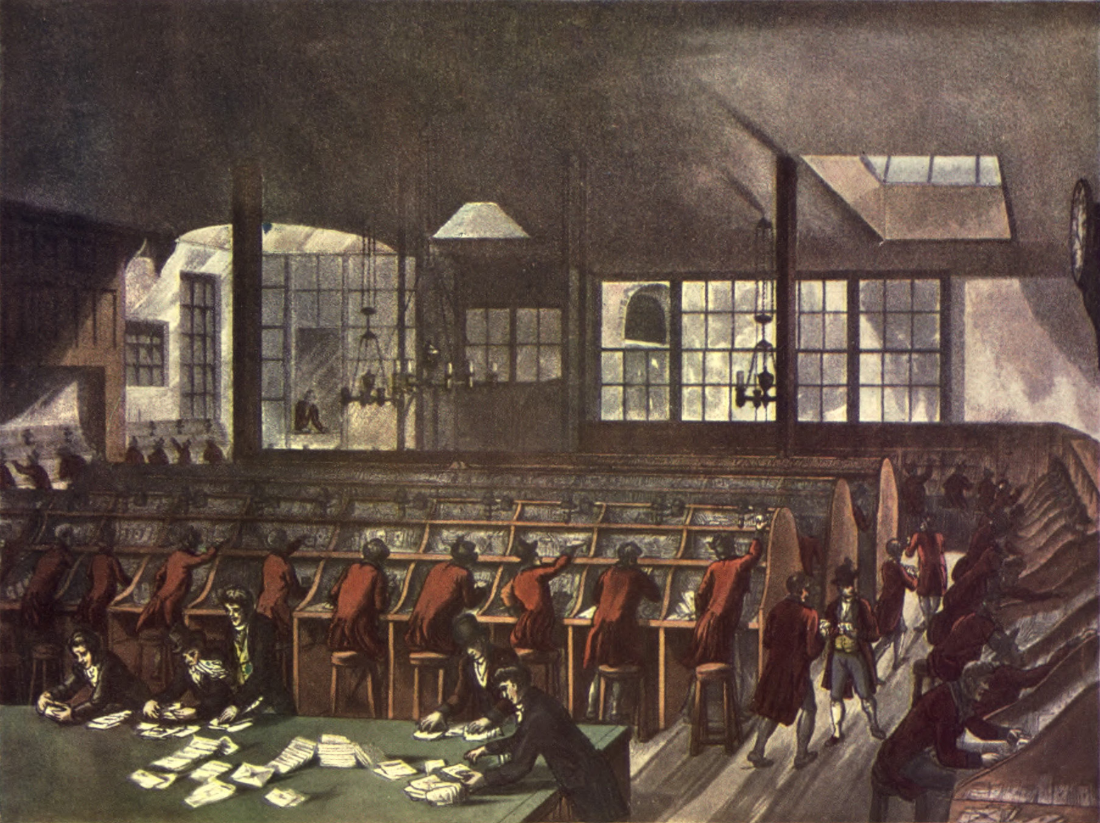
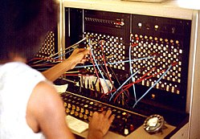
How to organise a network ?
Source: wikipedia : https://en.wikipedia.org/wiki/Post_office and https://en.wikipedia.org/wiki/Telephone_exchange

Slide 6
Agenda
Building a network
Virtual circuit organisation
Datagram organisation
Static routing
Distance vector routing
Link state routing

Slide 7
Virtual circuit
Basic idea
Create circuits through the network to transfer data divided in packets
Packets contain one (or more) labels
Simpler forwarding table
incoming label, nexthop, outgoing label

Slide 8


Virtual circuit
3 -> 5, South East
2 -> 3, South East
A
R1
3
5 -> 2, South East
3 -> 1, South East
R3
1
C
B
R2
1 -> 2, North East

Slide 9
Agenda
Building a network
Virtual circuit organisation
Datagram organisation
Static routing
Distance vector routing
Link state routing

Slide 10
Datagram organisation
Principles
Two types of devices
Hosts
Routers
Packet
Source and destination addresses

Slide 11

Datagram mode
Early work on this concept that led to the current Internet was done in France
Cyclades project lead by Louis Pouzin
http://goo.gl/lwdlwS

Slide 12
A network
A: West
B: East
A
R1
A: North
B: South-East
R3
A: North
B: North-East
R2
B
Contents of the forwarding table
Destination, nexthop/outgoing if

Slide 13
How to compute the forwarding tables ?
A simple solution: Port-station table
When a node boots, its forwarding table is empty, is it possible to learn automatically the forwarding table from the data packets ?

Slide 14
Another network
A
R1
R3
B
R2

Slide 15
A simple network
A: West
A
A->B
R1
A: North-West
B->A
B->A
R3
A: North
A->B
A->B
B->A
A->B
R2
B

Slide 16
Another network
B: S-E
A
B: S-W
R1
B->A
B: South
B->A
B->A
R3
B: East
B->A
B->A
B->A
B: North
B->A
R2
B
The port-station table can only be used in tree-shaped networks !

Slide 17
Source routing
Basic idea
Each node has a unique address
Each node knows its direct neighbors
How ?
Each packet contains the list of the addresses of intermediate nodes

Slide 18
Source routing (2)
A: West
R2: South-West
R3: East
A
A->B via R1,R3
R1
R3
A->B via R1,R3
B: South
R1: North-West
R2: South-West
R1: North
R2: North-East
B->A via R3,R2,R1
B->A via R3,R2,R1
A->B via R1,R3
R2
B->A via R3,R2,R1
B

Slide 19
Can we do better ?
Networks must be redundant to cope with failures
tree-shaped networks are not sufficient
Source routing consummes header space

Slide 20
Agenda
Building a network
Virtual circuit organisation
Datagram organisation
Static routing
Distance vector routing
Link state routing

Slide 21
Static routing
Compute forwarding tables for all nodes such that all nodes can send packets to any other nodes in the network
A
B
C
C
D
E
E
Paths to C
Paths to A

Slide 22
Static routing
?
What are the criterias that must be fulfilled ?
Each node must have at least one path towards each other node
No blackhole
The set of paths towards a given destination must form an acyclic graph
No forwarding loop

Slide 23

Static routing
Is this set of forwarding tables valid ?
Routing table
A : South
B : Local
C : East
E : South
Routing table
A : West [via B]
B : West
C : Local
D : West [via B]
E : South West
Routing table
A : Local
D : South
B : East
C : East [via B]
E: East [via B]
A
B
C
C
Routing table
A : East [via E]
B : North [via A]
C : East [via E]
D : Local
E : East
Routing table
A : West [via D]
B : North
C : North-East
D : West
E : Local
D
E
E
Paths to E
Paths to D
Paths to A

Slide 24
Static routing
Is this set of forwarding tables valid ?
Routing table
A : West
B : Local
C : East
D : South [via E]
E : South
Routing table
A : West [via B]
B : West
C : Local
D : West [via B]
E : South West
Routing table
A : Local
D : South
B : East
C : East [via B]
E: East [via B]
A
B
C
C
Routing table
A : North
B : North [via A]
C : East [via E]
D : Local
E : East
Routing table
A : North [via B]
B : North
C : North-East
D : West
E : Local
D
E
E
Paths to E
Paths to D
Paths to A

Slide 25
Static routing in practice
Forwarding tables are often computed based on a weighted graph along shortest paths
Routing table
A : West
B : Local
C : East
D : South [via E]
E : South
Routing table
A : West [via B]
B : West
C : Local
D : S-West [via E]
E : South West
Routing table
A : Local
D : East [via B]
B : East
C : East [via B]
E: East [via B]
3
2
A
B
C
C
1
Routing table
A : East [via E]
B : East [via E]
C : East [via E]
D : Local
E : East
5
2
Routing table
A : North [via B]
B : North
C : North-East
D : West
E : Local
2
1
D
3
E
E

Slide 26
Question
Link A-B fails, which tables must be updated ?
Routing table
A : West
B : Local
C : East
D : South [via E]
E : South
Routing table
A : West [via B]
B : West
C : Local
D : West [via B]
E : South West
Routing table
A : Local
D : South
B : East
C : East [via B]
E: East [via B]
A
B
C
C
Routing table
A : North
B : North [via A]
C : East [via E]
D : Local
E : East
Routing table
A : North [via B]
B : North
C : North-East
D : West
E : Local
D
E
E

Slide 27
Allocating addresses in IP networks
Example
Allocate 192.0.2.0/24 (256 addresses)
10.0.0.4/31
10.0.0.3/31
R1
192.0.2.192/26
10.0.0.2/31
10.0.0.5/31
192.0.2.0/26
R2
R3
10.0.0.1/31
10.0.0.0/31
192.0.2.64/26
192.0.2.128/26

Slide 28
IPv4 subnets
An IPv4 subnet is a group of IPv4 addresses that have the same prefix (high order n bits)
Examples
2.3.4.0/24 means 2.3.4.0 -> 2.3.4.255
3.4.5.128/25 means 3.4.5.128 -> 3.4.5.255
4.5.6.64/27 means 4.5.6.64 -> 4.5.6.95
What is the last address of the 5.6.7.32/29 ?

Slide 29
Allocating addresses
IPv6 campus network
2001:db8:1234::/48
2001:db8:1234:A::/52
2001:db8:1234:B::/52
2001:db8:1234:C::/52
2001:db8:1234:11::/56

Slide 30

Allocating addresses
Inside a campus
2001:db8:1234:A::/52
2001:db8:1234:A0::/54
2001:db8:1234:A8::/55
2001:db8:1234:A0::/54
2001:db8:1234:A8::/53
2001:db8:1234:AA::/55
2001:db8:1234:AE::/55
2001:db8:1234:A4::/54
2001:db8:1234:AC::/55

Slide 31
Packet forwarding on IPv4 routers
When an IPv4 router forwards an IPv4 packet, it always uses longest prefix match
Destination Gateway
0.0.0.0/0 192.168.0.1
127.0.0.1 lo0
130.104.0.0/16 192.168.0.2
130.104.12.128/26 192.168.0.3
130.104.12.192/27 192.168.0.4
192.168.0.0/24 eth0
Packets to 130.105.12.194, 130.104.12.176 130.104.12.254,

Slide 32
Packet forwarding on IPv6 routers
When an IPv6 router forwards an IPv6 packet, it always uses longest prefix match
Destination Gateway
::/0 fe80::dead:beef
::1 ::1
2a02:2788:2c4:16f::/64 eth0
2001:6a8:3080::/48 fe80::bad:cafe
2001:6a8:2d80::/48 fe80::bad:bad
2001:6a8::/32 fe80::aaaa:bbbb
Packets to 2001:6a8:3080::1234, 2001:2788:123a::1:1e, 2001:6a8:3880:40::2

Slide 33

Example
B’s routing table
destination interface/NH
::/0 2001:db8:5::C 2001:db8:2/47 2001:db8:6::E 2001:db8:5/48 South 2001:db8:6/48 East
2001:db8:7/48 West
RB
2001:db8:7/48
RB
2001:db8:6/48
2001:db8:1/48
2001:db8:5/48
RA
RC
RE
RA
RC
RE
2001:db8:4/48
2001:db8:3/48
2001:db8:2/48
A’s routing table
destination interface/NH
::/0 2001:db8:7::B
2001:db8:7/48 2001:db8:4::C
2001:db8:1/48 West
2001:db8:4/48 East
2001:db8:7/48 North
C’s routing table
destination interface/NH
2001:db8:1/48 2001:db8:5::B
2001:db8:2/47 2001:db8:3::E
2001:db8:2/48 2001:db8:5::B
2001:db8:3/48 East
2001:db8:4/48 West
2001:db8:5/48 North
2001:db8:6/47 2001:db8:5::B
E’s routing table
destination interface/NH
::/0 2001:db8:6::B
2001:db8:2/48 East 2001:db8:3/48 West 2001:db8:6/48 North

Slide 34
Agenda
Building a network
Virtual circuit organisation
Datagram organisation
Static routing
Distance vector routing
Link state routing

Slide 35
Dynamic routing protocols
Objective
Develop a distributed algorithm that automatically computes the routing tables of all routers in a network
Each router is configured with its addresses and a cost is associated to each directed link

Slide 36
Computing forwarding tables
How to compute the forwarding tables for all routers in a network ?
A
B
C
C
D
E
E
dest -> interface

Slide 37
Computing forwarding tables
Routing table
A : Local
D : South
B : East
C : East [via B]
E: East [via B]
Routing table
A : West
B : Local
C : East
D : South [via E]
E : South
Routing table
A : West [via B]
B : West
C : Local
D : West [via B]
E : South West
A
Cost=1
Cost=1
C
C
B
Routing table
A : North
B : North [via A]
C : East [via E]
D : Local
E : East
Cost=1
Cost=1
Routing table
A : North [via B]
B : North
C : North-East
D : West
E : Local
Cost=1
D
Cost=1
E
E

Slide 38
Distance vector routing
Objectives of the routing protocol
Automatically compute all forwarding tables so that each node can reach any node in the network with a loop-free path
Principle
Each node regularly sends a summary of its forwarding table to its neighbors

Slide 39
Distance vector
Routing table
B : 0 [Local]
Routing table
C : 0 [Local]
Routing table
A : 0 [ Local ]
Cost=1
Cost=1
C
C
A
B
Cost=1
Cost=1
Cost=1
Routing table
D : 0 [Local]
Routing table
E : 0 [Local]
D
D
E
E
Cost=1

Slide 40
Distance vector example (2)
Routing table
B : 0 [Local]
A : 1 [West]
Routing table
A : 0 [ Local ]
Routing table
C : 0 [Local]
A
B
C
C
D=0 ; A=1
Routing table
D : 0 [Local]
A : 1 [North]
D
Routing table
E : 0 [Local]
D
E
E
D=0 ; A=1

Slide 41
Distance vector example (3)
Routing table
A : 0 [ Local ]
D : 1 [South]
Routing table
B : 0 [Local]
A : 1 [West]
Routing table
C : 0 [Local]
C=0
A
B
C
C
C=0
Routing table
D : 0 [Local]
A : 1 [North]
Routing table
E : 0 [Local]
D : 1 [West]
A : 2 [West]
D
D
E
E

Slide 42
Distance vector example (4)
Routing table
B : 0 [Local]
A : 1 [West]
C : 1 [East]
Routing table
A : 0 [ Local ]
D : 1 [South]
Routing table
C : 0 [Local]
A
B
C
C
E=0;D=1;A=2;C=1
E=0;D=1;A=2;C=1
Routing table
D : 0 [Local]
A : 1 [North]
Routing table
E : 0 [Local]
D : 1 [West]
A : 2 [West]
C : 1 [North-East]
D
D
E
E
E=0;D=1;A=2;C=1

Slide 43
Distance vector example (5)
Routing table
B : 0 [Local]
A : 1 [West]
C : 1 [East]
E : 1 [South]
D : 2 [South]
Routing table
C : 0 [Local]
E : 1 [South-West]
D : 2 [South-West]
A : 3 [South-West]
Routing table
A : 0 [ Local ]
D : 1 [South]
B=0;A=1;C=1;D=2;E=1
A
B
C
C
B=0;A=1;C=1;D=2;E=1
Routing table
D : 0 [Local]
A : 1 [North]
E : 1 [East]
C : 2 [East]
Routing table
E : 0 [Local]
D : 1 [West]
A : 2 [West]
C : 1 [North-East]
D
D
E
E

Slide 44
Distance vector example (6)
Routing table
B : 0 [Local]
A : 1 [West]
C : 1 [East]
E : 1 [South]
D : 2 [South]
Routing table
A : 0 [ Local ]
D : 1 [South]
B : 1 [East]
C : 2 [East]
E : 2 [East]
Routing table
C : 0 [Local]
E : 1 [South-West]
D : 2 [South-West]
A : 2 [West]
B : 1 [West]
A
B
C
C
Routing table
D : 0 [Local]
A : 1 [North]
E : 1 [East]
C : 2 [East]
A=0;B=1;C=2;D=1;E=2
Routing table
E : 0 [Local]
D : 1 [West]
A : 2 [West]
C : 1 [North-East]
B : 1 [North]
D
D
E
E

Slide 45
Distance vector example (7)
Routing table
A : 0 [ Local ]
D : 1 [South]
B : 1 [East]
C : 2 [East]
E : 2 [East]
Routing table
B : 0 [Local]
A : 1 [West]
C : 1 [East]
E : 1 [South]
D : 2 [South]
Routing table
C : 0 [Local]
E : 1 [South-West]
D : 2 [South-West]
A : 2 [West]
B : 1 [West]
A
B
C
C
Routing table
D : 0 [Local]
A : 1 [North]
E : 1 [East]
C : 2 [East]
B : 2 [North]
Routing table
E : 0 [Local]
D : 1 [West]
A : 2 [West]
C : 1 [North-East]
B : 1 [North]
D
D
E
E

Slide 46
What is the distance vector sent by R5 after convergence ?
4
R1
R5
1
10
1
R2
1
R6
1
9
4
R3
R4

Slide 47
Distance vectors
How to deal with link failures ?
A
B
C
C
D
D
E
E

Slide 48
How to react ?
All routes that use a failed link are advertised with an infinite cost
Routing table
A : 0 [ Local ]
D : 1 [South]
B : ∞
C : ∞
E : ∞
Routing table
B : 0 [Local]
A : ∞
C : 1 [East]
E : 1 [South]
D : 2 [South]
Routing table
C : 0 [Local]
E : 1 [South-West]
D : 2 [South-West]
A : 2 [West]
B : 1 [West]
A
B
C
Routing table
D : 0 [Local]
A : 1 [North]
E : 1 [East]
C : 2 [East]
B : 2 [North]
A=0;B=∞;C=∞;D=1;E=∞
Routing table
E : 0 [Local]
D : 1 [West]
A : 2 [West]
C : 1 [North-East]
B : 1 [North]
D
E

Slide 49
Question
How does a router using distance vectors detect the failure of a link ?

Slide 50
DV sent by R4 when link fails ?
3
R1
R5
10
R2
R6
9
4
R3
R4
Default link weight is 1

Slide 51
Student question
What is the difference between a routing table and a forwarding table ?

Slide 52
Question
A distance vector router accepts a route towards destination d on link l if any of three conditions is met. What are these three conditions ?
d is not already in the routing table
d is already in the routing table, but with a shorter path
d is already in the routing table, but with a longer path
the sequence number of the distance vector is larger than the previous one
d is already in the routing table, but the route was learned from another link than l
d is already in the routing table, and the route was learned on link l

Slide 53
Reception of DV
Received(Vector V[],link l)
{ /* received vector from link l */
for each destination=d in V[]
{
if (d isin R[])
{ if ( ((V[d].cost+l.cost) < R[d].cost) OR ( R[d].link == l) )
{ /* better route or change to current route */
R[d].cost=V[d].cost+l.cost;
R[d].link=l;
}
}
else
{ /* new route */
R[d].cost=V[d].cost+l.cost;
R[d].link=l;
}
}

Slide 54
Example
Routing table
A : 0 [ Local ]
D : 1 [South]
B : ∞
C : ∞
E : ∞
Routing table
B : 0 [Local]
A : ∞
C : 1 [East]
E : 1 [South]
D : 2 [South]
Routing table
C : 0 [Local]
E : 1 [South-West]
D : 2 [South-West]
A : 2 [West]
B : 1 [West]
A
B
C
Routing table
D : 0 [Local]
A : 1 [North]
E : 1 [East]
C : 2 [East]
B : 2 [North]
A=0;B=∞;C=∞;D=1;E=∞
Routing table
E : 0 [Local]
D : 1 [West]
A : 2 [West]
C : 1 [North-East]
B : 1 [North]
D
E
D must remove all the routes learned from North that are announced with an ∞ cost

Slide 55
Example
Routing table
A : 0 [ Local ]
D : 1 [South]
B : ∞
C : ∞
E : ∞
Routing table
B : 0 [Local]
A : ∞
C : 1 [East]
E : 1 [South]
D : 2 [South]
Routing table
C : 0 [Local]
E : 1 [South-West]
D : 2 [South-West]
A : 2 [West]
B : 1 [West]
A
B
C
C
Routing table
D : 0 [Local]
A : 1 [North]
E : 1 [East]
C : 2 [East]
B : ∞
D=0;B= ∞;A=1;C=2;E=11
Routing table
E : 0 [Local]
D : 1 [West]
A : 2 [West]
C : 1 [North-East]
B : 1 [North]
D
D
E
E

Slide 56
Example
Routing table
A : 0 [ Local ]
D : 1 [South]
B : ∞
C : 3 [South]
E : 2 [South]
Routing table
B : 0 [Local]
A : ∞
C : 1 [East]
E : 1 [South]
D : 2 [South]
Routing table
C : 0 [Local]
E : 1 [South-West]
D : 2 [South-West]
A : 2 [West]
B : 1 [West]
B=0;A=∞;C=1;E=1;D=2
A
B
C
C
Routing table
D : 0 [Local]
A : 1 [North]
E : 1 [East]
C : 2 [East]
B : ∞
B=0;A=∞;C=1;E=1;D=2
Routing table
E : 0 [Local]
D : 1 [West]
A : 2 [West]
C : 1 [North-East]
B : 1 [North]
D
D
E
E

Slide 57
Example
Routing table
A : 0 [ Local ]
D : 1 [South]
B : ∞
C : 3 [South]
E : 2 [South]
Routing table
B : 0 [Local]
A : ∞
C : 1 [East]
E : 1 [South]
D : 2 [South]
Routing table
C : 0 [Local]
E : 1 [South-West]
D : 2 [South-West]
A : ∞∞
B : 1 [West]
C
A
B
C
Routing table
D : 0 [Local]
A : 1 [North]
E : 1 [East]
C : 2 [East]
B : ∞
E=0;A=2;D=1;C=1;B=1
E=0;A=2;D=1;C=1;B=1
D
E
D
E
Routing table
E : 0 [Local]
D : 1 [West]
A : 2 [West]
C : 1 [North-East]
B : 1 [North]
E=0;A=2;D=1;C=1;B=1

Slide 58
Example
Routing table
A : 0 [ Local ]
D : 1 [South]
B : ∞
C : 3 [South]
E : 2 [South]
Routing table
B : 0 [Local]
A : 3 [South]
C : 1 [East]
E : 1 [South]
D : 2 [South]
Routing table
C : 0 [Local]
E : 1 [South-West]
D : 2 [South-West]
A: 3 [South-West]
B : 1 [West]
A
B
C
C
Routing table
D : 0 [Local]
A : 1 [North]
E : 1 [East]
C : 2 [East]
B : 2 [East]
A=1;B=2;C=2;D=1;E=1
Routing table
E : 0 [Local]
D : 1 [West]
A : 2 [West]
C : 1 [North-East]
B : 1 [North]
D
D
E
E
Everything is ok ?

Slide 59
Another failure
Routing table
A : 0 [ Local ]
D : 1 [South]
B : 3 [South]
C : 3 [South]
E : 2 [South]
Routing table
B : 0 [Local]
A : 3 [South]
C : 1 [East]
E : 1 [South]
D : 2 [South]
Routing table
C : 0 [Local]
E : 1 [South-West]
D : 2 [South-West]
A: 3 [South-West]
B : 1 [West]
A
B
C
C
Routing table
D : 0 [Local]
A : 1 [North]
E : 1 [East]
C : 2 [East]
B : 2 [East]
A=1;B=∞;C=∞;D=1;E=∞
Routing table
E : 0 [Local]
D : 1 [West]
A : 2 [West]
C : 1 [North-East]
B : 1 [North]
D
D
E
E

Slide 60
Another failure
Routing table
A : 0 [ Local ]
D : 1 [South]
B : 3 [South]
C : 3 [South]
E : 2 [South]
Routing table
B : 0 [Local]
A : 3 [South]
C : 1 [East]
E : 1 [South]
D : 2 [South]
Routing table
C : 0 [Local]
E : 1 [South-West]
D : 2 [South-West]
A: 3 [South-West]
B : 1 [West]
A
B
C
C
Routing table
D : 0 [Local]
A : 1 [North]
E : ∞
C : ∞
B : ∞
A=0;D=1;B=3;C=3;E=2
Routing table
E : 0 [Local]
D : 1 [West]
A : 2 [West]
C : 1 [North-East]
B : 1 [North]
D
D
E
E
But A could also send its distance vector before D

Slide 61
Another failure
Routing table
A : 0 [ Local ]
D : 1 [South]
B : 3 [South]
C : 3 [South]
E : 2 [South]
Routing table
B : 0 [Local]
A : 3 [South]
C : 1 [East]
E : 1 [South]
D : 2 [South]
Routing table
C : 0 [Local]
E : 1 [South-West]
D : 2 [South-West]
A: 3 [South-West]
B : 1 [West]
D updates its routing table
A
B
C
C
Routing table
D : 0 [Local]
A : 1 [North]
E : 3 [North]
C : 4 [North]
B : 4 [North]
D=0;A=1;E=3;C=4;B=4
Routing table
E : 0 [Local]
D : 1 [West]
A : 2 [West]
C : 1 [North-East]
B : 1 [North]
D
D
E
E

Slide 62
Another failure
Routing table
A : 0 [ Local ]
D : 1 [South]
B : 5 [South]
C : 5 [South]
E : 4 [South]
Routing table
B : 0 [Local]
A : 3 [South]
C : 1 [East]
E : 1 [South]
D : 2 [South]
Routing table
C : 0 [Local]
E : 1 [South-West]
D : 2 [South-West]
A: 3 [South-West]
B : 1 [West]
A
B
C
C
Routing table
D : 0 [Local]
A : 1 [North]
E : 3 [North]
C : 4 [North]
B : 4 [North]
A=0;D=1;B=5;C=5;E=4
Routing table
E : 0 [Local]
D : 1 [West]
A : 2 [West]
C : 1 [North-East]
B : 1 [North]
D
D
E
E

Slide 63
Another failure
Routing table
A : 0 [ Local ]
D : 1 [South]
B : 5 [South]
C : 5 [South]
E : 4 [South]
Routing table
B : 0 [Local]
A : 3 [South]
C : 1 [East]
E : 1 [South]
D : 2 [South]
Routing table
C : 0 [Local]
E : 1 [South-West]
D : 2 [South-West]
A: 3 [South-West]
B : 1 [West]
A
B
C
C
Routing table
D : 0 [Local]
A : 1 [North]
E : 5[North]
C : 6 [North]
B : 6 [North]
A=1;D=0;B=6;C=6;E=5
Routing table
E : 0 [Local]
D : 1 [West]
A : 2 [West]
C : 1 [North-East]
B : 1 [North]
D
D
E
E
This problem is called counting to infinity
How can we prevent it ?

Slide 64
Preventing count to infinity
Split horizon
Split horizon with poisoning
Notes:
Pseudocode
Every N seconds:
for each link=l
{ /* one different vector for each link */
Vector=null;
for each destination=d in R[]
{
if (R[d].link<>l)
{
Vector=Vector+Pair(d,R[d].cost);
}
}
Send(Vector);
}

Slide 65
Agenda
Building a network
Datagram organisation
Virtual circuit organisation
Static routing
Distance vector routing
Link state routing

Slide 66
Link state routing
Objectives of the routing protocol
Compute all forwarding tables
Principle
Each node detects its direct neighbors
Each node regularly sends the list of its direct neighbors to all nodes

Slide 67
Discovering neighbours
Manually
Automatically
A:HELLO
A
B
B:HELLO
E:HELLO
E
E

Slide 68
Link state packets
Links
A-B : 1
A-D : 1
Links
A-B : 1
B-E : 1
B-C : 1
Links
B-C : 1
C-E : 1
A
B
C
C
Links
A-D : 1
D-E : 1
LSP : E [D:1];[B:1];[C:1]
LSP : E [D:1];[B:1];[C:1]
Links
A-D : 1
D-E : 1
D
D
E
E
Links
E-D : 1
E-B : 1
E-C : 1
LSP : E [D:1];[B:1];[C:1]
How to reliably send LSPs to all nodes ?

Slide 69
Distributing LSPs
Naive approach
Forward received LSP to all neighbors
Links
A-B : 1
B-E : 1
B-C : 1
E-D : 1
E-C : 1
Links
B-C : 1
C-E : 1
B-E : 1
D-E : 1
Links
A-B : 1
A-D : 1
LSP : E [D:1];[B:1];[C:1]
A
B
C
C
LSP : E [D:1];[B:1];[C:1]
Links
A-D : 1
D-E : 1
B-E : 1
E-C : 1
LSP : E [D:1];[B:1];[C:1]
D
D
E
E
Links
E-D : 1
E-B : 1
E-C : 1
With this approach, LSPs will loop forever...

Slide 70
Flooding
New LSP, flood !
Links
A-B : 1
B-E : 1
B-C : 1
New LSP, flood !
Links
B-C : 1
C-E : 1
Links
A-B : 1
A-D : 1
LSPs
LSPs
LSPs
A
B
C
C
LSP : E-0 [D:1];[B:1];[C:1]
LSP : E-0 [D:1];[B:1];[C:1]
Links
A-D : 1
D-E : 1
Links
A-D : 1
D-E : 1
D
D
E
E
Links
E-D : 1
E-B : 1
E-C : 1
LSP : E-0 [D:1];[B:1];[C:1]
LSPs
LSPs
E-0 [D:1];[B:1];[C:1]
New LSP, flood !

Slide 71
Flooding
A already knows E-0
LSPs
E-0 [D:1];[B:1];[C:1]
LSPs
E-0 [D:1];[B:1];[C:1]
Links
B-C : 1
C-E : 1
B-E : 1
D-E : 1
Links
A-B : 1
B-E : 1
B-C : 1
E-D : 1
E-C : 1
Links
A-B : 1
A-D : 1
LSP : E-0 [D:1];[B:1];[C:1]
LSPs
C
C
A
B
C already knows E-0
LSP : E-0 [D:1];[B:1];[C:1]
Links
A-D : 1
D-E : 1
B-E : 1
E-C : 1
LSP : E-0 [D:1];[B:1];[C:1]
D
Links
E-D : 1
E-B : 1
E-C : 1
D
E
E
LSPs
E-0 [D:1];[B:1];[C:1]
LSPs
E-0 [D:1];[B:1];[C:1]

Slide 72
After flooding
Each node knows full network topology
computes shortest paths from graph
Links
A-B, B-A : 1
B-E, E-B : 1
B-C, C-B : 1
E-D, D-E : 1
E-C, C-E : 1
A-D, D-A : 1
LSPs
E-0 [D:1];[B:1];[C:1]
A-0 [D:1];[B:1]
B-0 [A:1] [C:1] [E:1]
C-0 [B:1] [E:1]
D-0 [A:1] [E:1]
Links
A-B, B-A : 1
B-E, E-B : 1
B-C, C-B : 1
E-D, D-E : 1
E-C, C-E : 1
A-D, D-A : 1
LSPs
E-0 [D:1];[B:1];[C:1]
A-0 [D:1];[B:1]
B-0 [A:1] [C:1] [E:1]
C-0 [B:1] [E:1]
D-0 [A:1] [E:1]
Links
A-B, B-A : 1
B-E, E-B : 1
B-C, C-B : 1
E-D, D-E : 1
E-C, C-E : 1
A-D, D-A : 1
LSPs
E-0 [D:1];[B:1];[C:1]
A-0 [D:1];[B:1]
B-0 [A:1] [C:1] [E:1]
C-0 [B:1] [E:1]
D-0 [A:1] [E:1]
LSPs
E-0 [D:1];[B:1];[C:1]
A-0 [D:1];[B:1]
B-0 [A:1] [C:1] [E:1]
C-0 [B:1] [E:1]
D-0 [A:1] [E:1]
A
B
C
C
D
D
E
E
LSPs
E-0 [D:1];[B:1];[C:1]
A-0 [D:1];[B:1]
B-0 [A:1] [C:1] [E:1]
C-0 [B:1] [E:1]
D-0 [A:1] [E:1]
Links
A-B, B-A : 1
B-E, E-B : 1
B-C, C-B : 1
E-D, D-E : 1
E-C, C-E : 1
A-D, D-A : 1
Links
A-B, B-A : 1
B-E, E-B : 1
B-C, C-B : 1
E-D, D-E : 1
E-C, C-E : 1
A-D, D-A : 1
Paths to E
Paths to D
Paths to A

Slide 73
Summary
Building a network
Datagrams and Virtual Circuits
Static routing
Longest match packet forwarding in IP
Dynamic routing protocols
Distance Vector, Link State

