Slide 1
Part 9 iBGP
O. Bonaventure, 2016-2022

Slide 2
Agenda
Interdomain Routing
iBGP

Slide 3

BGP in large networks
What happens when a network contains tens, hundreds or thousands of routers ?
AS2
AS1
AS4
AS3

Slide 4
How to distribute BGP routes in a large network ?
AS3
AS1
eBGP
AS2
iBGP

Slide 5
IP addresses used on routers
AS3
AS1
A /64 prefix belonging
to AS2, e.g. 2001:222:12:/64
A /64 prefix belonging
to AS1, e.g. 2001:222:11:13:/64
AS2
A /64 prefix belonging
to the AS1, 2001:11:1:/64

Slide 6
A closer look at the BGP messages
2001:222:11:13::33
Prefix: p
AS Path : AS3
BGP Nexhop : 2001:222:11:13::33
AS1
AS3
p
Prefix: p
AS Path : AS1:AS3
BGP Nexhop : 2001:222:12::1234
Prefix: p
AS Path : AS3
BGP Nexhop : 2001:222:11:13::33
AS2
2001:222:12::1234

Slide 7
Endpoints of the eBGP sessions
eBGP sessions are TCP connections established between the IP addresses of the two routers on the peering link
2001:222:11:13::33
AS1
AS3
AS2
2001:222:12::1234
2001:222:12::5678

Slide 8
How to distribute BGP routes in a large network ?
Full mesh of iBGP sessions
Why ?

Slide 9

iBGP sessions in AS1
How many iBGP sessions inside AS1 ?
AS2
AS1
AS4
AS3
iBGP session

Slide 10
Endpoints of the iBGP sessions
A router has several IP addresses, on which address should an iBGP session terminate ?
Any IP address belonging to the router
Address is associated to an interface, if the interface stops, iBGP session stops as well even if the router is still reachable over other interfaces
A loopback address
A software only interface that is always up and announced through the intradomain routing protocol so that it remains reachable as long as the router has one interface up
Best Current Practice
What should be the endpoint of an iBGP session ?

Slide 11
How to deal with routers that are not connected to other ASes ?
Run BGP on these routers
Include them in iBGP full-mesh
AS3
AS1
AS2

Slide 12
How to deal with routers that are not connected to other ASes ?
Make sure that they will never have to forward a packet to an external destination
MPLS / Segment Routing
AS3
AS1
AS2

Slide 13
What are the roles of the IGP ?
The intradomain routing protocol distributes information about the reachability of :
IP prefixes associated to internal links between routers of the AS
IP addresses associated to loopback interfaces or routers of the AS
IP prefixes associated to peering links between a router of this AS and another AS

Slide 14
BGP Nexthop self
Helps to reduce # routes in the IGP
2001:222:11:13::33
Prefix: p
AS Path : AS3
BGP Nexhop : 2001:11:1001::1
AS1
2001:11:1001::1
AS3
Prefix: p
AS Path : AS1:AS3
BGP Nexhop : 2001:222:12::1234
Prefix: p
AS Path : AS3
BGP Nexhop : 2001:222:11:13::33
2001:11:1001::2
AS2
2001:222:12::1234

Slide 15
The BGP decision process
Ignore routes having an unreachable BGP nexthop
Prefer routes having the highest local-pref
Prefer routes having the shortest AS-Path
Prefer routes having the smallest MED
Prefer routes learned via eBGP sessions over routes learned via iBGP sessions
Prefer routes having the closest next-hop
Tie breaking rules : prefer route learned from the router with lowest router id

Slide 16
1st step of BGP decision process
1. Ignore routes having an unreachable BGP nexthop
Why would a BGP route contain an unreachable nexthop ?

Slide 17
Unreachable nexthop
Usually a transient issue
AS3
AS1
AS2

Slide 18
2nd step of BGP decision process
2. Prefer routes having the highest local-pref
Implement routing policies
Prefer customer routes over shared-cost and provide routers
Support backup routes
Local-pref attribute to added by the import filter on eBGP session and distributed to all routers over iBGP sessions

Slide 19
BGP routes towards prefix p on all routers inside AS1
What is the path followed by packets sent by R1 ?
What is the path followed by packets sent by R4 ?
AS1
local-pref=99
R1
R6
AS4
R3
p
R2
R5
local-pref=50
R4
Path towards p

Slide 20
3rd step of BGP decision process
3. Prefer routes having the shortest AS-Path
Some operators believe that a BGP route with a long AS Path has a lower performance than a route with a longer AS Path
This is not always true…

Slide 21
5th step of BGP decision process
5. Prefer routes learned via eBGP sessions over routes learned via iBGP sessions
Motivation : Hot potato routing
Routers should try to forward packets towards external destinations to another AS a quickly as possible

Slide 22
6th step of BGP decision process
6. Prefer routes having the closest next-hop
Motivation : Hot potato routing
Routers should try to forward packets towards external destinations to another AS a quickly as possible

Slide 23
BGP routes towards prefix p on all routers inside AS1
What is the path followed by packets sent by R1 ?
What is the path followed by packets sent by R2 ?
AS1
R1
R6
AS4
R3
p
R2
R5
R4
Path towards p

Slide 24
BGP routes towards prefix p on all routers inside AS1
AS3
AS5
AS2
p
AS1
R1
R6
AS4
R3
R2
R5
R4
What is the path followed by packets sent by R6 (then R1, R2) ?
Path towards p

Slide 25
4th step of BGP decision process
Prefer routes having the smallest MED
MED means Multi-Exit Discriminator
Motivation : Cold potato routing
Enable neighbour AS (usually customer) to indicate the best peering link to reach a given prefix

Slide 26
BGP routes towards prefix p on all routers inside AS1
What is the path followed by packets sent by R5 (then R1) ?
AS1
MED=99
R1
R6
AS4
R3
p
R2
R5
MED=50
R4
Path towards p

Slide 27
BGP routes towards prefix p on all routers inside AS1
AS3
AS2
IGP=7
IGP=9
MED=IGP
p
MED=IGP
AS1
AS4
IGP=4
R1
R6
MED=IGP
IGP=2
R3
R2
R5
MED=IGP
R4
Path towards p
Paths ? R6, R5,R4, R1, R3, R2

Slide 28
7th step of the BGP decision process
7. Tie breaking rules : prefer route learned from the router with lowest router id
Motivation : select a single best route towards each destination prefix
This best route is the route that can be advertised over eBGP session
Note that recent routers sometimes load balance (BGP Multipath) the traffic towards a given prefix over several routes (having the same BGP attributes)

Slide 29
Differences between iBGP and eBGP
Which routes are advertised by a router over iBGP and eBGP sessions ?
Over an eBGP session, a router advertises its best route towards each destination prefix
Provided this advertisement is allowed by the export filter
At most one route per destination prefix
Over an iBGP session, a router advertises its best route towards each destination prefix provided that this best route was learned over an eBGP session
Since iBGP sessions are in full-mesh, there is no need to readvertise a route learned over another iBGP session

Slide 30
Differences between iBGP and eBGP
Which filters are used over iBGP and eBGP sessions ?
Import and export filters are used over all eBGP sessions
Usually, there is a series of import filters attached to each peering link
Filters are usually implemented as modules that are combined together and associated to similar peering links (e.g. customer filter, provider filter, …)
No filter is applied on iBGP sessions

Slide 31
Which BGP routes are known ?
AS1
AS3
AS2

Slide 32
Differences between iBGP and eBGP
What are the attributes carried by iBGP and eBGP
Prefix : iBGP and eBGP
AS Path : iBGP and eBGP
AS Path is updated when a BGP message is sent over an eBGP session
Local-pref : iBGP
Local-pref cannot be used on eBGP sessions
MED : iBGP and eBGP
Nexthop : iBGP and eBGP
Nexthop is updated when a BGP message is sent over an eBGP session

Slide 33
What happens if iBGP sessions are missing ?
AS3
AS5
AS2
p
AS1
R1
R6
AS4
IGP=7
R5
R4
Path towards p
Paths ? R5,R4, R6, R1

Slide 34
What happens if iBGP sessions are missing ?
AS3
AS5
AS2
MED=99
p
AS1
R1
R6
MED=2
AS4
R5
MED=8
R4
Path towards p
Paths ? R5,R4, R6, R1

Slide 35
What happens if iBGP sessions are missing ?
AS3
AS5
AS2
p
AS1
R1
R6
MED=2
AS4
R5
MED=8
R4
Path towards p
Paths ? R5,R4, R6, R1

Slide 36
Conclusion
BGP depends on the underlying intradomain routing protocol
Establishment of the iBGP sessions
Resolution of the BGP nexthop
iBGP and eBGP play different roles
eBGP over sessions with routers in other ASes
iBGP sessions (in full mesh) inside an AS
The BGP decision process ranks routes
Hot potato versus cold potato routing

Slide 37
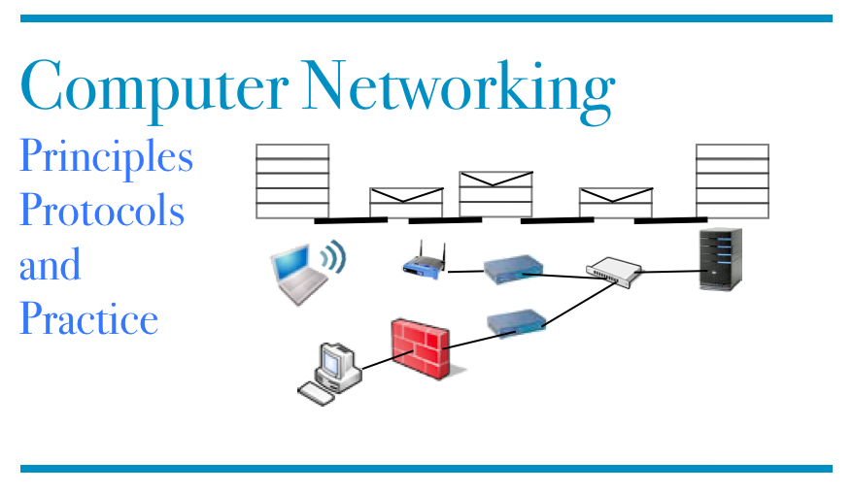
Reading list
1st edition, BGP section http://cnp3book.info.ucl.ac.be/network/network/#the-border-gateway-protocol

Slide 38
Agenda
Interdomain Routing
iBGP
Segment Routing

Slide 39
IPv6 Segment Routing
Objectives
Allow operators to use non-shortest paths inside their networks using Source routing paradigm
Provide advanced services
Traffic engineering
Middleboxing
See http://www.segment-routing.org and http://www.segment-routing.net

Slide 40

Source routing
Each packet contains intermediate nodes
RD via R5,R4
R3
R4
R7
RD via R5,R4
RD via R5,R4
R1
R2
R5
R8
RD
RD via R5,R4
RD via R5,R4
RD via R5,R4
R6
R9

Slide 41
What is a segment ?
An IPv6 address that identifies
A router in the network (node)
Advertised by the routing protocol
An outgoing link on a router
Advertised by the routing protocol
Can be used to realise specific paths
An abstract service (e.g. firewall)

Slide 42
IPv6 SR Header
32 bits
NxtHdr HLen
RType SLeft
First Flags Res.
Segment List[0]
Number of segments left. Pointer in address list
Segment List[1]
Segment List[n]
Type Length Res.
HMAC Key ID
HMAC (32 bytes)
Notes:
The Type 0 Routing header is specified in RFC2460
Two other types of routing headers have been defined. Type 1 is experimental and never used. Type 2 is specific for Mobile IPv6 that will be covered later.

Slide 43
SR capable host
Endhost
Adds SR header to each transmitted packet
HMAC allows network to check endhost is using a valid segment list

Slide 44

IPv6SR Example
2001:6a8:3080:1::a
2001:6a8:3080:1::a
2001:6a8:3080:3::FF
2001:6a8:3080:4::d
R1
R
R
R3
R
2001:6a8:3080:22::CC
R2
R
R
SRC: 2001:6A8:3080:1::A
2001:6A8:3080:22::CC
SRC: 2001:6A8:3080:1::A
NxtHdr HLen
RType 1
2001:6A8:3080:4::D
Reserved
NxtHdr HLen
RType 0
2001:6A8:3080:22::CC
Reserved
2001:6A8:3080:4::D
2001:6A8:3080:22::CC
2001:6A8:3080:4::D

Slide 45
Benefits of IPv6 Segment Routing
More control on the path followed by packets

Slide 46
Ingress router
If packet contains SR
Process according to SR list
If packet does not contain SR, router can
Add specific SR header to packet
Encapsulate packet in another packet that includes SR header
Packet destination is another router inside the network

Slide 47
Egress router
If packet was encapsulated, decapsulate packet so that endhost or external network receive normal packet

Slide 48

ICMP Redirect
2001:db8:1234:5678::BB
2001:db8:1234:5678::1
2001:db8:1234:5678::AA
R1
::/0
2001:db8:1234:5678::/64
R2
2001:db8:2345::/48
2001:db8:1234:5678::2

