Slide 1
BGP : Advanced topics
Olivier Bonaventure, UCLouvain, 2018

Slide 2
Agenda
iBGP and the BGP Decision process
How to scale iBGP to large networks ?
BGP traffic engineering

Slide 3

BGP in large networks
What happens when a network contains tens, hundreds or thousands of routers ?
AS2
AS1
AS4
AS3

Slide 4
How to distribute BGP routes in a large network ?
AS3
AS1
eBGP
AS2
iBGP

Slide 5
IP addresses used on routers
AS3
AS1
A /64 prefix belonging
to AS2, e.g. 2001:222:12:/64
A /64 prefix belonging
to AS1, e.g. 2001:222:11:13:/64
AS2
A /64 prefix belonging
to the AS1, 2001:11:1:/64

Slide 6
A closer look at the BGP messages
2001:222:11:13::33
Prefix: p
AS Path : AS3
BGP Nexhop : 2001:222:11:13::33
AS1
AS3
p
Prefix: p
AS Path : AS1:AS3
BGP Nexhop : 2001:222:12::1234
Prefix: p
AS Path : AS3
BGP Nexhop : 2001:222:11:13::33
AS2
2001:222:12::1234

Slide 7
Endpoints of the eBGP sessions
eBGP sessions are TCP connections established between the IP addresses of the two routers on the peering link
2001:222:11:13::33
AS1
AS3
AS2
2001:222:12::1234
2001:222:12::5678

Slide 8
How to distribute BGP routes in a large network ?
Full mesh of iBGP sessions
Why ?

Slide 9
Draw iBGP sessions in AS1
AS2
AS1
AS4
AS3

Slide 10
Endpoints of the iBGP sessions
A router has several IP addresses, on which address should an iBGP session terminate ?
Any IP address belonging to the router
Address is associated to an interface, if the interface stops, iBGP session stops as well even if the router is still reachable over other interfaces
A loopback address
A software only interface that is always up and announced through the intradomain routing protocol so that it remains reachable as long as the router has one interface up
Best Current Practice

Slide 11
How to deal with routers that are not connected to other ASes ?
Run BGP on these routers
Include them in iBGP full-mesh
AS3
AS1
AS2

Slide 12
How to deal with routers that are not connected to other ASes ?
Make sure that they wlll never have to forward a packet to an external destination
MPLS
AS3
AS1
AS2

Slide 13
What are the roles of the IGP ?
The intradomain routing protocol distributes information about the reachability of :
IP prefixes associated to internal links between routers of the AS
IP addresses associated to loopback interfaces or routers of the AS
IP prefixes associated to peering links between a router of this AS and another AS

Slide 14
BGP Nexthop self
Helps to reduce # routes in the IGP
2001:222:11:13::33
Prefix: p
AS Path : AS3
BGP Nexhop : 2001:11:1001::1
AS1
2001:11:1001::1
AS3
Prefix: p
AS Path : AS1:AS3
BGP Nexhop : 2001:222:12::1234
Prefix: p
AS Path : AS3
BGP Nexhop : 2001:222:11:13::33
2001:11:1001::2
AS2
2001:222:12::1234

Slide 15
The BGP decision process
Ignore routes having an unreachable BGP nexthop
Prefer routes having the highest local-pref
Prefer routes having the shortest AS-Path
Prefer routes having the smallest MED
Prefer routes learned via eBGP sessions over routes learned via iBGP sessions
Prefer routes having the closest next-hop
Tie breaking rules : prefer route learned from the router with lowest router id

Slide 16
1st step of BGP decision process
1. Ignore routes having an unreachable BGP nexthop
Why would a BGP route contain an unreachable nexthop ?

Slide 17
Unreachable nexthop
Usually a transient issue
AS3
AS1
AS2

Slide 18
2nd step of BGP decision process
2. Prefer routes having the highest local-pref
Implement routing policies
Prefer customer routes over shared-cost and provide routers
Support backup routes
Local-pref attribute to added by the import filter on eBGP session and distributed to all routers over iBGP sessions

Slide 19
BGP routes towards prefix p on all routers inside AS1
AS1
local-pref=99
R1
R6
AS4
R3
p
R2
R5
local-pref=50
R4

Slide 20
3rd step of BGP decision process
3. Prefer routes having the shortest AS-Path
Some operators believe that a BGP route with a long AS Path has a lower performance than a route with a longer AS Path
This is not always true…

Slide 21
5th step of BGP decision process
5. Prefer routes learned via eBGP sessions over routes learned via iBGP sessions
Motivation : Hot potato routing
Routers should try to forward packets towards external destinations to another AS a quickly as possible

Slide 22
6th step of BGP decision process
6. Prefer routes having the closest next-hop
Motivation : Hot potato routing
Routers should try to forward packets towards external destinations to another AS a quickly as possible

Slide 23
BGP routes towards prefix p on all routers inside AS1
AS1
R1
R6
AS4
R3
p
R2
R5
R4

Slide 24
BGP routes towards prefix p on all routers inside AS1
AS3
AS5
AS2
p
AS1
R1
R6
AS4
R3
R2
R5
R4

Slide 25
4th step of BGP decision process
Prefer routes having the smallest MED
MED means Multi-Exit Discriminator
Motivation : Cold potato routing
Enable neighbour AS (usually customer) to indicate the best peering link to reach a given prefix

Slide 26
BGP routes towards prefix p on all routers inside AS1
AS1
MED=99
R1
R6
AS4
R3
p
R2
R5
MED=50
R4

Slide 27
BGP routes towards prefix p on all routers inside AS1
AS3
IGP=7
AS2
MED=IGP
MED=IGP
p
AS4
AS1
R1
R6
MED=IGP
R3
IGP=2
R2
R5
MED=IGP
R4

Slide 28
7th step of the BGP decision process
7. Tie breaking rules : prefer route learned from the router with lowest router id
Motivation : select a single best route towards each destination prefix
This best route is the route that can be advertised over eBGP session
Note that recent routers sometimes load balance (BGP Multipath) the traffic towards a given prefix over several routes (having the same BGP attributes)

Slide 29
Differences between iBGP and eBGP
Which routes are advertised by a router over iBGP and eBGP sessions ?
Over an eBGP session, a router advertises its best route towards each destination prefix
Provided this advertisement is allowed by the export filter
At most one route per destination prefix
Over an iBGP session, a router advertises its best route towards each destination prefix provided that this best route was learned over an eBGP session
Since iBGP sessions are in full-mesh, there is no need to readvertise a route learned over another iBGP session

Slide 30
Differences between iBGP and eBGP
Which filters are used over iBGP and eBGP sessions ?
Import and export filters are used over all eBGP sessions
Usually, there is a series of import filters attached to each peering link
Filters are usually implemented as modules that are combined together and associated to similar peering links (e.g. customer filter, provider filter, …)
No filter is applied on iBGP sessions

Slide 31
Which BGP routes are known ?
AS1
AS3
AS2

Slide 32
Differences between iBGP and eBGP
What are the attributes carried by iBGP and eBGP
Prefix : iBGP and eBGP
AS Path : iBGP and eBGP
AS Path is updated when a BGP message is sent over an eBGP session
Local-pref : iBGP
Local-pref cannot be used on eBGP sessions
MED : iBGP and eBGP
Nexthop : iBGP and eBGP
Nexthop is updated when a BGP message is sent over an eBGP session

Slide 33
What happens if iBGP sessions are missing ?
AS3
AS5
AS2
p
AS1
R1
R6
AS4
IGP=7
R5
R4

Slide 34
What happens if iBGP sessions are missing ?
AS3
AS5
AS2
p
AS1
R1
R6
AS4
R5
R4

Slide 35
What happens if iBGP sessions are missing ?
AS3
AS5
AS2
p
AS1
R1
R6
AS4
R5
R4

Slide 36
Conclusion
BGP depends on the underlying intradomain routing protocol
Establishment of the iBGP sessions
Resolution of the BGP nexthop
iBGP and eBGP play different roles
eBGP over sessions with routers in other ASes
iBGP sessions (in full mesh) inside an AS
The BGP decision process ranks routes
Hot potato versus cold potato routing

Slide 37
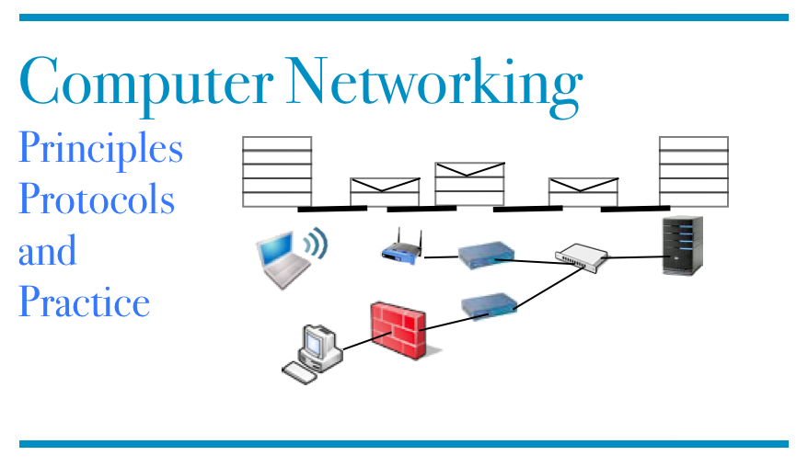
Reading list
1st edition, BGP section http://cnp3book.info.ucl.ac.be/network/network/#the-border-gateway-protocol
J. Park et al, “BGP Route Reflection Revisited”, IEEE Communications Magazine, June 2012, http://irl.cs.ucla.edu/~j13park/rr-commag.pdf

Slide 38
Agenda
iBGP and the BGP Decision process
How to scale iBGP to large networks ?
BGP traffic engineering

Slide 39
Interactions between IGP and iBGP
What are the interactions between iBGP and the intradomain routing protocol ?
iBGP sessions are TCP connections whose endpoints are reachable thanks to IGP
Endpoints of iBGP sessions are usually loopback interfaces advertised in IGP
BGP Nexthops are reachable thanks to IGP
BGP decision process uses reachability and IGP cost towards BGP nexthop to rank routes

Slide 40
Creation of iBGP sessions
How are iBGP sessions created on routers ?
Usually by manual configuration on each router
group INTERNET2-IPv6 {
type internal;
local-address 2001:468:a::1;
family inet6 {
any;
}
export NEXT-HOP-SELF;
peer-as 11537;
neighbor 2001:468:1::1 {
description ATLA;
}
...

Slide 41
Scaling issues with iBGP
In a network containing N routers
N*(N-1)/2 iBGP sessions need to be manually configured and maintained
Scalability issues
CPU usage to process and send iBGP messages
About 600k routes on IPv4 Internet today
Number of iBGP sessions on each router
TCP state, BGP Keepalives, …
Memory consumption
ADJ-RIB-IN, ADJ-RIB-OUT, ...

Slide 42
Improving iBGP scaling
Two approaches
Route Reflectors
A RR is a special iBGP router that is allowed, under specific conditions, to advertise over iBGP sessions routes learned over other iBGP sessions
BGP confederations
A large AS is divided in smaller (sub-)ASes containing a few tens of routers in iBGP full mesh. The sub-ASes use eBGP to exchange BGP routes

Slide 43
Route Reflectors
What is a Route Reflector ?
Which iBGP attributes differ with RR ?
What is their role ?
What are the advantages of using Route Reflectors compared to iBGP full mesh ?

Slide 44
A BGP Route Reflector
A RR has two types of iBGP neighbours
Clients
The RR learns routes from its clients, runs the BGP decision process and advertises its best route over al
Peers

Slide 45
How to design an iBGP hierarchy
A RR has two types of iBGP neighbours
R9
Non-Client sessions
RR1
R8
R1
R6
Client sessions

Slide 46
Operation of Route Reflectors
Reception of a new route
Run BGP decision process on RR
If best route has changed
If best route was learned from eBGP session
Advertise the best route to all iBGP sessions
If best route was learned from an iBGP client session
Advertise the best route to all iBGP sessions (clients and non-clients)
If best route was learned from a non-client iBGP session
Advertise the best route to all client iBGP sessions (non-client sessions are assumed to be in full-mesh and will also receive the new route from their own iBGP session)

Slide 47
Benefits of using RRs
Simplified configuration
A new router can be easily added to the network
Reduced memory and CPU usage on routers
Each router maintains fewer iBGP sessions
Route Reflectors do not announce all routes to their BGP clients, reducing their memory usage
Route Reflectors are often specialised devices with faster CPU and memory that only run BGP and IGP but do not forward regular packets

Slide 48
Caveats with Route Reflectors
Route reflectors hide routes to iBGP clients
A RR only advertises its best route towards each prefix over a given iBGP session
A RR runs the BGP decision process on the basis of its IGP routing table
iBGP clients could select a different best route than their RR
Route reflectors can increase convergence time after failures

Slide 49
Caveats with Route Reflectors
Since RRs advertise iBGP learned routes over iBGP sessions, a badly configured iBGP topology may cause loops
RR2
RR1
RR3
R1
R6

Slide 50
How to prevent loops
BGP Route Reflection introduces two new iBGP attributes
ORIGINATOR_ID
Set to the router id of the router that injects a route in iBGP
CLUSTER_LIST
When a RR receives a route, it checks whether its router id is included in the CLUSTER_LIST. If yes, the route is rejected.
When a RR sends a route over an iBGP session, it adds its router id to the CLUSTER_LIST

Slide 51
Fault tolerance
If a Route Reflector fails, a large number of BGP routers will be affected and lose BGP routes
How to mitigate this problem ?
Use redundant route reflectors that are deployed in pairs
Each BGP router is attached to at least two different RRs

Slide 52
Fault tolerance
In practice, each BGP router is usually attached to two RRs that are close to itself in the IGP topology
RR2
RR1
RR3
R1
R6

Slide 53
Route Reflectors
What are the routes learned if R3 acts as RR for the entire AS1 ?
AS1
R1
R6
AS4
R3
p
R2
R5
R4

Slide 54
Route Reflectors
What are the routes learned if both R3 and R5 act as RR for the entire AS1 ?
AS1
R1
R6
AS4
R3
p
R2
R5
R4

Slide 55
Which routes are selected ?
AS3
AS5
AS2
p
AS1
R1
R6
AS4
R3
R2
R5
R4

Slide 56
What is the best place for a single RR ?
AS3
AS5
AS2
p
AS1
R1
R6
AS4
R3
R2
R5
R4

Slide 57
What is the best location for two RR ?
AS3
AS5
AS2
p
AS1
R1
R6
AS4
R3
R2
R5
R4

Slide 58
Three Route Reflectors
AS3
AS5
AS2
p
AS1
R1
R6
AS4
R3
R2
R5
R4

Slide 59
Hierarchy of Route Reflectors
AS3
AS5
AS2
p
AS1
R1
R6
R8
RA
R7
R3
R5
R9
RB
R2
R4

Slide 60
What are the forwarding paths towards p advertised by AS6 ?
C=1
R5
R6
C=1
C=1
R1
C=5
R3
AS6

Slide 61
Agenda
iBGP and the BGP Decision process
How to scale iBGP to large networks ?
BGP traffic engineering

Slide 62
Prefer customer, ...
AS2
AS3
AS7
AS4
$
$
$
=
AS5
AS1
$
R1
R6
R3
AS6
R2
R5
$
R4

Slide 63
Forwarding paths from AS7 to AS8 and vice-versa
AS7
AS1
R1
R6
R3
R2
R5
R4
AS8

Slide 64

Customer wants packets towards p1 via R2 and p2 via R5
AS7
AS1
R1
R6
R3
R2
R5
R4
Customer
p1
p2

Slide 65
Fun with MED
iBGP full mesh
C=1
R5
R6
C=1
C=4
C=2
R1
R2
R3
MED=1
MED=0
MED=0
AS6
AS5
p
AS4

Slide 66
Fun with MED (2)
With RRs
C=1
R5
R6
C=1
C=4
C=2
R1
R2
R3
MED=1
MED=0
MED=0
AS6
AS5
p
AS4

Slide 67
Incoming traffic engineering
How can a customer distribute the load on its links ?
one third of traffic on each link ?
ISP
R1
R6
R3
R2
R5
R4
p
Customer

Slide 68
More specific prefixes
AS7
AS1
R1
R6
R3
p/48
R2
R5
R4
p/48
AS9
p1/49
p0/49

Slide 69
More specific prefixes
AS7
AS1
R1
R6
R3
p0/49 AS9
R2
R5
R4
p1/49 AS9
AS9
p1/49
p0/49

Slide 70
More specific prefixes
AS7
AS1
R1
R6
R3
p0/49 AS9
p/48 AS9
R2
R5
R4
p1/49 AS9
p/48 AS9
AS9
p1/49
p0/49

Slide 71
AS Path prepending
AS7
AS1
R1
R6
R3
p/48 AS9
R2
R5
R4
p/48 AS9:AS9:AS9
AS9
p1/49
p0/49

Slide 72
Traffic engineering AS path prepending
How does this traffic engineering technique works ?
Can it control incoming or outgoing traffic ?
What are its advantages and drawbacks ?

Slide 73
Backup links
How can an ISP provide backup services to its customers ?
ISP
R1
R6
R3
R2
R5
R4

Slide 74
BGP Communities
BGP Communities can be attached to BGP routes in import filter
To indicate geographical location
To indicate type of BGP session
…
BGP Communities can be attached to BGP routes in export filter
To request neighbour AS to treat the route in a specifix way

Slide 75
How to provide restricted transit ?
Customer2
ISP
R1
R6
R3
R2
R5
Customer1
Customer3

Slide 76
ISP provides primary connectivity between customer sites
ISP
R1
R6
R3
R2
R5
R4
Customer

Slide 77
How to provide richer customer policies ?
Customer wants to receive packets from US via AS1 and from Europe via AS2
AS2
R1
R6
R3
R2
R5
AS1
Customer

Slide 78
AS-Path length is not always a synonym of path quality
How to prefer AS1 in US, AS2 in Europe
AS1
AS2
ISP
R1
R6
R3
R2
R5

Slide 79
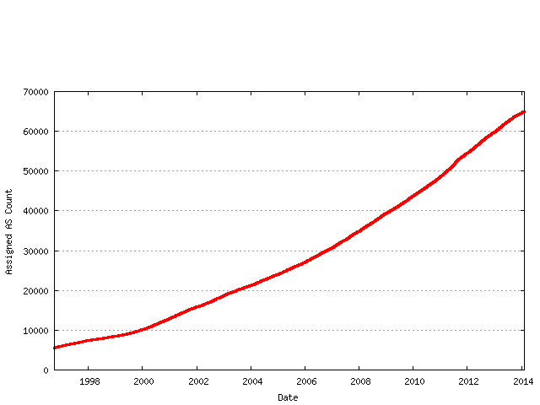
Things to remember when defining BGP policies
Any tweaking you do could affects scalability
Source http://bgp.potaroo.net/tools/asn32

Slide 80
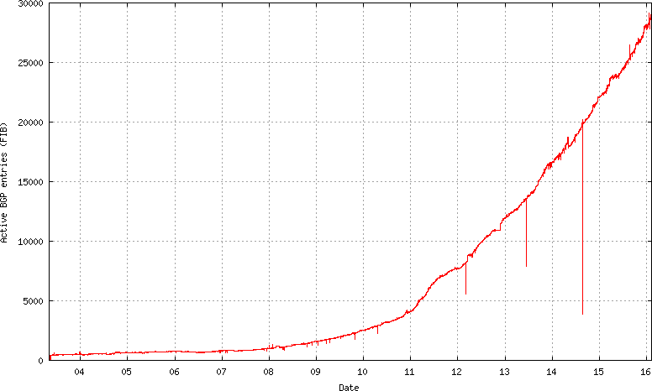
Size of IPv6 routing tables
Source http://bgp.potaroo.net/v6/as6447/

Slide 81
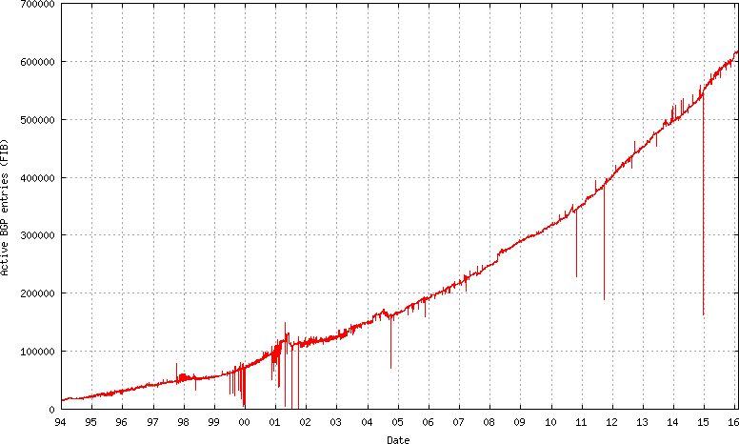
Size of IPv4 BGP routing tables
Source http://bgp.potaroo.net/as6447/

Slide 82
BGP communities
Are by default transitive..
Any BGP community that you add when receiving routes will be advertised all over the Internet
you should clean your BGP communities when advertising routes over eBGP, but router configuration languages do not always make this easy

Slide 83
Existing BGP communities
Sprint
https://www.sprint.net/index.php?p=policy_bgp
Looking glass https://www.sprint.net/lg/lg_start.php
Level3
http://www.scn.rain.com/~neighorn/PDF/Traffic_Engineering_with_BGP_and_Level3.pdf
NTT America
https://www.us.ntt.net/support/policy/routing.cfm
Internet2
https://noc.net.internet2.edu/i2network/maps-documentation/documentation/bgp-communities.html

Slide 84
References
K. Fster, Application of BGP Communities, The Internet Protocol Journal - Volume 6, Number 2, July 2003
B. Donnet and O. Bonaventure. On BGP Communities. ACM SIGCOMM Computer Communication Review, 38(2):55-59, April 2008.
http://inl.info.ucl.ac.be/publications/bgp-communities
B. Quoitin, S. Uhlig, C. Pelsser, L. Swinnen and O. Bonaventure. Interdomain traffic engineering with BGP. IEEE Communications Magazine Internet Technology Series, 41(5):122-128, May 2003.
http://inl.info.ucl.ac.be/publications/interdomain-traffic-engineering-bgp

