Slide 1
Bioinformatics
CS300
Introduction to Bioinformatics
Fall 2019
Oliver BONHAM-CARTER

Slide 2
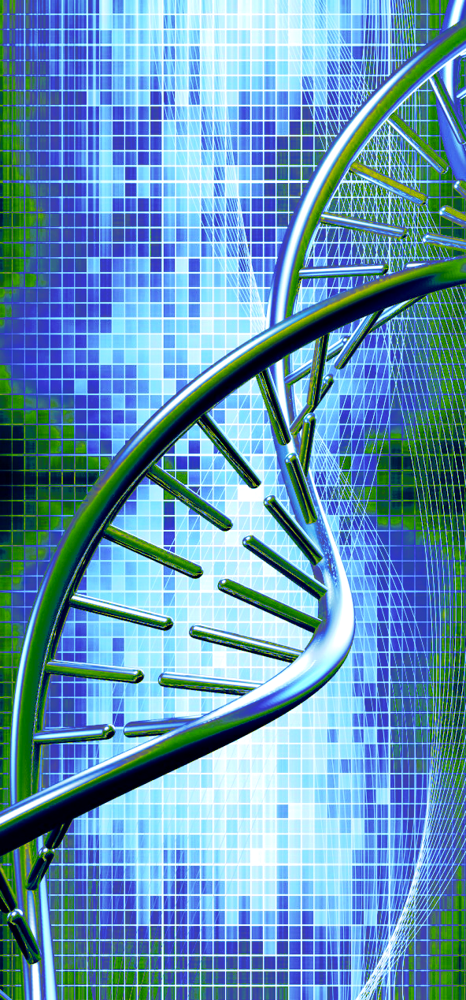
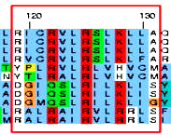
Introduction to Bioinformatics
BIO*300/CMPSC*300
Fall 2019
Class: Tuesday / Thursday, 11:00am - 12:15pm
Lab: Monday 2:30-4:20pm
(Alden Hall 101)
Bioinformatics is an emerging, rapidly expanding interdisciplinary discipline that studies how to effectively integrate concepts from computational sciences and biosciences. There is a high demand for scientists who are versed in both biology and computer science in the biomedical industry and research.
BIO 300/CMPSC 300 students will become familiar with the state-of-the-art bioinformatics software and the algorithms behind them. Through hands-on projects, students will explore current biological problems and will develop bioinformatics solutions to these issues.
This course counts as an Area A Biology Course and an Applications Course for Computer Science.
Questions? Contact Dr. BONHAM-CARTER at obonhamcarter@allegheny.edu

Slide 3

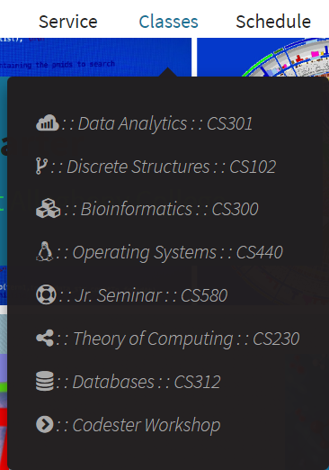
Class WebSite
Find:
Syllabus
Meeting place and times
    Class
    Lab
Calander
First slides
Etc.
https://www.cs.allegheny.edu/sites/obonhamcarter/

Slide 4



How To Be Successful
Come to classes!!!
Come to lab!!!
Read the book and handouts!
Keep up with your lab homework!

Slide 5

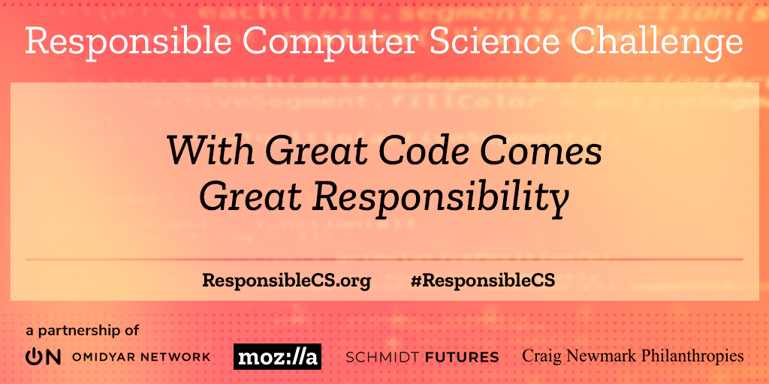
An Ethical Approach
We will spend time to learn about responsibly in the bioinformatics field and in its inquiry
Ethical considerations for research, building tools, implementing algorithms, working with life, etc ...

Slide 6
Bioinformatics is Many Things...
The science of collecting and
analyzing complex biological
data such as genetic codes.
A theoretical framework to
detect genes which
contribute to the onset of
unhealthy development.
The field of exploration into
data to describe the onset of
Illness, disease and
medical disorder
Is an interdisciplinary field that
develops methods and software
tools for understanding biological data.
Bioinformatics is both an umbrella term
for the body of biological studies
that use computer programming as part
of their methodology
The study of data
from living systems
to determine
patterns of life and health.
The development of tools to aid in the comparison
of genetic and genomic data and more
generally in the understanding of
evolutionary aspects of molecular biology.
A framework used to determine
the relatedness between people,
dogs, cats, mice, rats, rabbits,
or any living thing!

Slide 7
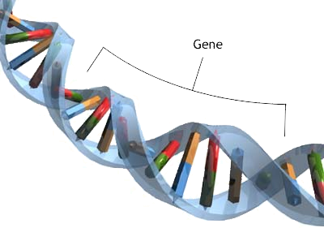
Bioinformatics:
The Study of DNA
DNA is the genetic material that houses genetic information.
Genes are written in this language
Understanding DNA allows us to understand how genes work.

Slide 8
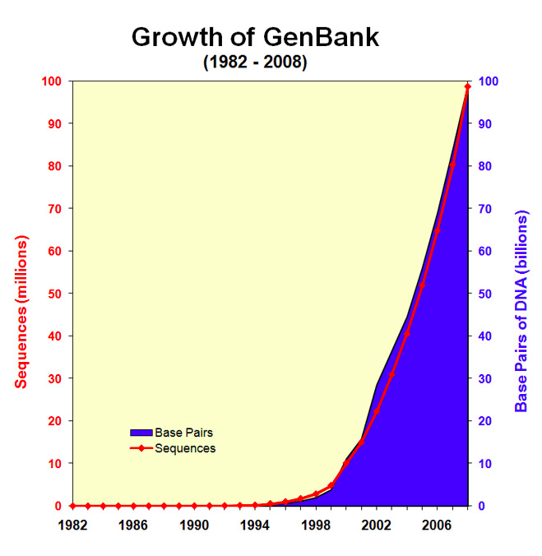
How Much DNA to Study?
Gen Bank: Public repository of DNA sequences and related data.
Seemingly exponential growth in amount of sequence data available for study
Intro to Bioinformatics slides:
http://slideplayer.com/slide/6238599/

Slide 9
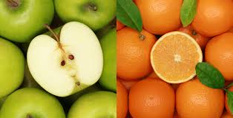
Use DNA to Compare...
DNA sequences
Genes
Proteins
Organisms
Why do we compare these things?
What is there to learn when we find that two things are the same? Or are not the same?

Slide 10
Comparing Regions?
We learn to scan millions of unknown DNA sequences to find familiar genes.
Does a gene have the same function each time we find it in a sequence? Same origins? Do the same disorders affect the copies of the gene?
Gene A
Dog
Seq?
Gene A is found in this unknown sequence

Slide 11
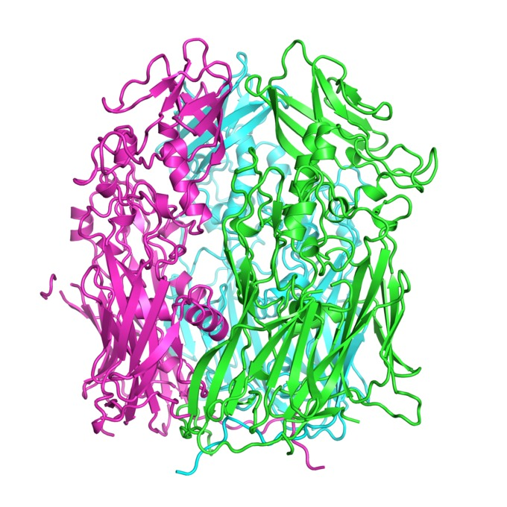
Comparing Protein
Two proteins (wildtype, non-wildtype) are compared to find causes of disorder.
Healthy
Unhealthy

Slide 12
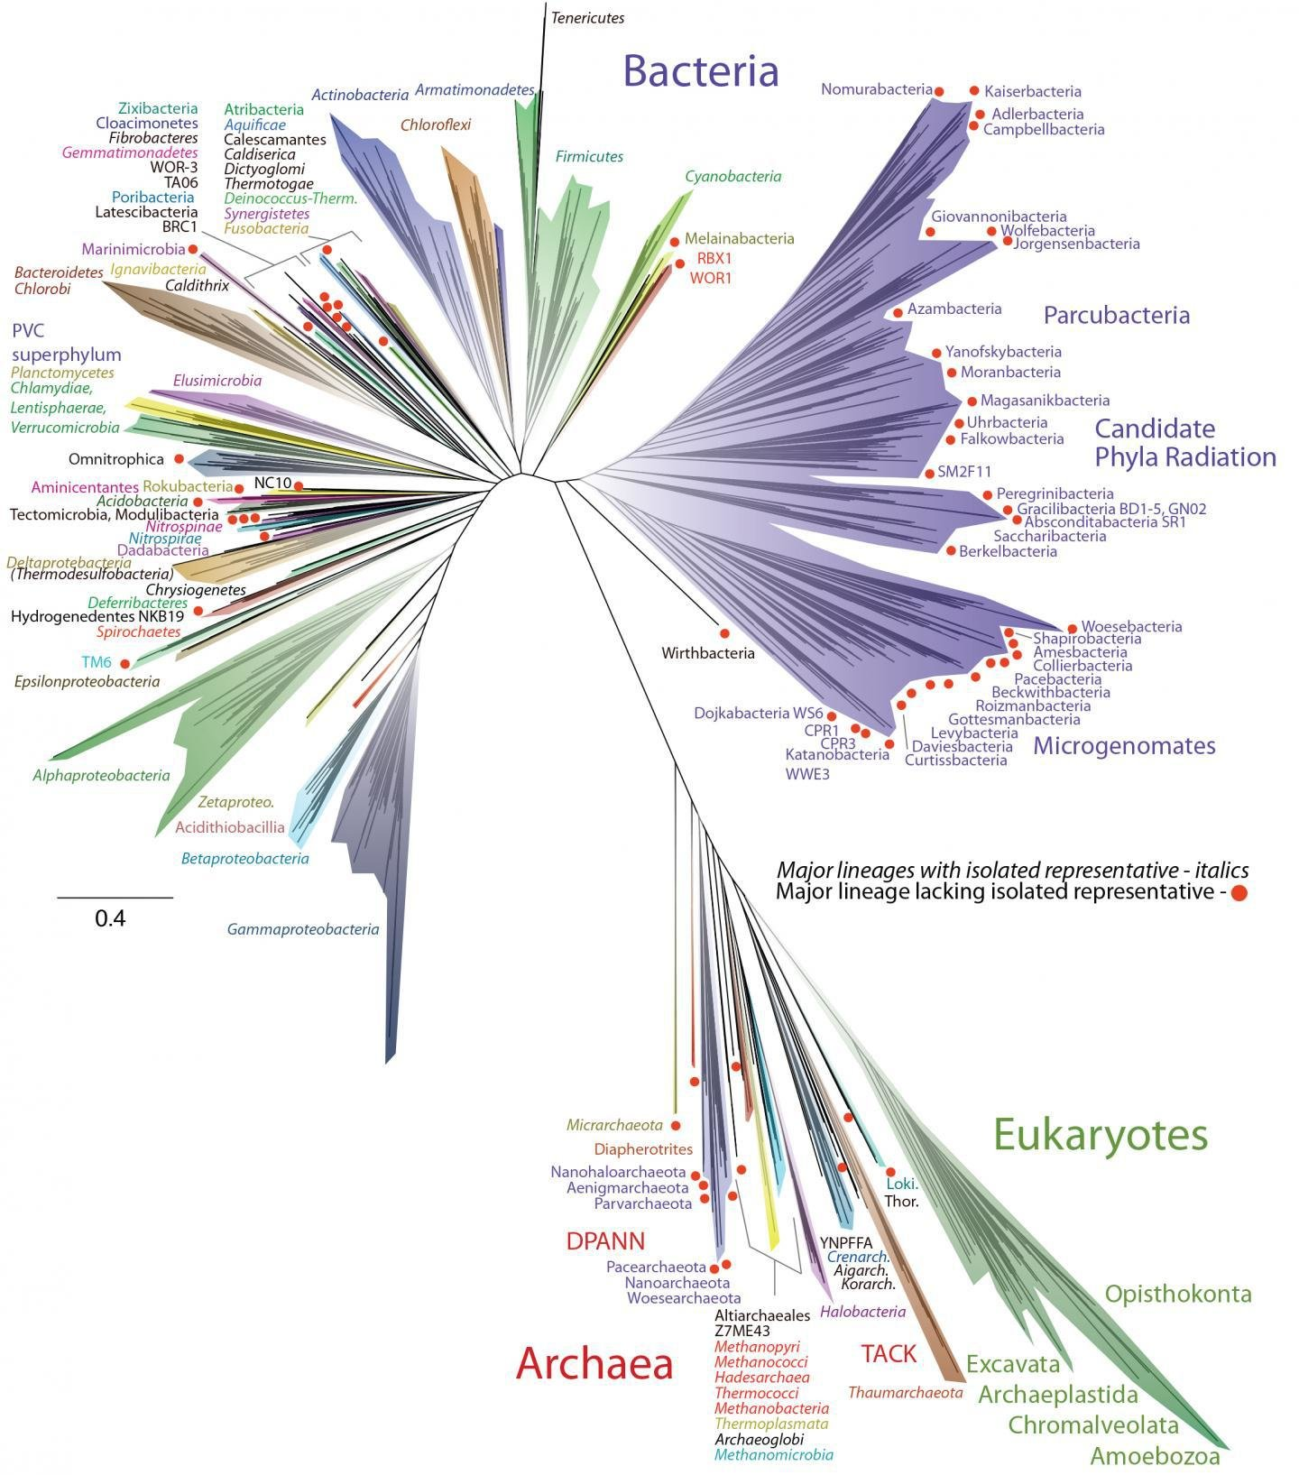
Tree of Life:
Determining
Relatedness
https://www.nytimes.com/2016/04/12/science/scientists-unveil-new-tree-of-life.html

Slide 13
So, Why Computer Science?
Comparisons of lots of sequence data
Ex: Compare seq A and seq B
  Find any differences that exist
Seq A: This it s goat!
Seq B: This is a boat!
Seq C: actcgaattt ctcgcattta cttttgtttt gaattcgcgc
Seq D: actcgaactt ctcgcattta ctttagttg gatttagcgc
What if these sequences get really long!
Healthy
Unhealthy
https://www.ncbi.nlm.nih.gov/nuccore/NC_030915.1

Slide 14
Objectives in Bioinformatics
Sequence analysis
Make/ use software tools to perform analyses
Add (publicly) available bio data
Identification of sequence similarities
Learn the function of sequences
Use DNA to answer questions
And more!
http://slideplayer.com/slide/6238599

Slide 15
As a Discipline
Discipline: a branch of knowledge, typically one studied in higher education.
Bioinformatics is formed out of three disciplines.
Bioinformatics
Biology,
Medicine
Computer
Science
Mathematics,
Statistics

Slide 16

Consider This!
Get into groups to discuss the following. Keep some notes.
List some potential applications of bioinformatics (inferring from today’s class)
Why else would you want to compare genetic material? How could this knowledge be meaningful?
How could knowing the relationships between organisms improve science and medicine?

Slide 17
What is Bioinformatics?
Clinical informatics
  Systems used to deal with patient health
  Clinical trial management systems, electronic health records, etc.
Laboratory information
  Systems to deal with scientific instrumentation and data management
  Connecting instruments together, managing laboratory flow, etc.
Bioinformatics
  Systems to deal with basic research data
  DNA, proteins, molecular things

Slide 18
Why Need Bioinformatics?
Able to fight disease with medicine
Avoid types of disorders by helping people make better health decisions before it’s too late
To process the massive amounts of health data that already exists.
  What can we learn from our experiments?
  Can we incorporate data into computer models to be run instead of using animal models?
  Other themes...

Slide 19

Study for Skills in Careers
Biologists:
  Computational skills
  Mathematical /statistical
  Programming for Automation
Computer scientists
  BioMedical skills
  Understanding of biological systems and mechanisms
  Early detection of disease by data
  Modeling of therapeutic remedies
  Others

Slide 20


Career Ideas
Software (bioinformatics) engineer
Research scientist in biotechnology
Data scientist
Project manager (pharmaceuticals, medical, etc)
Computational immunologist
Medical doctor (in clinical and research applications)

Slide 21
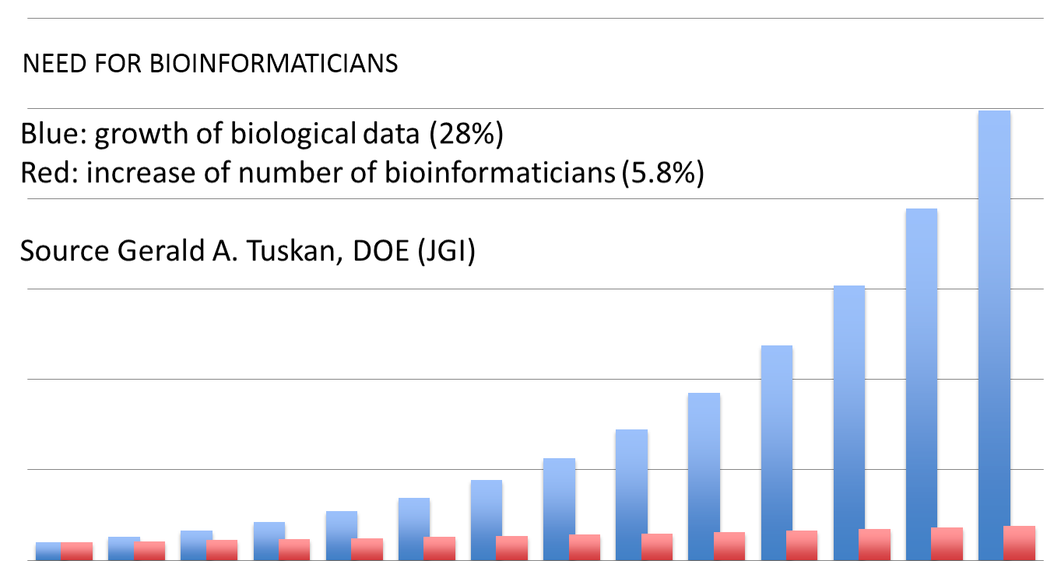
They Need You Out There!
Up to Present Day

Slide 22
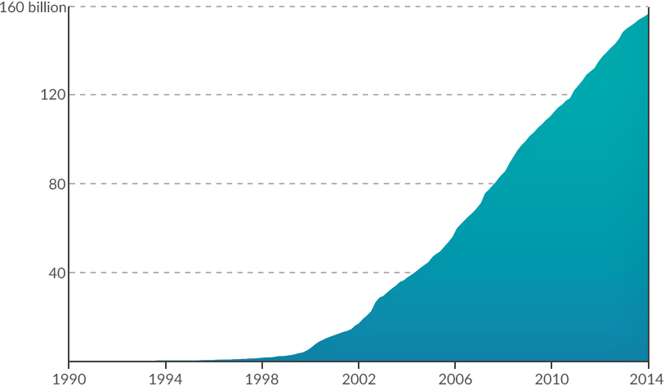
Rising Amounts of Data to Study
Exponential Growth of NIH base pairs through December 2013
Data is to be assembled into sequences (jigsaw puzzle pieces).

Slide 23
Researchers and Scientists
Bioinformatics Scientists are generally graduate-educated
research scientists whose work involves the development
of computer and technology-aided solutions to problems in
biochemistry and biological research.
Primary focus areas may include genomics
and proteomics.These professionals may be required
to create, maintain and utilize databases of complex
biodata,and utilize exsiting publicly available databases
containing similar information.
Go online to read more about careers!
https://www.recruiter.com/salaries/bioinformatics-scientists-salary/
Aug 2019

Slide 24
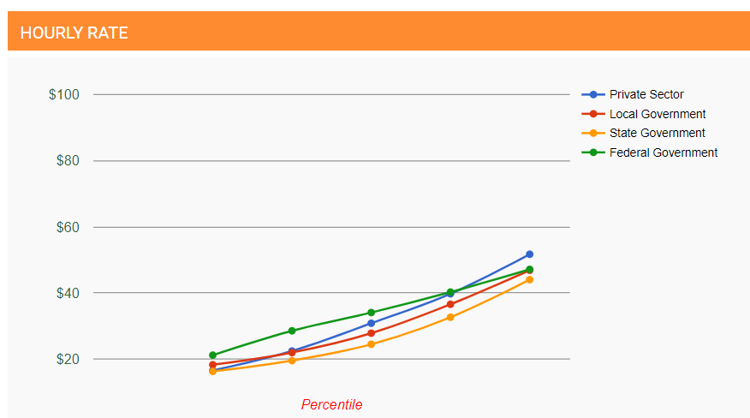
Wages
https://www.recruiter.com/salaries/bioinformatics-scientists-salary/
Aug 2019

Slide 25
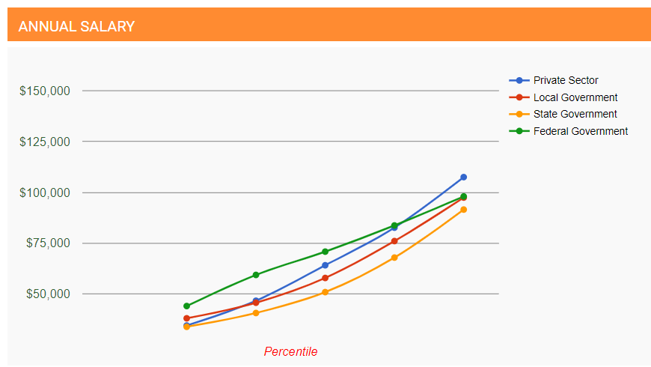
Salaries
https://www.recruiter.com/salaries/bioinformatics-scientists-salary/
Aug 2019

Slide 26
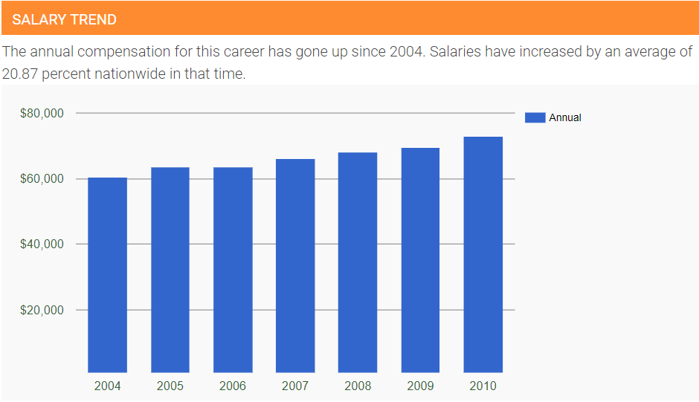
Trends
https://www.recruiter.com/salaries/bioinformatics-scientists-salary/
Aug 2019

Slide 27
Header
This
This

Slide 28
Objectives to Bioinformatics
This
This
http://slideplayer.com/slide/6238599

Slide 29
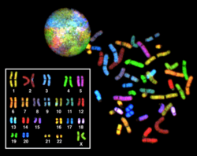
Bioinformatics ...
All about DNA!
Uses DNA to answer questions
What genes do you have?
Who else has these genes?
Are you related to others who have these genes?
“… Are you my mommy?”

Slide 30
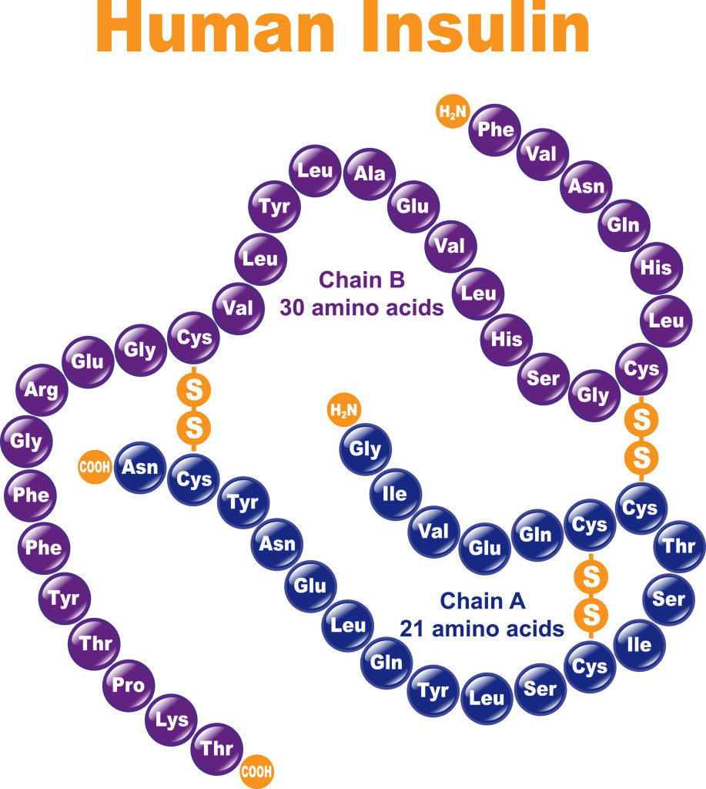
Birth of Bioinformatics
Sequence data: DNA, RNA and protein.
1950’s: Frederick Sanger determined the protein sequence of insulin 1950s.
By noting the makeup of insulin protein, researchers could understand how it worked.

Slide 31
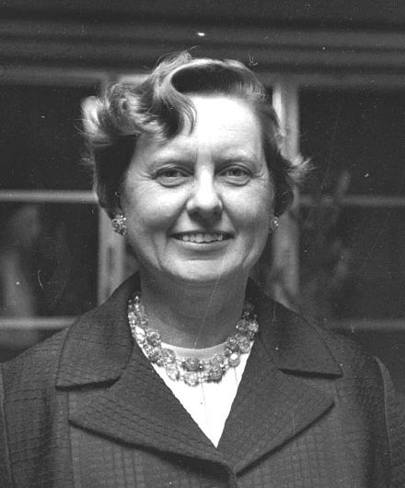
Birth of Bioinformatics
Margaret Oakley Dayhoff, who has been hailed by David Lipman, director of the National Center for Biotechnology Information, as the "mother and father of bioinformatics.
In 1960s and 70s Dayhoff created:
  The first protein database
  The first program for sequence assembly

Slide 32
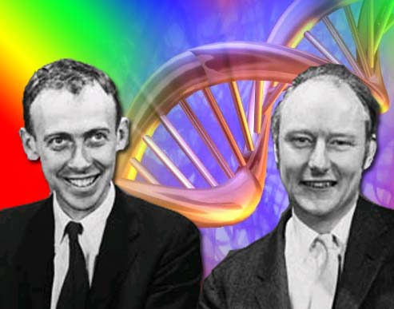
DNA: Discovery and Structure
1860: DNA discovered by Swiss chemist Friedrich Miescher
1950: Watson (American biologist) and Crick (English physicist) discover the molecular composition of DNA.
Watson and Crick
https://www.nature.com/scitable/topicpage/discovery-of-dna-structure-and-function-watson-397

Slide 33
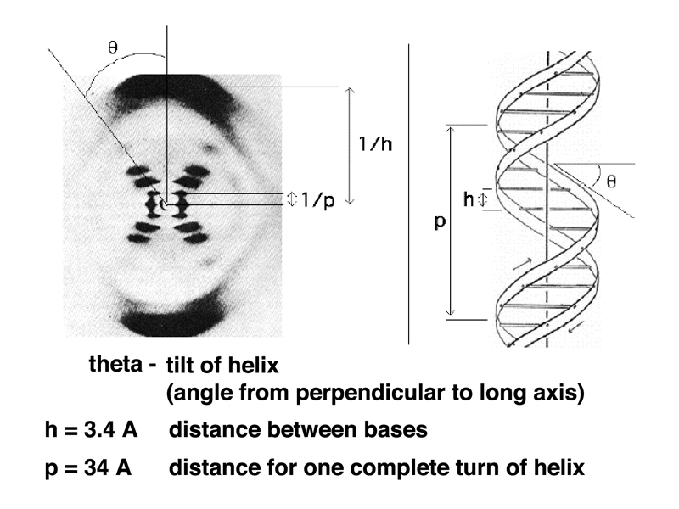
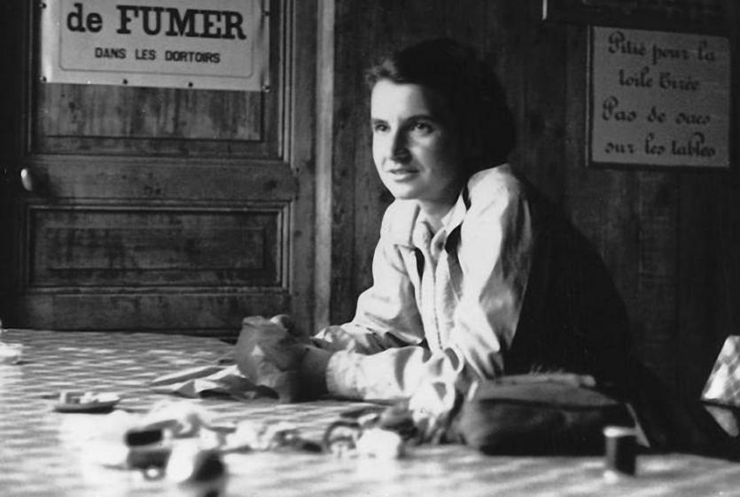
DNA: Discovery and Structure
1950’s Rosalind Franklin performed experiments on DNA material using X-ray crystallography to find DNA structure.
https://www.chemheritage.org/historical-profile/james-watson-francis-crick-maurice-wilkins-and-rosalind-franklin

Slide 34
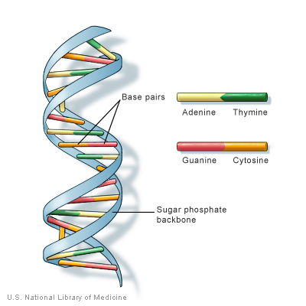
DNA, The structure
All this work contributed to knowing what a molecule of DNA looks like.

Slide 35
Header
This
This

