Slide 1
Bioinformatics
CS300
Crash course:
Structure and Replication of DNA
Fall 2019
Oliver BONHAM-CARTER

Slide 2

What is Bioinformatics?
Clinical informatics
  Systems used to deal with patient health
  Clinical trial management systems, electronic health records, etc.
Laboratory information
  Systems to deal with scientific instrumentation and data management
  Connecting instruments together, managing laboratory flow, etc.
Bioinformatics
  Systems to deal with basic research data
  DNA, proteins, molecular things

Slide 3
Why Need Bioinformatics?
Able to fight disease with medicine
Avoid types of disorders by helping people make better health decisions before it’s too late
To process the massive amounts of health data that already exists.
  What can we learn from our experiments?
  Can we incorporate data into computer models to be run instead of using animal models?
  Other themes...

Slide 4

Study for Skills in Careers
Biologists:
  Computational skills
  Mathematical /statistical
  Programming for Automation
Computer scientists
  BioMedical skills
  Understanding of biological systems and mechanisms
  Early detection of disease by data
  Modeling of therapeutic remedies
  Others

Slide 5


Career Ideas
Software (bioinformatics) engineer
Research scientist in biotechnology
Data scientist
Project manager (pharmaceuticals, medical, etc)
Computational immunologist
Medical doctor (in clinical and research applications)

Slide 6
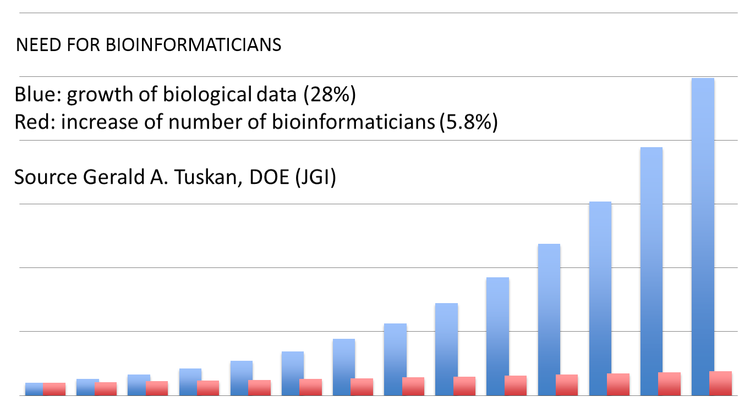
They Need You Out There!
Up to Present Day

Slide 7
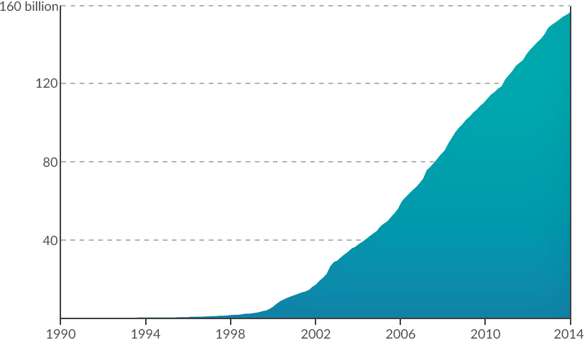
Rising Amounts of Data to Study
Exponential Growth of NIH base pairs through December 2013
Data is to be assembled into sequences (jigsaw puzzle pieces).

Slide 8
Researchers and Scientists
Bioinformatics Scientists are generally graduate-educated
research scientists whose work involves the development
of computer and technology-aided solutions to problems in
biochemistry and biological research.
Primary focus areas may include genomics
and proteomics.These professionals may be required
to create, maintain and utilize databases of complex
biodata,and utilize exsiting publicly available databases
containing similar information.
Go online to read more about careers!
https://www.recruiter.com/salaries/bioinformatics-scientists-salary/
Aug 2019

Slide 9
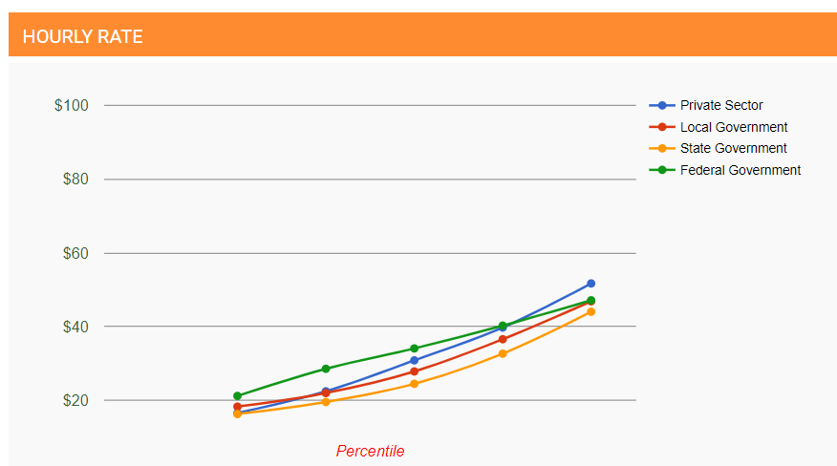
Wages
https://www.recruiter.com/salaries/bioinformatics-scientists-salary/
Aug 2019

Slide 10
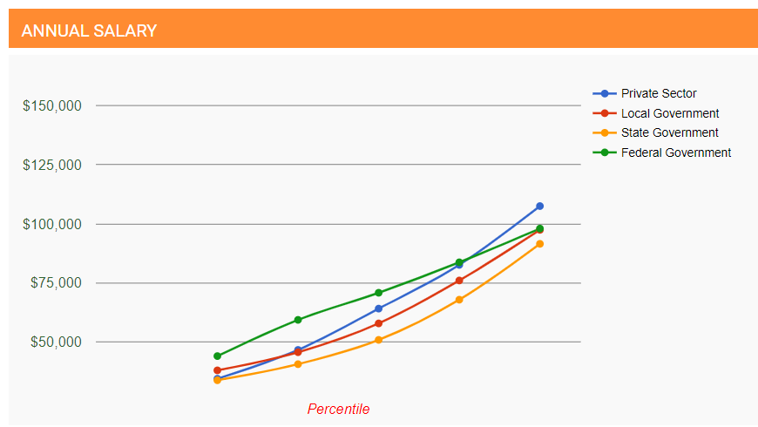
Salaries
https://www.recruiter.com/salaries/bioinformatics-scientists-salary/
Aug 2019

Slide 11
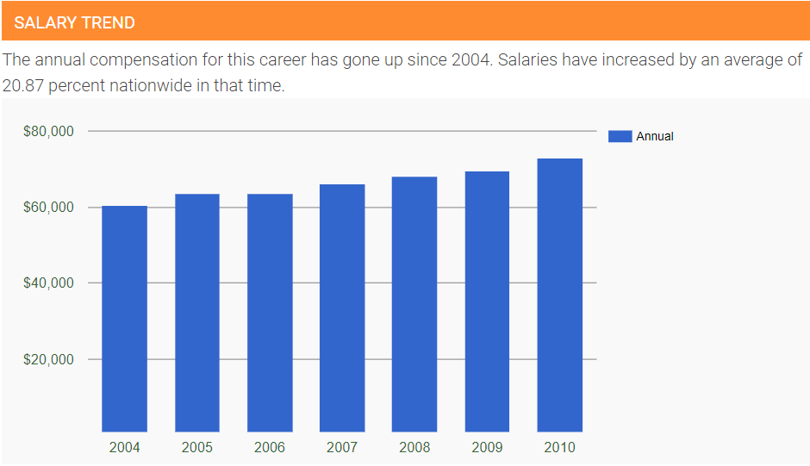
Trends
https://www.recruiter.com/salaries/bioinformatics-scientists-salary/
Aug 2019

Slide 12
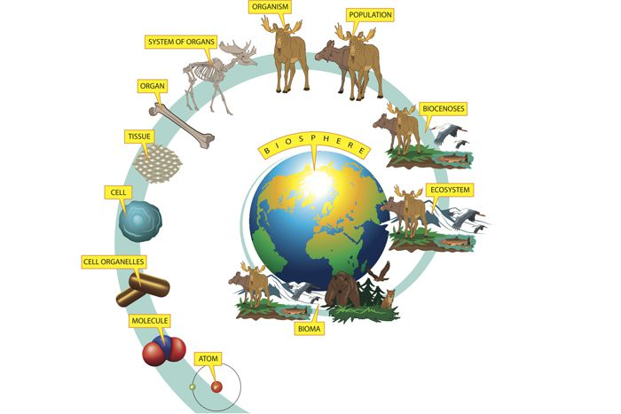
Some Background in Biology
What’s a
MAJOR
Commonality
Here?

Slide 13
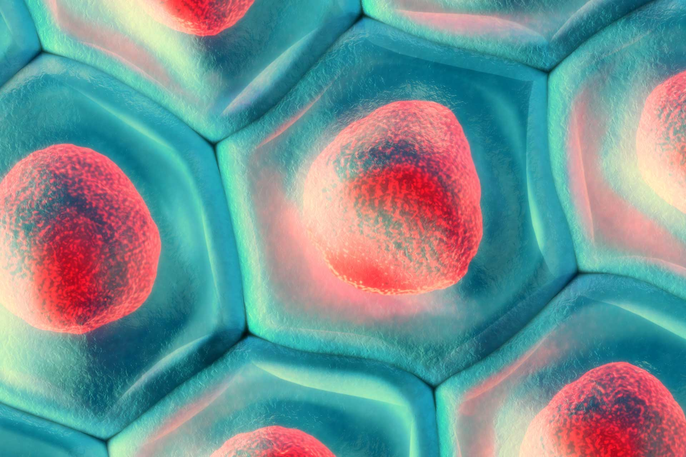
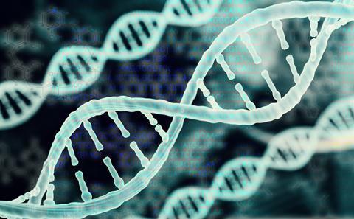
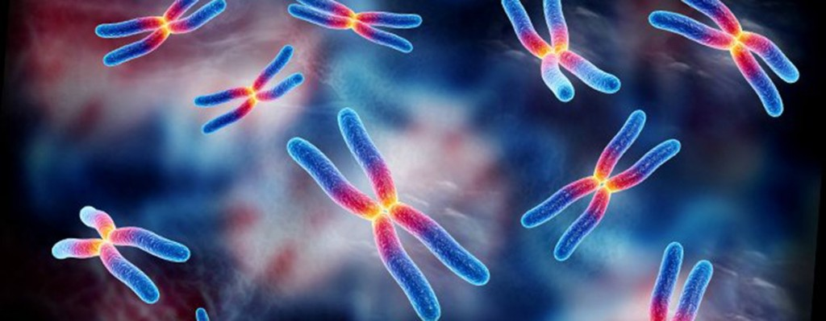
Organisms Have Genetic Systems!
And DNA is Often the Genetic Language

Slide 14
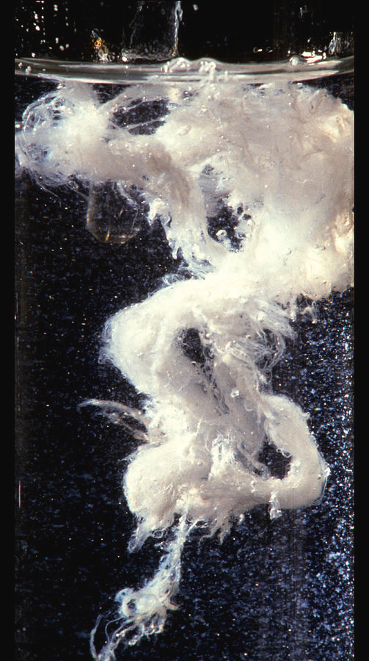
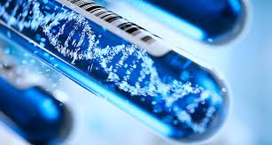
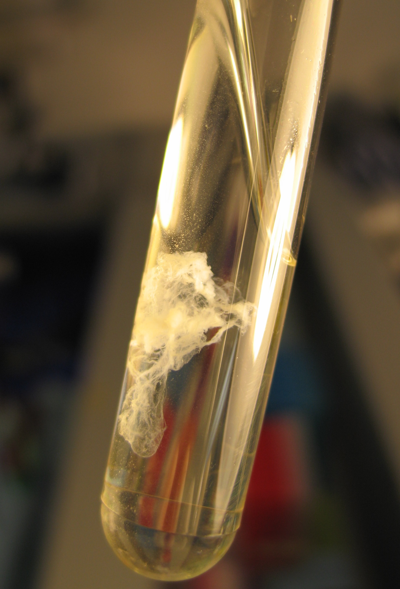
What Does Natural
DNA look Like?
NOT like
this!
Like this!
Like this!

Slide 15

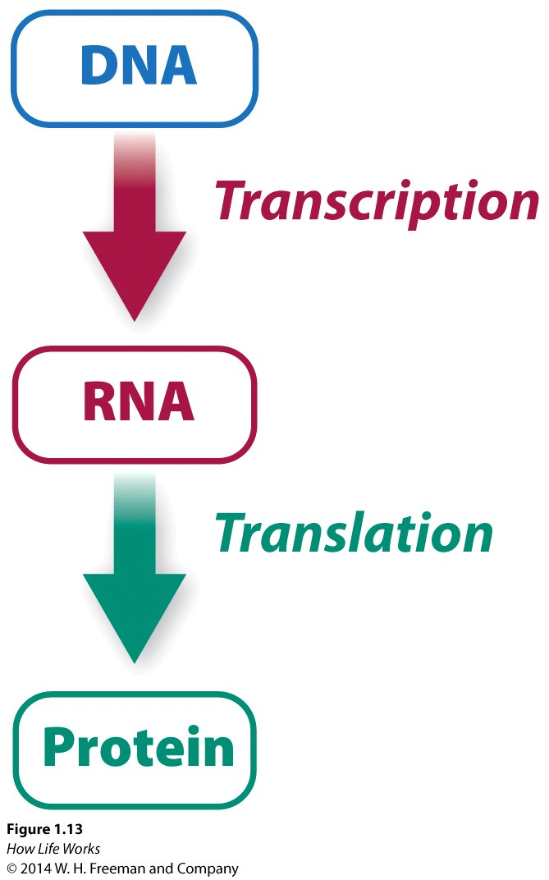
Central Dogma of
Molecular Biology
Dogma: a principle, or set of principles, laid down
by an authority as incontrovertibly true.
Dogma: The framework of a process.

Slide 16
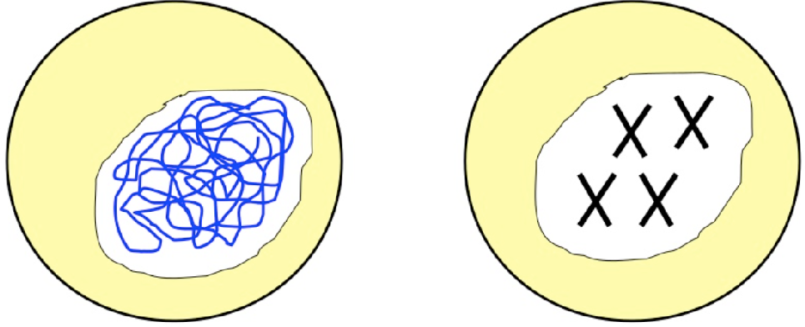
What is DNA?
Found in the nucleus of a cell in two different structures: chromatin and chromosomes
Genetic Material (Life’s blue prints)
Written inherited characteristics (genes)

Slide 17
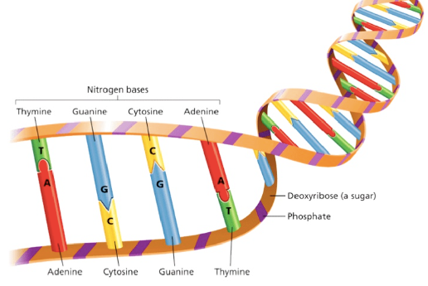
Molcular Building Blocks: ATGC
A-T
G-C

Slide 18
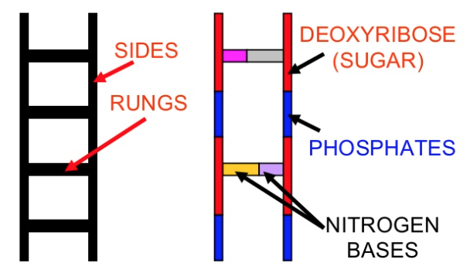
DNA Structure
Formed like a twisted ladder
There are two sides of the ladder
Sugar (deoxyribose)
Phosphates
Alternating
Rungs of the ladder
Nitrogenous bases

Slide 19
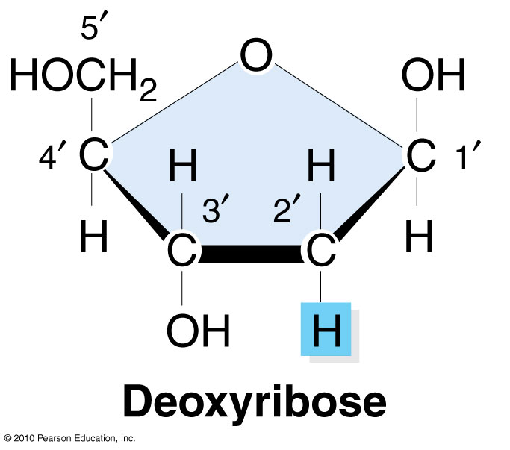
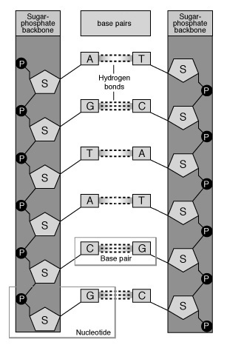
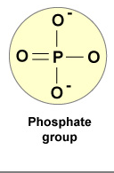
DNA Structure
Deoxyribose
Sugar
Phosphate
Phosphorus surrounded
by oxygens

Slide 20
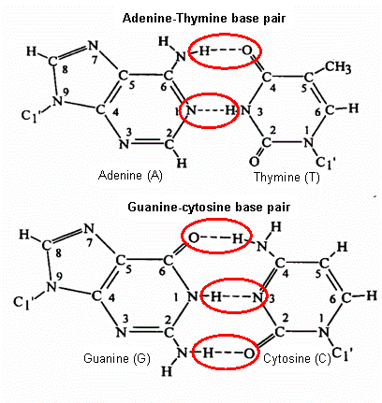
Base to Base Bonds:
How do nitrogenous bases pair?
Base-Specific bonding
Preserves distance between (DNA’s) backbones
Hydrogen bonds
Key to replication
A-T’s have two bonds
G-C’s have three bonds

Slide 21
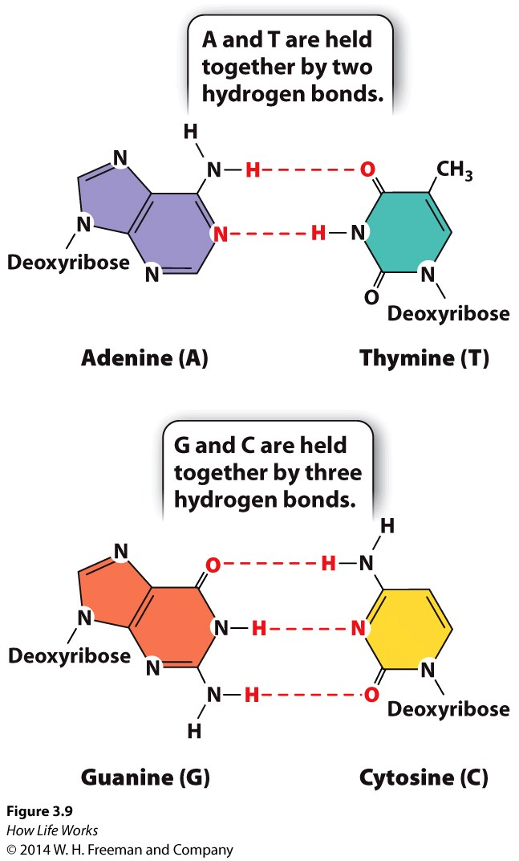
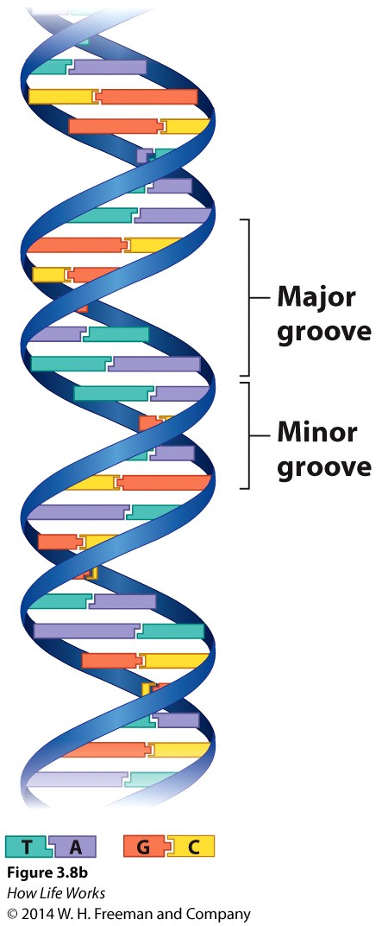
Purines and Pyrimidines
Purines and Pyrimidines are nitrogenous bases that comprising the two different types of nucleotide bases in DNA and RNA.
The two-carbon nitrogen ring bases (adenine and guanine) are purines, while the one-carbon nitrogen ring bases (thymine and cytosine) are pyrimidines.
Purines: adenine and guanine
Pyrimidine: thymine, cytosine, and uracil
Purines include a number of biologically important compounds, such as adenosine, caffeine, uric acid, and the two bases adenine and guanine, which are components of DNA and RNA.
http://study.com/academy/lesson/what-are-purines-definition-lesson-quiz.html
Only three pyrimidine bases (thymine, cytosine, and uracil) and two purine bases (adenine and guanine) are needed to produce the incredible diversity of species that inhabit the earth.

Slide 22
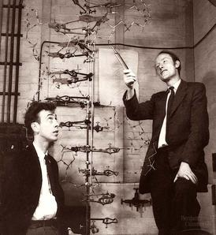
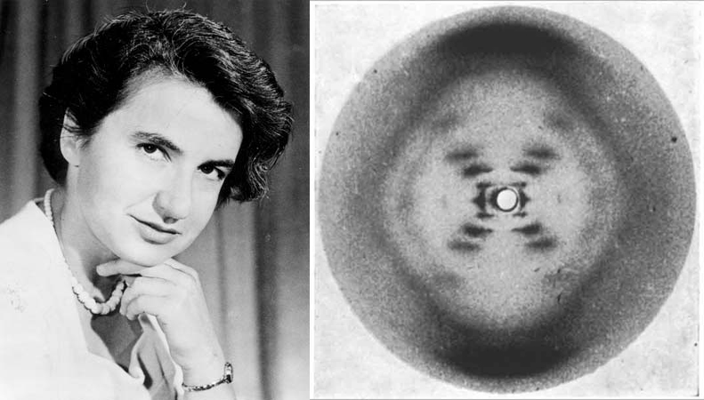

DNA Double Helix:
Discovery of Structure
Watson and Crick, 1953
Rosalind Franklin and her data from x-ray crystallography

Slide 23
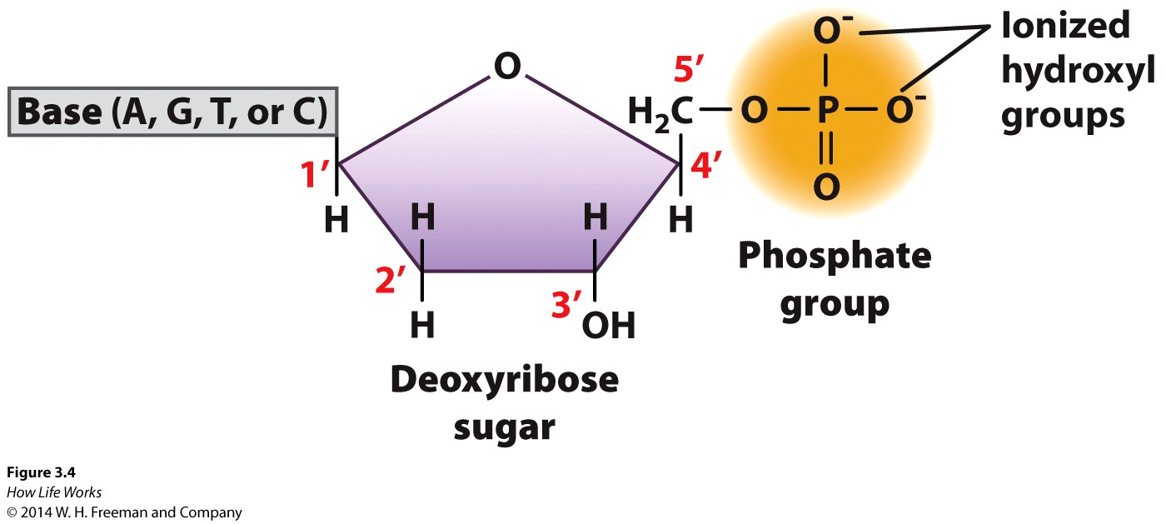
Nucleotide Structure
The support of rungs in the ladder.
One sugar
One phosphate group
One base (purine or pyrimidine)

Slide 24
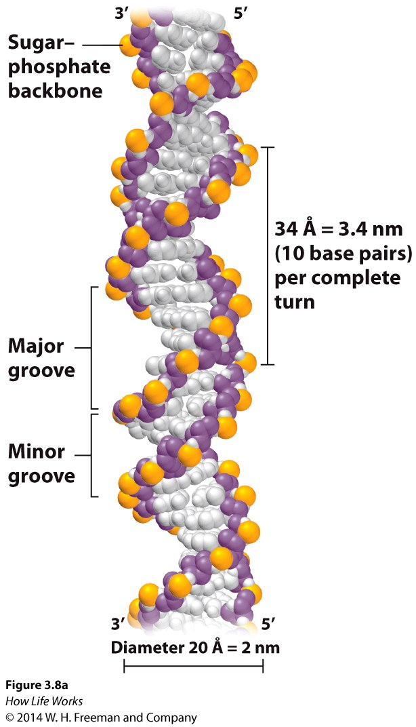
Structure of DNA
Double-stranded
Diameter – 2nm
Helix
  Complete turn = 10bp, 3.4nm
  Major groove
  Minor groove

Slide 25
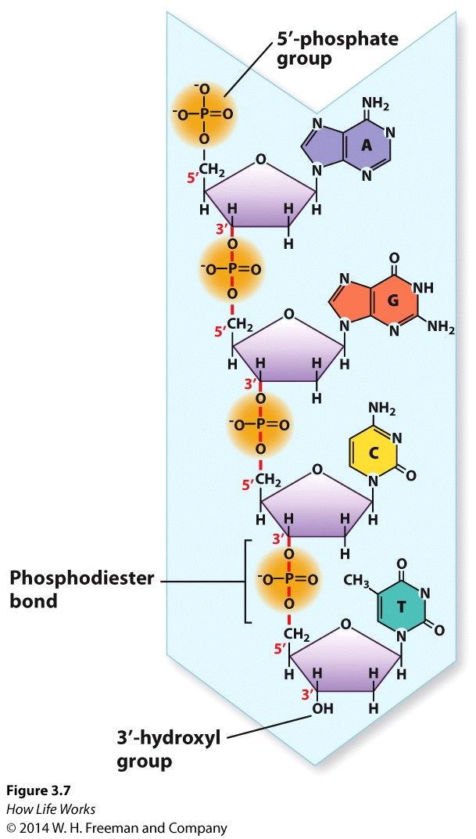
Structure of DNA
Nucleotides are joined by phosphodiester bonds
  phosphate to sugar
  covalent bonds
Polarity
  5’ end – phosphate group
  3’ end – hydroxyl group
AntiParallel: DNA read in 5’ to 3’ direction

Slide 26
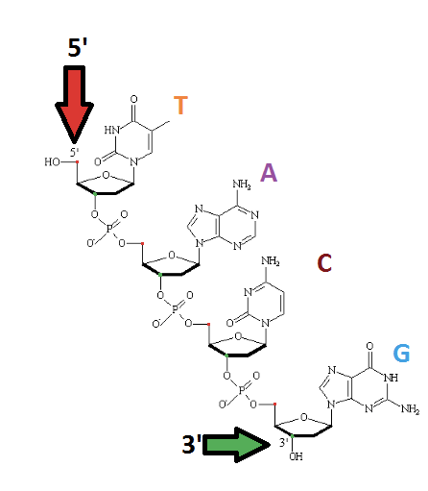
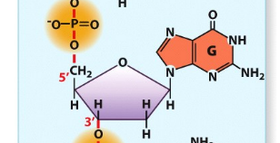
Five and Three Prime Ends
A key feature of all nucleic acids is that they have two distinctive ends: The 5' (5-prime) and 3' (3-prime) ends.
This terminology refers to the 5’ and 3’ carbons on the sugar.
For both DNA and RNA, the 5' end bears a phosphate, and the 3' end a hydroxyl group.
5’
3’
Note the ordering of carbons, hence 5’ to 3’

Slide 27
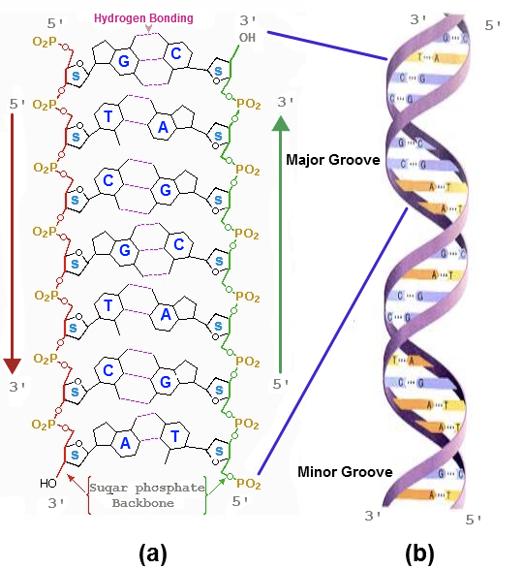
5’ to 3’ Directionality

Slide 28
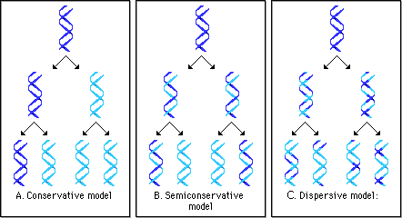
Proposed Mechanisms of
Replication Process
The two sides of the parent molecule unwind/unzip
Daughter strands are synthesized using parent strands as templates
Parent/daughter duplex winds back together
  Semi-conservative: a 2nd gen helix composed of parental strand and one daughter.

Slide 29
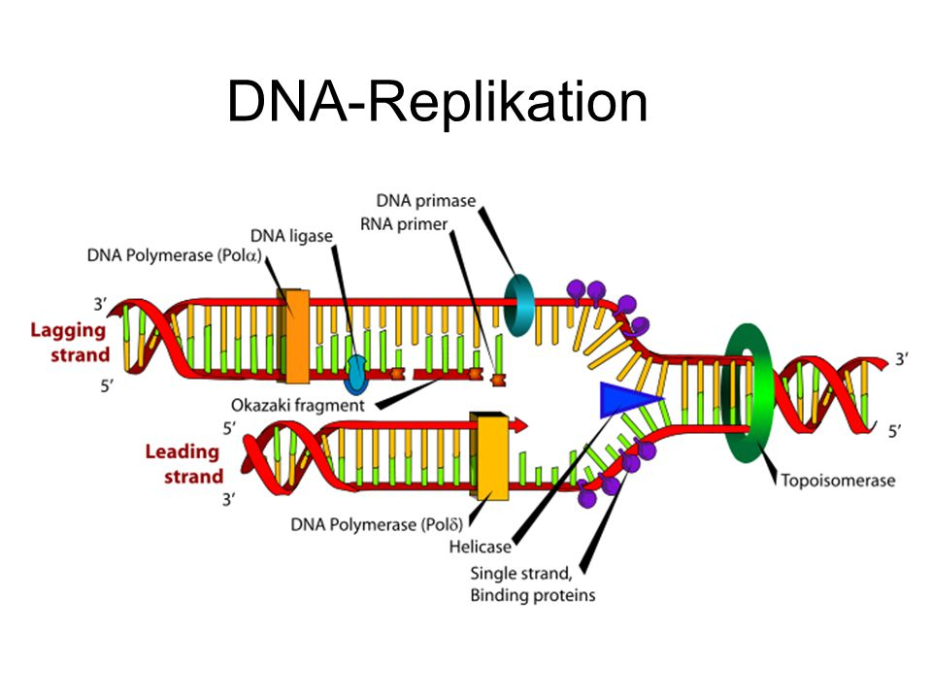
DNA Replication Process
http://www.hhmi.org/biointeractive/dna-replication-schematic

Slide 30
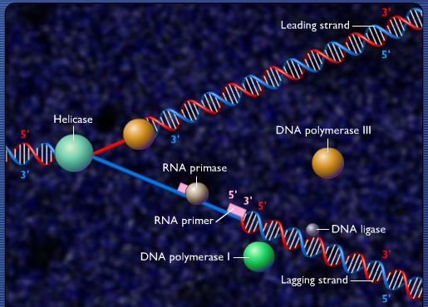
DNA Replication Enzymology
http://highered.mheducation.com/sites/0073525324/student_view0/chapter20/dna_replication_fork.html

Slide 31
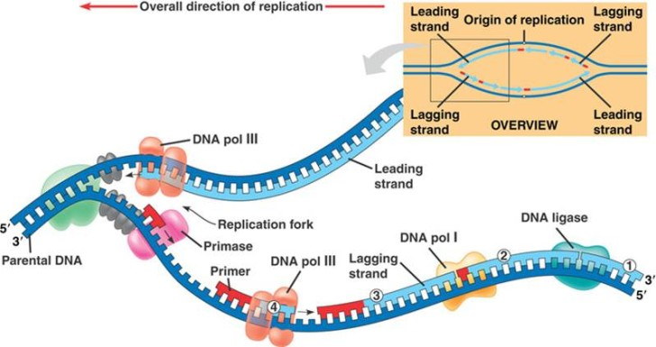
DNA Replication Enzymology
http://www.hhmi.org/biointeractive/dna-replication-basic-detail http://highered.mheducation.com/sites/0073525324/student_view0/chapter20/dna_replication_fork.html

Slide 32
Review Question 1
In the DNA sequence 5'–AGCT–3', the phosphodiester linkage between the adenine and the guanine connects:
A. The 2' end of the adenine to the 4' end of the guanine.
B. The 5' end of the adenine to the 3' end of the guanine.
C. The 5' end of the guanine to the 1' end of the adenine.
D. The 3' end of the adenine to the 5' end of the guanine.

Slide 33
Review Question 1
In the DNA sequence 5'–AGCT–3', the phosphodiester linkage between the adenine and the guanine connects:
A. The 2' end of the adenine to the 4' end of the guanine.
B. The 5' end of the adenine to the 3' end of the guanine.
C. The 5' end of the guanine to the 1' end of the adenine.
D. The 3' end of the adenine to the 5' end of the guanine.

Slide 34
Review Question 2
In the DNA of certain bacterial cells, 16% of the nucleotides are adenine. What are the percentages of the other nucleotides in the bacterial DNA?
A. 34% thymidine, 34% guanine, 16% cytosine
B. 34% uracil, 16% guanine, 16% cytosine
C. 16% thymidine, 34% guanine, 34% cytosine
D. 34% thymidine, 16% guanine, 34% cytosine

Slide 35
Review Question 2
In the DNA of certain bacterial cells, 16% of the nucleotides are adenine. What are the percentages of the other nucleotides in the bacterial DNA?
A. 34% thymidine, 34% guanine, 16% cytosine
B. 34% uracil, 16% guanine, 16% cytosine
C. 16% thymidine, 34% guanine, 34% cytosine
D. 34% thymidine, 16% guanine, 34% cytosine

Slide 36
Review Question 3
DNA replicates in a semi-conservative manner. This means
  one daughter strand is synthesized as a large fragment while the other is synthesized in smaller fragments, both in the 5’-3’ direction
  every newly formed double-stranded DNA molecule consists of one parental strand and one daughter strand
  every newly formed double-stranded DNA molecule is comprised of two new daughter strands
  one daughter strand is synthesized as a large fragment in the 5’-3’ direction while the other is synthesized in smaller fragments in the 3’-5’ direction

Slide 37
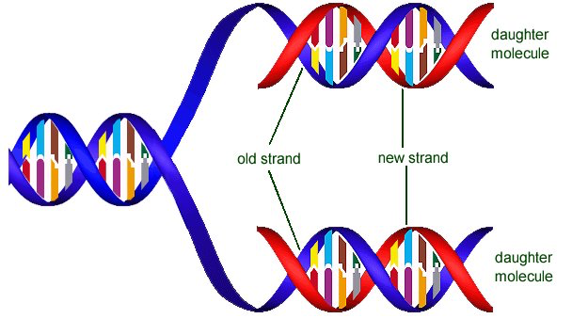
Review Question 3
DNA replicates in a semi-conservative manner. This means
  every newly formed double-stranded DNA molecule consists of one parental strand and one daughter

Slide 38

Supporting Videos
The Double Helix (Documentary about DNA discovery, 17 mins)
http://media.hhmi.org/biointeractive/films/Double_Helix.html
The Chemical Structure of DNA (3 mins)
http://www.hhmi.org/biointeractive/chemical-structure-dna
The Structure of DNA (6 mins)
https://www.youtube.com/watch?v=o_-6JXLYS-k
The def of 5’ and 3’ strands (1.5 mins)
https://www.youtube.com/watch?v=qWZYpHSXvJo

Slide 39

Python Programming
How to start up Python interactive mode?
How to add numbers?
How to create variables?
How to make print statements
Strings:
  How to work with strings
  How to count characters
  How to find characters.
Follow along in
class and save
your notes in
a text file!!
  Follow along and Save your notes in a text file.

Slide 40
Review Question 1
In the DNA sequence 5'–TGAC–3', the phosphodiester linkage between the guanine and the adenine connects:
A. the 3' end of the guanine to the 5' end of the adenine.
B. the 2' end of the adenine to the 3' end of the guanine.
C. the 5' end of the guanine to the 1' end of the adenine.
D. the 3' end of the adenine to the 5' end of the guanine.
E. the 5' end of the guanine to the 2' end of the adenine.

Slide 41
Review Question 1
In the DNA sequence 5'–TGAC–3', the phosphodiester linkage between the guanine and the adenine connects:
A. the 3' end of the guanine to the 5' end of the adenine.
B. the 2' end of the adenine to the 3' end of the guanine.
C. the 5' end of the guanine to the 1' end of the adenine.
D. the 3' end of the adenine to the 5' end of the guanine.
E. the 5' end of the guanine to the 2' end of the adenine.

Slide 42
Header
This
This

Slide 43
Header
This
This

