Slide 1
Bioinformatics
CS300
Crash course:
Transcription and Translation
Running Python in Docker or Online
Fall 2019
Oliver BONHAM-CARTER

Slide 2

Header
This
This

Slide 3

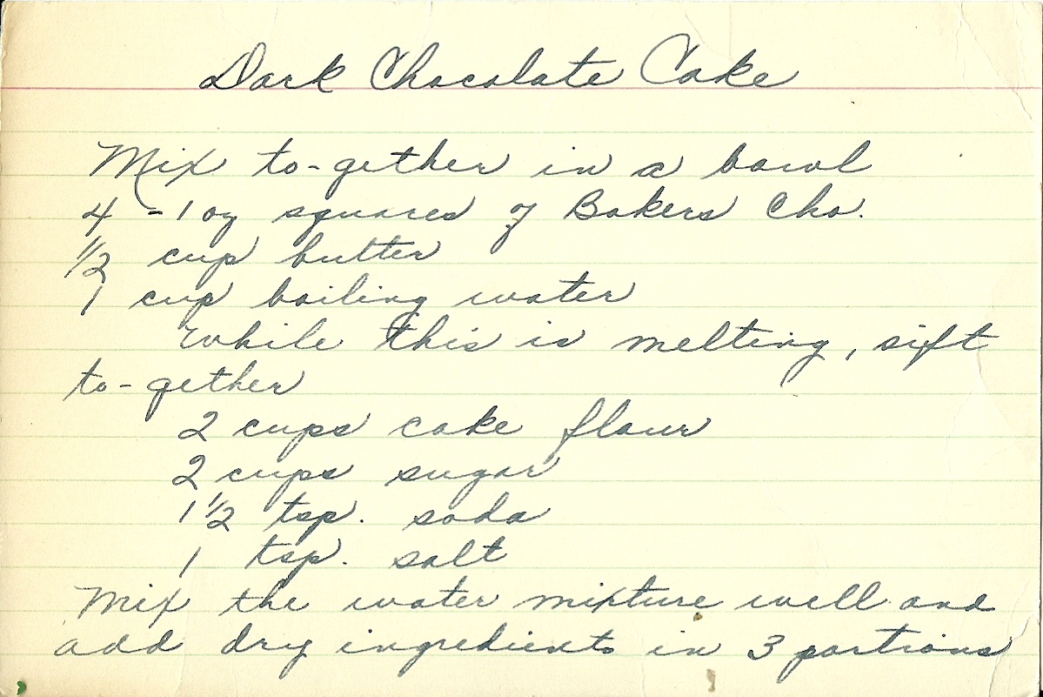
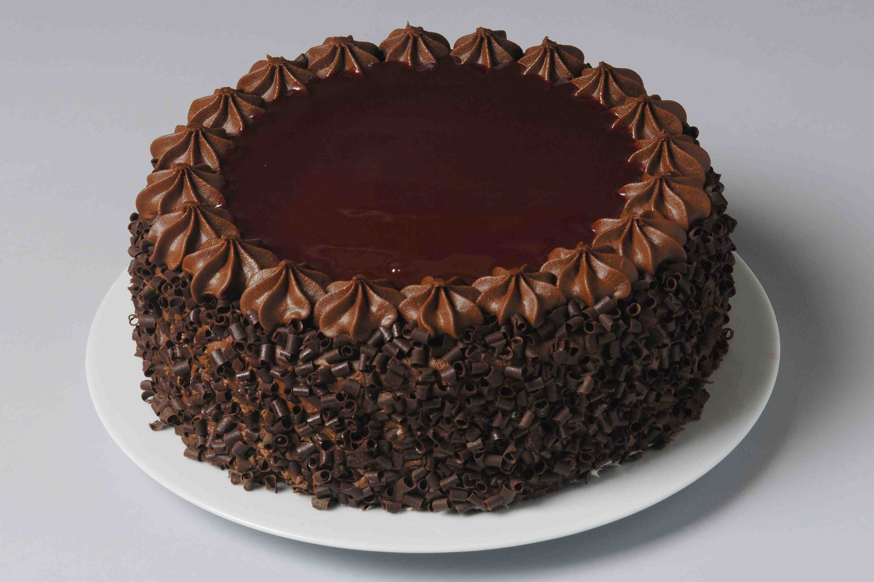
Gene Expression
Transcription and Translation
Transcription
copy a set of ingredients/instructions from a cookbook to create a recipe
Translation
use the recipe to create a dish

Slide 4


The Central Dogma of Molecular Biology

Slide 5
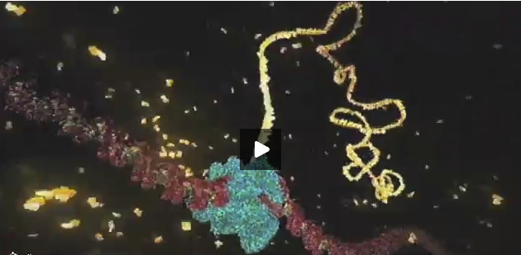
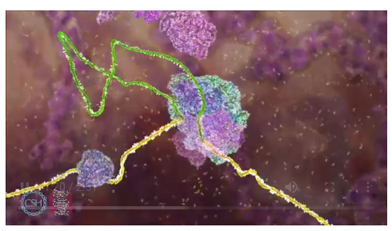
Animation:
Central Dogma of Biology
https://dnalc.cshl.edu/view/16933-3D-Animation-of-DNA-to-RNA-to-Protein.html

Slide 6

Transcription
Transcribe specific regions of DNA – genes
  Human genome ~25,000 genes (just 1.5% of genome)
RNA is the direct product of transcribing a gene (DNA)
  DNA -> RNA
  same language (nucleotides)
Messenger RNA (mRNA)
Transfer RNA
(tRNA)
Ribosomal RNA (rRNA)

Slide 7
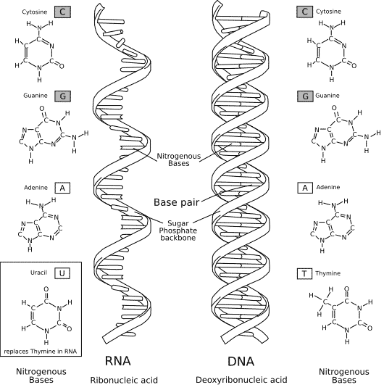
RNA vs DNA
RNA – uracil replaces thymine (no Ts in RNA)
RNA – single stranded (one backbone, no basepairs)
(RNA – slightly different sugar)

Slide 8
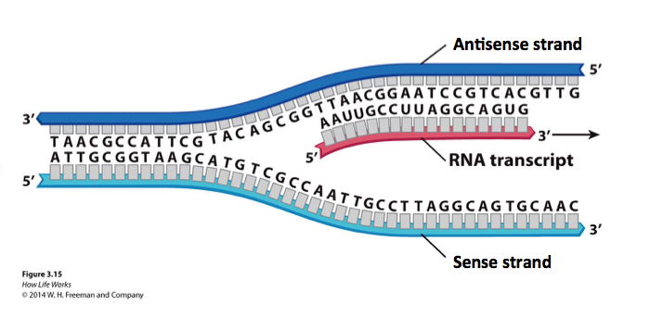
Genes exists on both strands of DNA…
Transcription occurs on the strand containing the gene whose product is needed.
The strand containing the gene is the antisense strand.
The RNA transcript is the complement of the antisense strand.

Slide 9
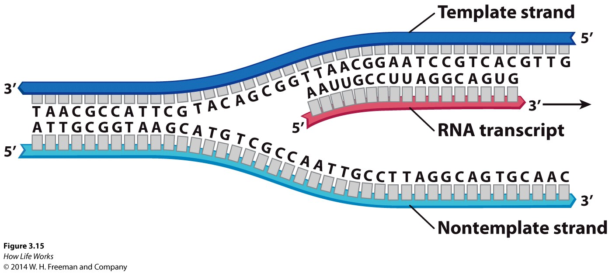
Antisense and Sense Strands of DNA – relative to the gene being transcribed
Antisense strand
Sense strand

Slide 10
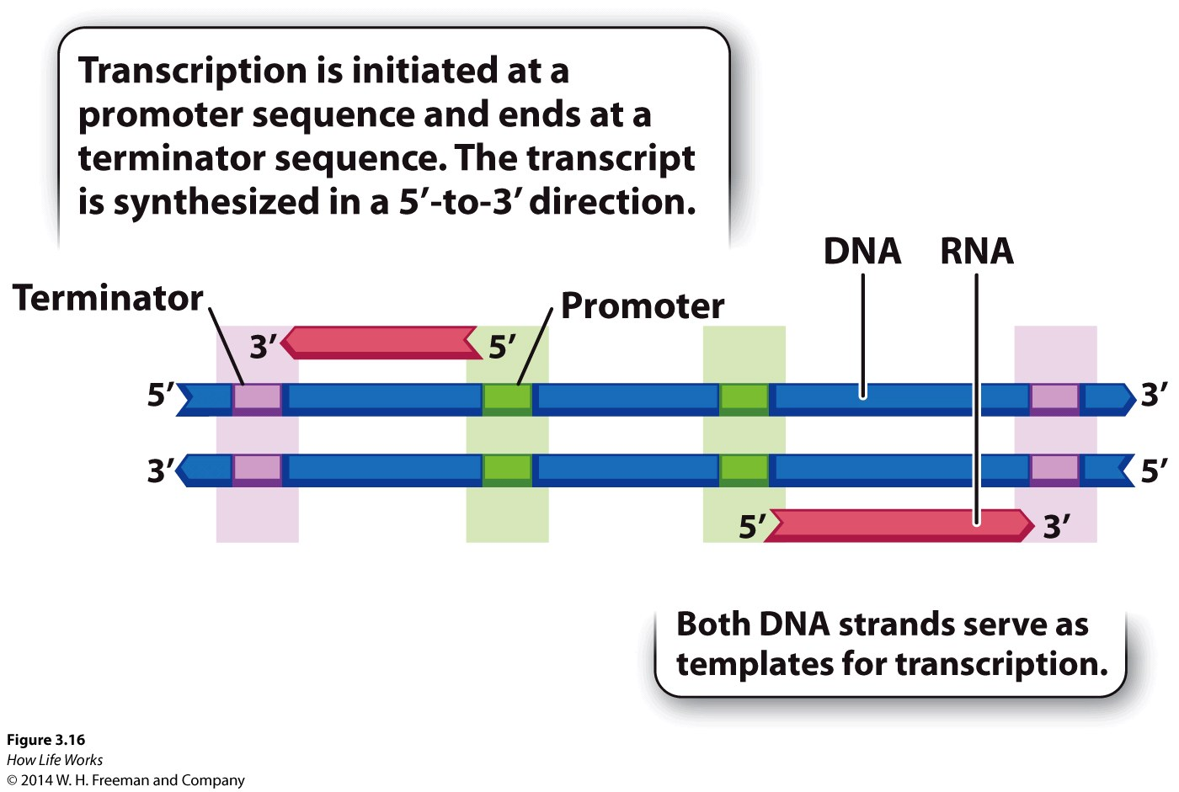
Genes have beginnings and ends - promoters and terminators

Slide 11
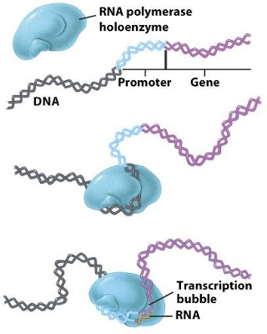
RNA Polymerase Binds at Promoter
RNA polymerase – enzyme that reads gene (DNA) and creates transcript (RNA)

Slide 12
Transcription
Transcribe specific regions of DNA – genes
  Human genome ~25,000 genes (just 1.5% of genome)
RNA is the direct product of transcribing a gene (DNA)
  DNA -> RNA
  same language (nucleotides)
Messenger RNA (mRNA)
Transfer RNA
(tRNA)
Ribosomal RNA (rRNA)

Slide 13
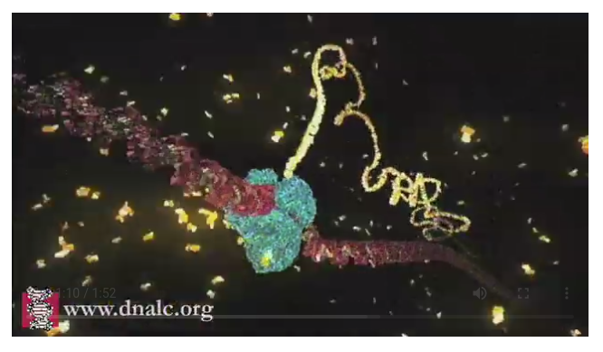
Transcription Video
https://www.dnalc.org/resources/3d/12-transcription-basic.html

Slide 14

Antisense strand
Sense strand

Slide 15
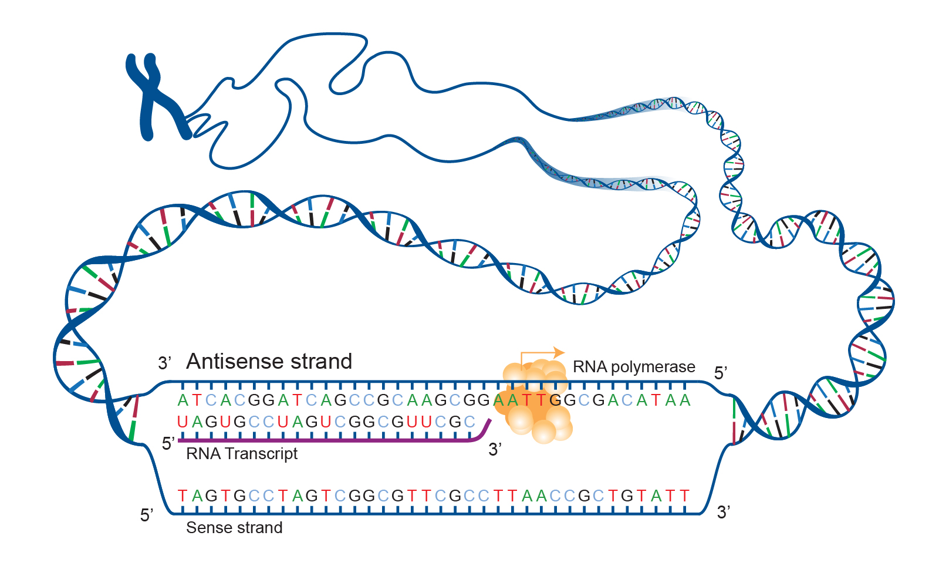
Sense and Antisense DNA
Antisense can also refer to a method for silencing genes. To silence a target gene, a second gene is introduced that produces an mRNA complementary to that produced from the target gene. These two mRNAs can interact to form a double-stranded structure that cannot be used to direct protein synthesis.
Antisense is the non-coding DNA strand of a gene
A cell uses antisense DNA strand as a template for producing messenger RNA (mRNA) that directs the synthesis of a protein.
Antisense strand
Sense strand

Slide 16
Exon and Introns
In most eukaryotic genes, coding regions (exons) are interrupted by noncoding regions (introns).
Introns do not contain the message and are removed from the RNA after transcription but prior to translation.
During the process of RNA splicing, introns are removed and exons joined to form a contiguous coding sequence.
Coding regions
exons
Add 2 eggs bhgty to the flour qwtzptlrbn and stir.
The information coding for a protein sequence
introns
Non-coding regions
Add 2 eggs to the flour and stir

Slide 17
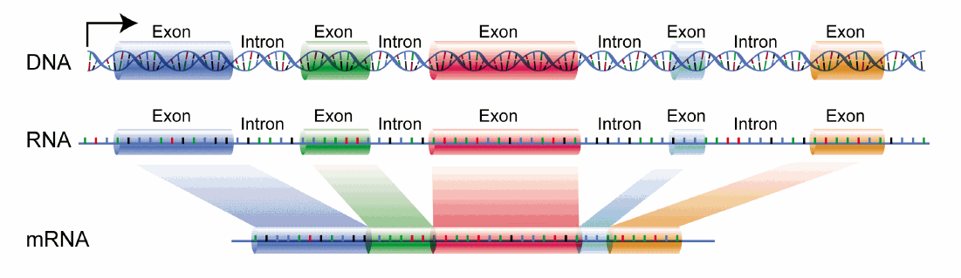
Splicing Exon Material
Exons: a segment of a DNA or RNA molecule containing information coding for a protein or peptide sequence.
Eukaryotic pre-mRNA contains exons and introns*
*some pre-mRNAs contain only one exon
a segment of a DNA or RNA molecule containing information coding for a protein or peptide sequence.

Slide 18
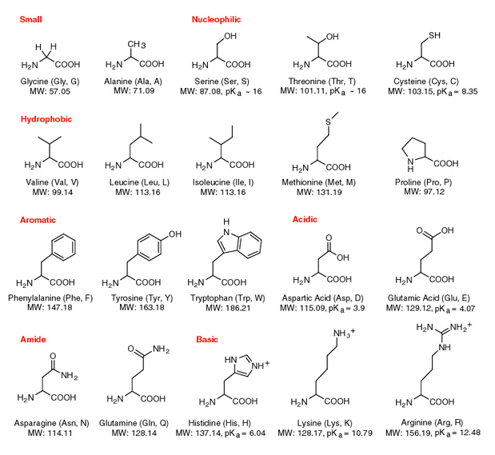
Proteins are made of amino acids

Slide 19

The Genetic Code: RNA into Protein
Triplet code
  Combinations of three nucleotides code for one amino acid
  Three nucleotides = codon
Redundancy
  Sometimes >1 codon codes for same amino acid
  20 amino acids, 64 possible codons
Start and Stop codons
  First codon of many transcripts is “AUG”, which codes for methionine
  Codons UAA, UAG, and UGA indicate the end of the transcript

Slide 20
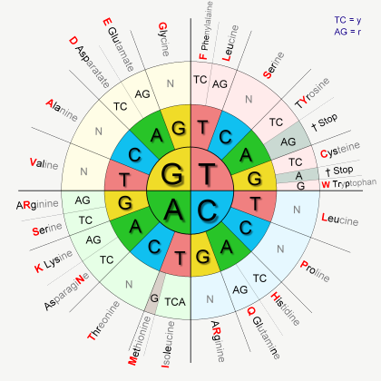
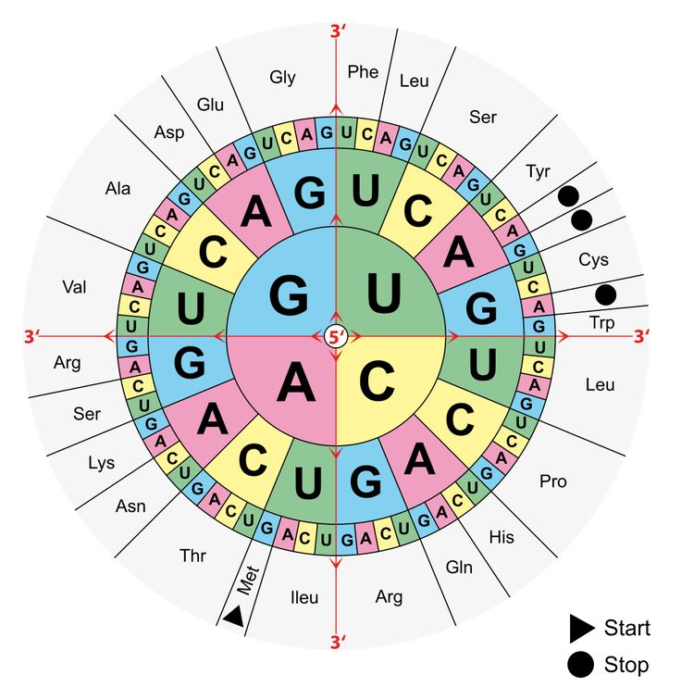
Another Triplet Table

Slide 21
Translation
The information from DNA is rewritten in a new language: RNA
Antisense strand
Sense strand

Slide 22

Translation Videos
mRNA Translation (2 mins)
  https://www.youtube.com/watch?v=8dsTvBaUMvw
Protein Synthesis and the Lean, Mean Ribosome Machines (7 mins)
  https://www.youtube.com/watch?v=h5mJbP23Buo
DNA transcription and translation (includes gene expression, 7 mins)
  https://www.youtube.com/watch?v=2BwWavExcFI

Slide 23
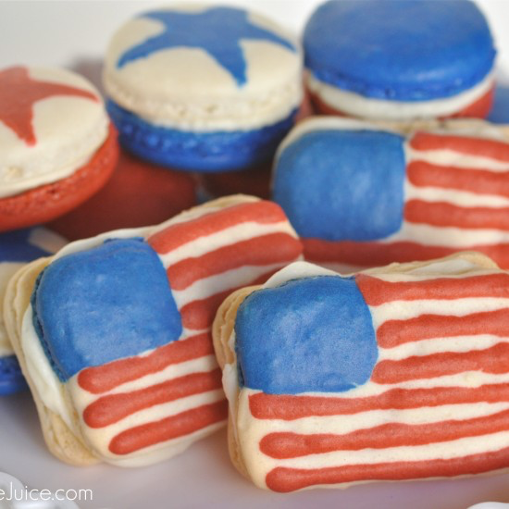
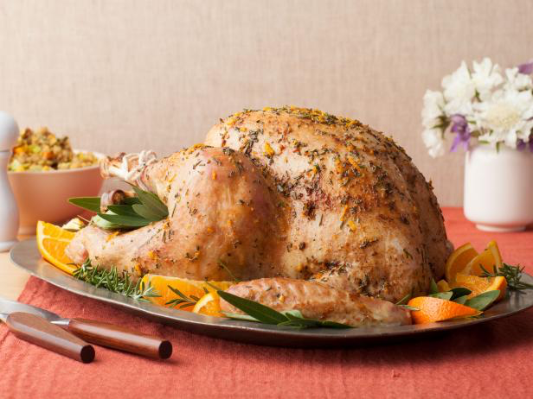
Genes vs Gene Expression
All genes are present in the genome
genes only expressed when needed
Of the many recipes in the cookbook…
… Only transcribe and translate
4th of July recipes in July
… Only transcribe and
translate the Thanksgiving
turkey recipe in November

Slide 24


Prepare to run some commands for Docker …
Or, wait for a few slides and run Python3 shell in your browser online

Slide 25
Note: If you are not using ToolBox, Docker should already be working in the background
Navigate to where you have stored your docker_getMeToThePython directory.

Slide 26
Mac and Windows ToolBox: find and run the “Docker QuickStart Terminal”
Note: See file, quickStartCommands.md, for these commands
Note: The Docker ToolBox commands to initiate server
Windows Quickstart Command:
"C:\Program Files\Git\bin\bash.exe" --login -i "C:\Program Files\Docker Toolbox\start.sh"
MacOS Quickstart Command:
bash --login '/Applications/Docker/Docker Quickstart Terminal.app/Contents/Resources/Scripts/start.sh'

Slide 27
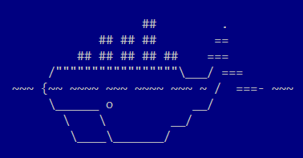
If your server was properly initialized then, you should see this cute whale.

Slide 28
Two ways to run Python3 in DockerQS or bash shell
See file, commands.md, for these notes
  docker run -t python3
  Or, build the container and run Python3 there
    docker build -t py_play .
  Mount a drive and then use bash to run Python3
    docker run -it --mount type=bind,source=$PWD,target=/home/py_play py_play

Slide 29

Or, try Python3 programming using an interactive shell from repl.it
Link: https://repl.it/languages/python3

Slide 30
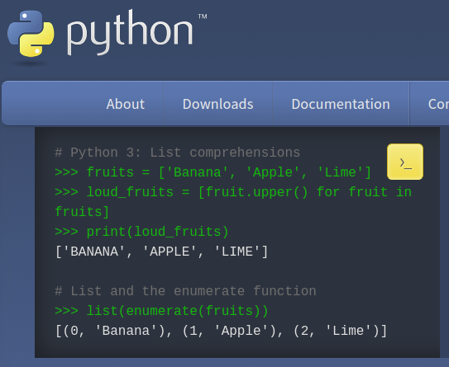
Some trouble to make Python3 work with Docker ToolBox
Install and use Python3 however you want!
Get Python3 from the Python Software Foundation
Login http://www.python.org/downloads

Slide 31
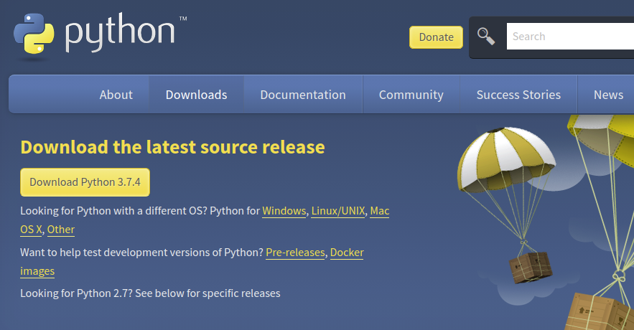
Download and install the version of Python3 for your OS being sure to add the PATH to the environmental variables (check the path option!)
Ask questions if you have trouble installing the program
Check with the installation material to learn how to launch
Python3 from your machine.

Slide 32
Python3
#Calculating values
3 / 4
2 * 6
3.1415 – 2.718
x = 1
y = 2
print(x+y)
result = x + y
print(“The result is :”,result)

Slide 33
Python3
# Integers, counting numbers
num_int = 1
# Floats, decimals
num_float = 3.1415
# Strings
s_str = ” Hello World”
# Combining variables in print statements
x_int = 1
print(" The integer variable is :", x_int)
num_float = 3.14
print(" The float variable is :", num_float)
s_str =("Hello World'')
print(" The integer is equal to", s_str)

Slide 34
Calculate
3 + 4 # Addition
3 − 4 # Subtraction
3 ∗ 4 # Multiplication
3 / 4 # Division of 3 by 4
# Modulus; Returns the remainder from the division 3 ∗ ∗4
3%4
# Powers; raise three to the power of four
= 3∗3∗3∗3
= 3^4
= pow(3,4)

Slide 35
Strings
# Remember each char of a string has own position
s_str = "ABC"
s_str[0] = 'A'
s_str[1] = 'B'
s_str[2] = 'C'
s_str[200] = ??
# Another way to iterate
# through a string using its length
for i_int in range(len(s_str)):
print(s_str[i_int])

Slide 36
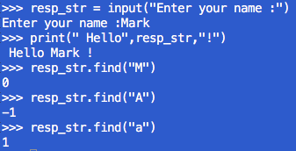
Counting and Finding
# Getting input from a user
resp_str = input(“Enter your name :”)
print(" Hello",resp_str,"!")
# Determine number of chars in a string
lengthOfName_int = len(resp_str)
# Find a subset-string in the string
resp_str.find("M")
resp_str.find("A")
resp_str.find("R")
resp_str.find("K")
resp_str.find("ARK")

Slide 37

Counting and Finding
Find char occurrence in a string
resp_str = “Hello!!”
resp_str.count("H")
resp_str.count("l")
Find number of specific triples in string.
resp_str = “Hellollollo!!”
resp_str.count("llo")
resp_str.find("llo")

Slide 38
Getting Input
Find char occurrence in a string
resp_str = “Hello!!”
resp_str.count("H")
resp_str.count("l")
Find number of specific triples in string.
resp_str = “Hellollollo!!”
resp_str.count("llo")

Slide 39
A Short Program
Watch for tabs that define code blocks
print("Welcome to the program!")
prmpt_str = " Please enter your name :"
# place the string above into input statement
name_str = input(prmpt_str)
print(" Your name is :",name_str)
print(" And is <<",len(name_str),">> chars long!")
# print the chars on lines
print(" What are the characters in the string? ")
for i in range(len(name_str)):
# note the tabs for this block!
# we iterate through the positions in string
print(" + char :",name_str[i])
# findout how many a's are in the name
numChar_int = name_str.count("a")
print(" The number of a's in your name :",numChar_int)
For this code, see file, pythonDemo.py, in your sandbox.

Slide 40

Consider This ...
Group work
Write a short program in Python3 that …
Accepts a short sequence of DNA (that you type in) and counts the occurrences of:
  A’s
  T’s
  G’s
  C’s
  “AT”, “TA”
  “GC” and “CG”

Slide 41
Then Consider This ...
Now, go get a real piece of DNA and try out your program
Link for organism: Gordonia phage Orchid, complete genome,
  https://www.ncbi.nlm.nih.gov/nuccore/NC_030915.1?report=fasta
What results did you find in terms of the pairs of AT’s, TA’s, GC’s and CG’s?
Are the numbers of pairs similar or dissimilar?

Slide 42
Supporting Videos
The DNA Double Helix (17 mins)
http://media.hhmi.org/biointeractive/films/Double_Helix.html
The Chemical Structure of DNA (3 mins)
http://www.hhmi.org/biointeractive/chemical-structure-dna

Slide 43

Python Programming
How to start up Python interactive mode?
How to add numbers?
How to create variables?
How to make print statements
Strings:
  How to work with strings
  How to count characters
  How to find characters.
Follow along in
class and save
your notes in
a text file!!
  Follow along and Save your notes in a text file.

