Slide 1

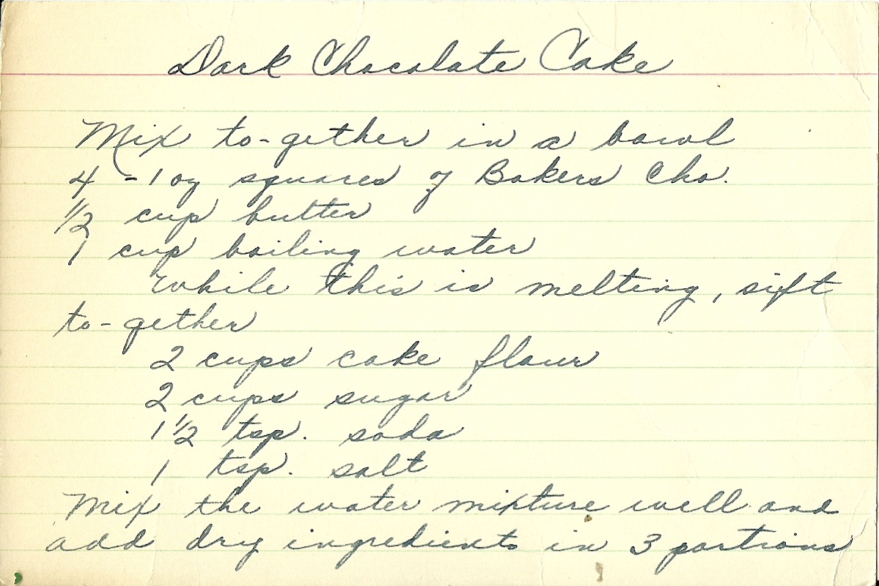
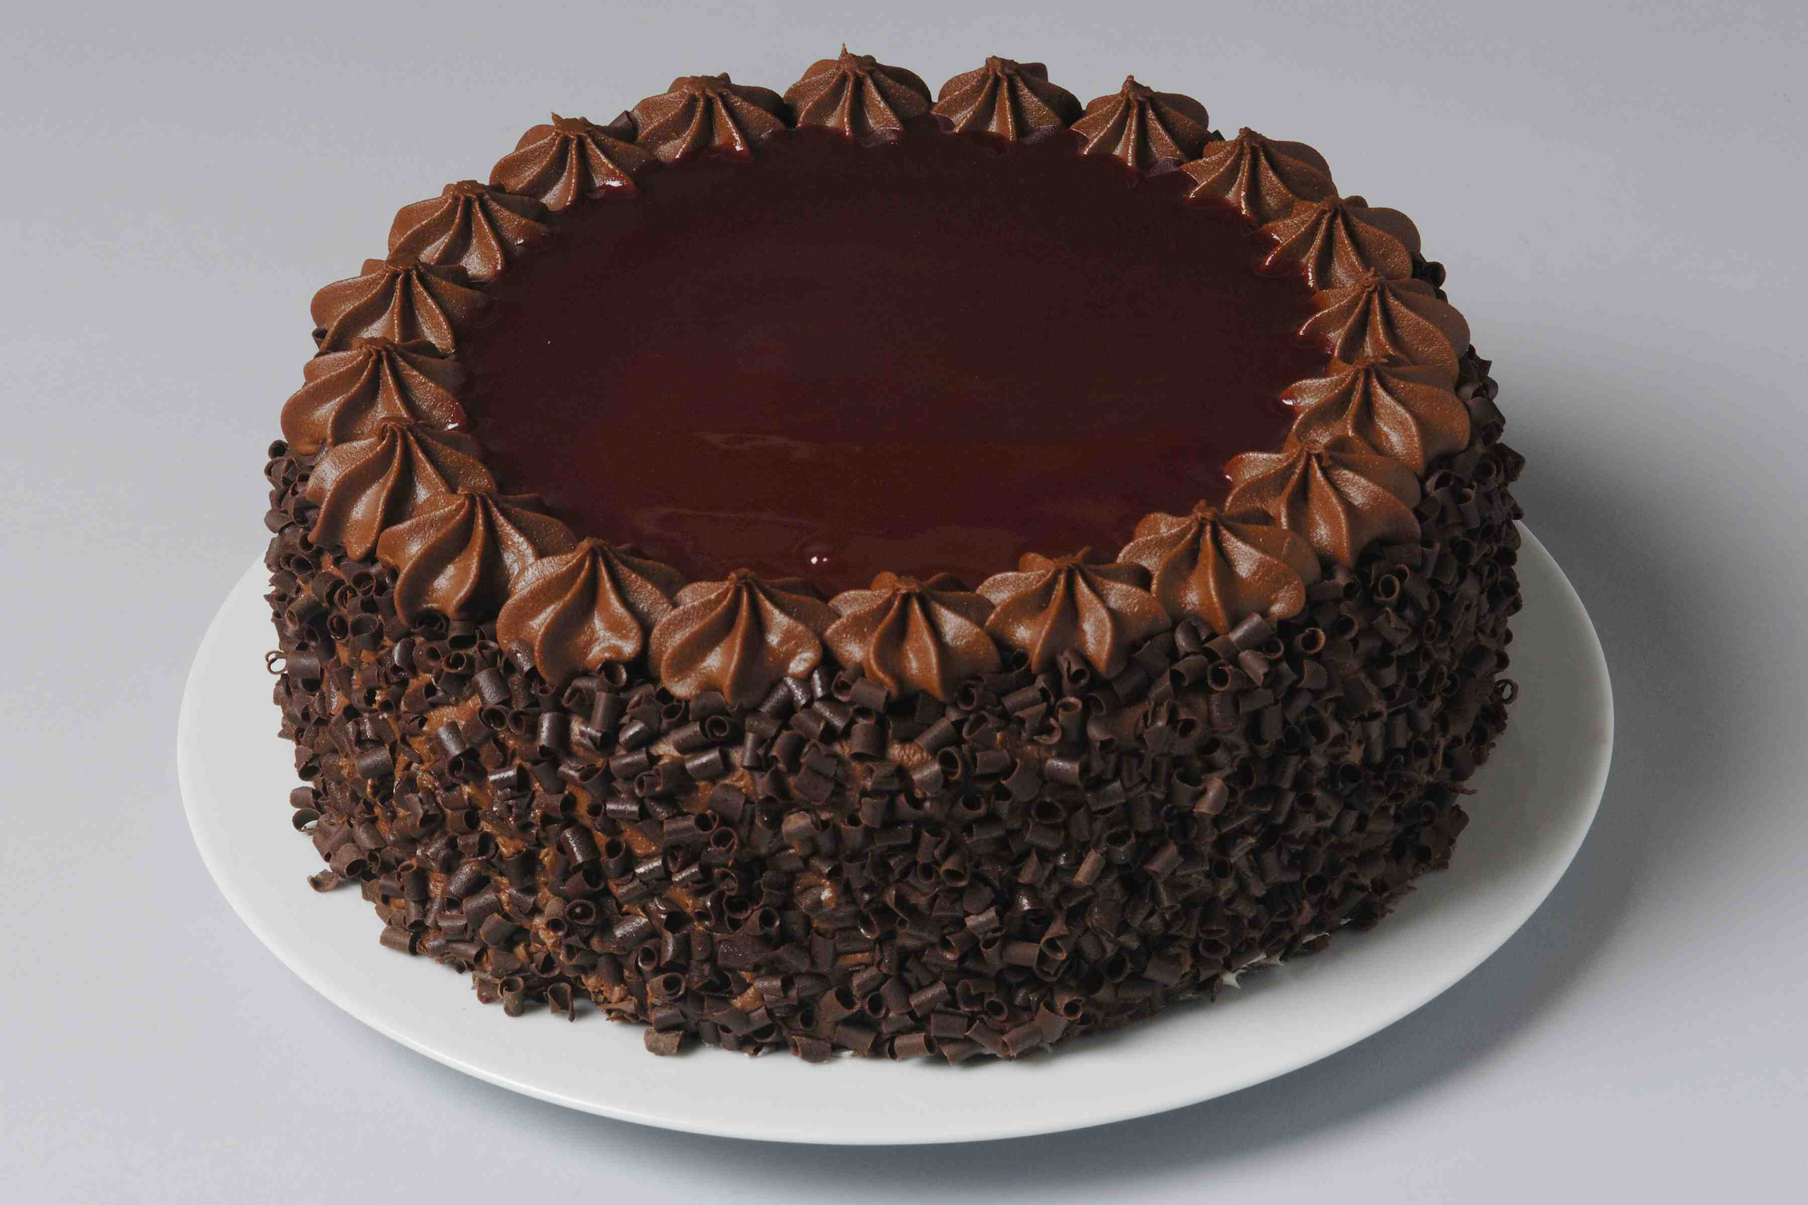
Gene Expression
Transcription and Translation
Transcription
copy a set of ingredients/instructions from a cookbook to create a recipe
Translation
use the recipe to create a dish
BIO*300/CMPSC*300 – SPRING 2016
CRASH COURSE IN MOLECULAR BIOLOGY

Slide 2


The Central Dogma of Molecular Biology

Slide 3

Transcription
Transcribe specific regions of DNA – genes
  Human genome ~25,000 genes (just 1.5% of genome)
RNA is the direct product of transcribing a gene (DNA)
  DNA -> RNA
  same language (nucleotides)
Messenger RNA (mRNA)
Transfer RNA
(tRNA)
Ribosomal RNA (rRNA)

Slide 4
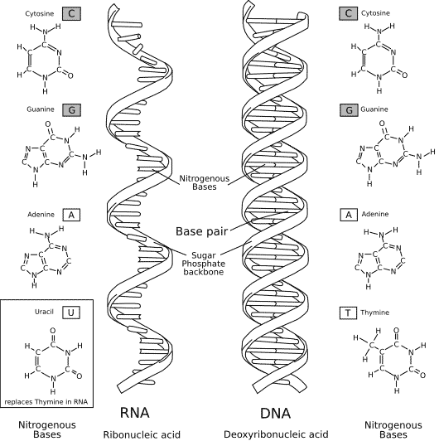
RNA vs DNA
RNA – uracil replaces thymine (no Ts in RNA)
RNA – single stranded (one backbone, no basepairs)
(RNA – slightly different sugar)

Slide 5
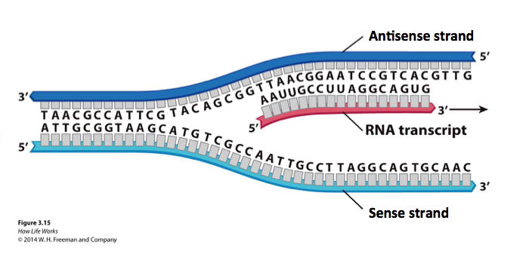
Genes exists on both strands of DNA….
…..transcription occurs on the strand containing the gene whose product is needed.
The strand containing the gene is the antisense strand.
The RNA transcript is the complement of the antisense strand.

Slide 6
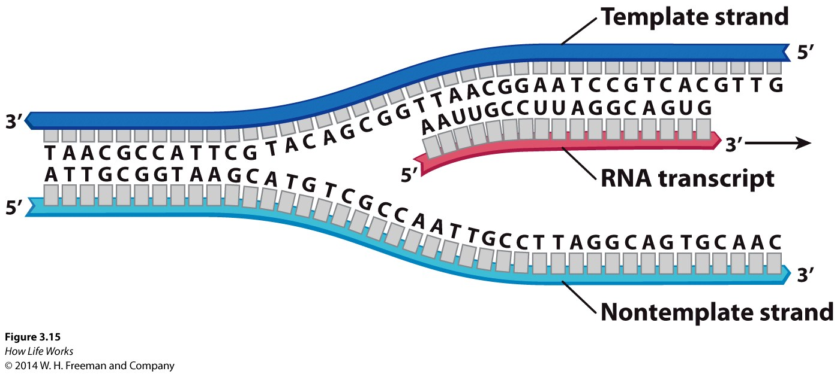
Antisense and Sense Strands of DNA – relative to the gene being transcribed
Antisense strand
Sense strand

Slide 7
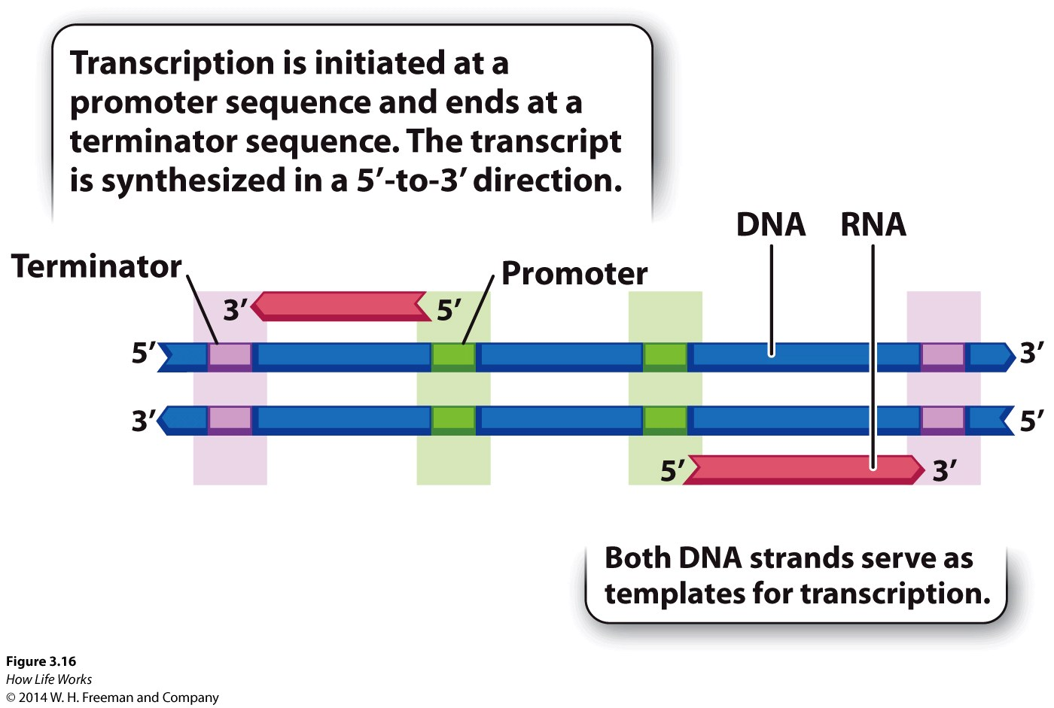
Genes have beginnings and ends - promoters and terminators

Slide 8
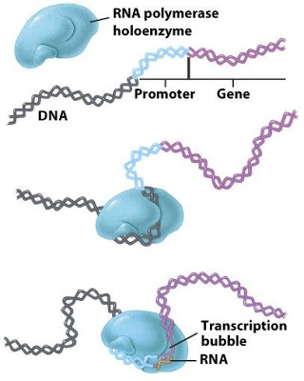
RNA polymerase binds at promoter
RNA polymerase – enzyme that reads gene (DNA) and creates transcript (RNA)

Slide 9
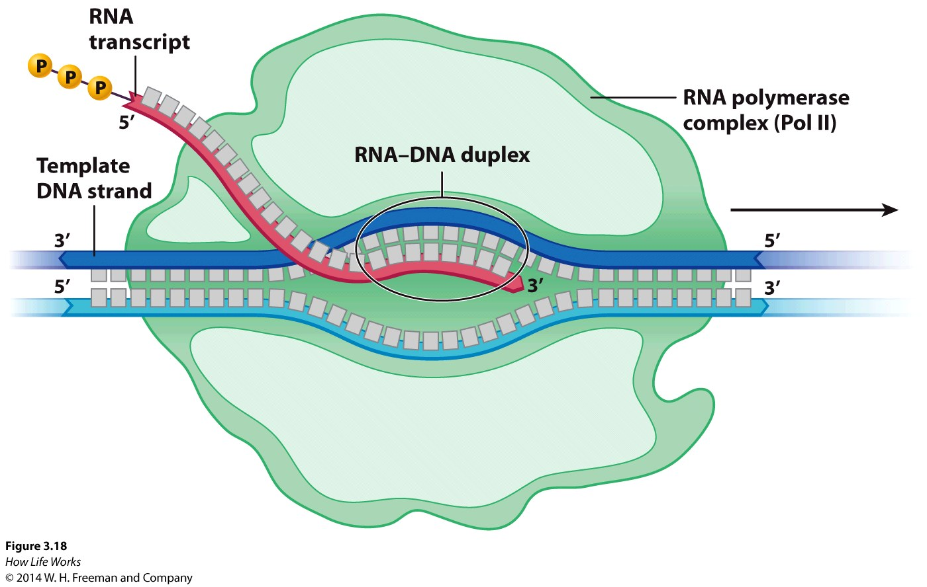
Transcription
Strands of DNA are separated – transcription bubble
RNA synthesis
  DNA template “read” in 3’ -> 5’ direction
  RNA synthesized in 5’ -> 3’ direction

Slide 10
Transcription Video
https://www.dnalc.org/resources/3d/12-transcription-basic.html
Watch video and read text below
“other factors” – no responsible for details, just watch process
Know the role of RNA polymerase

Slide 11

Antisense strand
Sense strand

Slide 12
Antisense strand
Sense strand

Slide 13
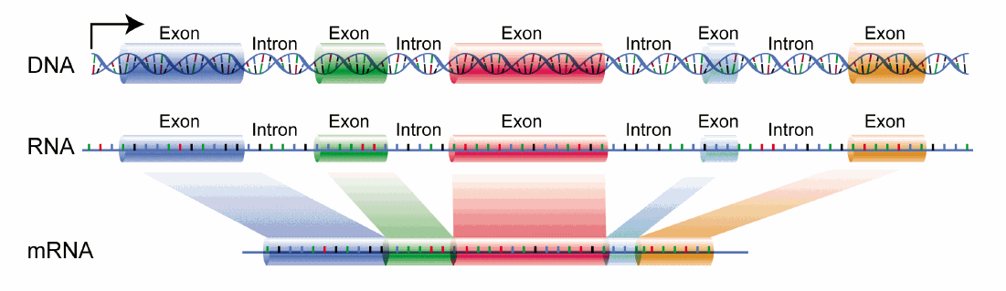
Splicing of some RNA sometimes…
Eukaryotic pre-mRNA contains exons and introns*
*some pre-mRNAs contain only one exon

Slide 14
Add 2 eggs bhgty to the flour qwtzptlrbn and stir.

Slide 15
Introns do not contain the message and are removed from the RNA after transcription but prior to translation.
exons
Add 2 eggs bhgty to the flour qwtzptlrbn and stir.
introns
Add 2 eggs to the flour and stir

Slide 16
Translation
Reading transcript (RNA) and creating protein (amino acids)
  new language!

Slide 17
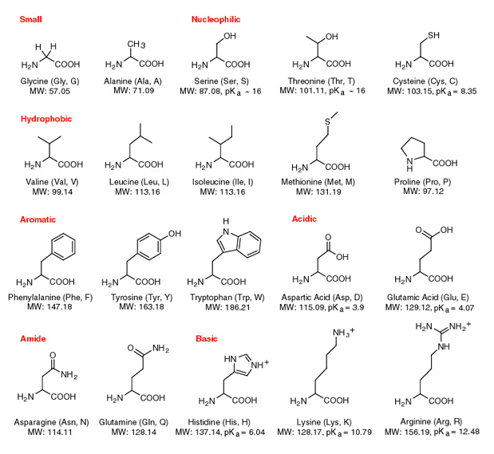
Proteins are made of amino acids

Slide 18
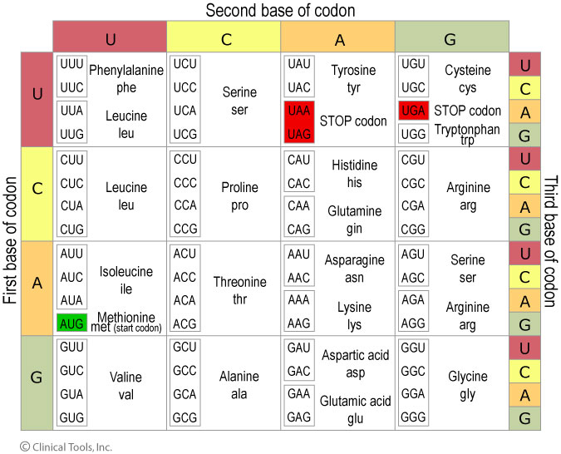
Genetic Code
“nucleotide to amino acid dictionary”

Slide 19
The Genetic Code
Triplet code
  Combinations of three nucleotides code for one amino acid
  Three nucleotides = codon
Redundancy
  Sometimes >1 codon codes for same amino acid
  20 amino acids, 64 possible codons
Start and Stop codons
  First codon of many transcripts is “AUG”, which codes for methionine
  Codons UAA, UAG, and UGA indicate the end of the transcript

Slide 20
Translation
Reading transcript (RNA) and creating protein (amino acids)
  new language!
Translation machinery:
  Transfer molecules - bring correct amino acid to ribosome
  Ribosome – factory that joins amino acids to build a protein

Slide 21
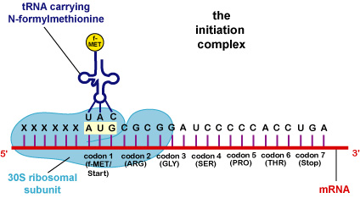
Translation
Transfer molecule brings next amino acid to complex.
Amino acid is specific – based on codon of RNA
Ribosome builds the protein by joining the amino acids
Transfer molecule w/ amino acid
Ribosome

Slide 22
Antisense strand
Sense strand

Slide 23
Antisense strand
Sense strand

Slide 24
Translation Videos
https://www.youtube.com/watch?v=8dsTvBaUMvw
Translation process is generic – specificity comes from the gene that was transcribed.
https://www.youtube.com/watch?v=h5mJbP23Buo
  Fun review of entire process of gene expression (transcription and translation)

Slide 25
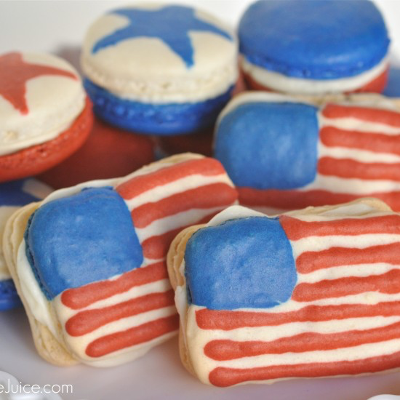
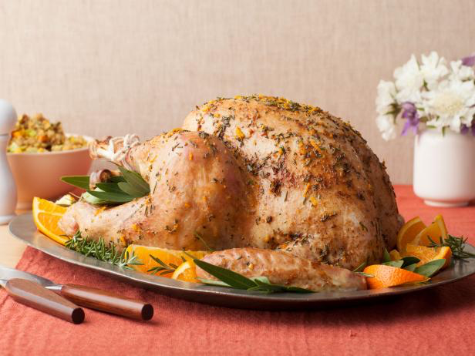
Genes vs Gene Expression all genes are present in the genome genes only expressed when needed
Of the many recipes in the cookbook…
….only transcribe and translate 4th of July recipes in July
Of the many recipes in the cookbook…
….only transcribe and translate the Thanksgiving turkey recipe in November

