Slide 1
Bioinformatics
CS300
Crash course:
Mutations
Fall 2019
Oliver BONHAM-CARTER

Slide 2


What is Mutation?
A natural process that changes the DNA sequence
A common process
  during replication of the human genome a “typo” occurs every 100,000 or so nucleotides
  that’s about 120,000 typos each time one of our cells divides
  most are repaired

Slide 3
What is Mutation?
Most mutations are neutral – no consequence
Some mutations are beneficial – provides advantage in particular environment
Some mutations are harmful

Slide 4
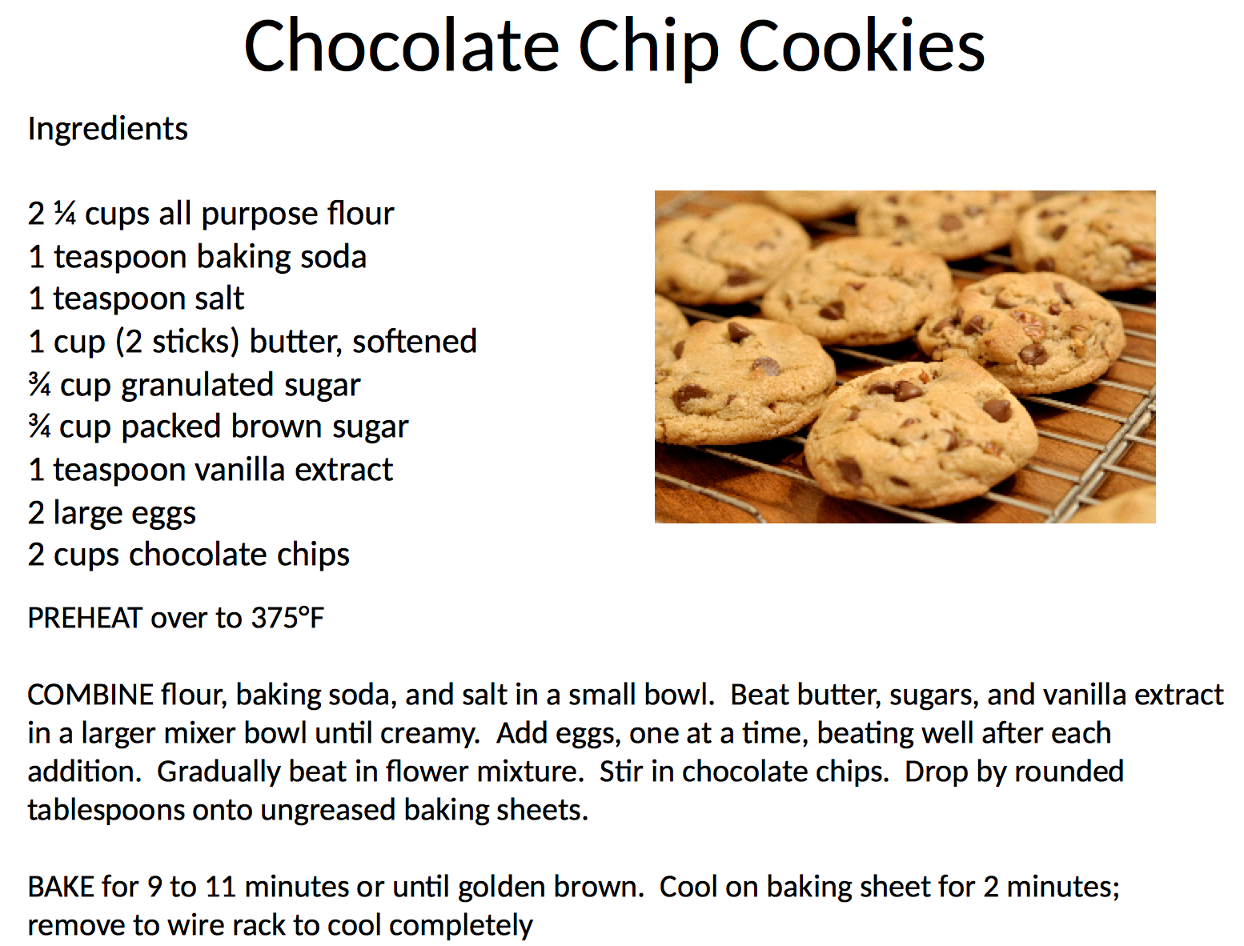
Wildtype recipe

Slide 5
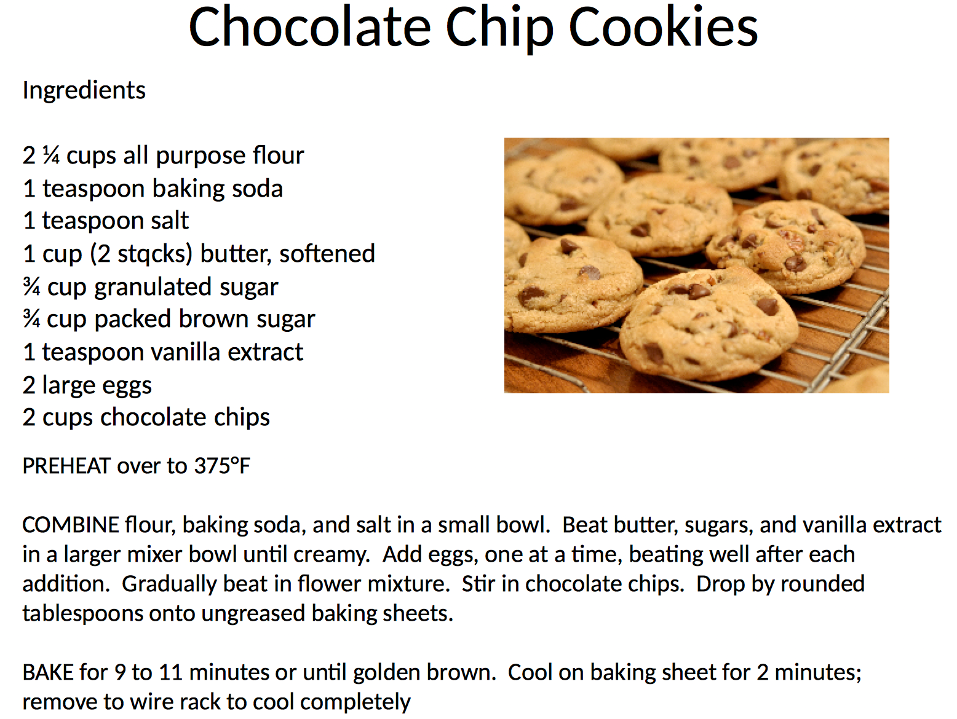
Mutation present!

Slide 6
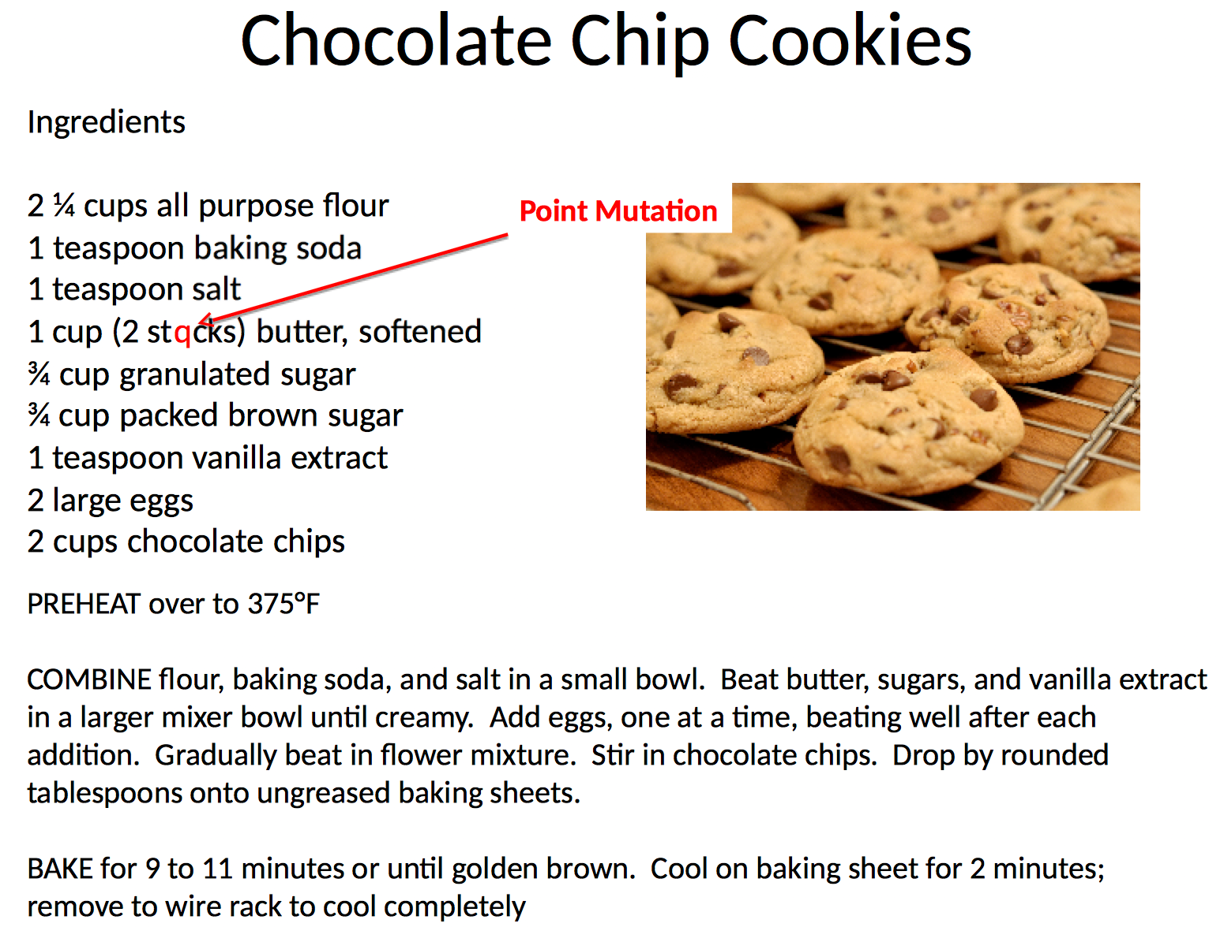
Mutation present!

Slide 7


Slide 8
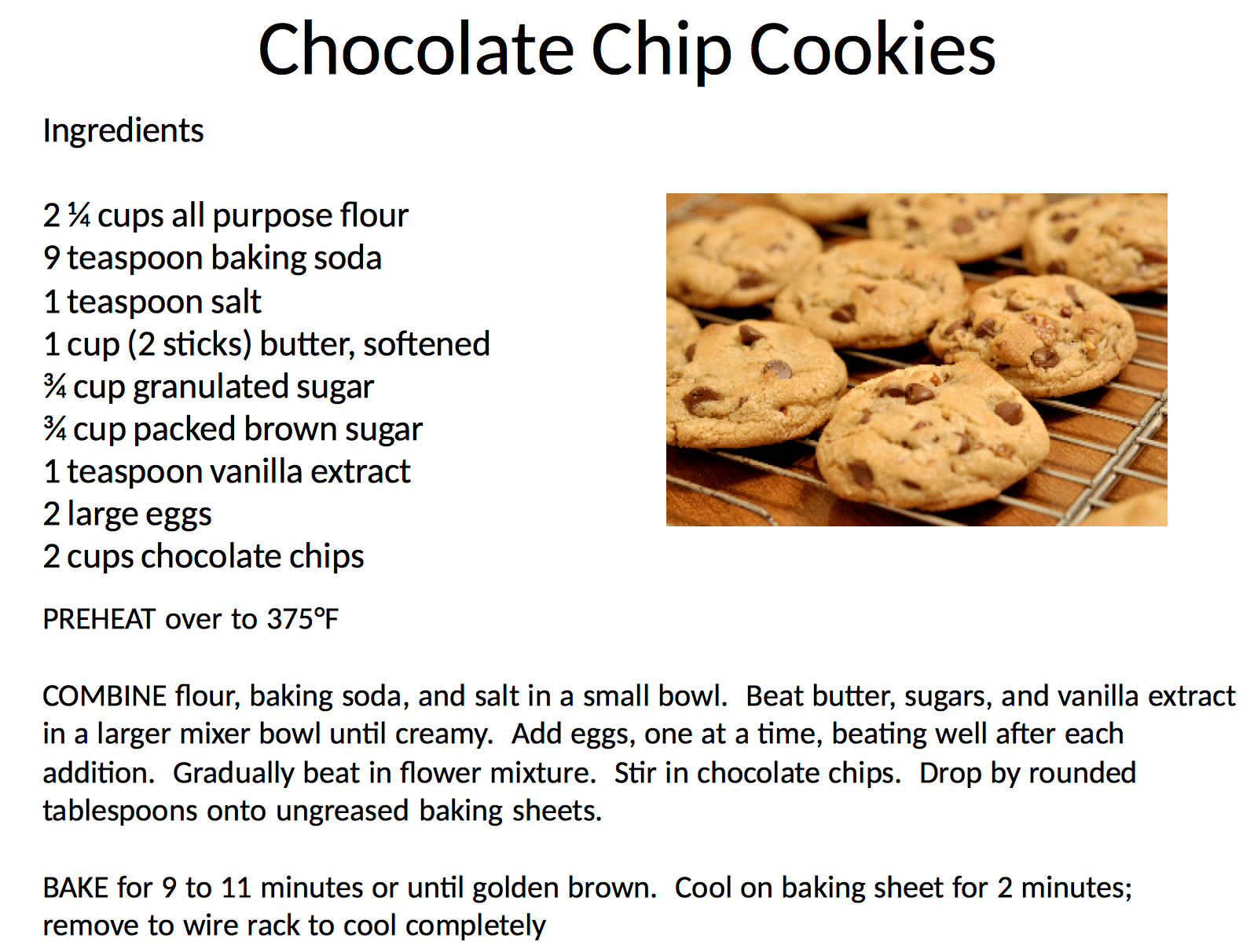
Mutation present!

Slide 9


Slide 10


Slide 11
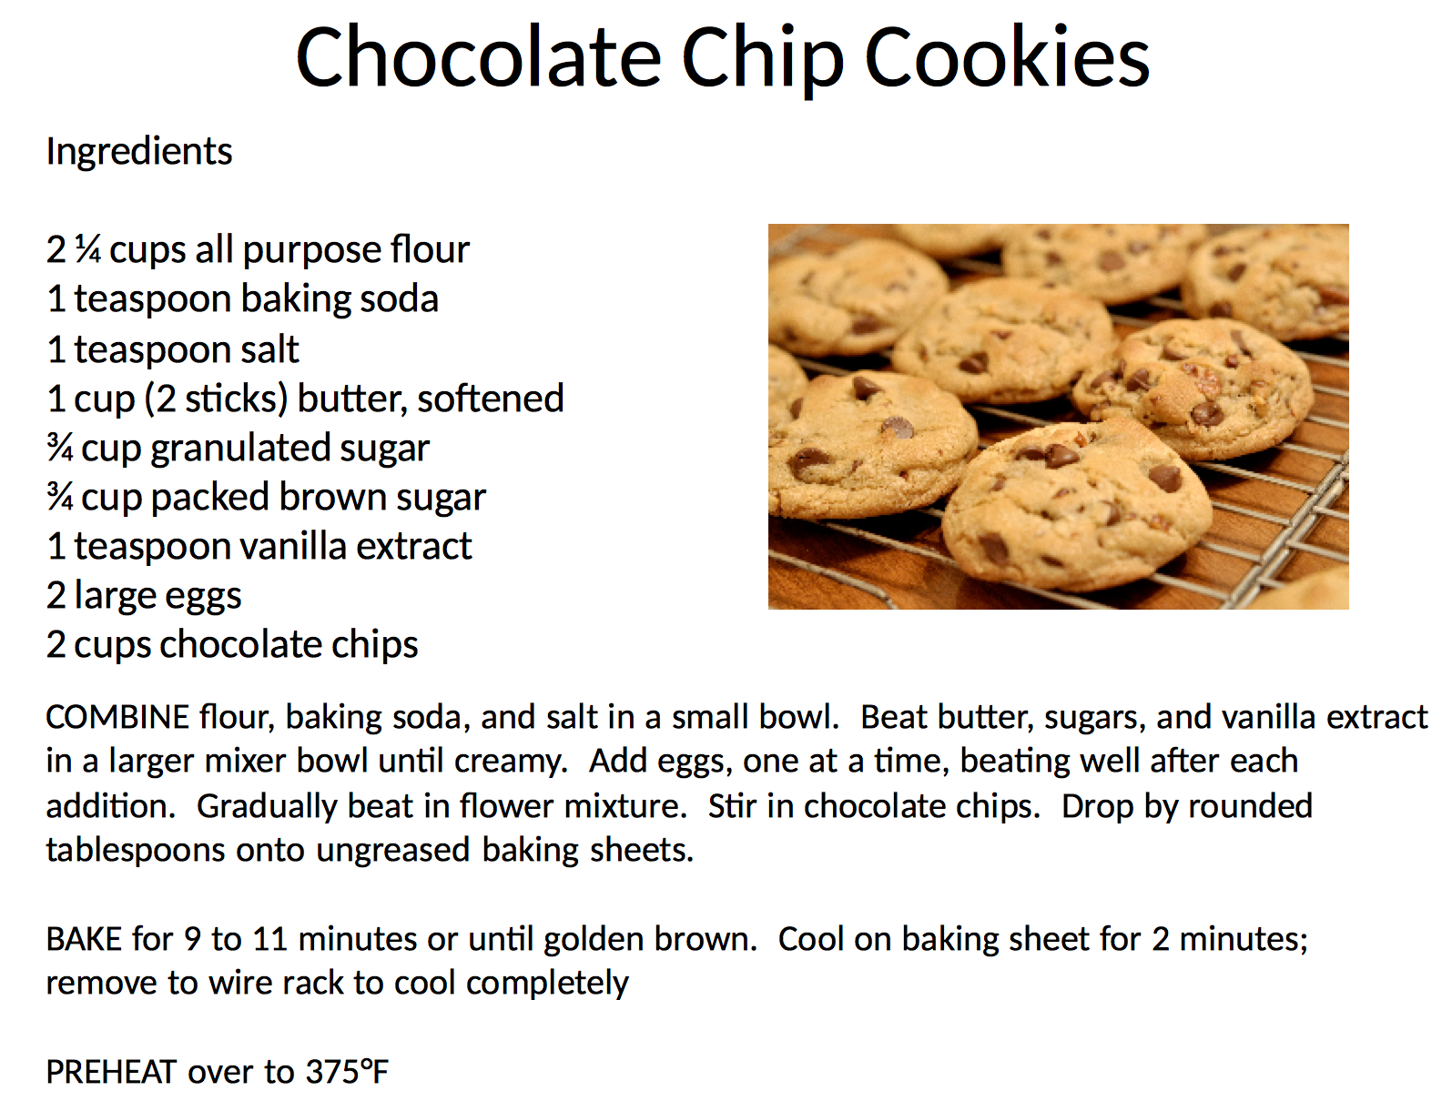
Mutation present!

Slide 12
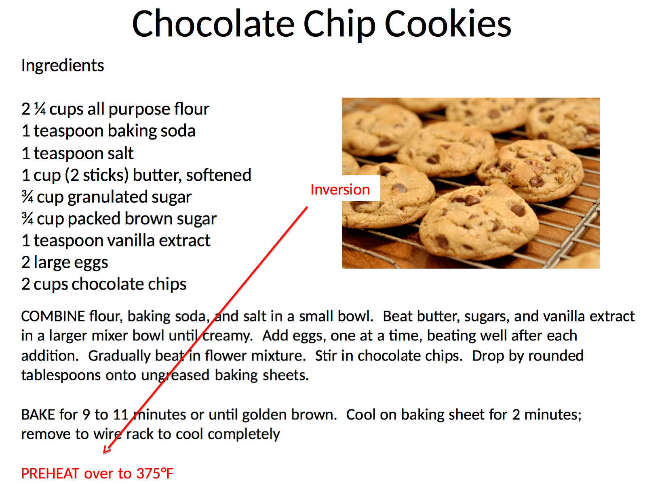

Slide 13


Slide 14

Mutation present!

Slide 15


Slide 16
Types of Mutations
Point mutation
  A mutation that only affects a single nucleotide of nucleic acid.
Inversion mutation
  A chromosome rearrangement in which a segment of a chromosome is reversed end to end
Substitution mutation
  An exchange of one base for another. Such a substitution could: change a codon to one that encodes a different amino acid and cause a small change in the protein produced.

Slide 17
Types of Mutations
Insertions
  an addition of one or more nucleotide base pairs into a DNA sequence.
Deletions
  A mutation (a genetic aberration) in which a part of a chromosome or a sequence of DNA is lost during DNA replication
Frameshift mutation
  Deletion or an insertion that results in the DNA being read from the wrong starting bases during transcription

Slide 18
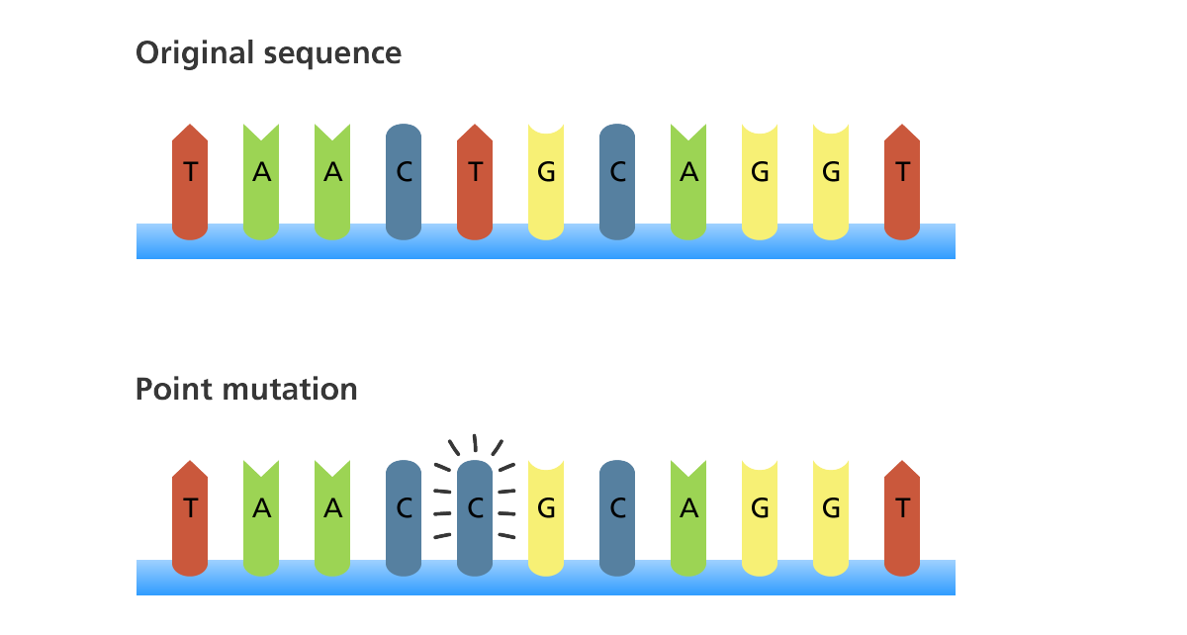
Mutation – Point Mutation
A point mutation is a mutation that exchanges one base for another

Slide 19
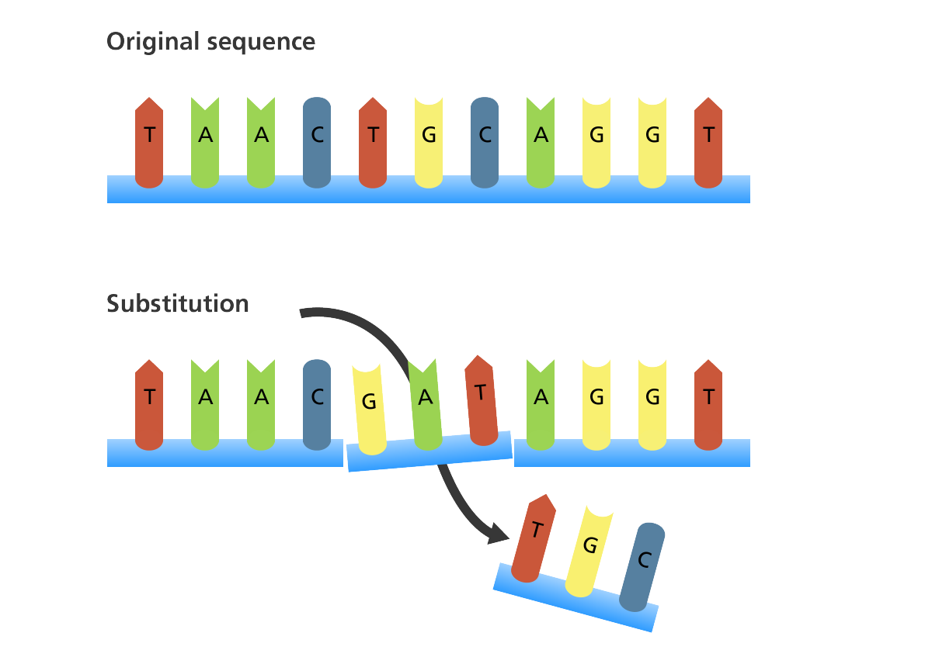
Mutation - Substitution
A substitution is a mutation where one or more bases in the sequence is replaced by the same number of bases

Slide 20
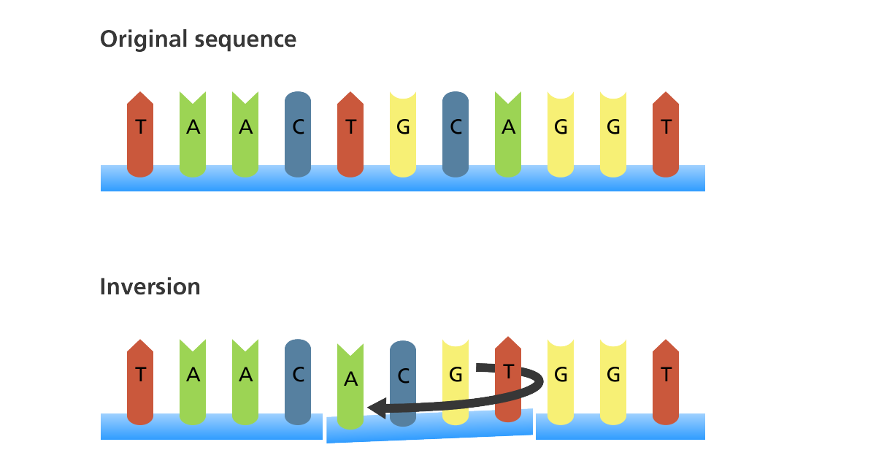
Mutation - Inversion
An inversion is a mutation where a segment of DNA is reversed

Slide 21
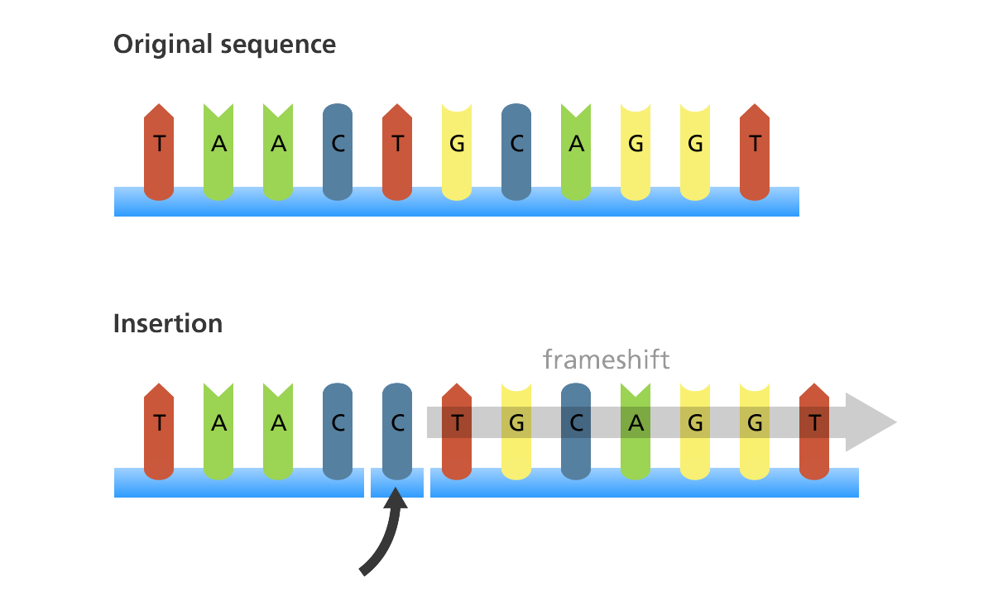
Mutation - Insertion
An insertion is a mutation in which one or more nucleotides are added into the DNA

Slide 22
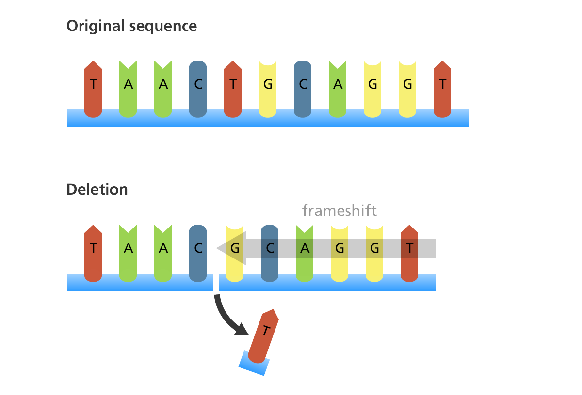
Mutation - Deletion
A deletion is a mutation in which one or more nucleotides are removed from the DNA sequence

Slide 23
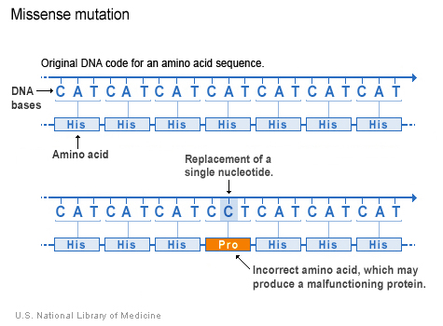
Frameshift Mutations
Remember that bases are read in
triplets (codons) to make protein.

Slide 24

Where Do Mutations Come From?
Cell division (meiosis) or can occur if an error is made as DNA copies itself during cell division
Often no trace of damage to protein as long as gene sequence is not interrupted

Slide 25
Where Do Mutations Come From?
Mistakes by the DNA polymerase during replication
  Can be repaired by repair enzymes – not always perfect
A C T G C G T A C
| | | | | | | | |
T G A T G C A T G

Slide 26
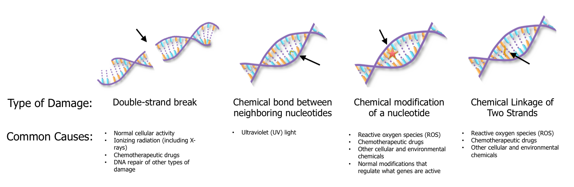
Where Do Mutations Come From?
DNA damage and imperfect repair
  Cell can still divide but DNA sequence has changed

Slide 27
Where Do Mutations Come From?
DNA damage and imperfect repair
  Cell can still divide but DNA sequence has changed

Slide 28
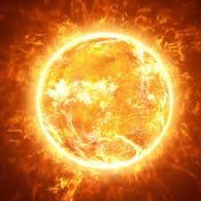
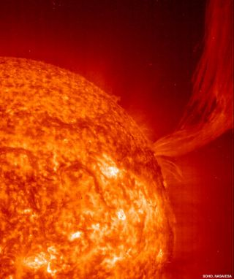
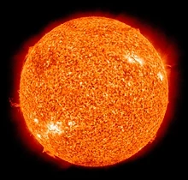

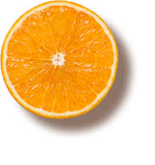
Where Do Mutations Come From?
Environmental factors: ultraviolet radiation from the sun

Slide 29
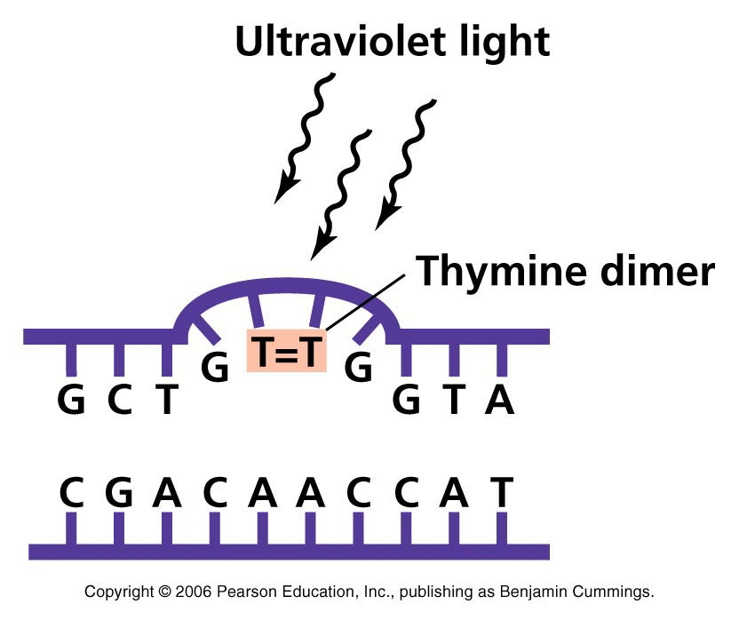
Where Do Mutations Come From?
UV light causes bond to form between adjacent Ts
If left unrepaired, polymerase “guesses”
  25% chance per site
  cell can still divide
  hopefully not in a gene
Chance of mistakes during repair process
  polymerase isn’t perfect
  cell can still divide
  hopefully not in a gene

Slide 30
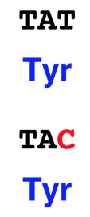
Consequences of Mutation?
Sometimes nothing happens
  “Silent mutations”
  Mutation does not occur in a gene
    Humans, just 1.5% of the genome
  Silent changes
    occurs in gene, but does not change message
    genetic code is redundant
You notice mutations when they interfere with some product production.

Slide 31
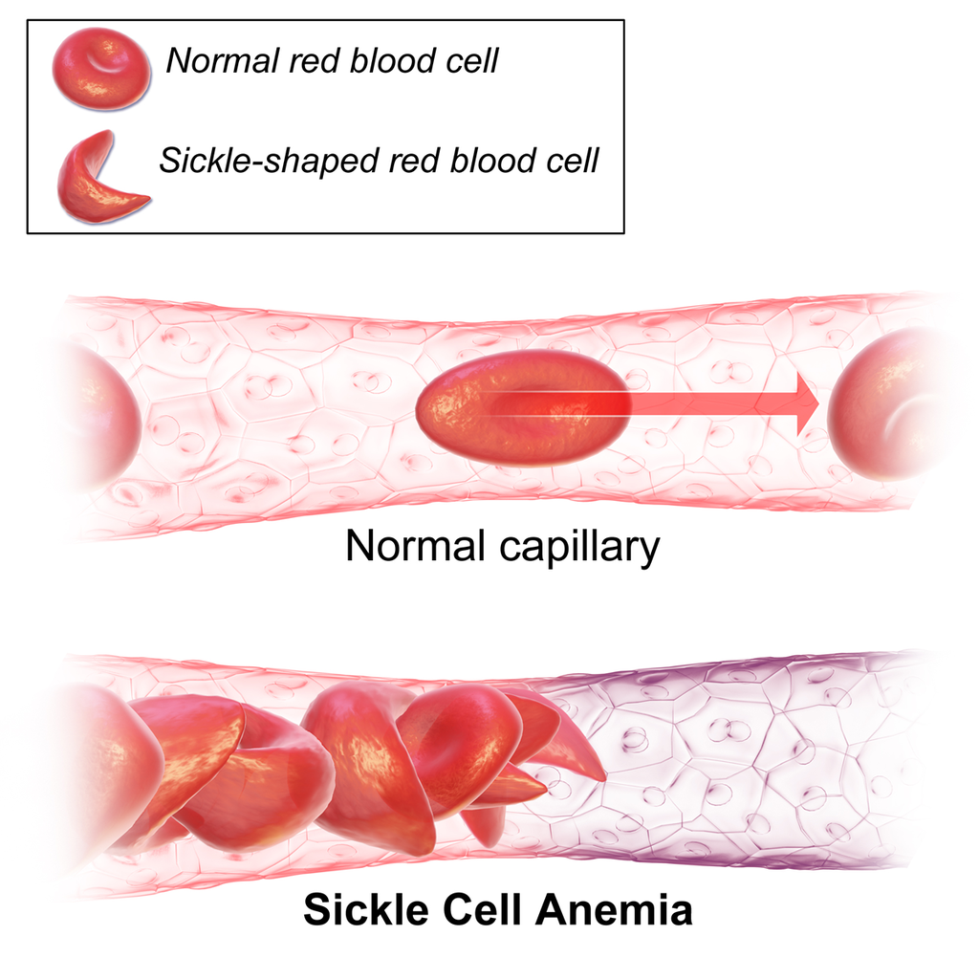
Sickle Cell Anemia:
A Missense Mutation
Sickle cells are in the shape of sickles.
An inherited form of anemia — a condition in which there are not enough healthy red blood cells to carry adequate oxygen throughout your body.
There's no cure for most people with sickle cell anemia.
Treatments can relieve pain and help prevent problems associated with the disease.
For more information:
https://www.mayoclinic.org/diseases-conditions/sickle-cell-anemia/symptoms-causes/syc-20355876

Slide 32
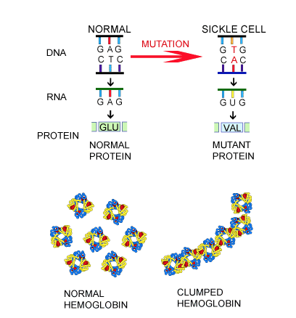
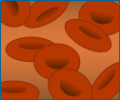

A Mutation Did This?
HBB gene - Sickle cell anemia – missense mutation
Normal RBC
Sickle RBC
A group of disorders that cause red blood cells to become misshapen and to break down.
Sickled red blood cells are abnormally shaped and ridgid
Sickle shape can interrupt blood flow

Slide 33
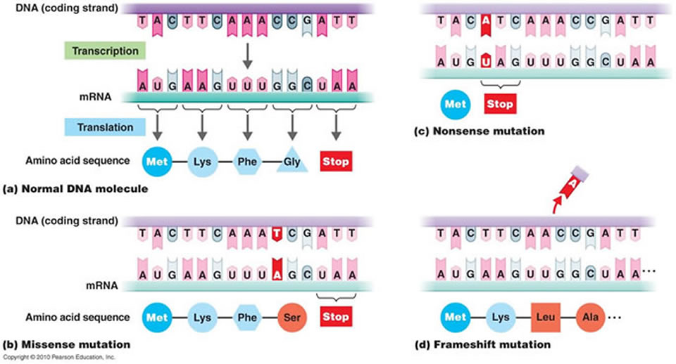
Frame Shift Mutation
Caused by an Insertion or a Deletion
Changes codons and corresponding amino acids after mutation site

Slide 34

Python Programming
Functions
Syntax
General coding
Follow along in
class and save
your notes in
a text file!!
  Follow along and Save your notes in a text file.

Slide 35
Header
This
This

Slide 36

Supporting Videos
The DNA Double Helix (17 mins)
http://media.hhmi.org/biointeractive/films/Double_Helix.html
The Chemical Structure of DNA (3 mins)
http://www.hhmi.org/biointeractive/chemical-structure-dna

Slide 37

Consider This...
This
This

Slide 38
Header
This
This

