Slide 1
Bioinformatics
CS300
Crash course:
Mutations
Fall 2017
Oliver Bonham-Carter

Slide 2


What is Mutation?
A natural process that changes the DNA sequence
A common process
  during replication of the human genome a “typo” occurs every 100,000 or so nucleotides
  that’s about 120,000 typos each time one of our cells divides
  most are repaired

Slide 3
What is Mutation?
Most mutations are neutral – no consequence
Some mutations are beneficial – provides advantage in particular environment
Some mutations are harmful

Slide 4
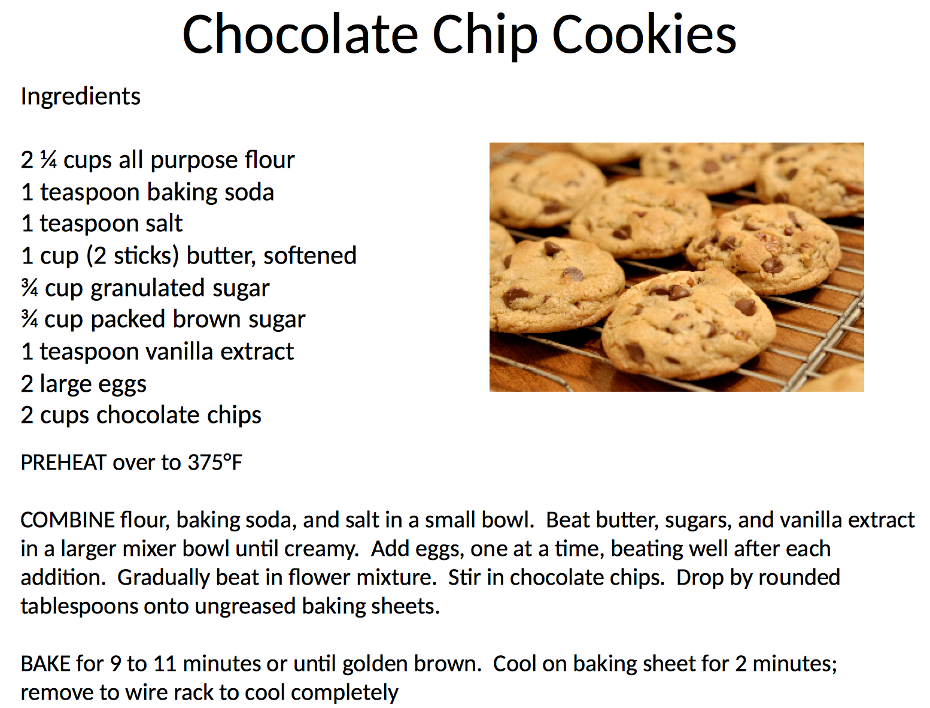

Slide 5
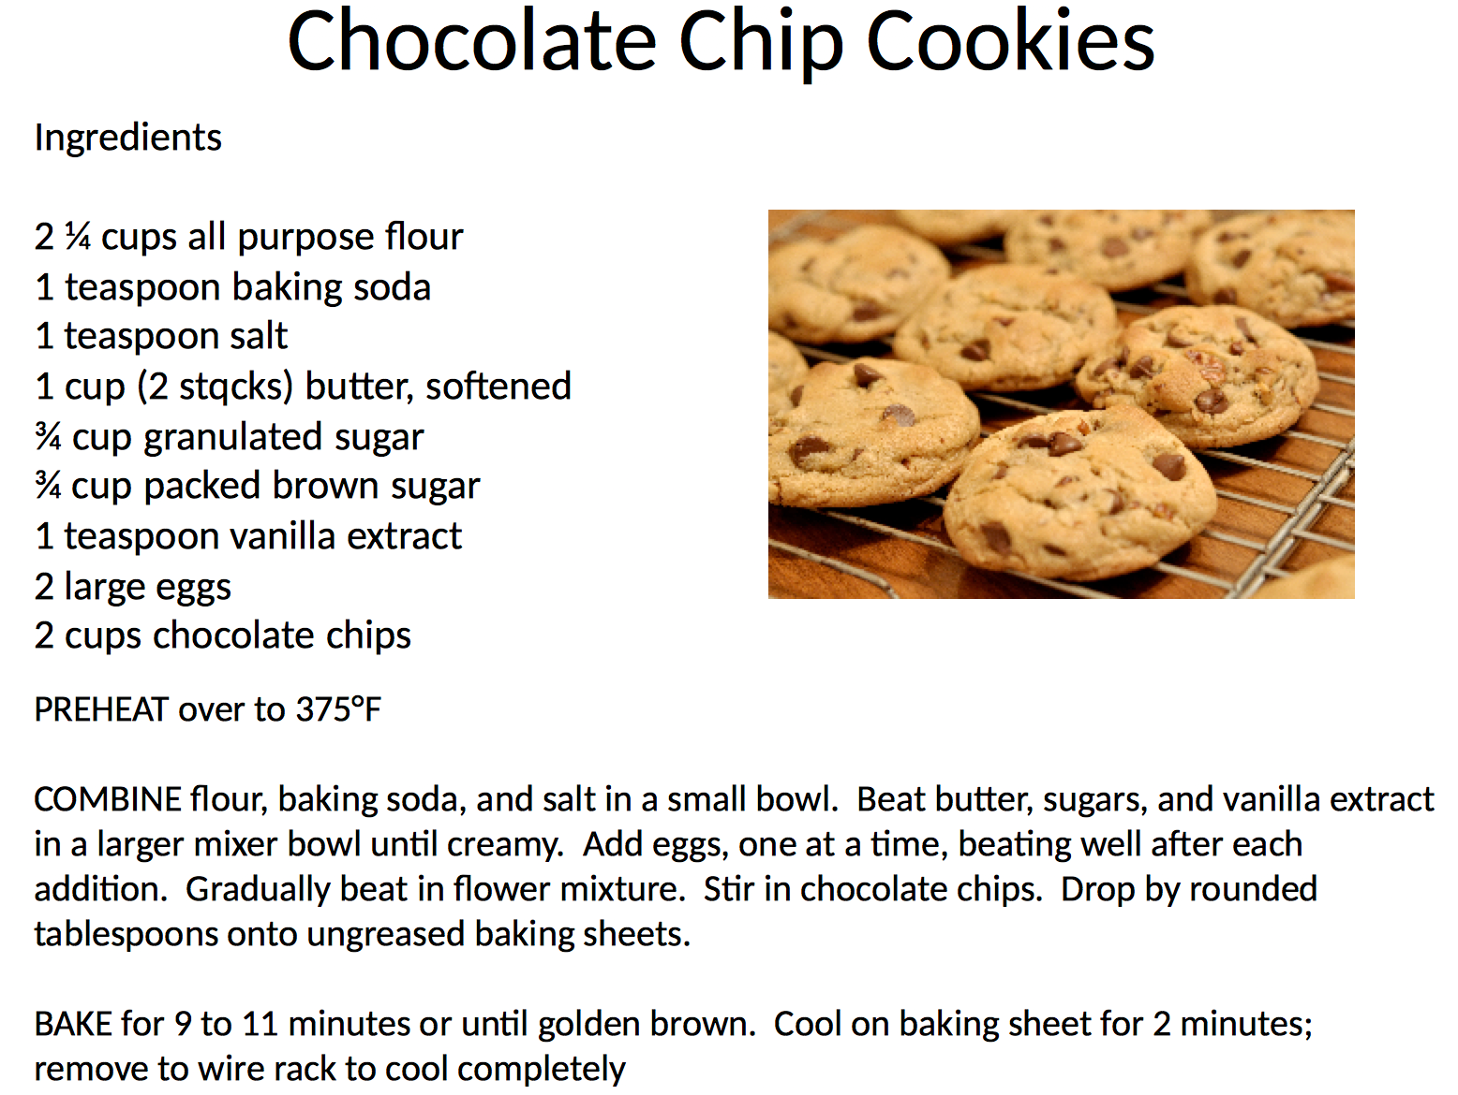

Slide 6
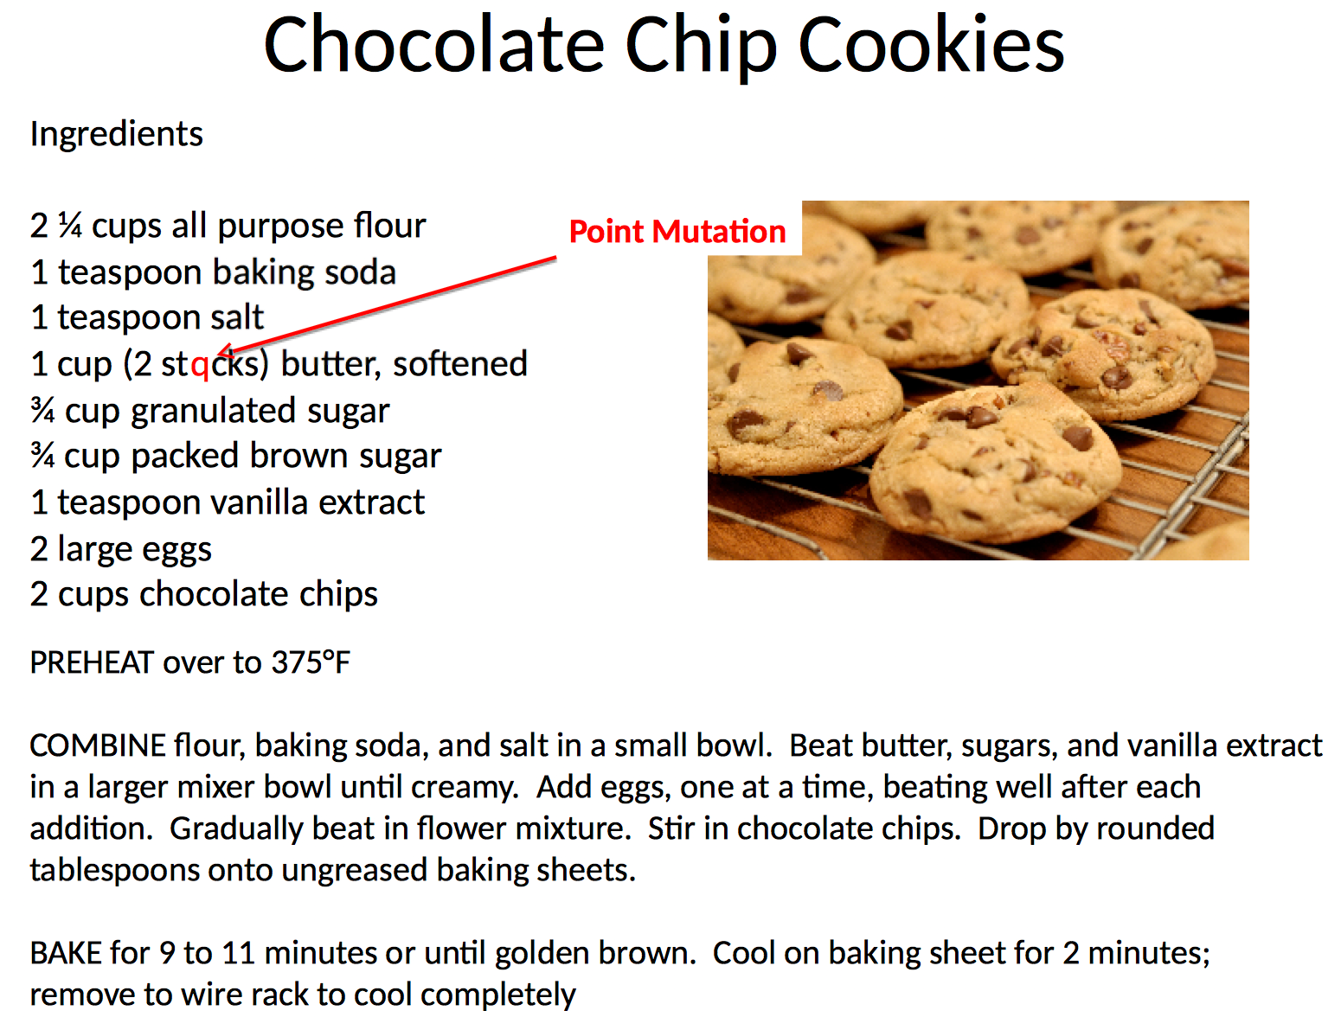

Slide 7


Slide 8
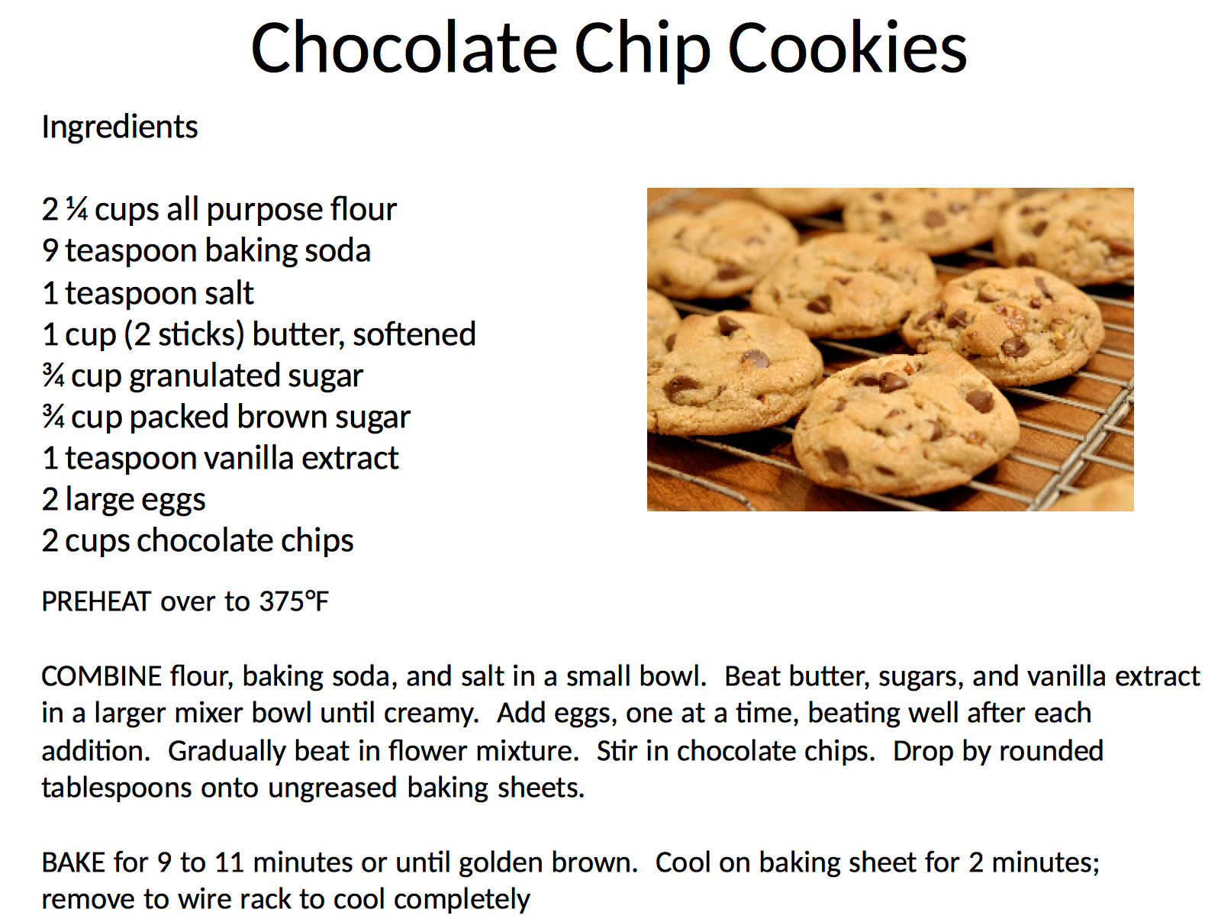

Slide 9


Slide 10


Slide 11
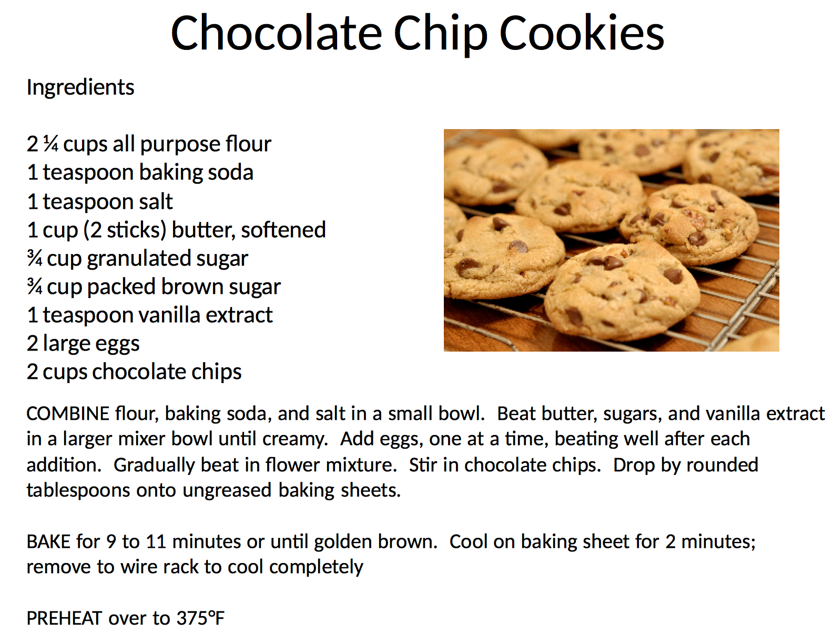

Slide 12
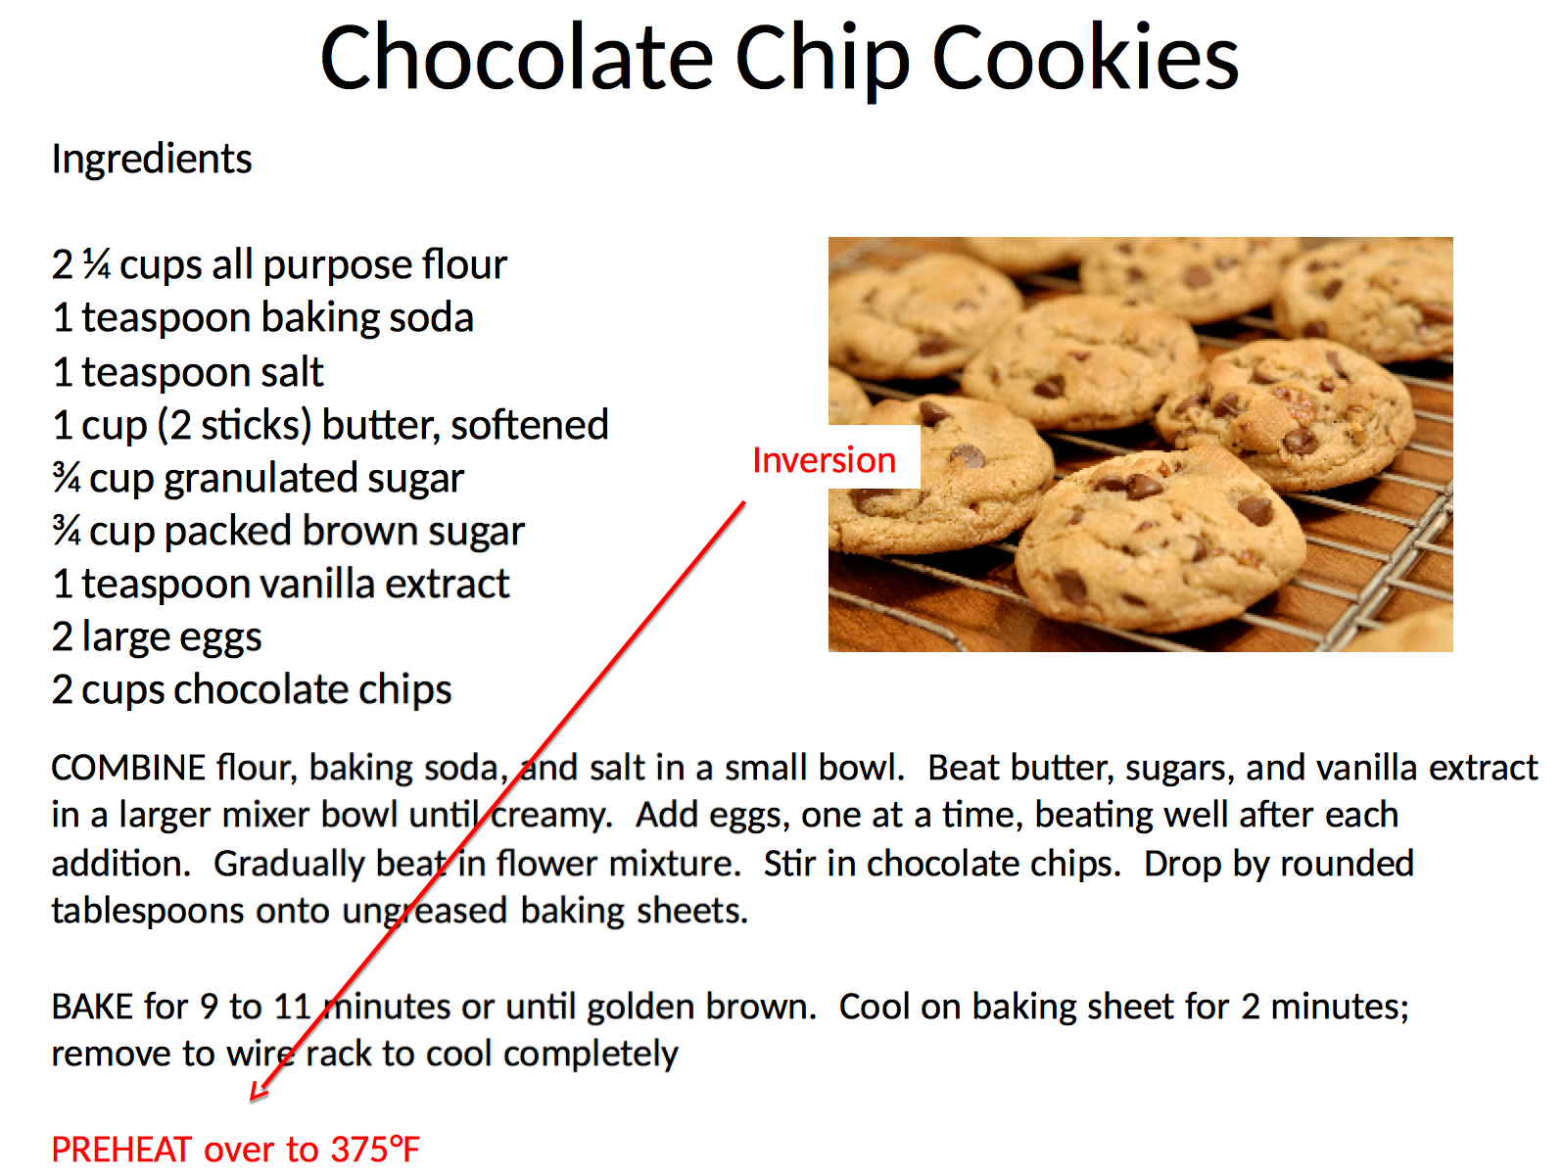

Slide 13


Slide 14


Slide 15


Slide 16
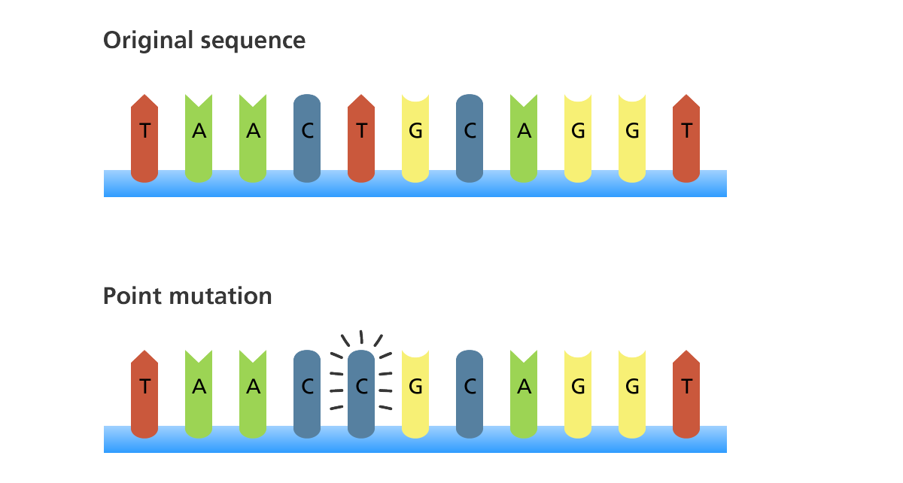
Mutation – Point Mutation
A point mutation is a mutation that exchanges one base for another

Slide 17
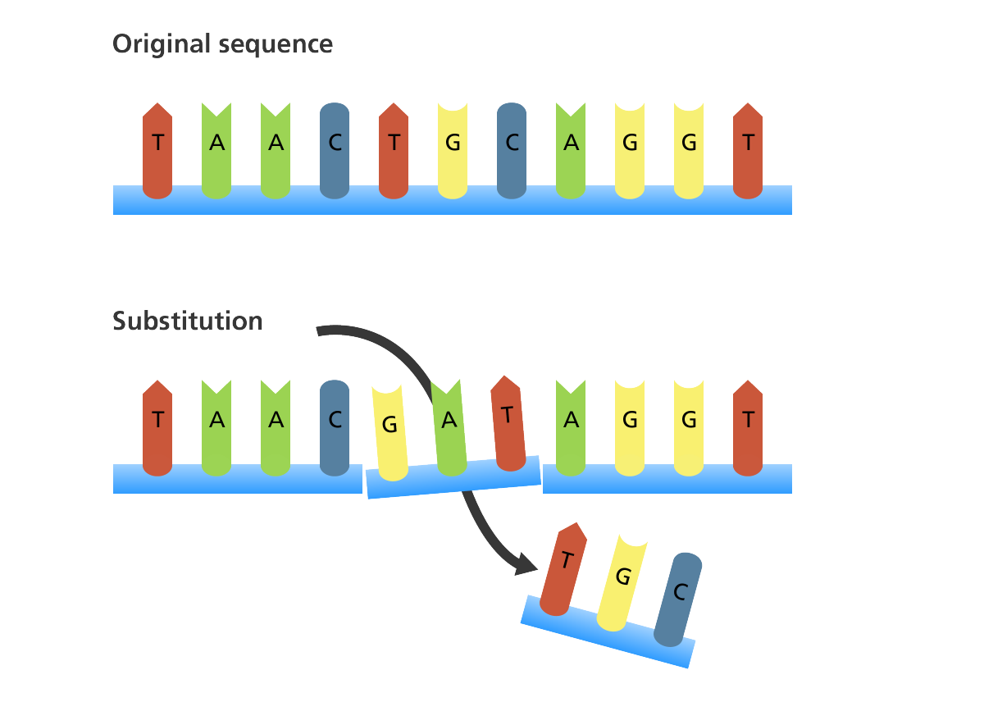
Mutation - Substitution
A substitution is a mutation where one or more bases in the sequence is replaced by the same number of bases

Slide 18
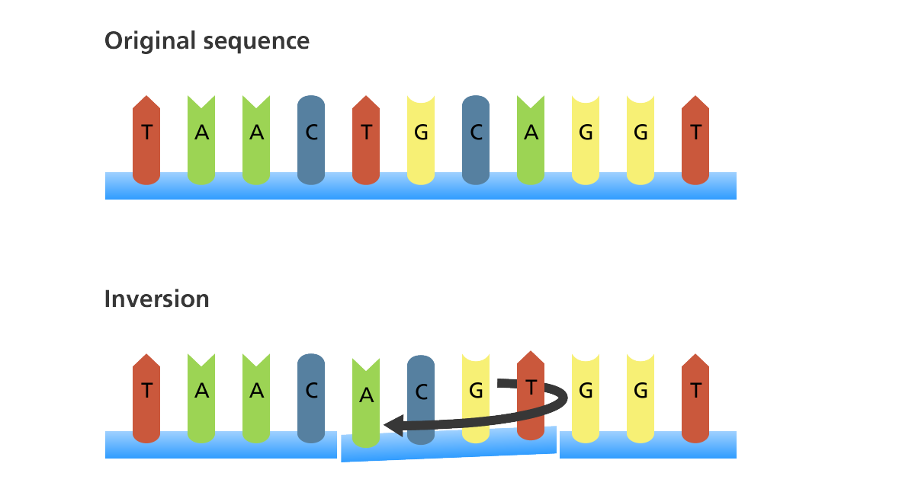
Mutation - Inversion
An inversion is a mutation where a segment of DNA is reversed

Slide 19
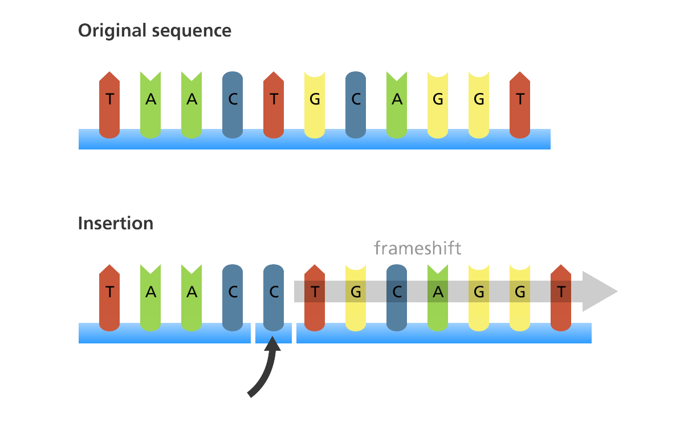
Mutation - Insertion
An insertion is a mutation in which one or more nucleotides are added into the DNA

Slide 20
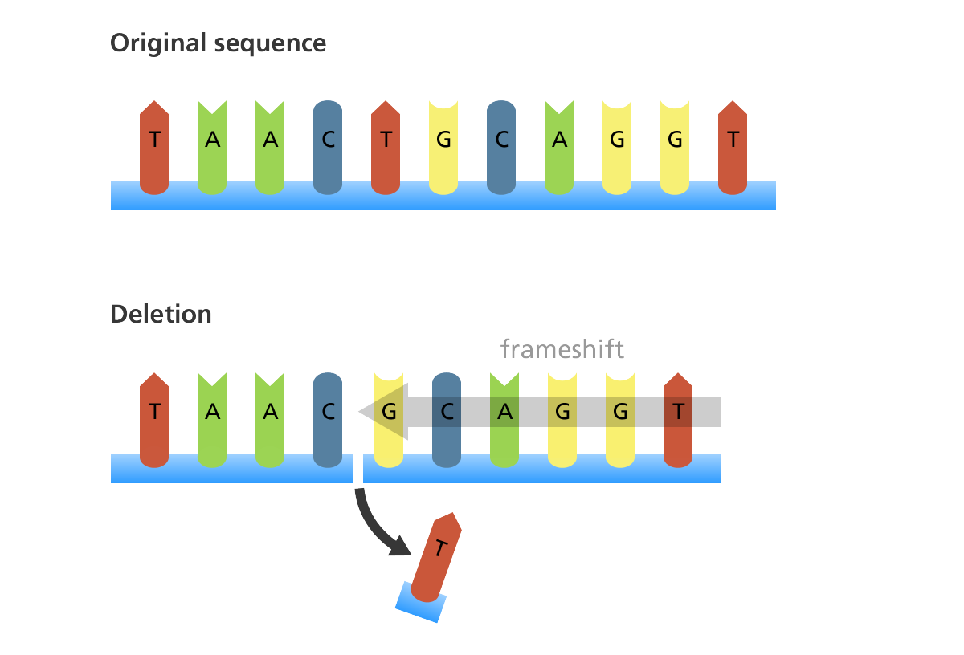
Mutation - Deletion
A deletion is a mutation in which one or more nucleotides are removed from the DNA sequence

Slide 21

Where do mutations come from?
Cell division (meiosis)
Usually okay as long as gene sequence is not interrupted

Slide 22
Where do mutations come from?
Mistakes by the DNA polymerase during replication
  Can be repaired by repair enzymes – not always perfect
A C T G C G T A C
| | | | | | | | |
T G A T G C A T G

Slide 23
Where do mutations come from?
Mistakes by the DNA polymerase during replication
  Can be repaired by repair enzymes – not always perfect
A C T G C G T A C
| | | | | | | | |
T G A T G C A T G

Slide 24
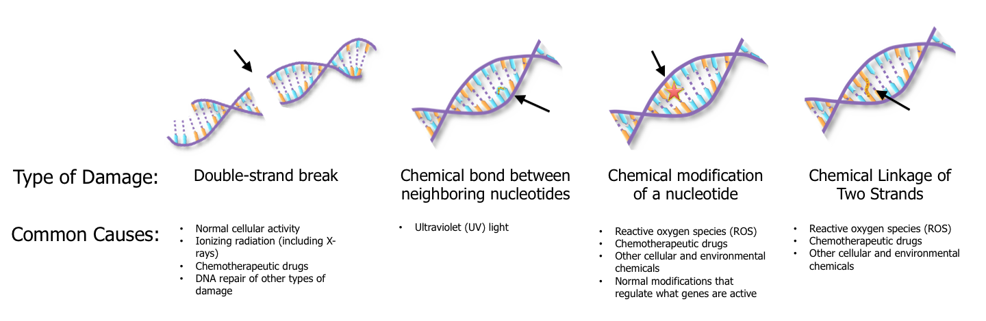
Where do mutations come from?
DNA damage and imperfect repair
  Cell can still divide but DNA sequence has changed

Slide 25
Where do mutations come from?
DNA damage and imperfect repair
  Cell can still divide but DNA sequence has changed

Slide 26
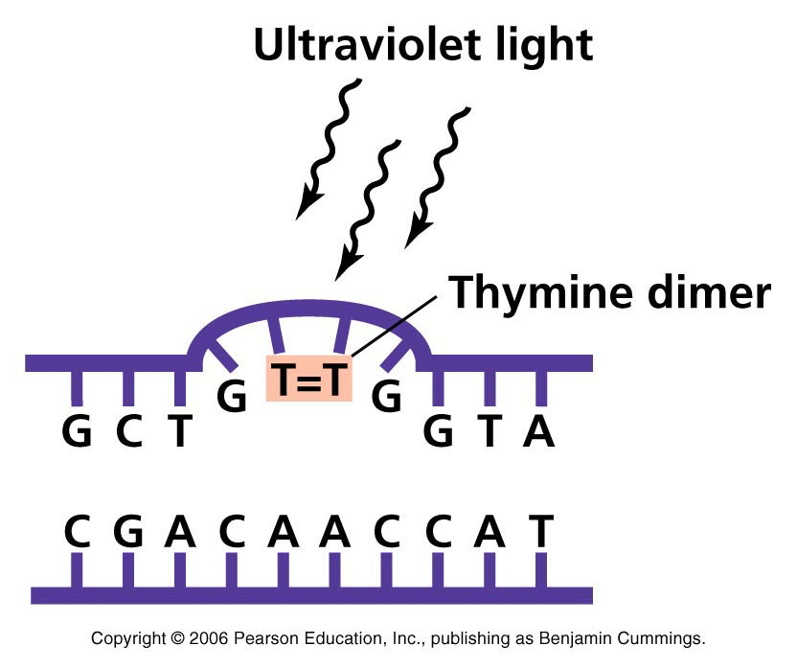
Where Do Mutations Come From?
UV light causes bond to form between adjacent Ts
If left unrepaired, polymerase “guesses”
  25% chance per site
  cell can still divide
  hopefully not in a gene
Chance of mistakes during repair process
  polymerase isn’t perfect
  cell can still divide
  hopefully not in a gene

Slide 27
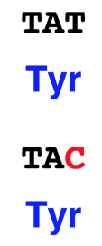
Consequences of Mutation?
Sometimes nothing
  “Silent mutations”
  Mutation does not occur in a gene
    Humans, just 1.5% of the genome
  Silent change
    occurs in gene, but does not change message
    genetic code is redundant

Slide 28
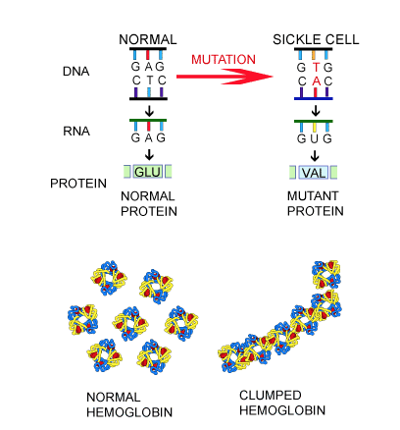
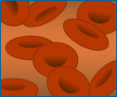

Consequences of Mutation?
HBB gene - Sickle cell anemia – missense mutation
Normal RBC
Sickle RBC
Sickled RBCs are abnormally shaped and ridgid
Sickle shape can interrupt blood flow

Slide 29
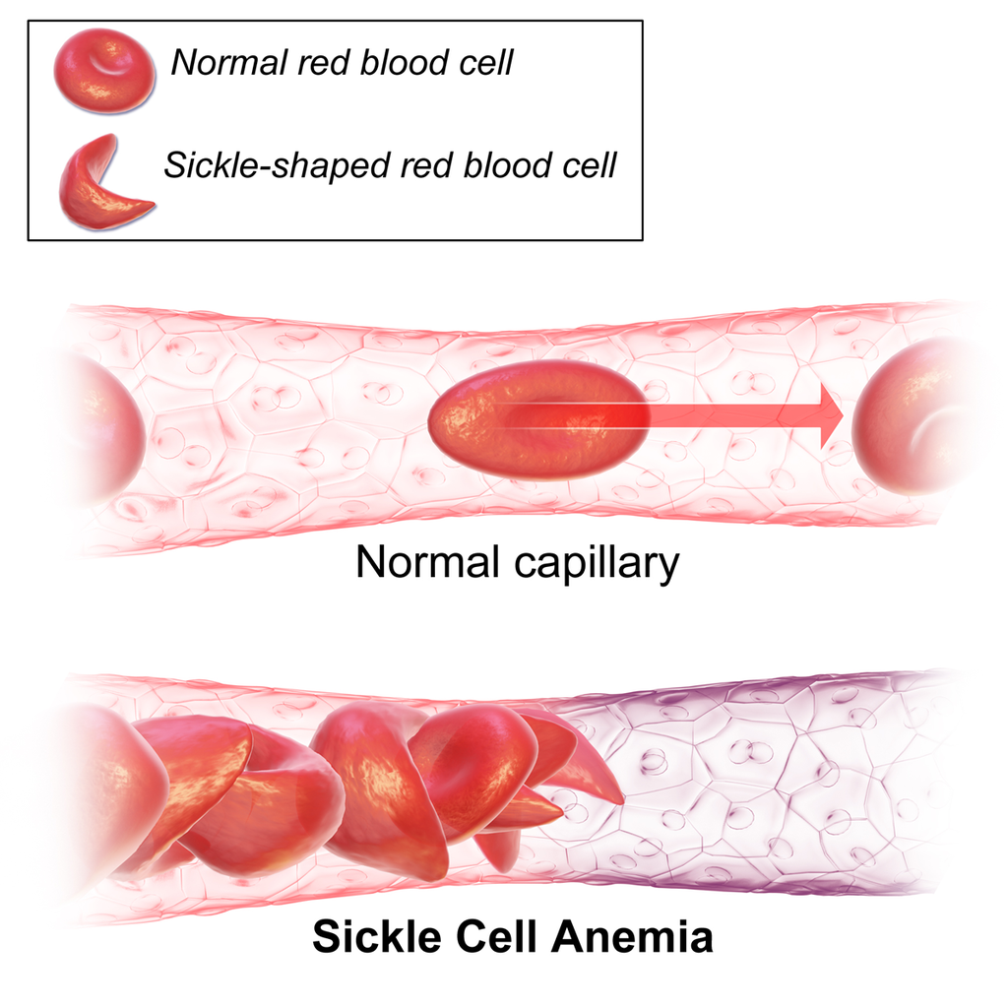
Consequences of Mutation?
HBB gene - Sickle cell anemia – missense mutation

Slide 30
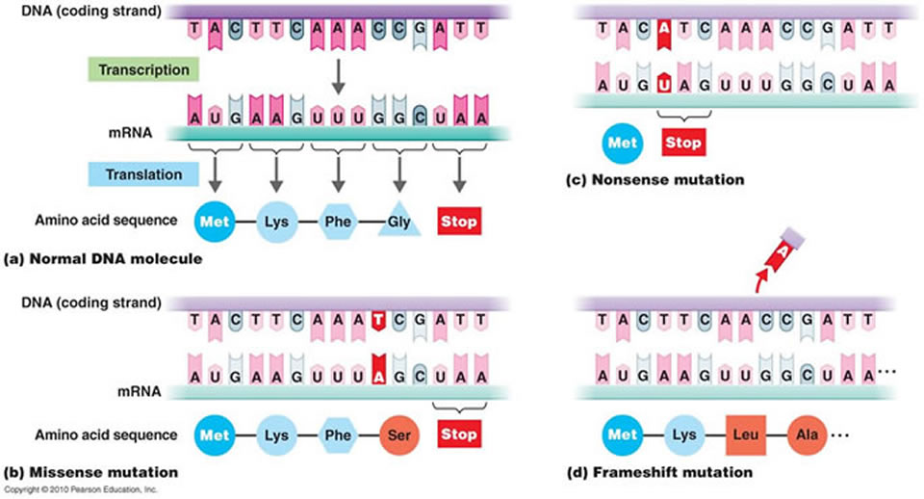
Frame shift mutation
Caused by an Insertion or a Deletion
Changes codons and corresponding amino acids after mutation site

Slide 31
Header
This
This

Slide 32
Header
This
This

Slide 33

Supporting Videos
The DNA Double Helix (17 mins)
http://media.hhmi.org/biointeractive/films/Double_Helix.html
The Chemical Structure of DNA (3 mins)
http://www.hhmi.org/biointeractive/chemical-structure-dna

Slide 34

Python Programming
Functions
Syntax
General coding
Follow along in
class and save
your notes in
a text file!!
  Follow along and Save your notes in a text file.

Slide 35

Consider This...
This
This

Slide 36
Header
This
This

