Slide 1
Bioinformatics
CS300
Chapter 1:
Using Bioinformatics to
study genetic disorders
Fall 2019
Oliver BONHAM-CARTER

Slide 2

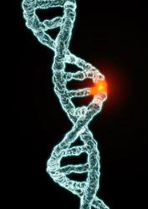
Genetic Disorder
A disorder/disease with a genetic component
Single gene disorders
Mutation(s) in the sequence of a single gene
Alters or eliminates protein product
Caused by one or more abnormalities in the genome
  substitutions
  insertions
  deletions
  rearrangements

Slide 3
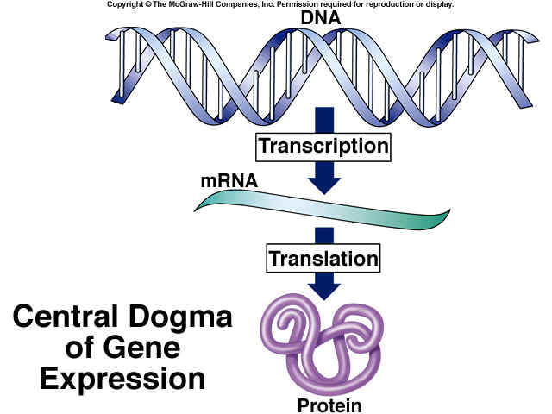
Mutations and Their
Potential Effects
NonSense Mutation: a mutation in which a sense codon that corresponds to one of the twenty amino acids specified by the genetic code is changed to a chain-terminating codon.
Mutation is
Here at DNA
Mutation is
noted here
at protein

Slide 4
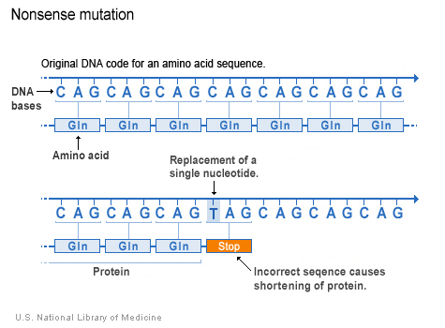
Mutations and Their
Potential Effects
Missense substitutions
Nonsense substitutions
Insertions/Deletions
Mutations that Alter Protein Products and
Mutations that Eliminate Protein Products
Mutations that Eliminate Protein Products
Missense substitutions
Nonsense substitutions
Insertions/Deletions

Slide 5


BioPython
Programming
# install biopython
python3 -m pip install biopython # global install
python3 -m pip install biopython –user # local install
  Follow along and Save your notes in a text file.
import Bio # from python3 shell
print(Bio.__version__) # 1.74
General Website:
https://biopython.org/
Getting Started:
https://biopython.org/wiki/Getting_Started

Slide 6

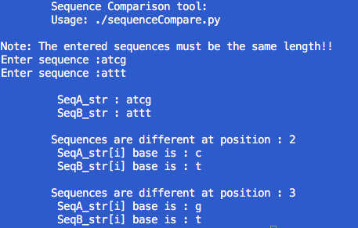

Two Cool Programs To Write!!
sequenceCompare.py
Compare sequences to
find their differences!
Derive protein
sequences
from DNA code!
smallTranslator.py

Slide 7

Where Do Some of These
Mutations Come From?

Slide 8
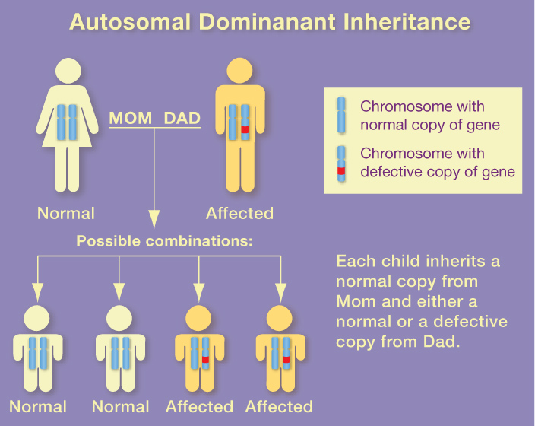

Slide 9
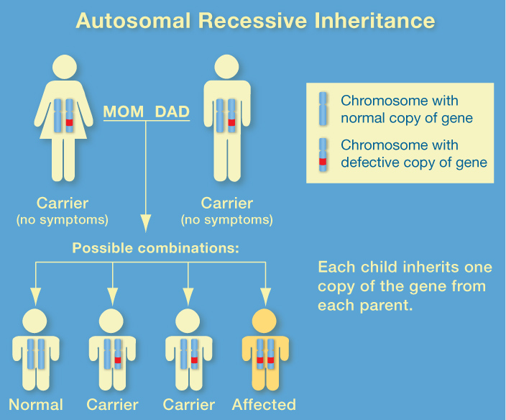

Slide 10
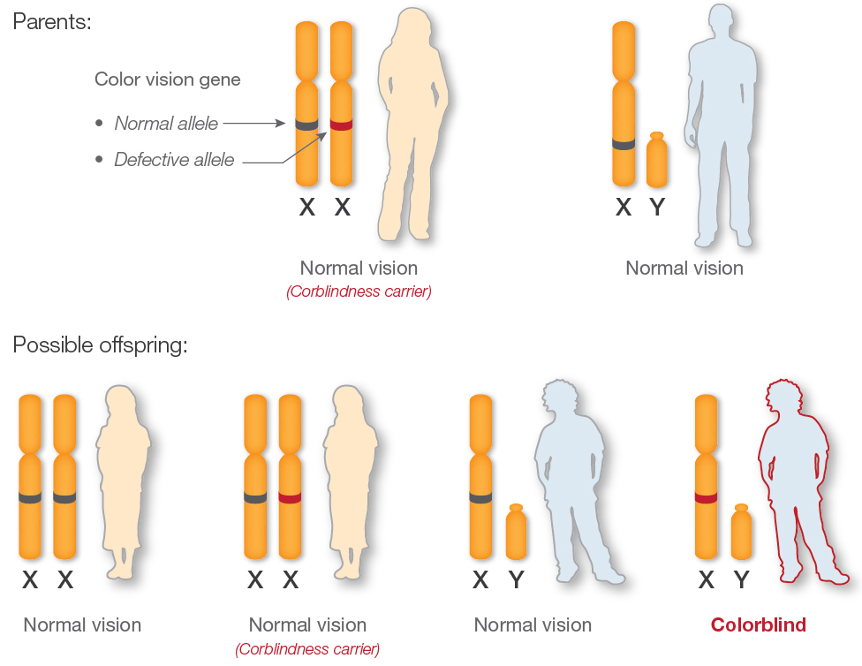
X-Linked Inharitance

Slide 11
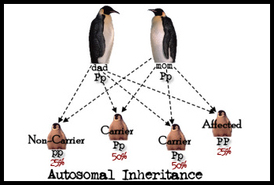
Single Gene Disorders
Inheritance patterns are relatively simple
Chances of inheritance in the text generation can be predicted by studying patterns in past generations.

Slide 12
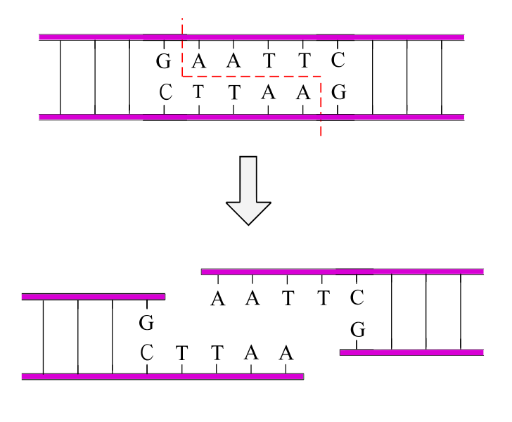
Single Gene Disorders
Most genes identified in the 1980s-1990s
  Pre-Bioinformatics: biological wet-lab work
Restriction enzymes to cut sequences
Cut DNA at specific sequence
  100s of different patterns
  Disorder-breading sequences could be studied

Slide 13
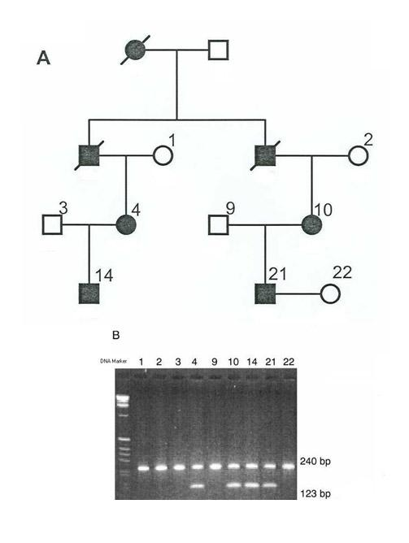
Single Gene Disorders
Pedigree analysis + Restriction Digest Analysis
Double bands indicate a carrier of a gene allele

Slide 14
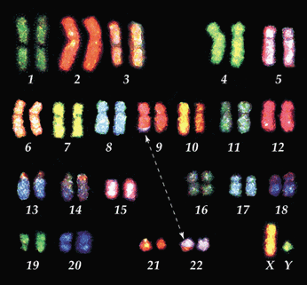
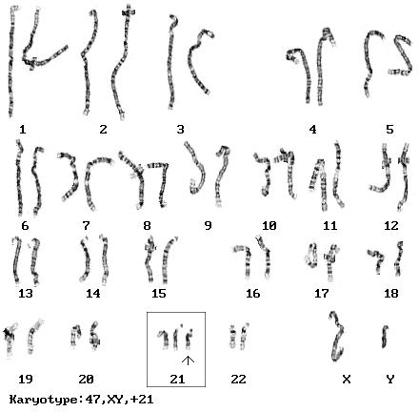
Cytogenetics
The field of biology concerned with mapping genes to specific locations on chromosomes

Slide 15
Genetic Disorder
A disease with a genetic component
Caused by one or more abnormalities in the genome
Complex or multifactorial disorders
  Do not have a single genetic cause
  Likely associated with the effects of multiple genes in combination with lifestyle and environmental factors
  Do not have a clear cut pattern of inheritance

Slide 16
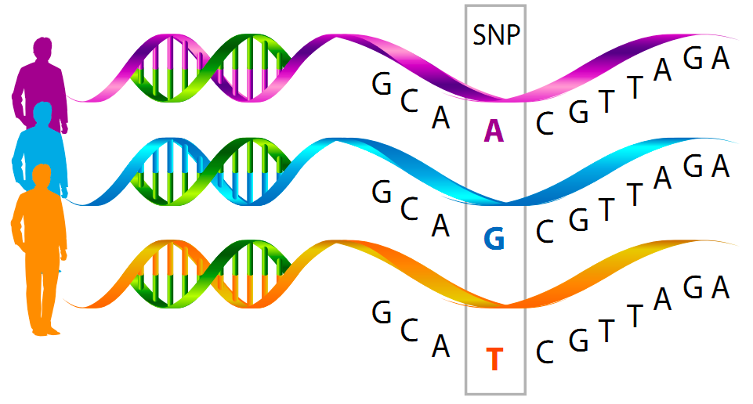
Genome-Wide Association Studies
new technology/analysis - early 2000s
  bioinformatics
screen 1000s of genomes at once for SNPs
  single nucleotide polymorphisms
  Some SNPs may indicate disorders

Slide 17
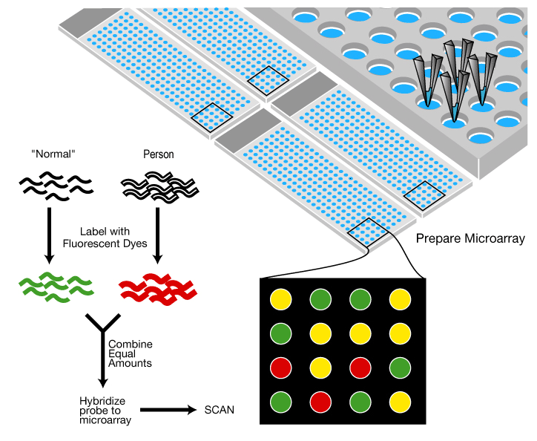
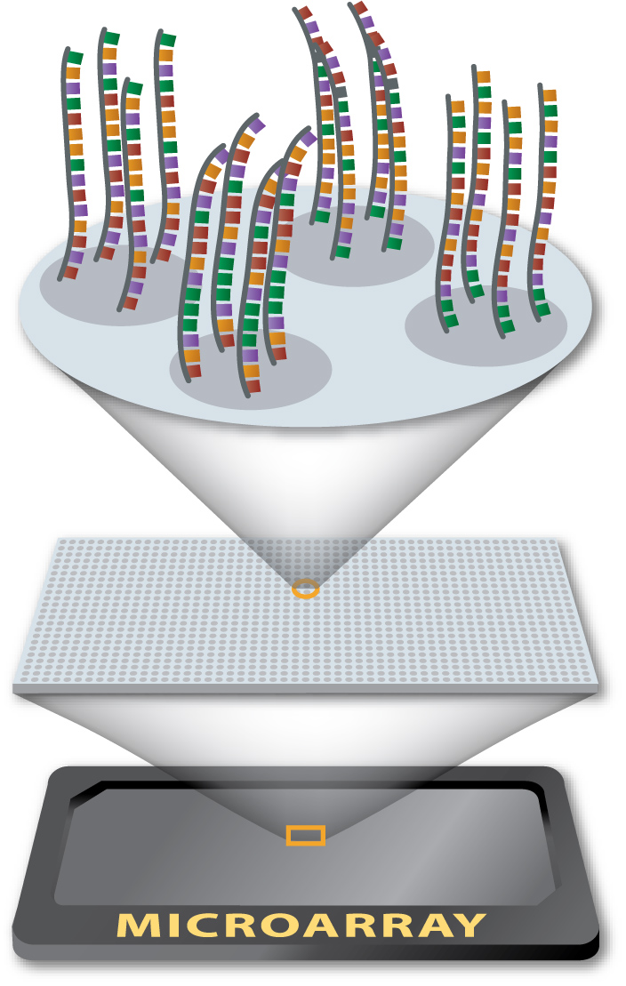
DNA Microarray
“Disease”
Testing for genes of a specific allele

Slide 18
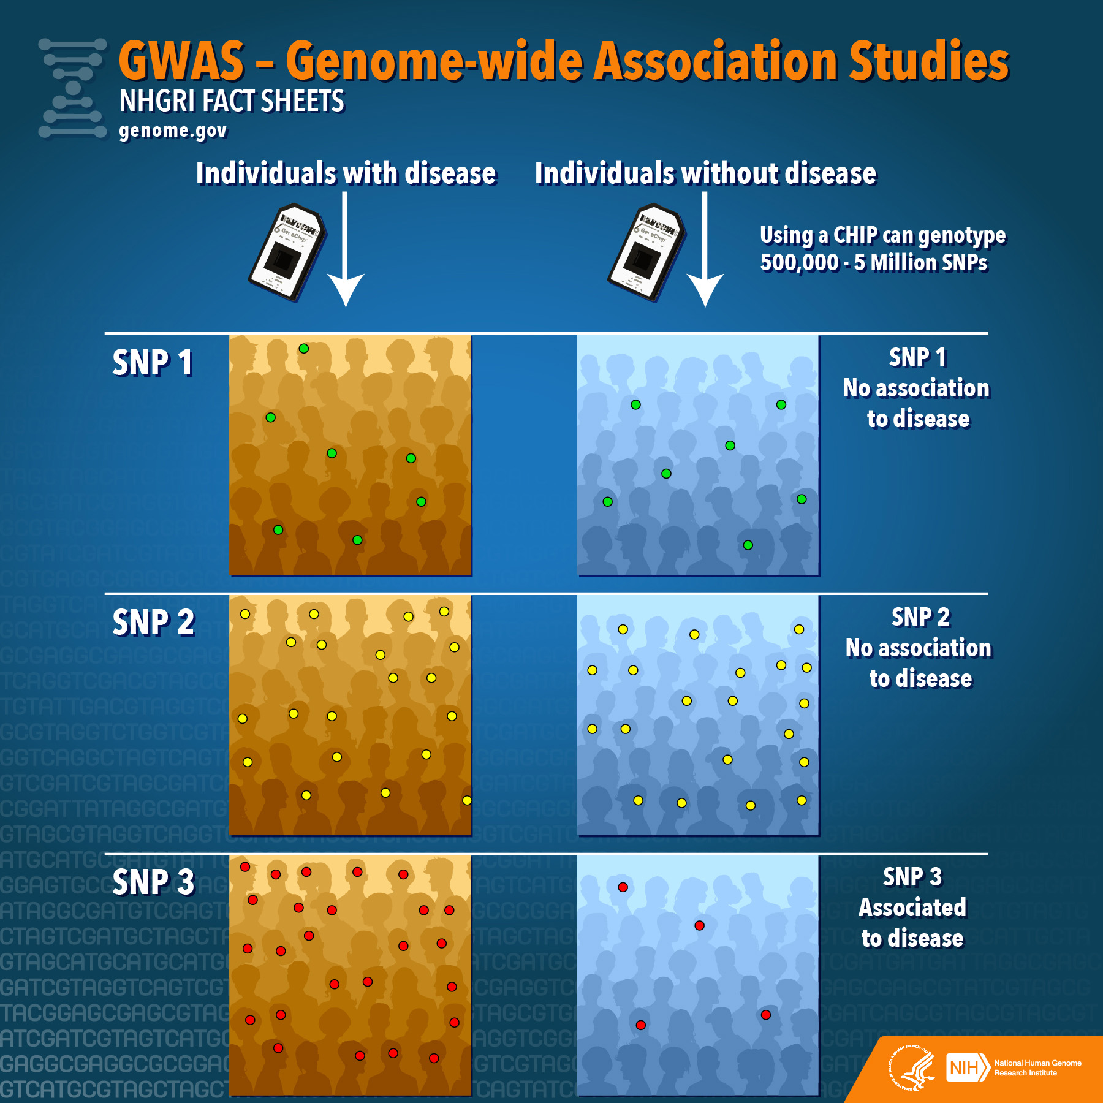

Slide 19
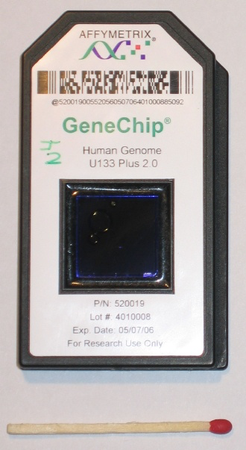
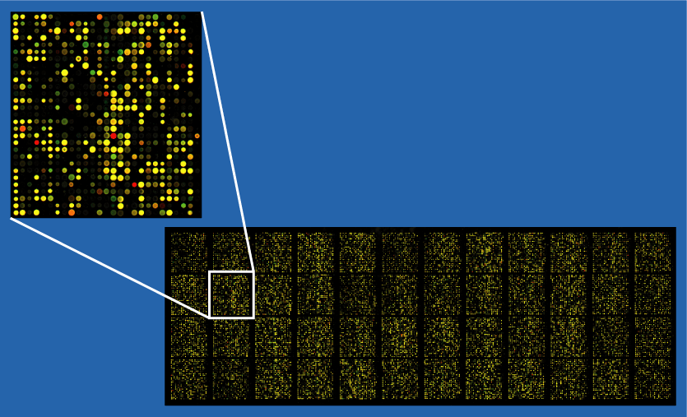
DNA Microarray

Slide 20
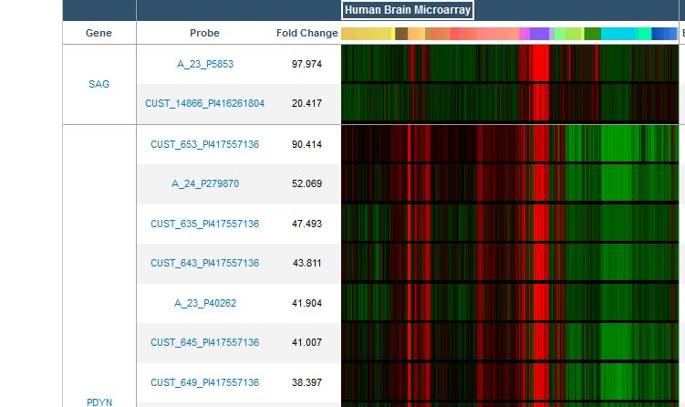
DNA Microarray

Slide 21
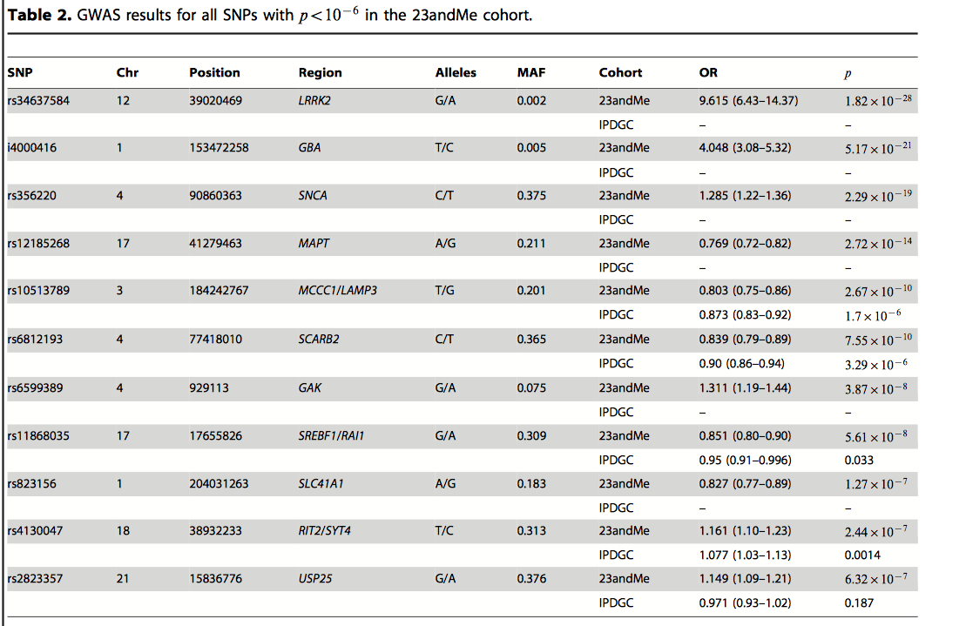
Candidate SNPs that May Be Correlated with Disorders Using Genome-Wide Association Studies (GWAS)

Slide 22


Data for Research
Typically Protein: Uniprot
  http://www.uniprot.org/
Search: Pink1 (protein)
Typically DNA and Genes: National Center for Biotechnology Informatics (NCBI)
  https://www.ncbi.nlm.nih.gov/
Search: “orchid” in Nucleotide database
  (https://www.ncbi.nlm.nih.gov/nuccore/NC_030915.1)

Slide 23

Python Programming
Loading, Writing files
Biopython
Fasta files
Follow along in
class and save
your notes in
a text file!!
  Follow along and Save your notes in a text file.

Slide 24
Header
This
This

