Slide 1
Bioinformatics
CS300
Chap 2
Computational Manipulation of DNA
Fall 2019
Oliver BONHAM-CARTER

Slide 2

Genes and Alleles
Gene: A distinct sequence of nucleotides forming a piece of a chromosome. In biology, a gene is a sequence of nucleotides in DNA or RNA that codes for a molecule (a protein) that has a function. During gene expression, the DNA is first copied into RNA which is then transcribed into protein.
Allele: One of two or more alternative forms of a gene that arise by mutation and are found at the same place on a chromosome.

Slide 3
Patterns of Inheritance by Alleles
Chromosome
1
Chromosome
2
Allele
1
A
a
Allele
2
A
A
A
a
a
A
a
a

Slide 4
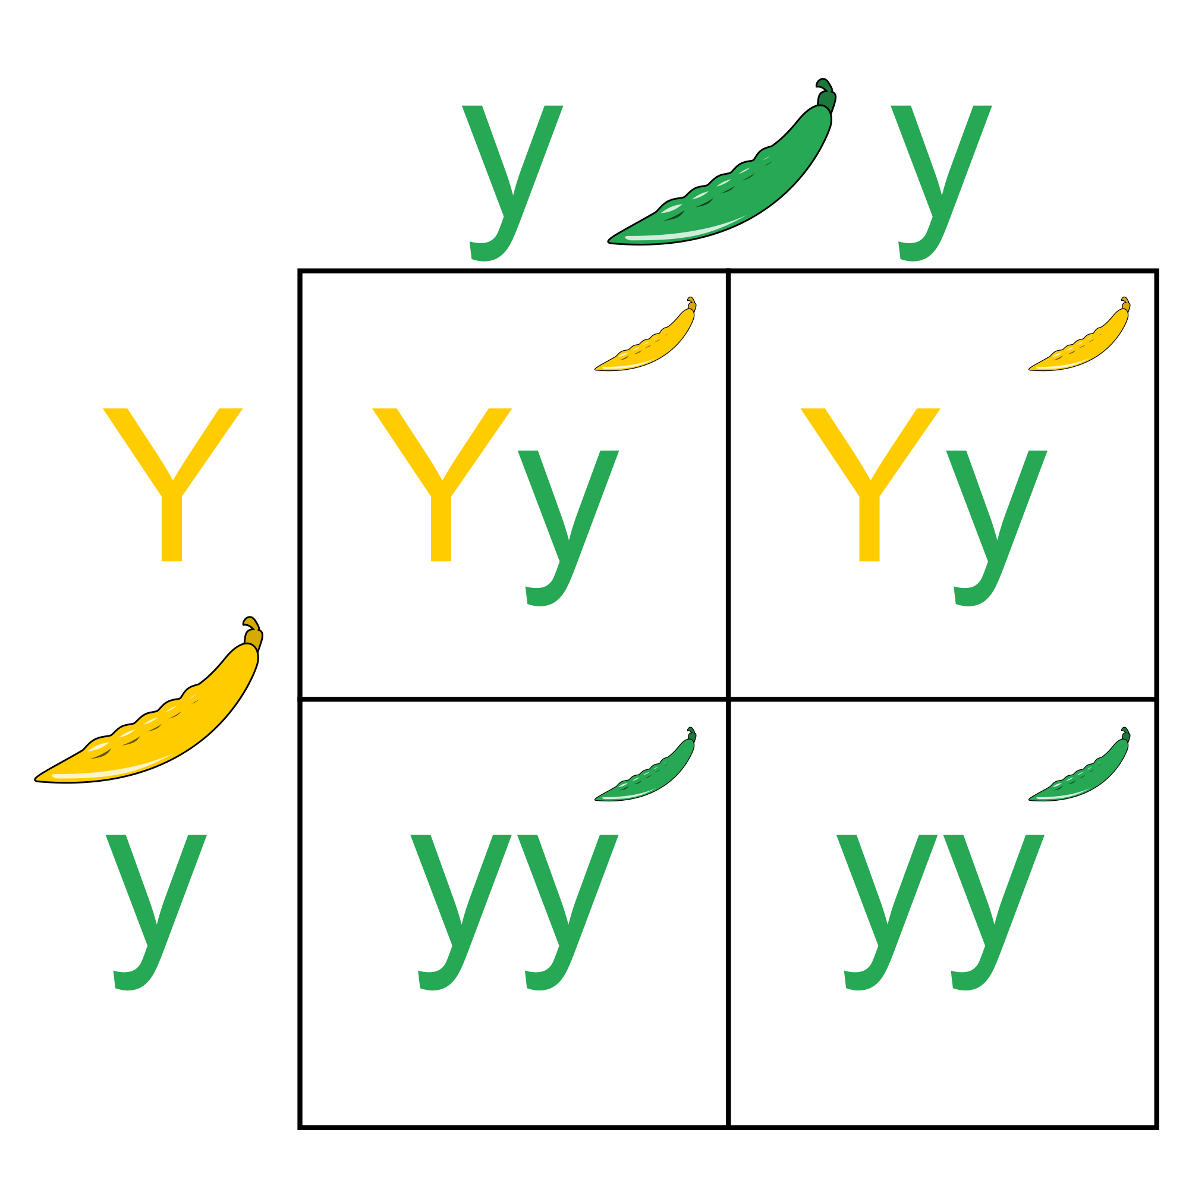
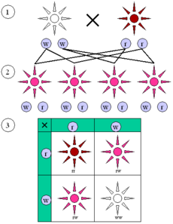
Understanding Alleles
What is the difference between a gene and an allele?
Answer: In the context of cystic fibrosis and the CFTR gene
Mendelian Genetics studies the alleles

Slide 5
The Cystic Fibrosis Gene
Cystic Fibrosis Transmembrane conductance: CFTR
Gene product is a bad regulator which fails to move water after displacing chloride ions in epithelial (thin tissue) cells
Water follows chloride ions by osmosis.
What if water regulation were not possible in the cells and organs?

Slide 6
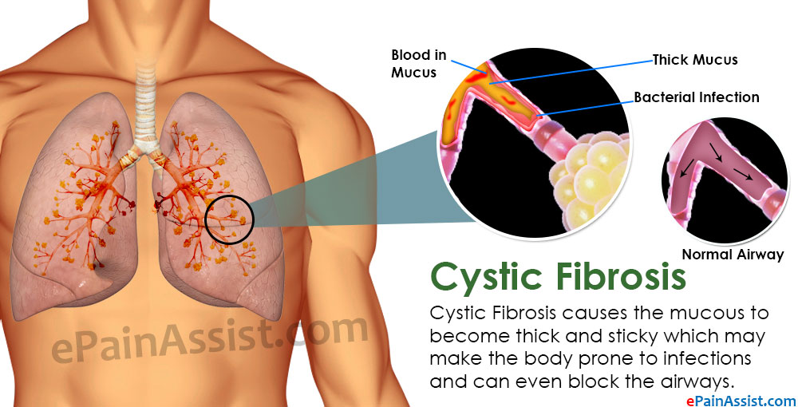
Cystic Fibrosis
Inherited medical condition of the secretory glands (producers of mucous and sweat)

Slide 7
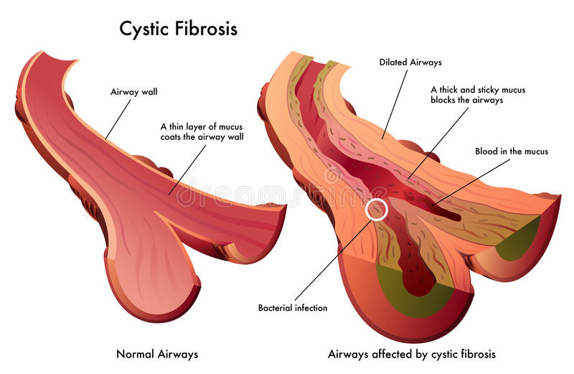
Cystic Fibrosis: Symptoms
Restricted flow in airways from mucous build-ups.
Suffocation

Slide 8
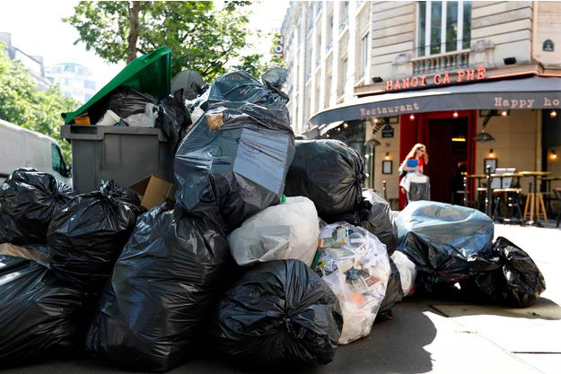
A Build-Up of Anything is Bad
What if the the garbage collection crews in Paris went on strike (as they did in 2016)?

Slide 9
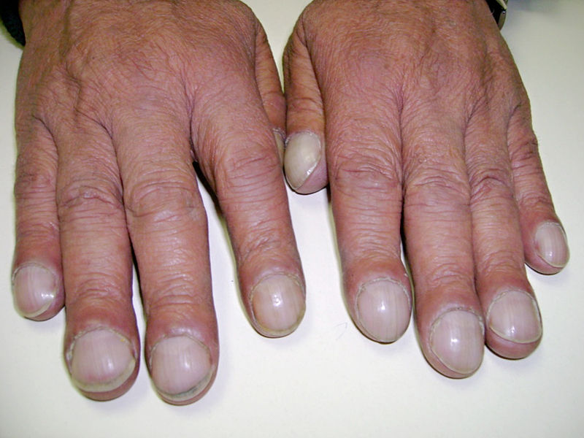
Cystic Fibrosis: Symptoms
Clubbed fingers: occurs in heart and lung diseases that reduce the amount of oxygen in the blood

Slide 10
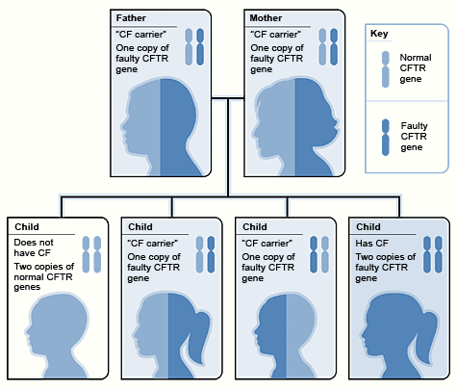
Cystic Fibrosis: Inheritance
Autosomal recessive type condition: one faulty gene is inherited from both parents (together) in order for the offspring to get this condition
Modeled via Mendelian Genetics
Impossible to know that someone is sure to get a condition.

Slide 11
The Cystic Fibrosis Gene
Cystic Fibrosis Transmembrane conductance: CFTR
Gene product is a bad regulator which fails to move water after displacing chloride ions in epithelial (thin tissue) cells
Water follows chloride ions by osmosis.
What happens if water regulation is impossible in the cells and organs?

Slide 12
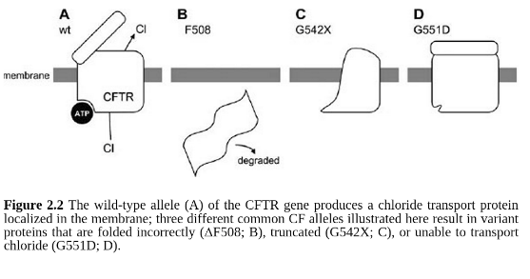

Three Bad Proteins From the Four
Short video of membrane transport proteins https://www.youtube.com/watch?v=EuLVCYrurok

Slide 13
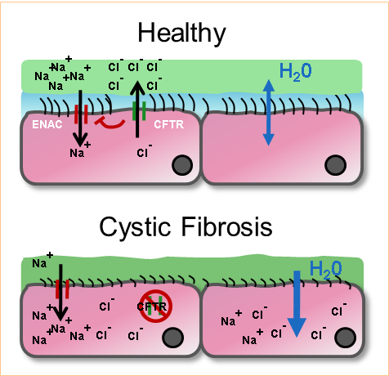
The Cystic Fibrosis Gene
Gene codes for four different proteins: only one working type to move chloride ions and enable water displacement.
Mucous build-up

Slide 14
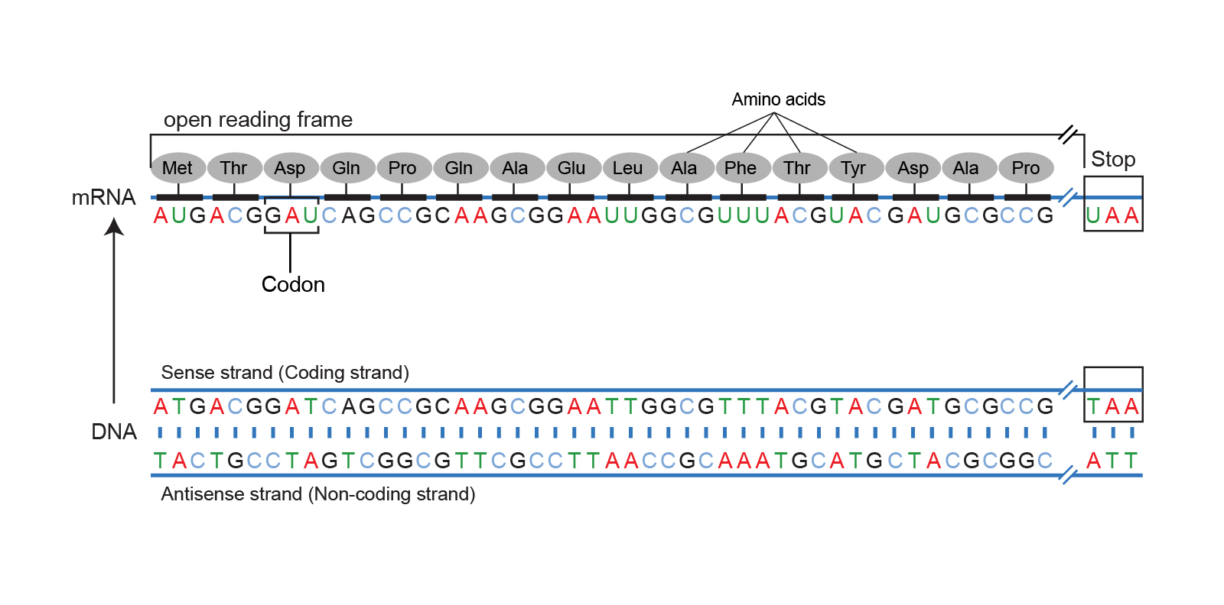
Open Reading Frames
An open reading frame (ORF) is the part of a reading frame that has the ability to be translated into protein.
An ORF is a continuous stretch of codons that begins with a start codon (usually AUG) and ends at a stop codon (usually UAA, UAG or UGA).
Cite: https://www.genome.gov/genetics-glossary/Open-Reading-Frame

Slide 15
Open Reading Frames:
Simple Example
Pam Can See The Man and Dog
Frame shift by one letter!
P amC anS eeT heM ana ndD og
Frame shift by two letters!
Pa mCa nSe eTh eMa nan dDo g
Frame shift by three letters
Pam Can See The Man and Dog
Reading by triplets
Notice how the code changes depending
on where you start reading? (That is a frameshift.)

Slide 16
Open Reading Frames:
DNA Example
Note: RF means reading frame, where you start reading the words.
Original: CAATGGCGAATCGACGTGTATAAA
RF1 - 5’ - CAA TGG CGA ATC GAC GTG TAT AAA – 3’
RF2 - 5’ - C AAT GGC GAA TCG ACG TGT ATA AA – 3’
RF 3 - 5’ - CA ATG GCG AAT CGA CGT GTA TAA A – 3’
3’ - CAA TGG CGA ATC GAC GTG TAT AAA - 5’ – RF 4
3’ - C AAT GGC GAA TCG ACG TGT ATA AA - 5’ – RF 5
3’ - CA ATG GCG AAT CGA CGT GTA TAA A - 5’ – RF 6

Slide 17
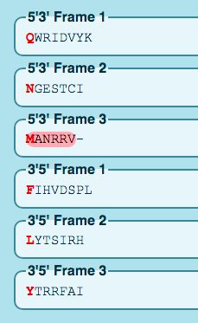

Open Reading Frames:
Online
#!/usr/bin/env python3
from Bio.Seq import Seq
#dna_str = "ATGATAGCCCGG"
dna_str = "CAATGGCGAATCGACGTGTATAAA"
sequence = Seq(dna_str)
RNAfromDNA_str = Seq.transcribe(sequence) # convert to RNA
DNAfromRNA_str = Seq.back_transcribe(sequence) # convert the RNA back to DNA
PROTfromRNA_str = Seq.translate(RNAfromDNA_str)
print(" Original seqDNA :",dna_str,"Length :",len(dna_str))
print(" DNA to RNA :",RNAfromDNA_str)
print(" RNA to DNA :",DNAfromRNA_str)
print(" PROT from RNA :",PROTfromRNA_str)
Original: CAATGGCGAATCGACGTGTATAAA
Translate is a tool which allows the translation of a nucleotide (DNA/RNA) sequence to a protein sequence.
  https://web.expasy.org/translate/
Biopython:: SmallTranslator_i.py

Slide 18
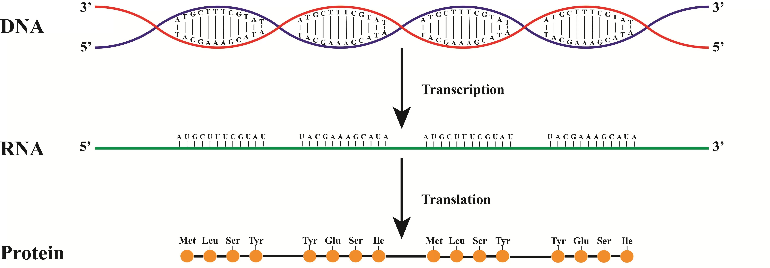
Sequence is Carrier?
How do we determine if a sequence carries the Cystic Fibrosis allele?
Get DNA sample and translate into protein. Then compare product protein sequence to that of a “working protein”
Is there a difference between the protein sequences?
?
?
?

Slide 19

Remember the Codon Table?
DNA triplets read in groups of three called codons, code amino acids
T’s from DNA are read as U’s as RNA after transcription

Slide 20
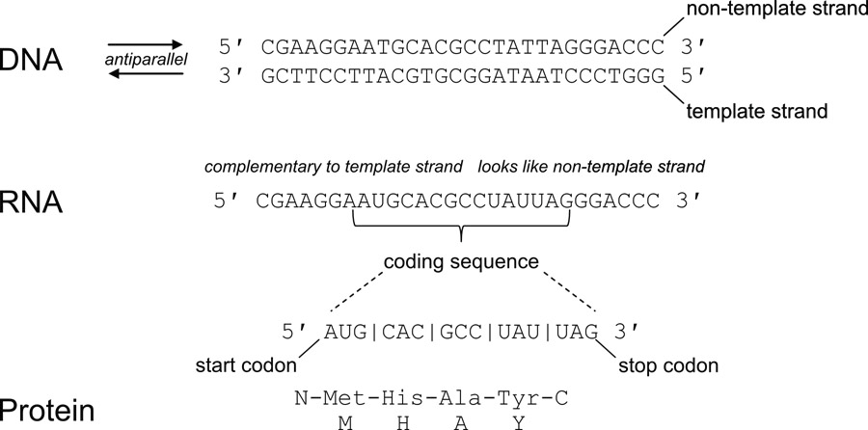
Summary:
The Steps to Study Protein
Translating DNA to find defects in the protein

Slide 21
Remember: DNA Must Be In 3’ to 5’
Direction To Find The Sequence
Unlabeled strands of DNA are assumed to be in the 5’ to 3’, (left to right) direction.
A new sequence is given to us for analysis.
What are the steps to place this sequence into a format for use with bioinformatics tools?
In 5’ to 3’?
DNA sequence
Place into 5’ to 3’
Do nothing
Translate and
study protein

Slide 22
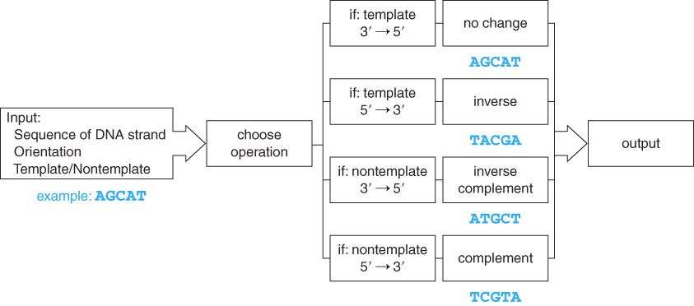
DNA Manipulation Algorithm
A series of steps when handling DNA
Output DNA in 3’ to 5’

Slide 23
The DNA Manipulation Algorithm
Input a DNA sequence, including details of being a template or non-template strand as well as its orientation
Convert to all uppercase
Choose the appropriate operation:
  If seq is the template strand and oriented 3’ -> 5’, simply output the same sequence
  If seq is the template strand and oriented 5’ -> 3’, inverse the sequence (traverse the string from right to left and add each character to output the string)
  If it is the non-template strand and oriented 3’ -> 5’, generate the inverse complement sequence ((i.) traverse the string from right to left and (ii) for each character, add the complement to the output string)
  If it is the non-template strand and oriented 5’ -> 3’, generate the complement ((i.) traverse the string from left to right and (ii) for each character add the complement to the output string)
Output the completed sequence, including 5’ and 3’ end labels

Slide 24
Transcription Algorithm
Input: template strand in the 3’ → 5’ orientation
Output: mRNA strand in the 5’ → 3’ orientation
  Traverse the string from left to right
    add complementary base to the output string
    (note T is now U)
DNA Seq = 3’ - ATGCGT - 5’
mRNA Seq = 5’ - AUGCGC - 3’

Slide 25
Alternative Transcription Algorithm
Input: non-template strand in the 5’ → 3’ orientation
Output: mRNA strand in the 5’ → 3’ orientation
  Traverse the string from left to right
    Replace all the T’s with U’s
DNA Seq = 5’ - ATGCGT - 3’
mRNA Seq = 5’ - AUGCGC - 3’

Slide 26
Translation Algorithm
Input: mRNA strand in the 5’ → 3’ orientation
Output: amino acid sequence
  Traverse the string looking at one codon at a time
  Add one amino acid corresponding to the protein sequence.
WAIT! Why is the 5’ to 3’
direction so important?!
Remember the carbon atoms on DNA?

Slide 27
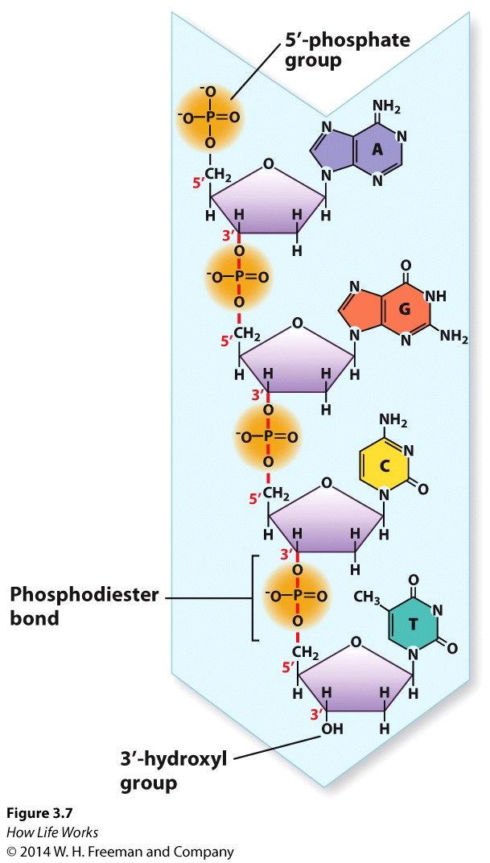
Review Question 1
In the DNA sequence 5'–AGCT–3', the phosphodiester linkage between the adenine and the guanine connects:
A. The 2' end of the adenine to the 4' end of the guanine.
B. The 5' end of the adenine to the 3' end of the guanine.
C. The 5' end of the guanine to the 1' end of the adenine.
D. The 3' end of the adenine to the 5' end of the guanine.

Slide 28
Review Question 1
In the DNA sequence 5'–AGCT–3', the phosphodiester linkage between the adenine and the guanine connects:
A. The 2' end of the adenine to the 4' end of the guanine.
B. The 5' end of the adenine to the 3' end of the guanine.
C. The 5' end of the guanine to the 1' end of the adenine.
D. The 3' end of the adenine to the 5' end of the guanine.

Slide 29
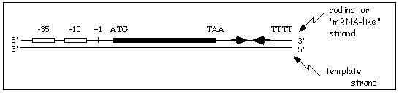
Template vs nonTemplate
Input:
  DNA sequence – AGCAT
  Strand – template (used to make mRNA) or non-template (the compliment of this strand that looks like mRNA)
  Orientation – 3’ -> 5’ or 5’ -> 3’
Output:
  Template strand in 3’ -> 5’ orientation ready for transcription

Slide 30

Python Programming
Biopython
Translation functions
  DNA → RNA
  RNA → DNA
  RNA → Protein
Gives a protein sequence to compare to the wild type protein sequence
Follow along in
class and save
your notes in
a text file!!
  Follow along and Save your notes in a text file.

Slide 31
Header
This
This

Slide 32
Header
This
This

Slide 33
Header
This
This

