Slide 1
Bioinformatics
CS300
Chap 2
Computational Manipulation of DNA
Fall 2019
Oliver BONHAM-CARTER

Slide 2

The Unnamed Sequence
Unlabeled strands of DNA are assumed to be in the 5’ to 3’, (left to right) direction.
A new sequence is given to us for analysis.
What are the steps to place this sequence into a format for use with bioinformatics tools?
In 5’ to 3’?
DNA sequence
Place into 5’ to 3’
Do nothing

Slide 3
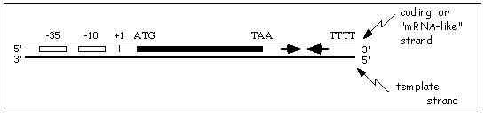
Template vs nonTemplate
Input:
  DNA sequence: AGCAT
  Strand: template (used to make mRNA) or non-template (the compliment of this strand that looks like mRNA)
  Orientation: 3’ -> 5’ or 5’ -> 3’
Output:
  Template strand in 3’ -> 5’ orientation ready for transcription

Slide 4
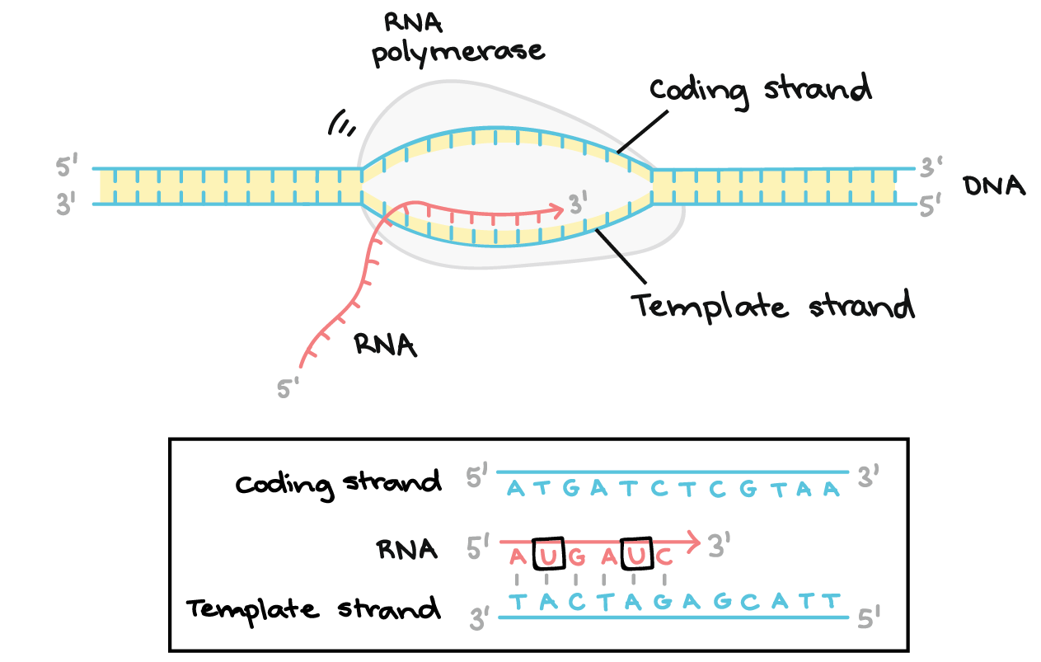
Non-template

Slide 5
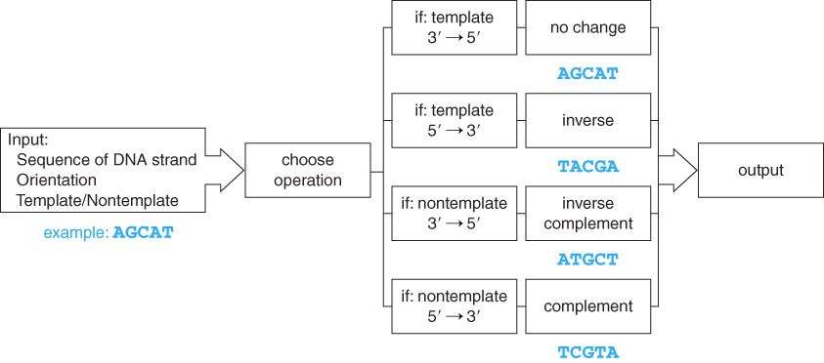
DNA Manipulation Algorithm
A series of steps when handling DNA
Output DNA in 3’ to 5’

Slide 6
The DNA Manipulation Algorithm
Input a DNA sequence, including details of being a template or non-template strand as well as its orientation
Convert to all uppercase
Choose the appropriate operation:
  If it is the template strand and oriented 3’ -> 5’, simply output the same sequence
  If it is the template strand and oriented 5’ -> 3’, inverse the sequence (traverse the string from right to left and add each character to output the string)
  If it is the non-template strand and oriented 3’ -> 5’, generate the inverse complement sequence ((i.) traverse the string from right to left and (ii) for each character, add the complement to the output string)
  If it is the non-template strand and oriented 5’ -> 3’, generate the complement ((i.) traverse the string from left to right and (ii) for each character add the complement to the output string)
Output the completed sequence, including 5’ and 3’ end labels

Slide 7
Transcription Algorithm
Input: template strand in the 3’ → 5’ orientation
Output: mRNA strand in the 5’ → 3’ orientation
  Traverse the string from left to right
    add complementary base to the output string
    (note T is now U)

Slide 8
Alternative Transcription Algorithm
Input: non-template strand in the 5’ → 3’ orientation
Output: mRNA strand in the 5’ → 3’ orientation
  Traverse the string from left to right
    Replace all the T’s with U’s

Slide 9
Translation Algorithm
Input: mRNA strand in the 5’ → 3’ orientation
Output: amino acid sequence
  Traverse the string looking at one codon at a time
  Add one amino acid corresponding to the protein sequence.

Slide 10
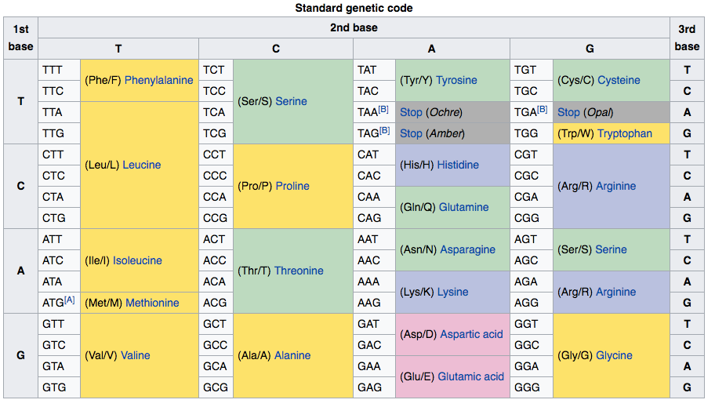
Codon Table to Translate the Protein Product
DNA triplets read in groups of three called codons and represent an amino acid

Slide 11

Python Programming
Biopython
DNA Manipulation Algorithm
Translation functions
  DNA → RNA
  RNA → DNA
  RNA → Protein
Follow along in
class and save
your notes in
a text file!!
  Follow along and Save your notes in a text file.

Slide 12
Header
This
This

Slide 13
Header
This
This

Slide 14
Header
This
This

