Slide 1
Bioinformatics
CS300
Chap 3
Differing DNA
and an Influenza Outbreak
Fall 2019
Oliver BONHAM-CARTER

Slide 2

Descent with Modification
Descent with modification is simply a passing traits from parent to offspring.
One of the fundamental ideas behind Charles Darwin's theory of evolution.
Traits are passed on to children in a process known as heredity.

Slide 3
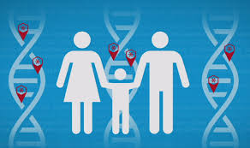
Passed Down From
Genome to Genome
DNA replication ensures a mostly faithful passing of the genome to progeny
What would be the consequence of 100% accurate replication?
Is that high similarity really desirable for a species?
How does decent with modification happen?

Slide 4
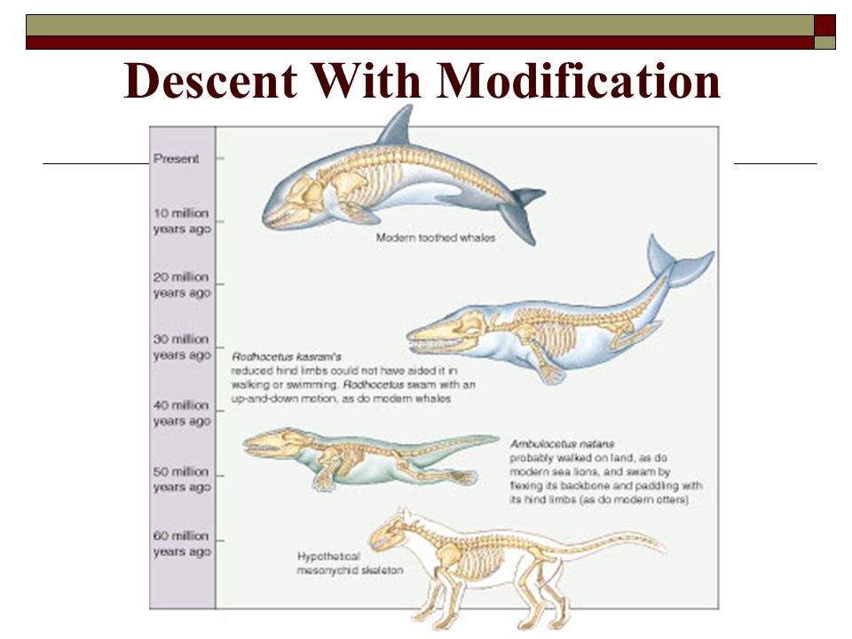
Present
Day
This
This
Long
Ago

Slide 5
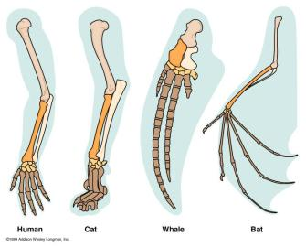
Same Bone, Different Day

Slide 6
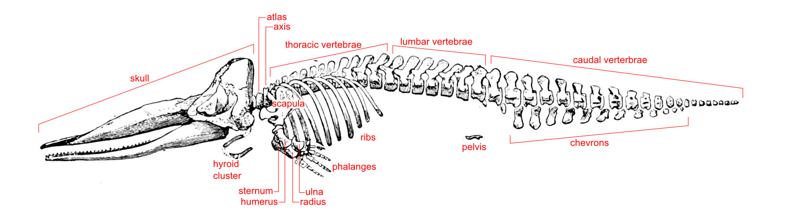
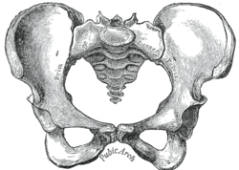
Same Bone, Different Day
This
This
Whale’s Pelvis
Human’s
Pelvis

Slide 7
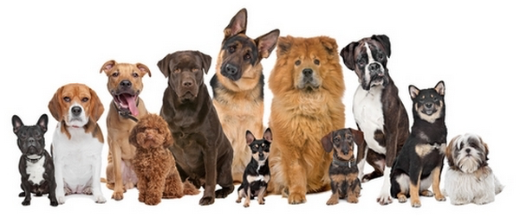
How Does Descent With
Modification Happen?
Mutation
• A change in a DNA sequence
• Results from errors in replication or repair
• Mutation is the ultimate source of genetic variation
Domestic Dog – Canis lupus familiaris
All descendent from the grey wolf
All the same species (sub-species)
Breeds – variation within the species

Slide 8
Sequence Variations
Sequences may have diverged from a common ancestor through various types of mutations:
substitutions (ACGA → AGGA)
insertions (ACGA → ACCGGAGA)
deletions (ACGGAGA → AGA)
You are UNIQUE and SLIGHTLY GENETICALLY DIFFERENT from each of your parents, grand parents, great grand parents …
Retro Viruses (Influenza, HIV, etc) are also unique and slightly genetically different from their ancesters

Slide 9
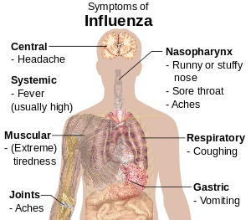
What Is Influenza?
Flu, also known as the influenza, is a contagious disease that is caused by the flu virus. It attacks the respiratory tract in humans (nose, throat, and lungs). The flu is different from a cold. Flu usually comes on suddenly and may include these symptoms:
Fever
Headache
Tiredness (can be extreme)
Dry cough
Sore throat
Nasal congestion
Body aches

Slide 10
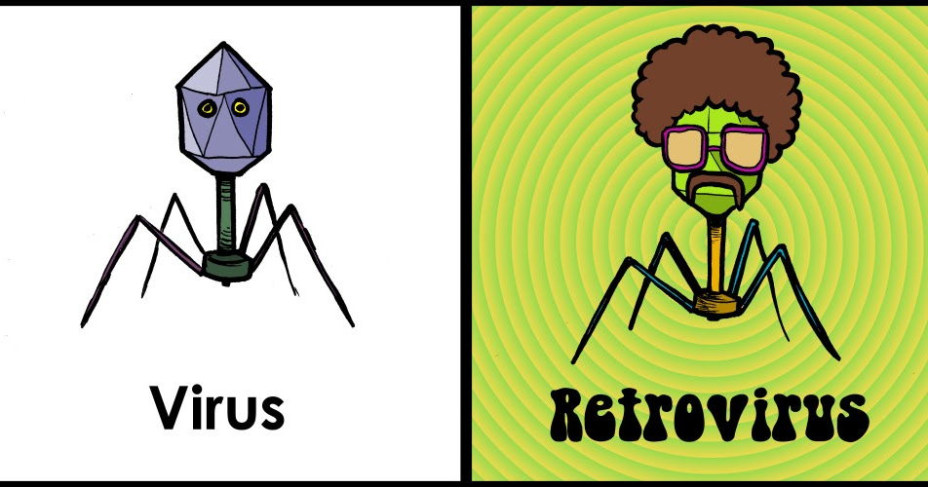
The Influenza Virus: an RNA Virus (or retro virus)
Like all living things, influenza makes small errors—mutations—when it copies its genetic code during reproduction.
Influenza lacks the ability to repair those errors, because it is an RNA virus; RNA, unlike DNA, lacks a self-correcting mechanism.
As a result, influenza is not genetically stable.

Slide 11
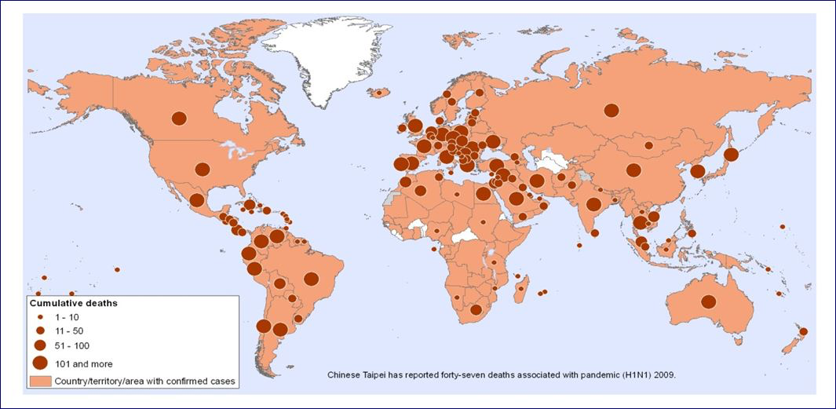
Tracking Infectious Disease
2009 H1N1 Influenza Pandemic
This
This

Slide 12
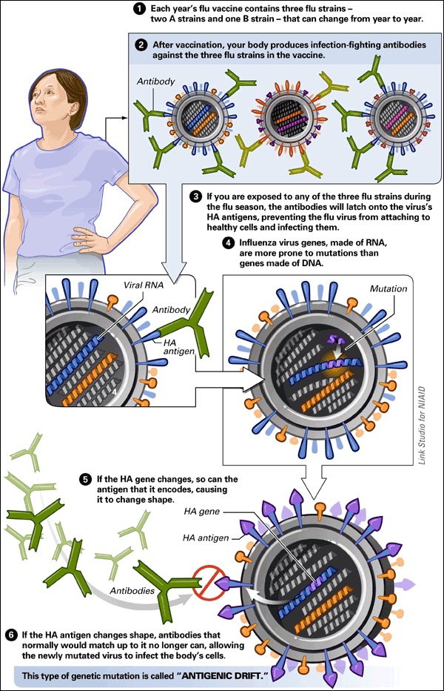
The Influenza Virus

Slide 13
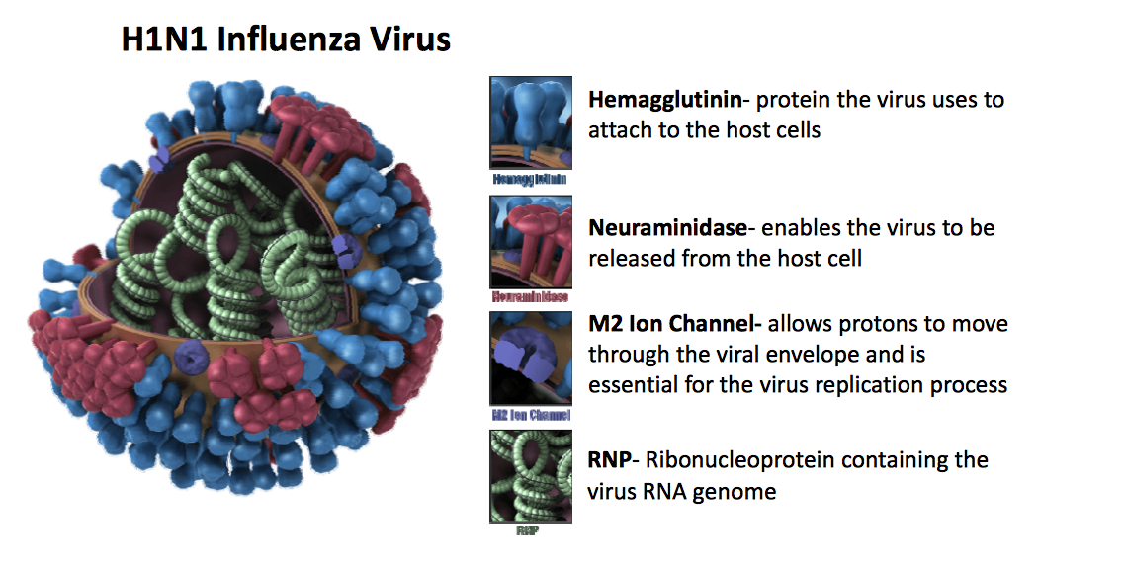
H1N1 Virus
This
This

Slide 14
Viral Evolution
Viruses evolve very quickly
  Some of the highest mutation rates known
    Arms race with immune system
  Viruses – mutation rate 0.0001 - 0.000001 mutations per base per generation
    One mutation every 10,000 – 1,000,000 nucleotides
    Influenza genome size = ~14,000 nucleotides
    Entire genome is coding regions (genes)
  Humans – 0.00000001 mutations per base per generation
    One mutation every 100,000,000 nucleotides
    Human genome size 3 billion nucleotides
    Only 1.5% of genome is coding regions (genes)

Slide 15
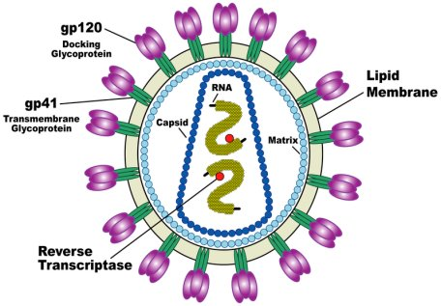
Viruses Using DNA vs RNA
DNA viruses are mostly double-stranded while RNA viruses are single-stranded.
RNA mutation rate is higher than DNA mutation rate.
Mutation causes major changes in virus genetic code

Slide 16
Viruses Using DNA vs RNA
DNA replication takes place in the nucleus while RNA replication takes place in the cytoplasm.
DNA viruses are stable while RNA viruses are unstable.
In DNA viruses, viral genetic code is injected in the host DNA for duplication and decoding.
RNA viruses skip DNA for duplication and decoding.

Slide 17
Reverse Transcription
Retroviruses do not kill the host cell initially because they can insert their genome into the host genome.
This process is called reverse transcription and is done by the viral protein reverse transcriptase. In the case of HIV, viral protein integrase then inserts the HIV DNA into host DNA.
High mutation rate of genetic material from one organism to another.
These mutations can be used to track virus spread.

Slide 18
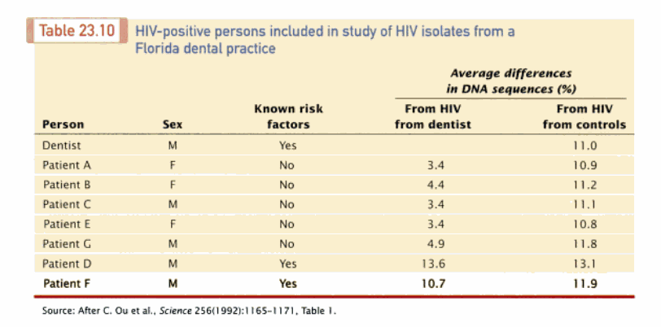
Molecular Epidemiology of
HIV Transmissions in a Dental Practice
How
related is
the DNA of
each
virus
infection?
Similar DNA implies closer relationship between organisms

Slide 19
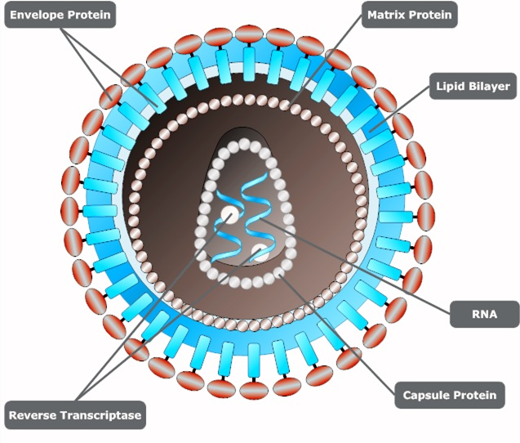

Supporting Videos
Retrovirus reverse transcripiton
https://www.youtube.com/watch?v=eS1GODinO8w

Slide 20
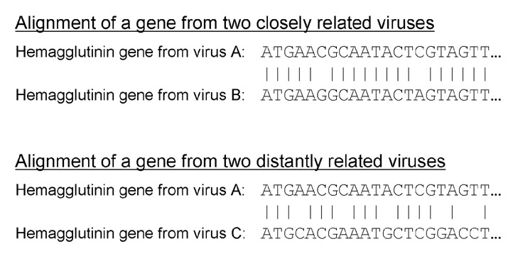
Pairwise Alignment
Similarity and Relatedness
This
Few Mismatches
Lots of Mismatches

Slide 21

Concept Questions:
Discuss With Your Group
How is similarity between genes related to the biological concept of descent from a common ancestor?
The influenza virus mutates so rapidly that you would likely be able to identify at least a couple of mutations over the length of the complete virus genome even if you sequenced two viruses from two different patients within the same influenza outbreak. What do you think might be some considerations in deciding whether two viruses with different genome sequences actually represent two different strains?
RNA viruses (retro viruses) are prone to genetic mutations during replication. After a mutation, parts of their genetics have been completely changed. Is it still possible to study their genetics (over long periods of time) given their code will quickly change? Why or why not?

Slide 22

Python Programming
Biopython
DNA Manipulation Algorithm
Translation functions
  DNA → RNA
  RNA → DNA
  RNA → Protein
Follow along in
class and save
your notes in
a text file!!
  Follow along and Save your notes in a text file.

Slide 23
Header
This
This

