Slide 1
Bioinformatics
CS300
Chap 3
Sequence Alignment:
Investigating an Influenza Outbreak
Fall 2019
Oliver BONHAM-CARTER

Slide 2

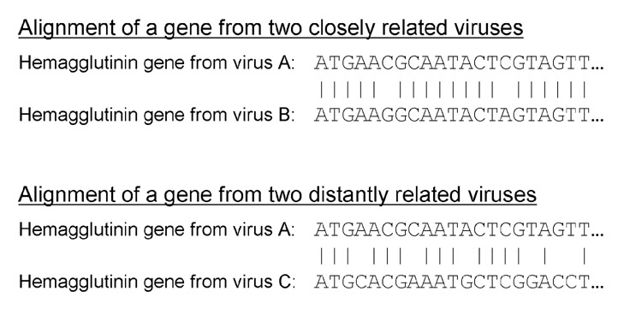
Pairwise Alignment
Similarity and Relatedness
This
Few Mismatches
Lots of Mismatches

Slide 3

Concept Questions:
Discuss With Your Group
How is similarity between genes related to the biological concept of descent from a common ancestor?
The influenza virus mutates so rapidly that you would likely be able to identify at least a couple of mutations over the length of the complete virus genome even if you sequenced two viruses from two different patients within the same influenza outbreak. What do you think might be some considerations in deciding whether two viruses with different genome sequences actually represent two different strains?
RNA viruses (retro viruses) are prone to genetic mutations during replication. After a mutation, parts of their genetics have been completely changed. Is it still possible to study their genetics (over long periods of time) given their code will quickly change? Why or why not?

Slide 4
What is Sequence Alignment?
Sequence alignment is a way of arranging the sequence of genetic material (DNA, RNA or protein) to identify regions of similarity that may be a consequence of functional, structural or evolutional relationships between the sequences.
How much of this gene
can be found in
the other sequence?

Slide 5
What is Global
Sequence Alignment?
We search for matches, matches and gaps between two sequences to determine their relatedness.
(*) indicate matches or similar nucleotides along sequence
Here, the sequences may share some common ancestor
ACGTACT ACGTAC-T ACGTACT----
ACTACGT AC-TACGT ----ACTACGT
** * ** *** * ***

Slide 6
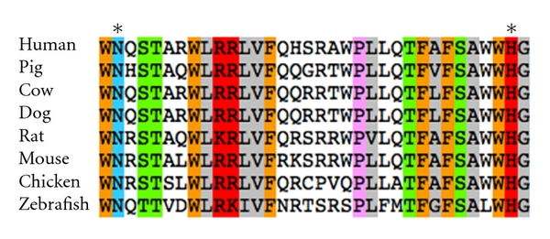
Ex:Sequence Alignment of Some Organisms
We compare protein samples from several different organisms.

Slide 7
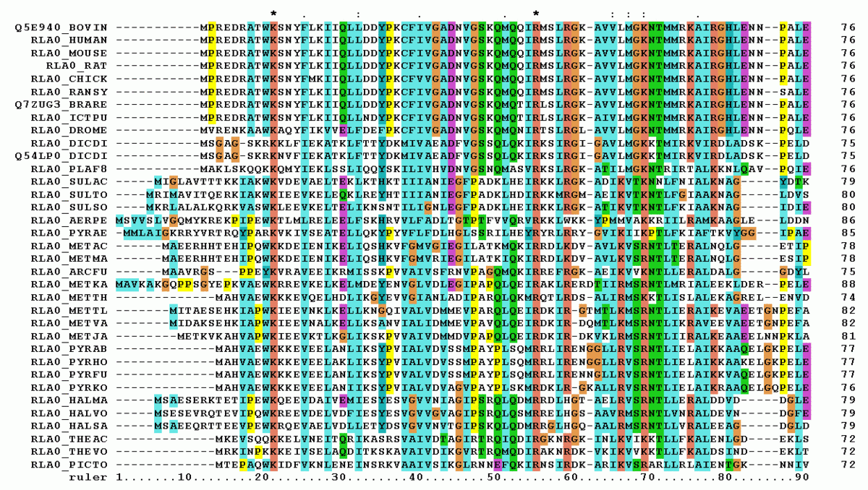
Ex: Sequence Alignment of Many Organisms
The common code have same nucleotides but there are still breaks in these common regions.

Slide 8
Needleman-Wunsch
Algorithm Background
Global Alignment: Used to determine which parts of a sequence (inside the sequence) are shared (common) with another sequence.
Developed by Saul B. Needleman and Christian D. Wunsch in 1970.
Dynamic programming to find optimal solution for matching the characters of the two sequences.

Slide 9
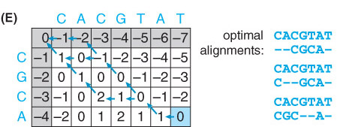
Global Pairwise Alignment
Steps to begin
  Initialization of the matrix
  Calculation of the scores given for a character by character comparison.
  Filling in a system of arrows in a trace-back matrix to uncover a path back to the start in the score matrix.
  Deducing the alignment by following the arrows in the trace-back matrix.

Slide 10
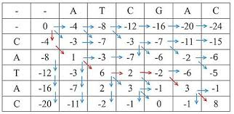
Needleman-Wunsch Algorithm
Create N x M matrix and place each sequence along one axis
Place score 0 at the up-left corner
Fill in 1st row & column with gap penalty multiples
Fill in the matrix with max value of 3 possible moves:
  Vertical move: Score + gap penalty
  Horizontal move: Score + gap penalty
  Diagonal move: Score + match/mismatch score
To reconstruct the optimal alignment, trace back where the max at each step came from, stop when hit the origin.

Slide 11
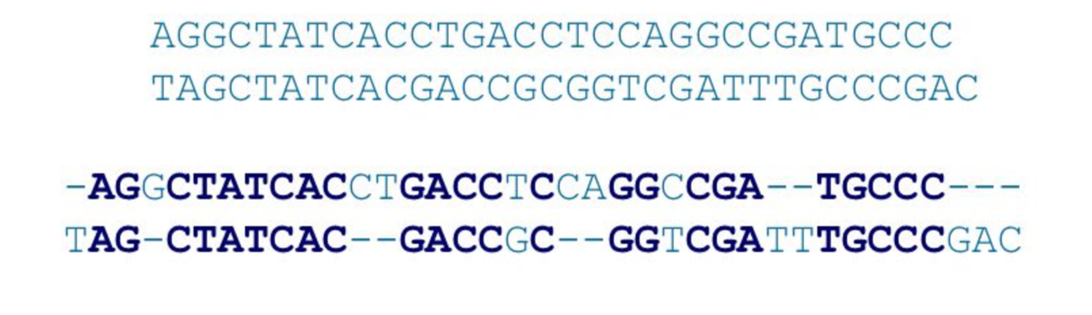
Terms
Alignment is divided up unto sub problems
Solutions are scored; the best solutions for char by char comparison are kept in the overall solution.
Match – bases of each sequence at position ARE same
Mismatch – bases of each sequence at position are NOT same
Gap – bases are not the same, some insert or deletion may have occurred.

Slide 12
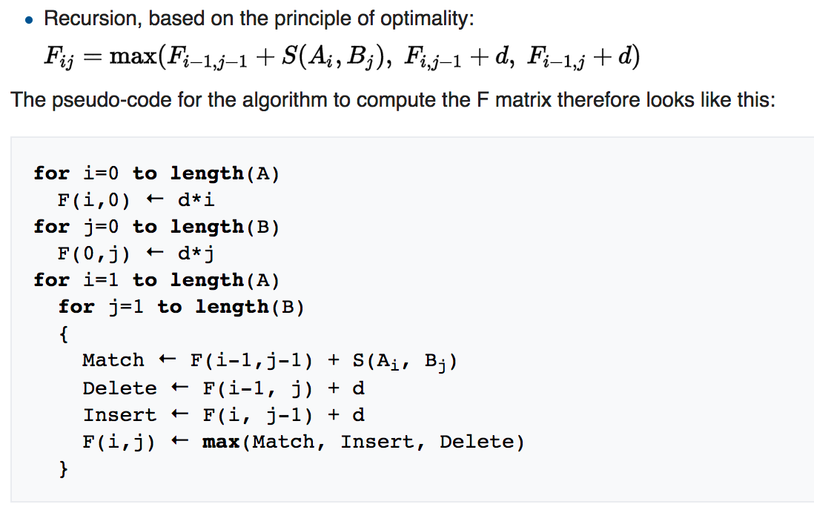
For each Element:
Three Calculations
https://en.wikipedia.org/wiki/Needleman%E2%80%93Wunsch_algorithm

Slide 13
Let’s Calculate!
_ A T C G
Gap: -1
Match: 1
Mismatch: 0
_
T
C
A

Slide 14
Add The Outer Values
_ A T C G
Gap: -1
Match: 1
Mismatch: 0
_
T
C
A
-1
-2
-3
0 -1 -2 -3 -4

Slide 15
Mismatch: A != T
_ A T C G
Gap: -1
Match: 1
Mismatch: 0
_
T
C
A
-1
-2
-3
0 -1 -2 -3 -4
Upperbox: -1 – 1 = -2
Sidebox: -1 – 1
= -2
Diag: 0 – 0
= 0

Slide 16
Mismatch: A != T
_ A T C G
Gap: -1
Match: 1
Mismatch: 0
_
T
C
A
-1
-2
-3
0
0 -1 -2 -3 -4
Upperbox: -1 – 1 = -2
Sidebox: -1 – 1
= -2
Diag: 0 – 0
= 0
Max
value

Slide 17
Match: T = T
_ A T C G
Gap: -1
Match: 1
Mismatch: 0
_
T
C
A
-1
-2
-3
0
0
0 -1 -2 -3 -4
Upperbox: -2 - 1 = -3
Sidebox: 0 – 1
= -1
Diag: -1 + 1
= 0
Max
value

Slide 18
Mismatch: T != C
_ A T C G
Gap: -1
Match: 1
Mismatch: 0
_
T
C
A
-1
-2
-3
0
0
-1
0 -1 -2 -3 -4
Upperbox: -3 – 1 = -4
Sidebox: 0 – 1
= -1
Diag: -2 + 0
= -2
Max
value

Slide 19
Mismatch: T != G
_ A T C G
Gap: -1
Match: 1
Mismatch: 0
_
T
C
A
-1
-2
-3
0
0
-1
-2
0 -1 -2 -3 -4
Upperbox: -4 – 1 = -5
Sidebox: -1 - 1
= -2
Diag: -3 - 0
= -3
Max
value

Slide 20
Filling in The Rest of the Values
_ A T C G
Gap: -1
Match: 1
Mismatch: 0
_
T
C
A
-1
-2
-3
0
-1
-1
0
0
-1
-1
1
0
-2
0
1
0 -1 -2 -3 -4
Alignment:
A T C G
_ T C A
http://experiments.mostafa.io/public/needleman-wunsch/

Slide 21
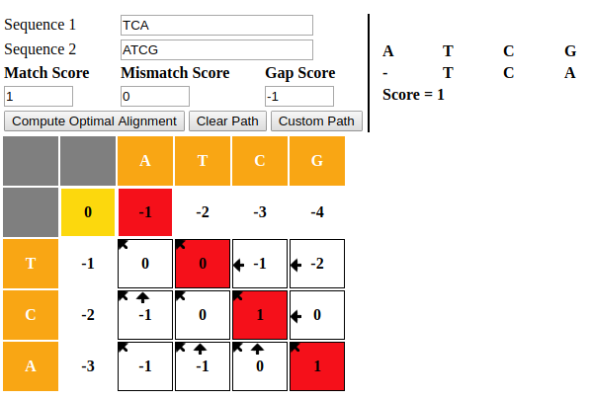
Follow the Arrows Back To
Find the Sequence Alignment
http://experiments.mostafa.io/public/needleman-wunsch/

Slide 22
To Get the Alignment
With each calculation, we placed an arrow to show how the score was calculated and to give us the actual alignment.
How do we read
this output?
Alignment:
A T C G
_ T C A

Slide 23


Up Ahead:
More Examples of Arrows

Slide 24
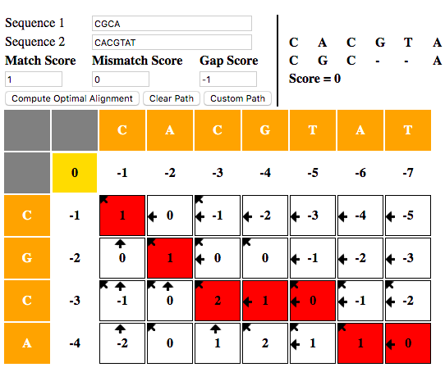
Follow the Arrows!
S1 = CGCA
S2 = CACGTAT

Slide 25
Example Alignment score = 0
Let:
Match = +1
Mismatch = 0
Gap = -1
 |  | C | A | C | G | T | A | T
 | 0 | -1 | -2 | -3 | -4 | -5 | -6 | -7
C | -1 | 1 | 0 | -1 | -2 | -3 | -4 | -5
G | -2 | 0 | 1 | 0 | 0 | -1 | -2 | -3
C | -3 | -1 | 0 | 2 | 1 | 0 | -1 | -2
A | -4 | -2 | 0 | 1 | 2 | 1 | 1 | 0

Slide 26
Example Alignment score = 0
Let:
Match = +1
Mismatch = 0
Gap = -1
 |  | C | A | C | G | T | A | T
 | 0 | -1 | -2 | -3 | -4 | -5 | -6 | -7
C | -1 | 1 | 0 | -1 | -2 | -3 | -4 | -5
G | -2 | 0 | 1 | 0 | 0 | -1 | -2 | -3
C | -3 | -1 | 0 | 2 | 1 | 0 | -1 | -2
A | -4 | -2 | 0 | 1 | 2 | 1 | 1 | 0
CACGTAT
--CGCA-

Slide 27
Example Alignment score = 0
Let:
Match = +1
Mismatch = 0
Gap = -1
 |  | C | A | C | G | T | A | T
 | 0 | -1 | -2 | -3 | -4 | -5 | -6 | -7
C | -1 | 1 | 0 | -1 | -2 | -3 | -4 | -5
G | -2 | 0 | 1 | 0 | 0 | -1 | -2 | -3
C | -3 | -1 | 0 | 2 | 1 | 0 | -1 | -2
A | -4 | -2 | 0 | 1 | 2 | 1 | 1 | 0
CACGTAT
C--GCA-

Slide 28
Example Alignment score = 0
Let:
Match = +1
Mismatch = 0
Gap = -1
 |  | C | A | C | G | T | A | T
 | 0 | -1 | -2 | -3 | -4 | -5 | -6 | -7
C | -1 | 1 | 0 | -1 | -2 | -3 | -4 | -5
G | -2 | 0 | 1 | 0 | 0 | -1 | -2 | -3
C | -3 | -1 | 0 | 2 | 1 | 0 | -1 | -2
A | -4 | -2 | 0 | 1 | 2 | 1 | 1 | 0
CACGTAT
CGC--A-

Slide 29
Example Alignment score = 0
Let:
Match = +1
Mismatch = 0
Gap = -1
 |  | C | A | C | G | T | A | T
 | 0 | -1 | -2 | -3 | -4 | -5 | -6 | -7
C | -1 | 1 | 0 | -1 | -2 | -3 | -4 | -5
G | -2 | 0 | 1 | 0 | 0 | -1 | -2 | -3
C | -3 | -1 | 0 | 2 | 1 | 0 | -1 | -2
A | -4 | -2 | 0 | 1 | 2 | 1 | 1 | 0
CACGTAT
--CGCA-
CACGTAT
C--GCA-
CACGTAT
CGC--A-

Slide 30

Python Programming
Biopython
DNA Manipulation Algorithm
Translation functions
  DNA → RNA
  RNA → DNA
  RNA → Protein
Follow along in
class and save
your notes in
a text file!!
  Follow along and Save your notes in a text file.

Slide 31
Header
This
This

