Slide 1
Bioinformatics
CS300
Horizontal Gene Transfer
Database, Tools, Multiseq Alignment
Fall 2019
Oliver BONHAM-CARTER

Slide 2


On Exam 1
Thursday, 10 October
Algorithms: design and implementation in Python
Basic Python programming: syntax, keywords and definitions
Tracking influenza by sequence study
Sequence alignment
Topics from recent lessons

Slide 3
On Exam 1
Thursday, 10 October
Questions similar to those on worksheets
Central Dogma of Biology
  Transcription, Translation
Mutations: types, causes and effects
Genetic disorders and their inheritance
STUDY YOUR SLIDES!

Slide 4
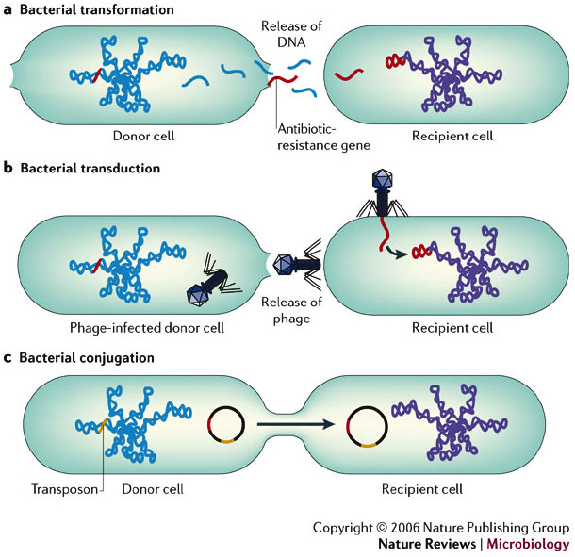
Horizontal Gene Transfer
Horizontal gene transfer (HGT) refers to the transfer of genes between organisms in a manner other than traditional reproduction.

Slide 5
What is HGT?
(Horizontal Gene Transfer)
The transmission of portions of genomic DNA between distant organisms
A process decoupled from vertical inheritance (no mating).
Various fragments of the genome are the result of different evolutionary histories and come from un-related organisms.
This can therefore complicate the investigations of evolutionary relatedness of lineages and species
Bacteria can acquire new traits such as antibiotic resistance or pathogenic toxins.

Slide 6
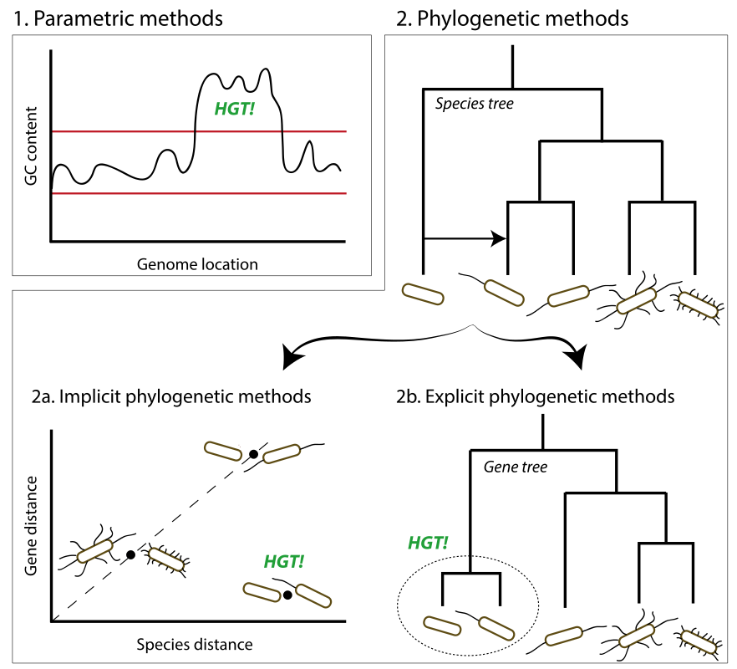
Detection of HGT:
Fragments that do not belong
Statistical
tests:
Elevated
GC content
in DNA
regions
The transmission of portions of genomic DNA between organisms
A process decoupled from vertical inheritance (no mating).
Various fragments of the genome are the result of different evolutionary histories and come from un-related organisms.
This can therefore complicate the investigations of evolutionary relatedness of lineages and species
Phylogenetic
tests using
relationship
trees:
Organisms
living
physically near
each other
show close
relations
Species
that are
too closely
related
to each
other
https://en.wikipedia.org/wiki/Inferring_horizontal_gene_transfer

Slide 7
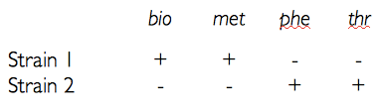
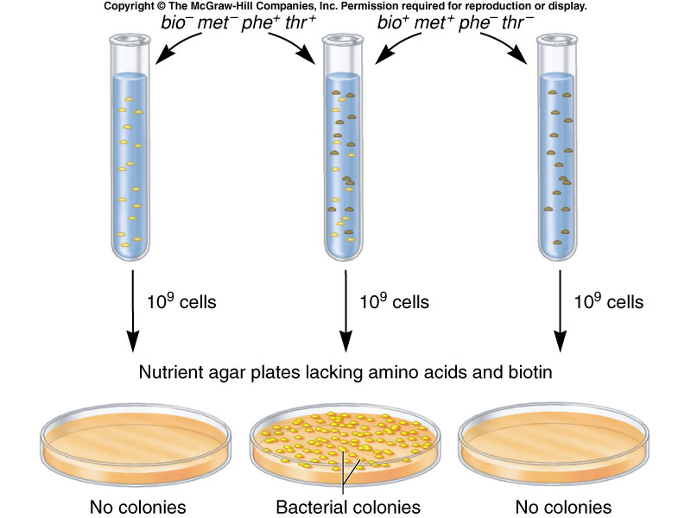
Genetic Sharing
Colonies have opposing growth requirements: each colony requires two extra genes to survive under conditions
Str 1 needs phe and thr, Str 2 needs bio, met.
In the experiment, colonies randomly share missing genes with each other.
Cells with HGT survive to make a new colony.

Slide 8
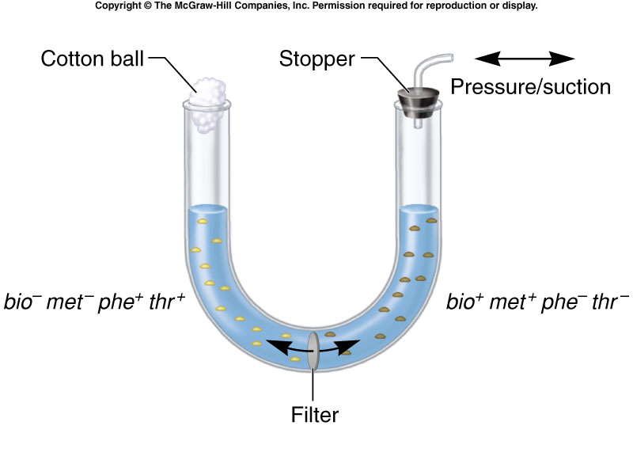
Transfer of Genes From
Physical Contact
New colony needs to
have genes from both
sides of filter to grow.
Filter prevents
gene passage

Slide 9
Mechanisms of DNA Transfer
Conjugation
  Conjugation is the process by which one bacterium transfers genetic material to another through direct contact.
Transduction
  Virus mediated transfer of DNA between bacteria
Transformation
  Requires release of DNA into the environment and then the manual take-up of the DNA by bacteria
https://www.nature.com/scitable/definition/conjugation-prokaryotes-290/

Slide 10
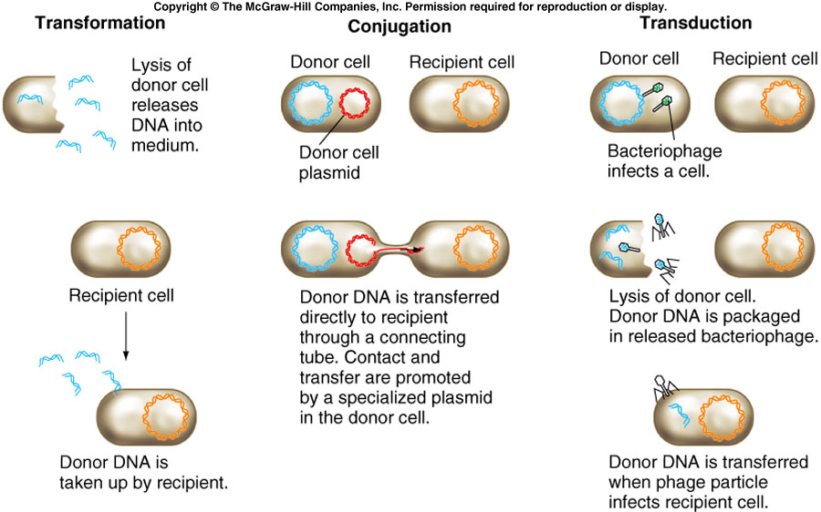
Mechanisms of DNA Transfer

Slide 11
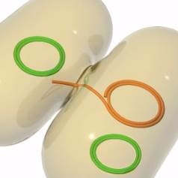
Bacterial Conjugation
Only specific bacteria can serve as donors
  Arber, Werner. "Horizontal gene transfer among bacteria and its role in biological evolution." Life 4.2 (2014): 217-224.
The donor bacterium carries a DNA sequence called the fertility factor, or F-factor.
The F-factor allows the donor to produce a thin, tubelike structure called a pilus, which the donor uses to contact the recipient and transfer genetic content to recipient.
https://www.nature.com/scitable/definition/conjugation-prokaryotes-290/
+
=
Donor +
Donor -
Donor+
Transfer of genetic material

Slide 12
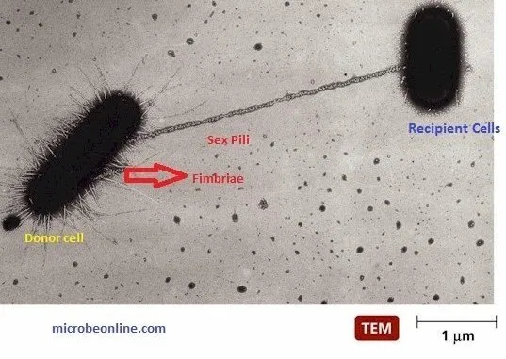
A Pilus : An Exchange Bridge
Gene sharing possible if F-Factor present
Fimbriae or pili (singlular: pilus): hair like filaments (tiny hollow projections)
Extend from the cell membrane into the external environment
A pilus is composed of subunits of the protein pilin
https://microbeonline.com/bacterial-pili-fimbriae-characteristics-types-and-medical-importance/

Slide 13
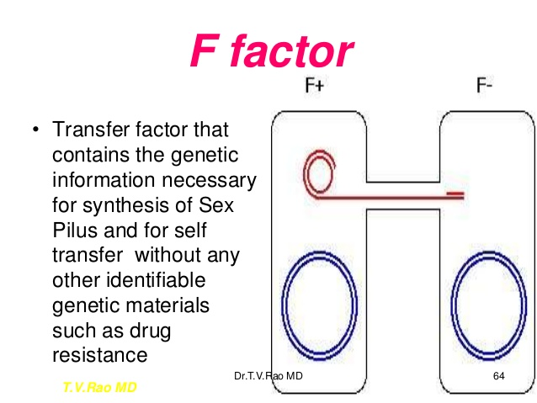
F Factor

Slide 14
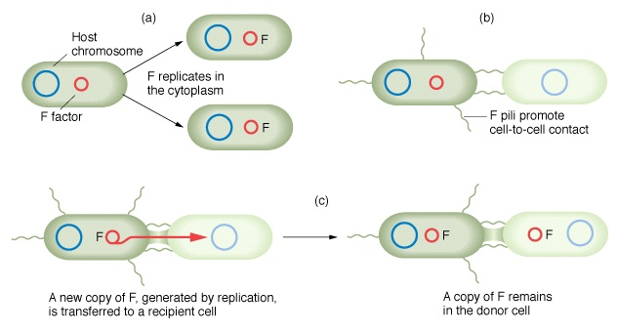
The F-Factor Material
F-Factor: a material (i.e., the fertility factor) that is encoded on the plasmid (bacterial DNA). F+ (has factor) F- (does not have factor)
Enables the creation of the pilus bridge to transfer circular piece of DNA
https://www.nature.com/scitable/definition/conjugation-prokaryotes-290/

Slide 15
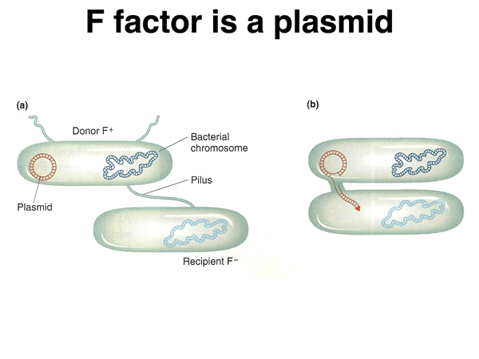
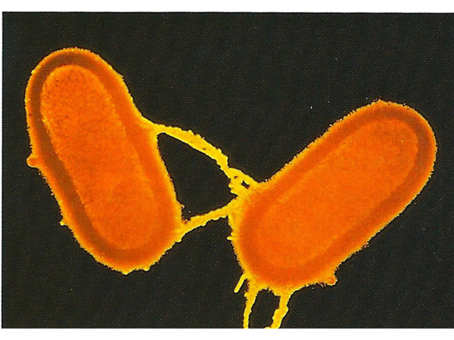
Transfer of Genetic Material
Plasmids are transferred containing genes of donor to recipient through the pilus
http://www.discoveryandinnovation.com/BIOL202/notes/lecture15.html

Slide 16
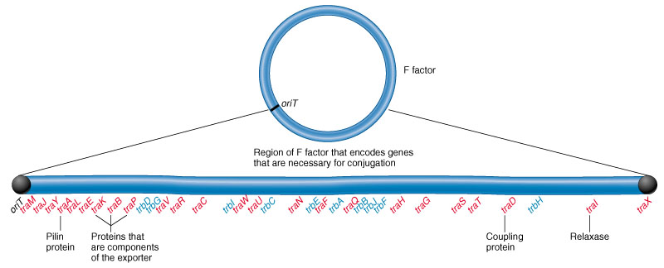
Plasmids Contain Genes

Slide 17
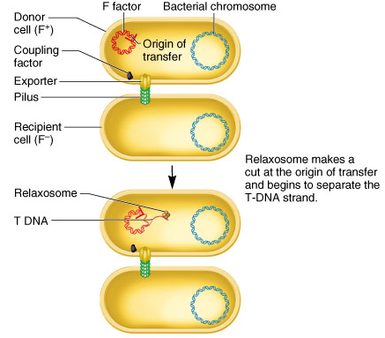
Mechanism of Transfer
The relaxosome: a complex of proteins facilitating plasmid transfer during bacterial conjugation
Relaxosome begins the transfer of T-DNA (transfer DNA) from donor to recipient

Slide 18
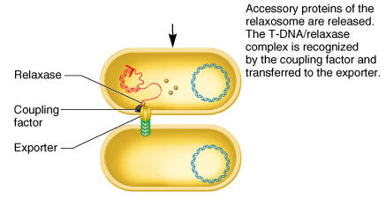
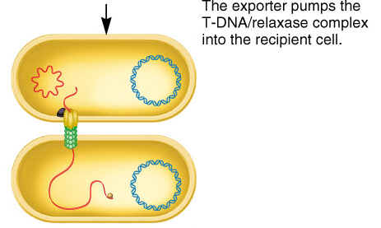
Mechanism of Transfer
T-DNA is separated but bound to relaxase protein.
Complex called nucleoprotein
Complex is recognized by a coupling factor, fed through exporter (conjugation tube)

Slide 19
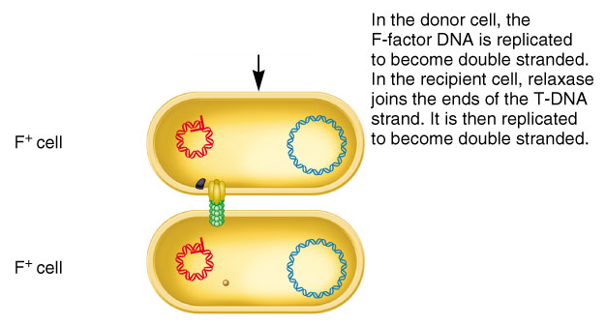
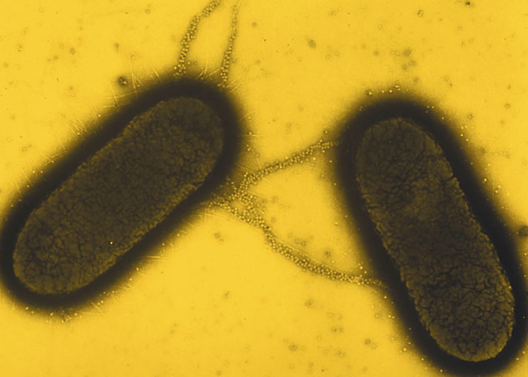
F Factor Transfer
Relaxase joins ends to produce circular molecule
Single strand of F-Factor are in both cells (DNA replication)

Slide 20
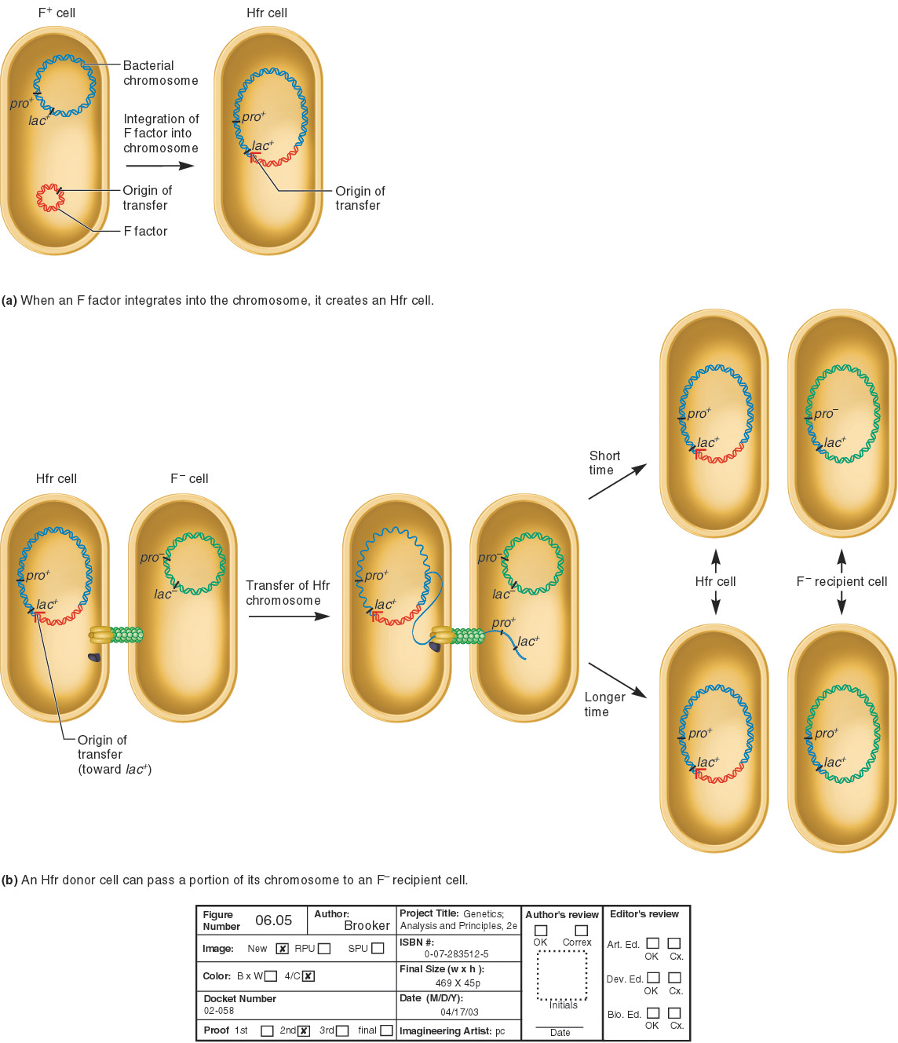
Integration of DNA into Chromosome
Genes encoded on F-Factor can integrate into host DNA and alter its genotype (genetics) and phenotype (look-like)
An Hfr strain was derived from an F+ strain
Episome:
DNA fragment that
can exist as a plasmid
and integrate into chromosome

Slide 21
Did You Say, Hfr Strain?
E. Coli strain discovered as Hfr (high frequency of recombination)
Hfr strain transfers chromosomal DNA from F- strains
Transfer begins at the origin of the transfer
The amount of DNA transferred depends on the time allowed for conjugation

Slide 22
Known Instances of HGT
Antibiotic resistance genes on plasmids
Insertion sequences
Pathogenicity islands
Toxin resistance genes on plasmids
Viruses and viroids
Organelle to nucleus transfers

Slide 23
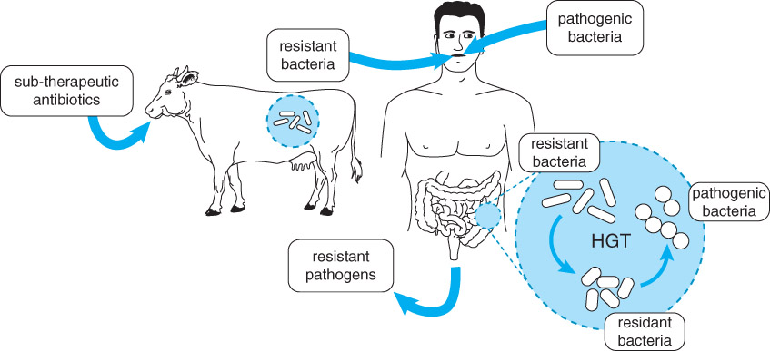
Horizontal Gene Transfer of Antibiotic Resistance

Slide 24
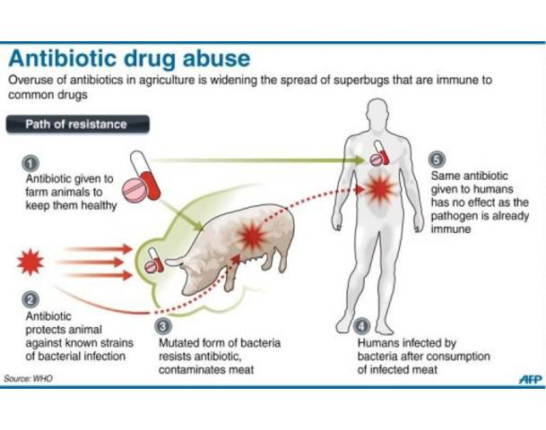
From Farm-to-Fork Spread of Antibiotic Resistance

Slide 25
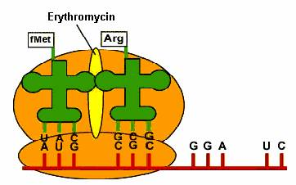
Use Multi-Sequence Alignment to
Search for Resistance Genes
Erythromycin – binds to bacterial ribosome and blocks translation

Slide 26

Supporting Videos
Horizontal Gene Transfer animation (1.5mins)
  https://www.youtube.com/watch?v=tCZhkxpzxDY
Antibiotic Resistance (4mins)
  https://ed.ted.com/lessons/how-antibiotics-become-resistant-over-time-kevin-wu

Slide 27
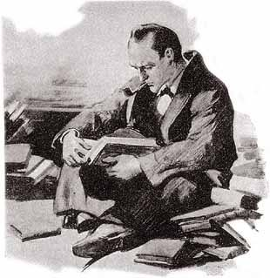
How do we find common regions in genetic material?
How do we
find common
regions in
genetic
material?

Slide 28
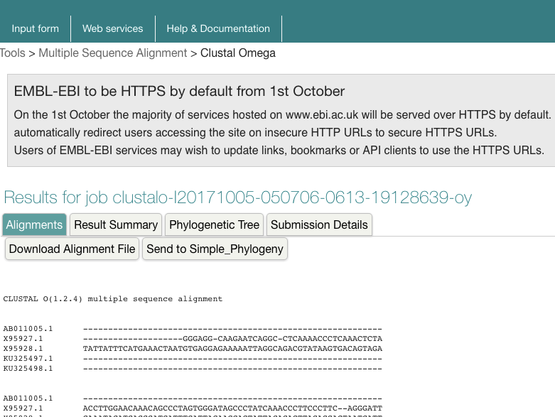
Multi-Sequence Alignment
Clustal Omega: MultiSequence Alignment
https://www.ebi.ac.uk/Tools/msa/clustalo/
Where are the
chucks of
common
genes?
Are these
chunks from
horizontal gene
transfers?

Slide 29
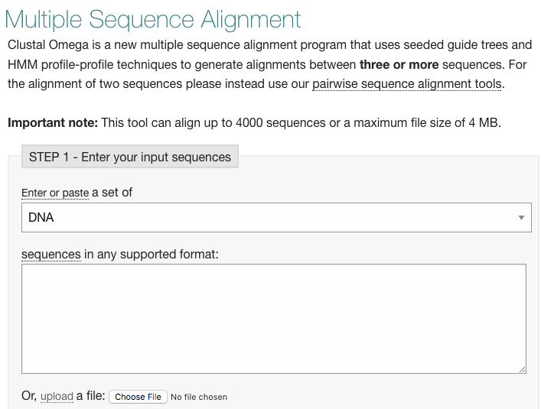
Clustal: Load Input Sequences
What is the likelihood that agricultural use of antibiotics is resulting in resistant human gut bacteria and/or resistant human pathogens?
ermB gene

Slide 30
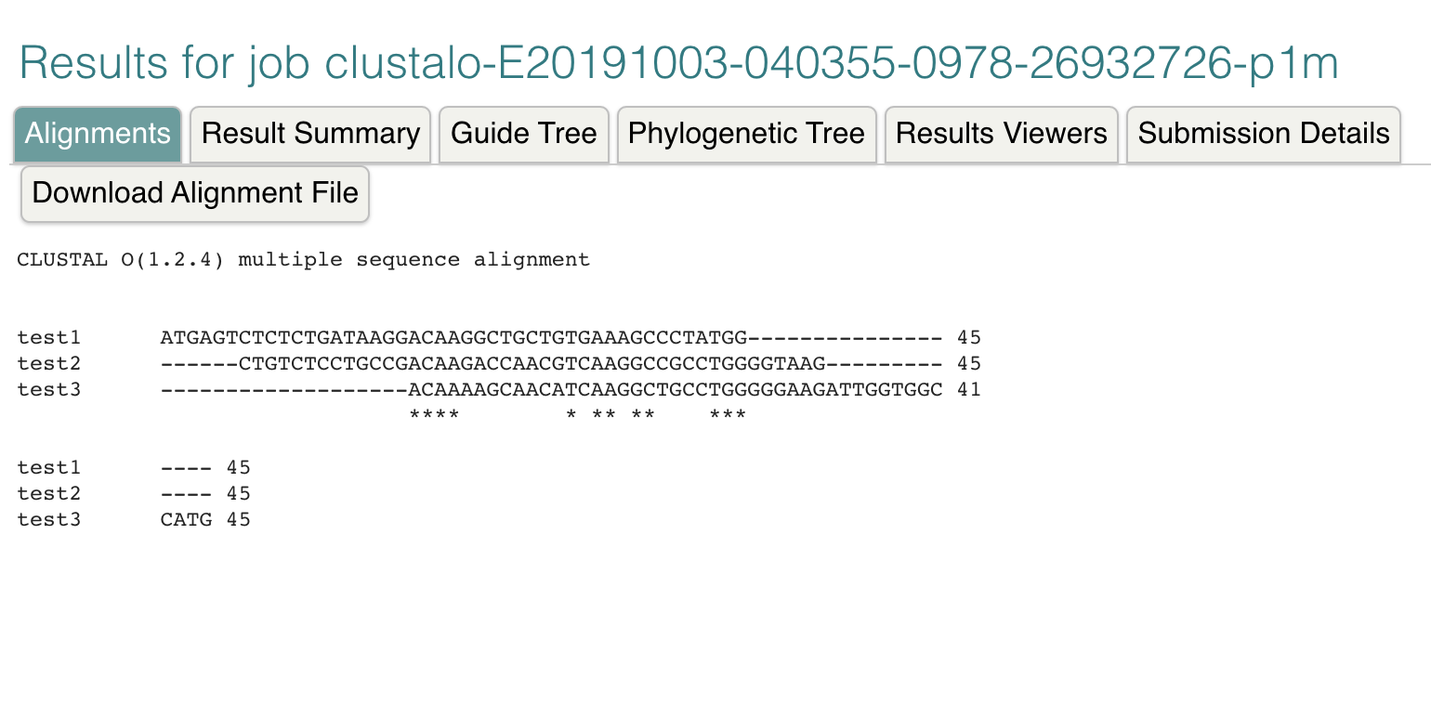
Using Example
DNA Sequences
What is the likelihood that agricultural use of antibiotics is resulting in resistant human gut bacteria and/or resistant human pathogens?
ermB gene

Slide 31
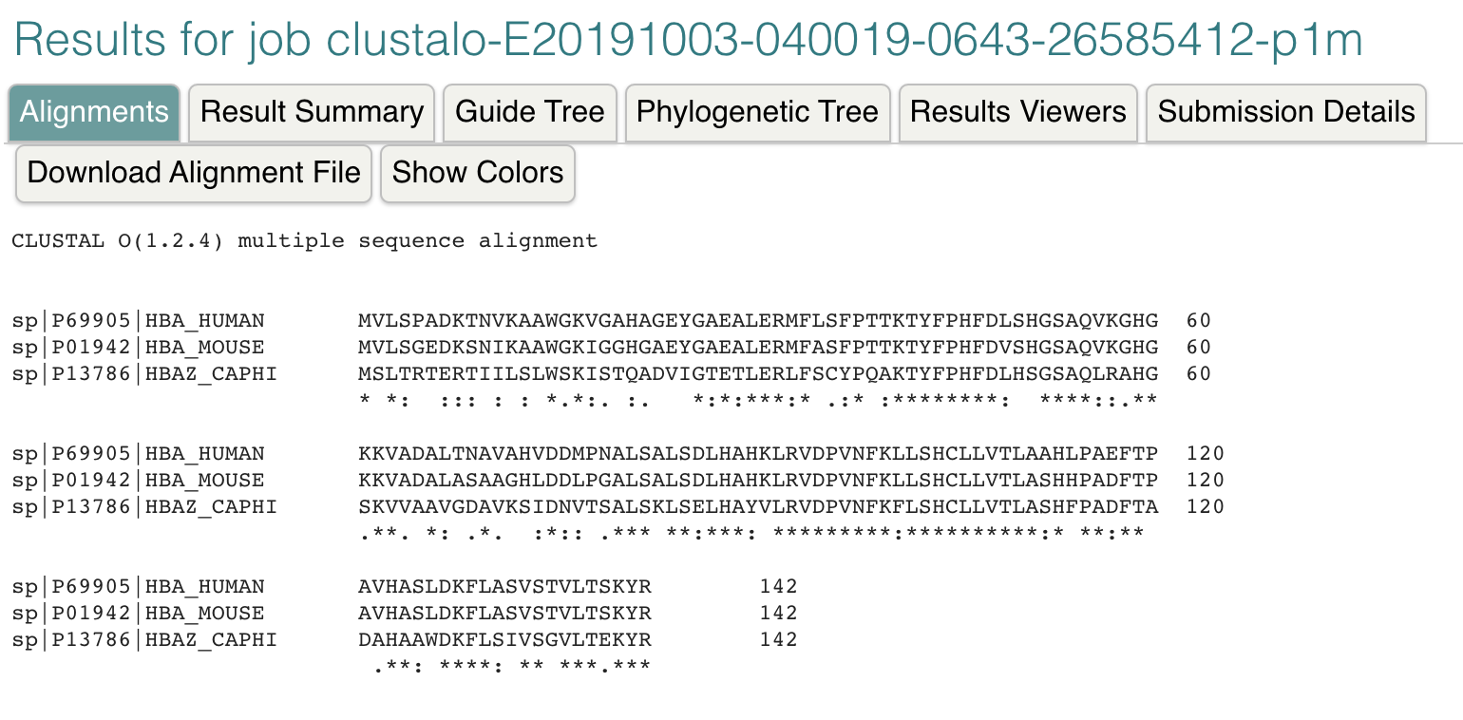
Using Example
Protein Sequences
What is the likelihood that agricultural use of antibiotics is resulting in resistant human gut bacteria and/or resistant human pathogens?
ermB gene
Results took about five minutes to get! :-/
Is there a way to get faster results?

Slide 32

BLAST: A Heuristic Approach to Database Searching
https://blast.ncbi.nlm.nih.gov/Blast.cgi
Basic Local Alignment Search Tool
  NCBI – DNA and protein sequence
  Compares one sequence to database of > 100 million
  Finds best hits (optimal alignments) in a matter of seconds
  (would take >3 years using Needlman-Wunsch algorithm)

Slide 33
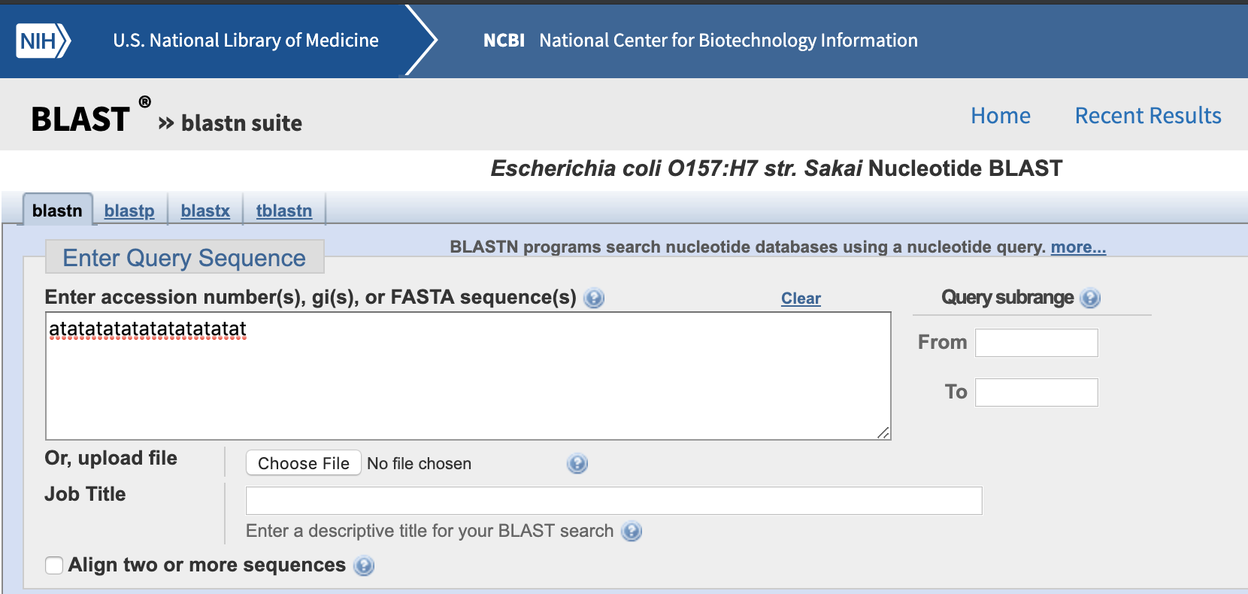
BLAST: A Heuristic Approach to Database Searching
Where does my sequence show up in other organisms?

Slide 34
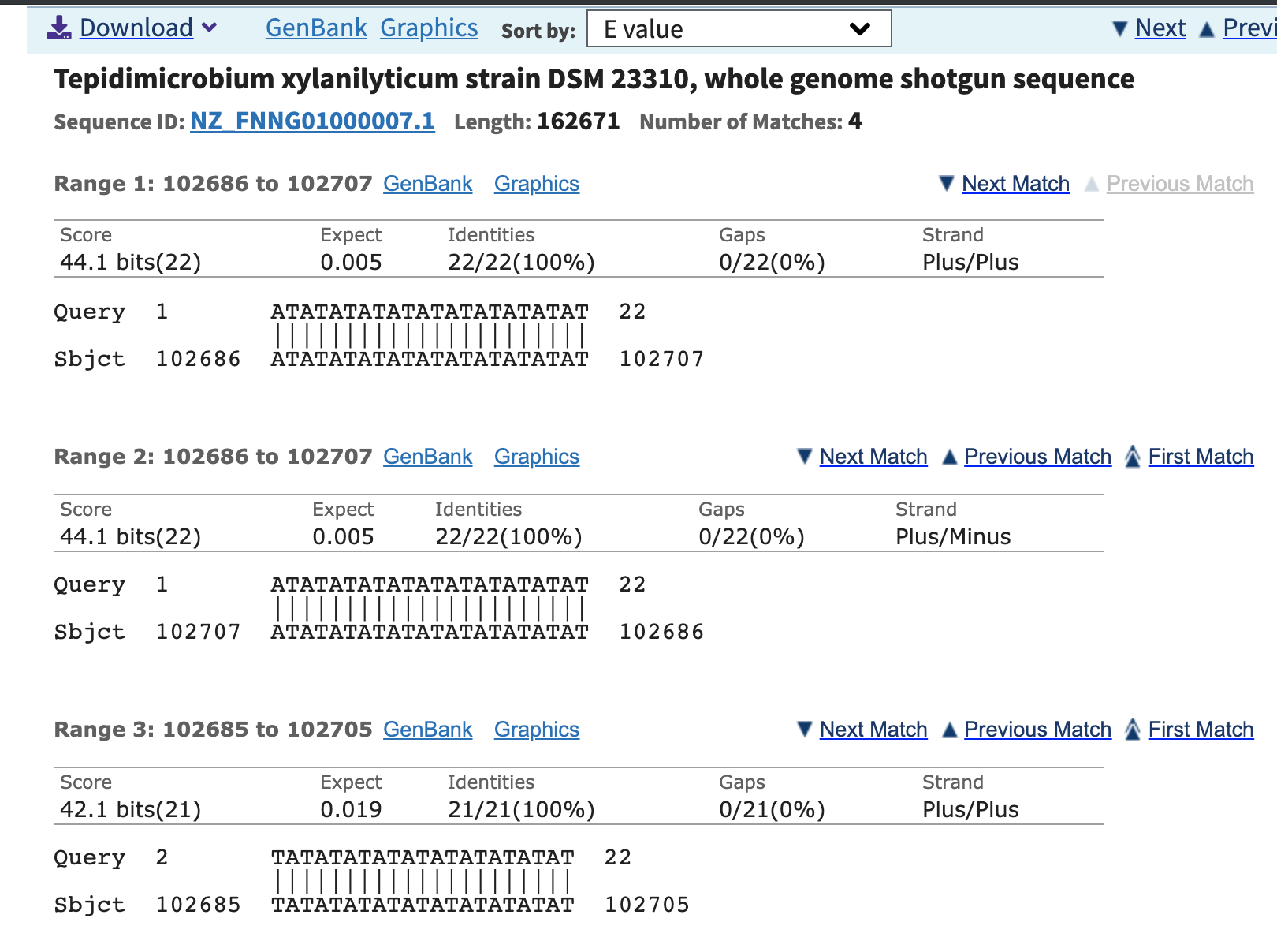
BLAST: Output

Slide 35
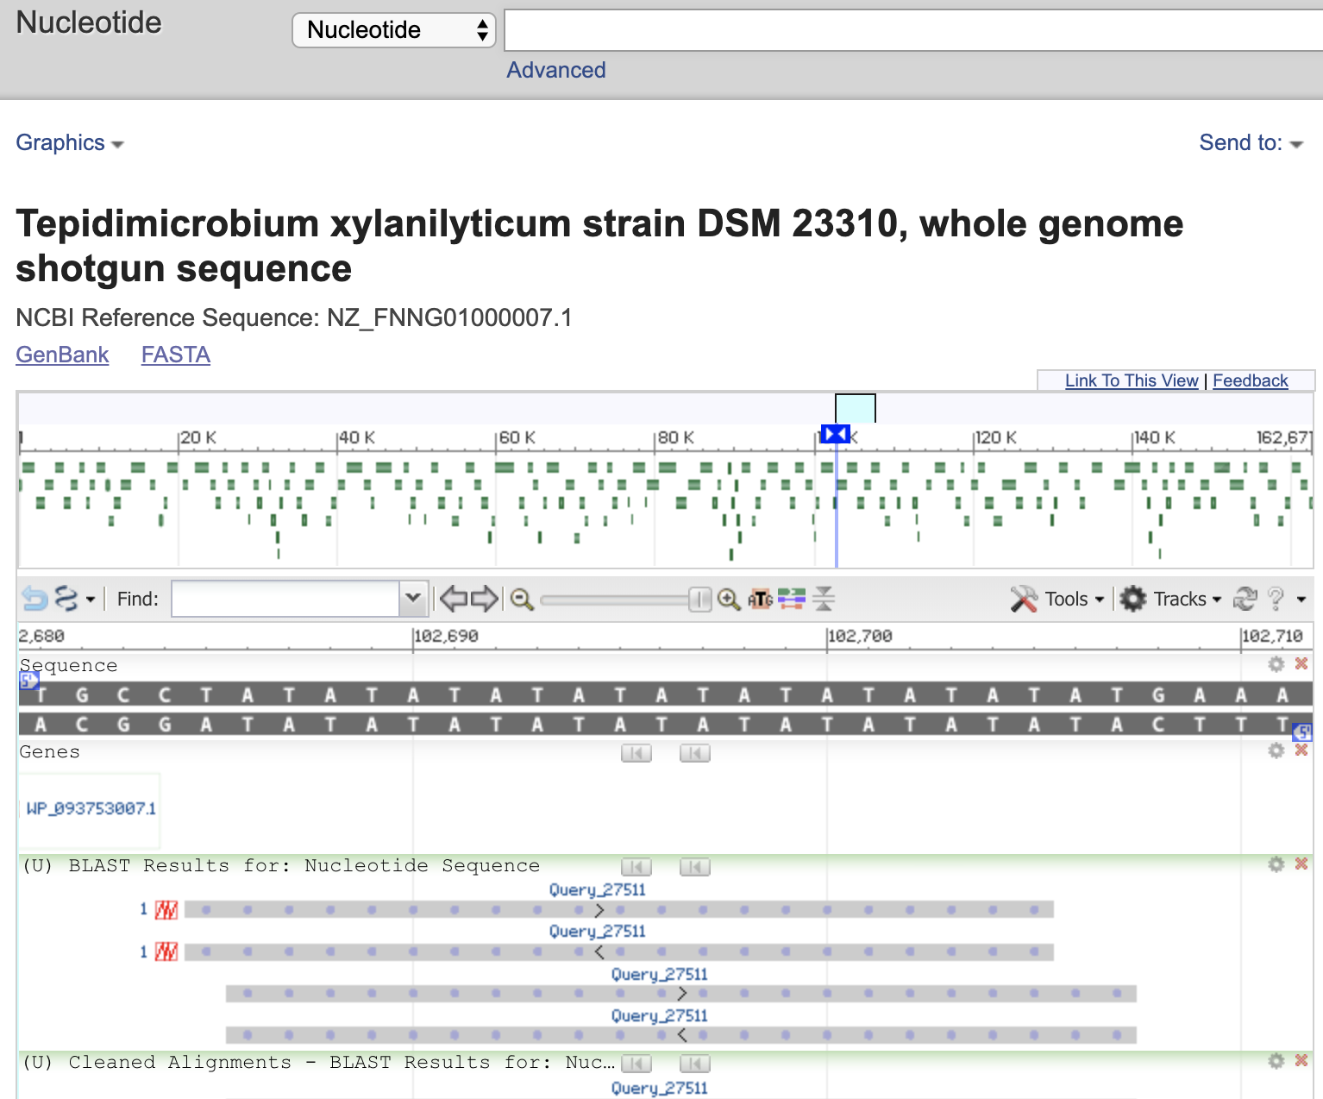
BLAST: Output

Slide 36
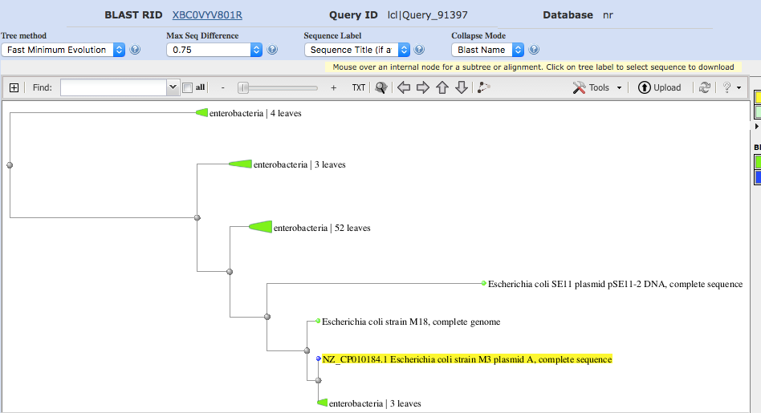
BLAST: Tree of Relations

Slide 37
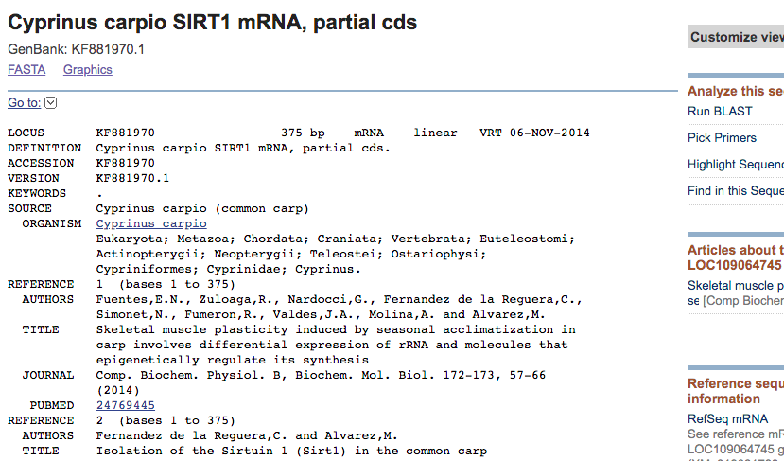
BLAST Demo
Sirt1 (member of the sirtuin family) is a nicotinamide adenosine dinucleotide (NAD)-dependent deacetylase that removes acetyl groups from various proteins. Sirt1 performs a wide variety of functions in biological systems.

Slide 38
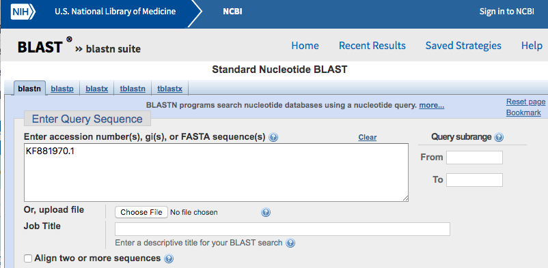
BLAST Demo
We are checking the occurrence of this RNA sequence, Cyprinus carpio SIRT1 mRNA, partial cds GenBank: KF881970.1) in many other sequences to determine common parts of code.

Slide 39
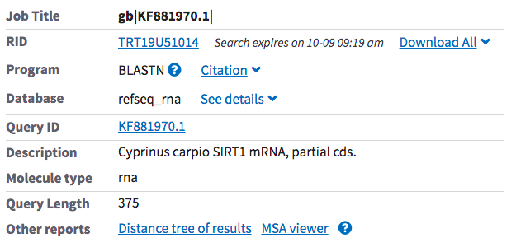
BLAST Demo
We get basic information from the search...

Slide 40
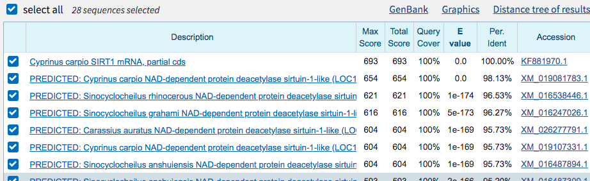
BLAST Demo
Cases (sequences) in which the subsequence is found in other sequences

Slide 41
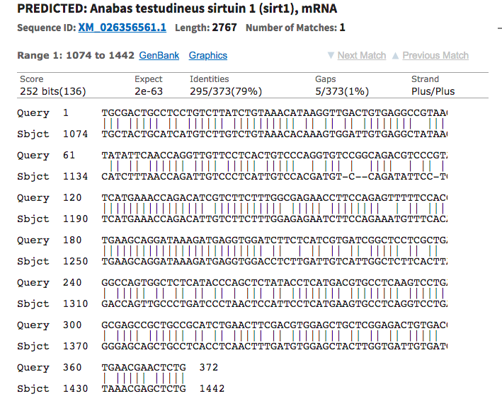
BLAST Demo

Slide 42

BLAST Tutorial:
DigitalWorldBiology
Want MORE!?
https://digitalworldbiology.com/tutorial/blast-for-beginners

Slide 43
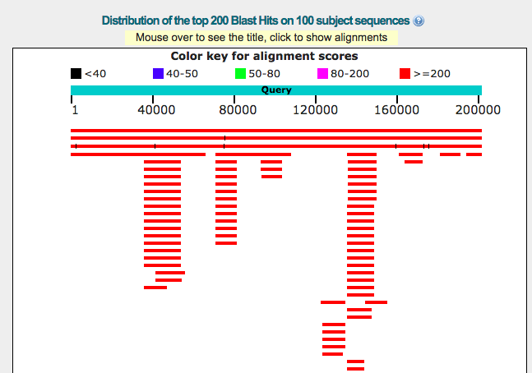
BLAST: Output

Slide 44
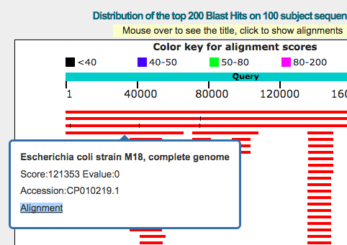
BLAST: Output

Slide 45
BLAST: Tree of Relations

Slide 46
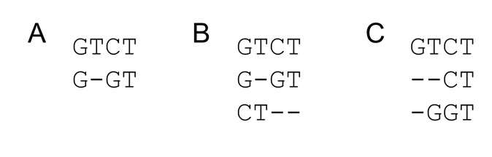
Multiple Sequence
Alignment: Clustal
Order matters
Solutions?
Needleman-Wunsch L x M x N matrix
  Impractical for long sequences
Heuristic
  Progressive alignment via a guide tree

Slide 47
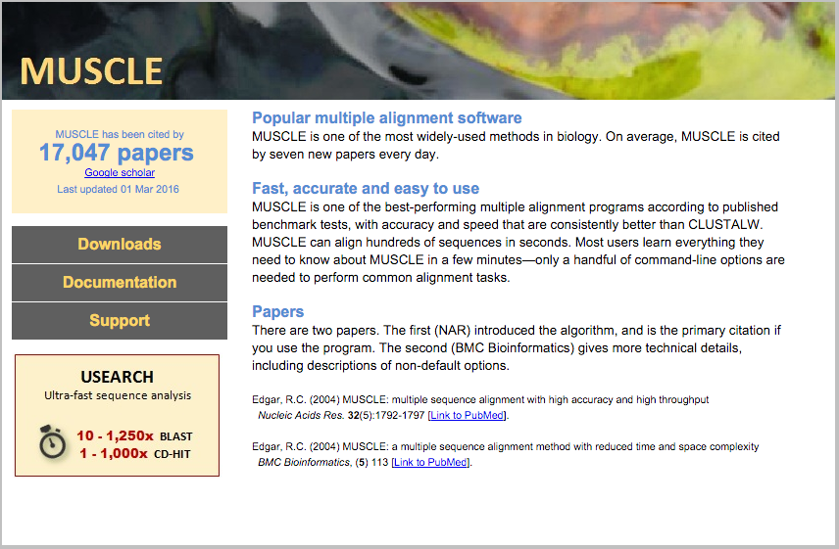
Multiple Sequence
Alignment: MUSCLE

Slide 48

Python Programming
Biopython
DNA Manipulation Algorithm
Translation functions
  DNA → RNA
  RNA → DNA
  RNA → Protein
Follow along in
class and save
your notes in
a text file!!
  Follow along and Save your notes in a text file.

Slide 49
Header
This
This

