Slide 1
Bioinformatics
CS300
Blast, Substitution Matrices and
Protein Alignments
(Chap 4 and 5 in textbook)
Fall 2019
Oliver BONHAM-CARTER

Slide 2

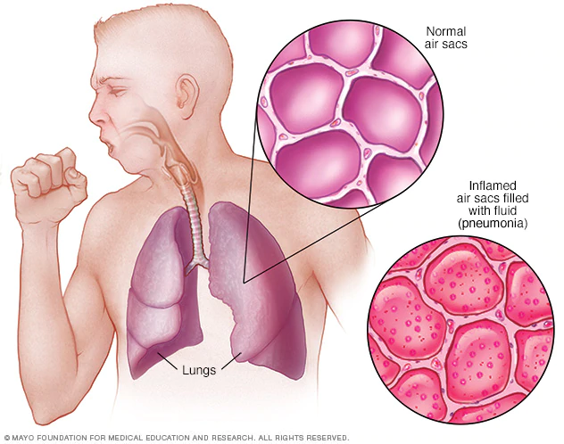
Pneumonia
Pneumonia is an infection that inflames the air sacs in one or both lungs. The air sacs may fill with fluid or pus (purulent material), causing cough with phlegm or pus, fever, chills, and difficulty breathing. A variety of organisms, including bacteria, viruses and fungi, can cause pneumonia.
A classic sign of bacterial pneumonia is a cough that produces thick, blood-tinged or yellowish-greenish sputum with pus.
https://www.mayoclinic.org/diseases-conditions/pneumonia/symptoms-causes/syc-20354204

Slide 3
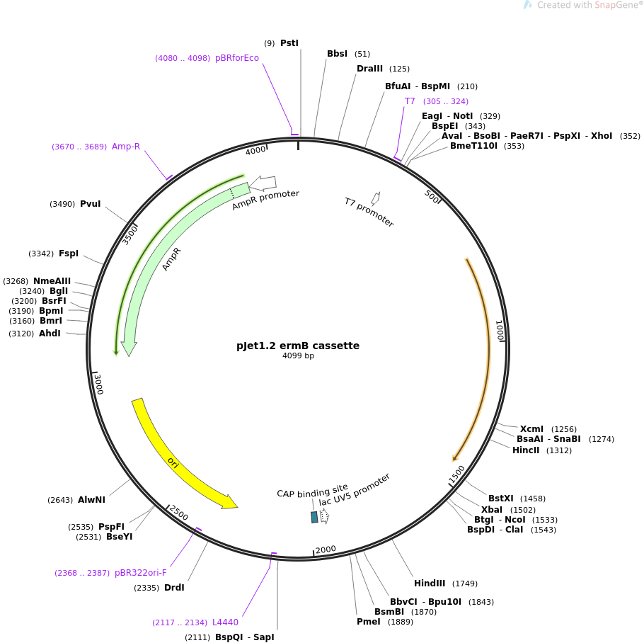
Human Pathogen Inquiry:
The ermB gene
An erythromycin-resistance gene from Streptococcus agalactiae, a gram-positive bacterial species commonly associated with the udders of cows, causing mastitis (i.e., inflammation of breast tissue that sometimes involves an infection and may cause fever)
https://www.addgene.org/117121/

Slide 4
Pneumonia and ermB
Drug resistant: Erythromycin is a macrolide antibiotic used to treat bacterial infections
Resistance is due to the ermB gene which has been noted in the bacteria, Streptococcus pneumonia – a common cause of bacterial pneumonia.

Slide 5

Horizontal Gene Transfer?
This type of pneumonia is not believed to have always been resistant to drugs.
Could the resistance gene have come from another bacteria via HGT?
How could we check what other bacterial organisms have a specific allele for the gene that effectively resists drugs?
We will use Blast for this task.

Slide 6
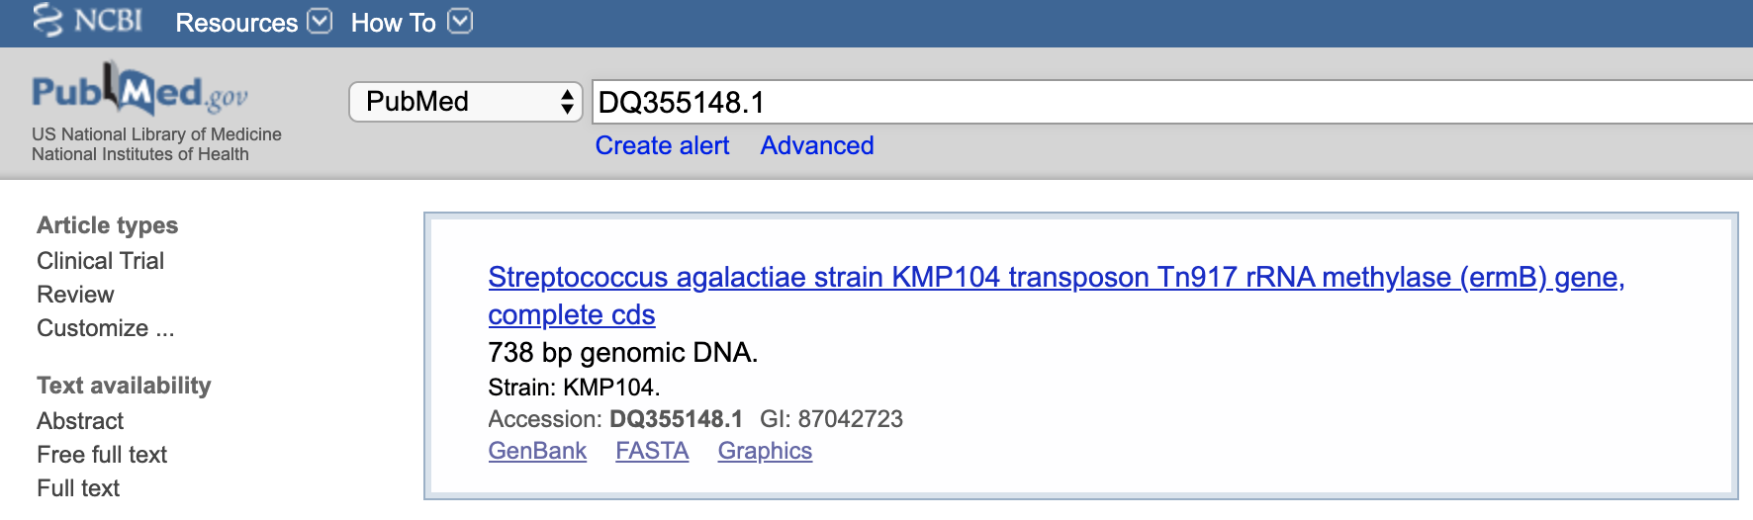
Blast to Study HGT
Locate the Accession number, DQ355148.1, on http://www.pubmed.gov
Streptococcus agalactiae strain KMP104 transposon Tn917 rRNA methylase (ermB) gene, complete cds
https://www.ncbi.nlm.nih.gov/nuccore/87042723/

Slide 7
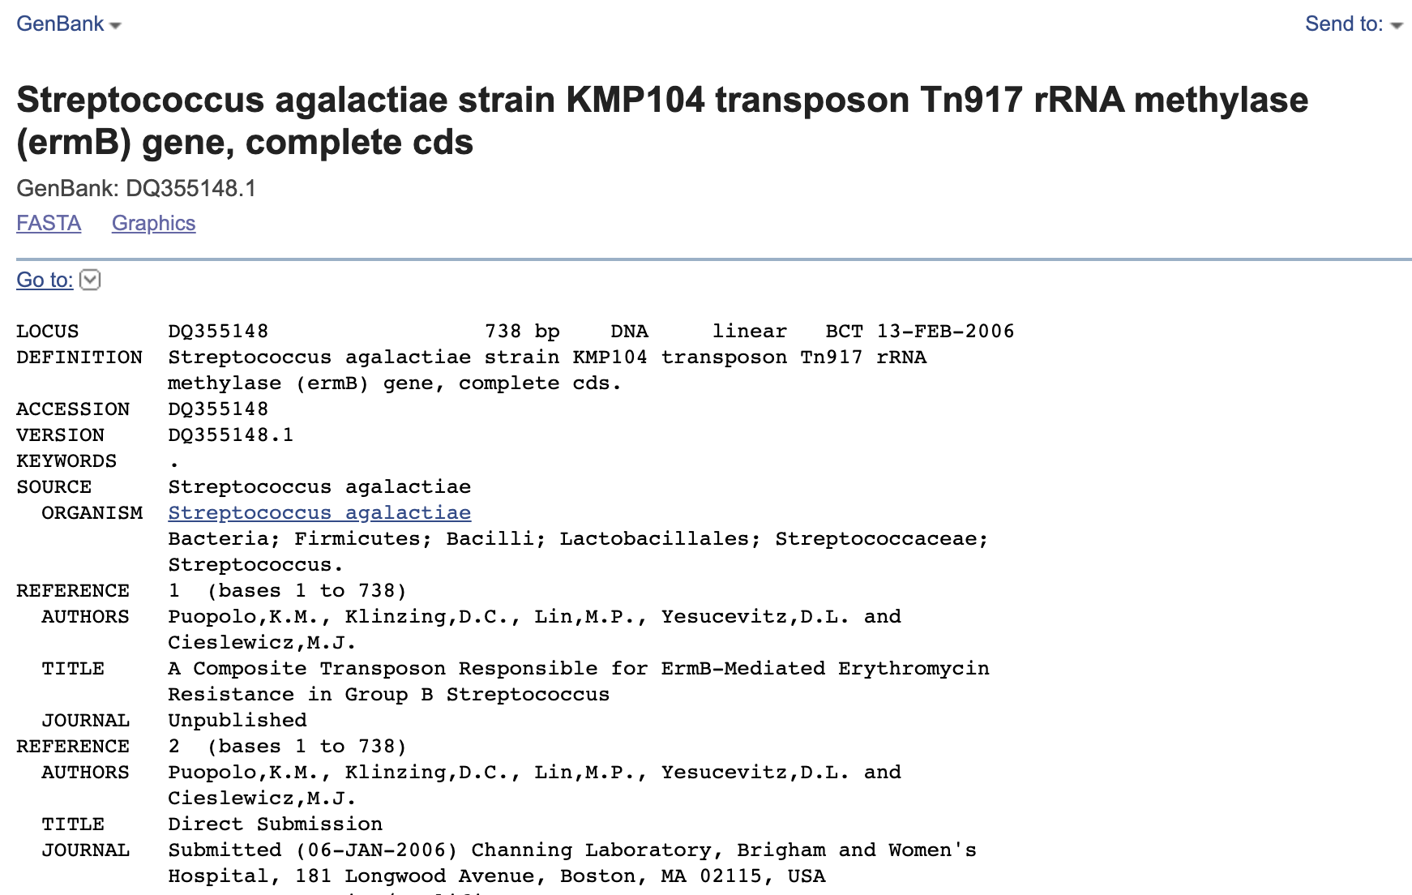
Find the Sequence
Get the
FASTA file:
“send to”
→
“FASTA”

Slide 8
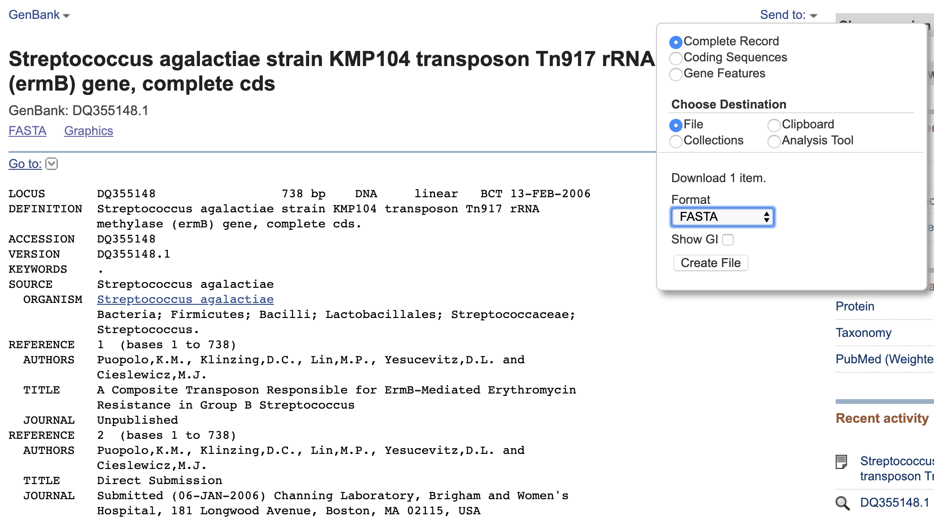
Save the Sequence

Slide 9
Ah, The Sequence in FASTA Format
>DQ355148.1 Streptococcus agalactiae strain KMP104 transposon Tn917 rRNA methylase (ermB) gene, complete cds
ATGAACAAAAATATAAAATATTCTCAAAACTTTTTAACGAGTGAAAAAGTACTCAACCAAATAATAAAAC
AATTGAATTTAAAAGAAACCGATACCGTTTACGAAATTGGAACAGGTAAAGGGCATTTAACGACGAAACT
GGCTAAAATAAGTAAACAGGTAACGTCTATTGAATTAGACAGTCATCTATTCAACTTATCGTCAGAAAAA
TTAAAACTGAACATTCGTGTCACTTTAATTCACCAAGATATTCTACAGTTTCAATTCCCTAACAAACAGA
GGTATAAAATTGTTGGGAATATTCCTTACCATTTAAGCACACAAATTATTAAAAAAGTGGTTTTTGAAAG
CCATGCGTCTGACATCTATCTGATTGTTGAAGAAGGATTCTACAAGCGTACCTTGGATATTCACCGAACA
CTAGGGTTGCTCTTGCACACTCAAGTCTCGATTCAGCAATTGCTTAAGCTGCCAGCGGAATGCTTTCATC
CTAAACCAAAAGTAAACAGTGTCTTAATAAAACTTACCCGCCATACCACAGATGTTCCAGATAAATATTG
GAAGCTATATACGTACTTTGTTTCAAAATGGGTCAATCGAGAATATCGTCAACTGTTTACTAAAAATCAG
TTTCATCAAGCAATGAAACACGCCAAAGTAAACAATTTAAGTACCGTTACTTATGAGCAAGTATTGTCTA
TTTTTAATAGTTATCTATTATTTAACGGGAGGAAATAA

Slide 10
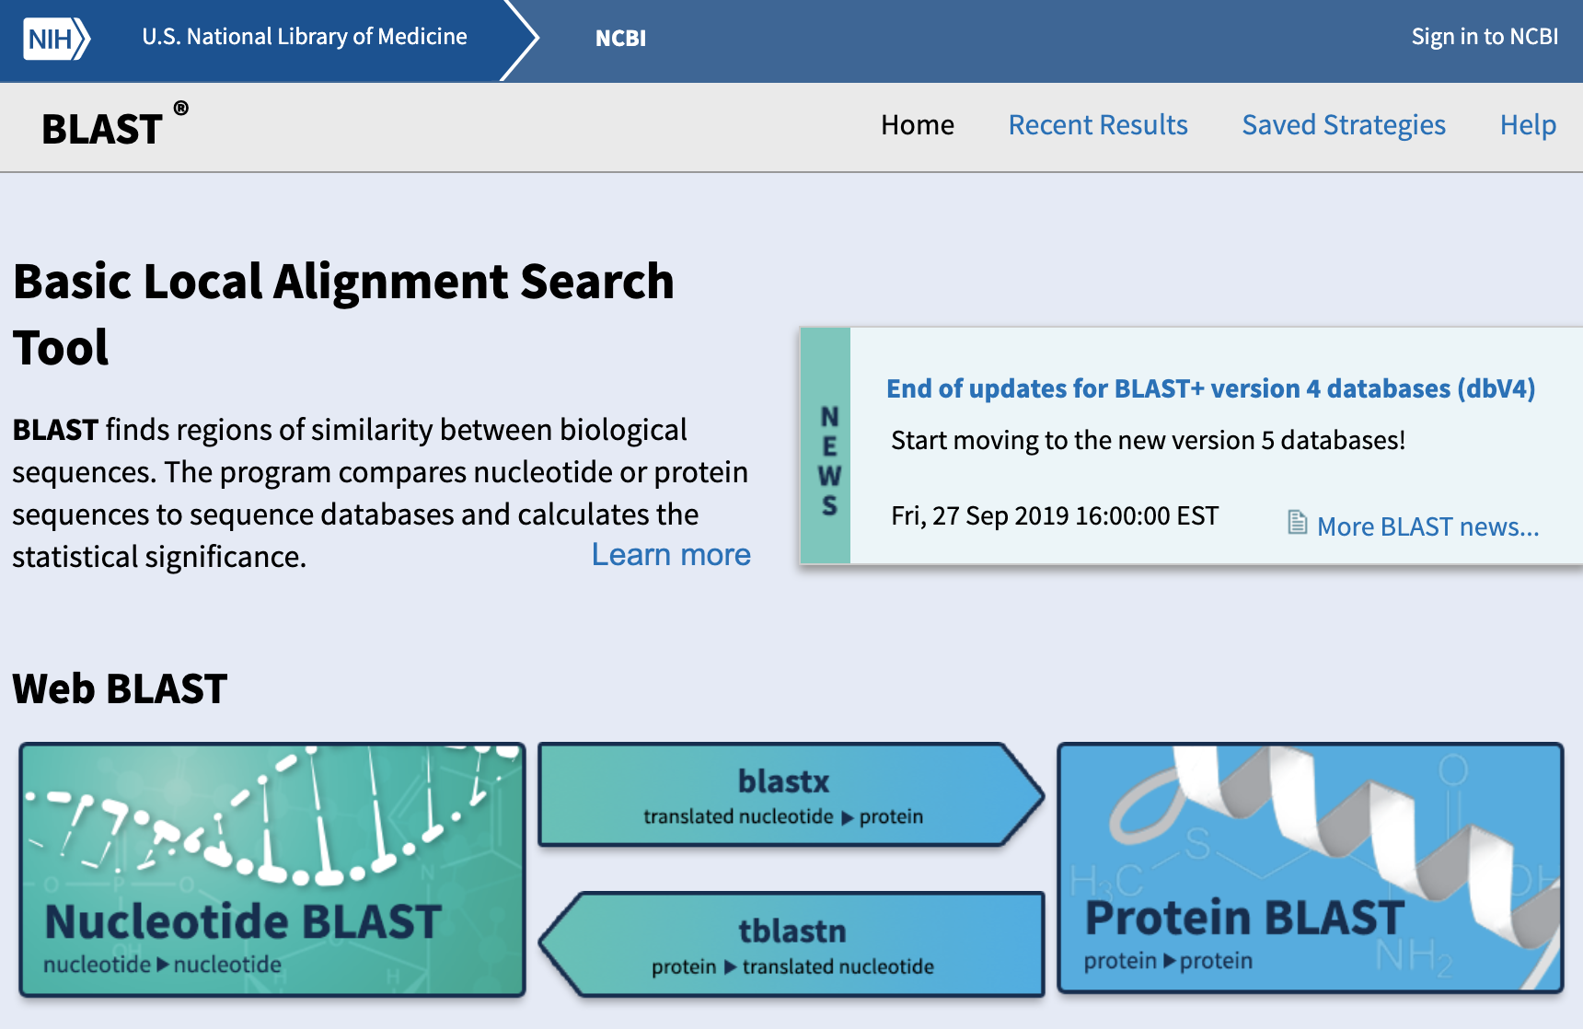
Blast Website
https://blast.ncbi.nlm.nih.gov/Blast.cgi

Slide 11
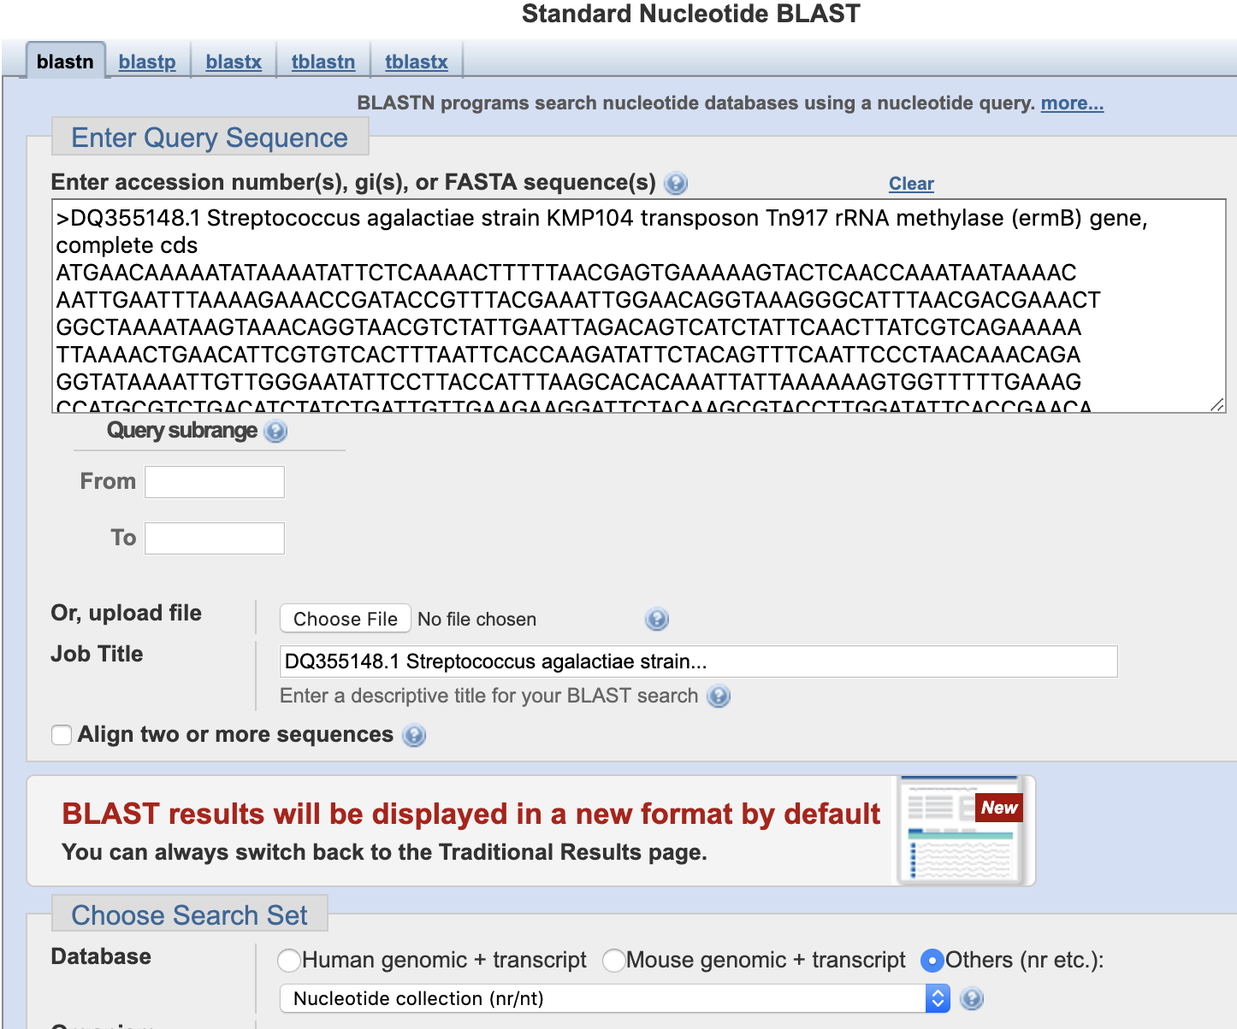
Run The Query
Use
database:
Nucleotide
collection (nr/nt)
Use database: Nucleotide collection (nr/nt)

Slide 12
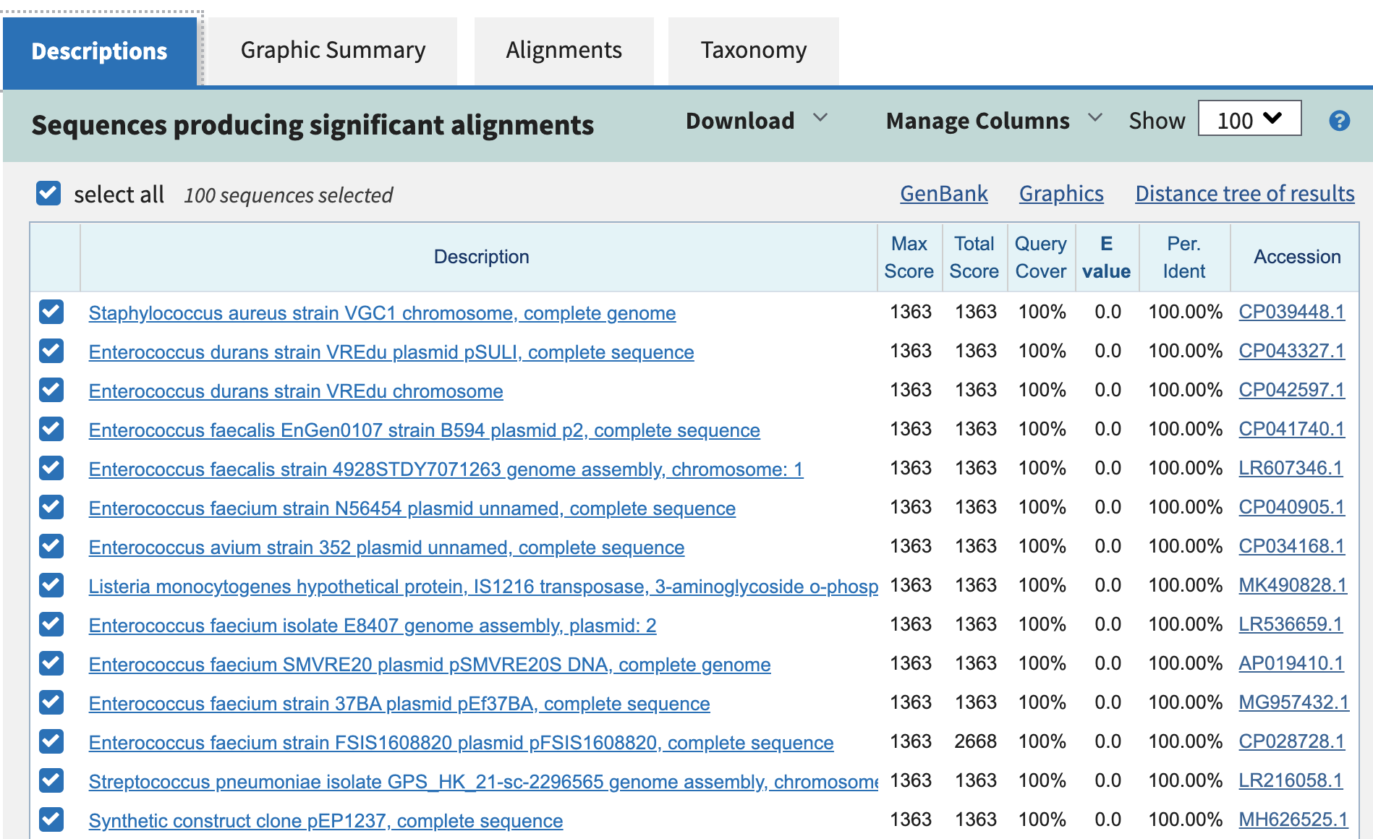
Results

Slide 13
Scores
Max Score
  The score of the best matching segment for local alignment, not global
Total Score
  The total scores of all matching segments found (same as max score if there is only one matching segment)
Query Coverage
  The percentage of the query sequence that aligned to some part of the match.
E-Value
  A statistical measure evaluating how likely it is that a match this good could occur by chance. Lower e-scores indicate that both sequences are truly similar and are not similar by chance alone. Identical sequences have e-scores of zero.
Max Indent
  The percentage of nucleotides that are identical between the query and the target sequences within the matching regions.

Slide 14
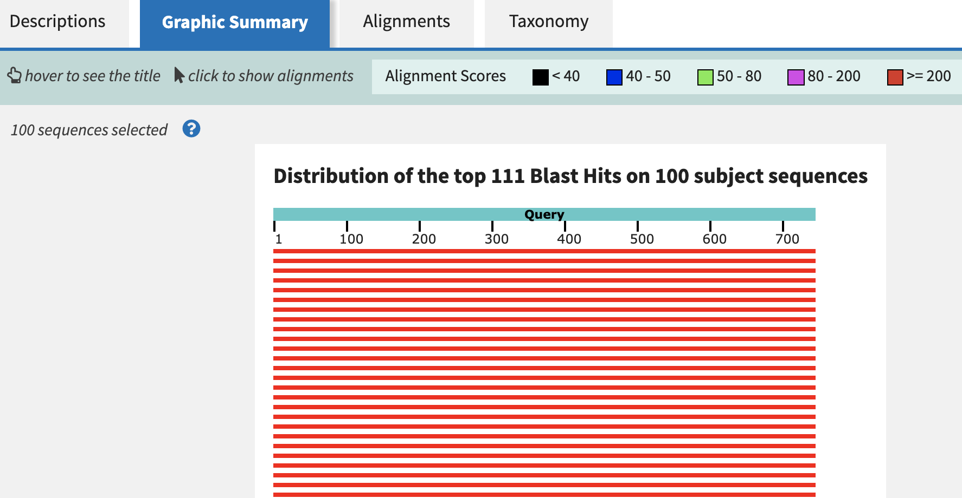
Results

Slide 15
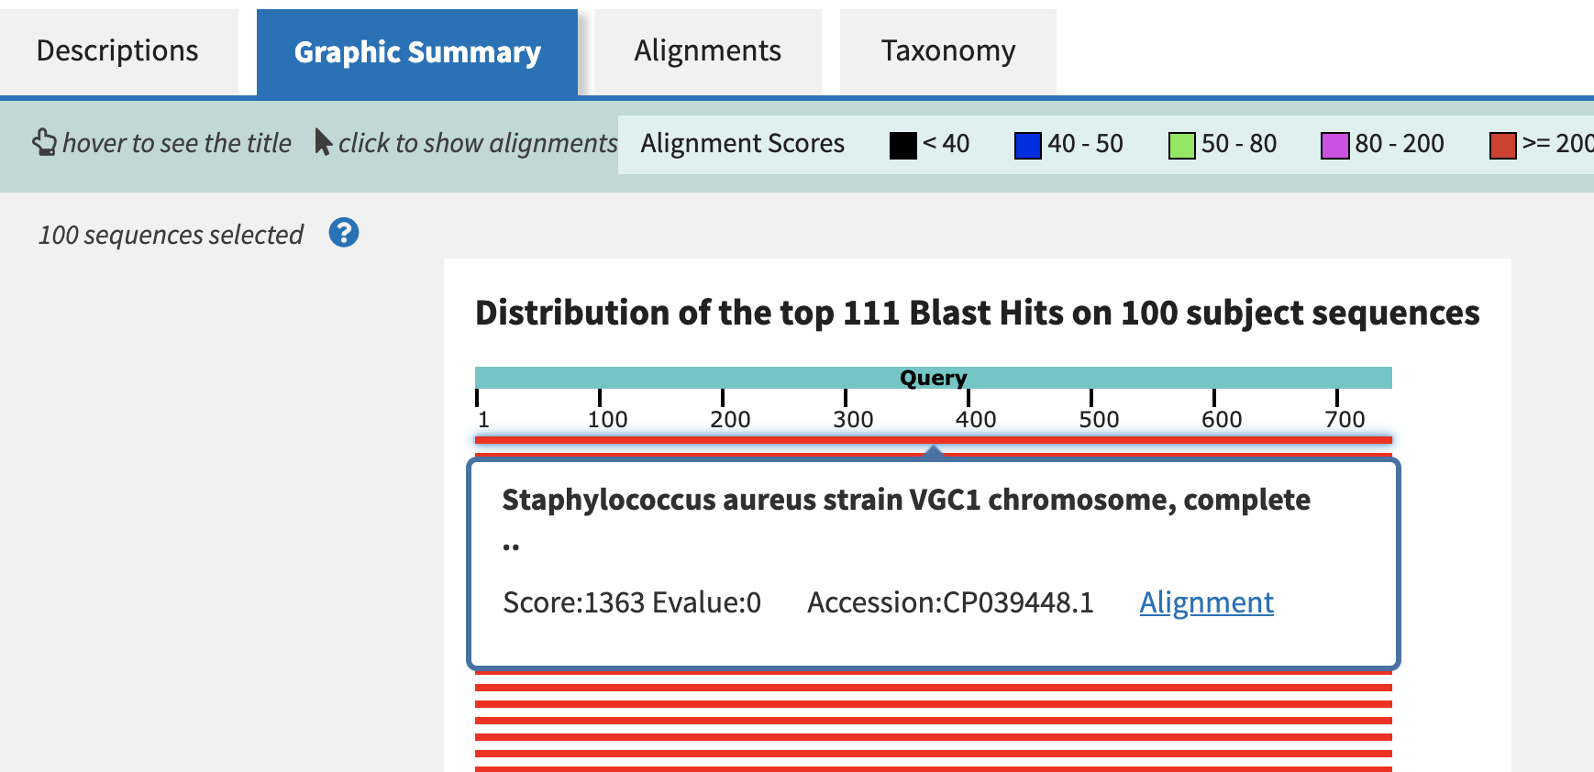
Results
Sequences
Producing
Significant
alignments.

Slide 16
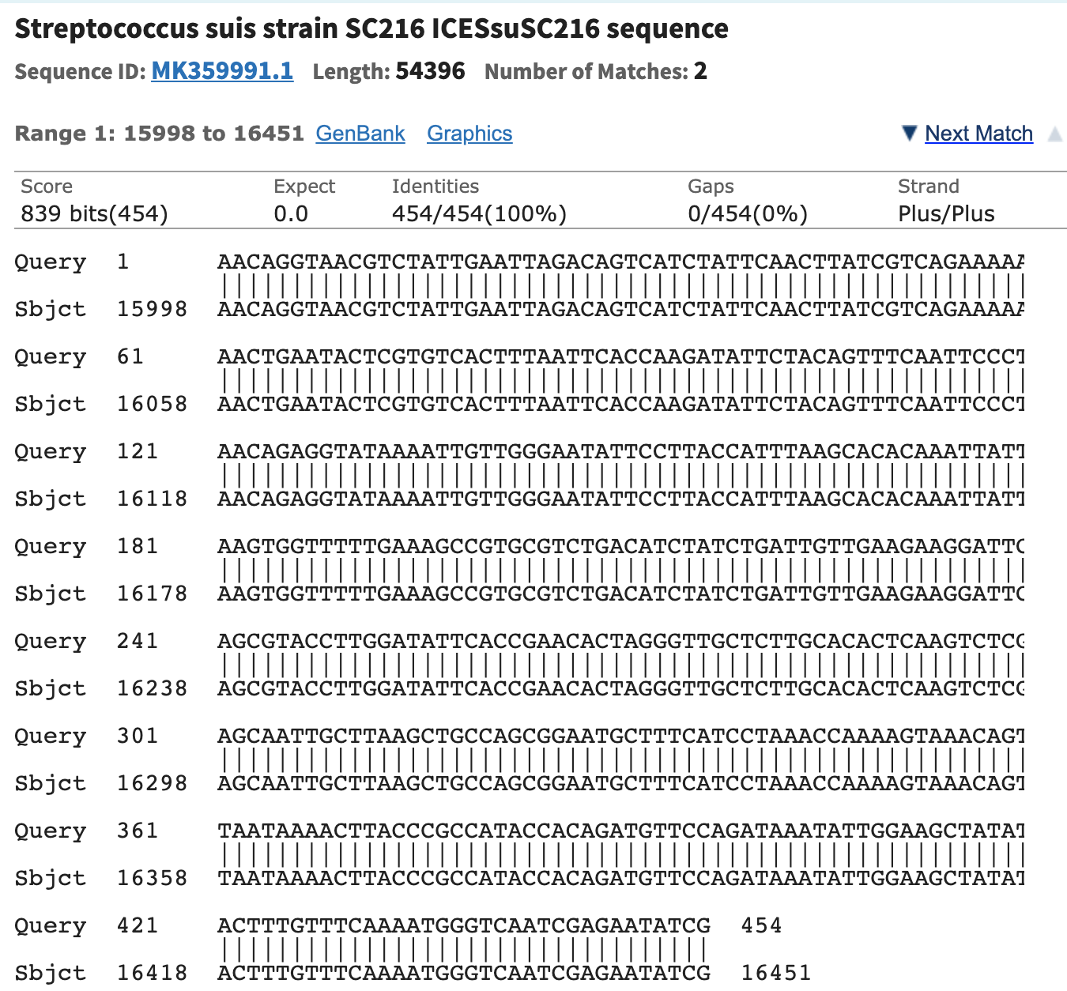
Results
An Identical
sequence in
another’s
genome

Slide 17
Back to HGT?
Typically, researchers allow for a 95% similarity between genes found between unrelated organisms.
Here, we may conclude that HGT is a good hypothesis but more research must be done to determine whether there was a chance for two organisms to be close enough to each other to share genetic material.

Slide 18
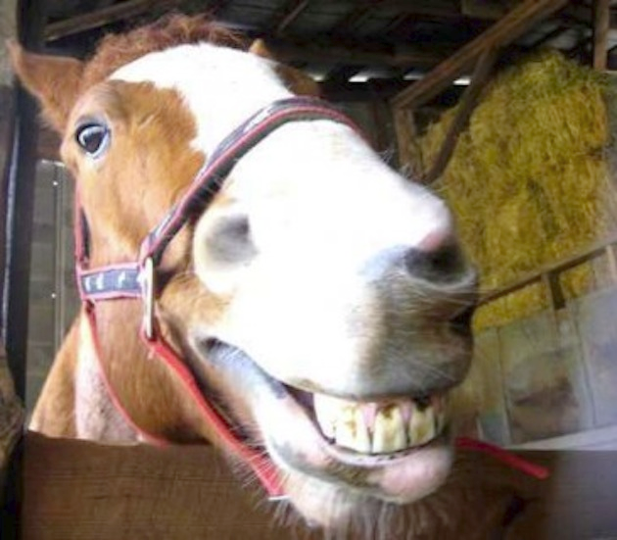
Blast is Cool!

Slide 19


Your Turn to Investigate!!!
Investigate a gene of resistance: ermA
Questions:
  What does this gene do? (hint: see Genbank record)
  About how many other organisms appear to have traces of the same gene sequence?
  What is the closest match? Which organism? What e-score?
GitHub Activity Repository:
https://classroom.github.com/a/DuBJW7yi
Due at 12:15 on 17 Oct. 2019
Make a directory: act1
Workfile: act1/blastWork.md

Slide 20
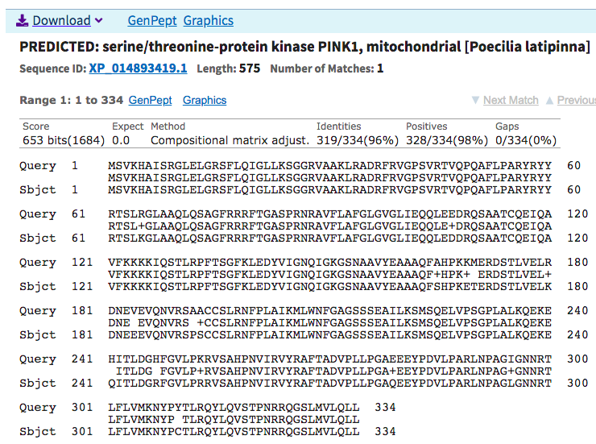
Predicted Protein Results?
Results may
not have been
experimentally
observed, DNA
can be translated
to produce this
protein.
The reading
frame of the
DNA might
produce a
different
protein than
this one

Slide 21
Header
This
This

Slide 22
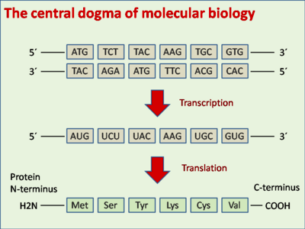
https://en.wikipedia.org/wiki/DNA_codon_table

Slide 23
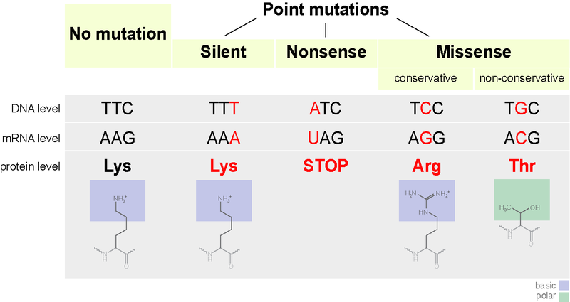
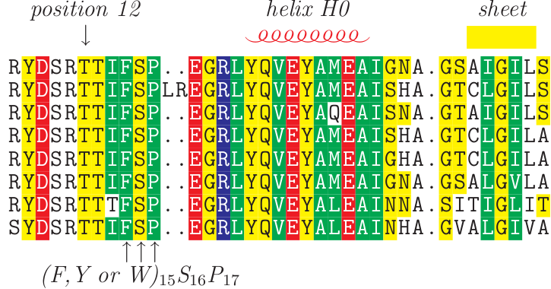
More About Silent Mutations
Redundant codons mean ~1/3 of DNA mutations often do not alter protein sequence
https://en.wikipedia.org/wiki/Silent_mutation

Slide 24
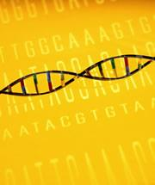

Silent Mutations
Are these mutations really so subtle?
Are there dangers involved?
  While the protein may be fine, the RNA has still has dangerous folding issues
Nature: Silent Mutations Speak Up: Overlooked genetic changes could impact on disease
  http://www.nature.com/news/2006/061221/full/news061218-12.html

Slide 25
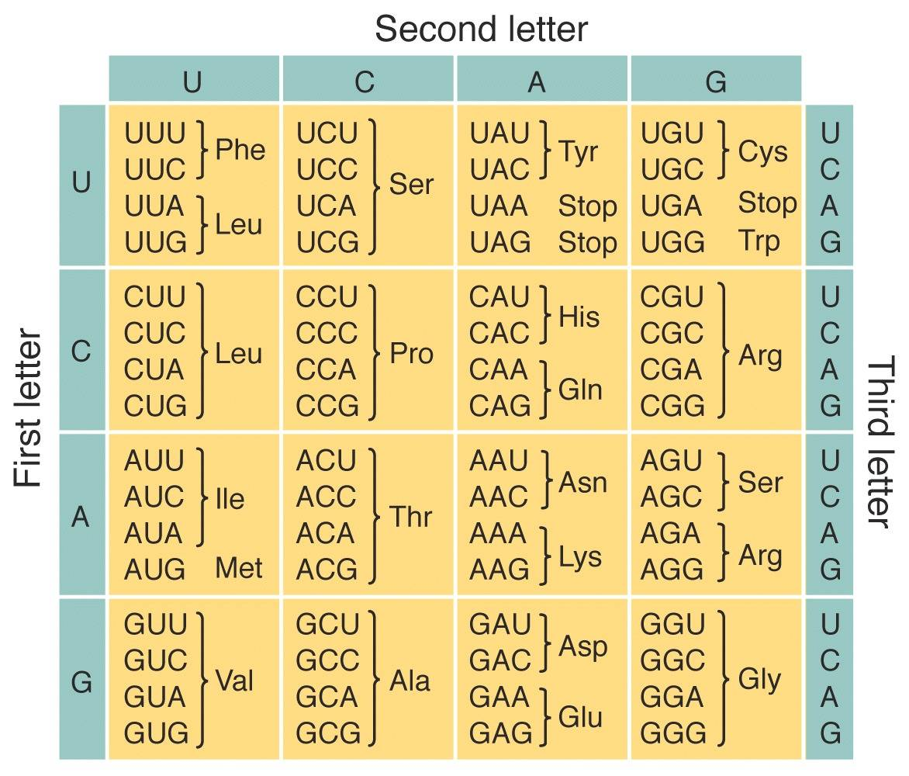
Notes:
Examples of codons from book/notes

Slide 26


Alphabetical Interests
With a larger protein “alphabet” (20 amino acids), it is much less likely to get matches by chance.
Matches are likely to be statistically significance
Amino acid changes are not equally harmful to protein structure
  Chemical complexes being replaced by similar chemical complex.
  Ex: Arginine (Arg) and Lysine (Lys)

Slide 27
Amino Acid Substitutions
Nucleotides – any substitution is “different”
Amino Acids
  Substituting similar ones is likely to retain protein structure and function
  Substituting dissimilar ones is likely to change protein structure and disrupt function

Slide 28
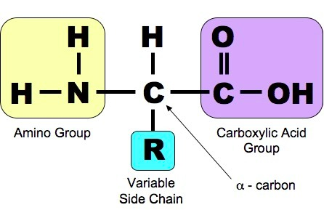
Amino Acid Substitutions

Slide 29
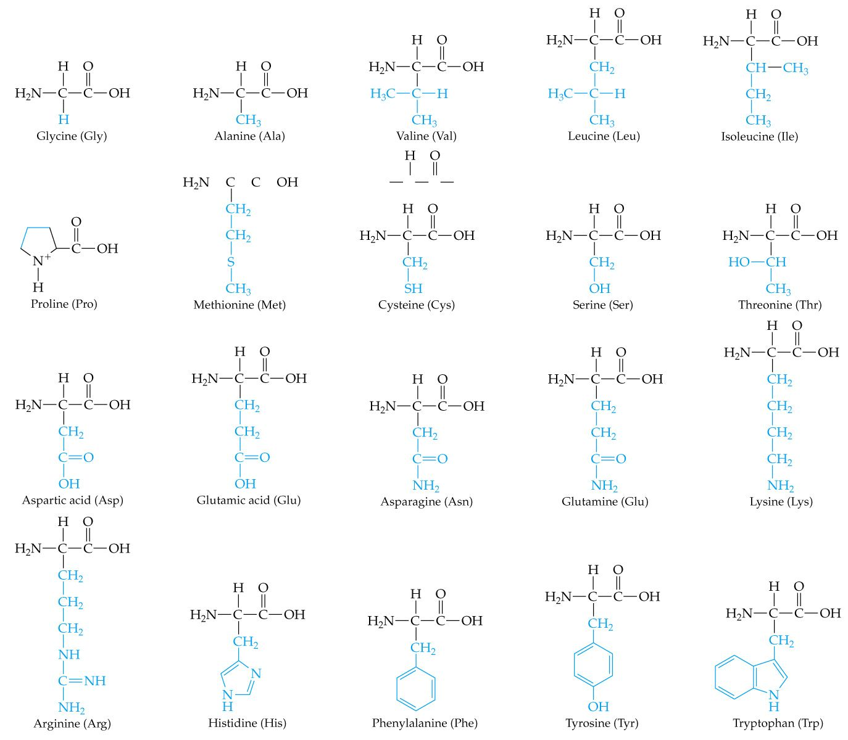
Amino Acid Substitutions

Slide 30
Amino Acid Components
Similarity of amino acids means
  Similar physicochemical properties (Physics + chemistry)
    Polar vs nonpolar
    Hydrophobic vs hydrophilic
    Positive electric charge vs negative electric charge
    Basic vs Acidic
Amino Acid Table: http://www.bio.davidson.edu/courses/genomics/jmol/aatable.html
Roles in Protein Structures
http://www.proteinstructures.com/Structure/Structure/amino-acids.html

Slide 31
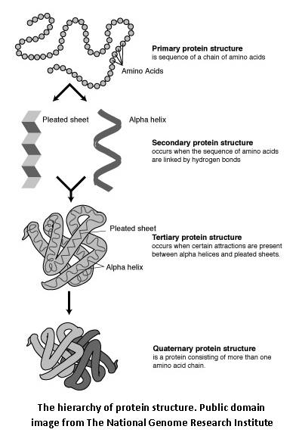
Amino Acids Determine
Protein’s Shape and Function

Slide 32
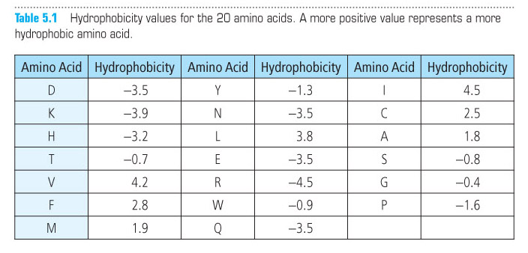
Scoring Amino Acid Substitutions
  Could we quantify sequence by physicochemical properties? (yes!)

Slide 33
Scoring Amino Acid Substitutions
Better to study evolution of real proteins from closely related organisms
Minimizes likelihood that an observed difference represents a series of more than one individual mutations
Species A – Ala Species B – Ile
Ala --> Ile : 1 mutation
Ala --> Pro --> Ser --> Ile : 3 mutations
No intermediate
mutations?
A few intermediate
mutations?

Slide 34
A Model of Evolutionary
Change in Proteins, Dayhoff et al., 1978
Global Pairwise Alignment
Observed frequency of each possible amino acid substitution:
10 log₁₀ (M_{ij}/f_{j})
M_{ij} - the probability of a mutation replacing amino i with j
f_{j} - the frequency of amino acid j in a large set of sequences

Slide 35
A Model of Evolutionary
Change in Proteins, Dayhoff et al., 1978
Global Pairwise Alignment
Observed frequency of each possible amino acid substitution:
10 log₁₀ (M_{ij}/f_{j})
Odds ratio
= 1 - substitution of j for i is no more likely than the chance of finding j randomly
> 1 - substitution is evolutionarily conserved
< 1 – substitution is selected against

Slide 36
A Model of Evolutionary
Change in Proteins, Dayhoff et al., 1978
Global Pairwise Alignment
Observed frequency of each possible amino acid substitution:
10 log₁₀ (M_{ij}/f_{j})
log-odds ratio – easier for scoring
Greater positive for likely (conservative) substitutions
Greater negative for unlikely (non-conservative) substitutions
Multiplied by 10 and rounded to nearest integer

Slide 37
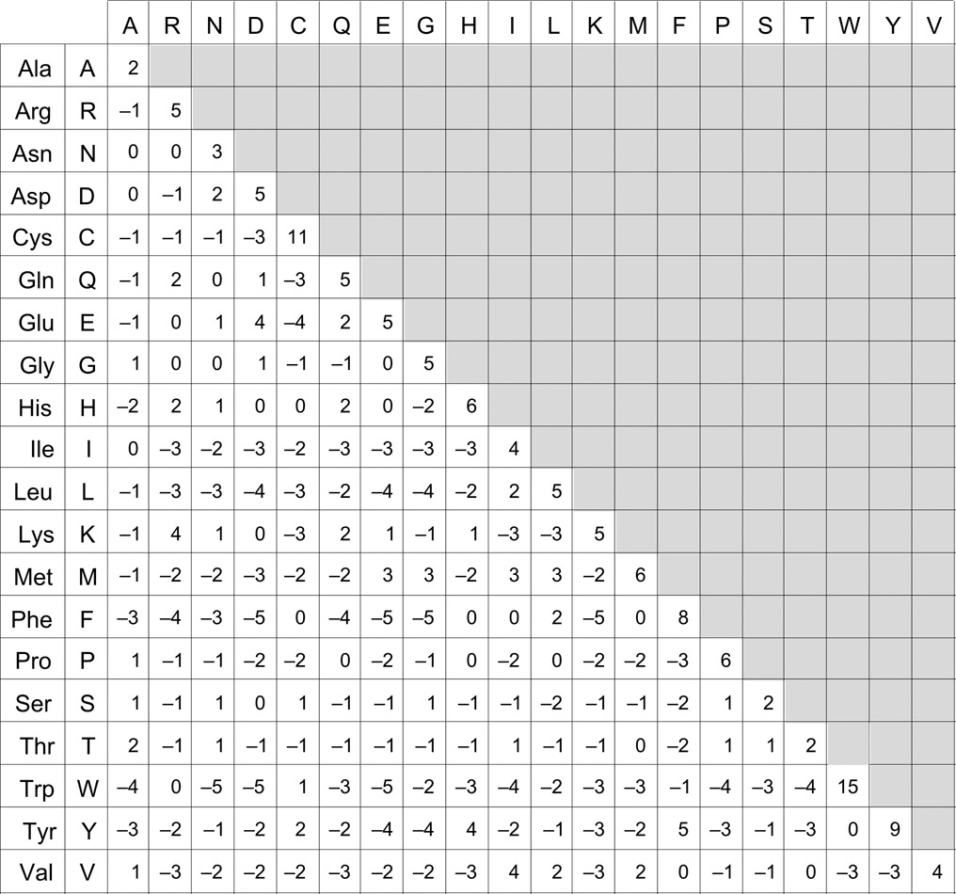
The
PAM
Matrix

Slide 38
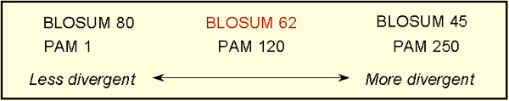
PAM matrices
Point Accepted Mutation
Family of matrices PAM 1, PAM 80, PAM 120, PAM 250
The number in the name of a PAM matrix (i.e., the ‘n’ in PAM n) represents the evolutionary distance between the sequences on which the matrix is based

Slide 39
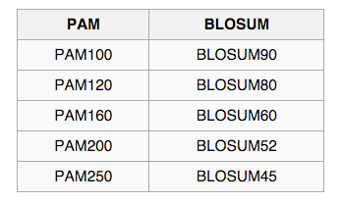
PAM vs BLOSUM
General Use
  PAM 120
  BLOSUM 62*
Closely Related Species
  PAM 60
  BLOSUM 80
Distantly Related Species
  PAM 250
  BLOSUM 45
*BLOSUM 62 – used by BLAST – computed by choosing blocks of local alignments more than 62% identical

Slide 40
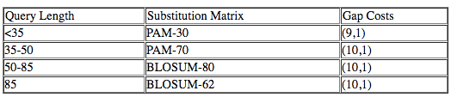
Blast Subst Matrices
Scoring for possible residue pair alignment
Different substitution matrices are for detecting similarities according to degrees of divergence.
BLOSUM-62 matrix good for detecting most weak protein similarities
Provisional table of recommended substitution matrices and gap costs for various query lengths is
https://www.ncbi.nlm.nih.gov/blast/html/sub_matrix.html

Slide 41

BLOSUM matrix
Heinkoff and Heinkoff, 1992
BLOcks SUbstition Matrix - Blocks of local alignments
p_{ij} - probability j replacing i
q_{i} and q_{j} - probabilities of finding the amino acids i and j in any protein sequence
λ - scaling factor, set such that the matrix contains easily computable integer values.
BLOSUM # - # = minimum % similarity of sequences compared

Slide 42
Needleman-Wunsch Algorithm:
Nucleotide Alignment – Chap 3
Create N x M matrix
Place each sequence along one axis
Place score 0 at the up-left corner
Fill in 1st row & column with gap penalty multiples
Fill in the matrix with max value of 3 possible moves:
  Vertical move: Score + gap penalty
  Horizontal move: Score + gap penalty
  Diagonal move: Score + match/mismatch score
The optimal alignment score is in the lower-right corner
To reconstruct the optimal alignment, trace back where the max at each step came from, stop when hit the origin.

Slide 43
Needleman-Wunsch Algorithm:
Protein Alignment – Chap 5
Create N x M matrix
Place each sequence along one axis
Place score 0 at the up-left corner
Fill in 1st row & column with gap penalty multiples
Fill in the matrix with max value of 3 possible moves:
  Vertical move: Score + gap penalty
  Horizontal move: Score + gap penalty
  Diagonal move: Score + match/mismatch score from sub. matrix
The optimal alignment score is in the lower-right corner
To reconstruct the optimal alignment, trace back where the max at each step came from, stop when hit the origin.

Slide 44
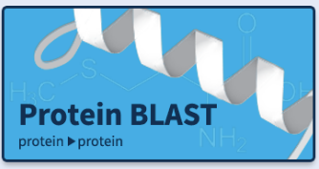
Blast-Off!!
Let’s blast some protein sequences
https://blast.ncbi.nlm.nih.gov/Blast.cgi#dtr_Query_98931

Slide 45

Python Programming
Biopython
DNA Manipulation Algorithm
Translation functions
  DNA → RNA
  RNA → DNA
  RNA → Protein
Follow along in
class and save
your notes in
a text file!!
  Follow along and Save your notes in a text file.

