Slide 1
Bioinformatics
CS300
Genome Sequencing and Assembly
Fall 2017
Oliver Bonham-Carter

Slide 2

What is a Genome?
An organism’s complete set of DNA, including all of its genes, regulatory regions, non-coding regions, etc.
An organism’s complete set of genetic instructions

Slide 3
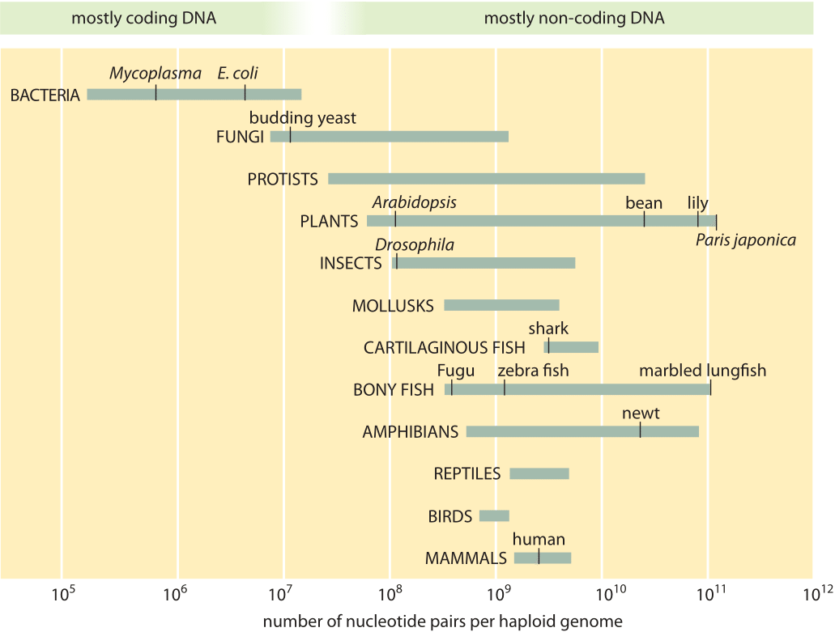

Slide 4
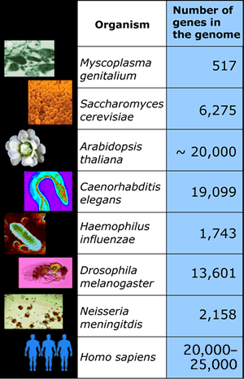
What Is In a Genome?

Slide 5
Genome Projects
Goals:
  Determine complete genome sequence of an organism
  Annotate protein-coding genes and other important genome-encoded features

Slide 6
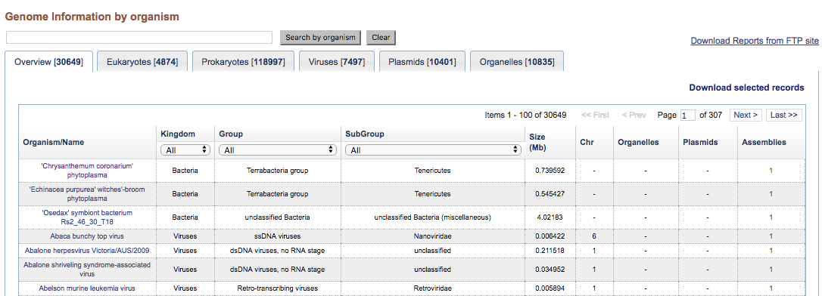


Genome Projects
Projects:
  Over 15,000 genome projects in progress or completed
https://www.ncbi.nlm.nih.gov/genome/browse/
Cancer Genomics
Shotgun Metagenomics

Slide 7
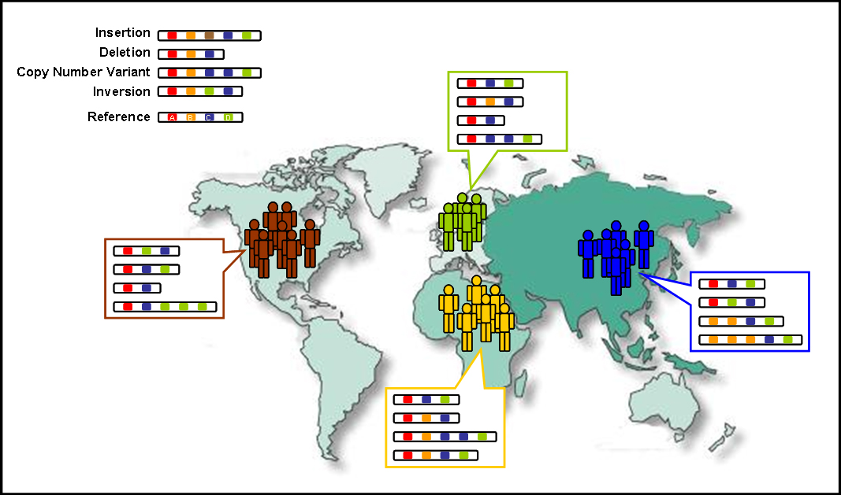
Genome Projects
Contrast genetic material of populations to determine ancestry
https://en.wikipedia.org/wiki/1000_Genomes_Project#Human_genetic_variation
Cancer Genomics
Shotgun Metagenomics

Slide 8
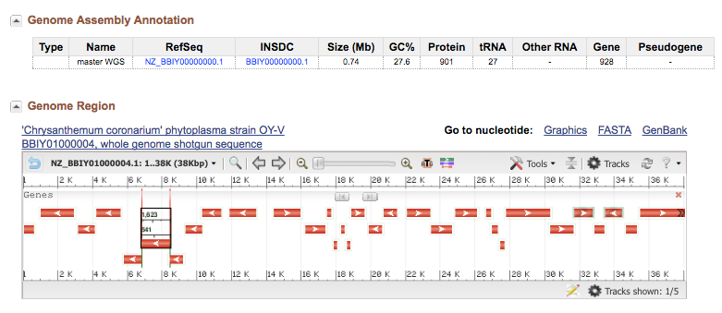
Genome Projects: Data
Locate genes for proteins in sequences.
https://www.ncbi.nlm.nih.gov/genome/browse/

Slide 9
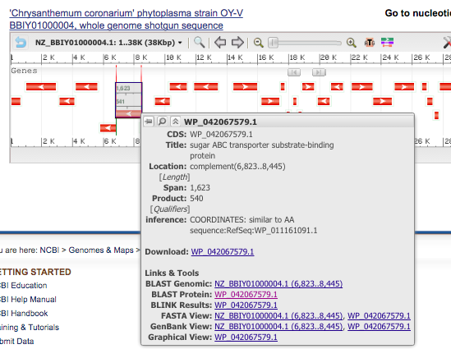
Genome Projects: Data
Protein meta data
Run
Blast

Slide 10
Human Genetic Variation
Having diverse human genetic information helps to spot genetic conditions
Genetic drift: a random fluctuation in the population frequency of a trait
  Occurring in subsequent generations and would result in the loss of all variation in the absence of external influence

Slide 11

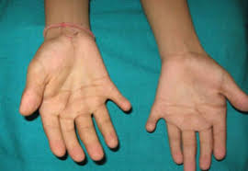
Detection By Comparison
Early detection of genetic problems by being able to compare genomes to some “wild-type” genome.
Ellis-Van Creveld syndrome, a sixth finger
Hapsburg jaw

Slide 12
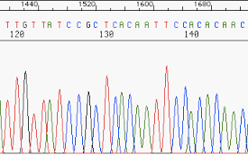
Genome Sequencing
Bases are recorded as little peaks
Reads = Small segments of DNA from sequencer machine
Contigs = Segments of partially combined reads

Slide 13
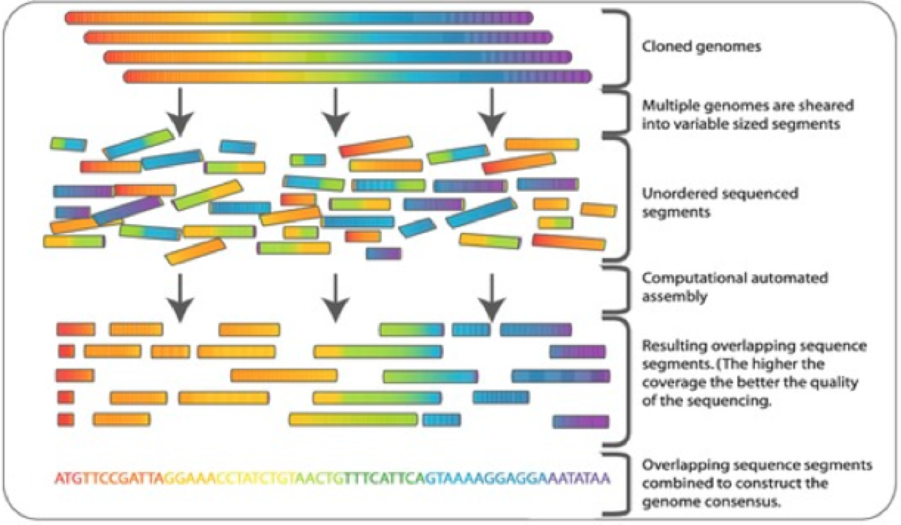
Genome Sequencing
Combine pieces like a jigsaw puzzle

Slide 14
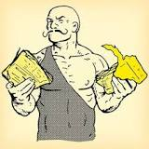
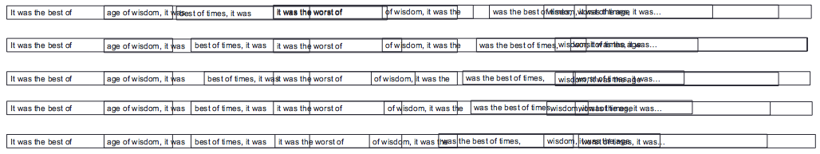
Shredded Book Reconstruction
Dickens accidentally shreds first printing of Tale of Two Cities

Slide 15
times, it was the age
It was the best of
age of wisdom, it was
best of times, it was
it was the age of
it was the age of
it was the worst of
of times, it was the
of times, it was the
of wisdom, it was the
the age of wisdom, it
the best of times, it
the worst of times, it
worst of times, it was
wisdom, it was the age
was the worst of times,
was the best of times,
was the age of foolishness,
was the age of wisdom
times, it was the worst

Slide 16
times, it was the age
It was the best of
age of wisdom, it was
best of times, it was
it was the age of
it was the age of
it was the worst of
of times, it was the
of times, it was the
the best of times, it
of wisdom, it was the
the age of wisdom, it
the best of times, it
the worst of times, it
worst of times, it was
wisdom, it was the age
was the worst of times,
was the best of times,
was the age of foolishness,
was the age of wisdom
times, it was the worst

Slide 17
times, it was the age
It was the best of
age of wisdom, it was
best of times, it was
it was the age of
it was the age of
it was the worst of
of times, it was the
of times, it was the
the best of times, it
of wisdom, it was the
best of times, it was
the age of wisdom, it
the best of times, it
the worst of times, it
worst of times, it was
wisdom, it was the age
was the worst of times,
was the best of times,
was the age of foolishness,
was the age of wisdom
times, it was the worst

Slide 18
times, it was the age
It was the best of
age of wisdom, it was
best of times, it was
it was the age of
it was the age of
it was the worst of
of times, it was the
of times, it was the
the best of times, it
of wisdom, it was the
best of times, it was
the age of wisdom, it
the best of times, it
the worst of times, it
worst of times, it was
wisdom, it was the age
was the worst of times,
was the best of times,
was the age of foolishness,
Assembly Parameter:
100% identify across 4 words
was the age of wisdom
times, it was the worst

Slide 19
times, it was the age
It was the best of
age of wisdom, it was
best of times, it was
it was the age of
it was the age of
it was the worst of
of times, it was the
was the best of times,
of times, it was the
the best of times, it
of wisdom, it was the
best of times, it was
the age of wisdom, it
the best of times, it
the worst of times, it
worst of times, it was
wisdom, it was the age
was the worst of times,
was the best of times,
was the age of foolishness,
Assembly Parameter:
100% identify across 4 words
was the age of wisdom
times, it was the worst

Slide 20
times, it was the age
It was the best of
age of wisdom, it was
best of times, it was
it was the age of
it was the age of
it was the worst of
It was the best of
of times, it was the
was the best of times,
of times, it was the
the best of times, it
of wisdom, it was the
best of times, it was
the age of wisdom, it
the best of times, it
the worst of times, it
worst of times, it was
wisdom, it was the age
was the worst of times,
was the best of times,
was the age of foolishness,
Assembly Parameter:
100% identify across 4 words
was the age of wisdom
times, it was the worst

Slide 21
times, it was the age
It was the best of
age of wisdom, it was
best of times, it was
it was the age of
it was the age of
it was the worst of
It was the best of
of times, it was the
was the best of times,
of times, it was the
the best of times, it
of wisdom, it was the
best of times, it was
the age of wisdom, it
of times, it was the
the best of times, it
of times, it was the
the worst of times, it
worst of times, it was
wisdom, it was the age
was the worst of times,
was the best of times,
was the age of foolishness,
was the age of wisdom
times, it was the worst

Slide 22
Tale of Two Cities
Charles Dickens
It was the best of times, it was the worst of times, it was the age of wisdom, it was the age of foolishness, it was the epoch of belief, it was the epoch of incredulity, it was the season of Light, it was the season of Darkness, it was the spring of hope, it was the winter of despair, we had everything before us, we had nothing before us, we were all going direct to Heaven, we were all going direct the other way - in short, the period was so far like the present period, that some of its noisiest authorities insisted on its being received, for good or for evil, in the superlative degree of comparison only.

Slide 23
times, it was the age
It was the best of
age of wisdom, it was
Repeats pile up – actual placement of each individual fragment unknown
best of times, it was
it was the age of
it was the age of
it was the worst of
It was the best of
of times, it was the
was the best of times,
of times, it was the
the best of times, it
of wisdom, it was the
best of times, it was
the age of wisdom, it
of times, it was the
the best of times, it
of times, it was the
the worst of times, it
worst of times, it was
wisdom, it was the age
was the worst of times,
was the best of times,
was the age of foolishness,
Assembly Parameter:
100% identify across 4 words
was the age of wisdom
times, it was the worst

Slide 24
times, it was the age
It was the best of
Repeats pile up – actual placement of each individual fragment unknown
Repeats can cause ambiguity and prevent proper assembly
age of wisdom, it was
best of times, it was
it was the age of
it was the age of
it was the worst of
It was the best of
of times, it was the
was the best of times,
of times, it was the
the best of times, it
of wisdom, it was the
best of times, it was
the age of wisdom, it
of times, it was the
the best of times, it
of times, it was the
the worst of times, it
times, it was the age
worst of times, it was
times, it was the worst
wisdom, it was the age
was the worst of times,
was the best of times,
was the age of foolishness,
Assembly Parameter:
100% identify across 4 words
was the age of wisdom
times, it was the worst

Slide 25
times, it was the age
It was the best of
Repeats pile up – actual placement of each individual fragment unknown
Repeats can cause ambiguity and prevent proper assembly
age of wisdom, it was
best of times, it was
it was the age of
it was the age of
it was the worst of
It was the best of
of times, it was the
was the best of times,
of times, it was the
the best of times, it
of wisdom, it was the
best of times, it was
the age of wisdom, it
of times, it was the
the best of times, it
of times, it was the
the worst of times, it
times, it was the age
worst of times, it was
times, it was the worst
wisdom, it was the age
was the worst of times,
It was the best of times, it was the [age/worst]
was the best of times,
was the age of foolishness,
Assembly Parameter:
100% identify across 4 words
was the age of wisdom
times, it was the worst

Slide 26
Genome Sequencing

Slide 27
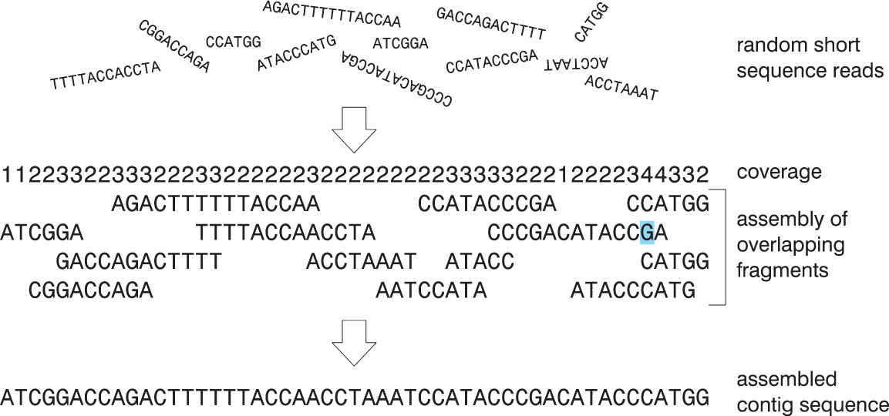
Coverage

Slide 28
Finding the Largest Overlap
Consider two fragment assembly:
  If there is more than one overlap, choose the longest overlap
  Assume the sequences are not identical
  Assume neither sequence is a substring of the other
  The longest possible overlap is length of the shorter sequence-1

Slide 29
Finding the Largest Overlap
Consider two fragment assembly:
  If there is more than one overlap, choose the longest overlap
  Assume the sequences are not identical
  Assume neither sequence is a substring of the other
  The longest possible overlap is length of the shorter sequence-1

Slide 30
Finding the Largest Overlap
Consider two fragment assembly:
  If there is more than one overlap, choose the longest overlap
  Assume the sequences are not identical
  Assume neither sequence is a substring of the other
  The longest possible overlap is length of the shorter sequence-1

Slide 31
Dealing with Noisy Sequencing Data
Sequencing errors
Ambiguities leading to incorrect base-calling
Modify the algorithm so that the overlap exceeds some threshold value (instead of being perfect match)
  Check if the number of matching bases is threshold value x n
  With the threshold value being between 0 and 1

Slide 32
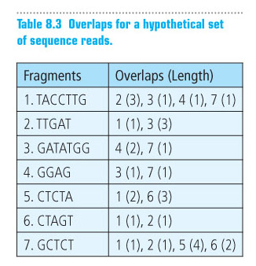
Assembling a Contig

Slide 33
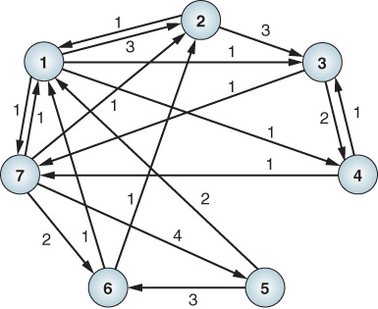
Assembling a Contig: graph representation

Slide 34
Header
This
This

Slide 35
Header
This
This

Slide 36


Blast-Off!!
Let’s blast some protein sequences
https://blast.ncbi.nlm.nih.gov/Blast.cgi#dtr_Query_98931

Slide 37

Python Programming
Biopython
DNA Manipulation Algorithm
Translation functions
  DNA → RNA
  RNA → DNA
  RNA → Protein
Follow along in
class and save
your notes in
a text file!!
  Follow along and Save your notes in a text file.

