Slide 1
Genome Annotation: Sequence-Based Gene Prediction
BIO 300/CMPSC 300
Dr. Kristen Webb
Spring 2016

Slide 2
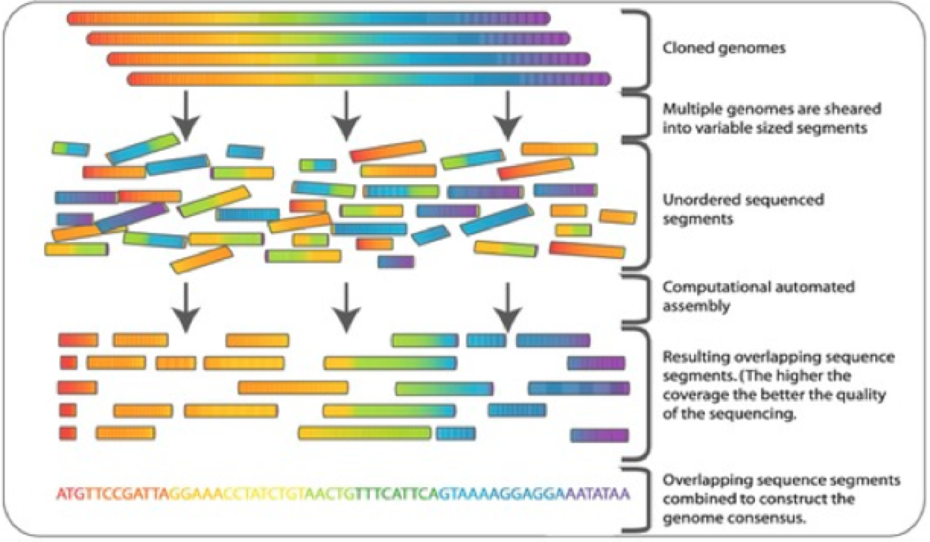
Genome Projects
Goals:
  Determine complete genome sequence of an organism
Notes:
Handed a textbook but it’s in a different language – that you don’t speak or read – can see there’s a lot of information, but it doesn’t really make sense to you.

Slide 3
Genome Projects
Goals:
  Determine complete genome sequence of an organism
  Annotate protein-coding genes and other important genome-encoded features
    find
    identify
    characterize
    describe
Notes:
Give meaning to the text
Where are the genes? Where are the regulatory regions? Where are the non-coding regions?

Slide 4
Genome Projects
Goals:
  Determine complete genome sequence of an organism
  Annotate protein-coding genes and other important genome-encoded features
    find
    identify
    characterize
    describe
    computational predictions later confirmed at the lab bench
Notes:
Mutate regions we suspect are functional (we break them) and then observe the consequences.
Ex – think you found the gene that codes for hemoglobin, create a mutant were that DNA sequence is altered – early stop codon or something – observe that hemoglobin protein is not produced – that’s your gene for hemoglobin.

Slide 5
Prediction Algorithms
Alignment-based – find genes/features based on conserved sequences is well-studied organisms (database searching)
  Automatic assignment based on sequence similarity (best BLAST hit): gene name, protein name, function
  Quality vs Quantity
Notes:
similar sequences must be in the database
How similar is similar enough to be considered same gene/feature? Might mistakenly identify something that’s really different. Might overlook/miss features that are functional.

Slide 6
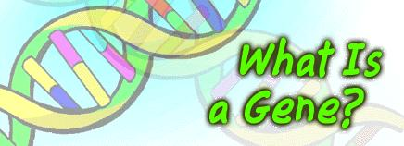
Prediction Algorithms
Sequence-based – find features based on specific sequences

Slide 7
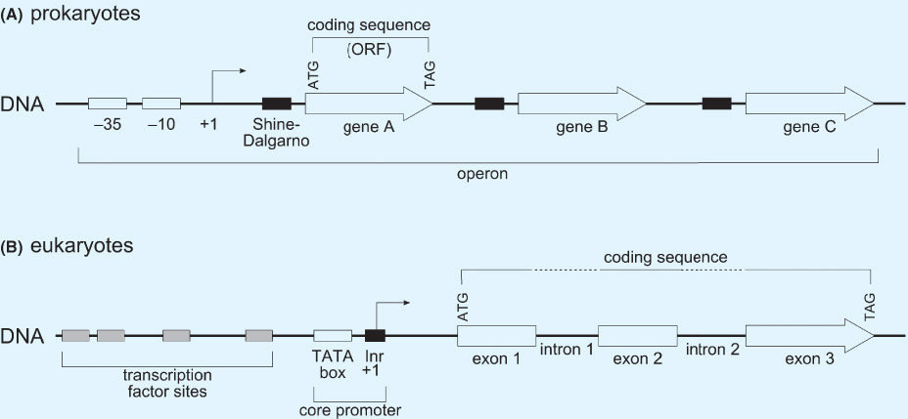
Prediction Algorithms
Sequence-based – find features based on specific sequences

Slide 8
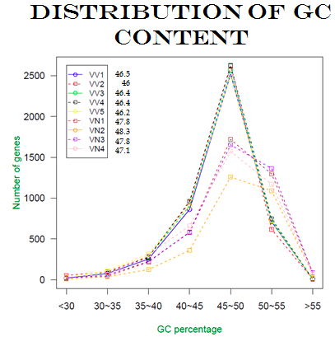
Prediction Algorithms
Content-based – consider overall properties of the sequence when making predictions
  nucleotide frequency
  codon frequency/codon bias
GC Content for all V. vulnificus and V.naverensis gene predictions

Slide 9
Prediction Algorithms
Content-based – consider overall properties of the sequence when making predictions
  nucleotide frequency
  codon frequency/codon bias
GC Content for all V. vulnificus and V.naverensis gene predictions - Most of the genomes contained a high percentage of genes with GC contents between 45-50%.

Slide 10
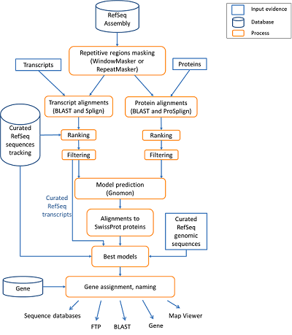
Prediction Algorithms
Probabilistic – combination of sequence-based and content-based plus probability
  “annotation pipeline”

Slide 11
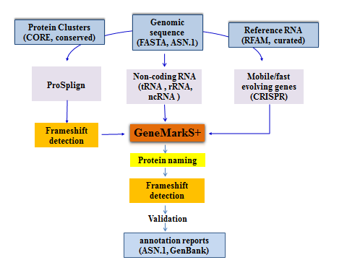
NCBI Prokaryotic Annotation Pipeline
Combines sequence-based algorithm with alignment-based approach
  Protein-coding genes
  Structural RNAs (5S, 16S, 23S)
  Transfer RNAs
  Small non-coding RNAs
Rely only on properties of DNA and training set of genes
http://www.ncbi.nlm.nih.gov/genome/annotation_prok/process/

Slide 12
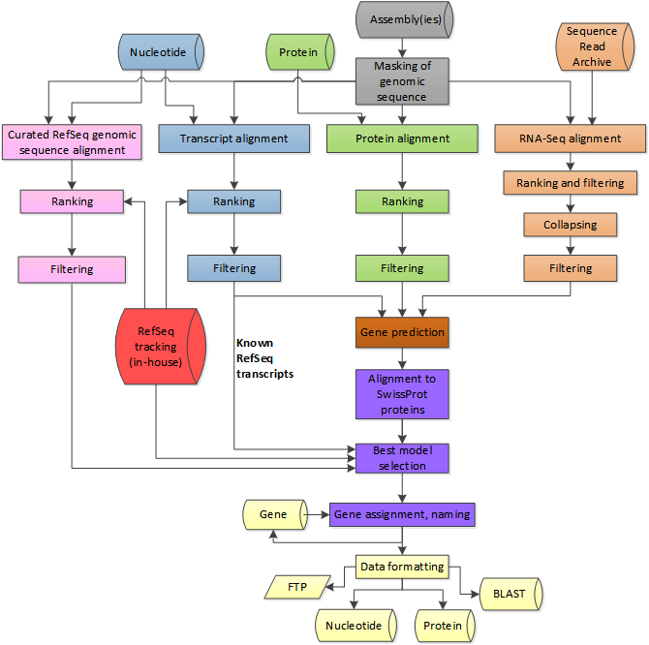
NCBI Eukaryotic Annotation Pipeline
http://www.ncbi.nlm.nih.gov/genome/annotation_euk/process/

Slide 13
NCBI Eukaryotic Annotation Pipeline
masking
  try to identify and ignore non-coding regions
alignment-based predictions
sequence/content-based predictions from alignment-based
best selected (probability), named, and released
http://www.ncbi.nlm.nih.gov/genome/annotation_euk/process/

Slide 14
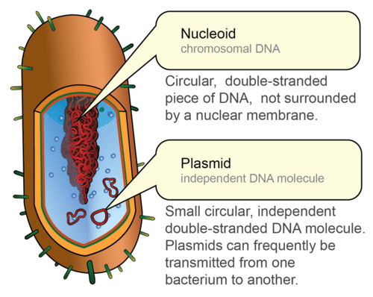
Prokaryotic versus Eukaryotic Genomes
Prokaryotes
  1 circular chromosome
    “genome”
  extra DNA in plasmids
    smaller, self-replicating

Slide 15
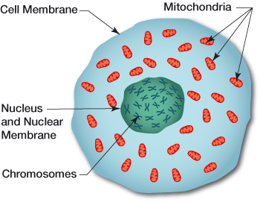
Prokaryotic versus Eukaryotic Genomes
Eukaryotes
  Multiple linear chromosomes
    “genome”
  Extra DNA in mitochondria/chloroplast
Notes:
Some do have plasmids – okay to simplify and say no plasmids
Some operons – okay to simplify and say no operons

Slide 16
Prokaryotic versus Eukaryotic Genomes
Organism | Amount of DNA (bp) | # of genes | Genes per million bases
Escherichia coli | 4,600,000 | 4,400 | 950
Saccharomyces cerevisiae | 12,000,000 | 5,800 | 480
Drosophila melanogaster | 180,000,000 | 13,700 | 76
Mus musculus | 2,600,000,000 | 25,000 | 11
Homo sapiens | 2,900,000,000 | 25,000 | 10
Notes:
more nucleotides to sift through to find genes

Slide 17
Need to know feature structure
Comparison of Prok vs Euk transcription unit structures

Slide 18
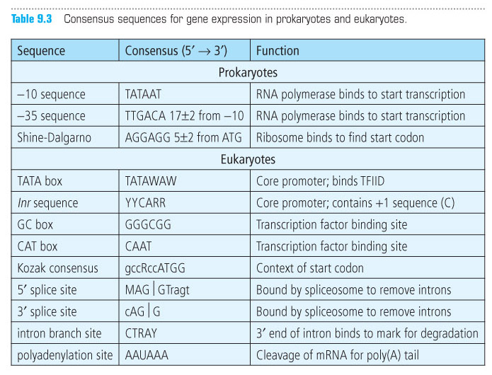
Consensus Sequences

Slide 19
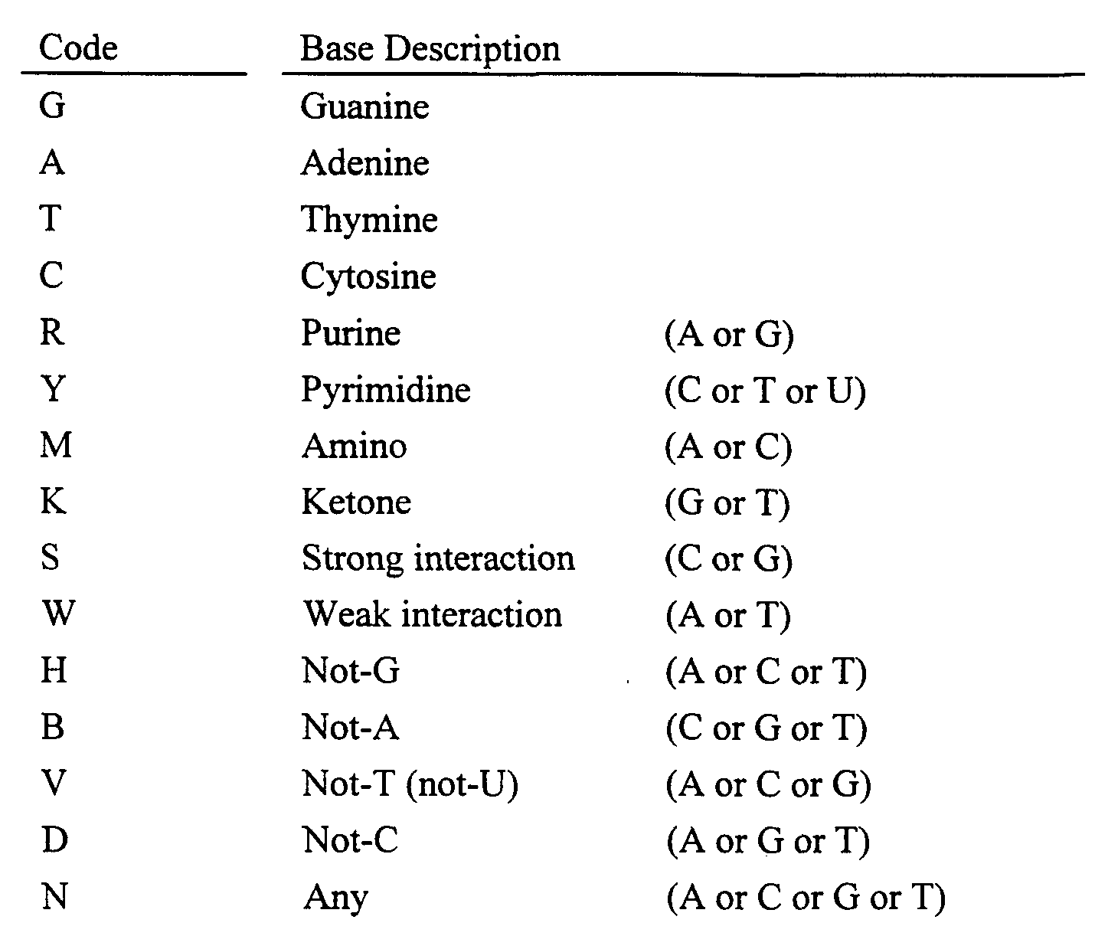
IUB Ambiguity Codes

Slide 20
Open Reading Frame
Notes:
ORF – open reading frame – sequence that has the potential to code for a protein
Starts with a start codon – ATG – ends with a stop codon – TGA, TAG, TAA

Slide 21
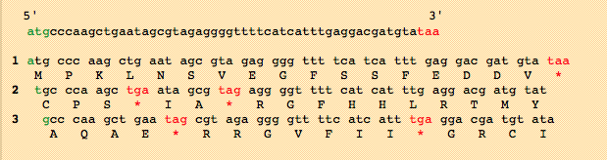
Open Reading Frame (ORF)
Notes:
Every region of DNA has six possible reading frames, three in each direction. Usually longest open reading frame is the one that codes for the gene

Slide 22
Class Activity: NCBI – ORF Finder
Use NCBI ORF Finder to annotate a plasmid
Describe generic pattern-matching algorithm using ORF finder as an example

