Slide 1
Bioinformatics
CS300
Prediction and
Modeling Protein Structure
Fall 2019
Oliver BONHAM-CARTER

Slide 2


Exam 2
Monday 18th November 2019 during lab.
Multiple choice and very similar to exam 1
Ten questions, ten points a piece.
Conceptually-oriented, concerning material from class discussion, slides and activities

Slide 3
General Topics
Gene sequencing
Horizontal gene transfer
Blast, tasks and outputs
Annotation tasks for a newly sequenced genomes
Gene prediction; concepts
Genomes; main differences in terms of annotation
  Prokaryotic and Eukaryotic
Substitution matrices
Translation of Genes in DNA
Open reading frames, NCBI’s ORF finder tool
Gene prediction landmarks
Protein Folding

Slide 4

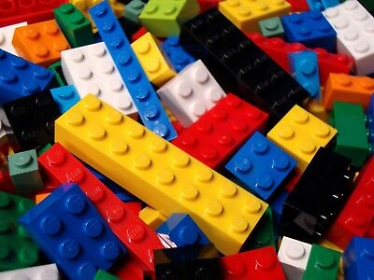
Properties From
Combining Pieces
From
these
pieces?
A cool living room
made from Lego pieces!

Slide 5
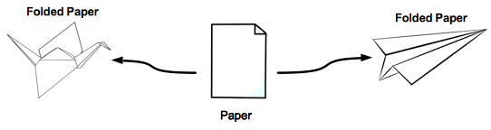



Properties From Folding

Slide 6
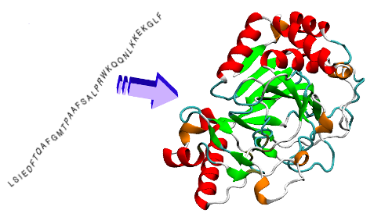
Protein Folding
linear chain of amino acids produced by ribosome during translation
folds into functional, 3D state based on properties of amino acids and structure

Slide 7
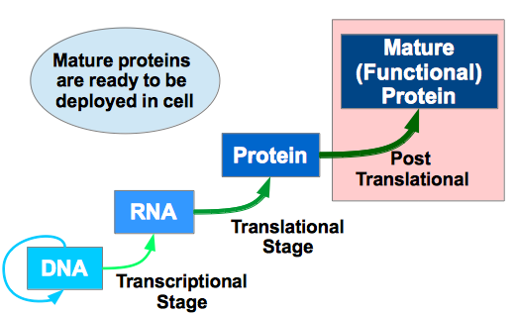
Protein Folding and the
Central Dogma of Biology
Folding
Stage!

Slide 8
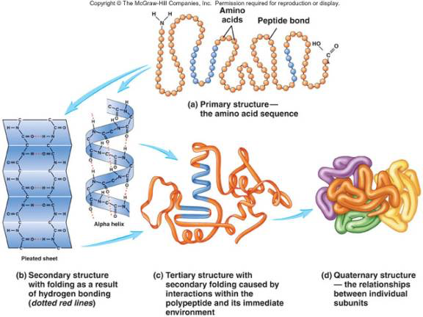
Protein Folding: Four Stages
Linear chain of amino acids produced by ribosome during translation
Folds into functional, 3D state based on properties of amino acids and structure

Slide 9
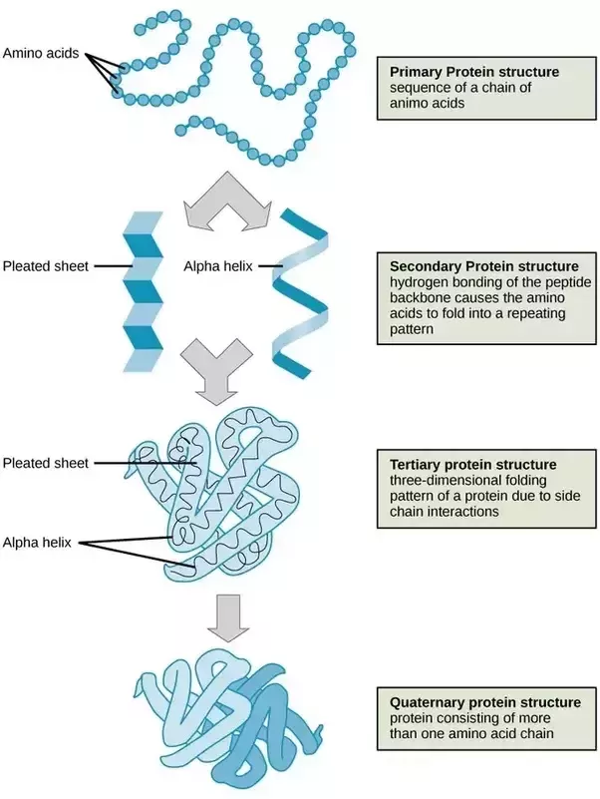
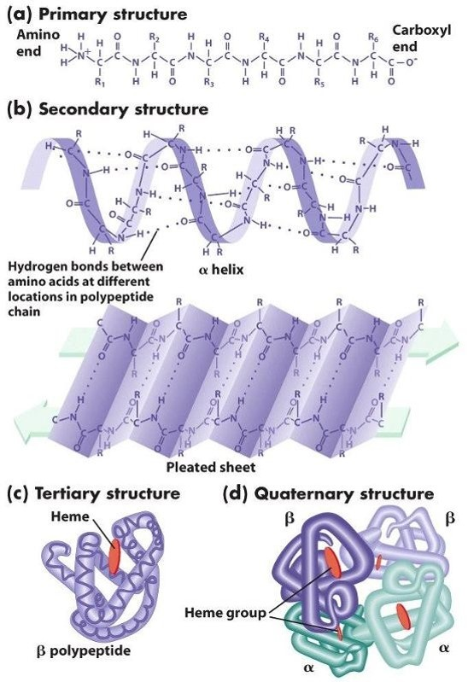
Protein
Folding:
Another
View

Slide 10

Supporting Videos
Protein Folding (3 mins)
  https://www.youtube.com/watch?v=yZ2aY5lxEGE
What is a protein? (3D shape and function, 3 mins)
  https://www.youtube.com/watch?v=qBRFIMcxZNM
Protein folding simulation (3 mins)
  https://www.youtube.com/watch?v=meNEUTn9Atg

Slide 11
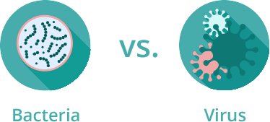
Protein Folding - Applications
Protein must fold correctly to function
Misfolded proteins
  Accumulation – Huntington’s and Parkinson’s disease
  Tagged for degradation – emphysema, cystic fibrosis
    Pharmaceutical chaperones – fold mutated proteins to render them functional
Antiviral drug development
  Antibiotics vs antivirals
    Bacteria – cells
    Viruses – invade host’s cells

Slide 12
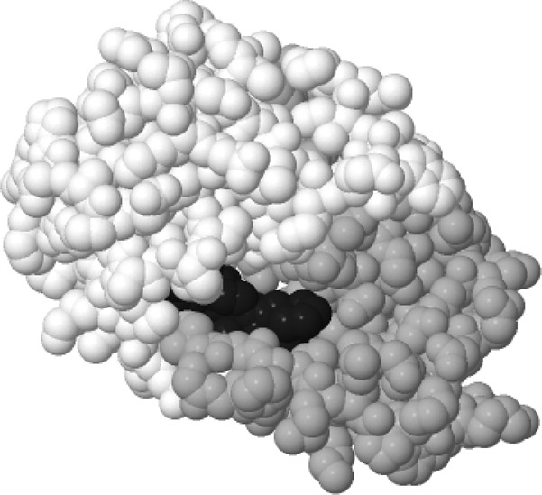
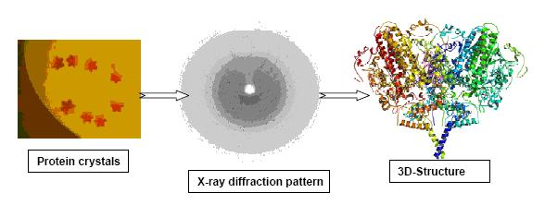
Protein Folding - Applications
Antimicrobial Drugs: helps to...
Be effective against the disease-causing agent
Be selectively toxic
  kill or inhibit the microbe without harming the host
Rational Drug Design: helps to...
  Understand 3-D structure of viral proteins
  Design drugs to fit protein and block function
Laboratory – challenging to predict 3-D structure

Slide 13
Genomics & Computational Structural Biology
Genomics
  Determines the ordered sequence of nucleotides in a genome
  Assigns predicted functions to regions of nucleotides via annotation
Computational Structural Biology
  Takes predicted gene sequence for translation into primary amino acid sequence
  Predicts 3-D protein structure based on primary amino acid sequence
  Note: this step is very difficult because the number of possible outcomes to process and consider is enormous
  The study of structural rules and their contribution to the final mature protein.

Slide 14
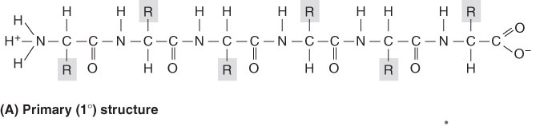
Structural Rules for Protein Folding
Linus Pauling – Studied the limitations on protein folding
  Nature of chemical bonds between amino acids
  Bond angles
  Rotation of atoms
  Flexibility of side chains
Christian B. Anfisen – Studied the influence of thermodynamics of cellular environment

Slide 15
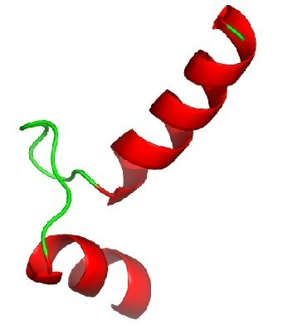
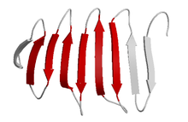
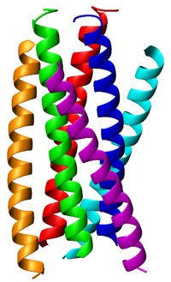
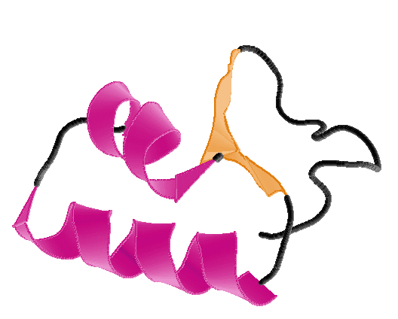
Parts of Protein (Structures)
Helices Sheets
Coils Turns

Slide 16
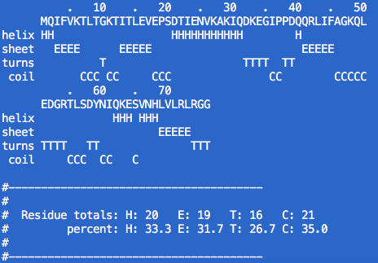
Protein Folding: An Idea of Structure
Garnier: a text-based, command-line tool from EMBOSS
  Input: protein sequence in fasta format
  Output: a model of folding in text base
  Usage: garnier file.fasta
H: Helices, E: Sheets
T: Turns, C: Coils
Ref: http://emboss.open-bio.org/rel/rel6/apps/garnier.html

Slide 17
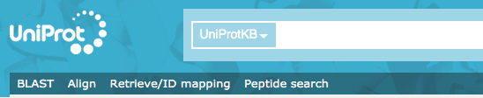
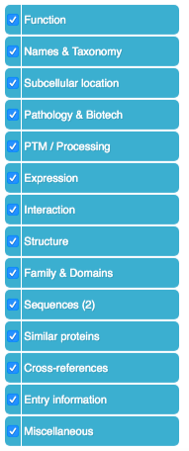
PDB: Protein Data Bank
Protein Information: The mission of UniProt is to provide the scientific community with a comprehensive, high-quality and freely accessible resource of protein sequence and functional information.
Some protein study databases require information from UniProt to find protein samples.
https://www.uniprot.org/

Slide 18

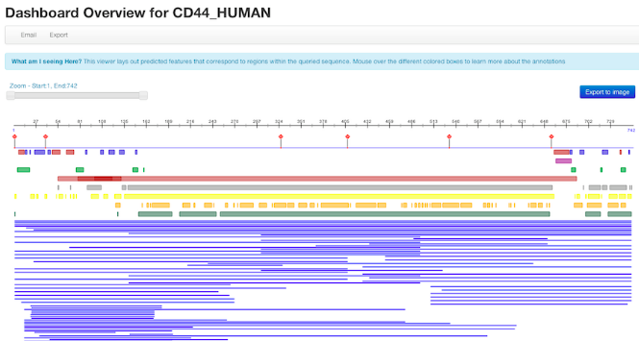
PDB: Protein Data Bank
Structural Annotations of protein: prediction of protein function, e.g. assisting in the annotation of subcellular localization (LocTree, LocTree2, NLSpred), identifying protein-protein interaction sites (PPSites) and protein-DNA binding sites, and more.
https://www.predictprotein.org/
https://open.predictprotein.org/

Slide 19

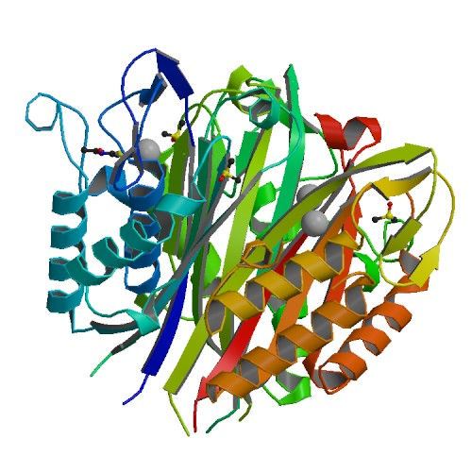
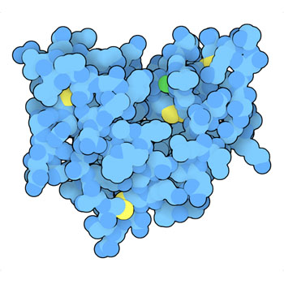
PDB: Protein Data Bank
Protein archives: This resource is powered by the Protein Data Bank archive-information about the 3D shapes of proteins, nucleic acids, and complex assemblies that helps students and researchers understand all aspects of biomedicine and agriculture, from protein synthesis to health and disease.
http://www.rcsb.org/

Slide 20
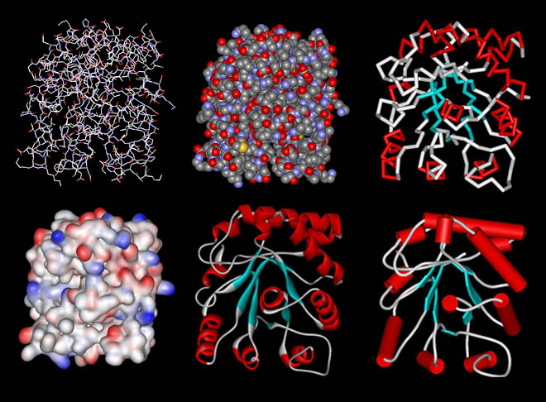
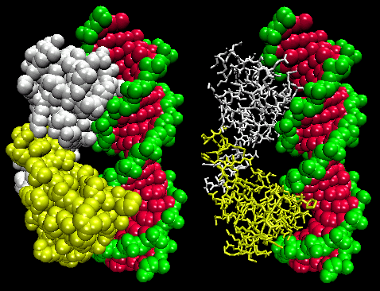
Protein DataBase (PDB)
Database for 3-D structural data of large biological molecules
https://www.rcsb.org/
Data is viewable using jmol.

Slide 21
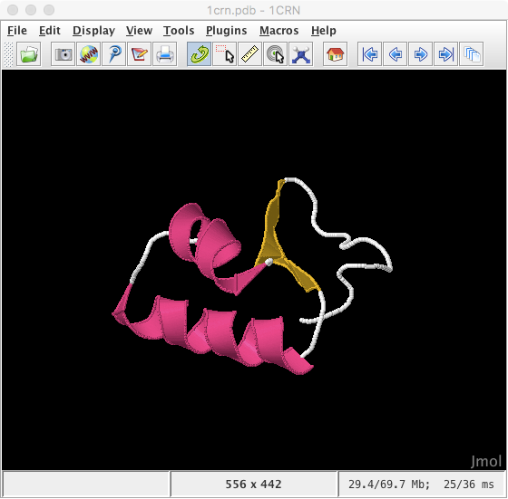

Jmol: A Graphical Viewer
For Protein Sequences
Download:
  http://jmol.sourceforge.net/
Wiki:
  http://wiki.jmol.org/index.php/Jmol_Application#Installing_Jmol_Application

Slide 22

Python Programming
Biopython
DNA Manipulation Algorithm
Translation functions
  DNA → RNA
  RNA → DNA
  RNA → Protein
Follow along in
class and save
your notes in
a text file!!
  Follow along and Save your notes in a text file.

Slide 23
Header
This
This

