Slide 1
Bioinformatics
CS300
Domains according
to UniProt and String
Fall 2019
Oliver BONHAM-CARTER

Slide 2

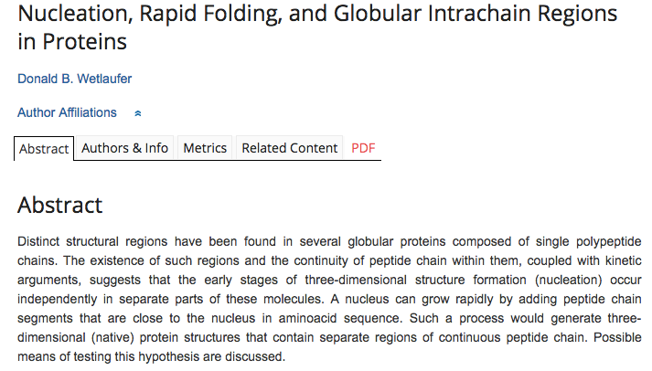

Proteins Fold Into Specific
Structures for Functionality
Different regions in same protein (domains) performing specific tasks.

Slide 3
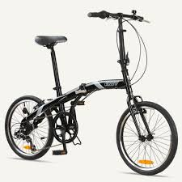
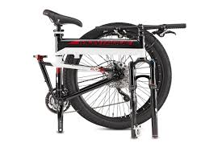
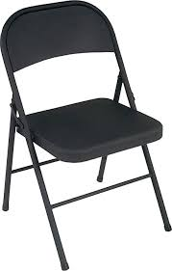

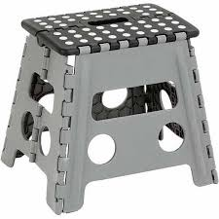
Structures For Functions
This
This

Slide 4
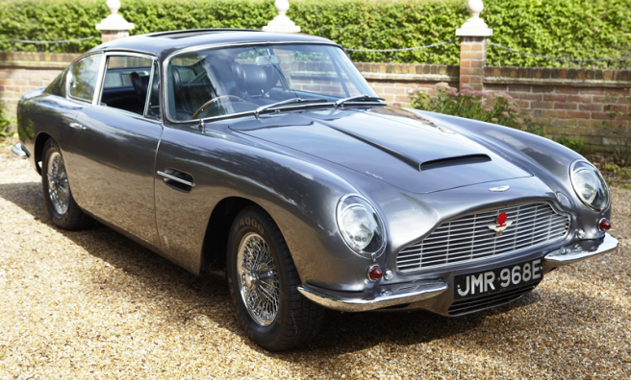
Structures for Functions
Windows to allow driver to see
out while driving
Ventilation
for cooling
Headlights for
driving at night
License plate:
for Identification
Door for letting
driver into the car
Wheels,
necessary
for mobility

Slide 5
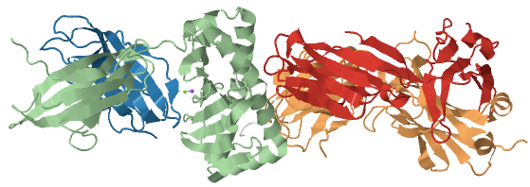
Proteins Also Have Specific
Functional Regions, Too!
Protein Data Bank:
5WLG

Slide 6
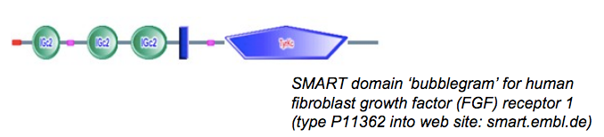
Domains
A protein domain is a conserved part of a given protein sequence and (tertiary) structure.
Can evolve, function, and exist independently of the rest of the protein chain
Each domain forms a compact three-dimensional structure
Often can be independently stable and folded.
http://slideplayer.com/slide/6923398/

Slide 7
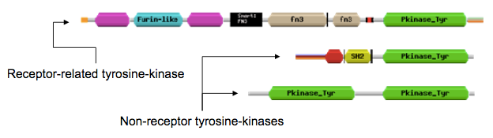
Protein Modularity
Discrete functional units
Found domains do not occur in the same order across proteins.
Domains are considered separately in protein function predictions
http://slideplayer.com/slide/6923398/

Slide 8
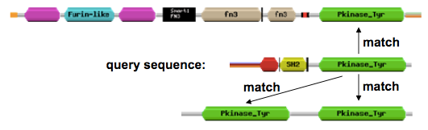
Finding a Domain?
Alignment across proteins may show domains
Use databases to match similar parts of proteins
  Pfam, Smart, Interpro and others

Slide 9
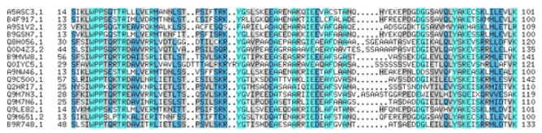
Alignment?!
Provide more info about a protein’s family, relatedness and other details.
Domain landmarks include: low-complexity or disorder to suggest that these regions may have a specific syntax or pronounced grammar.
http://slideplayer.com/slide/6923398/

Slide 10
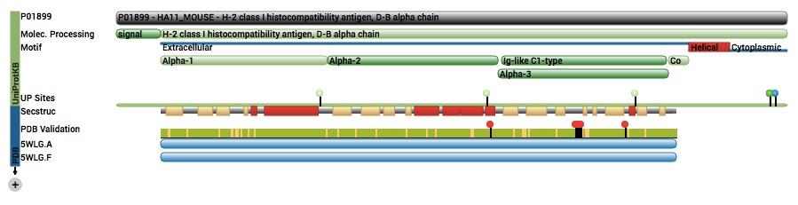
Domains By PDB
Domains give the protein special qualities:
  Domain Names: Alpha1, Alpha2, Alpha3, Ig-like C1-type
  Protein Data Bank ID: 5WLG
  This protein:
    https://www.rcsb.org/pdb/explore/explore.do?structureId=5WLG
  Help with features
    https://www.rcsb.org/pages/help/featureView

Slide 11
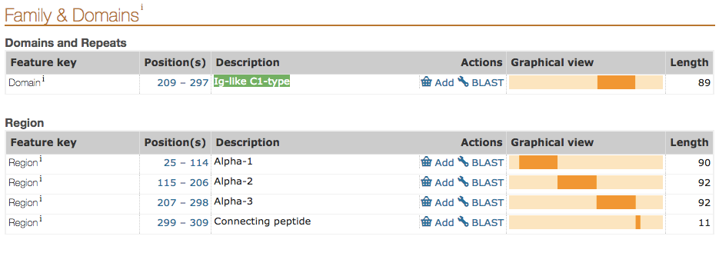
Domains By Uniprot
Domains give the protein special qualities:
  Domain Names: Alpha1, Alpha2, Alpha3, Ig-like C1-type
  UniProt ID: P01899
      A Protein Knowledge Base
      http://www.uniprot.org/uniprot/P01899#family_and_domains

Slide 12
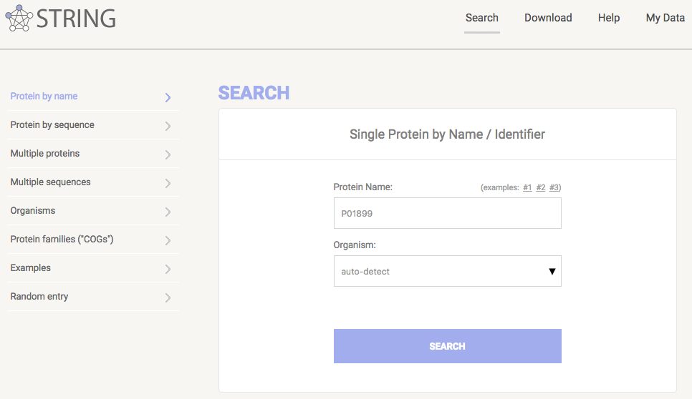
STRING: Functional Protein
Association Networks
String DB ID P01899
http://string-db.org/
https://string-db.org/

Slide 13
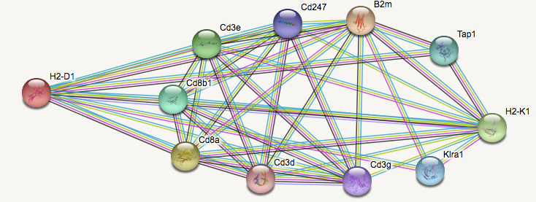
STRING: Functional Protein
Association Networks
Known and predicted protein-protein interactions
How does a protein interact with others?
What types of interactions are these (across all known genomes, of any organism)?

Slide 14
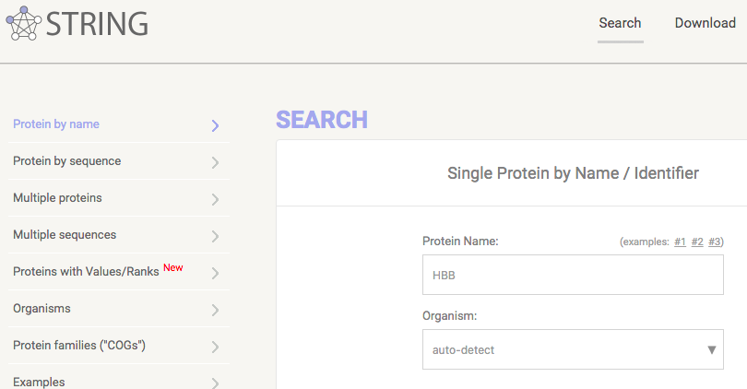
STRING: Functional Protein
Association Networks
Question: What proteins (from genes) interact with HBB protein (from the gene)?
https://string-db.org/

Slide 15
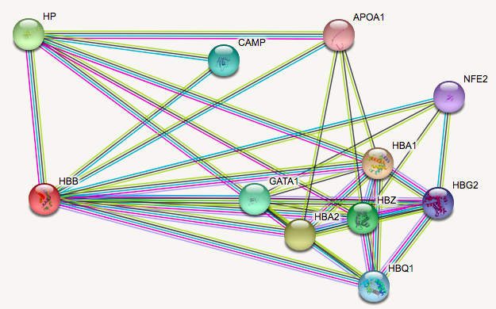
STRING: Functional Protein
Association Networks
Answer: Lots!
https://string-db.org/

Slide 16
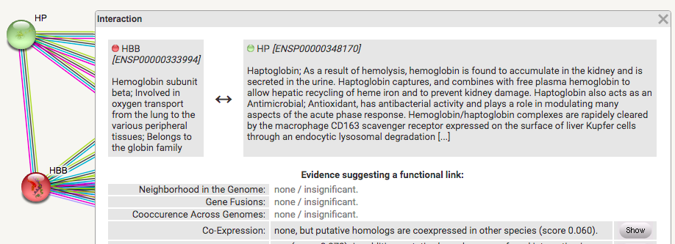
STRING: Functional Protein
Association Networks
What kinds of interactions?
https://string-db.org/

Slide 17
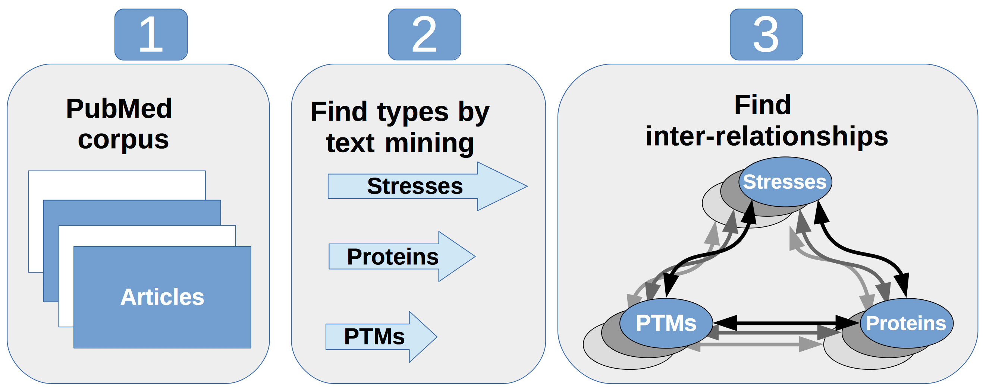
Criteria to Determine Relations
There are many ways to measure the distance
between two different proteins
  Text Mining

Slide 18
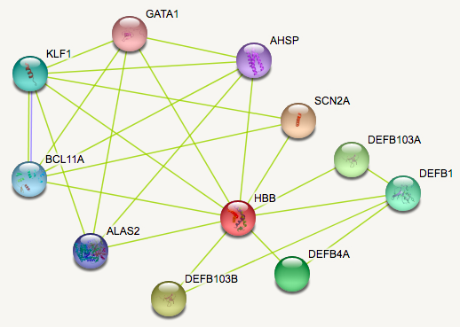
String: by Text Mining
HBB’s interactions according to the literature
https://string-db.org/

Slide 19
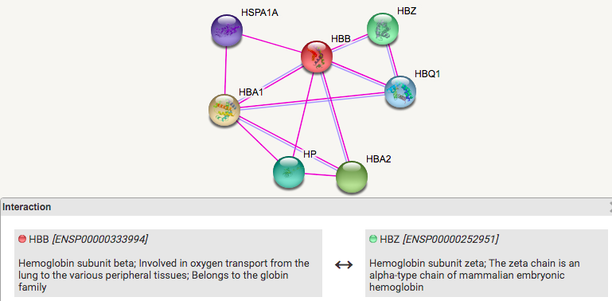
String: Linked Experimentally
Experiments performed to show that protein are related

Slide 20
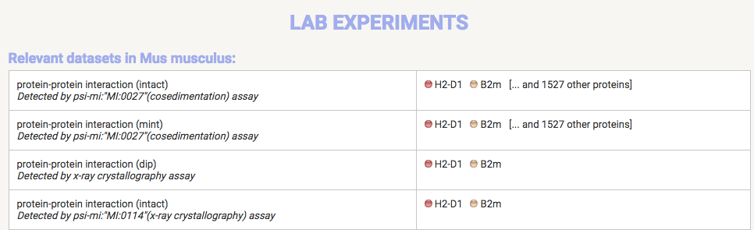
String: Linked Experimentally
Learn about the experiments

Slide 21
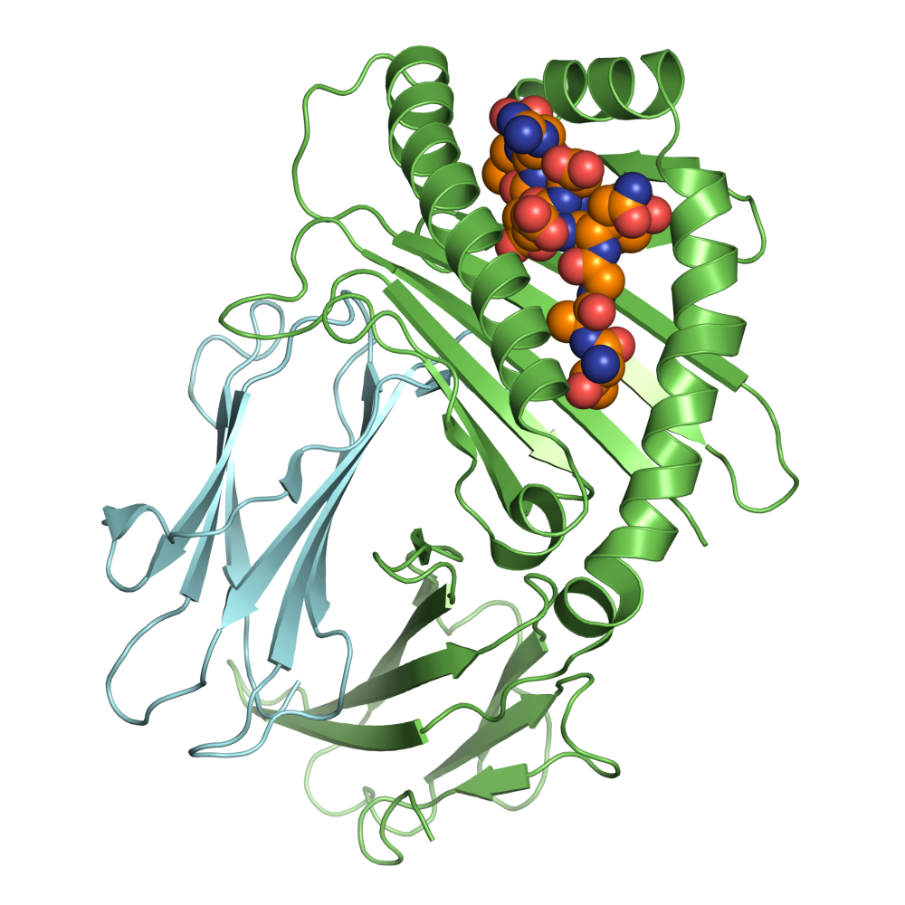
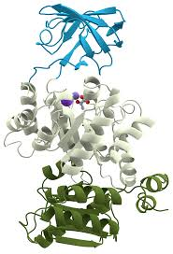
Criteria to Determine Relations
Other ways to measure the distance
between two different proteins
  Neighborhood
  Experiments
  Databases
  Co-Expression
  And others...

Slide 22
More Information?
Unify the representation of gene and gene product attributes across all species information
  AmiGO 2: Gene ontology
    http://amigo.geneontology.org/amigo/landing
Information of effects of genetic variation on human health
  Genetics Home Reference
    https://ghr.nlm.nih.gov/

Slide 23


Header
Pick your favorite protein and head-over to:
  http://www.uniprot.org/
  example: P01899, gene name: H2-D1
Then check out the networks at:
https://string-db.org/

Slide 24

Python Programming
Biopython
DNA Manipulation Algorithm
Translation functions
  DNA → RNA
  RNA → DNA
  RNA → Protein
Follow along in
class and save
your notes in
a text file!!
  Follow along and Save your notes in a text file.

Slide 25
Header
This
This

