Slide 1
Bioinformatics
CS300/BIO300
The Great Review
Fall 2019
Oliver BONHAM-CARTER

Slide 2

Thursday, 5th Dec
Dr. Thu of the Dept of Biology will present on Thursday at 11:45am – 12:15pm
Main ideas
  How do we make sense of a large amount of data in gene expression analysis or proteomics?
  Looking for patterns, instead of focusing on one gene/protein at a time
  Computational tools to look for pattern (hierarchical clustering, pathway enrichment analysis)
  Examples of how we use these data (cancer subtyping, proteins involved in regeneration in planarian worm)
This
This

Slide 3
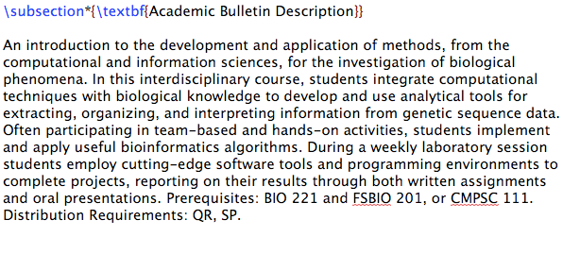
Course Summary

Slide 4
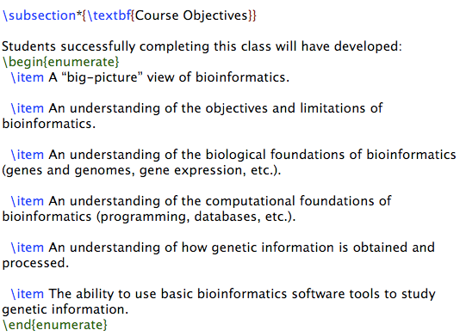
Course Objectives
Students successfully completing this class will have developed:
  A “big-picture” view of bioinformatics.
  An ethical foundation
  An understanding of the objectives and limitations of bioinformatics.
  An understanding of the biological foundations (genes and genomes, gene expression, etc.).
  An understanding of the computational foundations (programming, databases, etc.).
  An understanding of how genetic information is obtained and processed.
  The ability to use basic bioinformatics software tools to study genetic information.

Slide 5
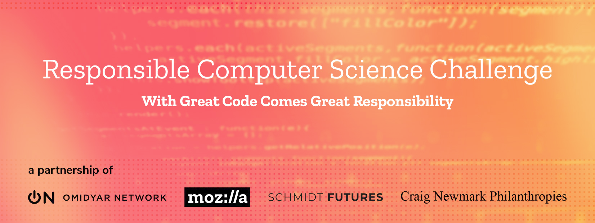

An Ethically
Conscious Course
This
This
We had lab assignments in which ethical considerations were explored
We met speakers who cam to talk about
  The ethical use of data in the health sciences
  The responsible use of robotics technology in automation

Slide 6
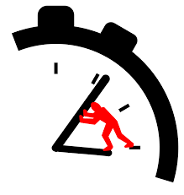
How Did We
Meet These Objectives?
Let’s go back and
revisit some of our
discussions and slides.

Slide 7
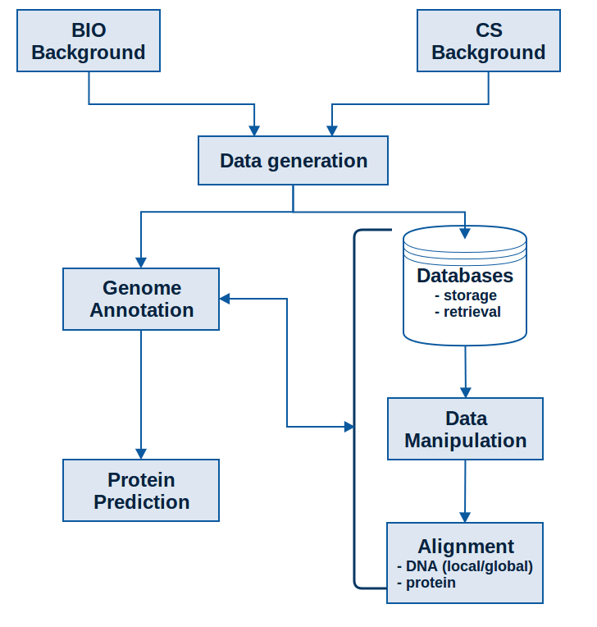
Course Outline

Slide 8
We Started With ...
The Central Dogma
Of Biology

Slide 9
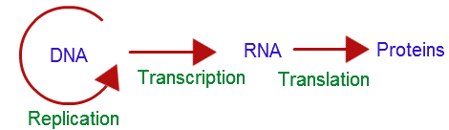
The Central Dogma
Of Biology
“the coded genetic information hard-wired into DNA is transcribed into individual transportable cassettes, composed of messenger RNA (mRNA); each mRNA cassette contains the program for synthesis of a particular protein (or small number of proteins)“ - NCBI

Slide 10


The Central Dogma of Molecular Biology

Slide 11

Transcription
Transcribe specific regions of DNA – genes
  Human genome ~25,000 genes (just 1.5% of genome)
RNA is the direct product of transcribing a gene (DNA)
  DNA -> RNA
  same language (nucleotides)
Messenger RNA (mRNA)
Transfer RNA
(tRNA)
Ribosomal RNA (rRNA)

Slide 12

Translation
The information from DNA is rewritten in a new language: RNA
Antisense strand
Sense strand

Slide 13

The Genetic Code: RNA into Protein
Translation
Triplet code
  Combinations of three nucleotides code for one amino acid
  Three nucleotides = codon
Redundancy
  Sometimes >1 codon codes for same amino acid
  20 amino acids, 64 possible codons
Start and Stop codons
  First codon of many transcripts is “AUG”, which codes for methionine
  Codons UAA, UAG, and UGA indicate the end of the transcript

Slide 14
We Talked About...
Data Generation:
Or where the data
comes from for research
in Bioinformatics

Slide 15
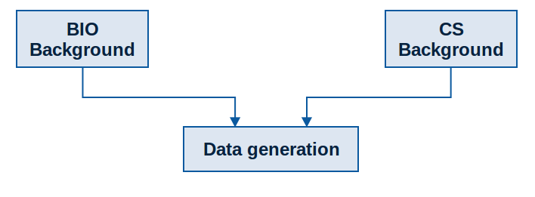
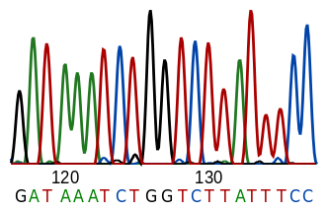
From The Course Outline
We get DNA data by
combining biology
and computer science

Slide 16
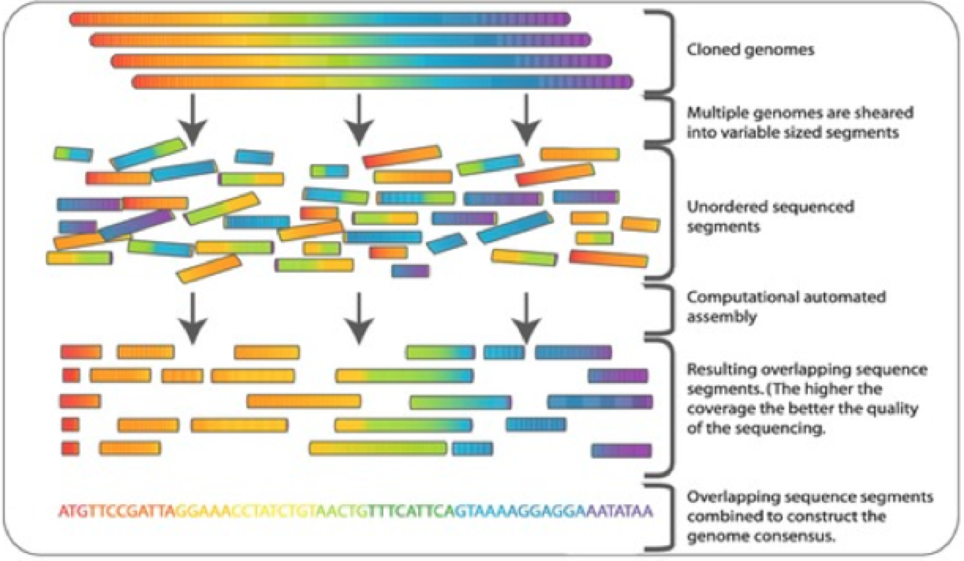
Genome Sequencing
The technology works by “exploding” DNA into smaller, manageable pieces
Then it recombines pieces (Reads) into bigger pieces (Contigs)
And then it combines contigs bigger chunks like a jigsaw puzzle

Slide 17
times, it was the age
It was the best of
Repeats pile up – actual placement of each individual fragment unknown
Repeats can cause ambiguity and prevent proper assembly
age of wisdom, it was
best of times, it was
it was the age of
it was the age of
it was the worst of
It was the best of
of times, it was the
was the best of times,
of times, it was the
the best of times, it
of wisdom, it was the
best of times, it was
the age of wisdom, it
of times, it was the
the best of times, it
of times, it was the
the worst of times, it
times, it was the age
worst of times, it was
times, it was the worst
wisdom, it was the age
was the worst of times,
It was the best of times, it was the [age/worst]
was the best of times,
was the age of foolishness,
Assembly Parameter:
100% identify across 4 words
was the age of wisdom
times, it was the worst

Slide 18
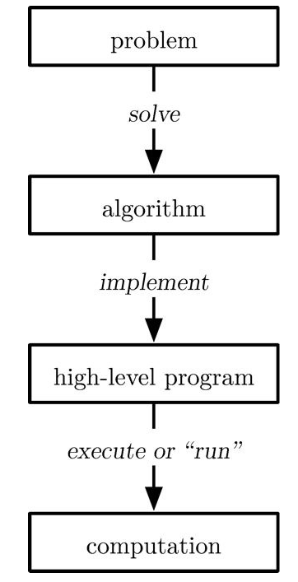
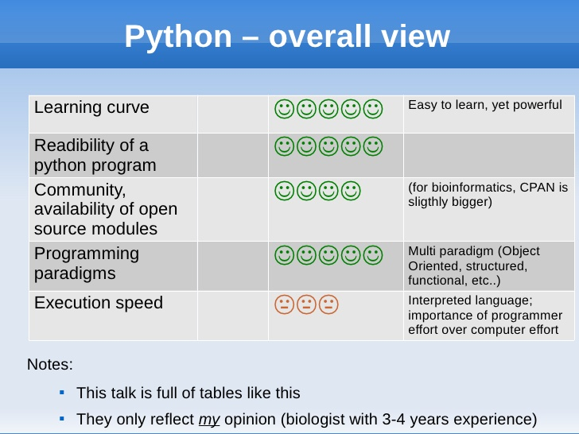
Computation

Slide 19
We Talked About...
Databases:
Places where data
is stored for further
research

Slide 20
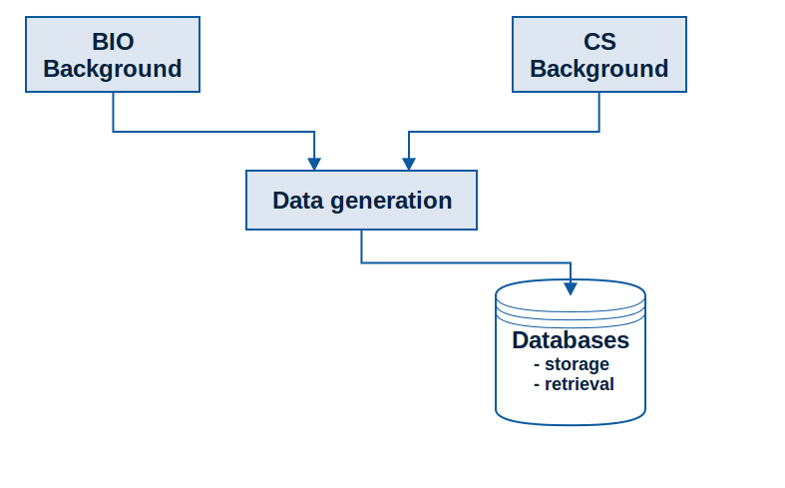


From The Course Outline

Slide 21



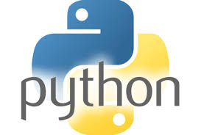
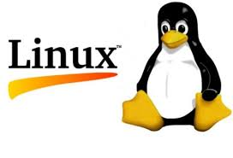

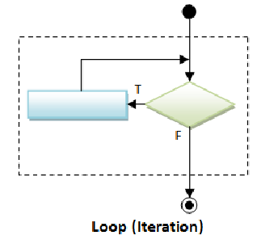
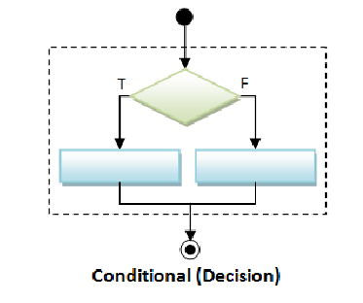
Databases (and Tools)
GitHub

Slide 22
Biological Data and Databases
To learn how to use a Web-based genomic databases and tools.
To understand the types of information stored in genomic databases.
To learn how to use different interfaces to find and retrieve genomic information.
Write Python program to find patterns (start and stop codons) in DNA sequences

Slide 23
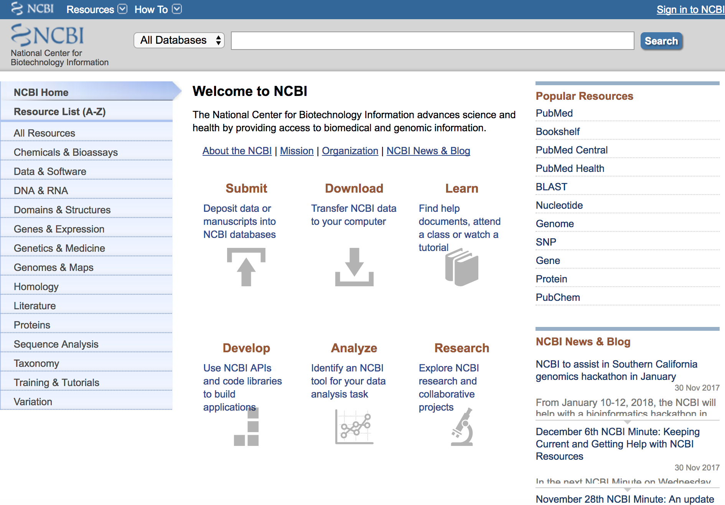
DB Interfaces: NCBI
NCBI Browser

Slide 24
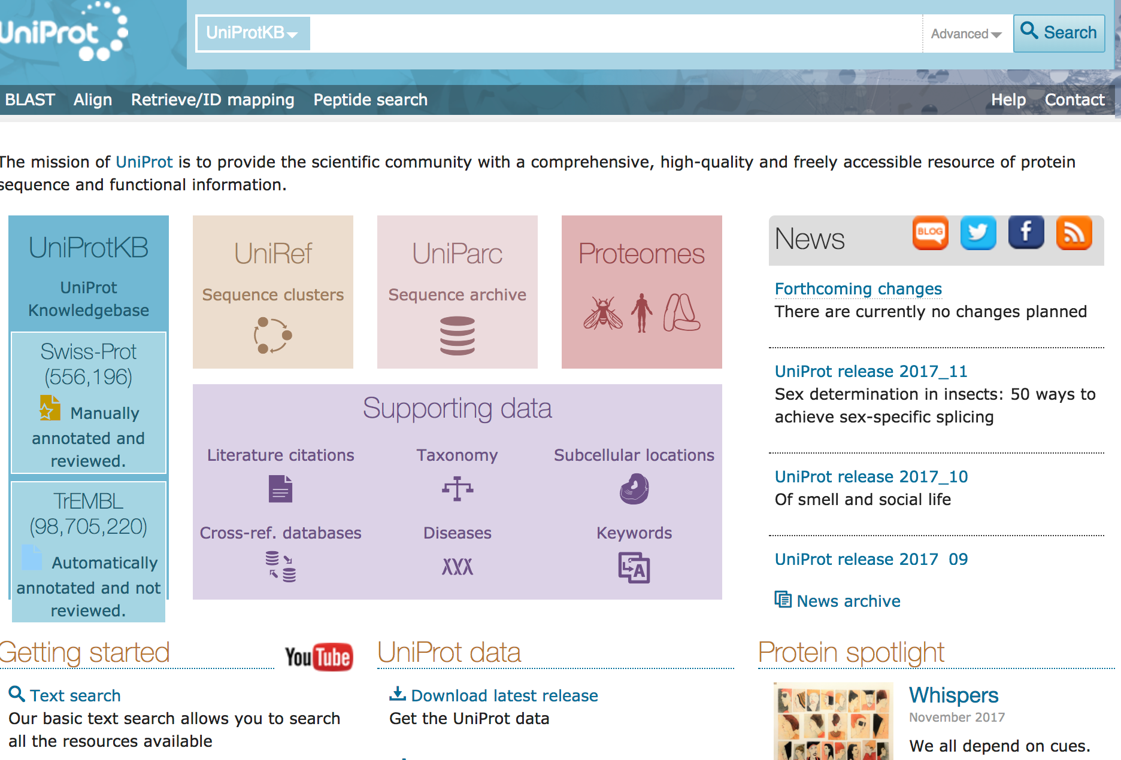
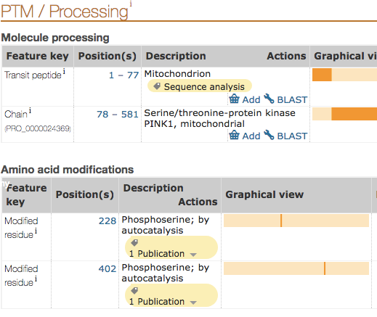
DB Interfaces: UniProt
UniProt Browser

Slide 25
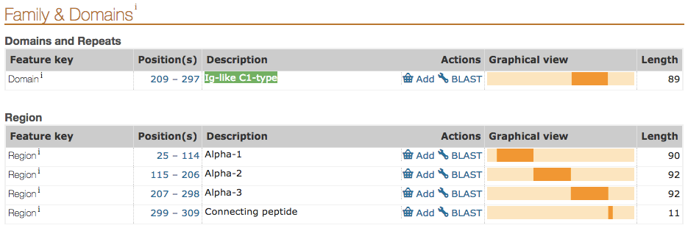
Domains By Uniprot
DB Interfaces: UniProt
Domains give the protein special qualities:
  Domain Names: Alpha1, Alpha2, Alpha3, Ig-like C1-type
  UniProt ID: P01899
      A Protein Knowledge Base
      http://www.uniprot.org/uniprot/P01899#family_and_domains

Slide 26
We Talked About...
Data Manipulation:
How we begin to find
meaning in the data

Slide 27
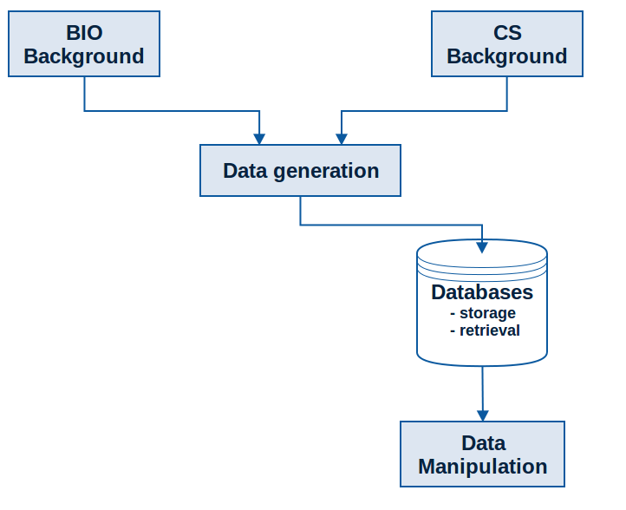
From The Course Outline

Slide 28
Data Manipulation
To become familiar with tools that can be used to manipulate sequences in a variety of ways and make basic comparisons between sequences
Understand the structure and orientation of string representations of DNA and protein sequences
Gain experience with string manipulation using Python and its application to DNA and protein sequence data.
Understand how genetic information is computationally decided and appreciate the important complications in working with sequences (introns/exons, start codons, template/nontemplate strand orientation, etc)

Slide 29
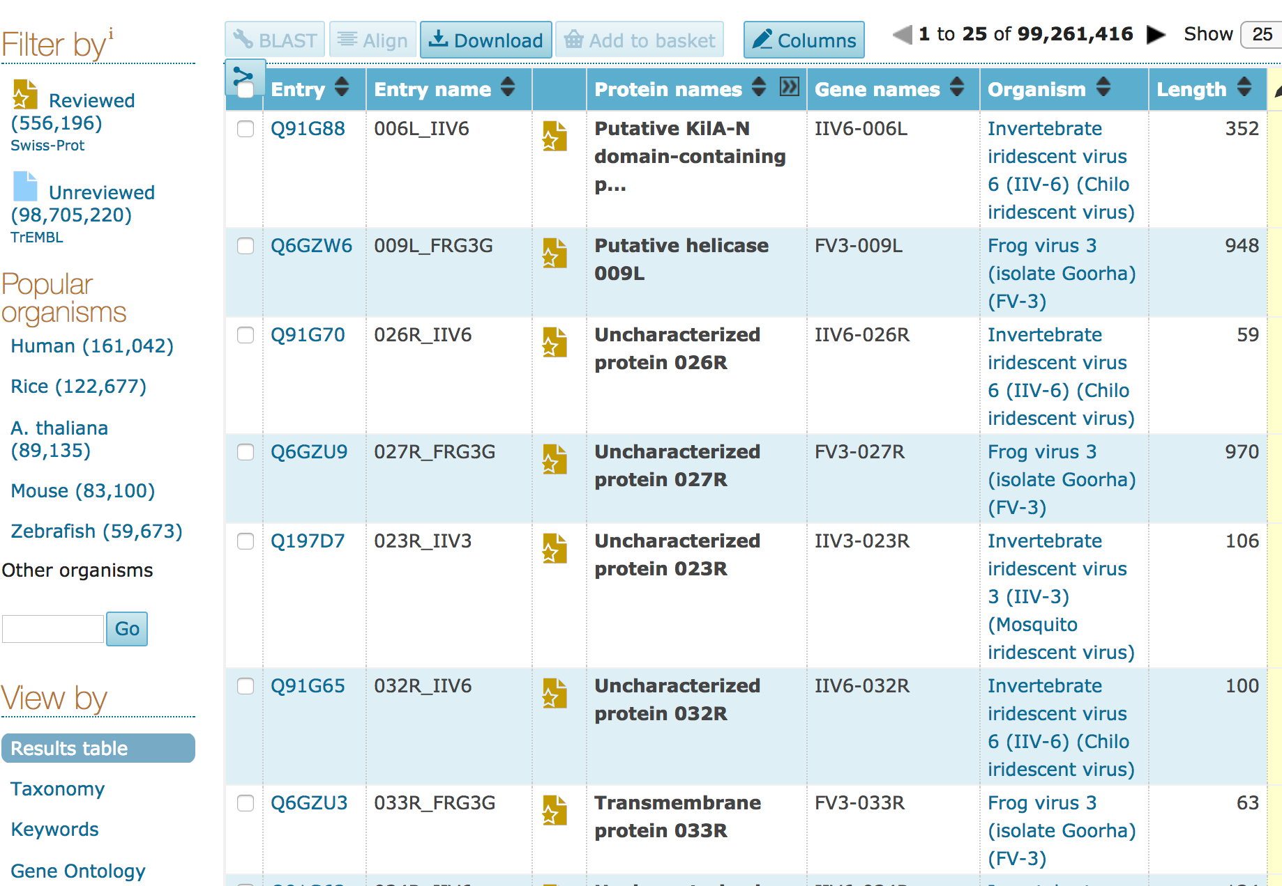
Databases...
UniProt Browser

Slide 30
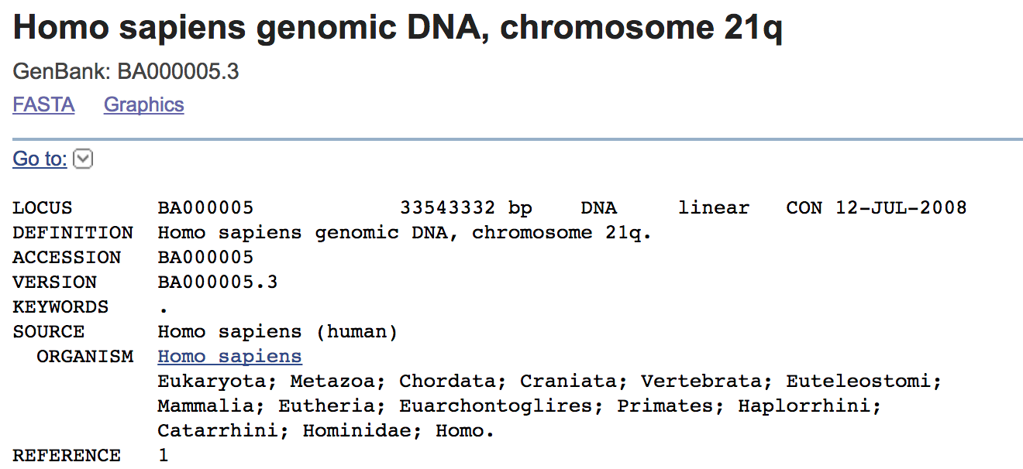
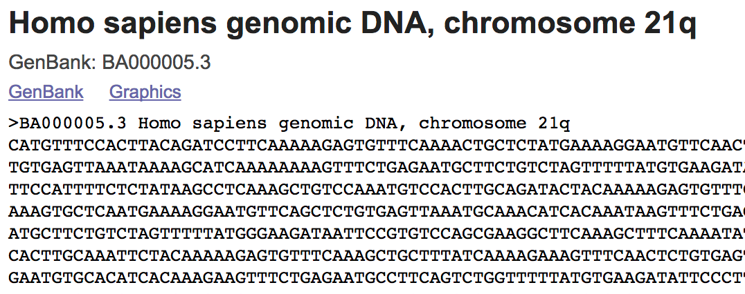
Pulling Data From Databases...

Slide 31
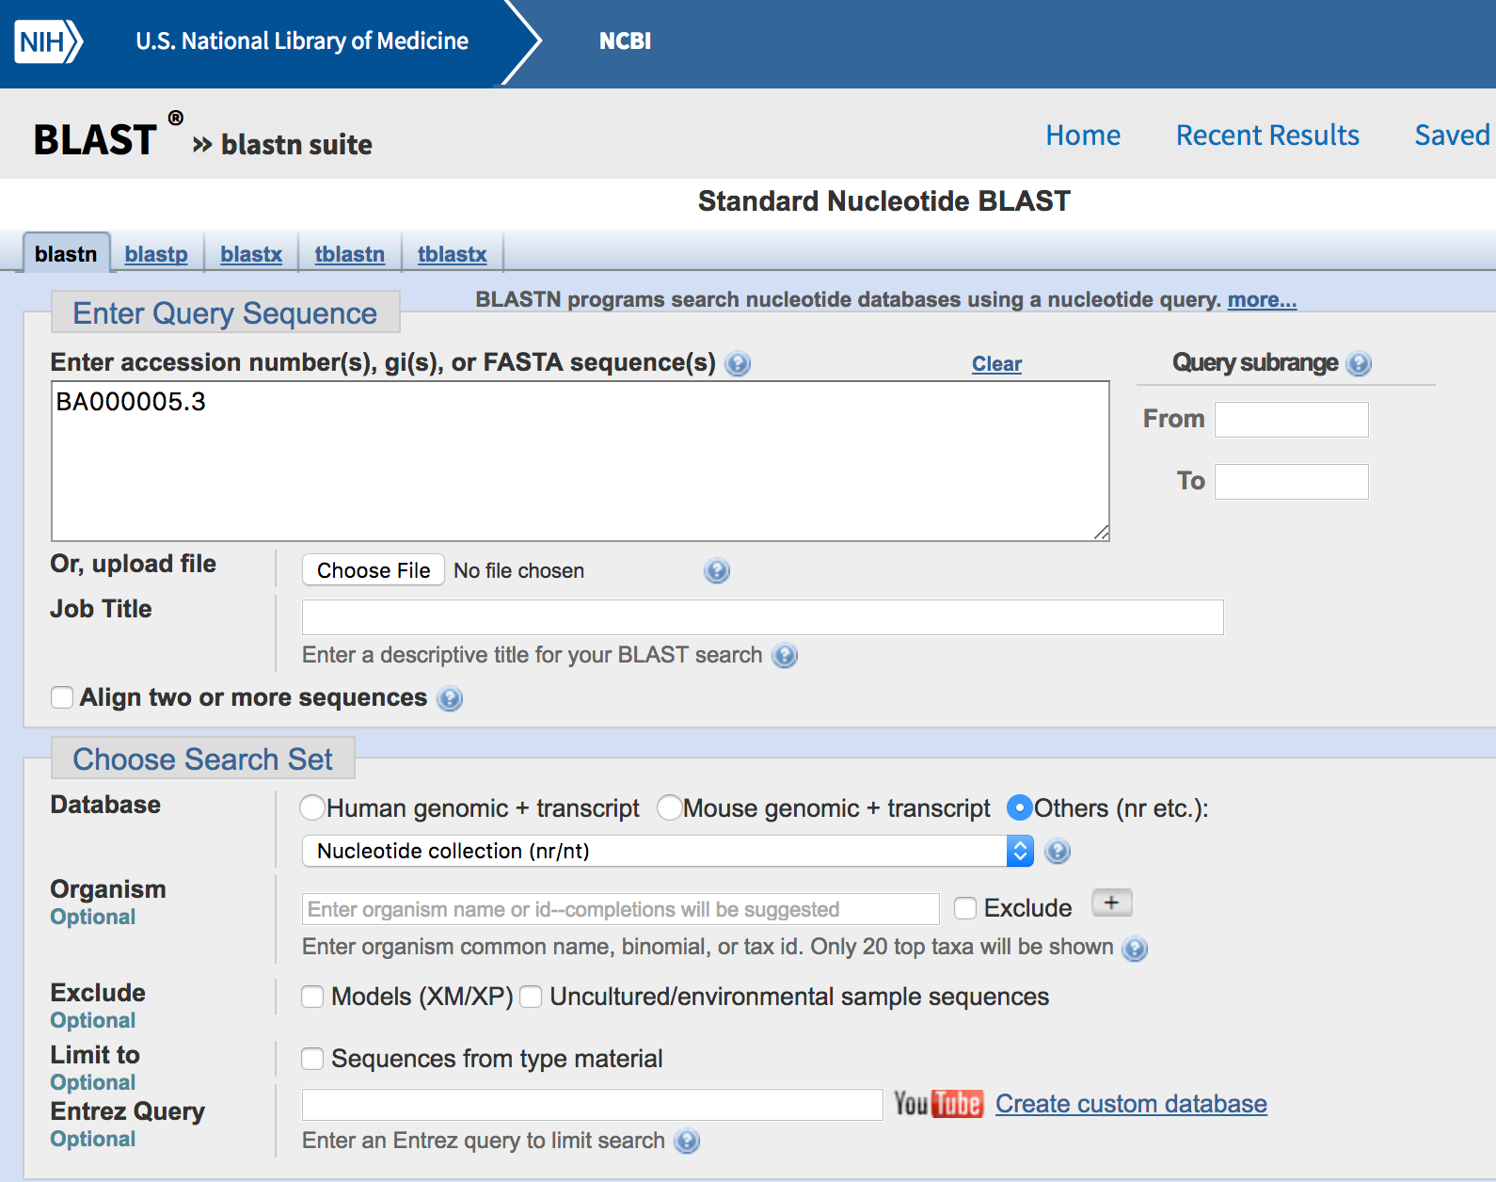
Using Tools With Databases
BLAST

Slide 32
We Talked About...
Sequence Alignment:
Comparing sequences
to discover similarities
and differences

Slide 33
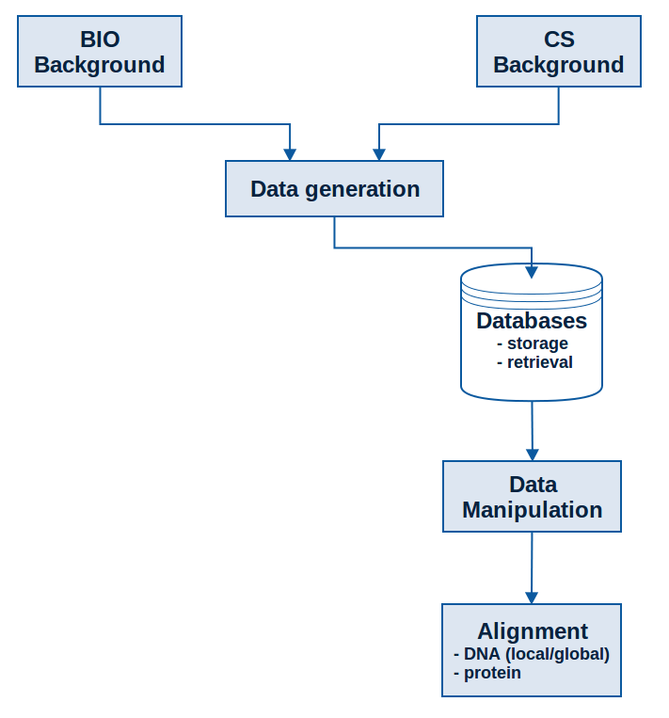
From The Course Outline

Slide 34
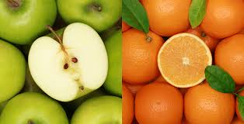
Comparing Things!
DNA sequences
Genes
Proteins
Organisms
How to compare these things?
What do we learn by comparison?

Slide 35
Sequence Alignment
DNA - Nucleotides
To understand the value of aligning genes and recognize the practical applications of this technique.
To gain familiarity with the use of Web-based alignment tools to explore sequence similarity and understand how to modify their parameters.
To know how the Needleman-Wunsch algorithm optimally aligns any two sequences.
Understand how the Needleman-Wunsch algorithm can be modified to yield other alignments.

Slide 36

What is Mutation?
Aligning Sequences
To Locate Mutations
A natural process that changes the DNA sequence
A common process
  during replication of the human genome a “typo” occurs every 100,000 or so nucleotides
  that’s about 120,000 typos each time one of our cells divides
  most are repaired

Slide 37
Sequence Alignment: Needleman-Wunsch
Let:
Match = +1
Mismatch = 0
Gap = -1
 |  | C | A | C | G | T | A | T
 | 0 | -1 | -2 | -3 | -4 | -5 | -6 | -7
C | -1 | 1 | 0 | -1 | -2 | -3 | -4 | -5
G | -2 | 0 | 1 | 0 | 0 | -1 | -2 | -3
C | -3 | -1 | 0 | 2 | 1 | 0 | -1 | -2
A | -4 | -2 | 0 | 1 | 2 | 1 | 1 | 0
CACGTAT
--CGCA-
CACGTAT
C--GCA-
CACGTAT
CGC--A-

Slide 38
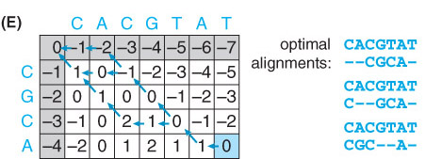
Global Pairwise Alignment
Steps to begin
  Initialization of the matrix
  Calculation of the scores given for a character by character comparison.
  Filling in a system of arrows in a trace-back matrix to uncover a path back to the start in the score matrix.
  Deducing the alignment by following the arrows in the trace-back matrix.

Slide 39
Alignment to Compare Regions
We learn to scan millions of unknown DNA sequences to find familiar genes.
Does gene have same function in each sequence? Same origin?
Gene A
Seq1
Seq2
Gene A is found in this unknown sequence

Slide 40
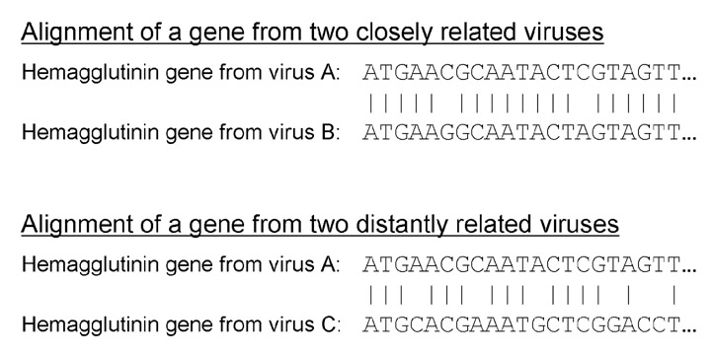
Pairwise Alignment
Similarity and Relatedness
This
Few Mismatches
Lots of Mismatches

Slide 41
Sequence Alignment
Protein – Amino Acids
Understand the use of a substitution matrix to score amino acid similarity in a protein sequence alignment.
Gain experience using protein alignment to develop hypotheses about protein function based on sequence similarity.
Know how protein alignment differs algorithmically from DNA alignment.
Know how substitution matrix is developed and how different matrices might be used to produce better alignments in particular situations.

Slide 42
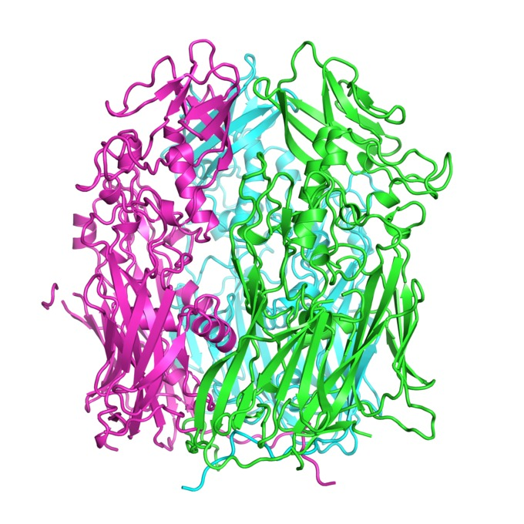
Comparing Protein
Two proteins (wildtype, non-wildtype) are compared to find causes of disorder.
Healthy
Unhealthy

Slide 43
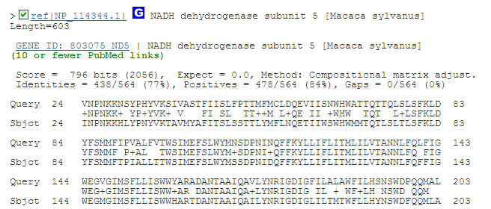
Aligning Sequences
NCBI – PROTEIN BLAST

Slide 44
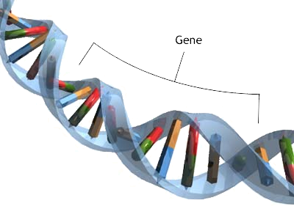
Bioinformatics:
The Study of DNA
DNA is the genetic material that houses genetic information.
Genes are written in this language
Understanding DNA allows us to understand how genes work.

Slide 45
We Talked About...
Genome annotation:
Finding relevant
regions in sequences

Slide 46
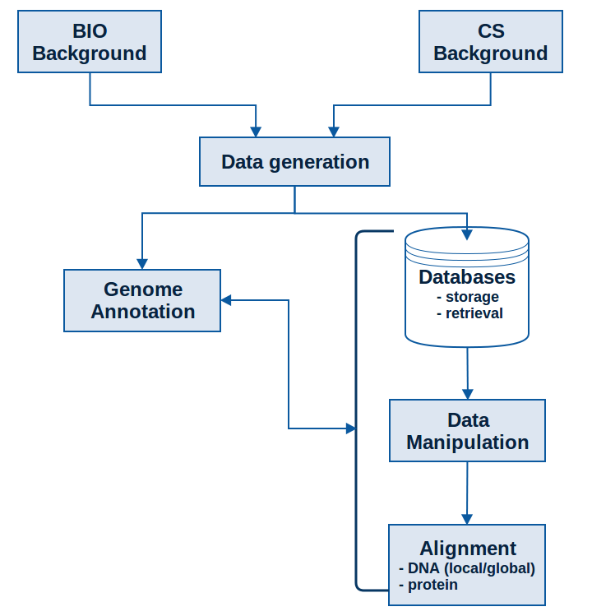
Course Outline

Slide 47
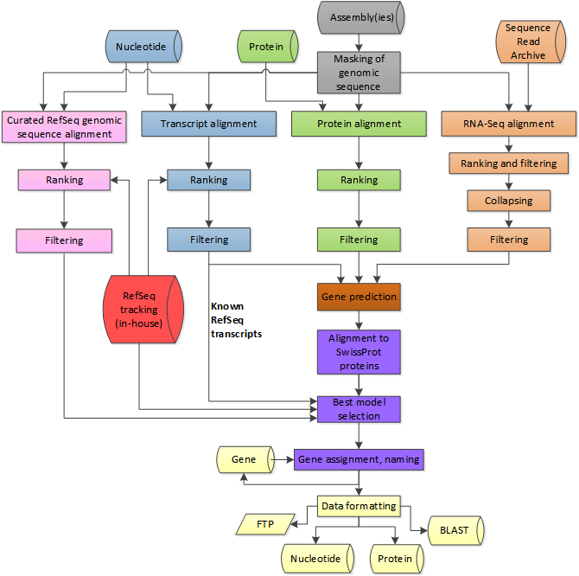
Genome Annotation: Algorithms
Alignment-based
Sequence-based
Content-based
Probabilistic
Be able to combine content-based and probabilistic methods of gene discovery to identify the most probable locations of introns and exons in a eukaryotic DNA sequence

Slide 48
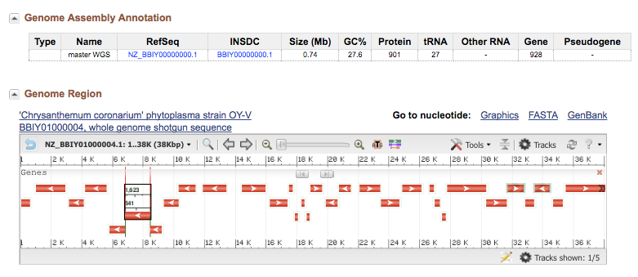
Genome Annotation
Locate genes for proteins in sequences.
https://www.ncbi.nlm.nih.gov/genome/browse/

Slide 49
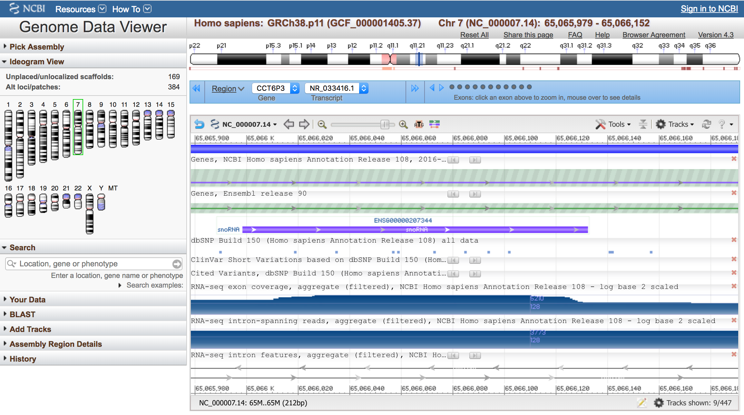
Genome Annotation
https://www.ncbi.nlm.nih.gov/genome/gdv/browser/?context=Nucleotide&acc=NR_145729.1

Slide 50
Genome Annotation
alignment-based
sequence-based
content-based
probabilistic
New data – deposited into databases such as NCBI

Slide 51
We Talked About...
Protein Prediction:
Determining what
protein exist in a
sequence and how they
might behave.

Slide 52
Course Outline

Slide 53
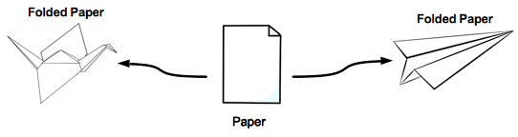
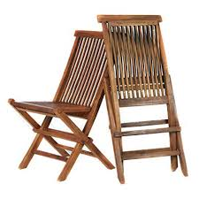


Properties From Folding

Slide 54
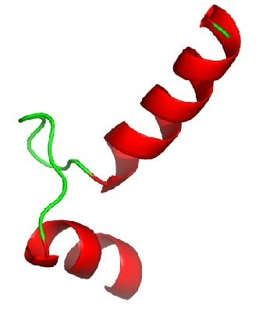
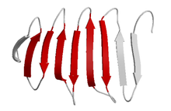
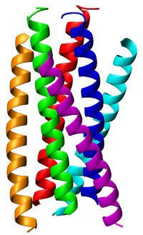
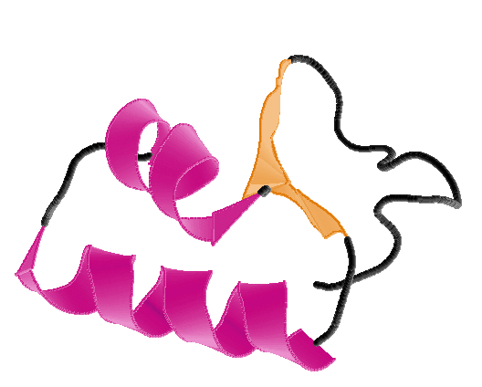
Parts of Protein (Structures)
Helices Sheets
Coils Turns

Slide 55
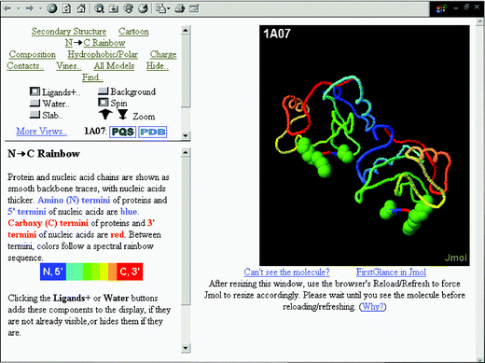
Protein Prediction
Know how to use available tools to examine the experimentally determined structures of proteins and visualize structural an functional features
Appreciate the value and limitations of predicting 3-D structure from sequence alone

Slide 56
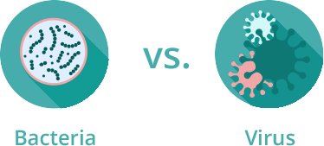
Protein Folding - Applications
Protein must fold correctly to function
Misfolded proteins
  Accumulation – Huntington’s and Parkinson’s disease
  Tagged for degradation – emphysema, cystic fibrosis
    Pharmaceutical chaperones – fold mutated proteins to render them functional
Antiviral drug development
  Antibiotics vs antivirals
    Bacteria – cells
    Viruses – invade host’s cells

Slide 57
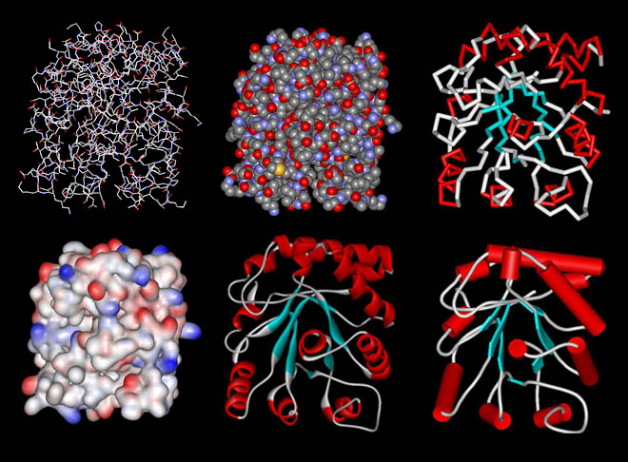
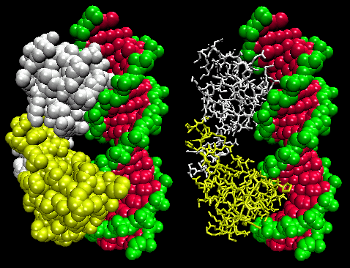
Protein DataBase (PDB)
Database for 3-D structural data of large biological molecules
https://www.rcsb.org/
Data is viewable using jmol.

Slide 58
In Closing ...
Bioinformatics
is diverse
and exciting!

Slide 59
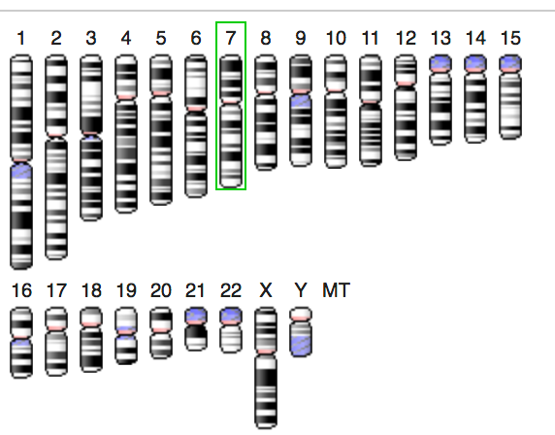
Bioinformatics Accomplishments
A “big-picture” view of bioinformatics.
An understanding of the objectives and limitations of bioinformatics.
An understanding of the biological foundations of bioinformatics (genes and genomes, gene expression, etc.).

Slide 60
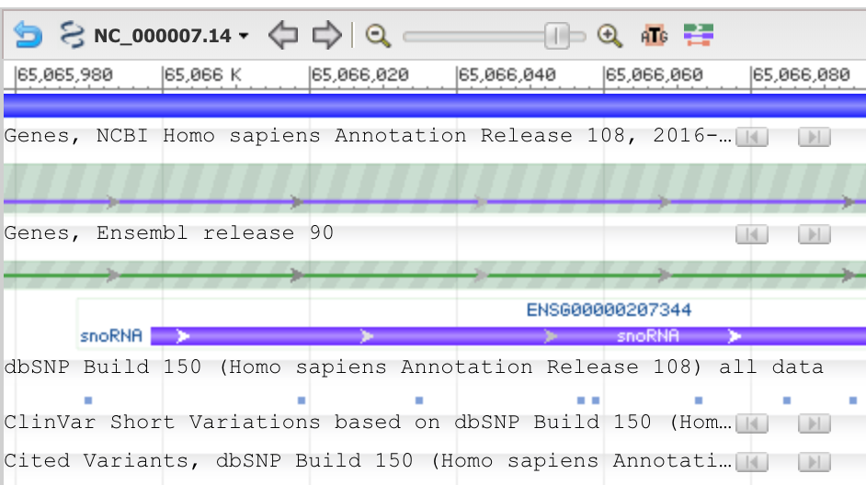
Bioinformatics Accomplishments
An understanding of the computational foundations of bioinformatics (programming, databases, etc.).
An understanding of how genetic information is obtained and processed.
The ability to use basic bioinformatics software tools to study genetic information.

Slide 61
What’s Next?
Bioinformatics could
provide you with a
satisfying career and
plenty of room to
advance

Slide 62
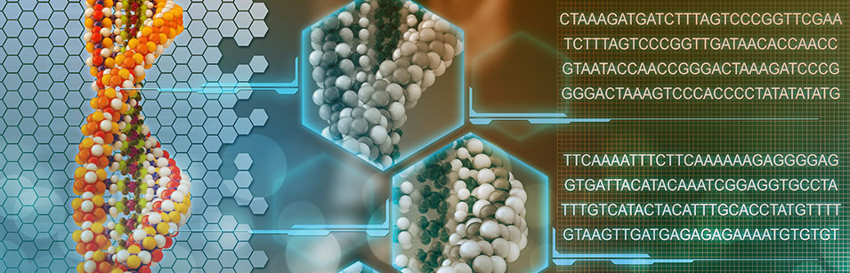
The Value of the
Bioinformatics Skills
There is a great need for Bioinformaticians!

Slide 63

Skills in Careers
Biologists:
  Computational skills
  Mathematical /statistical
  Programming for Automation
Computer scientists
  BioMedical skills
  Understanding of biological systems and mechanisms
  Early detection of disease by data
  Modeling of therapeutic remedies
  Others

Slide 64


Skills in Careers
Software (bioinformatics) engineer
Research scientist in biotechnology
Data scientist
Project manager (pharmaceuticals, medical, etc)
Computational immunologist
Medical doctor (in clinical and research applications)

Slide 65
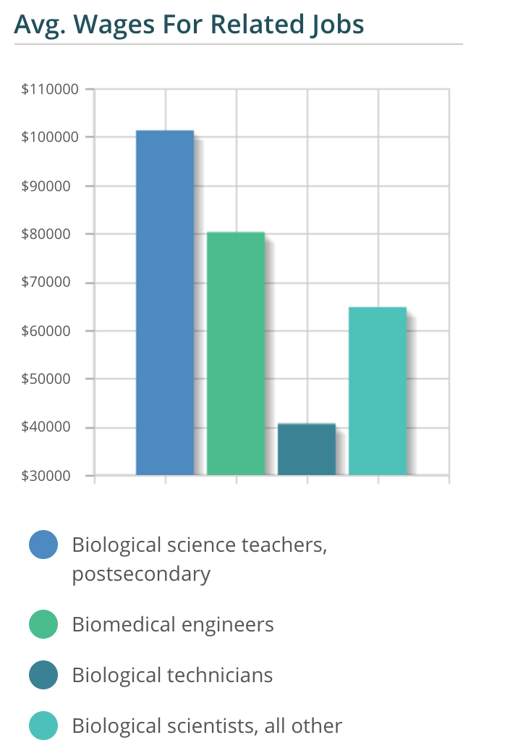
High Paying Careers

Slide 66

High Paying Careers
https://www.glassdoor.com/Salaries/bioinformatics-research-scientist-salary-SRCH_KO0,33.htm

Slide 67

High Paying Careers
https://www.glassdoor.com/Salaries/bioinformatics-scientist-salary-SRCH_KO0,24.htm

Slide 68
Careers in Bioinformatics
Research scientist
Bioinformatician
Bioinformatics programmer
Software Developer
Analyst
Statistician
Physician
Project manager
Database developer and administrator
Technical assistant and technical sales representative
or any jobs where biologists are currently hired
(some of these may require graduate education)

Slide 69
Bioinformatics Internship and Career resources
Resources
http://www.iscb.org/iscb-careers-job-database
http://www.bioinformatics.org/jobs/
http://www.bioplanet.com/
http://www.bio-itworld.com/BioIT/JobOpenings.aspx
http://www.biospace.com/
www.glassdoor.com
http://www.jobs-salary.com/jobs.php?
Campus Resources

Slide 70
The Value of the
Bioinformatics Skills
BioScientists
Computer
Scientists
Employment Prospects
Computation is becoming
essential for biological and
biomedical research
BioSciences provide an
increasing number of
problems and challenges

Slide 71

In Bioinformatics,
there is ...

Slide 72
Header
This
This

