Slide 1
Bioinformatics
CS300
Crash course:
Structure and Replication of DNA
Fall 2017
Oliver Bonham-Carter

Slide 2

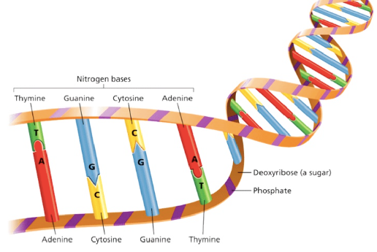
The Structure and
Replication of DNA

Slide 3
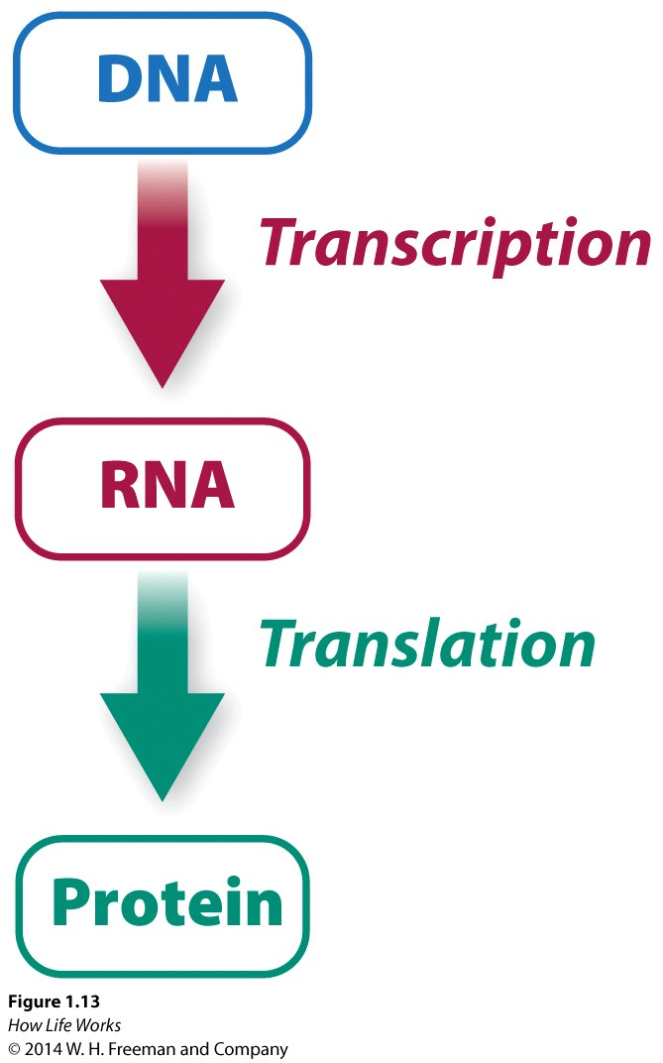
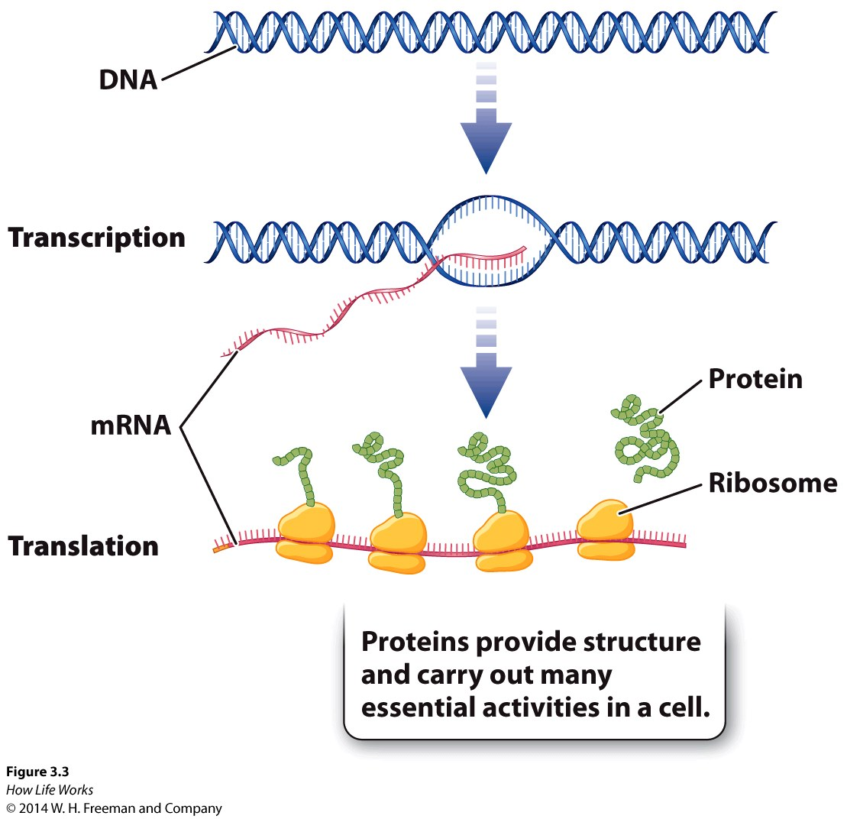
Central Dogma of Molecular Biology
Central Dogma: The framework of a process.

Slide 4
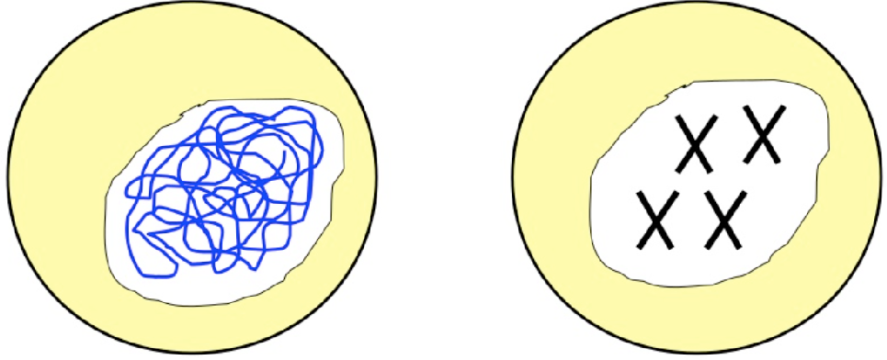
What is DNA?
Found in the nucleus of a cell in two different structures: chromatin and chromosomes
Genetic Material (Life’s blue prints)
Written inherited characteristics (genes)

Slide 5
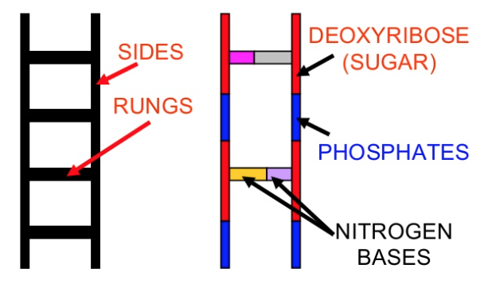
DNA Structure
Formed like a twisted ladder
There are two sides of the ladder
Sugar (deoxyribose)
Phosphates
Alternating
Rungs of the ladder
Nitrogenous bases

Slide 6
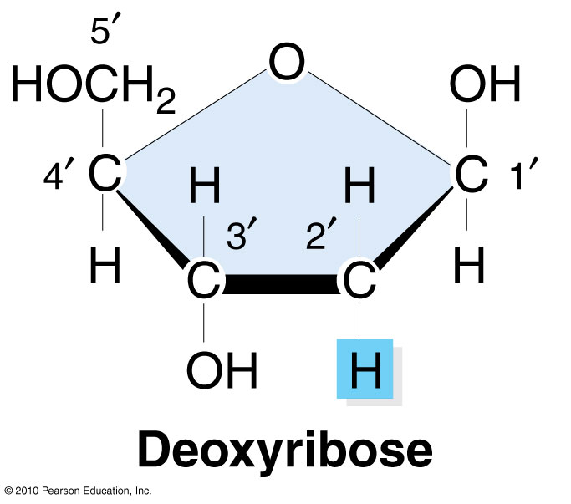
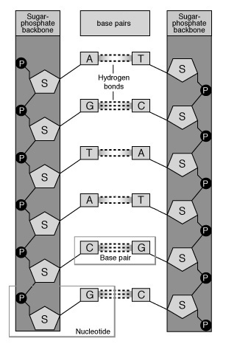
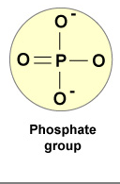
DNA Structure
Deoxyribose
sugar
Phosphate
Phosphorus surrounded
by oxygens

Slide 7
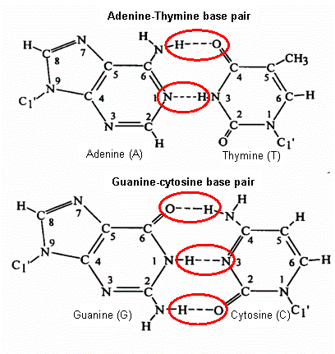
Base to Base Bonds:
How do nitrogenous bases pair?
Base-Specific bonding
Preserves distance between (DNA’s) backbones
Hydrogen bonds
Key to replication

Slide 8
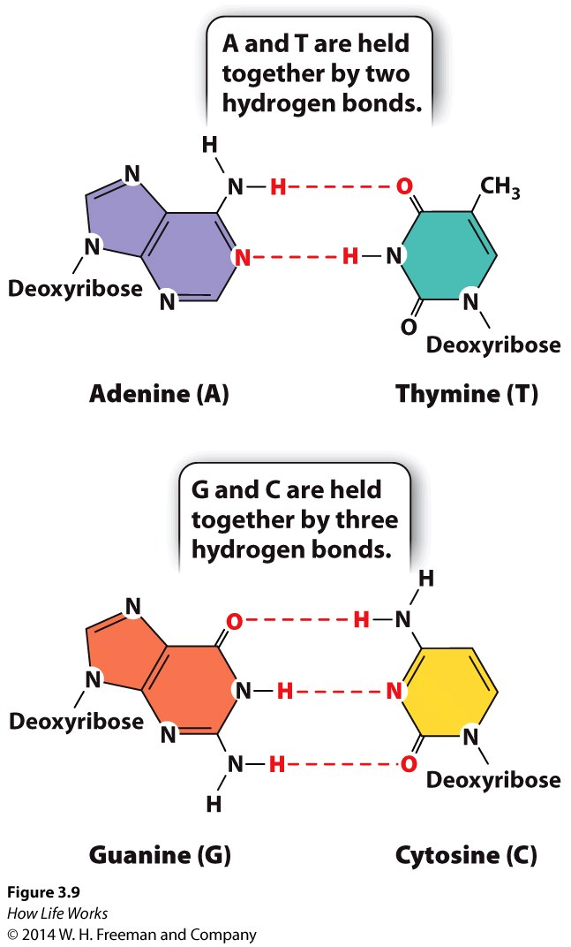
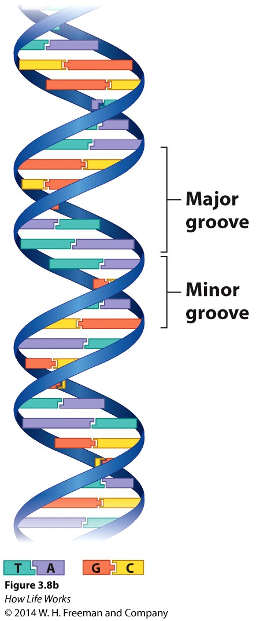
Purines and Pyrimidines
Purines: adenine and guanine
Pyrimidine: thymine, cytosine, and uracil
Purines include a number of biologically important compounds, such as adenosine, caffeine, uric acid, and the two bases adenine and guanine, which are components of DNA and RNA.
Only 3 pyrimidine bases (thymine, cytosine, and uracil) and 2 purine bases (adenine and guanine) are needed to produce the incredible diversity of species that inhabit the earth.
http://study.com/academy/lesson/what-are-purines-definition-lesson-quiz.html

Slide 9
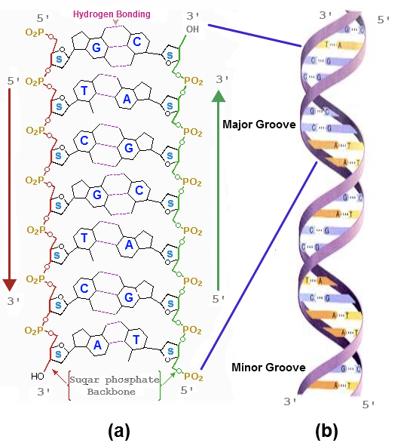
DNA as a model and by its atomic elements

Slide 10
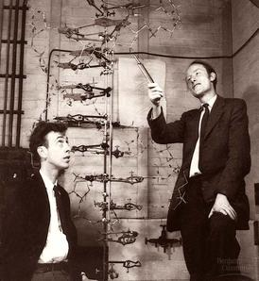
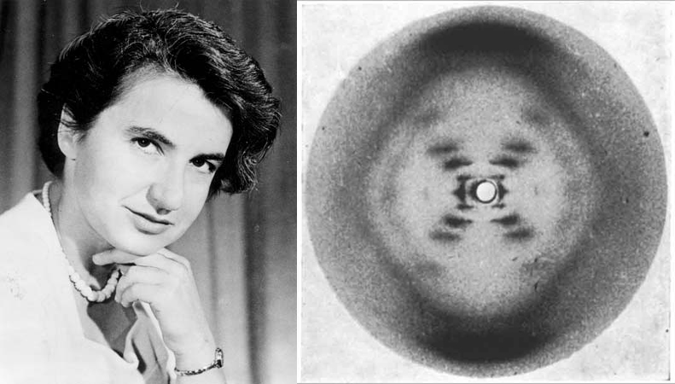

DNA Double Helix:
Discovery of Structure
Watson and Crick, 1953
Rosalind Franklin and her data from x-ray crystallography

Slide 11
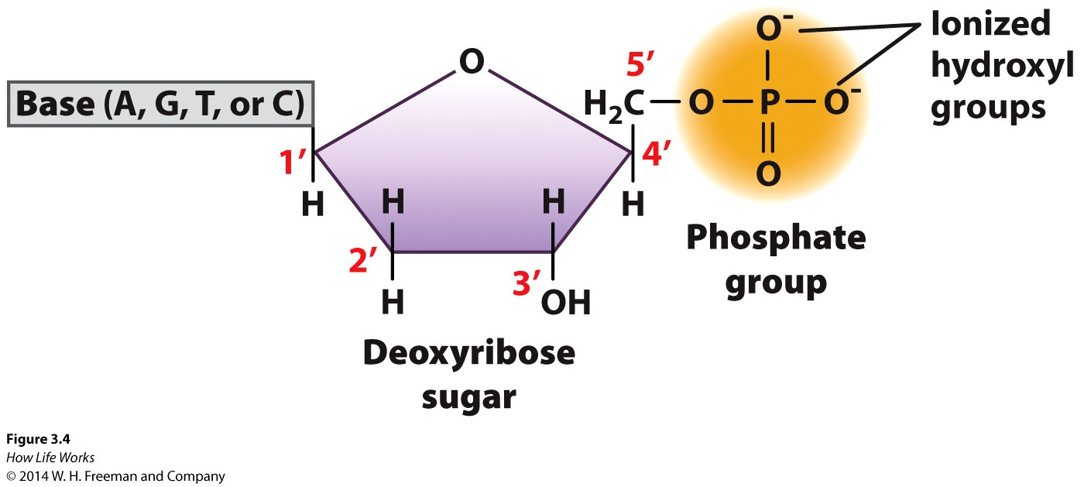
Nucleotide Structure
The support of rungs in the ladder.
One sugar
One phosphate group
One base (purine or pyrimidine)

Slide 12
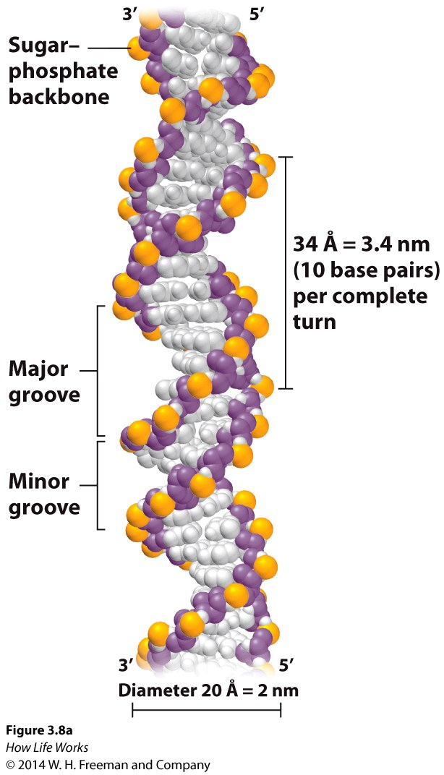
Structure of DNA
Double-stranded
Diameter – 2nm
Helix
  Complete turn = 10bp, 3.4nm
  Major groove
  Minor groove

Slide 13
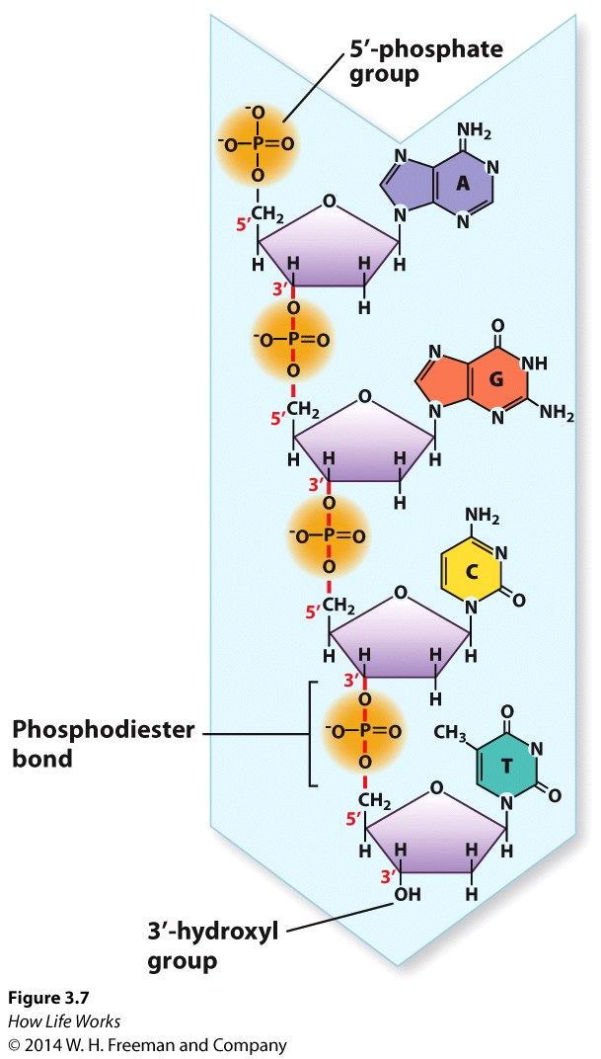
Structure of DNA
Nucleotides are joined by phosphodiester bonds
  phosphate to sugar
  covalent bonds
Polarity
  5’ end – phosphate group
  3’ end – hydroxyl group
DNA created in 5’ -> 3’ direction

Slide 14
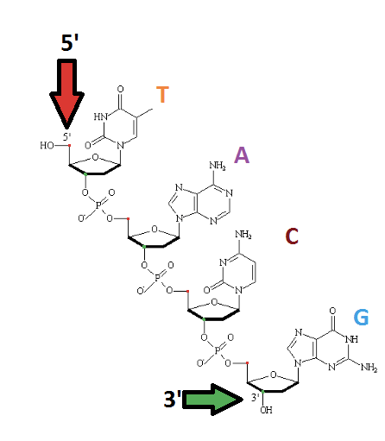
Five and Three Prime Ends
A key feature of all nucleic acids is that they have two distinctive ends: The 5' (5-prime) and 3' (3-prime) ends.
This terminology refers to the 5’ and 3’ carbons on the sugar.
For both DNA and RNA, the 5' end bears a phosphate, and the 3' end a hydroxyl group.

Slide 15
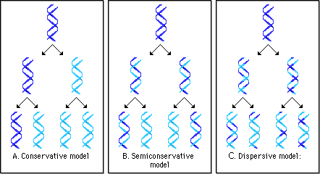
DNA Replication Process
The two sides of the parent molecule unwind/unzip
Daughter strands are synthesized using parent strands as templates
Parent/daughter duplex winds back together
  Semi-conservative: a 2nd gen helix composed of parental strand and one daughter.

Slide 16
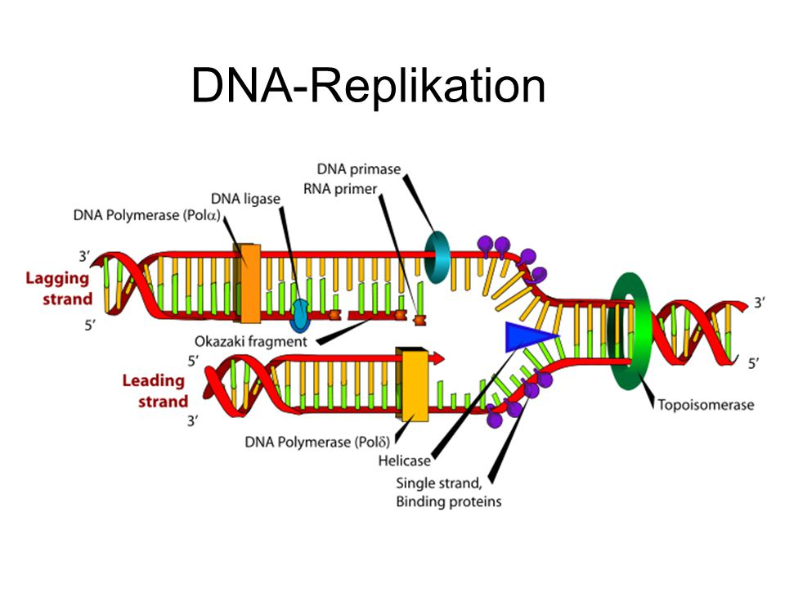
DNA Replication Process
http://www.hhmi.org/biointeractive/dna-replication-schematic

Slide 17
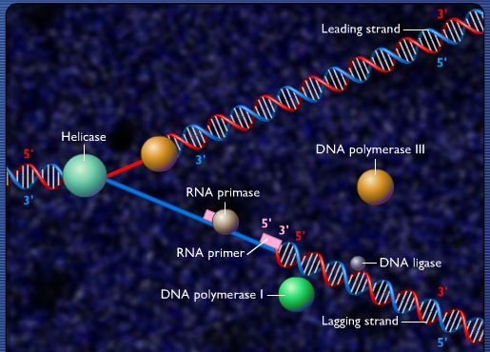
DNA Replication Enzymology
http://highered.mheducation.com/sites/0073525324/student_view0/chapter20/dna_replication_fork.html

Slide 18
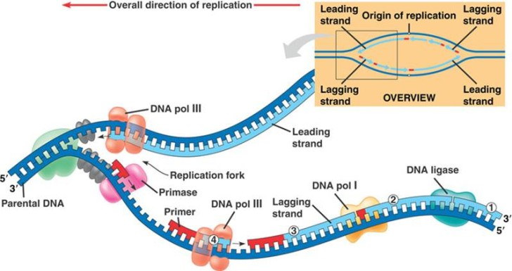
DNA Replication Enzymology
http://www.hhmi.org/biointeractive/dna-replication-basic-detail http://highered.mheducation.com/sites/0073525324/student_view0/chapter20/dna_replication_fork.html

Slide 19
Review Question 1
In the DNA sequence 5'–TGAC–3', the phosphodiester linkage between the guanine and the adenine connects:
A. the 3' end of the guanine to the 5' end of the adenine.
B. the 2' end of the adenine to the 3' end of the guanine.
C. the 5' end of the guanine to the 1' end of the adenine.
D. the 3' end of the adenine to the 5' end of the guanine.
E. the 5' end of the guanine to the 2' end of the adenine.

Slide 20
Review Question 1
In the DNA sequence 5'–TGAC–3', the phosphodiester linkage between the guanine and the adenine connects:
A. the 3' end of the guanine to the 5' end of the adenine.
B. the 2' end of the adenine to the 3' end of the guanine.
C. the 5' end of the guanine to the 1' end of the adenine.
D. the 3' end of the adenine to the 5' end of the guanine.
E. the 5' end of the guanine to the 2' end of the adenine.

Slide 21
Review Question 2
In the DNA of certain bacterial cells, 16% of the nucleotides are adenine. What are the percentages of the other nucleotides in the bacterial DNA?
A. 34% thymidine, 34% guanine, 16% cytosine
B. 34% uracil, 16% guanine, 16% cytosine
C. 16% thymidine, 34% guanine, 34% cytosine
D. 34% thymidine, 16% guanine, 34% cytosine

Slide 22
Review Question 2
In the DNA of certain bacterial cells, 16% of the nucleotides are adenine. What are the percentages of the other nucleotides in the bacterial DNA?
A. 34% thymidine, 34% guanine, 16% cytosine
B. 34% uracil, 16% guanine, 16% cytosine
C. 16% thymidine, 34% guanine, 34% cytosine
D. 34% thymidine, 16% guanine, 34% cytosine

Slide 23
Review Question 3
DNA replicates in a semi-conservative manner. This means
  one daughter strand is synthesized as a large fragment while the other is synthesized in smaller fragments, both in the 5’-3’ direction
  every newly formed double-stranded DNA molecule consists of one parental strand and one daughter strand
  every newly formed double-stranded DNA molecule is comprised of two new daughter strands
  one daughter strand is synthesized as a large fragment in the 5’-3’ direction while the other is synthesized in smaller fragments in the 3’-5’ direction

Slide 24
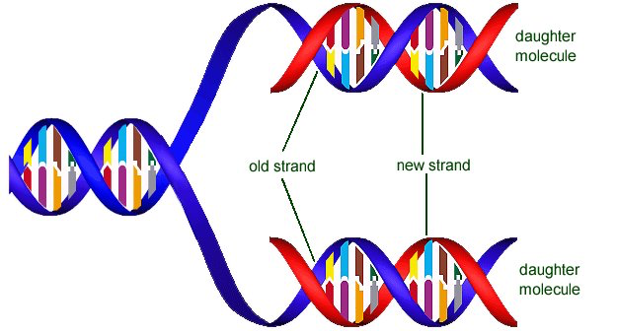
Review Question 3
DNA replicates in a semi-conservative manner. This means
  every newly formed double-stranded DNA molecule consists of one parental strand and one daughter

Slide 25

Supporting Videos
The DNA Double Helix (17 mins)
http://media.hhmi.org/biointeractive/films/Double_Helix.html
The Chemical Structure of DNA (3 mins)
http://www.hhmi.org/biointeractive/chemical-structure-dna

Slide 26

Python Programming
How to start up Python interactive mode?
How to add numbers?
How to create variables?
How to make print statements
Strings:
  How to work with strings
  How to count characters
  How to find characters.
Follow along in
class and save
your notes in
a text file!!
  Follow along and Save your notes in a text file.

Slide 27
Header
This
This

Slide 28
Header
This
This

