Slide 1
Bioinformatics
CS300
Crash course:
Transcription and Translation
Fall 2017
Oliver Bonham-Carter

Slide 2

Header
This
This

Slide 3

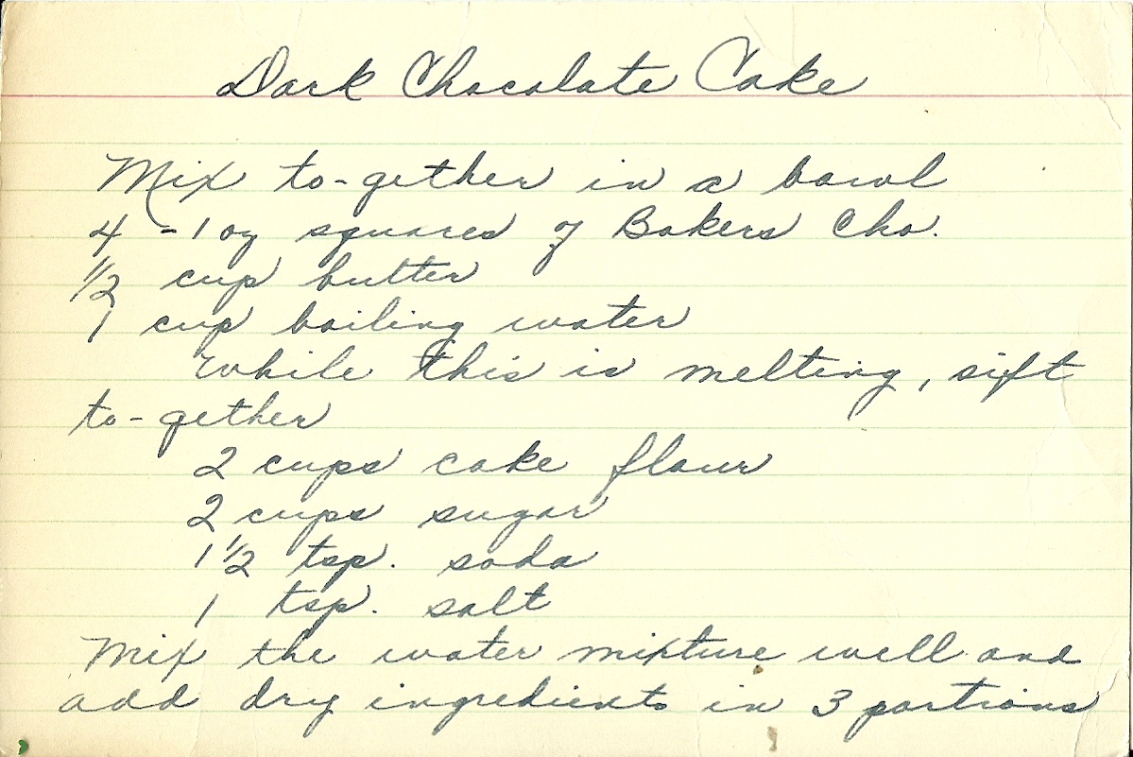
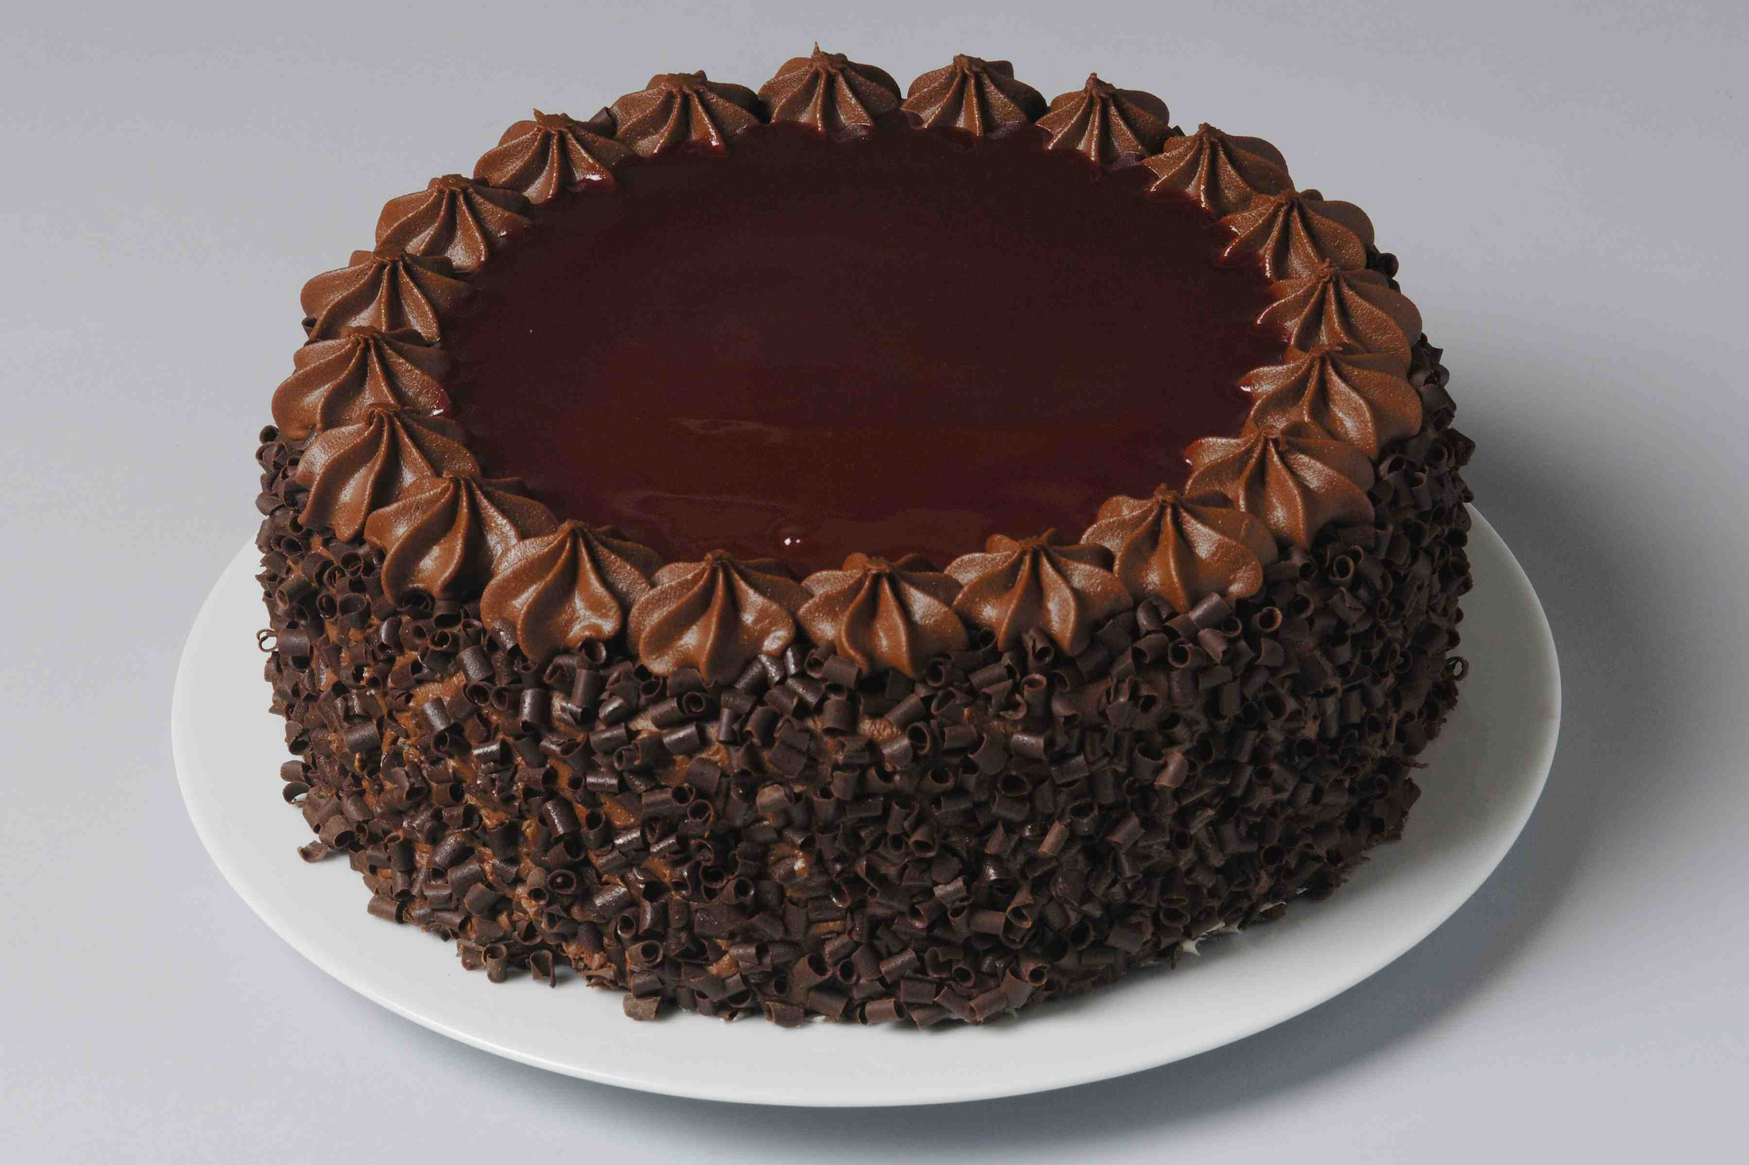
Gene Expression
Transcription and Translation
Transcription
copy a set of ingredients/instructions from a cookbook to create a recipe
Translation
use the recipe to create a dish

Slide 4


The Central Dogma of Molecular Biology

Slide 5

Transcription
Transcribe specific regions of DNA – genes
  Human genome ~25,000 genes (just 1.5% of genome)
RNA is the direct product of transcribing a gene (DNA)
  DNA -> RNA
  same language (nucleotides)
Messenger RNA (mRNA)
Transfer RNA
(tRNA)
Ribosomal RNA (rRNA)

Slide 6
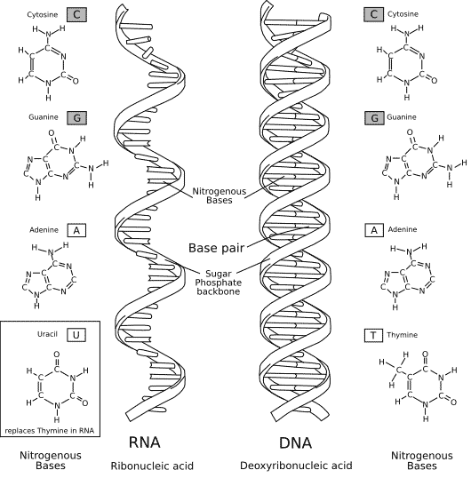
RNA vs DNA
RNA – uracil replaces thymine (no Ts in RNA)
RNA – single stranded (one backbone, no basepairs)
(RNA – slightly different sugar)

Slide 7
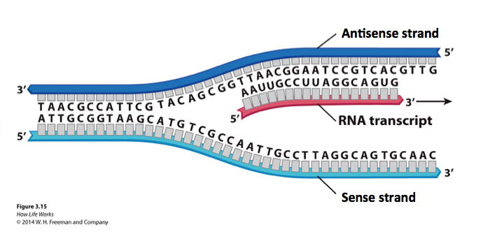
Genes exists on both strands of DNA…
Transcription occurs on the strand containing the gene whose product is needed.
The strand containing the gene is the antisense strand.
The RNA transcript is the complement of the antisense strand.

Slide 8
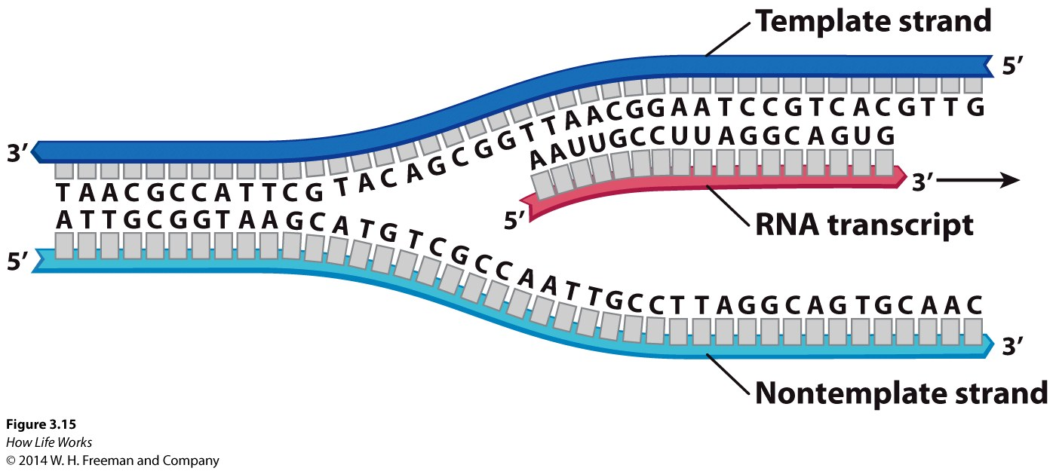
Antisense and Sense Strands of DNA – relative to the gene being transcribed
Antisense strand
Sense strand

Slide 9
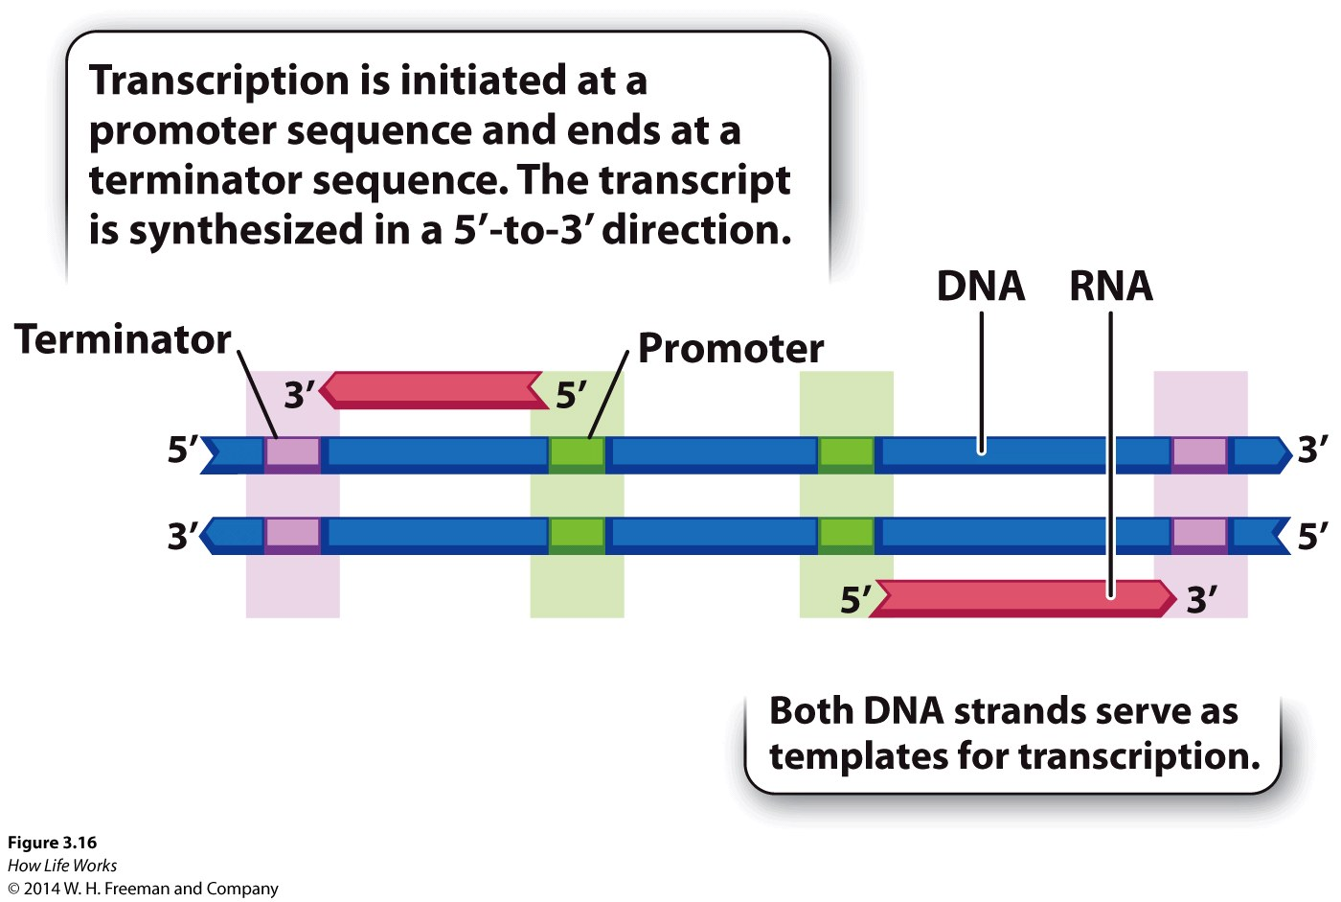
Genes have beginnings and ends - promoters and terminators

Slide 10
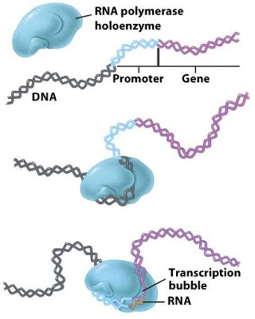
RNA Polymerase Binds at Promoter
RNA polymerase – enzyme that reads gene (DNA) and creates transcript (RNA)

Slide 11
Transcription
Transcribe specific regions of DNA – genes
  Human genome ~25,000 genes (just 1.5% of genome)
RNA is the direct product of transcribing a gene (DNA)
  DNA -> RNA
  same language (nucleotides)
Messenger RNA (mRNA)
Transfer RNA
(tRNA)
Ribosomal RNA (rRNA)

Slide 12
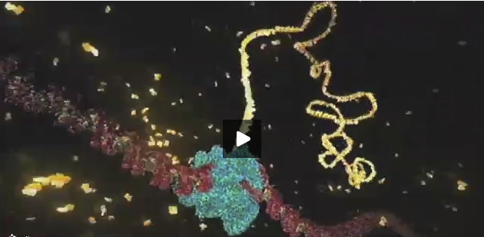
Transcription Video
https://www.dnalc.org/resources/3d/12-transcription-basic.html

Slide 13

Antisense strand
Sense strand

Slide 14
Antisense strand
Sense strand

Slide 15
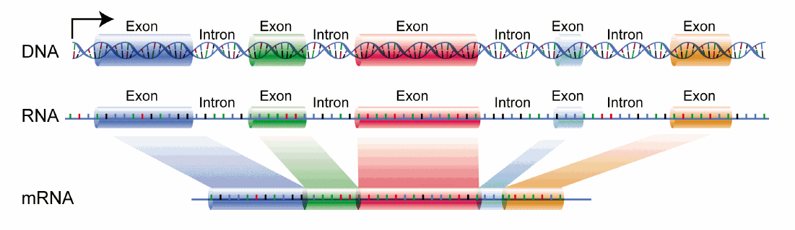
Splicing Exon Material
Exons: a segment of a DNA or RNA molecule containing information coding for a protein or peptide sequence.
Eukaryotic pre-mRNA contains exons and introns*
*some pre-mRNAs contain only one exon
a segment of a DNA or RNA molecule containing information coding for a protein or peptide sequence.

Slide 16
Introns do not contain the message and are removed from the RNA after transcription but prior to translation.
exons
Add 2 eggs bhgty to the flour qwtzptlrbn and stir.
introns
Add 2 eggs to the flour and stir

Slide 17
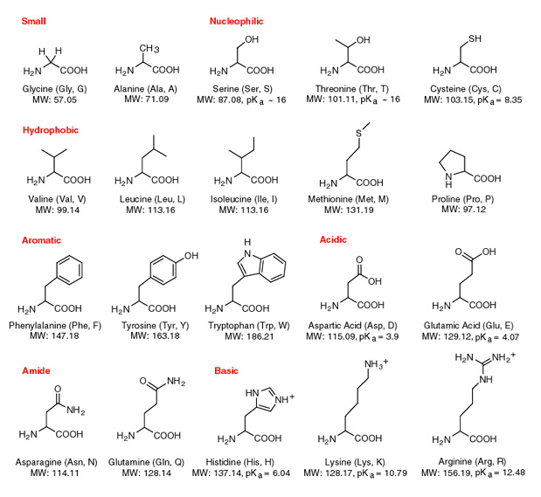
Proteins are made of amino acids

Slide 18

The Genetic Code: RNA into Protein
Triplet code
  Combinations of three nucleotides code for one amino acid
  Three nucleotides = codon
Redundancy
  Sometimes >1 codon codes for same amino acid
  20 amino acids, 64 possible codons
Start and Stop codons
  First codon of many transcripts is “AUG”, which codes for methionine
  Codons UAA, UAG, and UGA indicate the end of the transcript

Slide 19
Translation
The information from DNA is rewritten in a new language: RNA
Antisense strand
Sense strand

Slide 20

Translation Videos
mRNA Translation (2 mins)
  https://www.youtube.com/watch?v=8dsTvBaUMvw
Translation process is generic – specificity comes from the gene that was transcribed.
Protein Synthesis and the Lean, Mean Ribosome Machines (7 mins)
  https://www.youtube.com/watch?v=h5mJbP23Buo
Fun review of entire process of gene expression (transcription and translation)

Slide 21

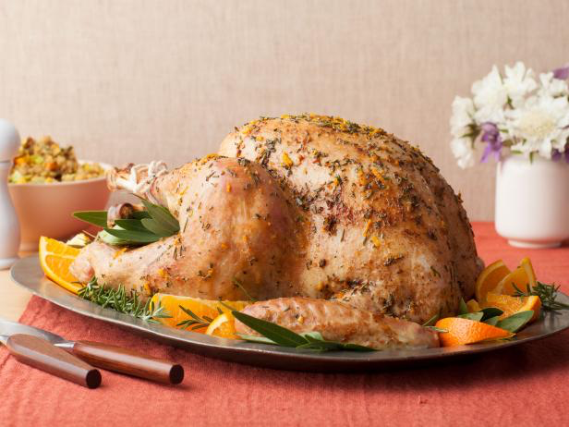
Genes vs Gene Expression
All genes are present in the genome
genes only expressed when needed
Of the many recipes in the cookbook…
… Only transcribe and translate
4th of July recipes in July
… Only transcribe and
translate the Thanksgiving
turkey recipe in November

Slide 22
Supporting Videos
The DNA Double Helix (17 mins)
http://media.hhmi.org/biointeractive/films/Double_Helix.html
The Chemical Structure of DNA (3 mins)
http://www.hhmi.org/biointeractive/chemical-structure-dna

Slide 23

Python Programming
How to start up Python interactive mode?
How to add numbers?
How to create variables?
How to make print statements
Strings:
  How to work with strings
  How to count characters
  How to find characters.
Follow along in
class and save
your notes in
a text file!!
  Follow along and Save your notes in a text file.

Slide 24

Consider This...
This
This

Slide 25
Header
This
This

